Slide 1
PhD Meeting – 19/09
Guilherme

Slide 2
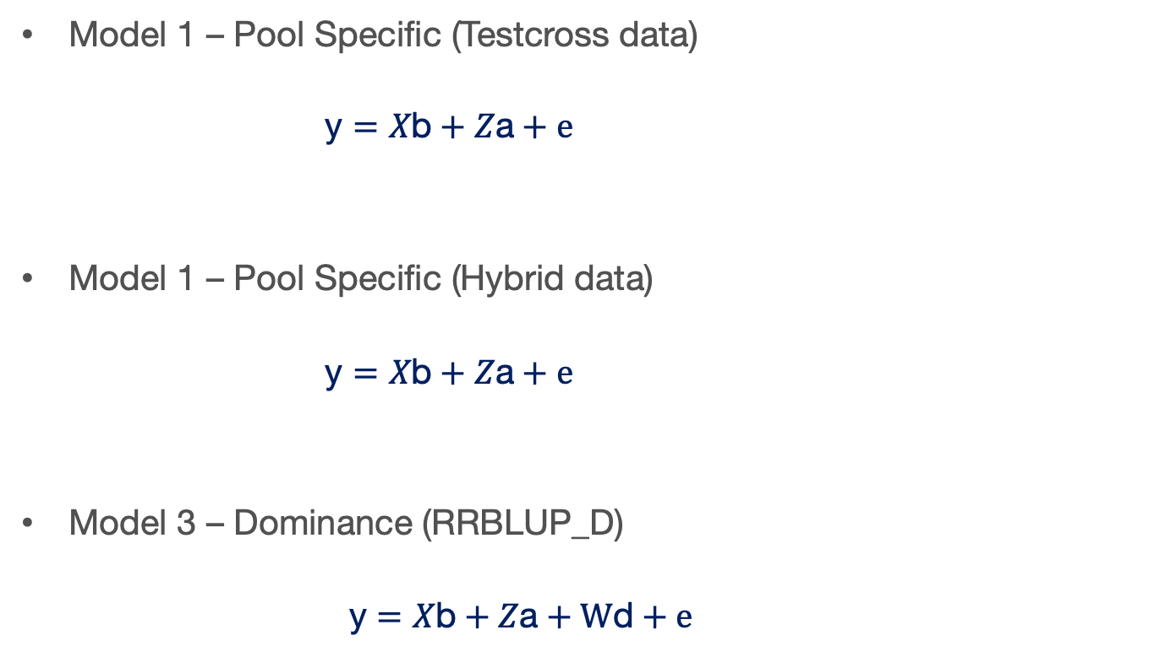
Models

Slide 3
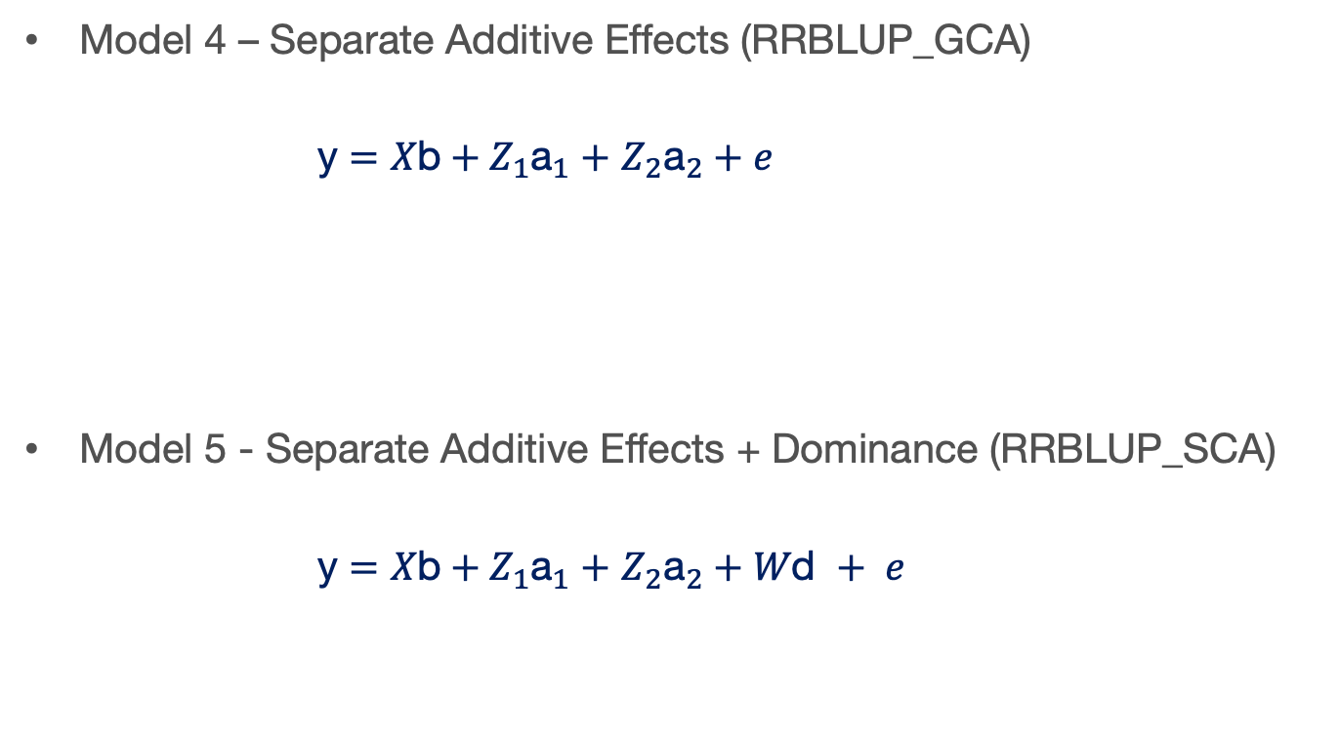
Models

Slide 4
Last week
Still running the simulations
Some results I’ve got

Slide 5
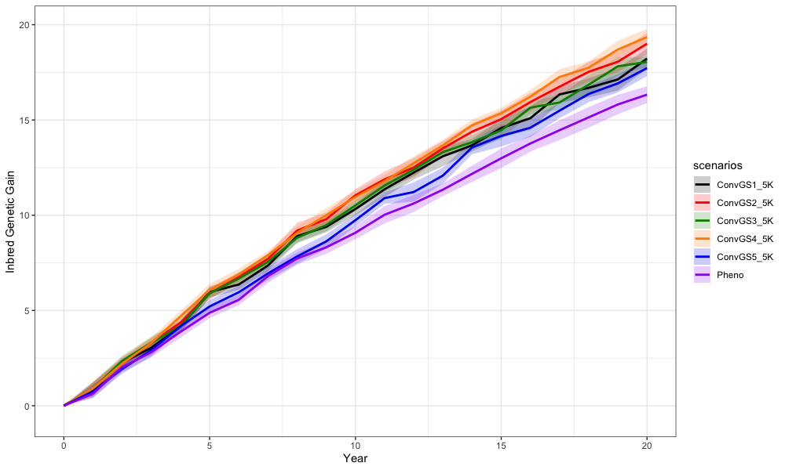
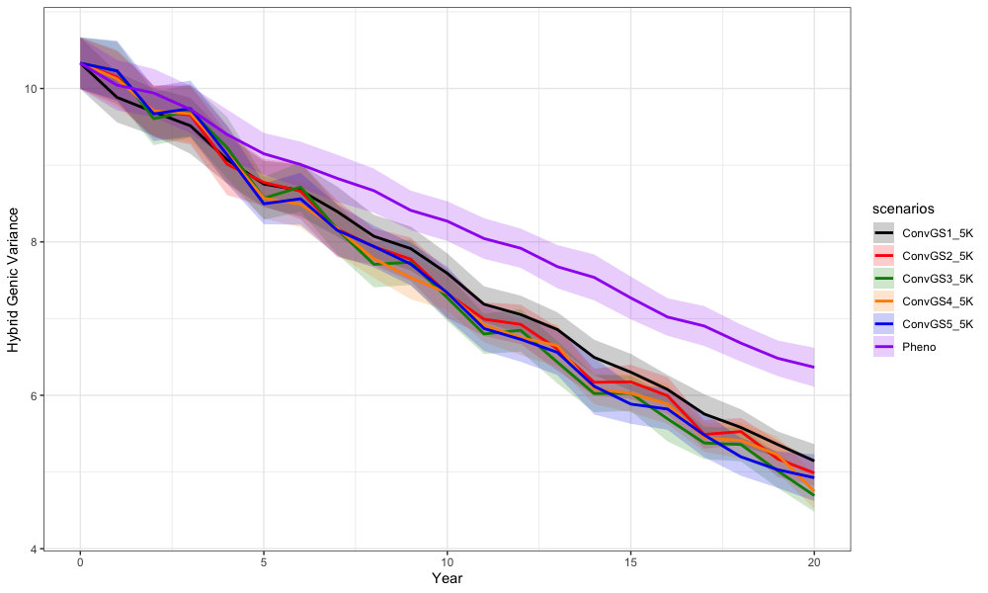

Slide 6
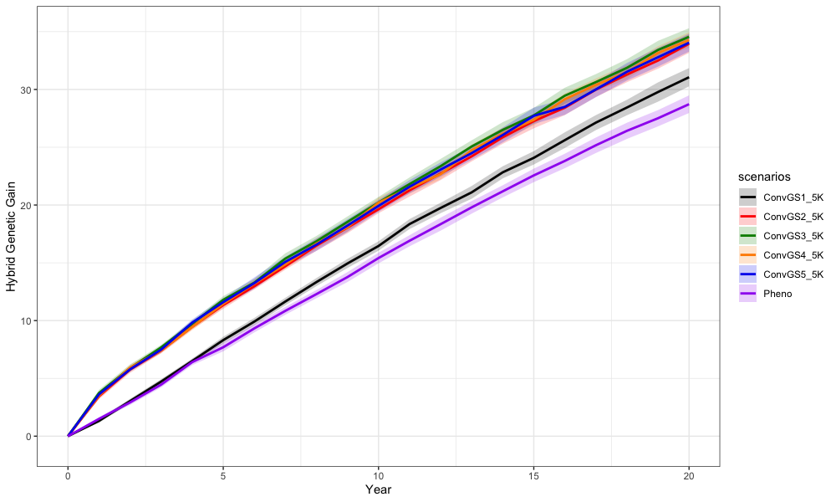

Slide 7
Next…
Change the population size
And review the code again

