Slide 1
Jana
Lab meeting
2020-03-19
@HighlanderLab

Slide 2
Agenda
AlphaPart
Current version of the software
Paper
Future work

Slide 3
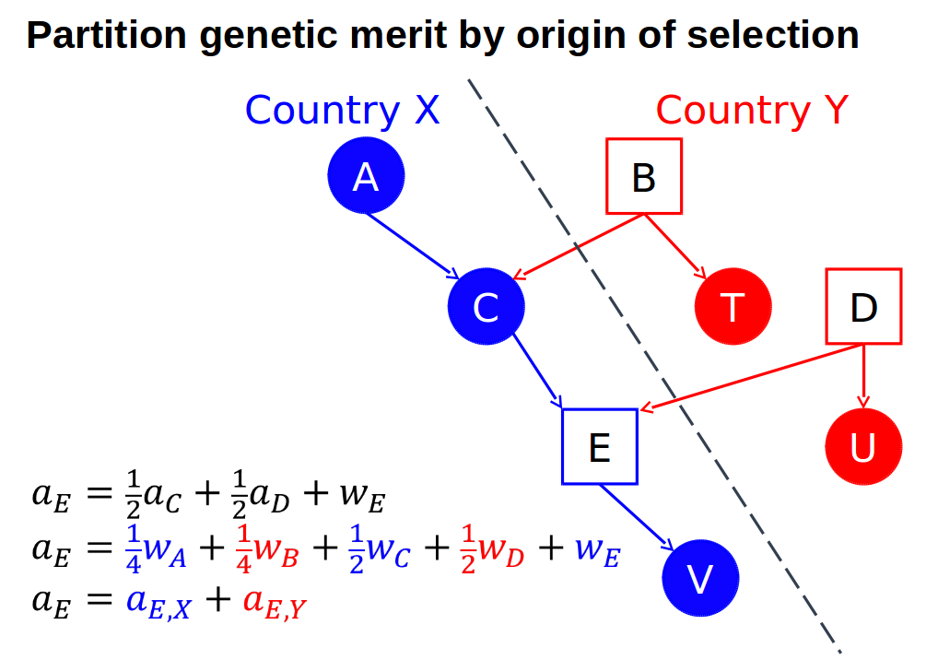
Current version
AlphaPart
R-package (CRAN)
Partitioning of genetic trend
(García-Cortés et al., 2008)
Paths of information
(females-males,
import-domestic …)
Pedigree data,
breeding values
PA
MST

Slide 4
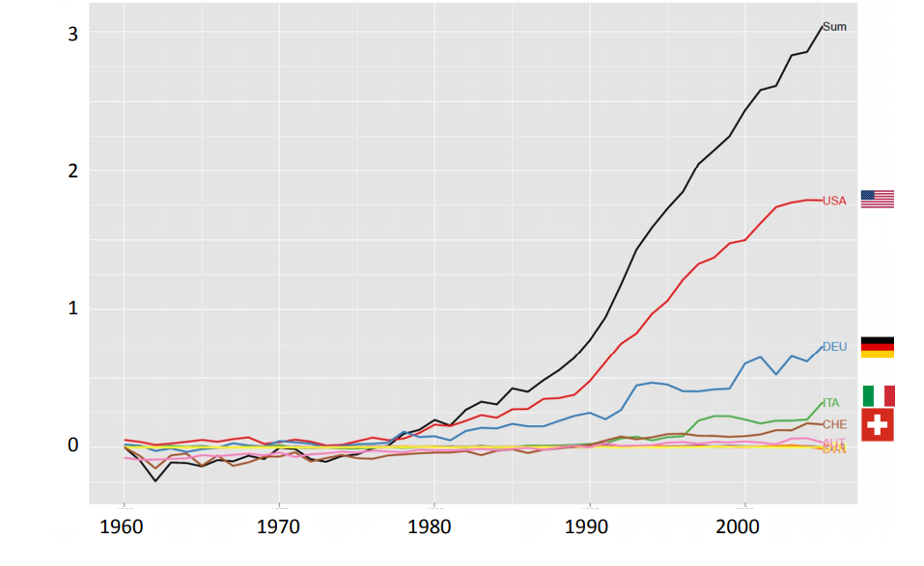
Current version
Example: international genetic trends for protein yield in Brown Swiss bulls (Gorjanc, 2011)

Slide 5
Paper
Submitted to Animal
Includes:
package description
Functions, dataset
demonstration on a pig breeding example
Simulation
Partition

Slide 6
Paper - pig breeding example
Simulation
Single breed, two tiers
(nucleus, multiplier)
Two traits
Import into multiplier
Partition
By gender-tier
Males and females
recycled
NUCLEUS
Males imported to multiplier from nucleus
Trait 1
h² = 0.25
Trait 2
h² = 0.1
MaleFlow100 = 100% import
Females
recycled
MaleFlow20 = 20% import, 80% recycled
MULTIPLIER
Trait 1
h² = 0.25

Slide 7
Paper - results
Distribution of BVs

Slide 8
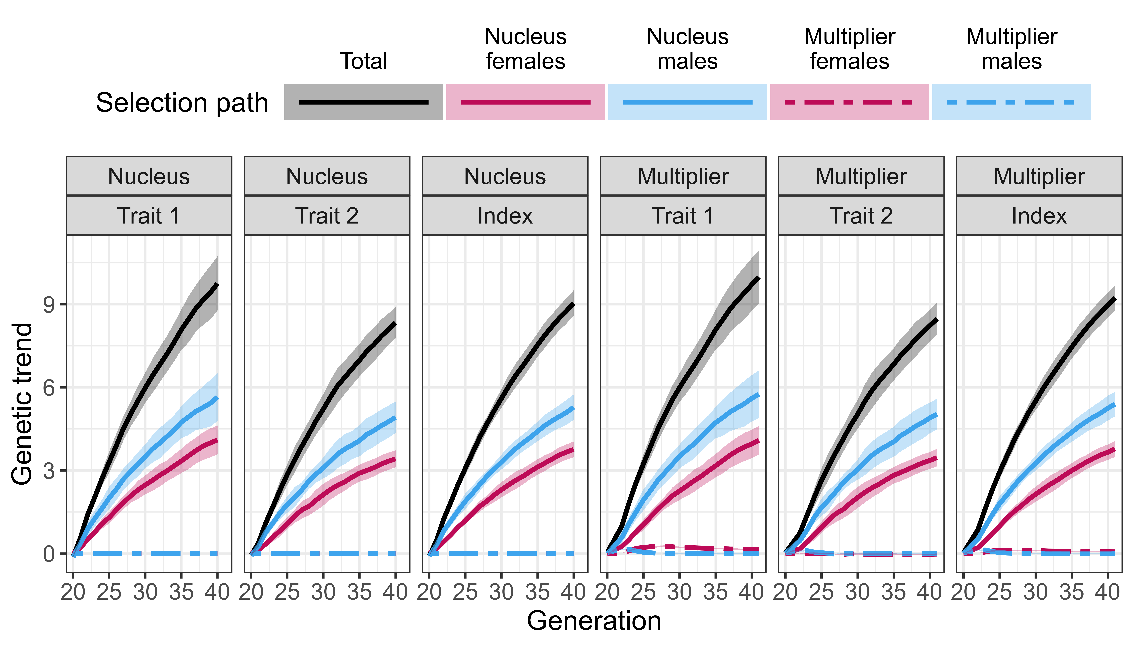
Paper - results
Partition: MaleFlow100

Slide 9
Paper - results
Partition: MaleFlow100

Slide 10
Paper - results
Freely available AlphaPart
Multiplier outperforms nucleus
Nucleus-multiplier gene flow
Direct, indirect
Multiplier selection
Accuracy of selection

Slide 11
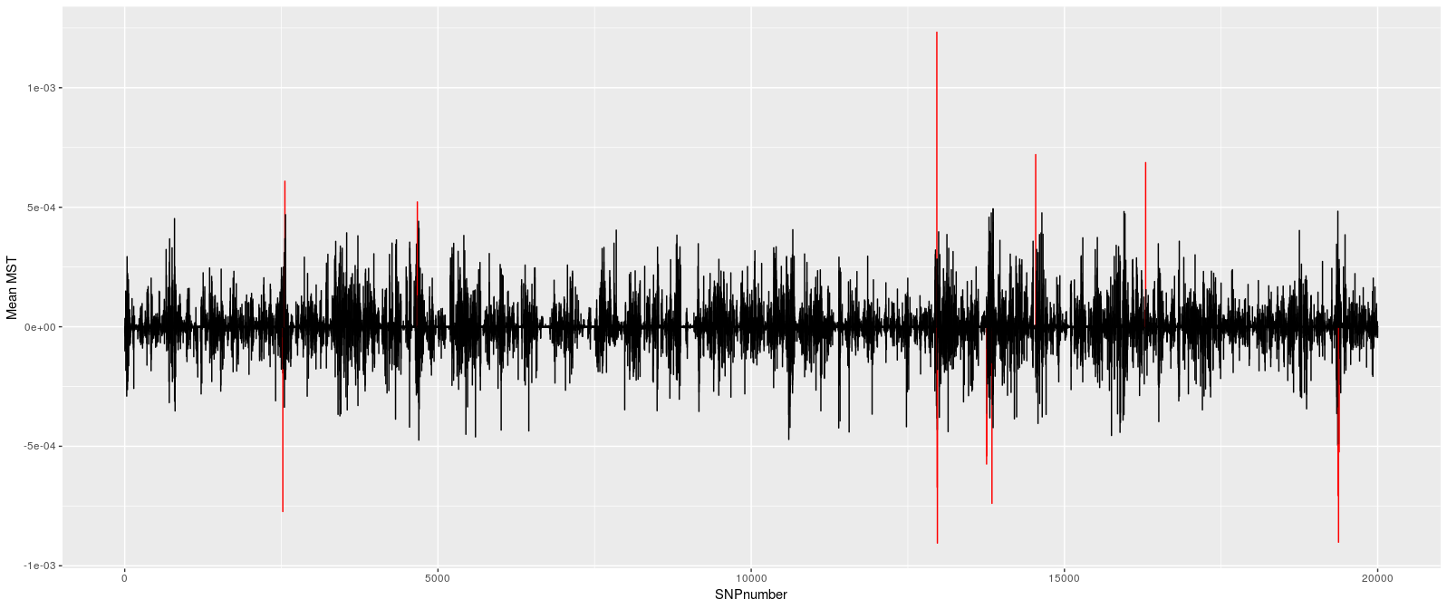
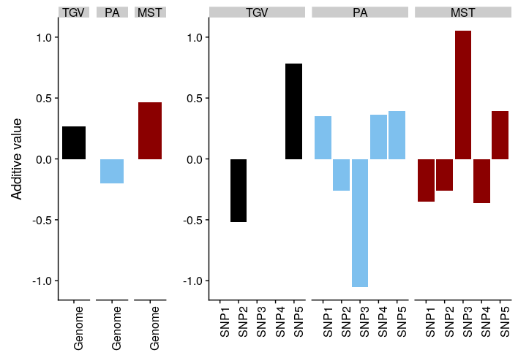
AlphaPart – future work
1. “loci unpacking”
Which genome regions drive genetic gain
Sources of haplotypes / alleles

Slide 12
AlphaPart – future work
2. partitioning of genetic variance
Change the function
3. uncertainty of contributions – sampling from posterior distribution
Multiple samples (structure)

