Slide 1
Student meeting 05/09/2019

Slide 2
Barbara 05/09/2019
Basic concept
Use tree sequences instead of marker (SNP chip) data in genomic prediction
Trees
encode and summarize the outcomes of evolutionary processes
use way less space than whole genome marker data storing similar information

Slide 3
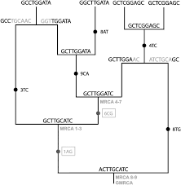
Tsinfer/tskit
Ancestral recombination graph
↑ samples/variants =↑ comp. time/space
tsinfer
succinct tree sequence
stores structure shared by multiple adjacent trees only 1x

Slide 4
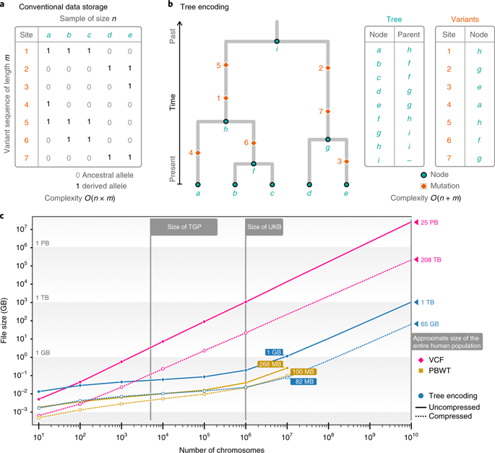
Inferring whole-genome histories in large population datasets
Jerome Kelleher *, Yan Wong, Anthony W. Wohns , Chaimaa Fadil , Patrick K. Albers and Gil McVean

Slide 5
Estimate haplotype phases with Eagle
⇓
Infer succinct trees with tsinfer
⇓
Build relationship matrices using tree sequences
⇓
Run and compare genomic predictions + GWAS

Slide 6
Eagle
Whole chromosome haplotypes
Only male genotypes -> population based algorithm
PCA/MDS
sub-population connectedness
tskit/tsinfer
Ancestral state of alleles

Slide 7
Genomic predictions
Standard gblup
Haplotype gblup
Tree gblup -> accounts for
Epistasis
LD among QTL-markers
Different OTLs in different populations (herds)

Slide 8
Jon 05/09/2019
Manuscript
Results section
Data Carpentry workshop yesterday (Bash, Python)

Slide 9
Next
Manuscript
GWAS
Might be getting data soon
Backburner:
Start with thesis literature review
2nd paper introduction and M&M
2nd year progress report presentation

Slide 10
Discussion topics
Principal component analysis
Optimal contribution algorithm
MCMC sampling methods (e.g. Gibbs)
Spatial analysis with nested designs

Slide 11
Jana student meeting 5th September 2019
AlphaPart
Reallocation of resources
Helping Barbara with tsinfer

Slide 12
AlphaPart
Model:
Mean as fixed
Generation as fixed
Tier as fixed
Generation + Tier as fixed
Generation + Tier + Generation:Tier as fixed
Partition | trend | standardization issue

Slide 13
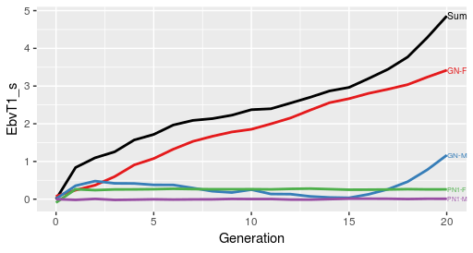
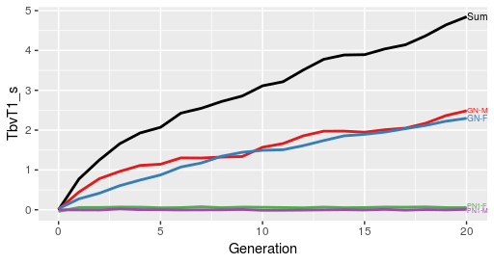
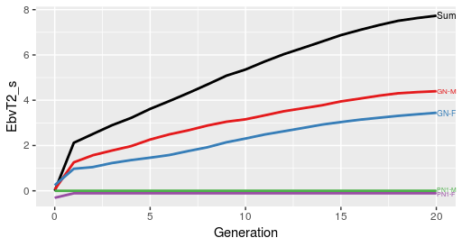
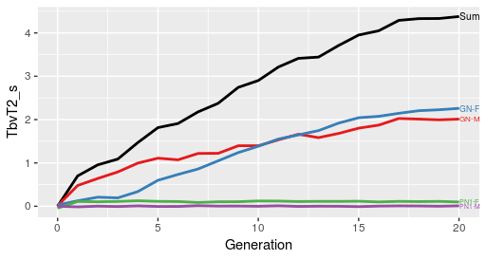
BLUP Model: Pheno ~ Generation, h2 = 0.25
TRAIT 1
TRAIT 2

Slide 14
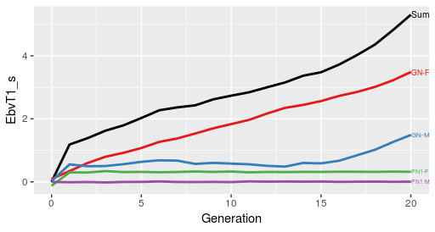
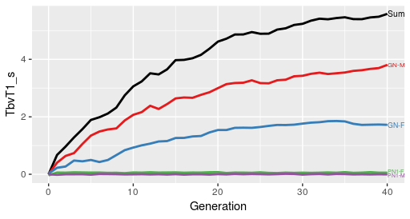
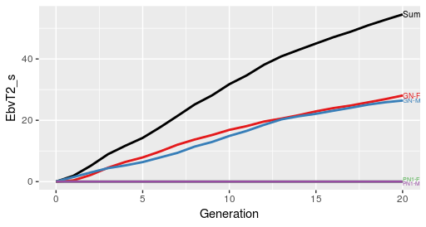
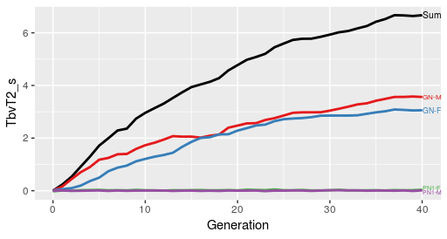
BLUP Model: Pheno ~ Tier + Generation, h2 = 0.25
TRAIT 1
TRAIT 2

Slide 15
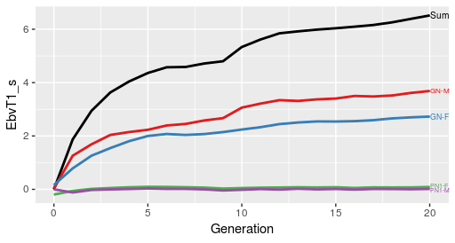
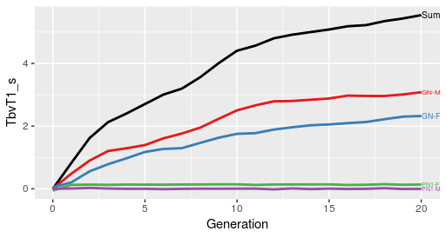
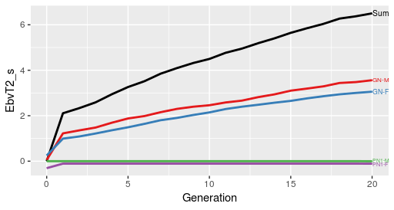
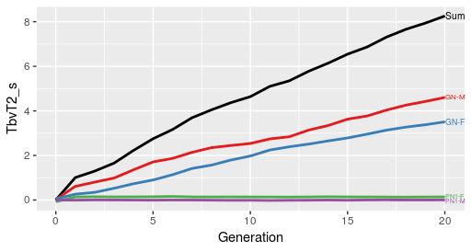
BLUP Model: Pheno ~ Tier + Generation, h2 = 0.99
TRAIT 1
TRAIT 2

Slide 16
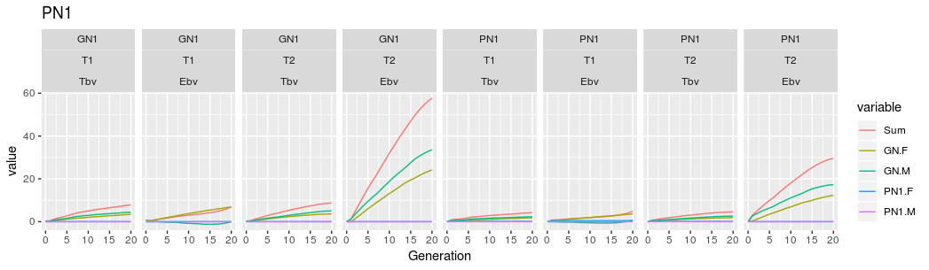
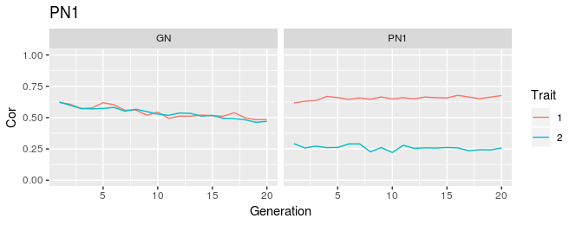
Partition
Accuracies

Slide 17
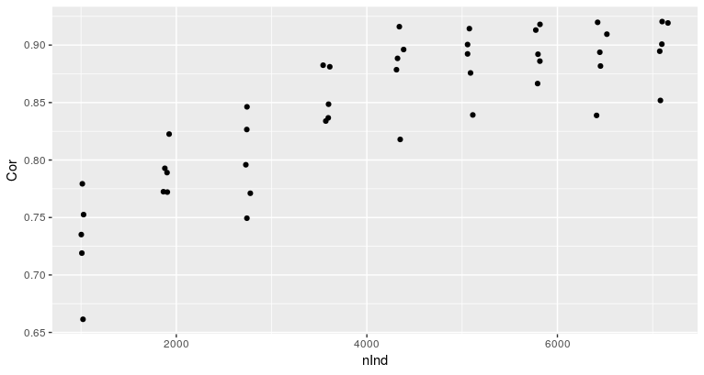
Rellocation of resources
- what size reference population is adequate?
To high?

Slide 18
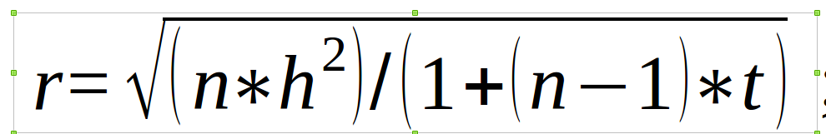
Accuracy of the parents EBVs:
Accuracy of parent average (ssGBLUP)
- Average 30 replications of phenotype per cow
= sqrt((30 * 0.25) / (1 * (30 - 1) * 0.375) = 0.83 → r²_{mother} = 0.69
0.7 – 0.9 → r²_{father} = 0.49 – 0.81
r_{PA} = sqrt(1/4 * (r²_{mother} + r²_{father}))
- low r_{father}: sqrt(1/4 * (0.69 + 0.49)) = 0.54
- high r_{father}: sqrt(1/4 * (0.69 + 0.81)) = 0.61

Slide 19
Topics:
MCMC / Metropolis Hastings sampling
Single value decomposition / eigen values of relationship matrix / PCA

