Slide 1
Jana
Sire use strategies + OCS
Reallocation of funds

Slide 2
Sire use strategies + OCS
AlphaSim + python
PT
TRUNCATION
Sire selection
and use
5 sires / 5 years
GS-PS
Genetic gain
5 sires / 1 year
GS-C
GS-BD
Genetic variability
1 sire / 5 years
GS
N_{e}
45
Conversion
efficiency
OCS
Target degrees
50
Accuracy
55
Rate of coancestry
60
75

Slide 3
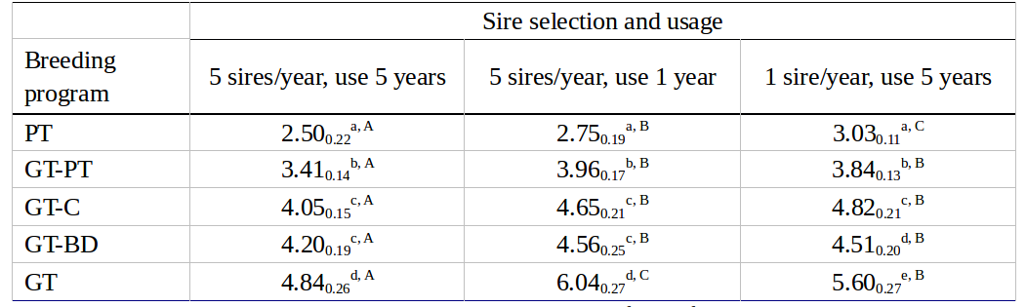
Sire use strategies + OCS
Genetic gain

Slide 4
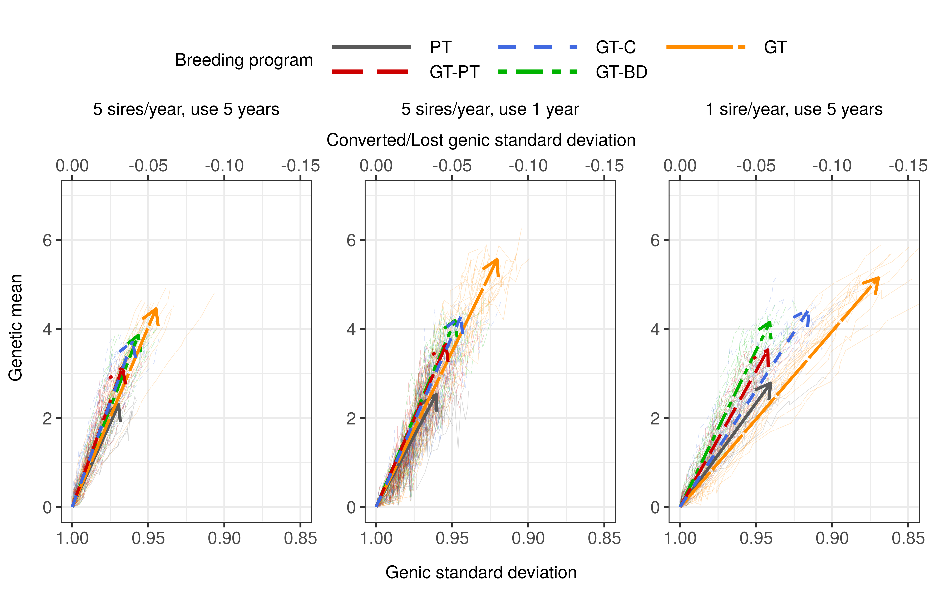
Sire use strategies + OCS
Conversion efficiency

Slide 5
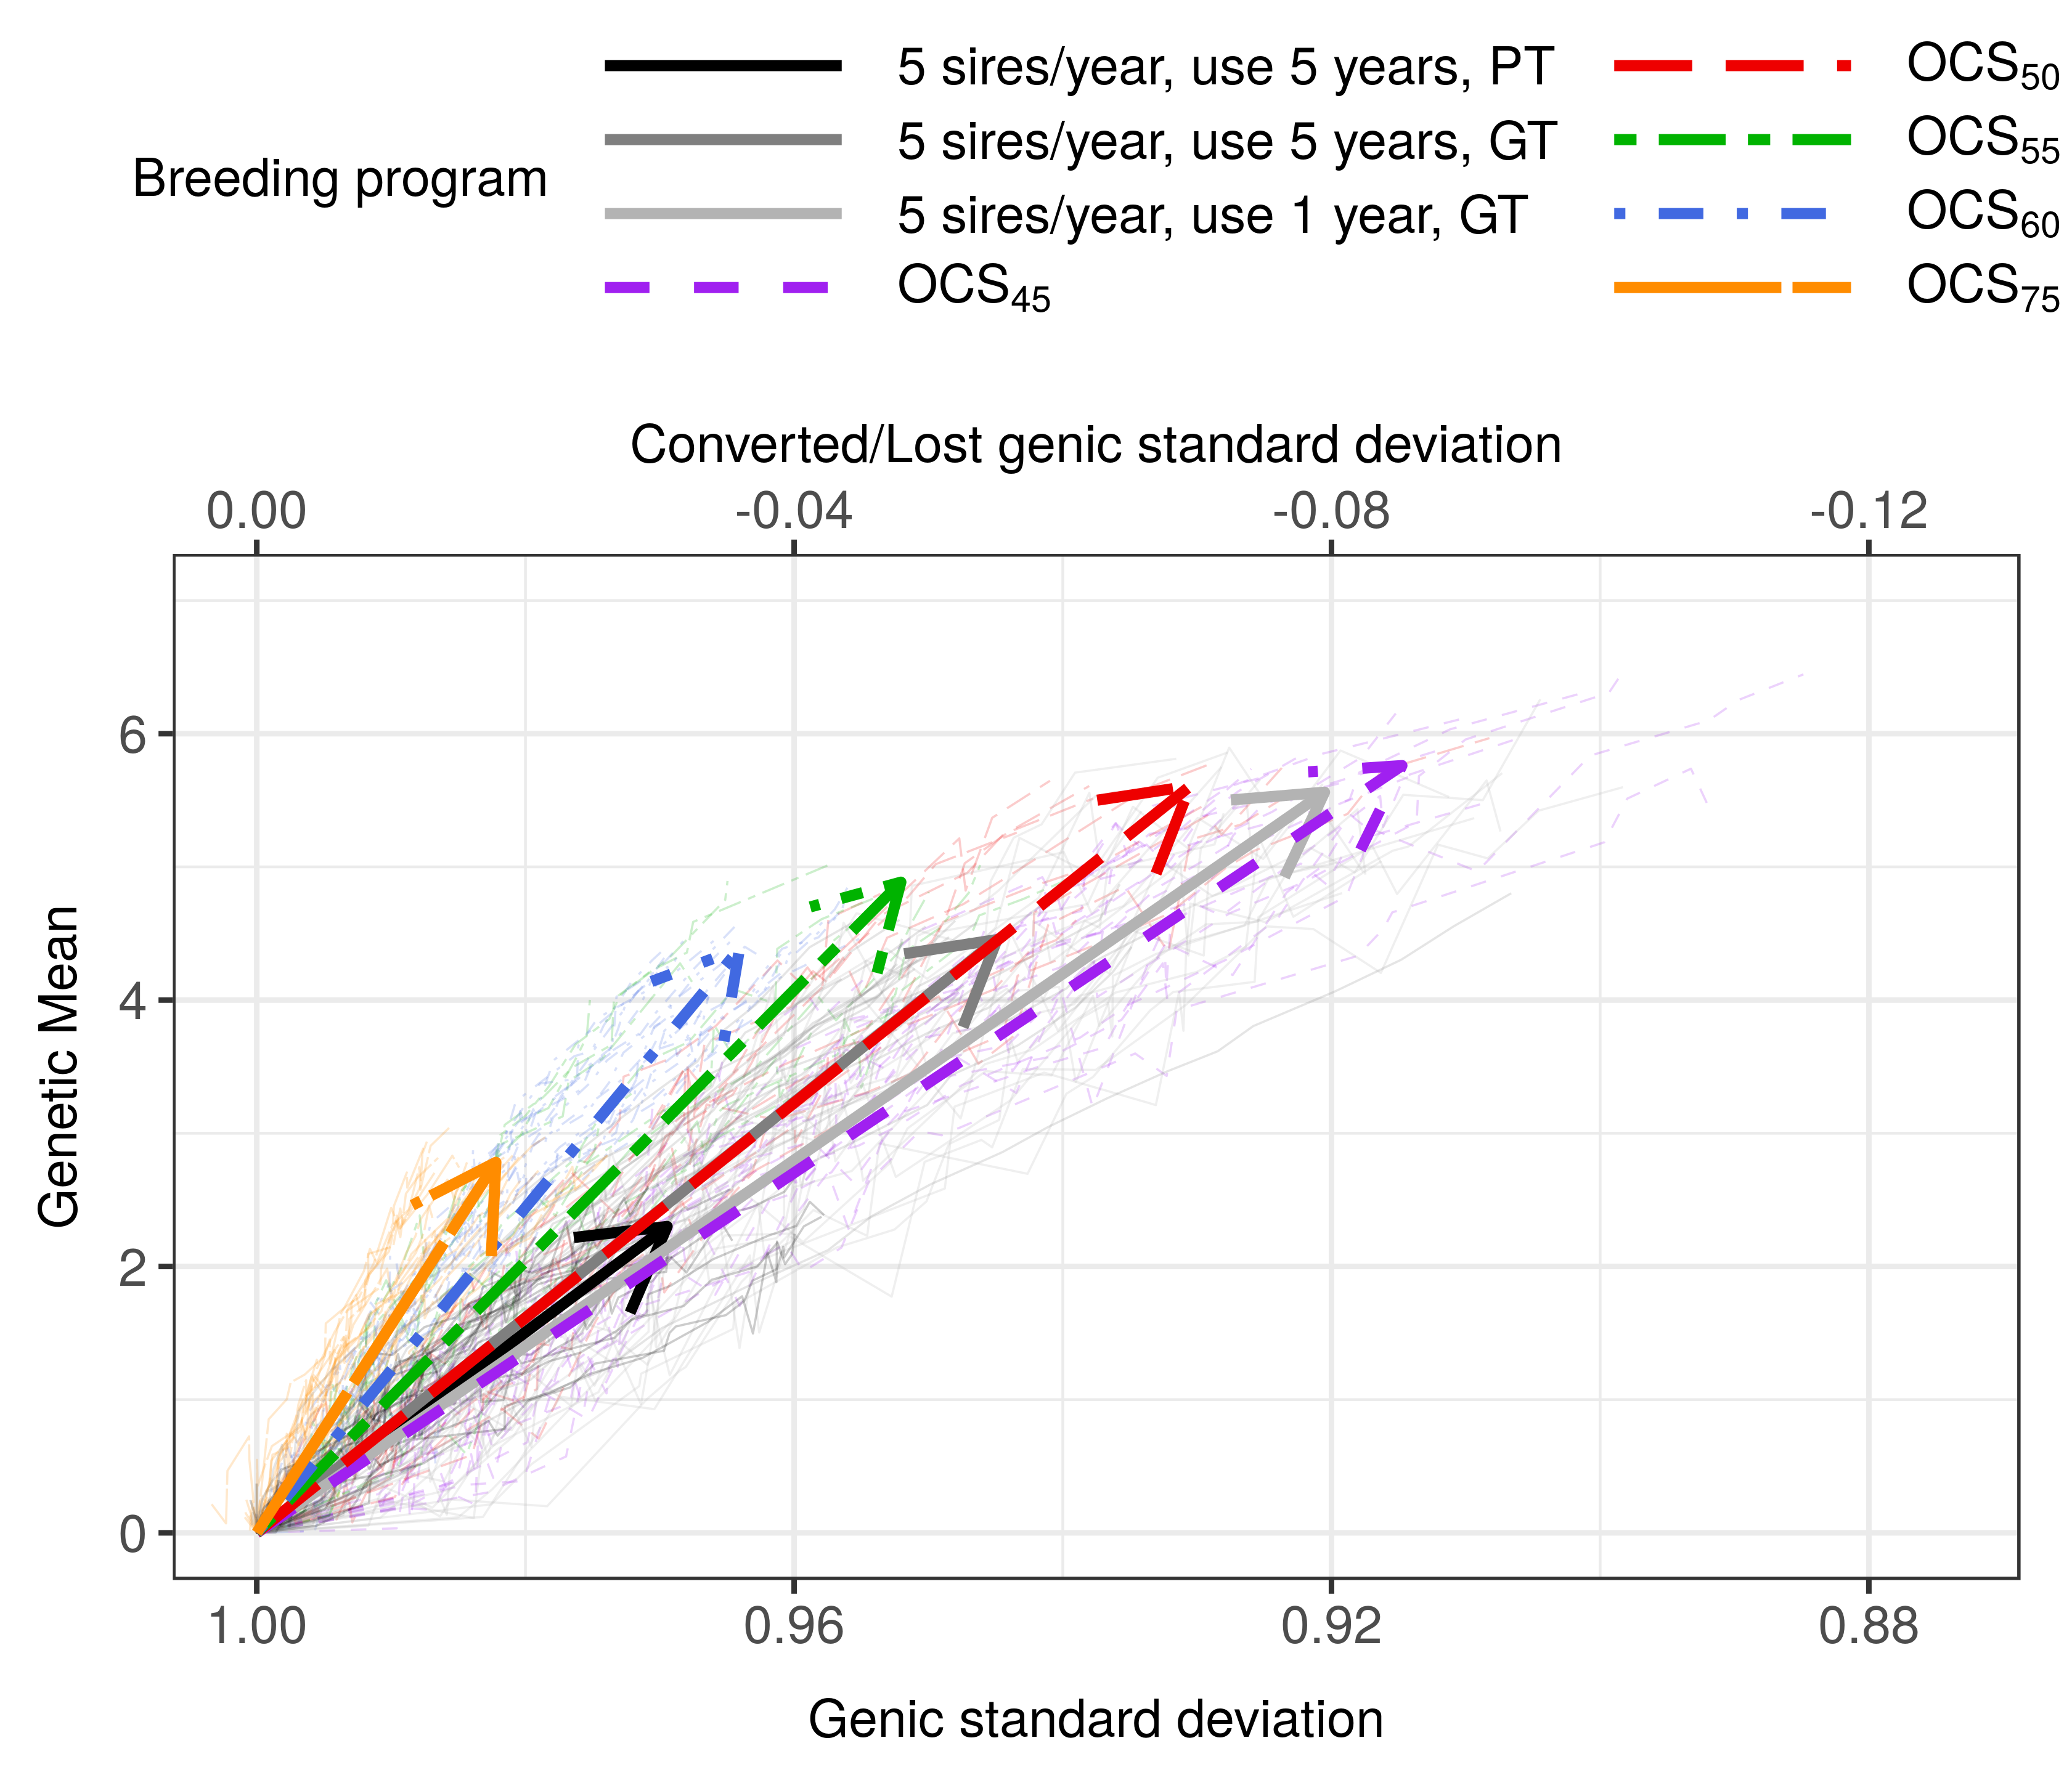
Sire use strategies + OCS
OCS

Slide 6

Resource allocation
Conventional selection
for phenotyping
REDUCE PHENOTYPING
Genomic selection
= for phenotyping
for genotyping =

Slide 7
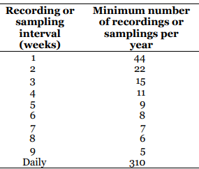
Resource allocation
Do we have a starting reference / do we need to build it?
Reducing phenotyping by how much?
      Standard milk recording schemes:
      ICAR
Which animals to phenotype:
selection or updating reference population?
Price of phenotyping : price of genotyping

Slide 8
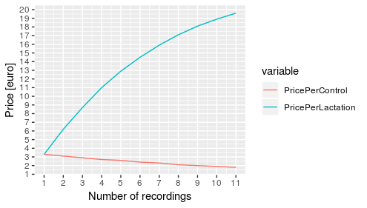
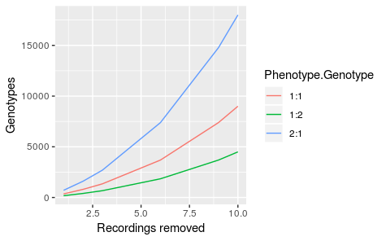
Resource allocation
Price of phenotyping →
phenotype : genotype
2:1, 1:1, 1:2
How many genotypes
if we remove #recordings

Slide 9
Resource allocation
Phenotype:
Genotype
NoControls Reduced
Which animals to genotype
Reference
1
1:1
1
2
YES
2
3
X% female
Y% male
6
9
10
2:1
1
2
2
3
X% female
Y% male
6
9
10
1:2
1
2
2
3
X% female
Y% male
6
9
10
1
1:1
1
2
NO
2
3
X% female
Y% male
6
9
10
2:1
1
2
2
3
X% female
Y% male
6
9
10
1:2
1
2
2
3
X% female
Y% male
6
9
10

Slide 10
Resource allocation
Plausability of scenarios:
      Money for reference
      Speed of update
      Number of animals for update / selection
      Computational burden

Slide 11
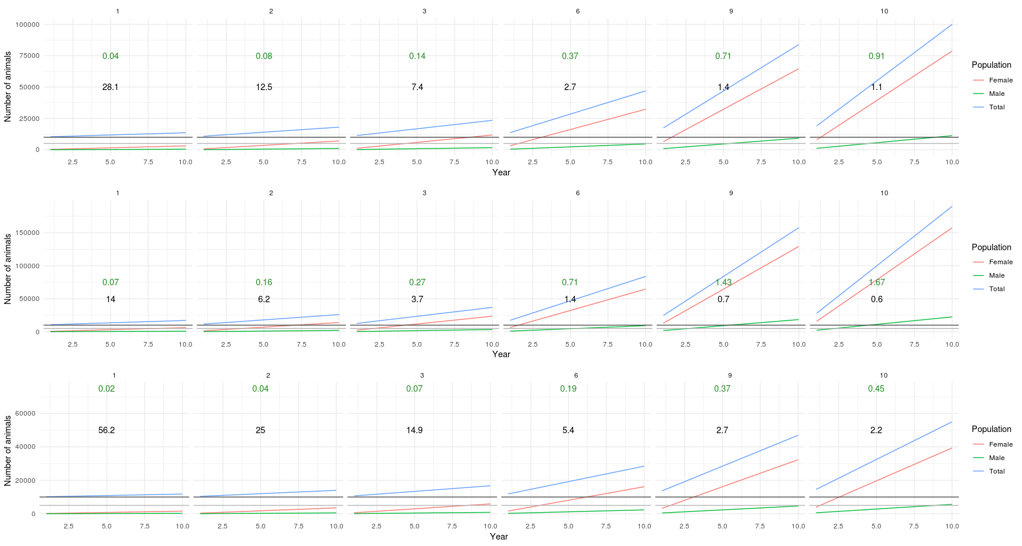
Resource allocation

Slide 12
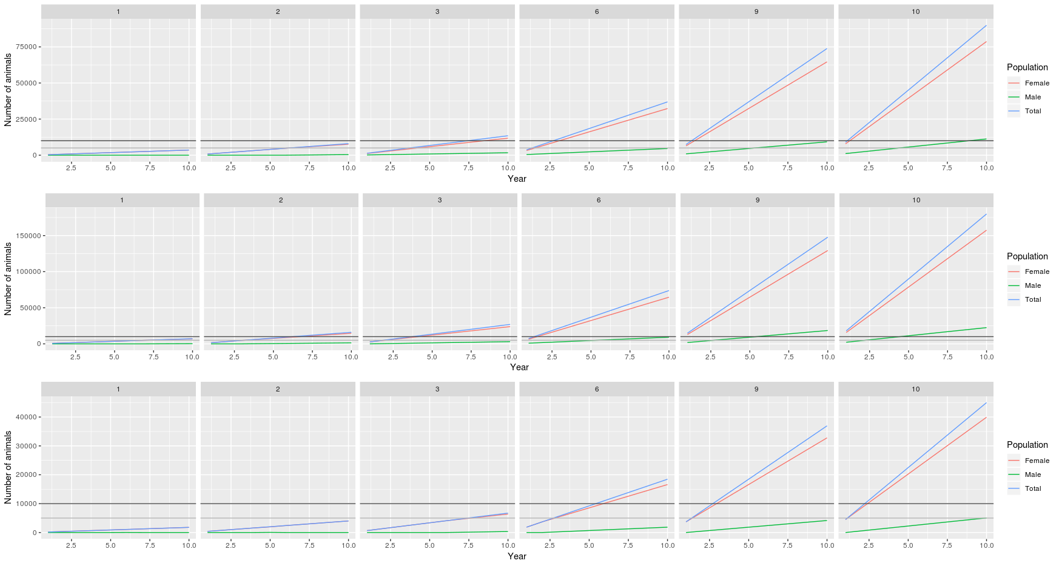
Resource allocation

Slide 13
Resource allocation
Simulation:
      conventional / genomic selection
      Simulation of phenotypes: repeated phenotypes - PE, Herd, Herd Year, Herd Test Day effects
      BV prediction: Single step, repeatability model

