Slide 1
Jana
Student meeting 15-08-2019
Reallocation of funds
AlphaPart package + paper

Slide 2


Resource allocation
Conventional selection
for phenotyping
Price of genotyping
Reduce phentoyping
by x
Price of phenotyping
Number of animals for
Selection / reference
REDUCE PHENOTYPING
Use genotypes for
Selection / update
Genomic selection
= for phenotyping
for genotyping =

Slide 3
Resource allocation
Minimum number of animals in the reference
Running test scenarios – only male genotyping

Slide 4
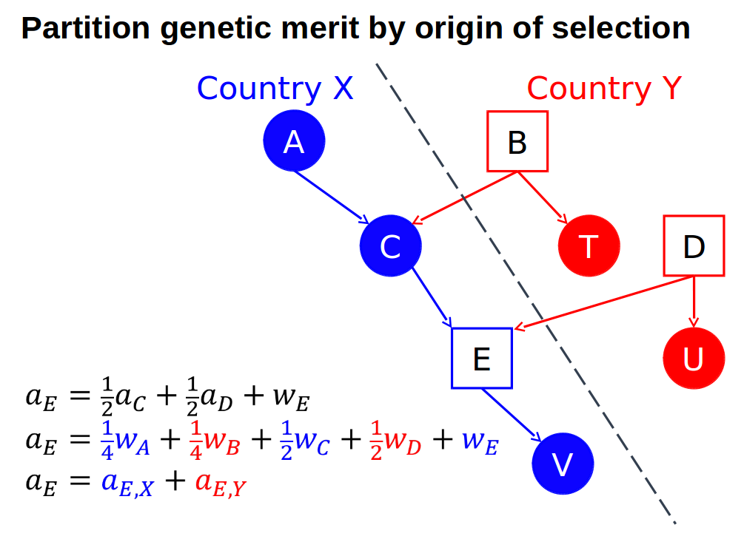
AlphaPart
R package for partition of genetic values
PA
MST

Slide 5

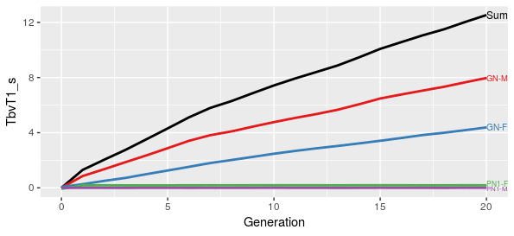


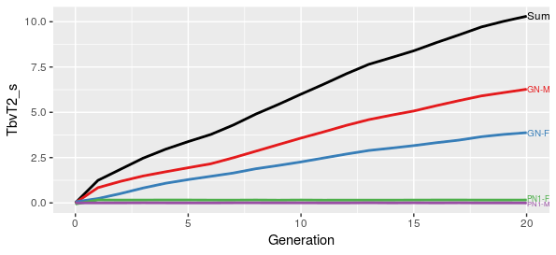
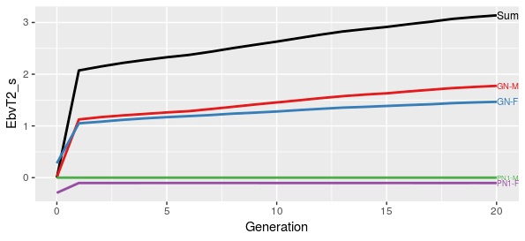
AlphaPart
High h², many information
Trait1 TGV EBV
Trait2: less information

Slide 6
AlphaPart
Lower h² – even worse
cor(MST_{true}, MST_{est}) ~ 0
Analysis: sensitivity to h²

Slide 7
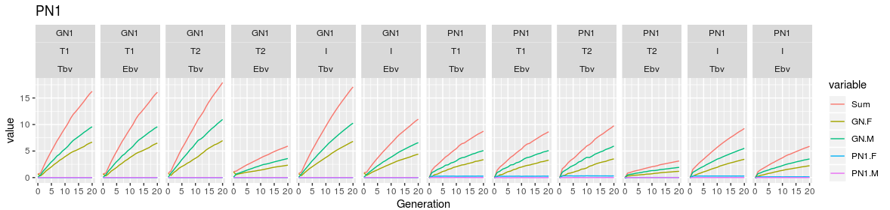
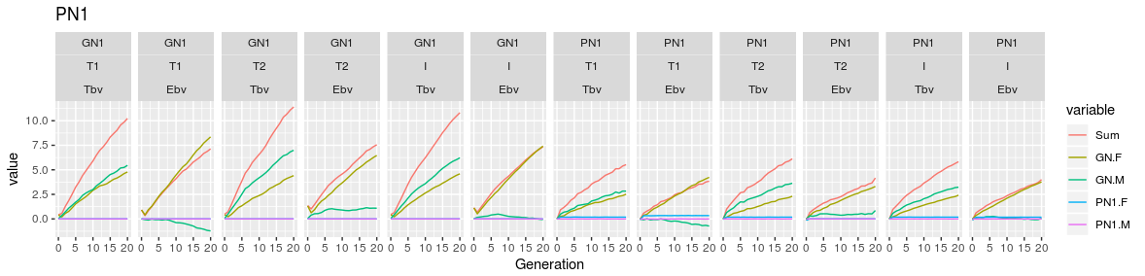
AlphaPart
h² = 0.99
h² = 0.5

Slide 8
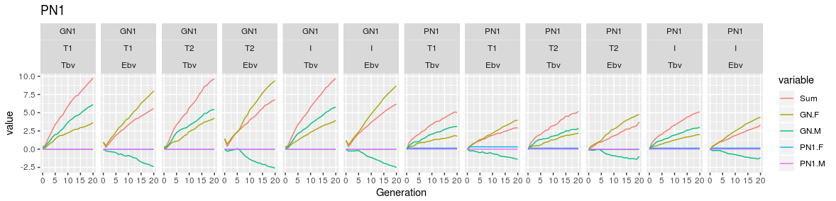
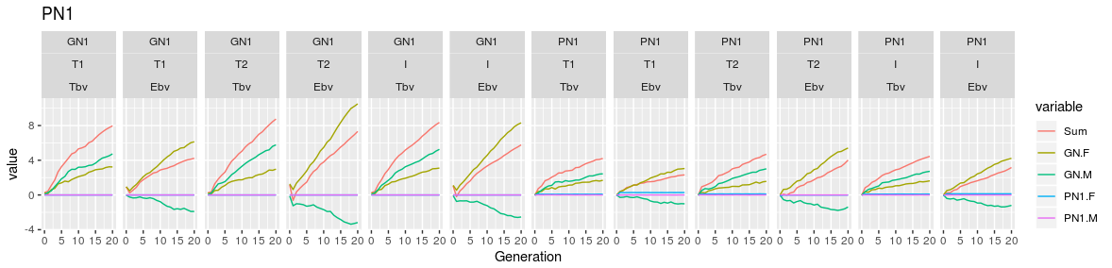
AlphaPart
h² = 0.25
h² = 0.1

Slide 9
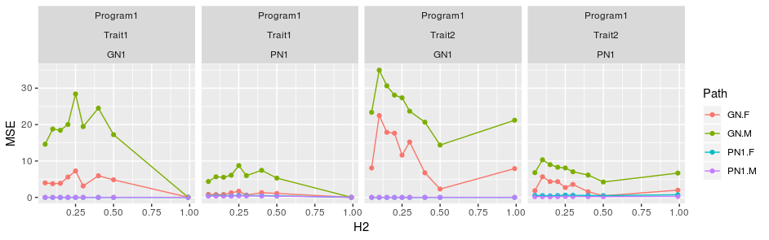
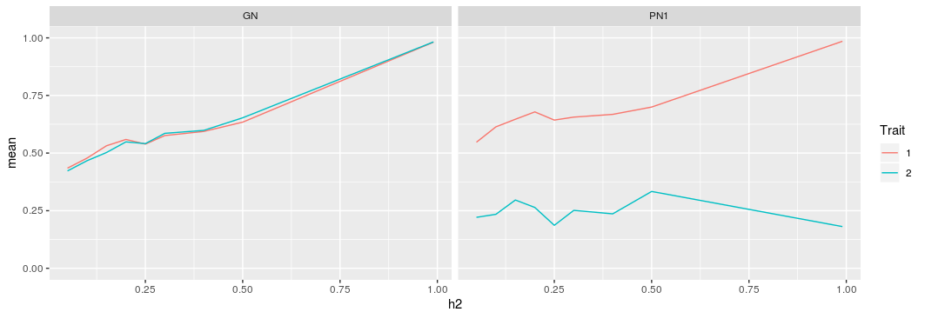
AlphaPart
MSE: partition_{TBV} - partition_{EBV}
accuracy

Slide 10
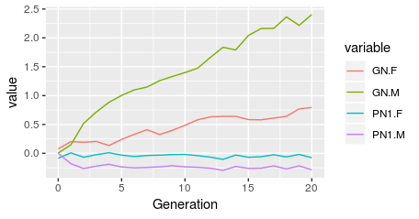
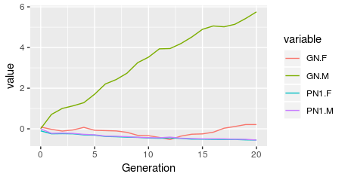
AlphaPart
Bayesian: Gibbs sampling
Trait 1: h² = 0.25
Trait 2: h² = 0.25

Slide 11
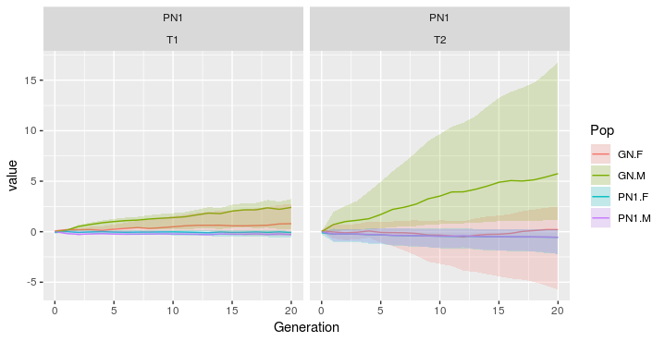
AlphaPart

