Slide 1
Student meeting 19th September 2019
Jana
AlphaPart: R-package for partitioning genetic trend
Reallocation of resources:
  Reallocate money from phenotyping to genotyping

Slide 2
AlphaPart
Pig breeding examples: nucleus + reproduction
Models:
  Intercept + animal
  Tier + generation (fixed) + animal (random)
  Tier * generation (fixed) + animal (random)

Slide 3

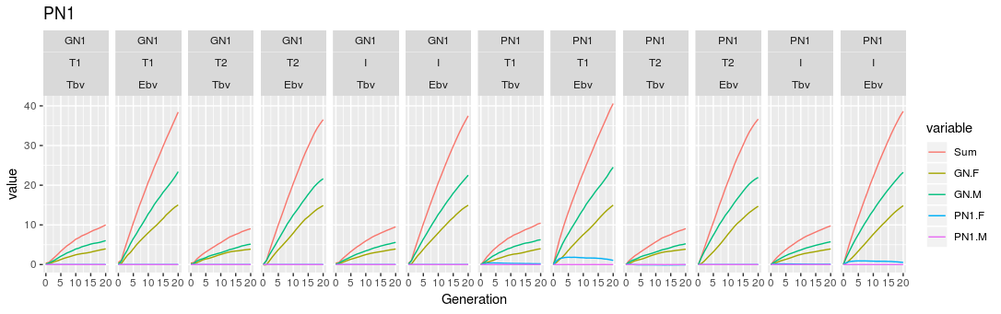
AlphaPart
Fixed the generation + tier model
Partition, h² = 0.25

Slide 4
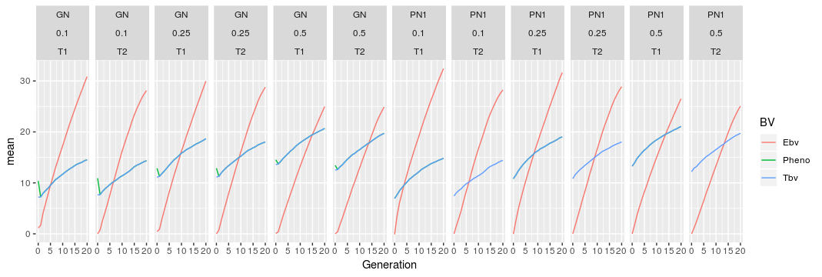
AlphaPart
Genetic trend: fixed effects model

Slide 5
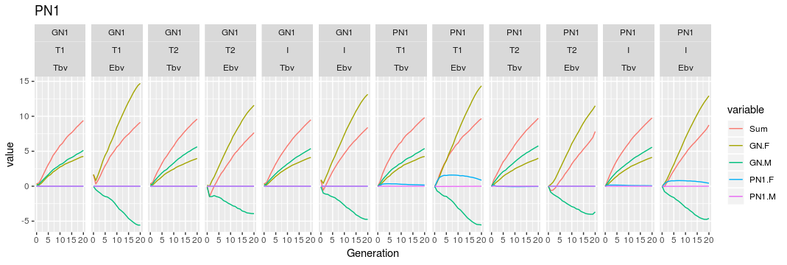
AlphaPart
Did not fix the intercept model
Partition, h² = 0.25

Slide 6
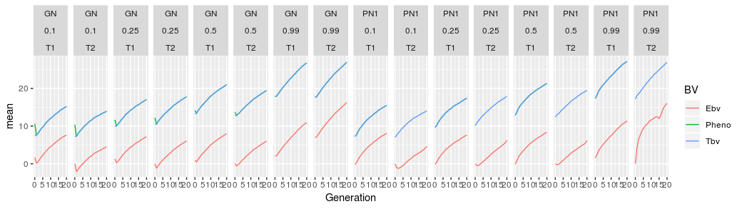
AlphaPart
Genetic trend: intercept model

Slide 7
Rellocation of resources
Baseline: conventional selection, 11 recordings of phenotype / lactation
Genomic scenarios - variables:
  Initial training population: yes / no
  # phenotype recordings / lactation (10, 9, 8, 5, 2, 1)
  Price of genotype vs price of phenotype

Slide 8
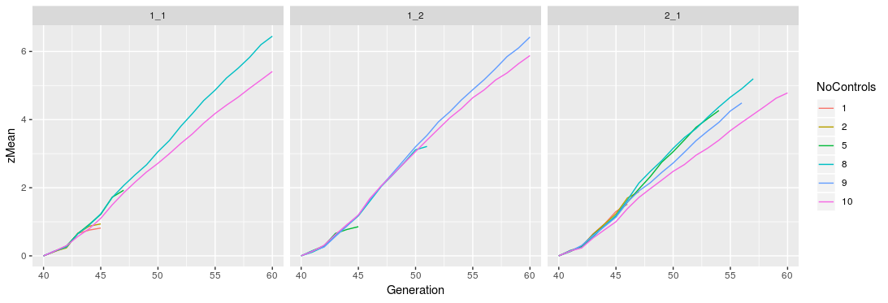
Rellocation of resources
Ran the reference:yes scenarios (18) – one test rep
Scenarios failes: too many animals for blupf90
Price phenotype =
price genotype
Cheap genotype
Expensive genotype

Slide 9
Rellocation of resources
Questions:
  Keep last X generations of genotypes / keep them all
Options:
  Limit the number of genotyped animals
  Get unlimited blupf90 + APY for large training set
  Cut the generations?

