Slide 1
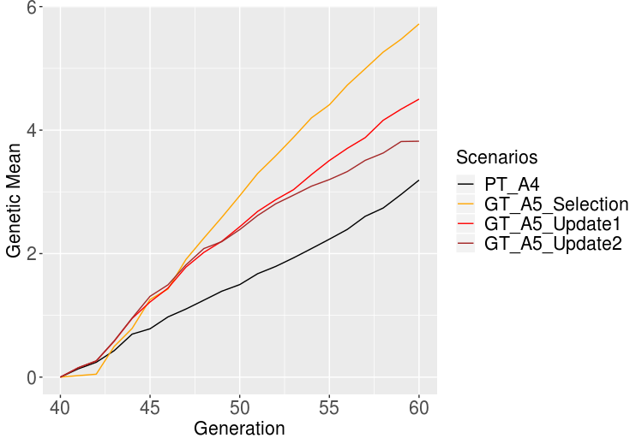
Jana
student meeting 22nd August 2019
Rellocation of resources – test run
Update1 = only ADD animals to the reference
Update2 = take the oldest generation out

Slide 2
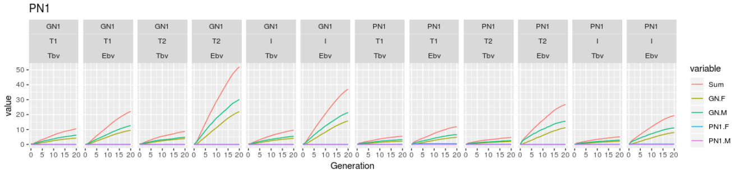
Jana
student meeting 22nd August 2019
AlphaPart
  Added fixed effects to the model → improvement

Slide 3
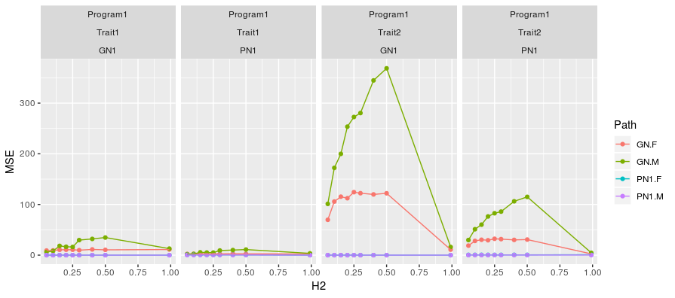
Jana
student meeting 22nd August 2019
AlphaPart
  Still problems – now at higher h² and MSE

