Slide 1
Jana
What is happening with the partition?
Reallocation of financial resources in a cattle breeding program

Slide 2
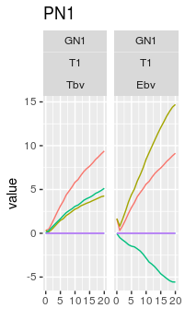
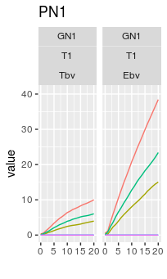
AlphaPart: what is happening with the fathers?
What is happening with the partition?
Intercept model:
Year + Tier:

Slide 3
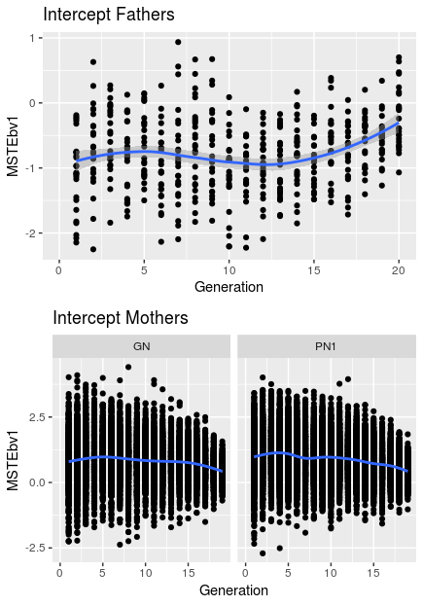
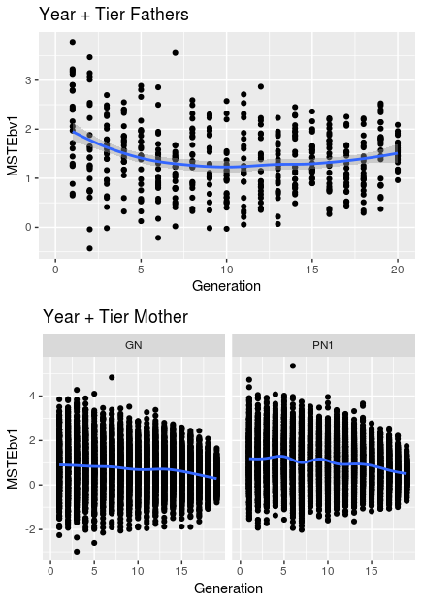
AlphaPart: what is happening with the fathers?
1) Check the MST values of the parents

Slide 4
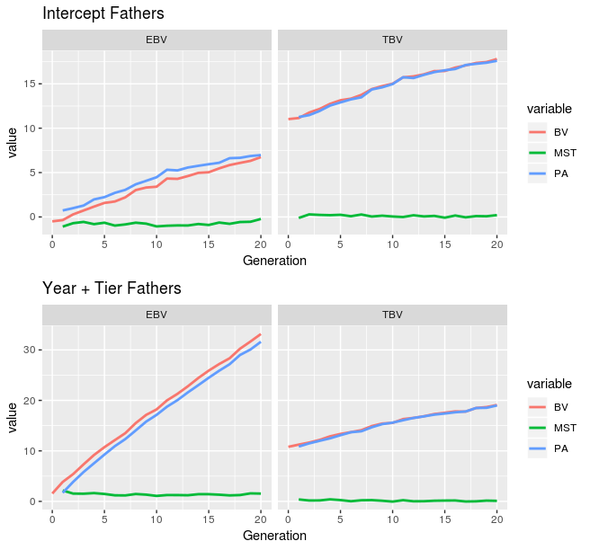
AlphaPart: what is happening with the fathers?
1) Check the MST values of the fathers
Negative MST for the fathers

Slide 5
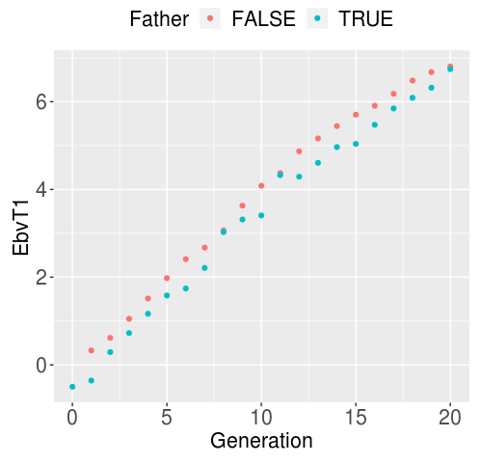
AlphaPart: what is happening with the fathers?
2) Check the EBVs of fathers / non-fathers
Are we not selecting the best males?
Remark: This are the EBVs from the last estimation!

Slide 6
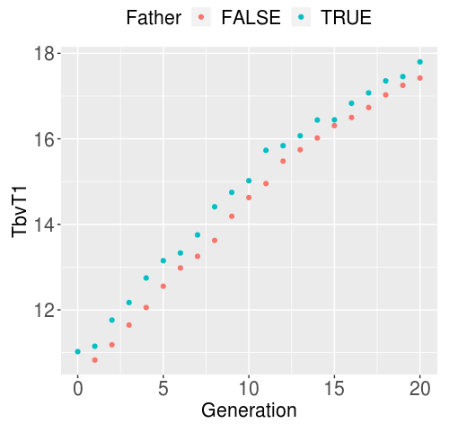
AlphaPart: what is happening with the fathers?
2) Check the EBVs of fathers / non-fathers
We are selecting the best males!

Slide 7
AlphaPart: what is happening with the fathers?
2) What is happening? Either ...
We are not selecting the males with best EBVs → but the TBVs are OK?
The EBVs for fathers are dropping over generations (are worsening!)

Slide 8
AlphaPart: what is happening with the fathers?
2) What is happening?
We are not selecting the males with best EBVs →

Slide 9
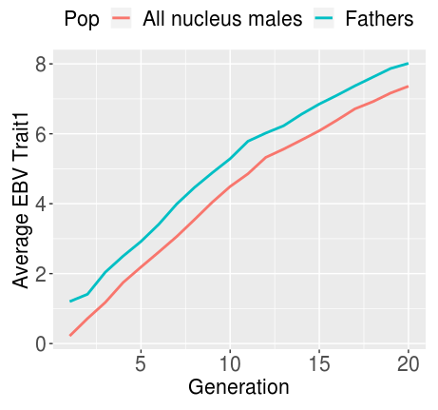
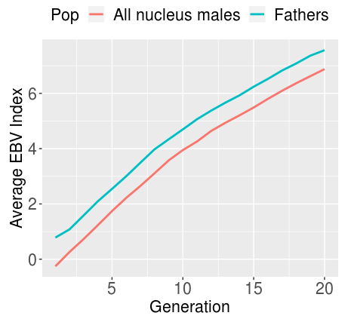
AlphaPart: what is happening with the fathers?
2) What is happening?
We are not selecting the males with best EBVs
EBVs at the time of selection
THIS IS OK!!!

Slide 10
AlphaPart: what is happening with the fathers?
2) What is happening?
The EBVs for fathers are dropping over generations (are worsening!) ???

Slide 11
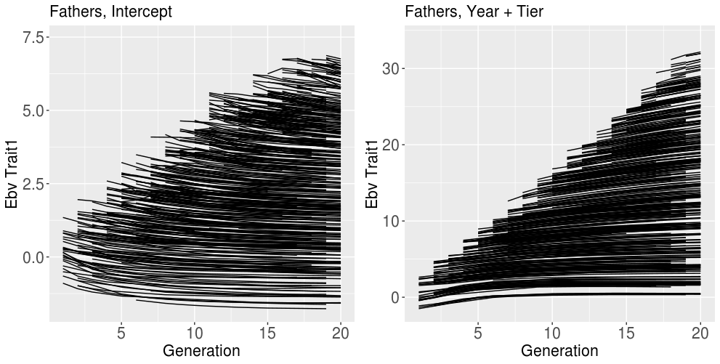
AlphaPart: what is happening with the fathers?
2) What is happening?
EBVs over time

Slide 12
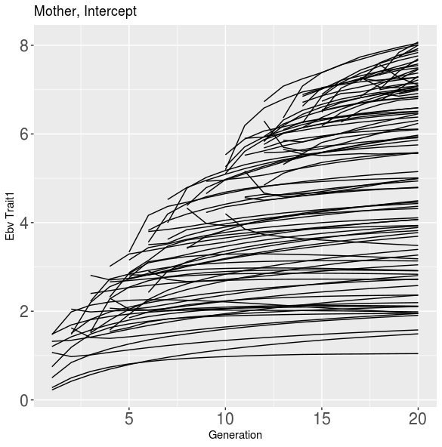
AlphaPart: what is happening with the fathers?
2) What is happening?
EBVs over time

Slide 13
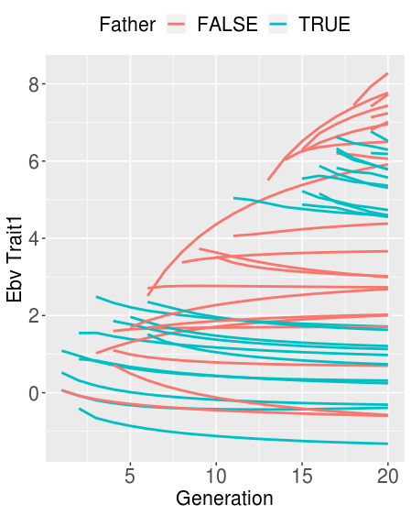
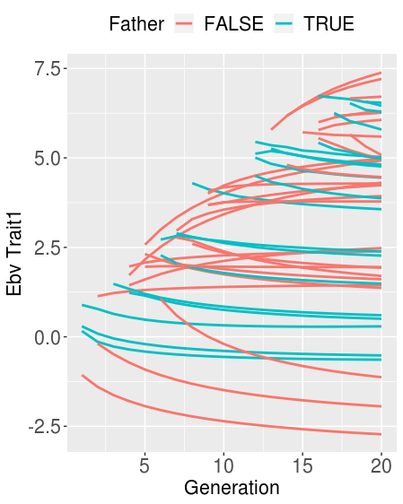
AlphaPart: what is happening with the fathers?
2) What is happening? INTERCEPT MODEL
Fathers’ EBVs → constantly dropping
Two samples from father/non-father population

Slide 14
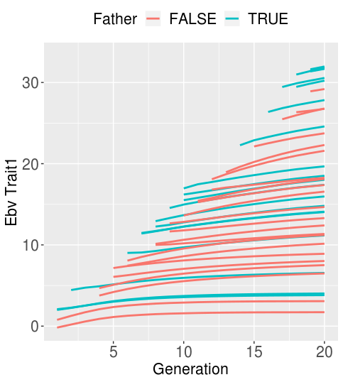
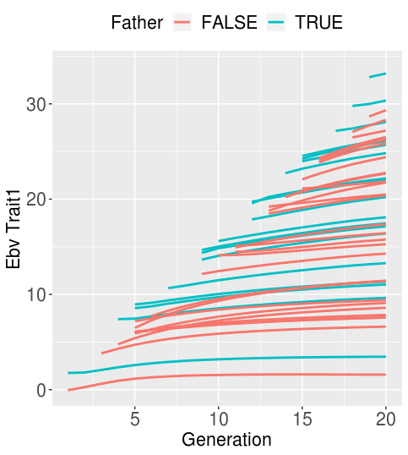
AlphaPart: what is happening with the fathers?
2) What is happening? YEAR + TIER MODEL
Two samples from father/non-father population

Slide 15
AlphaPart: what is happening with the fathers?
2) What is happening?
Model: EBV ~ Indiv + Generation
For fathers: coefficient for generation = -0.038
For non-fathers: ~ 0.003

Slide 16
AlphaPart: what is happening with the fathers?
Writing a paper:
Introduction, implementation (functions) writen
Result and discussion

Slide 17
Reallocation of resource
Writing a paper:
Introduction, material and methods written
Running reference:yes scenarios (1rep)
Result and discussion

