Slide 1
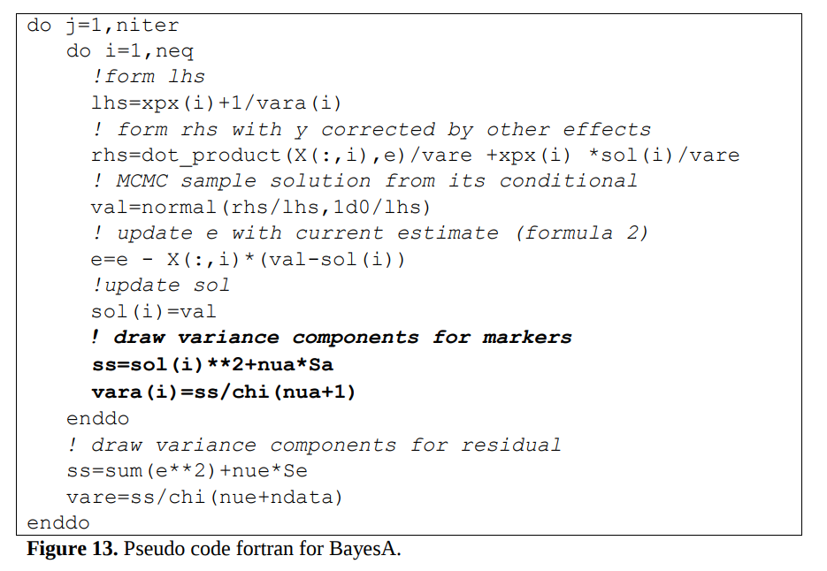
BayesA

Slide 2
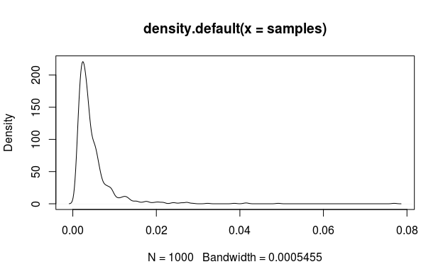
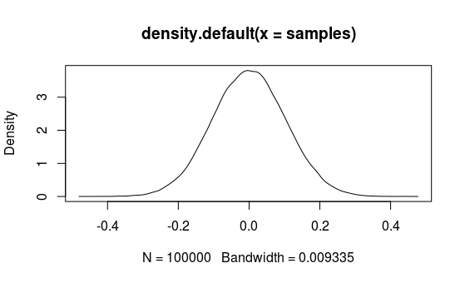
BayesA
Two levels of modeling the data (Meuwissen et al., 2001)
  Model at the level of the data (same as BLUP)
  Model at the level of variance of chromosomal segments (SNPs): prior + data
Loci with differential variance (prior)
All loci have some effect
Different from RR-BLUP:
All loci same variance
Different from BayesB:
Subset selection
Draw variance for
SNP effect
var_{alpha}
Draw SNP effect
from N(mean,var_{alpha})

Slide 3
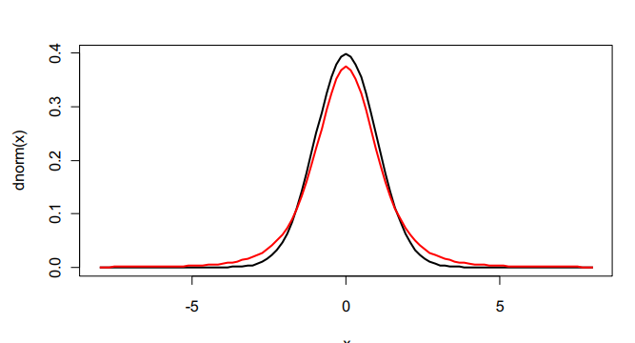
BayesA
Intercept y and SNP effect α: normal distribution
σ_{e} and σ_{α}; scaled inverted χ²
  Correspondons to prior(scaled t distribution) for marker effects – fat tails
  Large marker effects not unlikely
  (Legarra, Bases for Genomic Prediction)
  Convenient: when combined
  with data, scaled inverted χ²

Slide 4
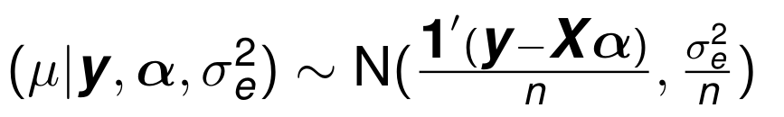

BayesA
Sample mean μ - NORMAL
Fernando
Meuwissen
  X=design matrix of SNP effects
  g=vector of SNP effects
# sample intercept
ycorr = ycorr + x[,1]*b[1];
rhs = sum(ycorr)/vare;
invLhs = 1.0/(nrecords/vare);
mean = rhs*invLhs;
b[1] = rnorm(1,mean,sqrt(invLhs));
sum(ycorr) * varE
varE * n

Slide 5
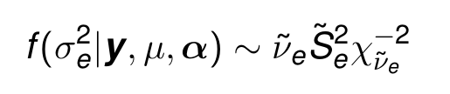


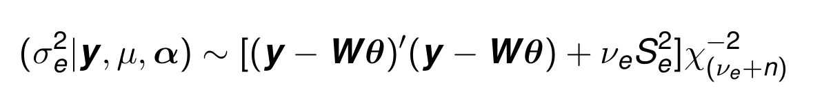
BayesA
Sample σ_{e}– INVERTED χ²
With prior χ⁻²(-2, 0)
#chosen d.f. = 3, scale = 0
# sample vare
vare = ( t(ycorr)%*%ycorr )/rchisq(1,nrecords + 3);
y_{corr}’y_{corr}; where y_{corr} is y corrected for the current solution vector

Slide 6
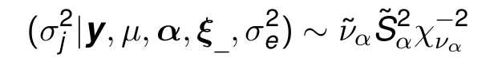
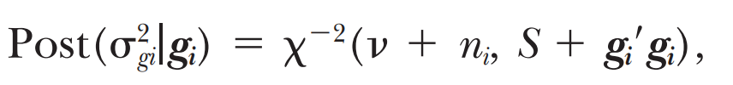
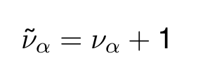
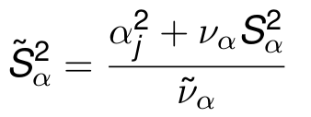
BayesA
Sample σ_{α} – INVERTED χ²
; where n = number of haplotype effects at i
# sample variance for each locus
# chosen d.f. = 4, v_{α} = 5
var[locus] = (scalea*4+b[locus]*b[locus])/rchisq(1,4.0+1)

Slide 7

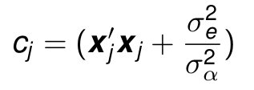
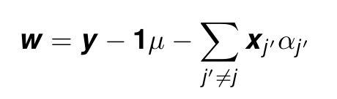
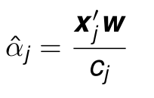
BayesA
Sample SNP effect α - NORMAL
X’X + λ
Pheno – mean – solution with effect of i set to 0
# sample effect for each locus
ycorr = ycorr + x[,locus]*b[locus]; #unadjust y for this locus
rhs = t(x[,locus])%*%ycorr/vare;
lhs = t(x[,locus])%*%x[,locus]/vare + 1.0/var[locus];
invLhs = 1.0/lhs;
mean = invLhs*rhs;
b[locus]= rnorm(1,mean,sqrt(invLhs));
ycorr = ycorr - x[,locus]*b[locus];

Slide 8
BayesA
Sample SNP effect α
# sample effect for each locus
rhs = t(x[,locus])%*%ycorr/vare;
lhs = t(x[,locus])%*%x[,locus]/vare + 1.0/var[locus];
invLhs = 1.0/lhs;
mean = invLhs*rhs;
*varE
# sample effect for each locus
rhs = t(x[,locus])%*%ycorr;
lhs = t(x[,locus])%*%x[,locus] + vare/var[locus];
(X’X + λ) * g = X’y

