Slide 1
student meeting 12th September 2019

Slide 2
Troy Rowan
PhD Meeting 05 September 2019
Manuscript reviews
MU sequence imputation pipeline
Local adaptation null permutations
GPSM simulations

Slide 3
GPSM simulation progress
A few new “results”
Can we use GPSM h² as test for polygenic selection?
Implementation as a Snakemake pipeline
Param file → runs sims → pulls genotypes → → Manhattan plots/calculates success stats
Almost ready for showtime
Interest in a Snakemake tutorial?
Here or “big” lab meeting?
Notes:
<number>

Slide 4
GPSM runs
Example:
1,000 QTL
15 generations of selection (10 burn in)
6,000 individuals per analysis
QTL Distribution | Selection strategy | Chip h² estimate (SE) | True “selected alleles” (False positives)
Gamma | True BV | 0.782 (0.0082) | 8
Gamma | Random | 0.892 (0.0049) | 0 (1 false +)
Normal | True BV | 0.781 (0.0081) | 14
Normal | Random | 0.884 (0.0051) | 0 (1 false +)
Notes:
<number>

Slide 5
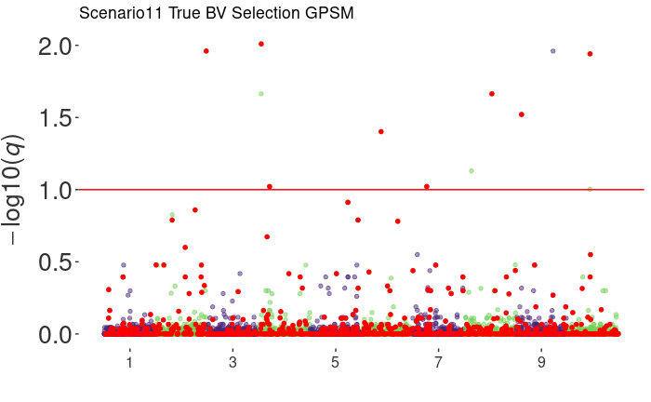
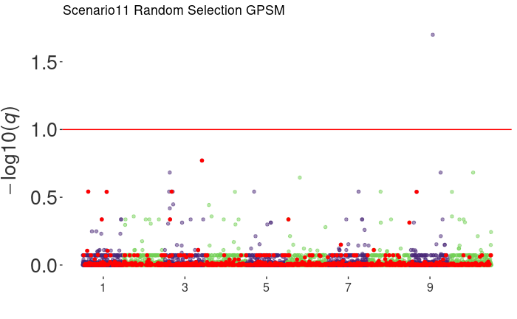
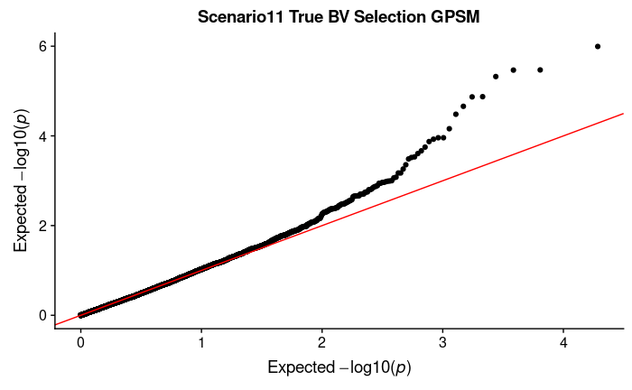
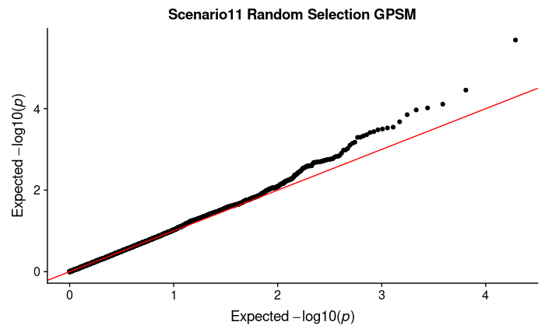
Scenario 11(Gamma QTL effects)
Notes:
<number>

Slide 6
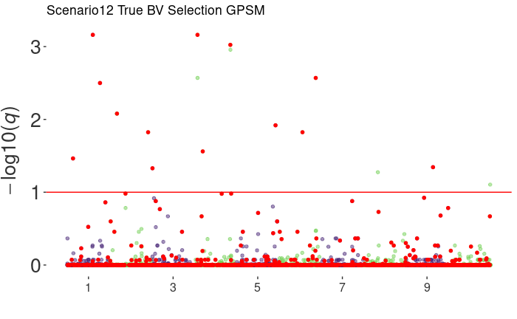
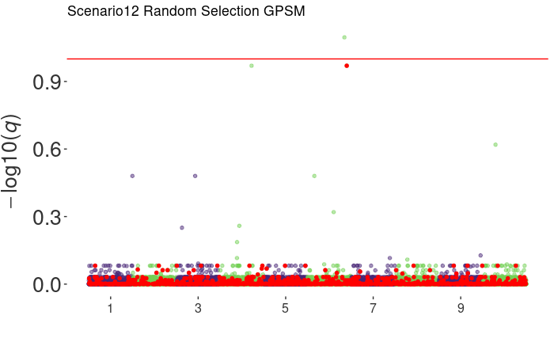
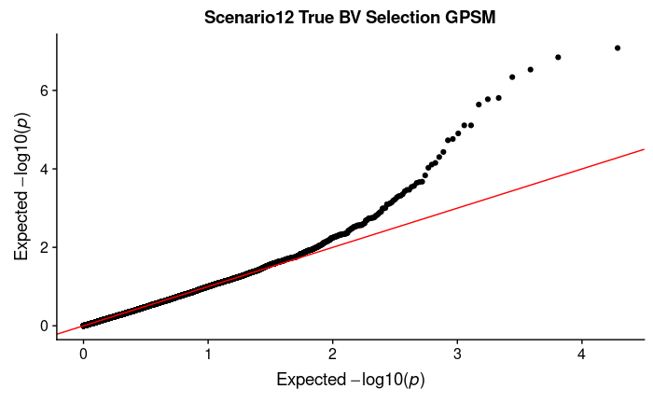
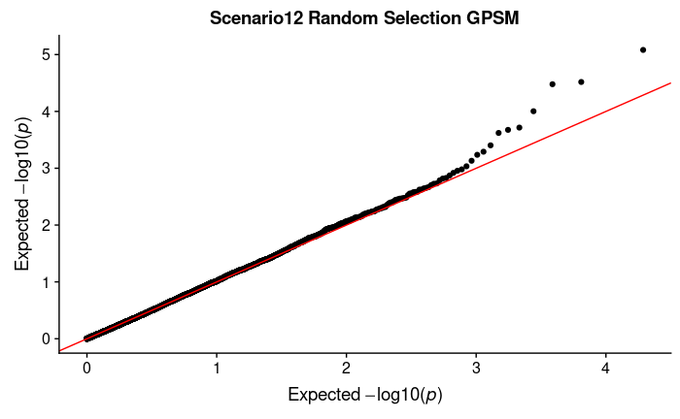
Scenario 12 (Normal QTL effects)
Notes:
<number>

Slide 7
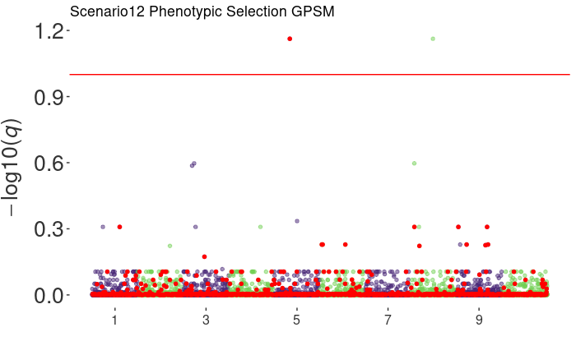
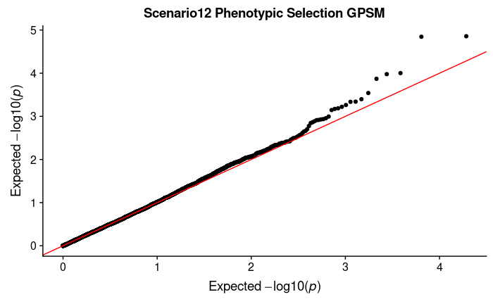
Phenotypic Selection...
What is the h² of selection (as a trait)?
Notes:
<number>

Slide 8
Guilherme – 12/09
Still running the simulations
Some results

Slide 9
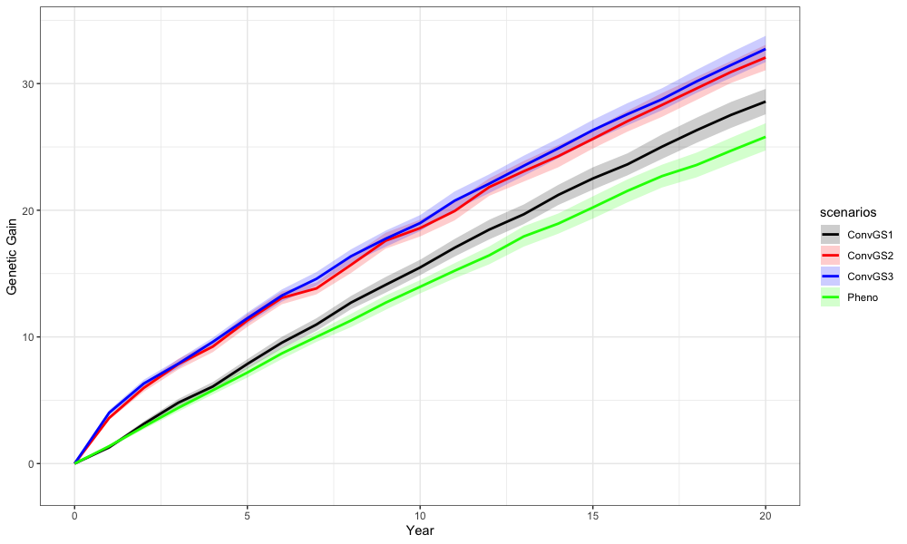
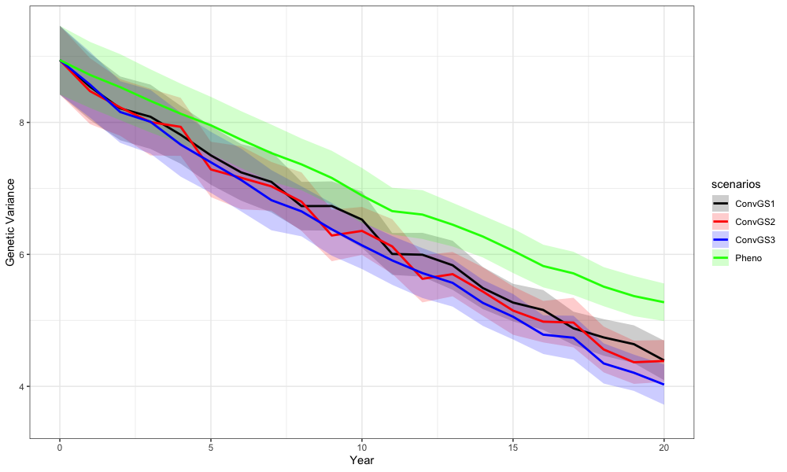
Parcial results

Slide 10
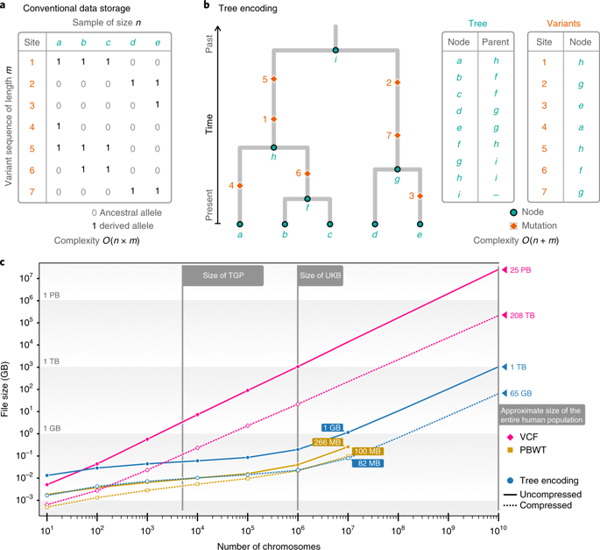
Barbara Tsinfer/tskit

Slide 11
Tsinfer/tskit
Estimate haplotype phases with Eagle
⇓
Infer succinct trees with tsinfer
⇓
Build relationship matrices using tree sequences
⇓
Run and compare genomic predictions + GWAS

Slide 12
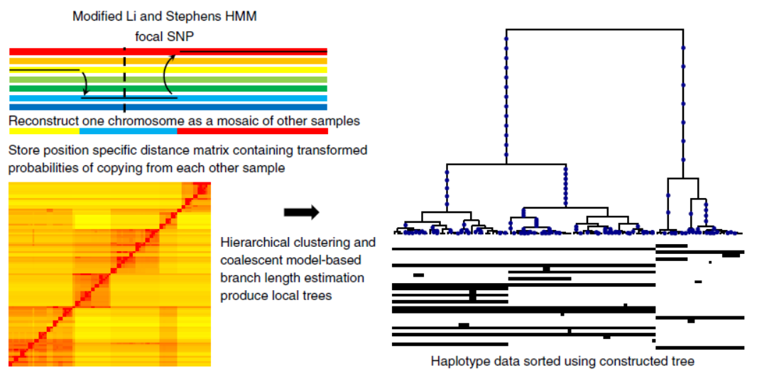
Relate
4
Mutations
Branch lengths
1
2
3
A method for genome-wide genealogy estimation for thousands of samples
Leo Speidel , Marie Forest, Sinan Shi and Simon R. Myers

Slide 13
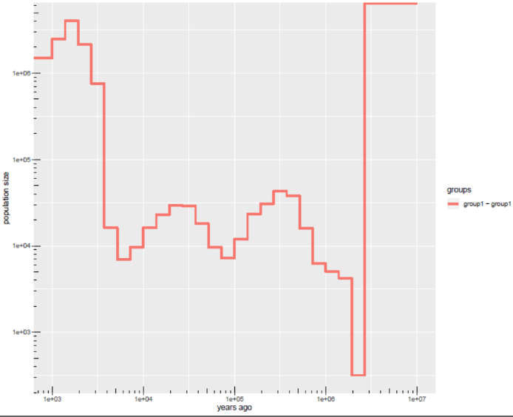
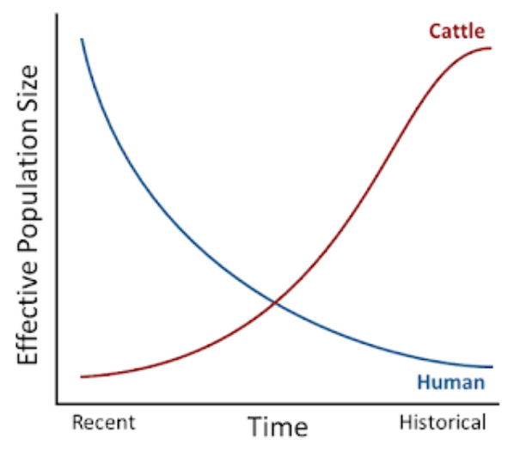
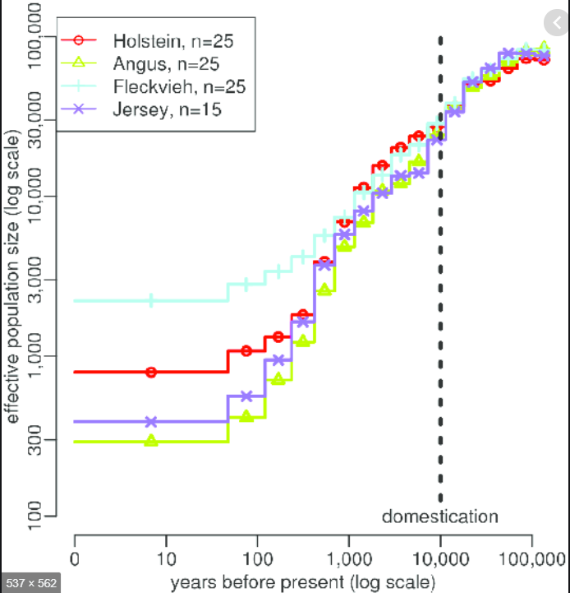
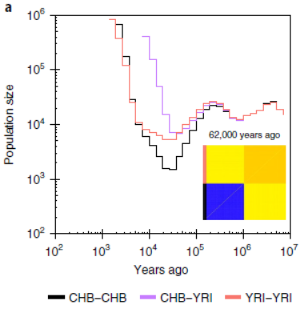
Relate
Estimate effective population sizes

Slide 14
Jon 12/09/2019
Manuscript
Intro, MMs, Results finished
Discussion structure!
Principal components analysis review

Slide 15
Next
Manuscript → Results corrections, discussion
GWAS
Try different imputation tools in Tassel
Backburner:
Start with thesis literature review
2nd paper introduction and M&M
2nd year progress report presentation

Slide 16
Discussion topics
Principal component analysis
Optimal contribution algorithm
MCMC sampling methods (e.g. Gibbs)
Spatial analysis with nested designs
Log ratios
Degrees of freedom, test statistics

Slide 17
Jana student meeting 22nd August 2019
AlphaPart
Ran a simple simulation → everything OK
Two tier simulation – ???
Reallocation of resources

Slide 18
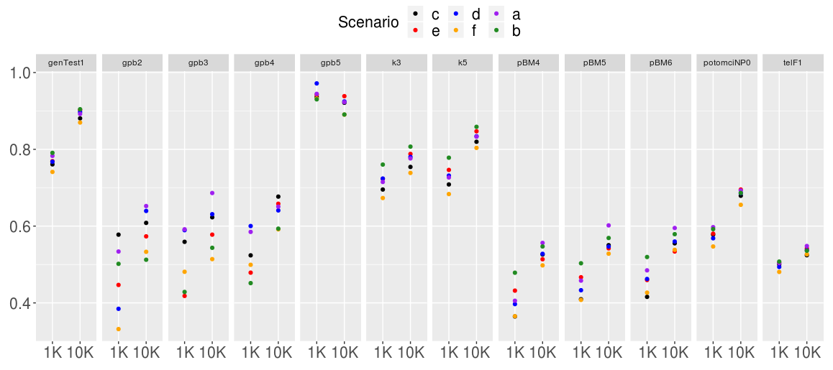
Jana student meeting 22nd August 2019
Scenarios differing in variance components, h² = 0.25
Parent average
genTest
genTest AI bulls
PB
Cows
Bull dams
Elite off
F calves

Slide 19
Jana student meeting 22nd August 2019
Running scenarios with reference: yes
18 scenarios:
Price of pheno:geno 1:1, 1:2, 2:1
No phenotype recordings: 10, 9, 8, 5, 2, 1
Wrote parameters in a file –> python script to run them all

