Slide 1
PhD Meeting
19th September 2019

Slide 2
PhD Meeting
19th September 2019
Guilherme

Slide 3
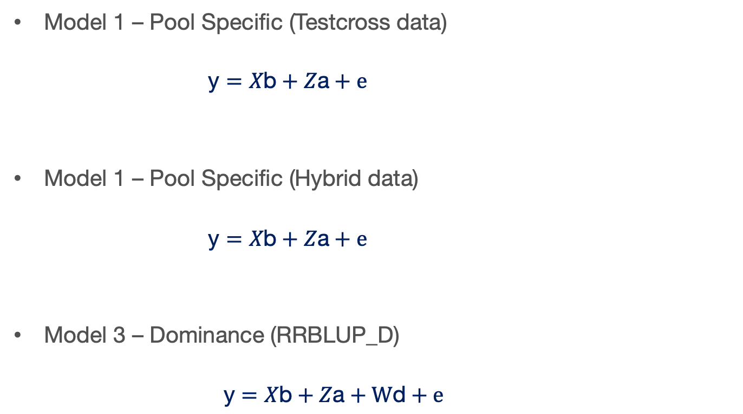
Models

Slide 4
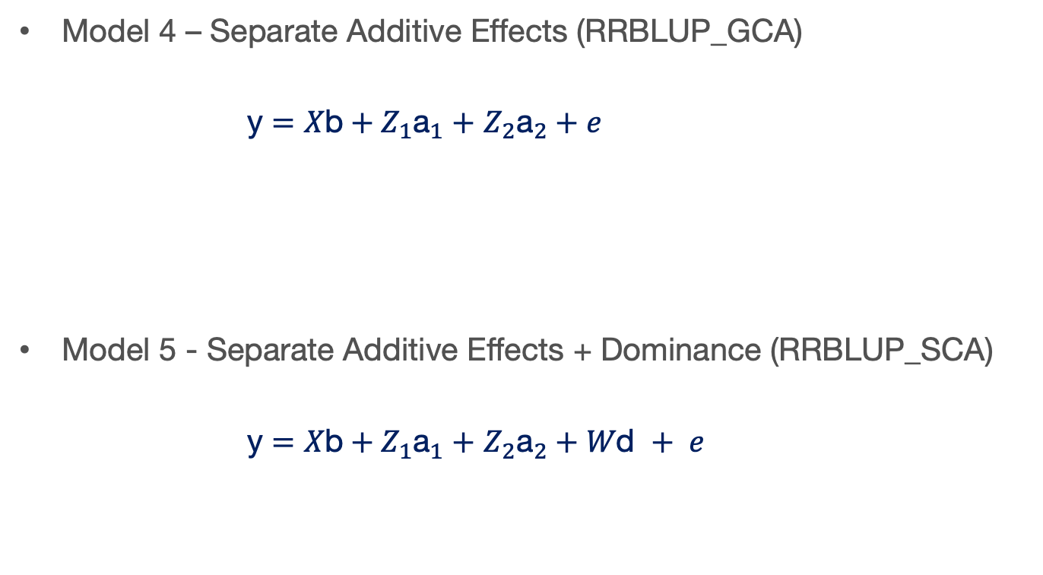
Models

Slide 5
Last week
Still running the simulations
Some results I’ve got

Slide 6
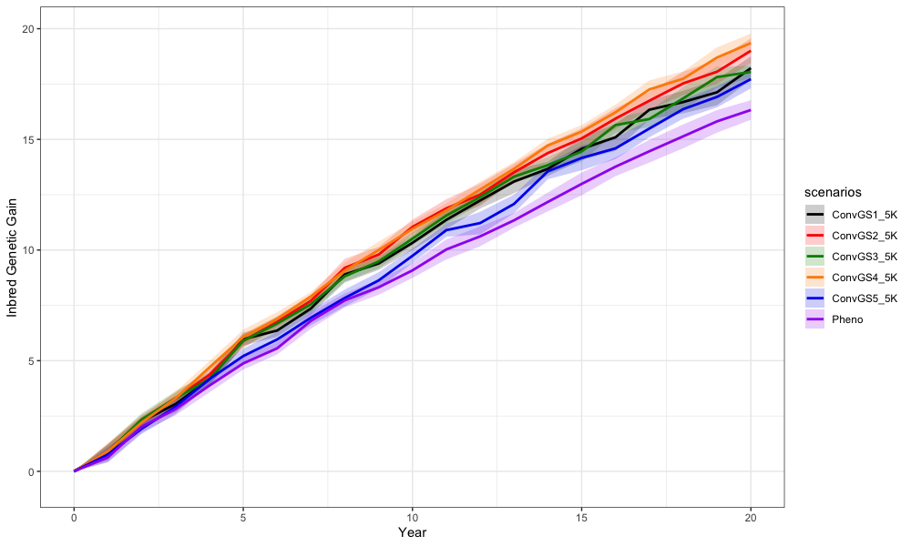
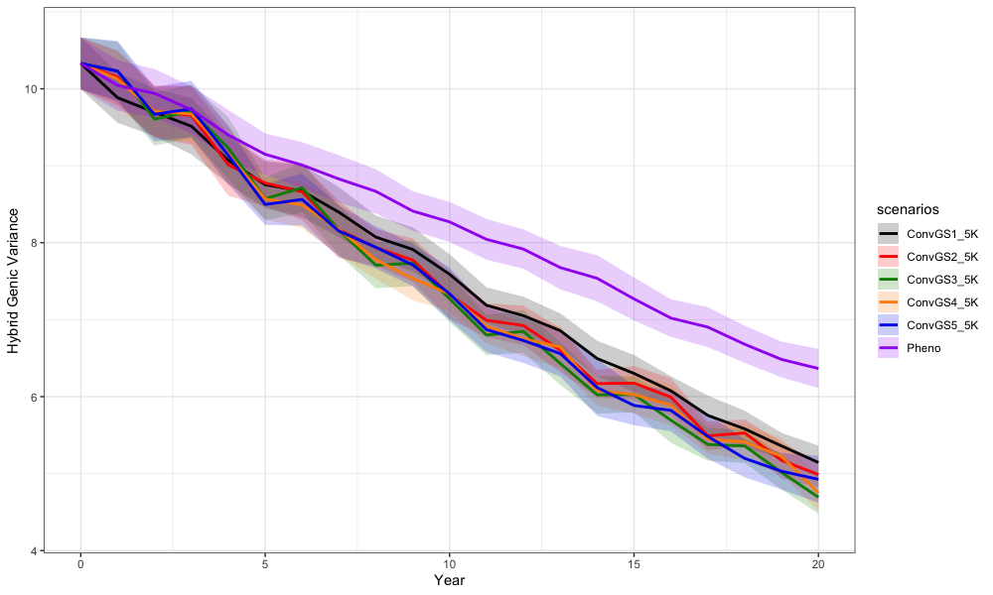

Slide 7
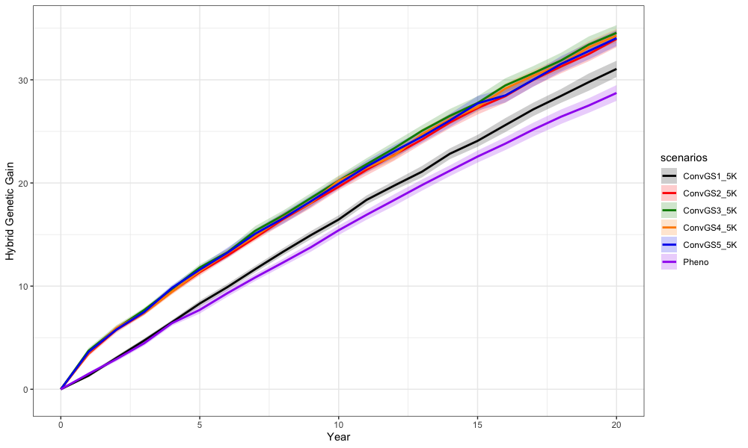

Slide 8
Next…
Change the population size
And review the code again

Slide 9
PhD Meeting
19th September 2019
Troy

Slide 10
MU sequence imputation pipeline
Local adaptation null permutations
GPSM simulations

Slide 11
Generation Proxy Selection Mapping
Generation Proxy Selection Mapping
Idea: Fit some “generation proxy” in GWAS model to map ongoing selection within a population
Simulations: Validate that it works, see where strengths/limitations are
Testing:
  N_{e}
  Selection intensity
  Genetic architectures

Slide 12
Constant parameters (for now)
Cattle demography in AlphaSimR
10 Chromosomes with 1,000 SNPs each
500 ♀️ per generation (4 offspring each)
20 generations of selection (after 5 burn-in)
  True BV, phenotypic, random
400 individuals per generation in GPSM analysis
GWAS using GEMMA
  Plots of q-values, identifying true QTL

Slide 13
GPSM simulation progress
Simulated parameters:
  Number of QTL
    10K, 5K, 2.5K, 1K, 500, 200, 100, 10
  Effect distributions
    Normal,Gamma (2 shapes)
  N_{e} (males per generation)
    50, 25, 10

Slide 14
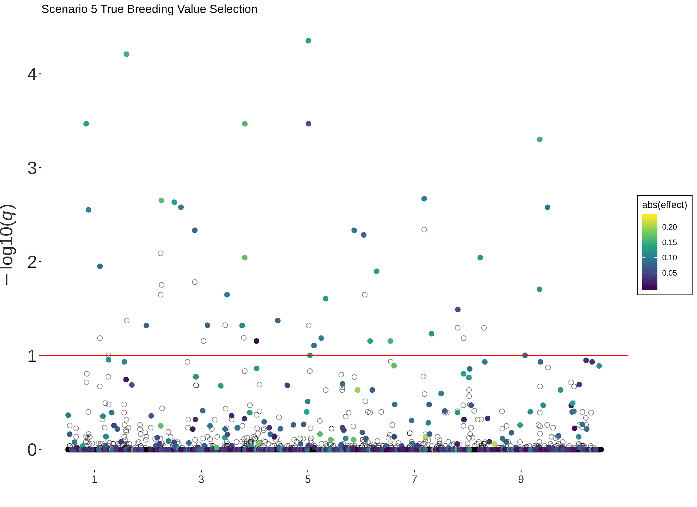
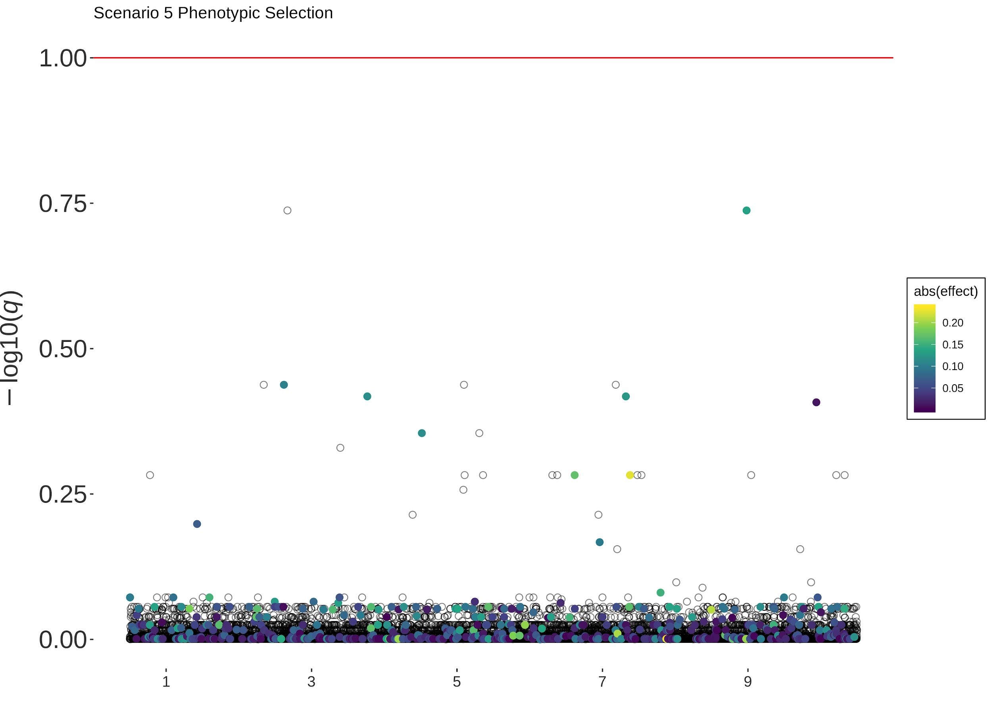
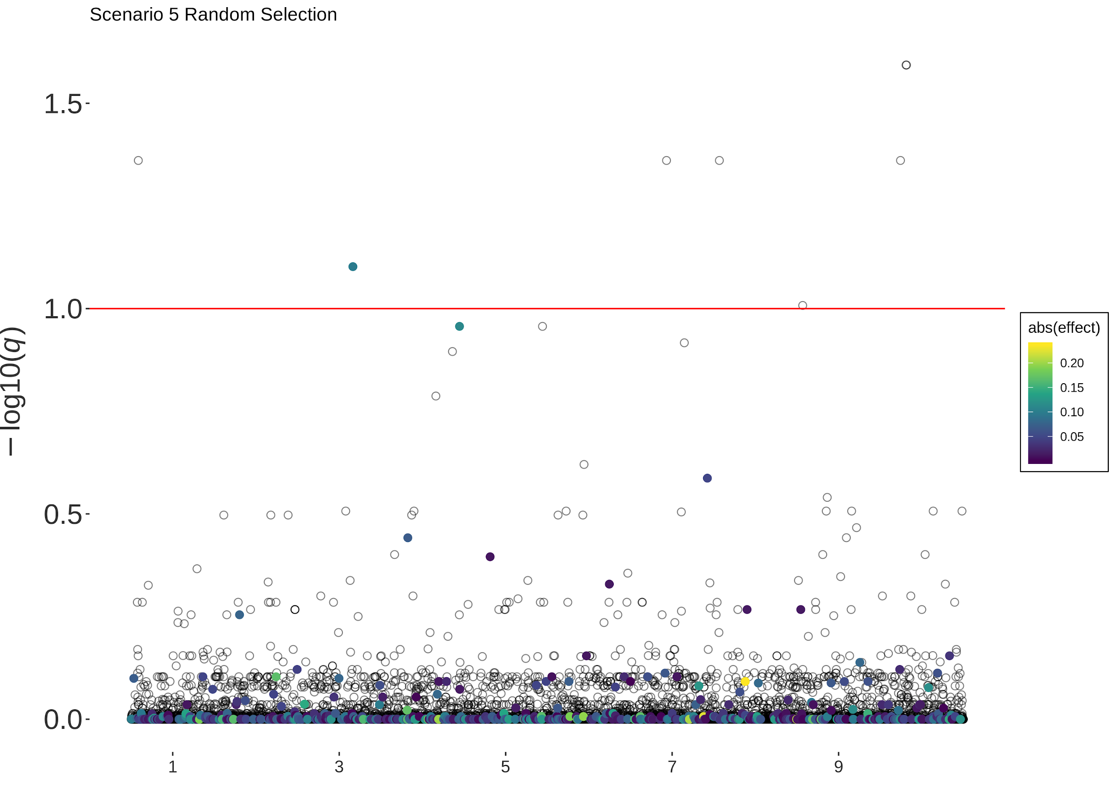
Scenario 5 (Normal QTL, 50 Sires)

Slide 15
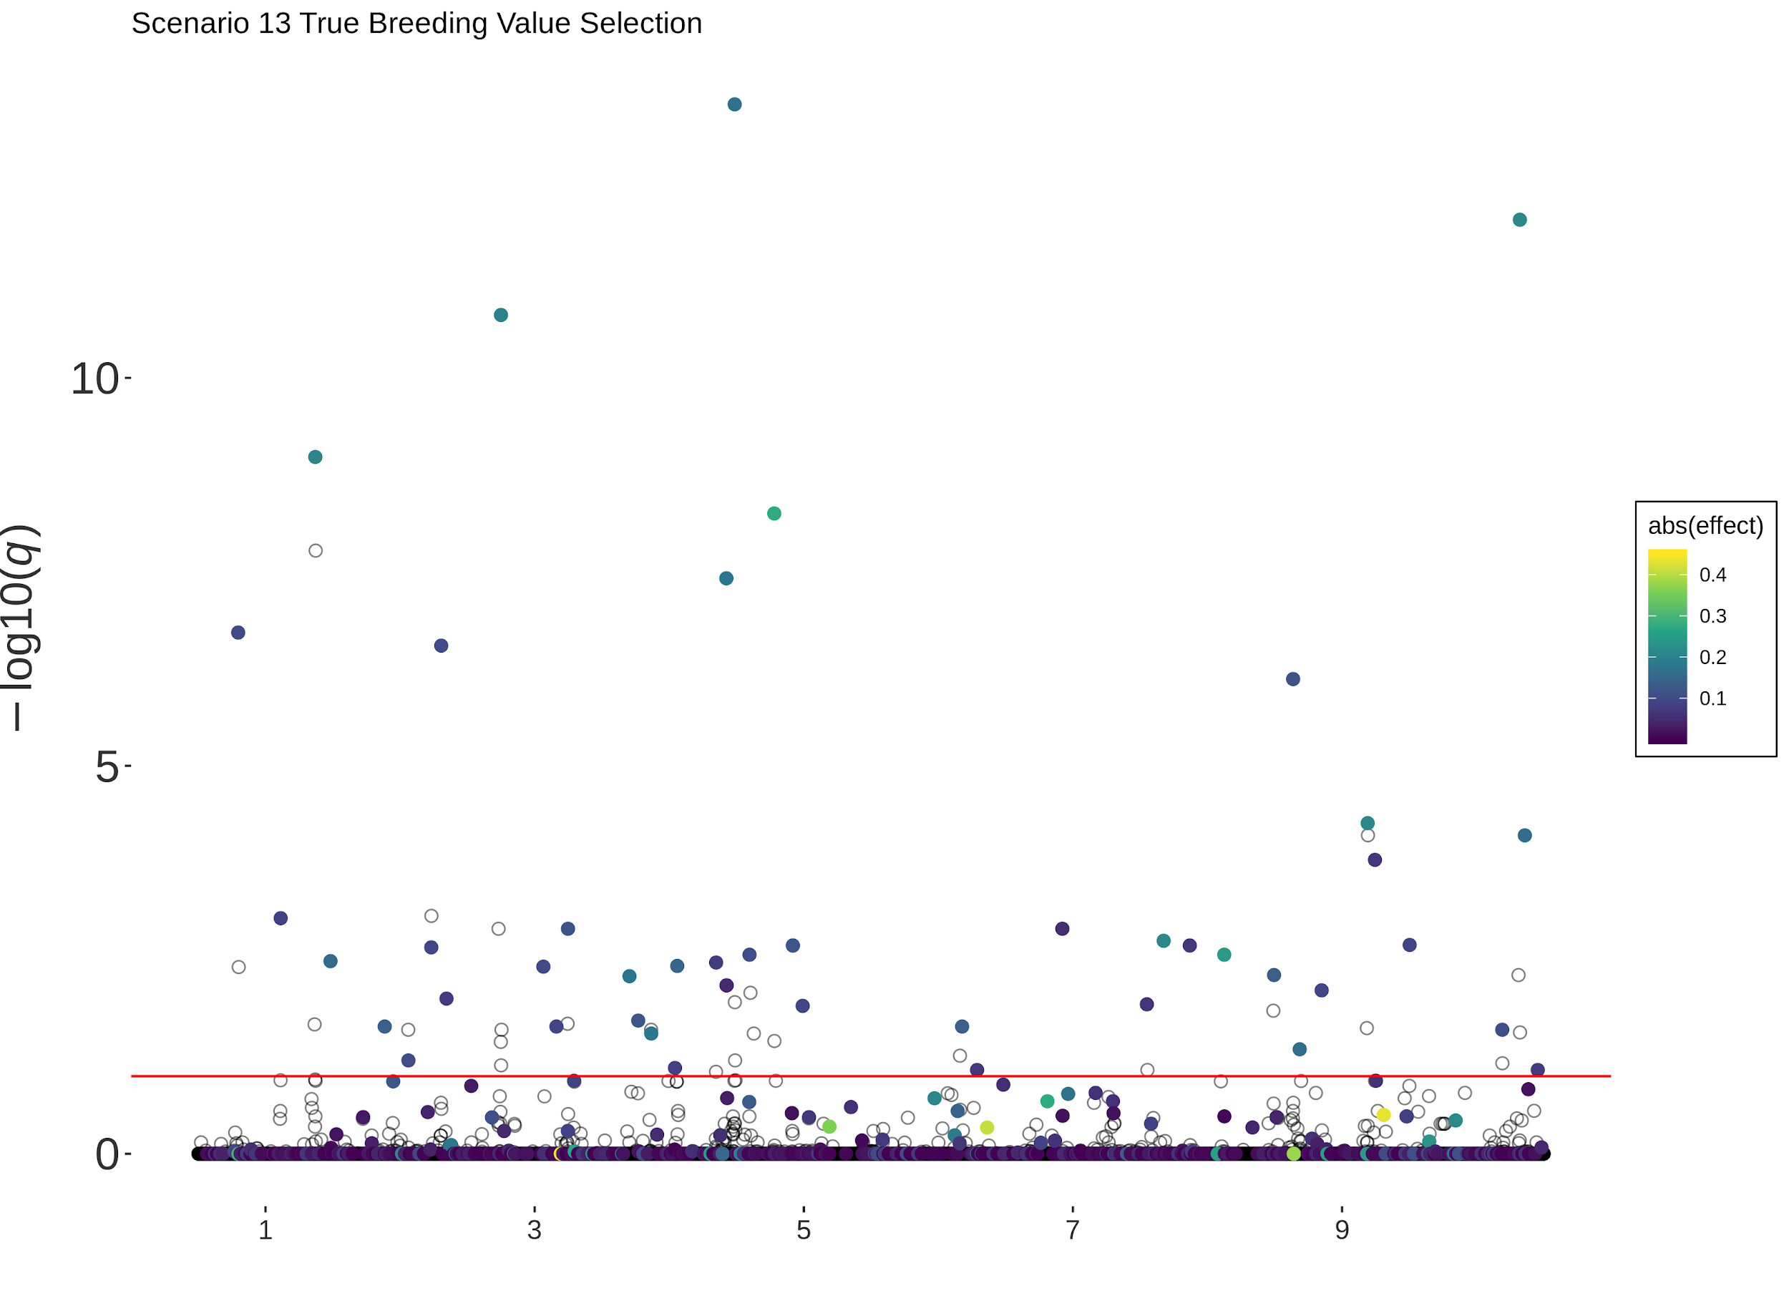
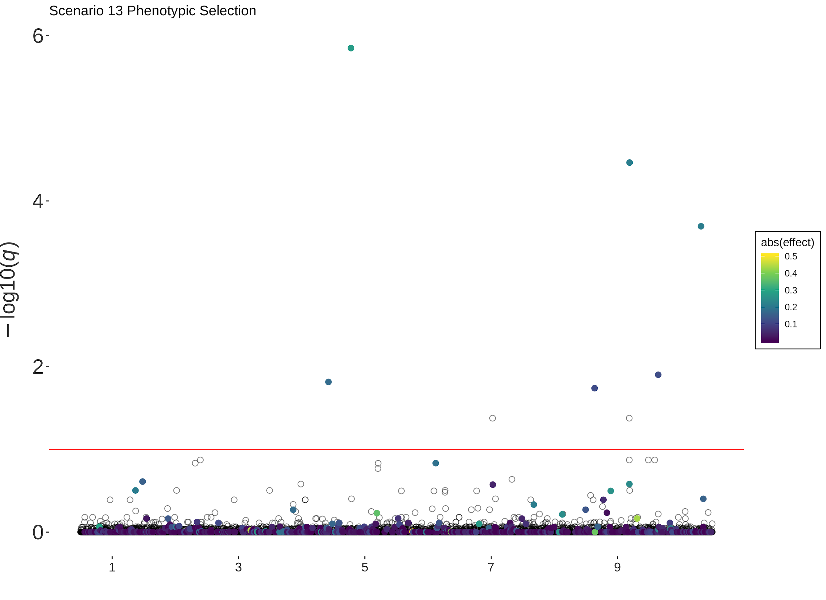
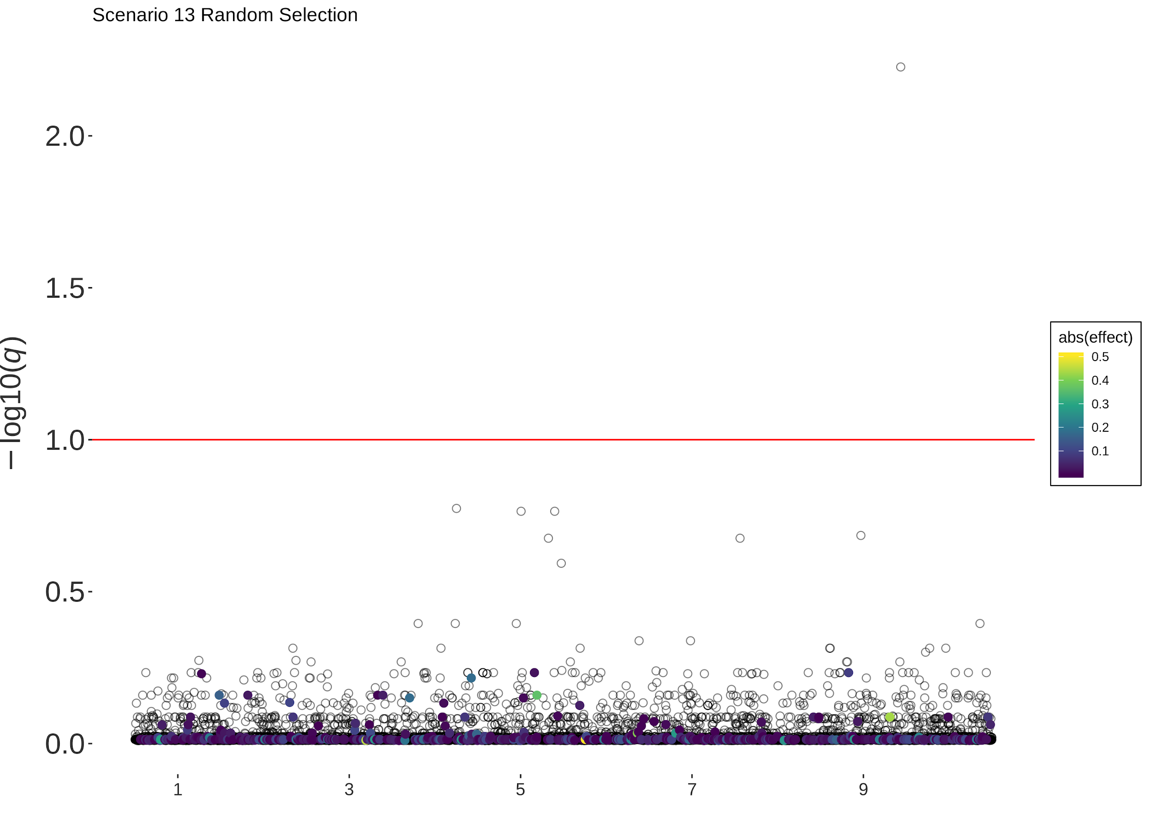
Scenario 13 (Gamma, 50 Sires)

Slide 16
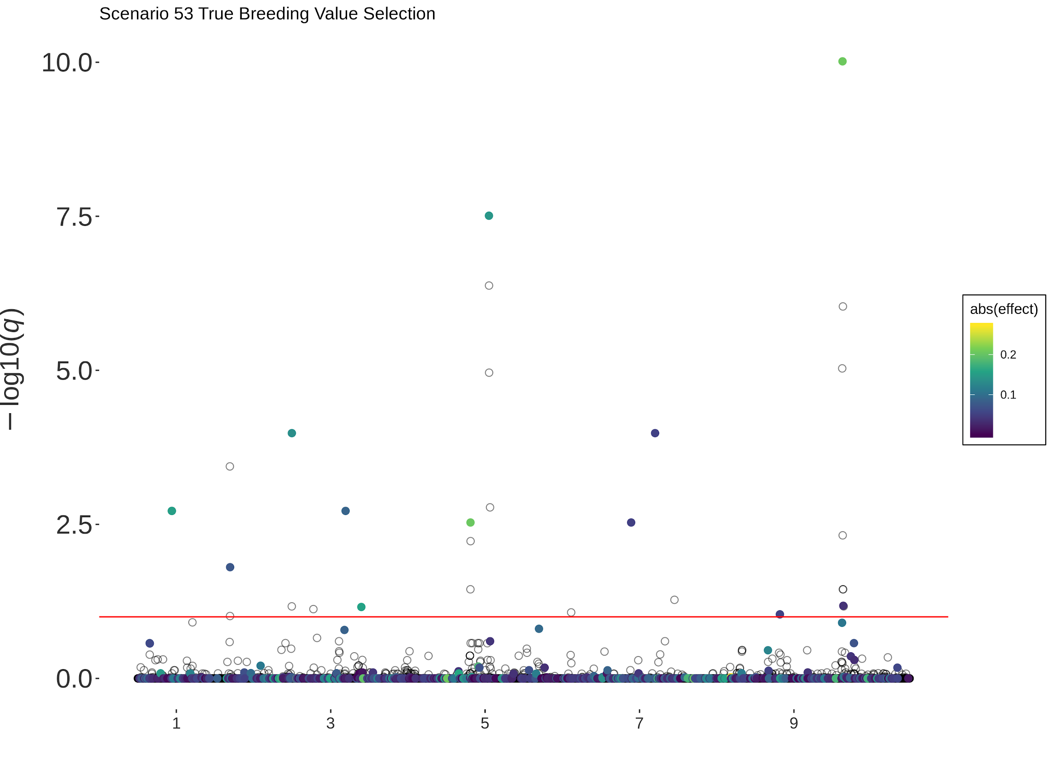
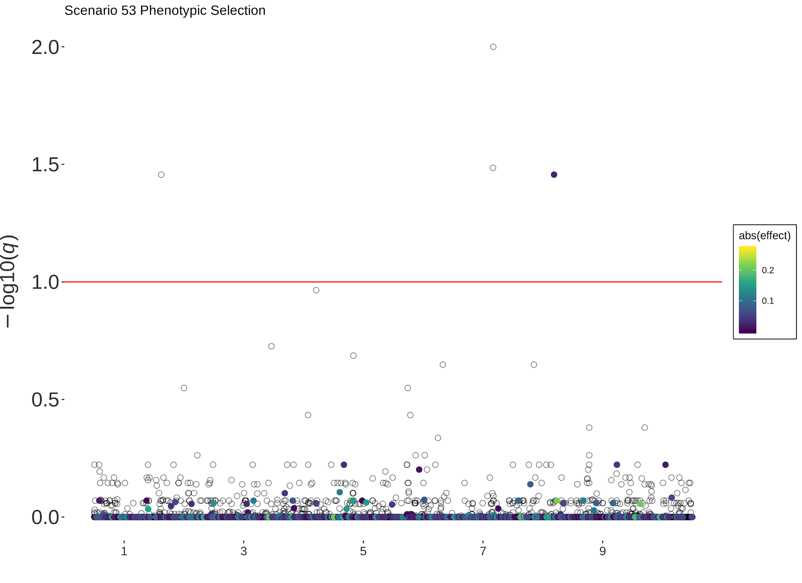
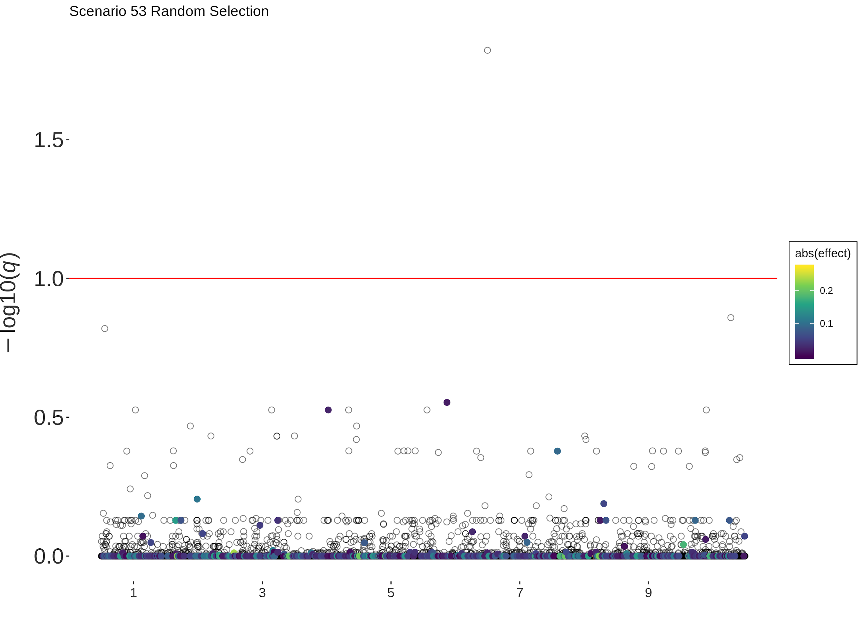
Scenario 53 (Normal, 10 Sires)

Slide 17
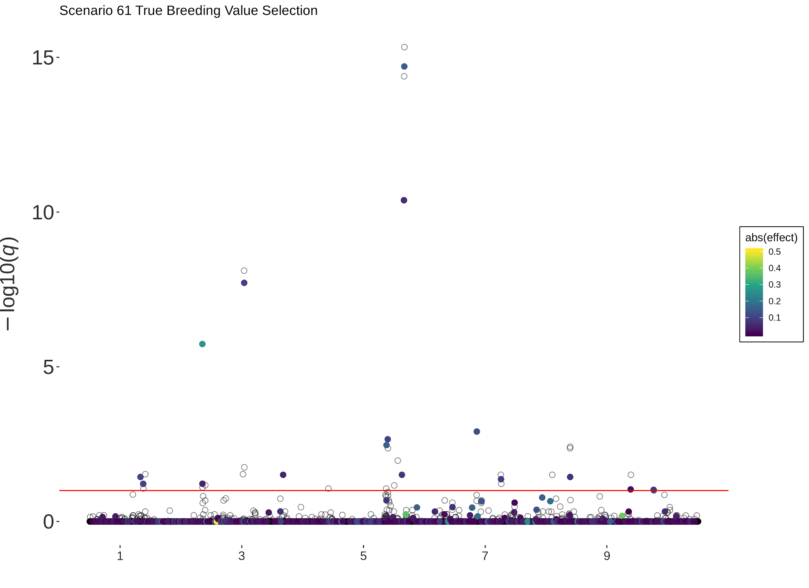
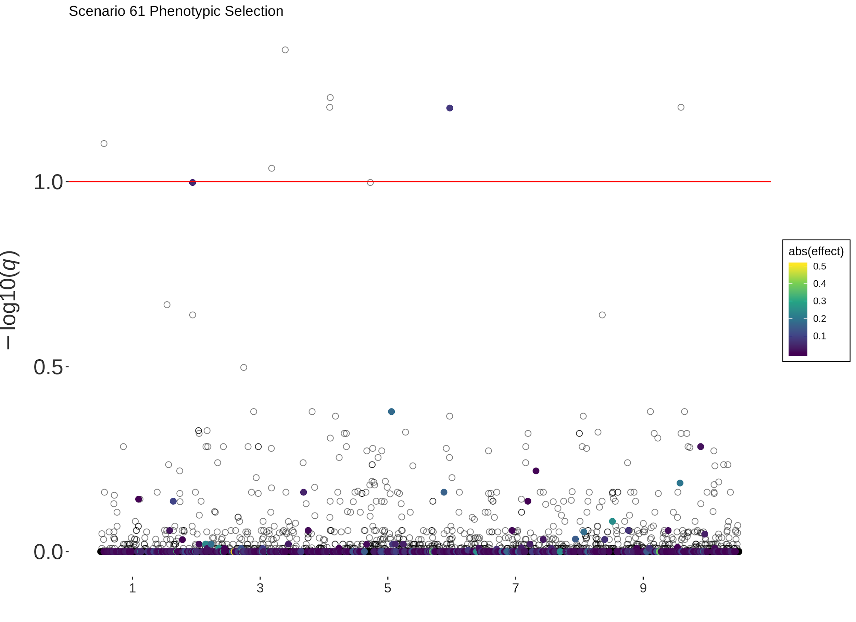
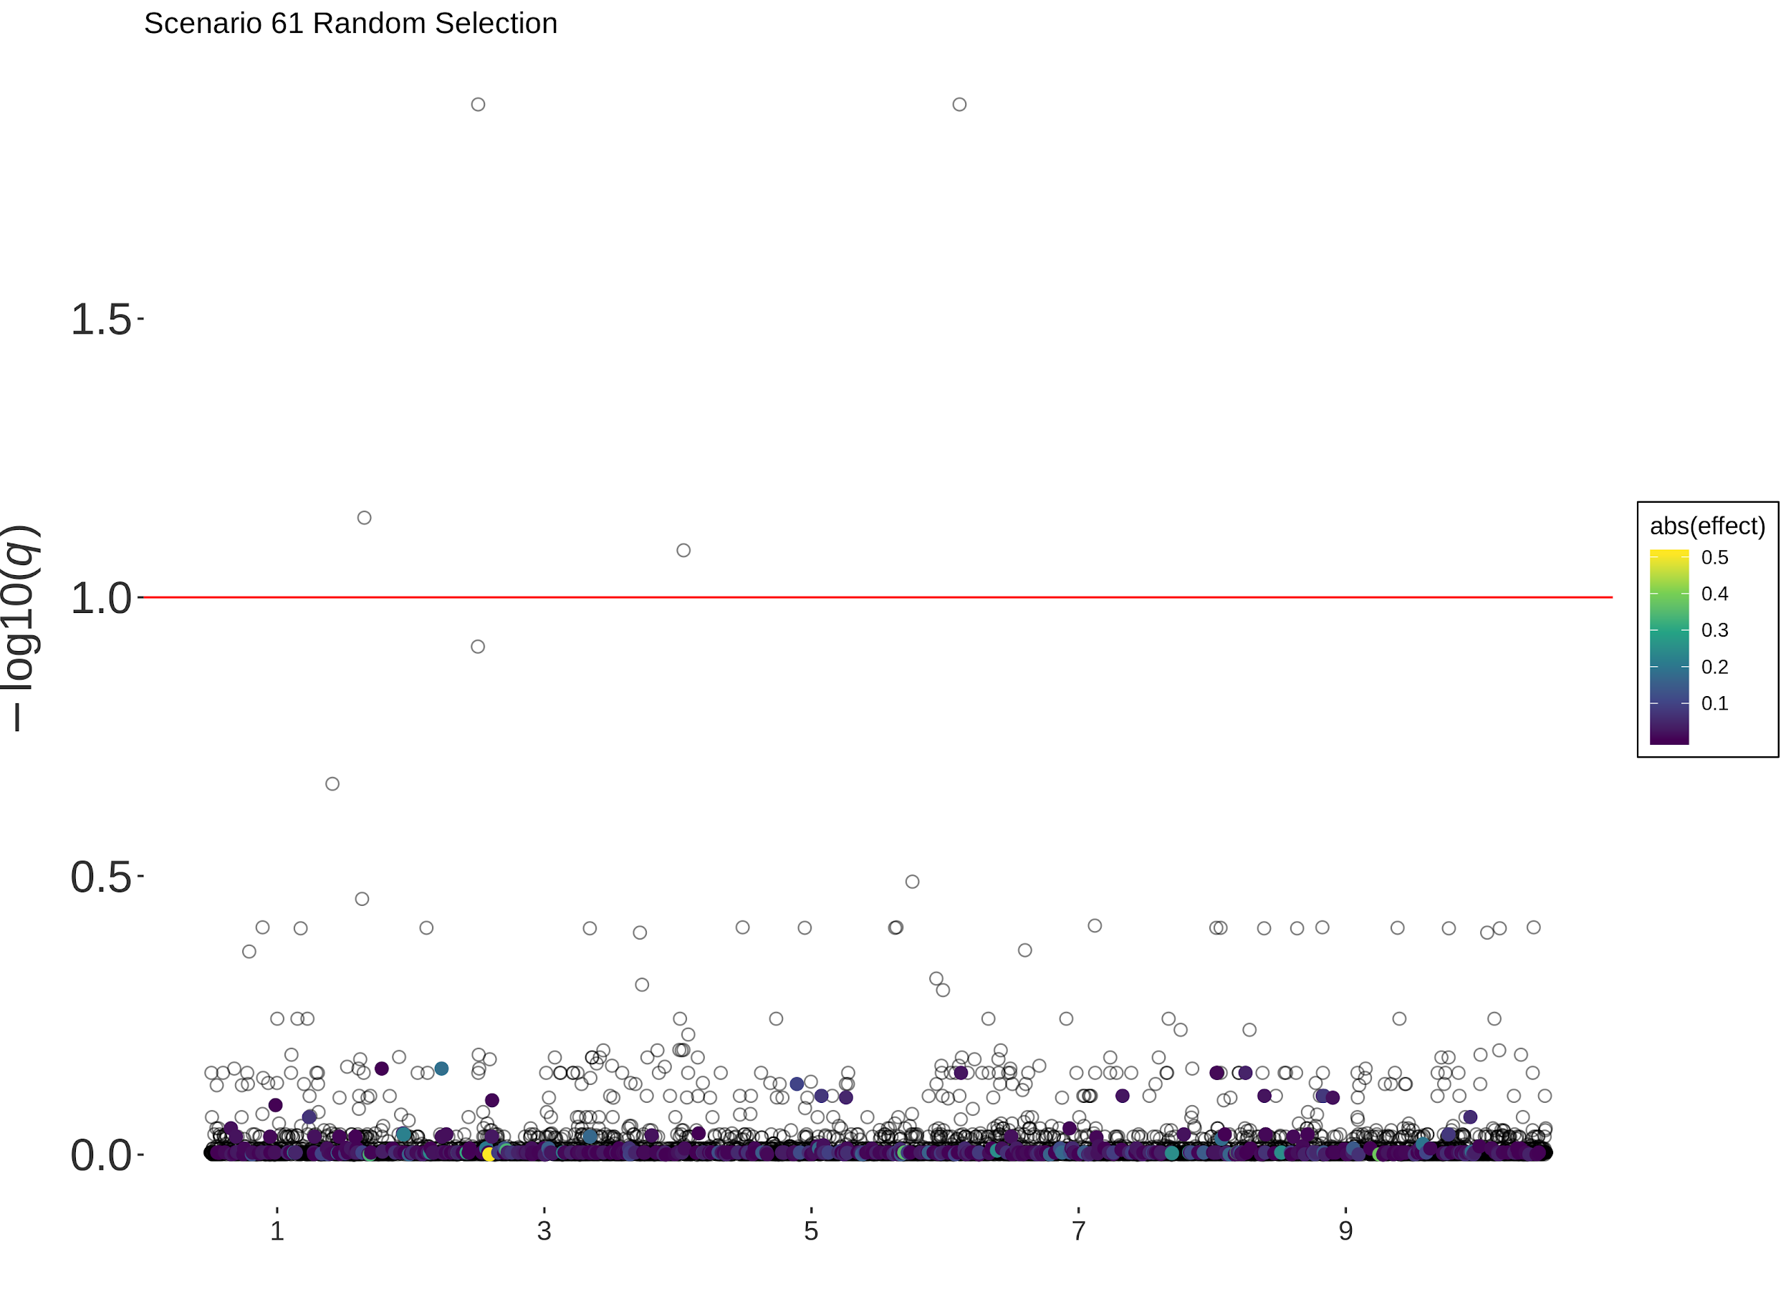
Scenario 61 (Gamma, 10 Sires)

Slide 18
Next up...
Selection intensities
Number of generations
Uneven generation sampling
  Reflect real datasets
Track AF changes of QTL by generation
Changes to global LD
  Can we detect polygenic selection even when no loci turn up in our analysis?

Slide 19
PhD Meeting
19th September 2019
Jana

Slide 20
Still working on ...
AlphaPart: R-package for partitioning genetic trend
Reallocation of resources:
  Reallocate money from phenotyping to genotyping

Slide 21
AlphaPart
Pig breeding examples: nucleus + reproduction
Models:
  Intercept + animal
  Tier + generation (fixed) + animal (random)
  Tier * generation (fixed) + animal (random)

Slide 22
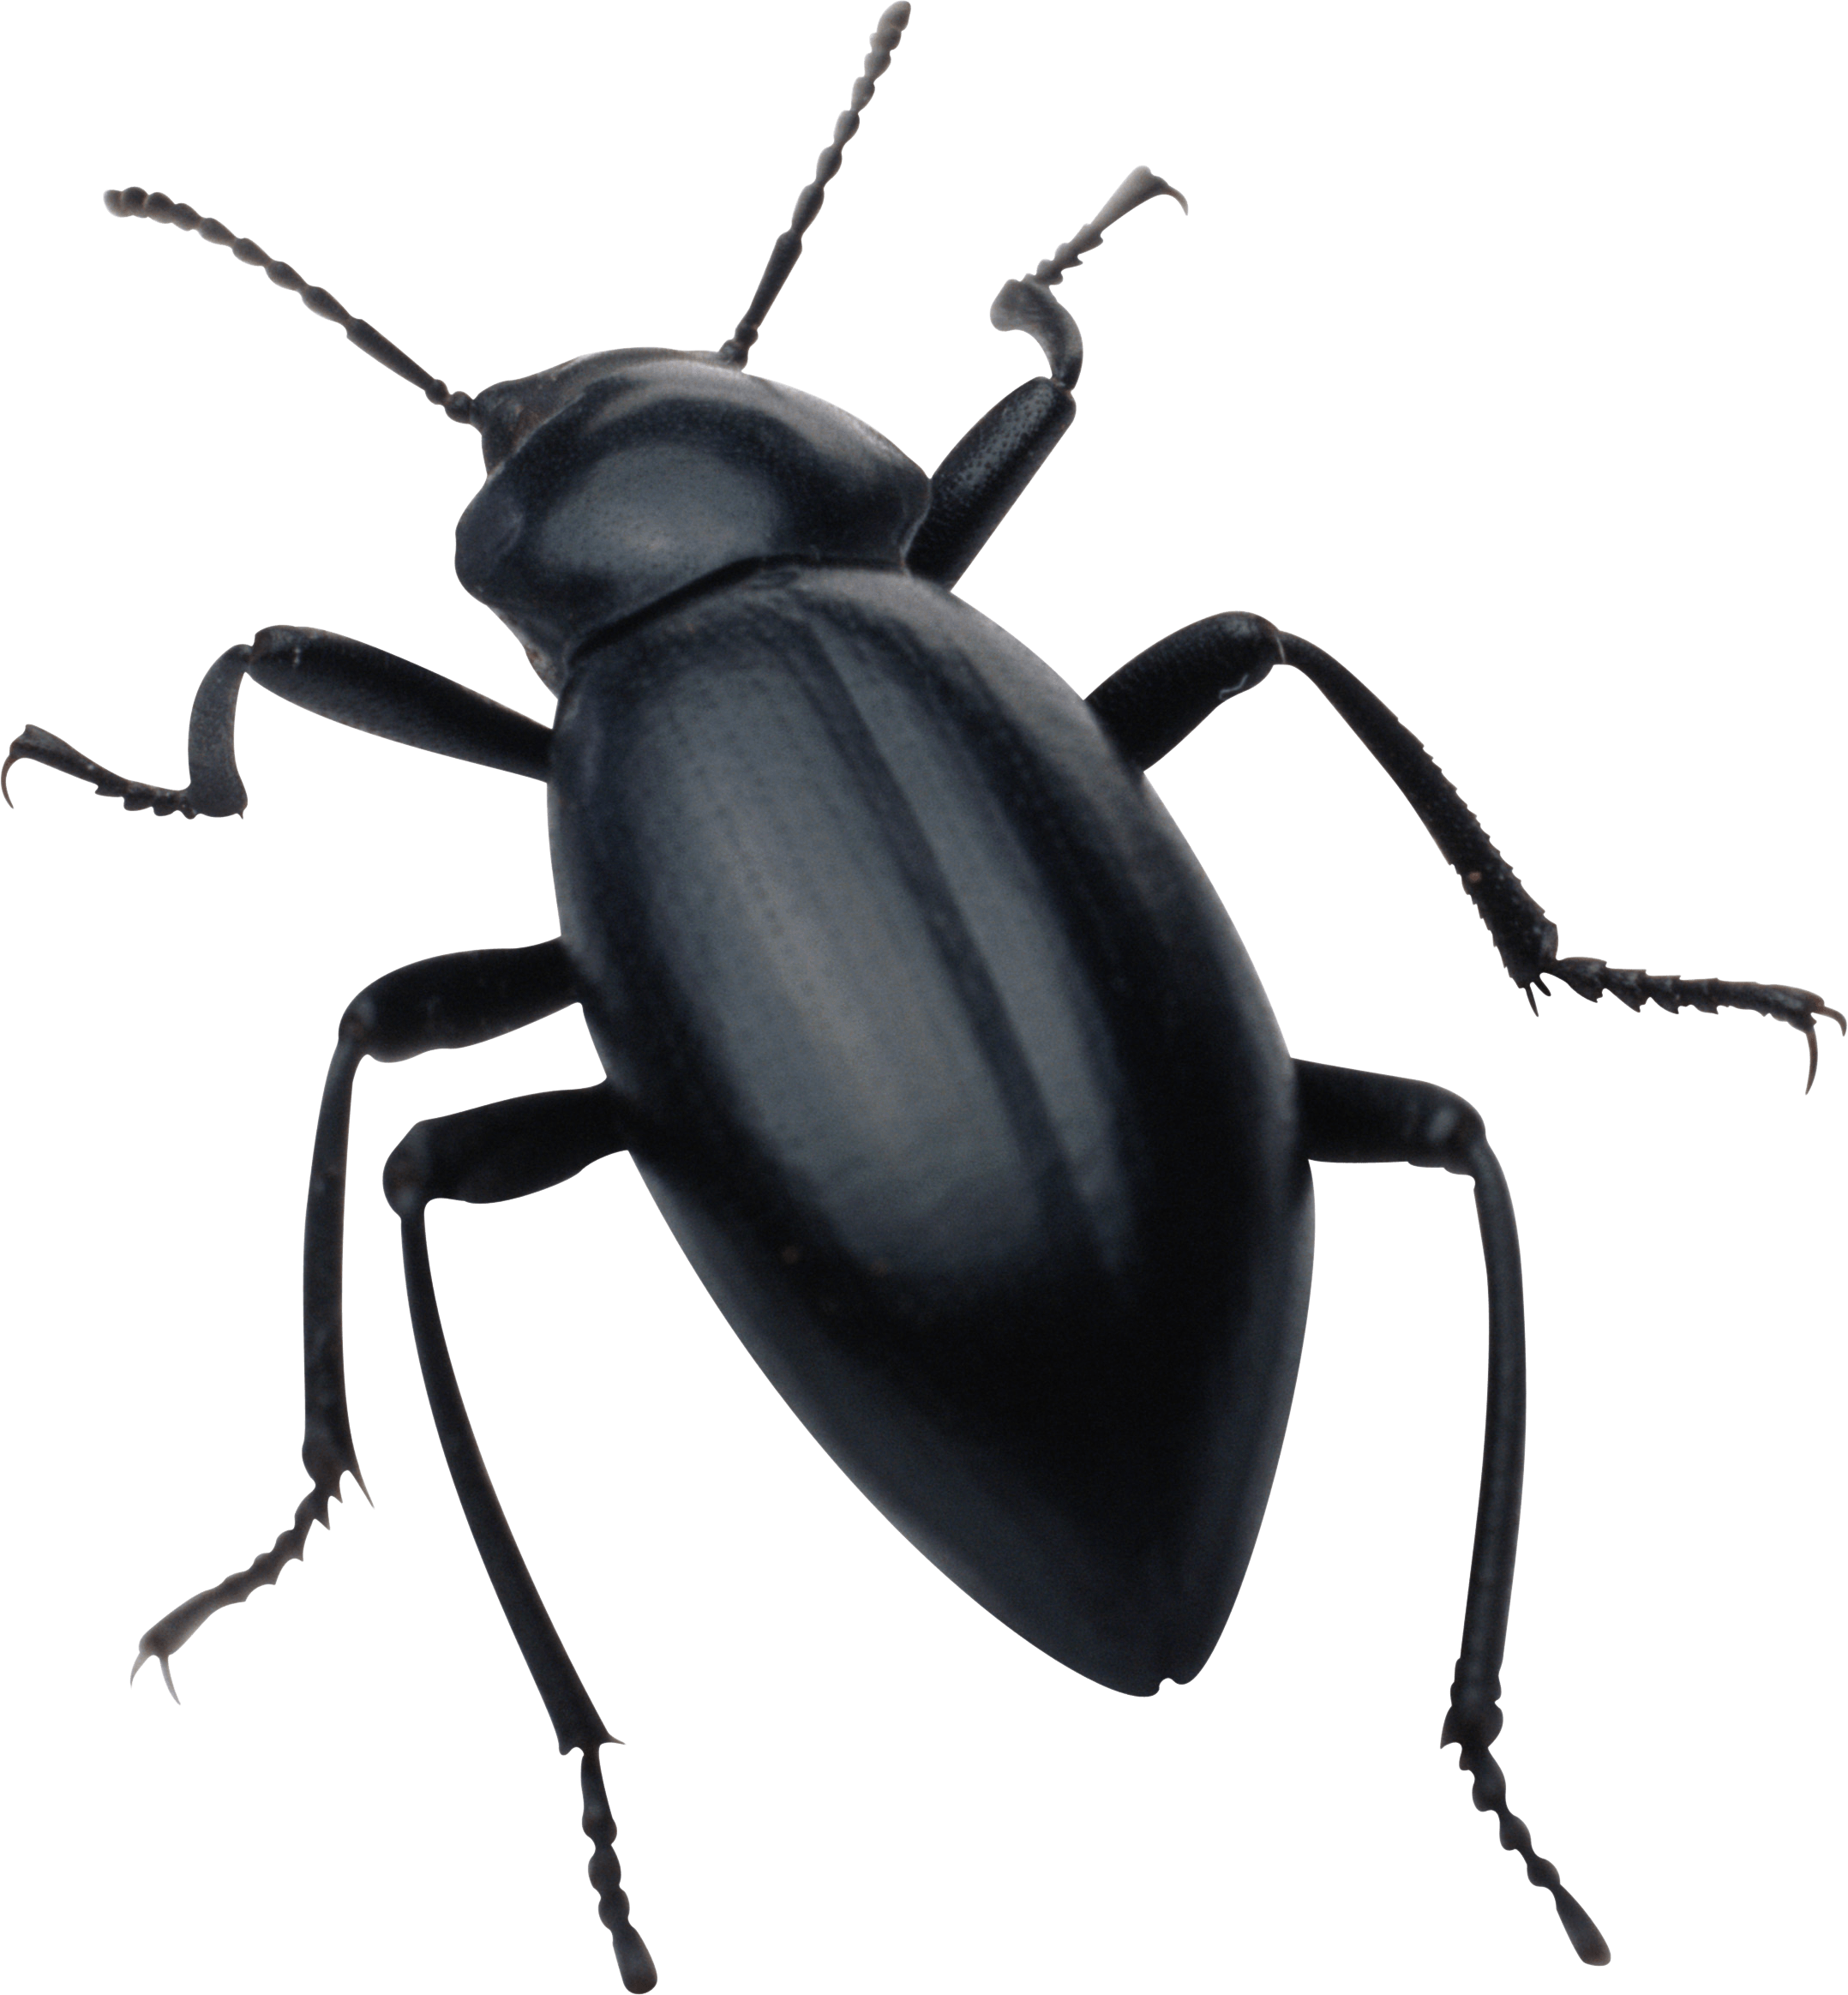
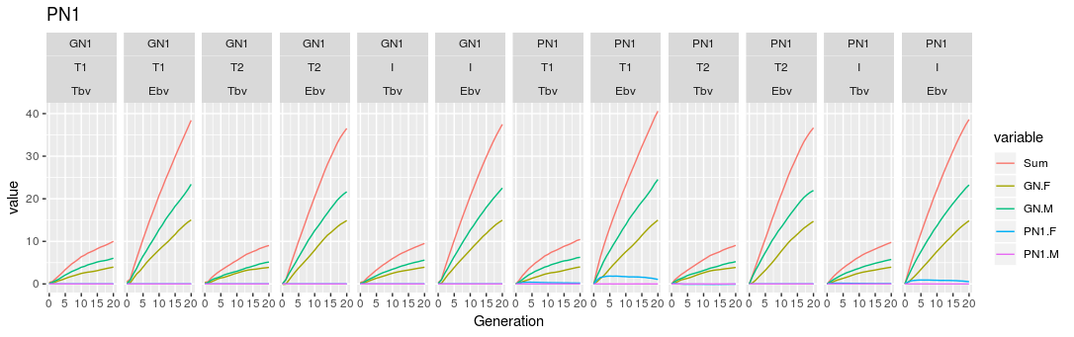
AlphaPart
Fixed the generation + tier model
Partition, h² = 0.25

Slide 23
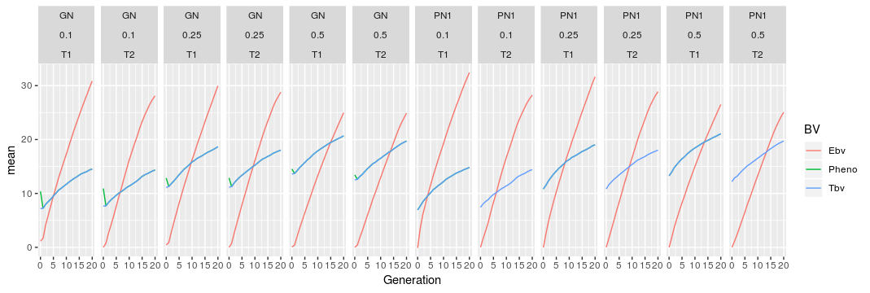
AlphaPart
Genetic trend: fixed effects model

Slide 24
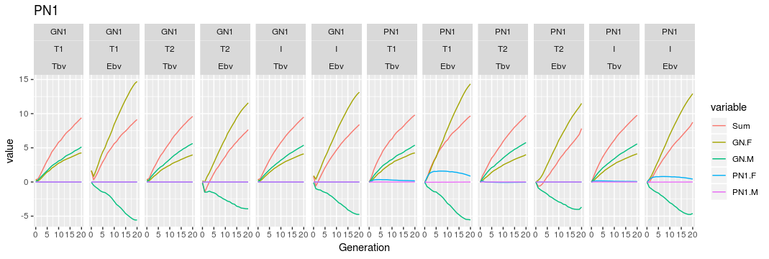
AlphaPart
Did not fix the intercept model
Partition, h² = 0.25

Slide 25
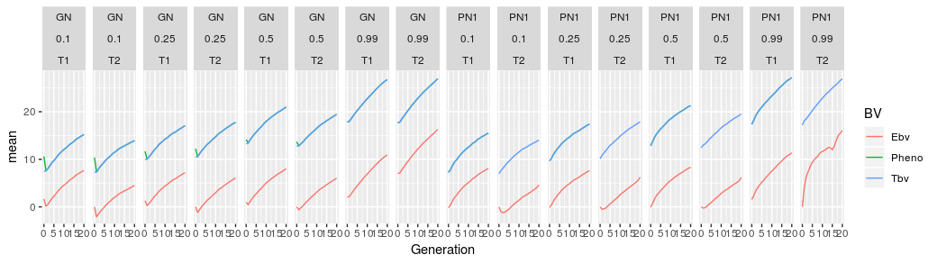
AlphaPart
Genetic trend: intercept model

Slide 26
Rellocation of resources
Baseline: conventional selection, 11 recordings of phenotype / lactation
Genomic scenarios - variables:
  Initial training population: yes / no
  # phenotype recordings / lactation (10, 9, 8, 5, 2, 1)
  Price of genotype vs price of phenotype

Slide 27
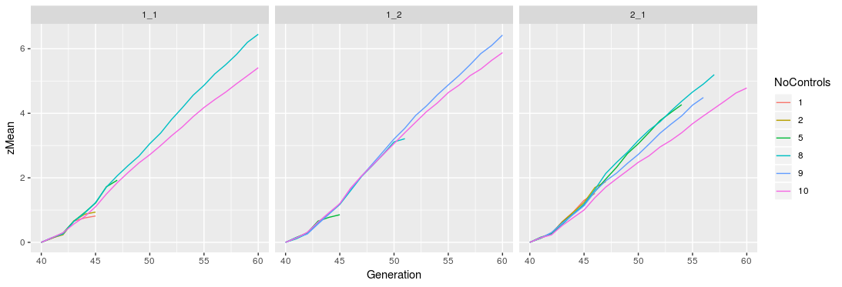
Rellocation of resources
Ran the reference:yes scenarios (18) – one test rep
Scenarios failes: too many animals for blupf90
Price phenotype =
price genotype
Cheap genotype
Expensive genotype

Slide 28
Rellocation of resources
Questions:
  Keep last X generations of genotypes / keep them all
Options:
  Limit the number of genotyped animals
  Get unlimited blupf90 + APY for large training set
  Cut the generations?

Slide 29
PhD Meeting
19th September 2019
Barbara

Slide 30
Relate
Output
.anc= tree notations
.mut= details on each SNP
← mutation rate in the cattle ∼1.1 × 10−8 per base pair per gamete (~ identical to human)
NGS-based reverse genetic screen for common embryonic lethal mutations compromising fertility in livestock/ Carole Charlier et al./ Genome Res. 2016
→ _popsize.coal = coalescence rates and cross-coalescence rates for specified populations

Slide 31
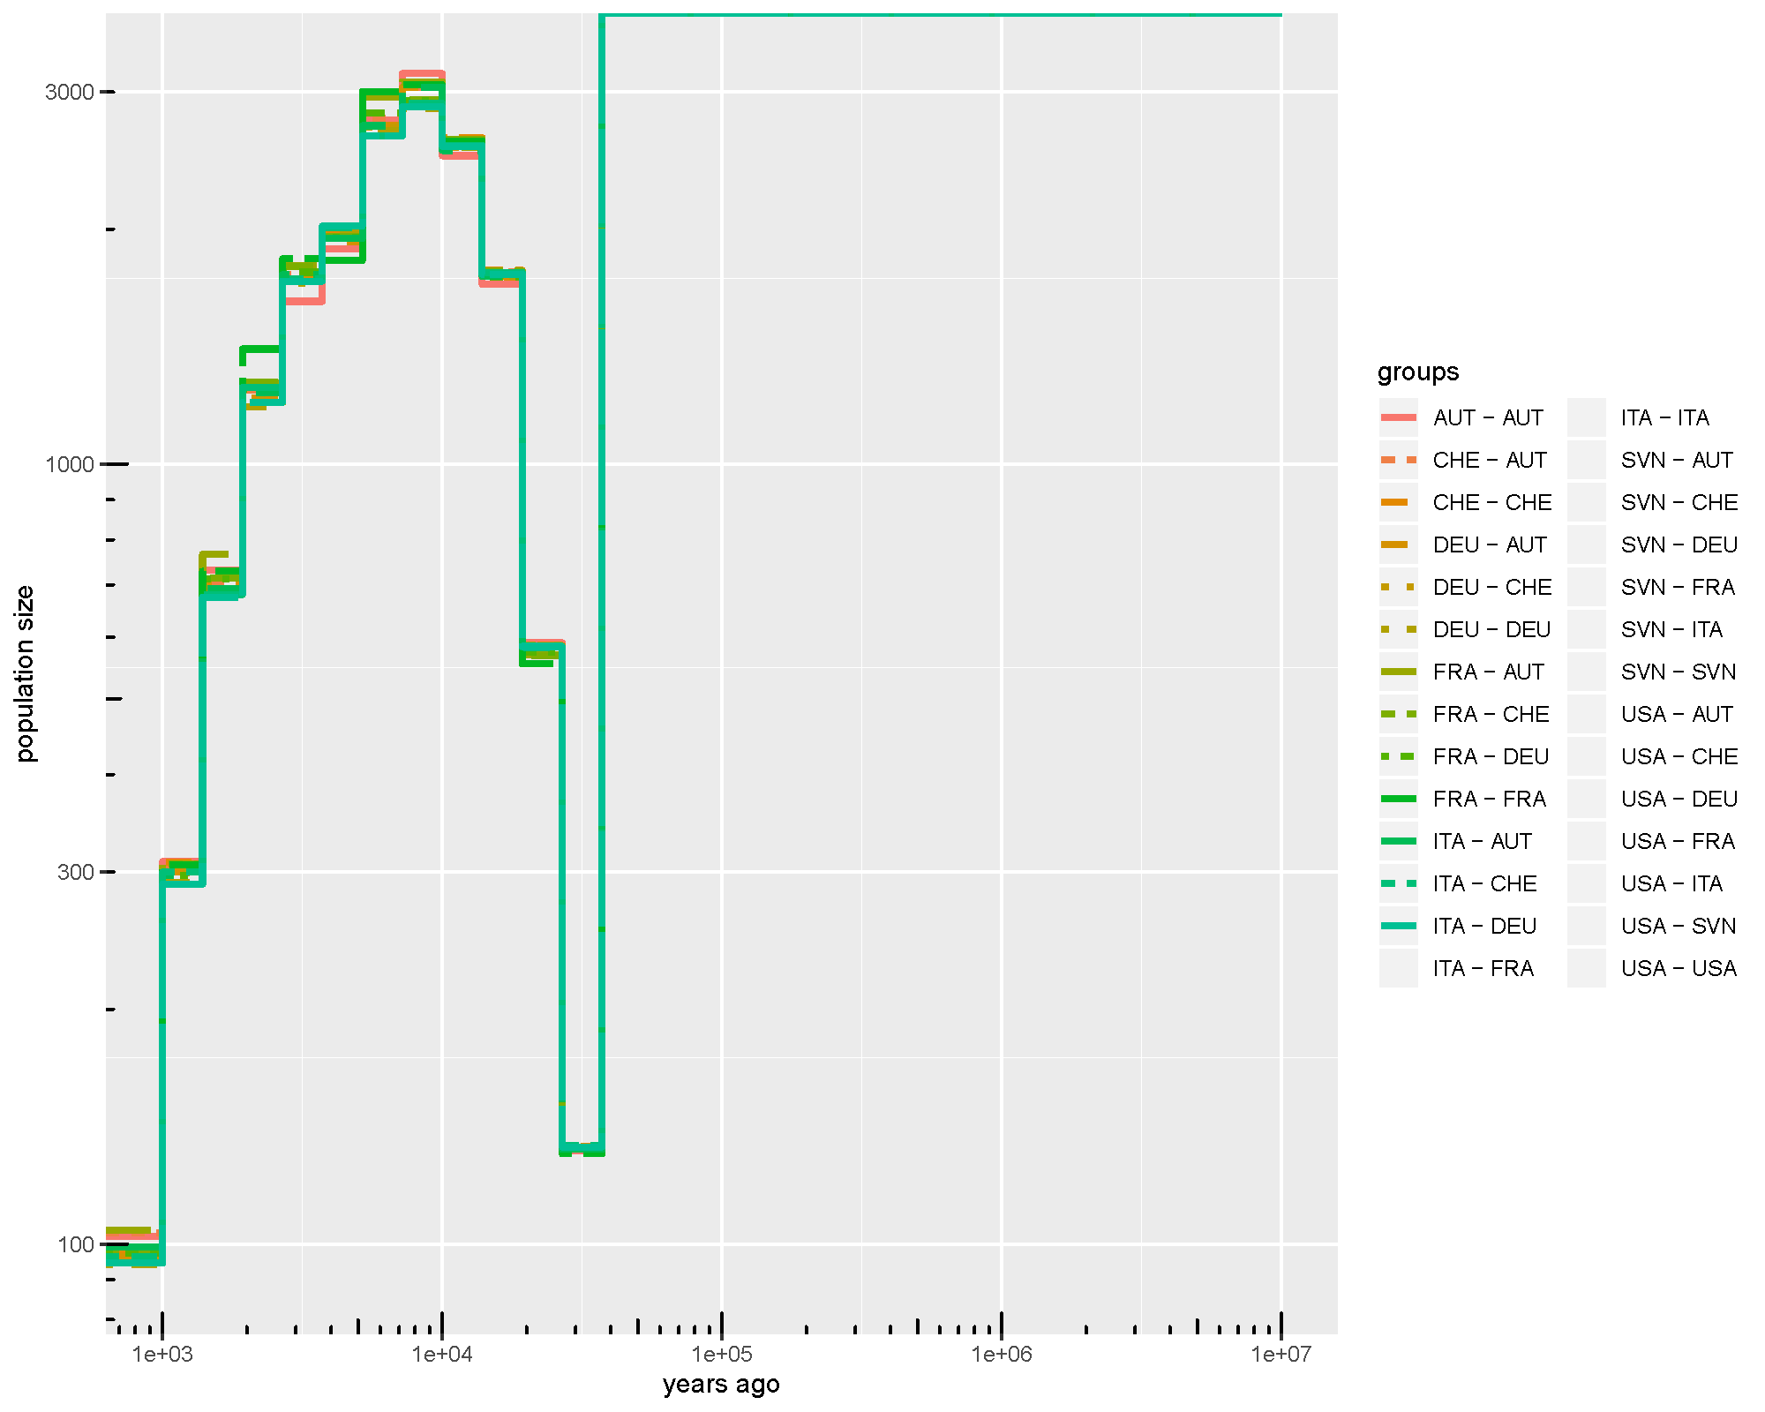
N samples = random 100

Slide 32
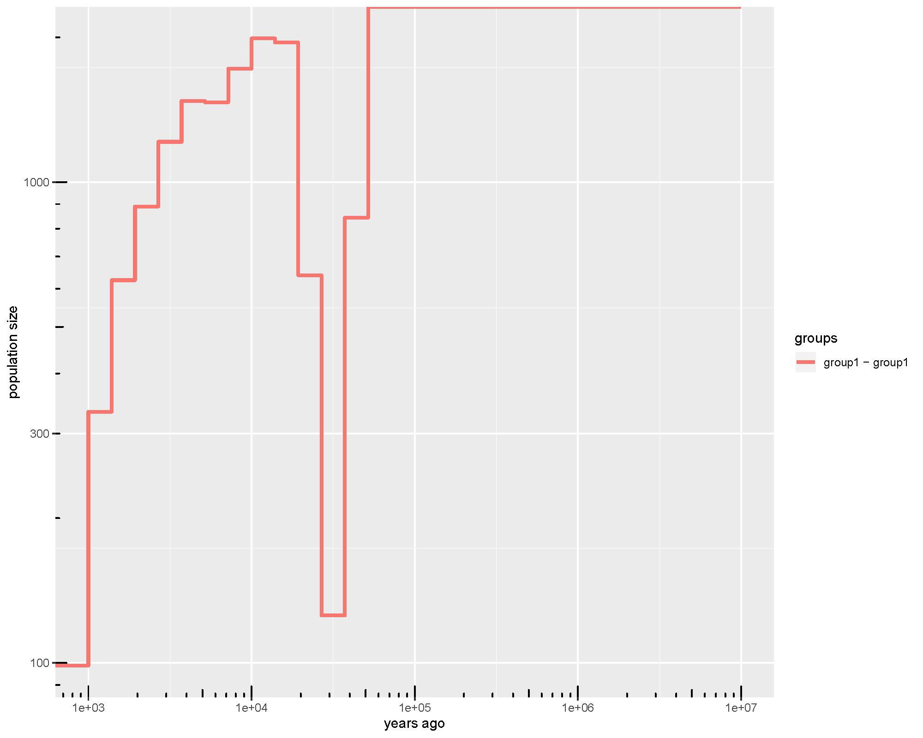
N samples = random 200

Slide 33
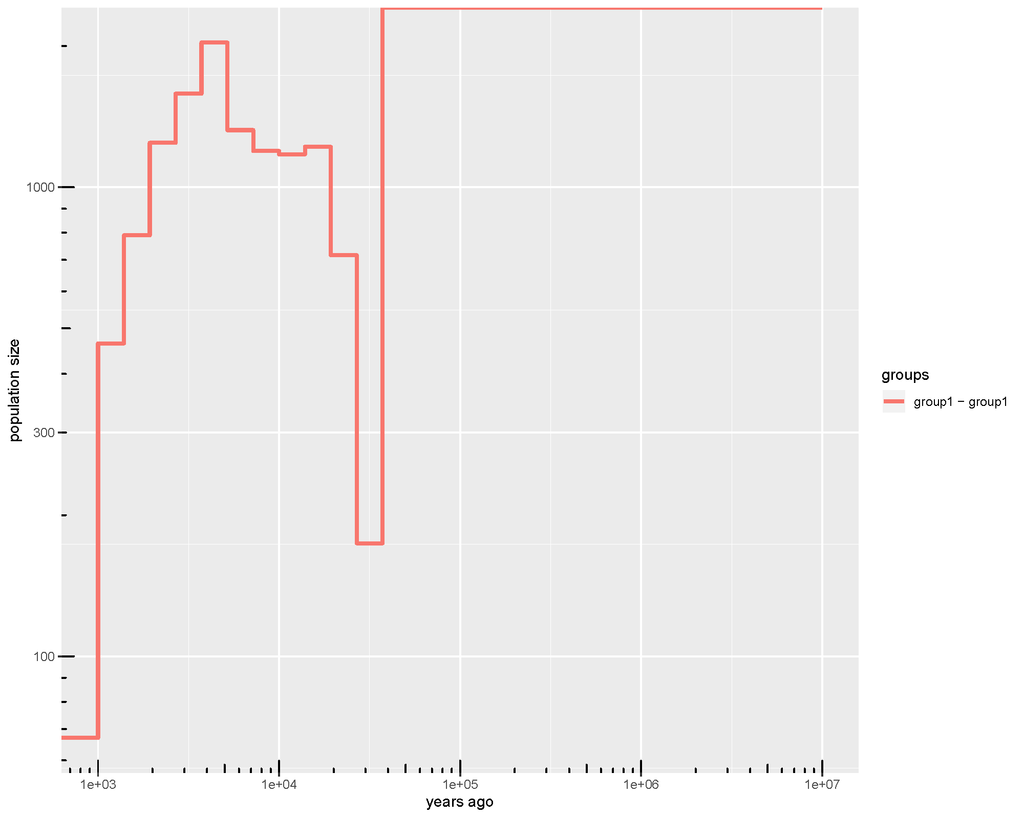
N samples = random 500

Slide 34

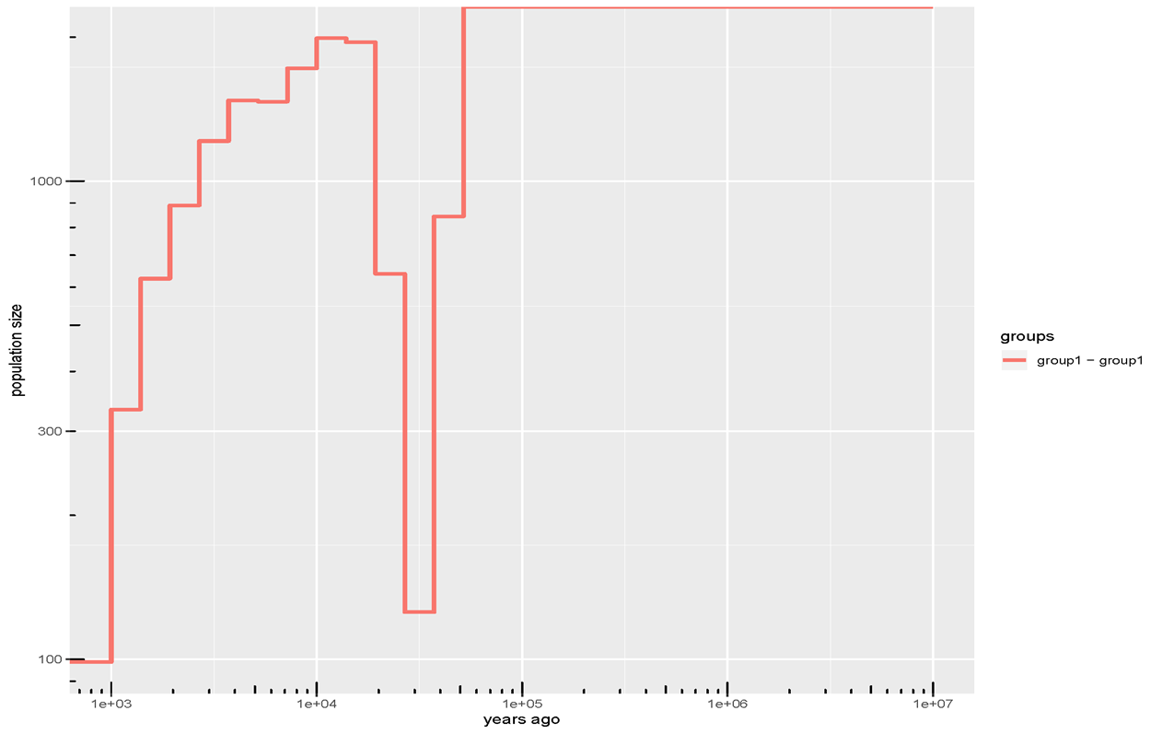
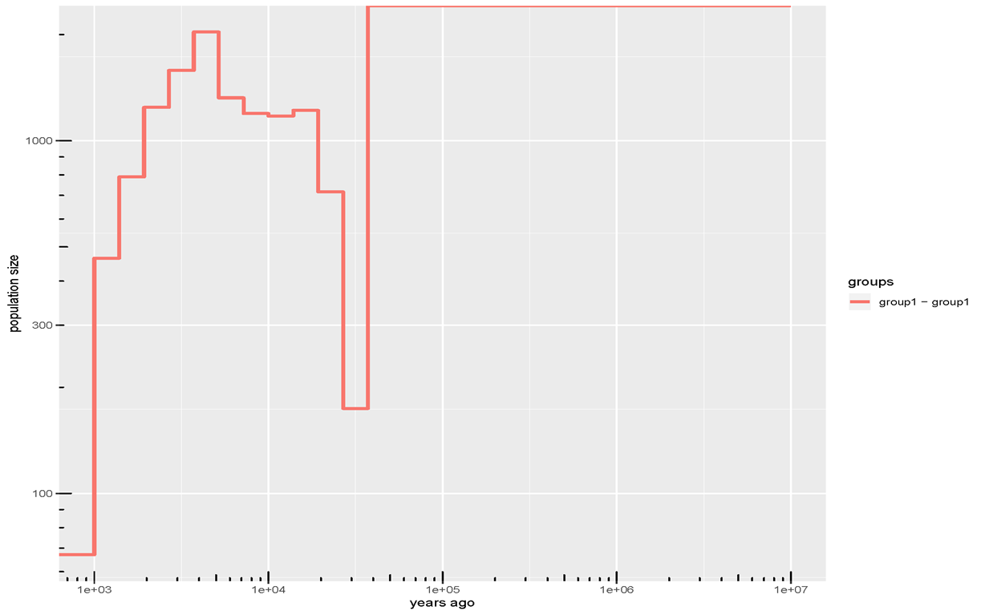
100:200:500
Orig -7
AUT
CHE
DEU
FRA
ITA
SVN
USA
100
Orig - 8
AUS
AUT
CHE
DEU
FRA
ITA
SVN
USA
200
Orig -9
AUT
CAN
CHE
DEU
FRA
ITA
NLD
SVN
USA
500

