Slide 1





Simulation of realistic cattle populations
JANA OBŠTETER
09th June 2020
Notes:
<number>

Slide 2
Content
1) Stochastic simulation
2) R code
3) Examples of use
Notes:
<number>

Slide 3
Content
1) Stochastic simulation
2) R code
3) Examples of use
Notes:
<number>

Slide 4
Stochastic simulation
1. Simulate specie demography
correct effective population size, linkage disequlibrium pattern
Specified in the software
Coalescent / forward in time simulation
2. Simulate historical breeding
“burn-in” period
Random or conventional selection
To obtain the population structure
3. Simulate testing scenarios
Notes:
<number>

Slide 5
Stochastic simulation
1. Simulate specie demography
2. Simulate historical breeding and
3. Simulate testing scenarios
Selection procedure → select the parents (TGV, EBV, phenotypes)
Mate the parents
Create new generation of individuals
with the parameters obtained from a breeding programme
Notes:
<number>

Slide 6
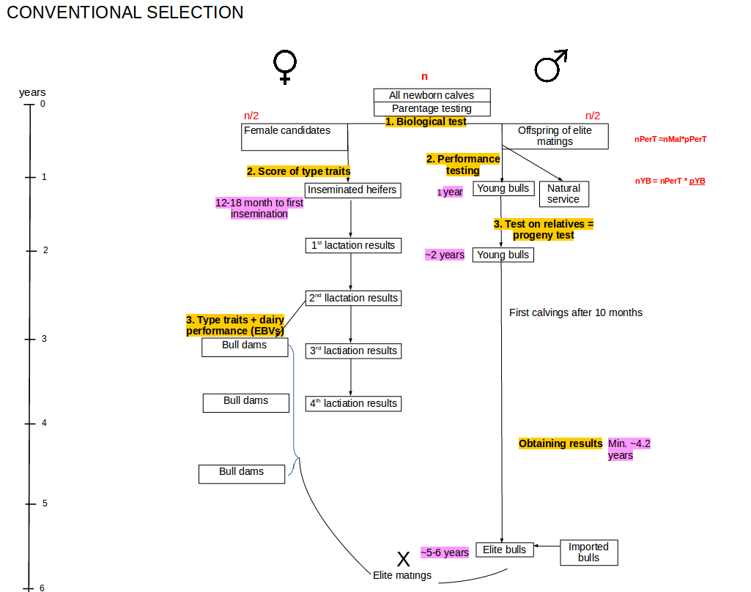

Slide 7
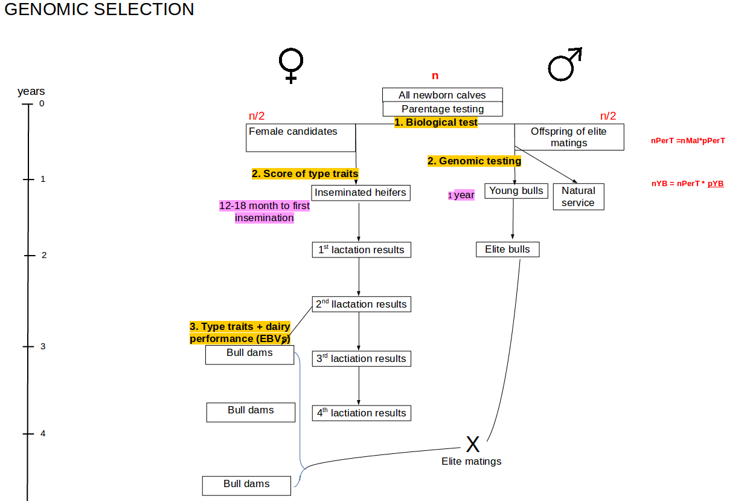

Slide 8
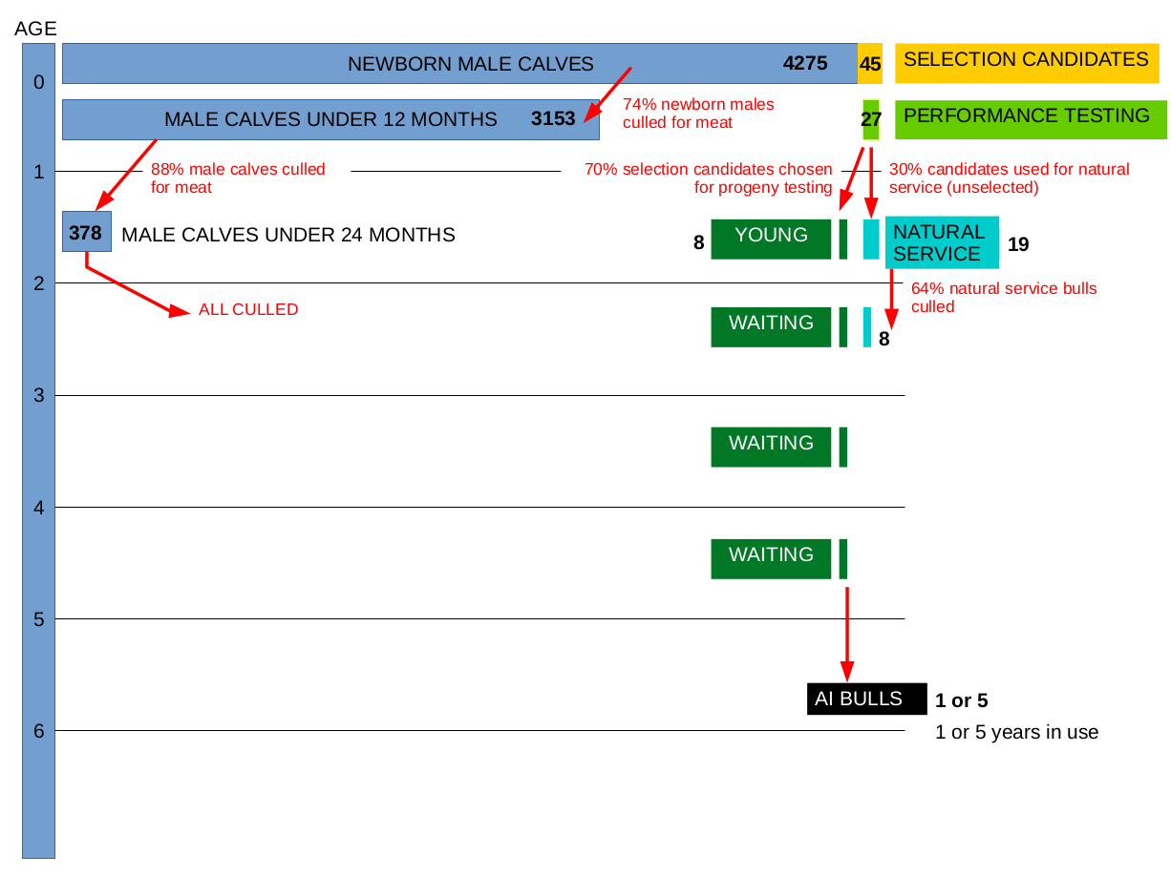

Slide 9
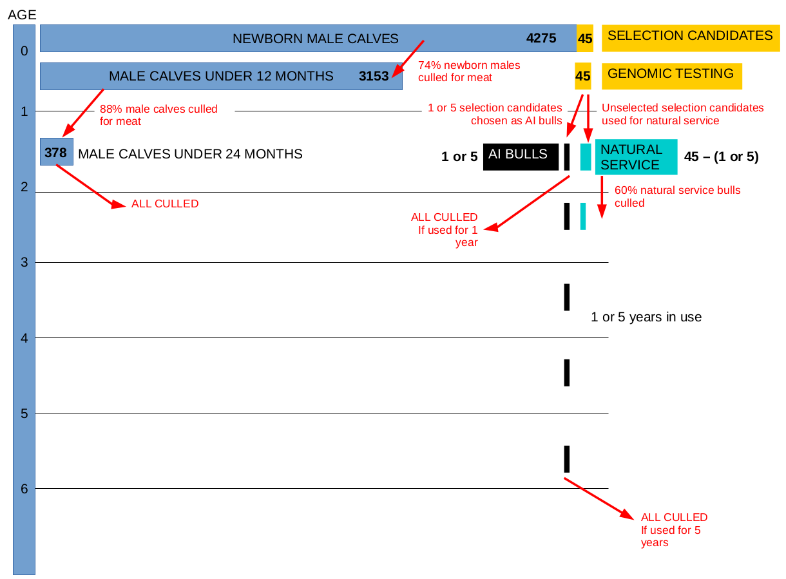

Slide 10
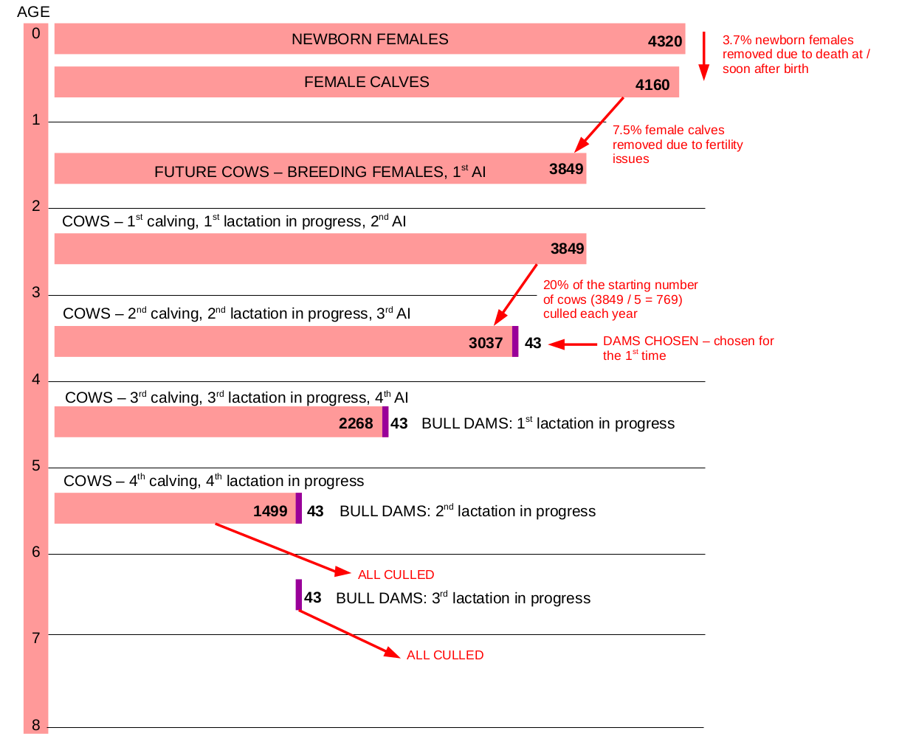

Slide 11

Content
1) Stochastic simulation
2) R code
Gabriela Mafra Fortuna’s simulation for Girolando cattle
3) Examples of use
Notes:
<number>

Slide 12
###--- Simulate founder population ---###
FOUNDERPOP <- runMacs(nInd = nInd*2,
nChr = nChr,
segSites = nQtl+nSnp,
inbred = FALSE,
species = "CATTLE",
split = nGenSplit,
ploidy = 2L)
###--- Add traits ---###
# Create simulation parameters
SP <- SimParam$new(FOUNDERPOP)
# Set genetic variance for trait 1
varA = 1
# Set residual variance for trait 1 in two populations
varE1 = 3.3; varE2 = 5
# Add trait 1: MY - additive
SP$addTraitA(nQtlPerChr=nQtl, mean = 0, var = varA)
SP$setGender("yes_sys")
SP$addSnpChip(nSnp)
###--- Select starting individuals ---###
holstein <- newPop(FOUNDERPOP[1:nInd])
gir <- newPop(FOUNDERPOP[(nInd+1):(nInd*2)])
1. Specie demography
2. Historical breeding
3. Testing scenarios

Slide 13
Founders
No pedigree structure
Pattern of relatedness not correct

Slide 14
###--- Burn-in ---###
NBurninGen = 20
# Select the starting individuals from the founders
bnMales = selectInd(holstein, nInd=40, use="rand", gender="M")
bnFemales = selectInd(holstein, nInd=250, use="rand", gender="F")
for(i in 1:nBurninGen){
# Create new generation
offs <- c(offs, randCross2(bnFemales, bnMales, nCrosses = bnFemales@nInd, nProgeny = 20))
# Set phenotype for female offspring
offs <-setPheno([offs@gender=="F"], varE1)
# Save offspring
offs[[i]] <- c(offs[[i]][offs[[i]]@gender=="F"],
offs[[i]][offs[[i]]@gender=="M"])
# Select the parents
bnMales <- selectInd(offs, nInd=50, use="rand", gender="M")
bnFemales <- selectInd(offs, nInd=500, use="pheno", gender="F")
}
1. Specie demography
2. Historical breeding
RANDOM MATING
Select (the parents)
Create new individuals
Mate
3. Testing scenarios

Slide 15
Founders
No pedigree structure
Pattern of relatedness not correct
Randomly selected population
Some pedigree structure
Some pattern of relatedness
Many generations
No categories

Slide 16
###--- Initiate a breeding programme ---###
# Select animals categories
1. Specie demography
2. Historical breeding
CONVENTIONAL SCHEME
Initiate a programme
3. Testing scenarios

Slide 18
###--- PSEUDO CODE ---###
estimate_EBVs(data from random selection)
# FEMALE SELECTION
# age 0: select female calves
Select XX female_calves from animals_age_0
#age 1: select females for breeding
Select XX heifers from animals_age_1
#age 2: select cows remaining after 1st lactation
Select XX cows2 from animals_age_2
#age 3: select cows remaining after 2st lactation
cows3 = animals_age_3(sex = "female", number = XX)
#age 4: select cows remaining after 3st lactation
cows4 = animals_age_4(sex = "female", number = XX)
#age 5: select cows remaining after 4st lactation
cows3 = animals_age_5(sex = "female", number = XX)
#continue this for a given number of lactations
#age XX: select bull dams
#select top females from a given set of cows at a given age
1. Specie demography
2. Historical breeding
CONVENTIONAL SCHEME
Initiate a programme
3. Testing scenarios

Slide 20
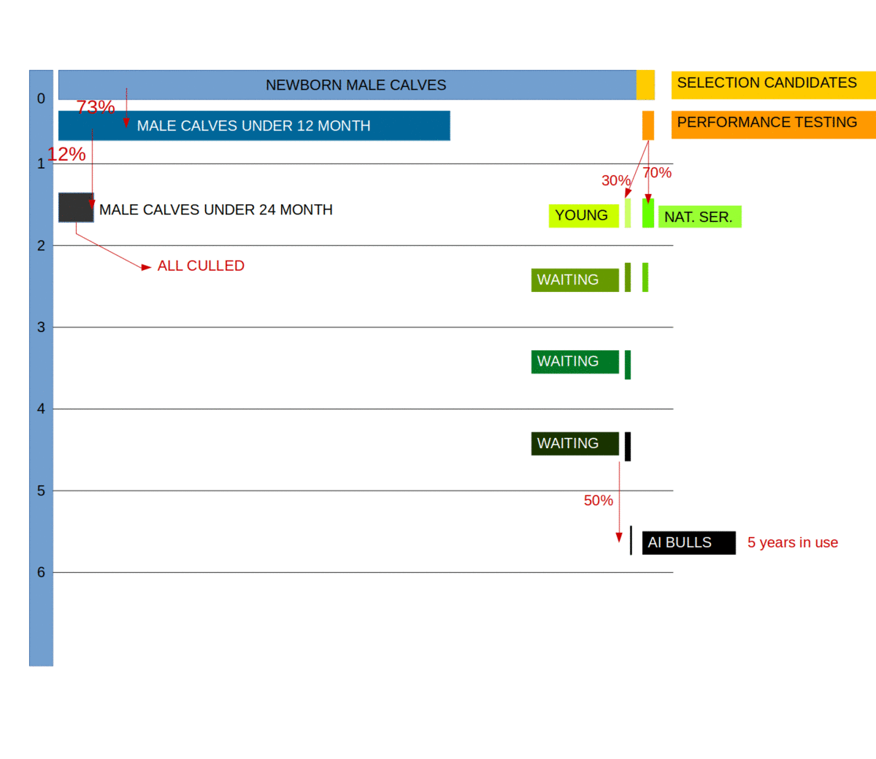

Slide 21
###--- PSEUDO CODE ---###
# PROMOTE ANIMALS
estimate_EBVs(data from random selection)
# MALE SELECTION
#age 0: select males from elite matings for performance testing
male_candidates = animals_age_0(sex = "male", number = XX)
#age 1: select top males for progeny testing
young_bulls = animals_age_1 (sex = "male", number = XX)
#age 2: select top males in progeny testing
young_bulls = animals_age_2(sex = "male", number = XX)
#age 3: select top males in progeny testing
young_bulls = animals_age_3(sex = "male", number = XX)
#age 4: select top males in progeny testing
young_bulls = animals_age_4(sex = "male", number = XX)
#Do this for however logn your progeny testing lasts
#age 5: select progeny tested males from CHOSEN years (thid depends on how long a bull is used for in your population)
elite_bulls = animals_age_5(sex = "male", number = XX)
elite_bulls = animals_age_6(sex = "male", number = XX)
elite_bulls = animals_age_7(sex = "male", number = XX)
elite_bulls = animals_age_8(sex = "male", number = XX)
# INSEMINATION
#cows with elite bulls + young bulls
#bull dams with elite bulls
#create newborns
1. Specie demography
2. Historical breeding
CONVENTIONAL SCHEME
Initiate a programme
3. Testing scenarios

Slide 22
###--- R code ---###
###--- Initiate a breeding programme ---###
# Select animals categories
# number of calfs
nCA = 5000
# number of youngBulls, progenyTest, eliteSire
nYB = 2500; nPTB = 300; nES = 30
# number of youngFemales, cows, eliteDam
nFM = 4500; nCW = 3000; nED = 1500
# Estimate breeding values
burninRec = runEBV(burninRec)
# Calfs: age < 1 year
femCalfs <- selectInd(offs[[20]], gender="F", nCA, use="rand")
maleCalfs <- selectInd(offs[[20]], gender="M", nCA, use="rand")
# Young bulls and Females: age 1-2
for(i in 18:19){
youngBulls <- selectInd(offs[[i]], gender="M", nYB, use="rand")
youngFemales <- selectInd(offs[[i]], gender = "F", nFM, use = "rand")
}
1. Specie demography
2. Historical breeding
CONVENTIONAL SCHEME
Initiate a programme
3. Testing scenarios

Slide 23
###--- Initiate a breeding programme ---###
# Select animals categories
# Elite Dams and multipliers: 2nd & 3d lactations
for(i in 16:17){
offs_f <- offs[[i]][offs[[i]]@gender=="F"]
eliteDam <- selectInd(offs_f, nED, use="ebv"))
Cows <- selectInd(offs_f, nCW, use="ebv", selectTop=FALSE)
}
# Progeny test bulls: age 2-6 (4 years)
for(i in 14:17){
# set ebvs for tested bulls
offs[[i]]@ebv = as.matrix(burninRec[burninRec$IId %in% offs[[i]]@id, "EbvT1"])
# Select progeny tested bulls
progenyTest <- selectInd(offs[[i]], gender="M", nPTB, use="ebv")
}
1. Specie demography
2. Historical breeding
CONVENTIONAL SCHEME
Initiate a programme
3. Testing scenarios

Slide 24
###--- Initiate a breeding programme ---###
# Select animals categories
# Elite Sire: age 6-10 years
for(i in 10:13){
generation = I
# set ebvs for tested bulls
offs[[i]]@ebv = as.matrix(burninRec[burninRec$IId %in% offs[[i]]@id, "EbvT1"])
# Select elite sires
eliteSire <- selectInd(offs[[i]], gender="M", nPTB, use="ebv")
}
#Mate the individuals → create the newborns
#Mate elite dams with elite sires
offs0 <- randCross2(eliteDam, eliteSire, nCrosses=elite_f@nInd, nProgeny=1)
#Mate cows with elite sires
offs1 <- randCross2(Cows, eliteSire, nCrosses=multiplier@nInd, nProgeny=1)
#Mate heifers with bulls in progeny testing (young bulls)
offs2 <- randCross2(youngFemales, progenyTest, nCrosses=nFM, nProgeny=1)
#Mate cows with bulls in progeny test (young bulls)
offs3 <- randCross2(Cows, progenyTest, nCrosses=multiplier@nInd, nProgeny=1)
1. Specie demography
2.
CONVENTIONAL SCHEME
Initiate a programme
3. Testing scenarios

Slide 25
###--- Run a breeding programme ---###
# PSEUDO CODE
# FEMALE SELECTION
#here you do the same as above, except you choose from previous years categories
female_calves = select_from_previous_year_newborns(sex = "female", number = xx)
#age 1: select females for breeding
heifers = select_from_previous_years_female_calves(sex = "female", number = XX)
#age 2: select cows remaining after 1st lactation
cows2 = select_from_previous_years_heifers(sex = "female", number = XX)
#age 3: select cows remaining after 2st lactation
cows3 = select_from_previous_years_cows2(sex = "female", number = XX)
...
#age XX: select bull dams
#MALE SELECTION
#age 0: select males from elite matings for performance testing
male_candidates = select_from_previous_year_newborns(sex = "male", number = xx)
#age 1: select top males for progeny testing
young_bulls1 = select_from_previous_years_male_candidates(sex = "male", number = XX)
#age 2: select top males in progeny testing
young_bulls2 = promote_previous_years_young_bulls1(sex = "male", number = XX)
#age 3: select top males in progeny testing
young_bulls3 = promote_previous_years_young_bulls2(sex = "male", number = XX)
...
#Do this for however long your progeny testing lasts
#age 5: select progeny tested males
elite_bulls5 = select_from_young_bulls4(sex = "male", number = XX)
#keep the old bulls in
elite_bulls6 = promote_previous_years_elite_bulls5(sex = "male", number = XX)
...
1. Specie demography
2.
CONVENTIONAL SCHEME
Select (the parents)
Create new individuals
Mate
3. Testing scenarios

Slide 26
###--- Run a breeding programme ---###
for (gen in 20:40) {
# estimate breeding values
nuclRec = runEBV(randomMatinData)
#Select maleCalves
maleCalfs <- selectInd(offspring[[gen-1]], nYB, use="rand")
#Select young bulls
youngBulls <- selectInd(maleCalfs[[gen-1]], nYB, use="rand")
# young bulls reach puberty and enter progeny test
youngBulls[[gen-1]]@ebv =
as.matrix(nuclRec[nuclRec$IId %in% youngBulls[[gen-1]]@id,
"EbvT1"])
# select sires for progeny testing
progenyTest <- selectInd(youngBulls[[gen-1]], nPTB, use="ebv")
# keep progeny testing for 4 generations
reproProgTest <- c(progenyTest[[gen-1]], progenyTest[[gen-2]], progenyTest[[gen-3]], progenyTest[[gen-4]])
# Select elite sires for AI
eliteSire <- selectInd(progenyTest[[gen-4]], nES, use="ebv")
# Keep elite sires in for 4 generations
elite_m <- c(eliteSire[[gen-1]], eliteSire[[gen-2]],
eliteSire[[gen-3]], eliteSire[[gen-4]])
1. Specie demography
2.
CONVENTIONAL SCHEME
Select (the parents)
Create new individuals
Mate
3. Testing scenarios

Slide 27
###--- Run a breeding programme ---###
for (gen in 20:40) {
#Select females
femaleCalfs <- selectInd(offspring[[gen-1]], gender="F", nFM, use="rand")
youngFemales <- selectInd(femaleCalfs[[gen-1]], nFM, use="rand")
eliteDam <- selectInd(youngFemales[[gen-1]], nED, use="pheno")
...
#Mate the individuals
#Mate elite dams with elite sires
offs0 <- randCross2(elite_f, elite_m,
nCrosses=elite_f@nInd,
nProgeny=1)
#Mate cows with elite sires
offs1 <- randCross2(multiplier, elite_m,
nCrosses=multiplier@nInd, nProgeny=1)
#Mate heifers with bulls in progeny testing (young bulls)
offs2 <- randCross2(youngFemales[[1]], reproProgTest,
nCrosses=nFM,
nProgeny=1)
#Mate cows with bulls in progeny test (young bulls)
offs3 <- randCross2(multiplier, reproProgTest,
nCrosses=multiplier@nInd, nProgeny=1)
1. Specie demography
2.
CONVENTIONAL SCHEME
Select (the parents)
Create new individuals
Mate
3. Testing scenarios

Slide 28
Founders
No pedigree structure
Pattern of relatedness not correct
Randomly selected population
Some pedigree structure
Some pattern of relatedness
Many generations
Selected population
Correct pedigree structure
Correct pattern of relatedness
Many generations
Different categories of animals

Slide 29
Content
1) Stochastic simulation
2) R code
3) Examples of use
Notes:
<number>

Slide 30
Testing genomic scenarios in small cattle population
Mimicked a realistic cattle population ~30,000 active animals (Slovenian Brown Swiss)
20 years burn-in + 20 years evaluation
Python wrapper around
AlphaSim (Faux et al., 2012),
blupf90 (Misztal et al., 2002), ssGBLUP
AlphaMate (Gorjanc and Hickey, 2018)
Notes:
<number>

Slide 31
Truncation selection
PT
GT-PT
GT
PT
Progeny tested sires
Preselection on
gEBV
Genomically tested sires
Notes:
<number>

Slide 32

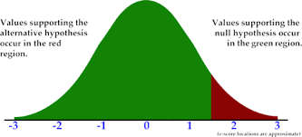
Truncation selection
PT
GT-PT
GT
PT
PT
Progeny tested sires
Preselection on
gEBV
Genomically tested sires
Scenarios | Which fathers do we use? | Kako očete uporabljamo?
PT | sires | 5 očetov / 5 let 5 očetov / 1 let 1 oče / 5 let
GT-PT | sires
GT-BM | sires for bull dams
GT | sires
PT
GT-PT
GT
GT

Slide 33
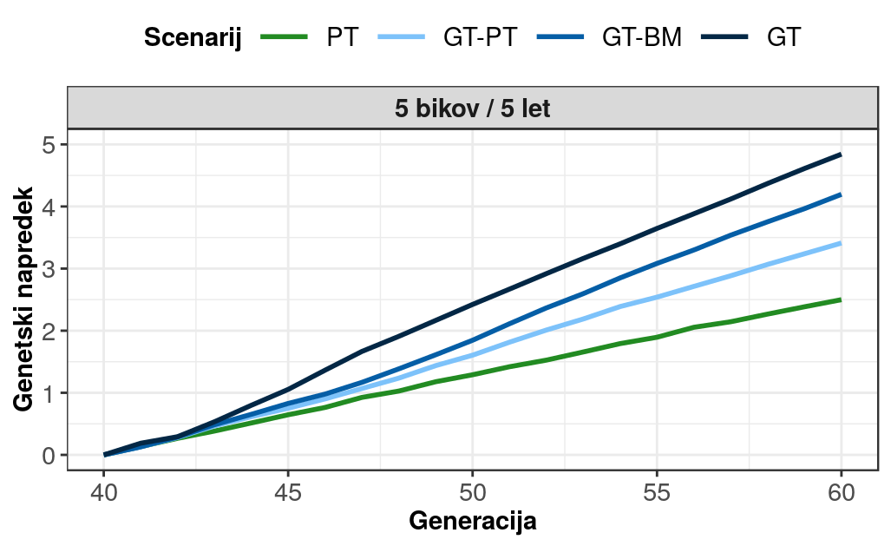
Genetic gain
4,8
4,2
3,4
2,4

Slide 34
Truncation selection
PT
GT-PT
GT
PT
PT
Progeny tested sires
Preselection on
gEBV
Genomically tested sires
Scenarios | Which fathers do we use? | How do we use them?
PT | sires | 5 sires / 5 years 5 sires / 1 years 1 sire / 5 years
GT-PT | sires
GT-BM | sires for bull dams
GT | sires
PT
GT-PT
GT
GT

Slide 35
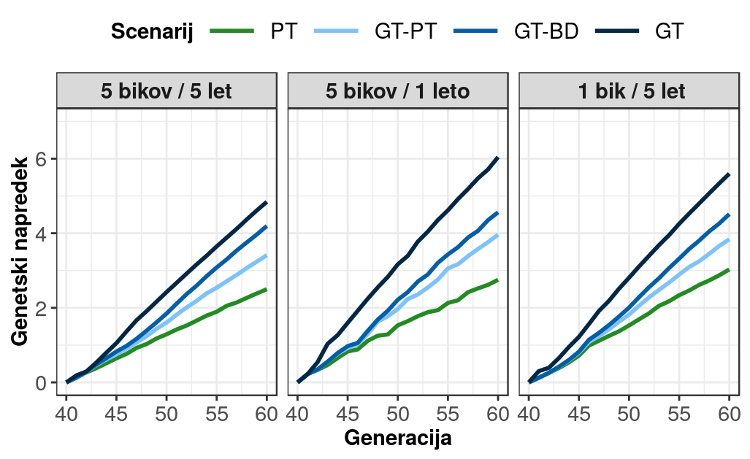
Genetski napredek
2,4 – 4,8
2,8 – 6,0
3,0 – 5,6

Slide 36
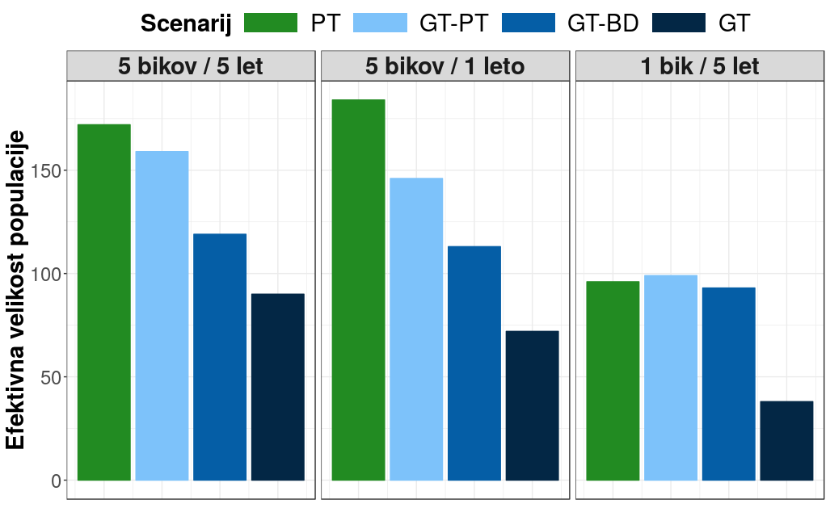
Effective population size

Slide 37
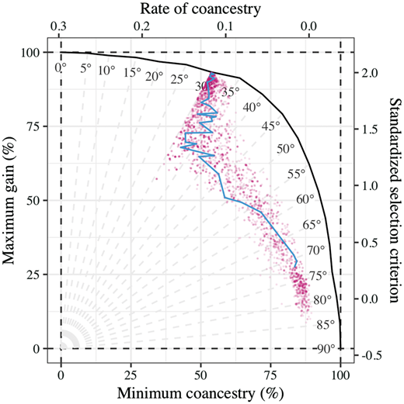
Truncation vs optimum contribution selection
Optimized selection and use of sires
Active bulls (PT, GT) + young candidates
Target degrees:
45
50
55
60
75
Notes:
<number>

Slide 38
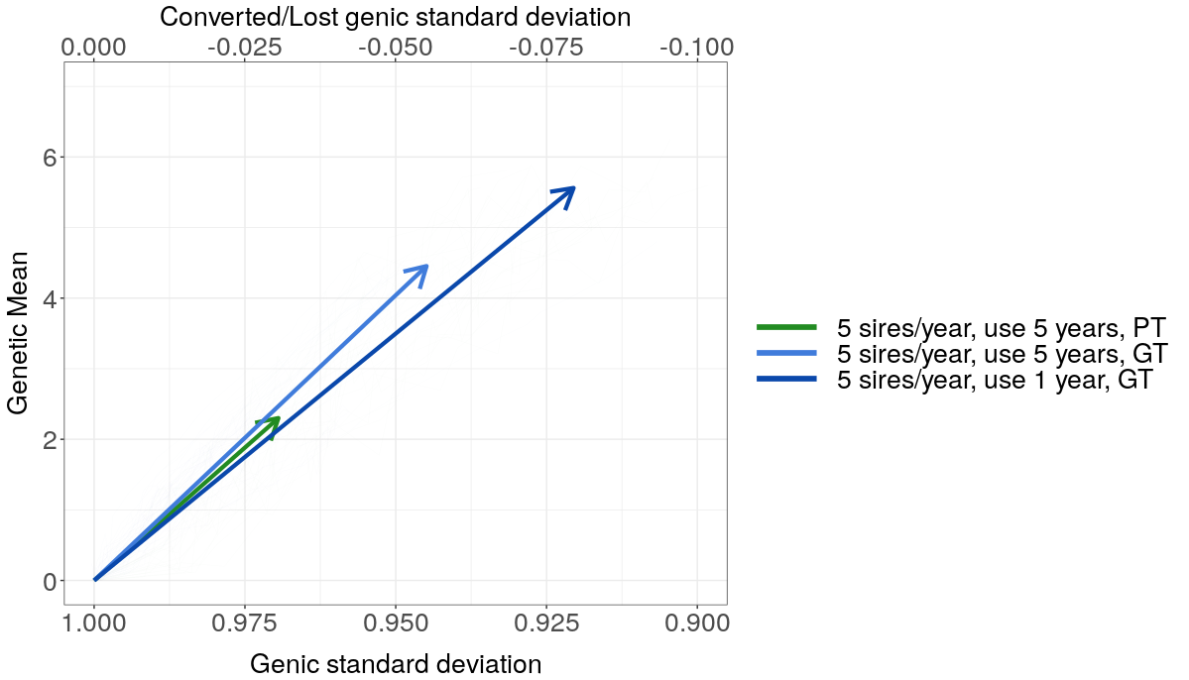
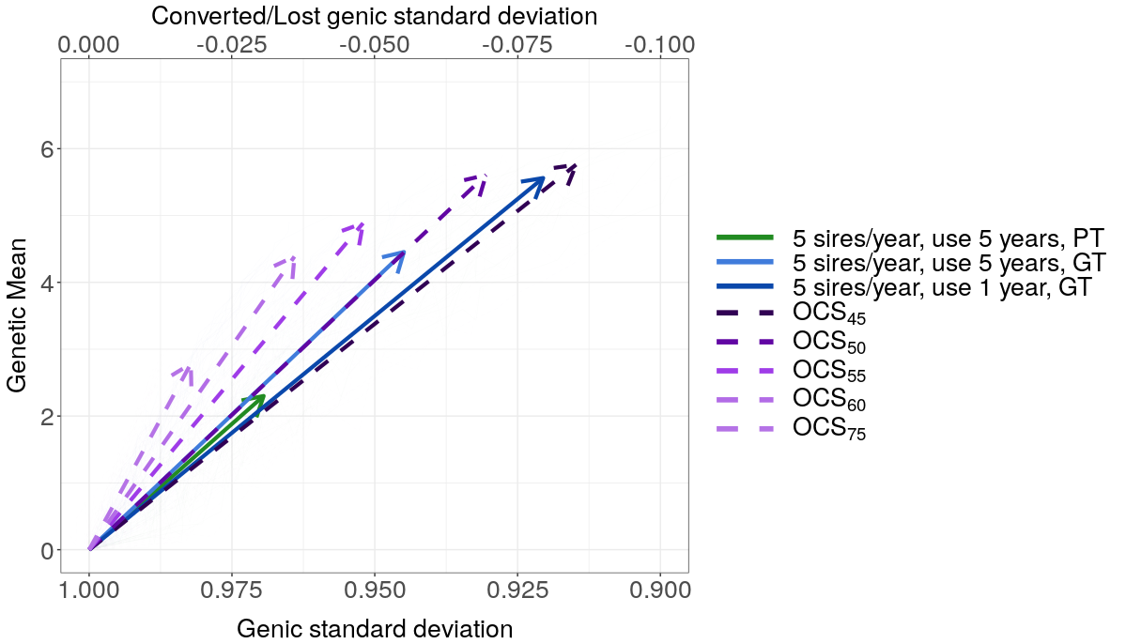
Truncation vs OCS
Notes:
<number>

Slide 39
Thank you for your attention!
Questions?

