Slide 1





Simulation of realistic cattle populations
JANA OBŠTETER
09th June 2020
Notes:
<number>

Slide 2
Content
1) Stochastic simulation
2) Examples of use
3) R example
Notes:
<number>

Slide 3
Content
1) Stochastic simulation
2) Examples of use
3) R example
Notes:
<number>

Slide 4
Stochastic simulation
1. Simulate specie demography
correct effective population size, linkage disequlibrium pattern
Specified in the software
Coalescent / forward in time simulation
2. Simulate historical breeding
“burn-in” period
Random or conventional selection
To obtain the population structure
3. Simulate testing scenarios
Notes:
<number>

Slide 5
Stochastic simulation
1. Simulate specie demography
2. Simulate historical breeding and
3. Simulate testing scenarios
Create new generation of individuals
Selection procedure → select the parents (TGV, EBV, phenotypes)
Mate the parents
with the parameters obtained from a breeding programme
Notes:
<number>

Slide 6
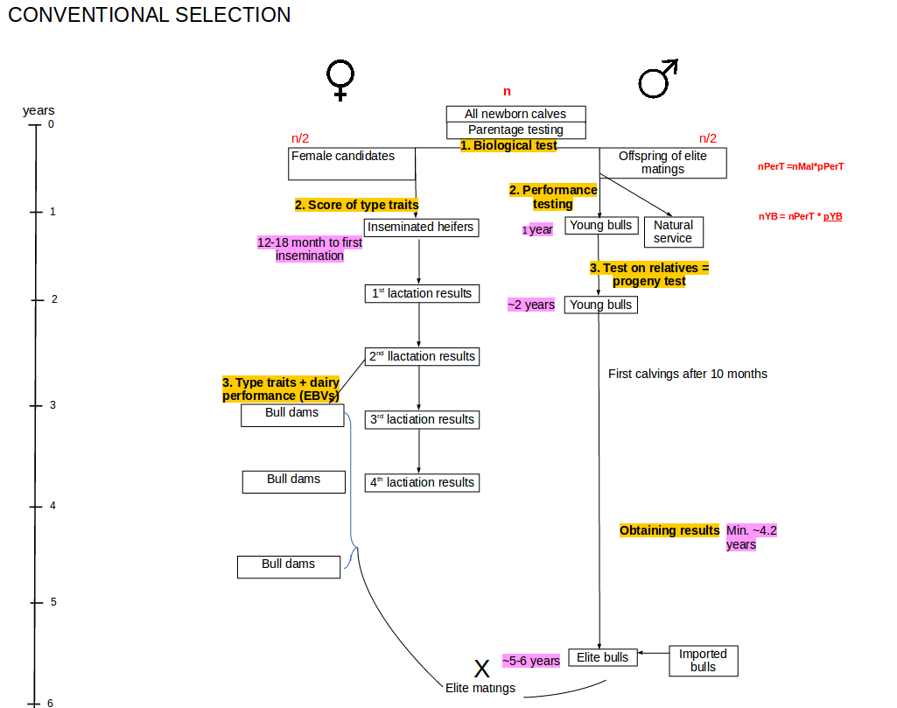

Slide 7
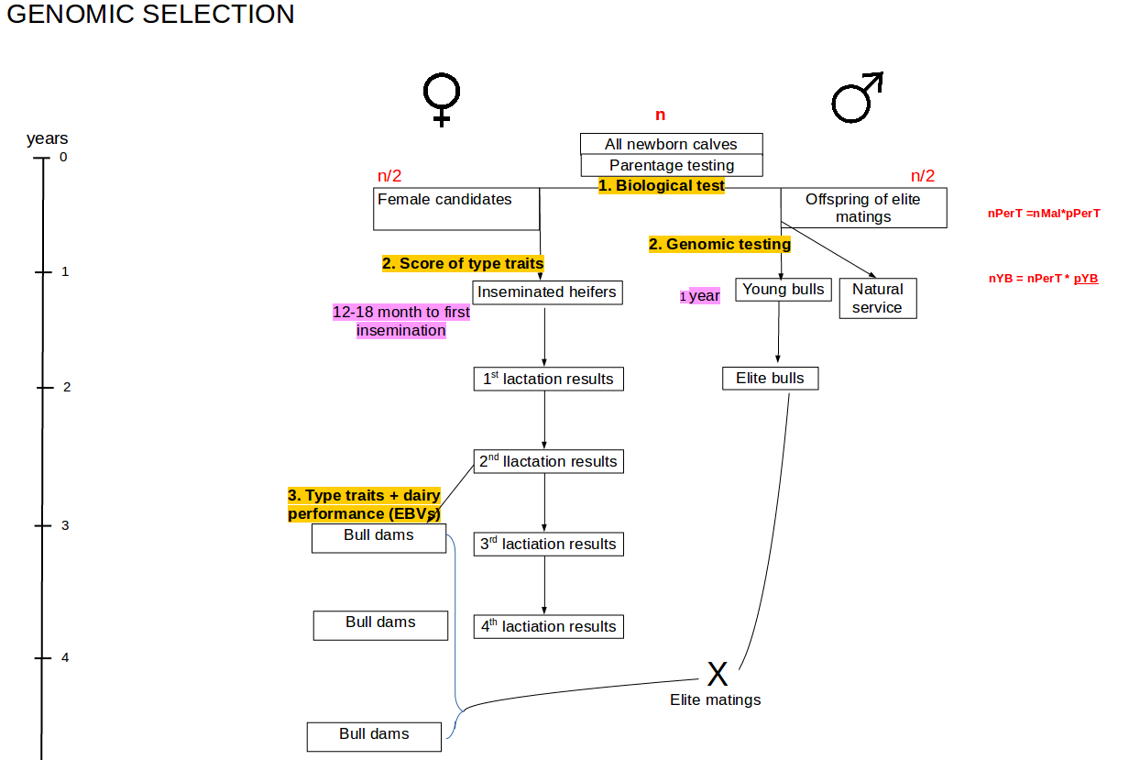

Slide 8
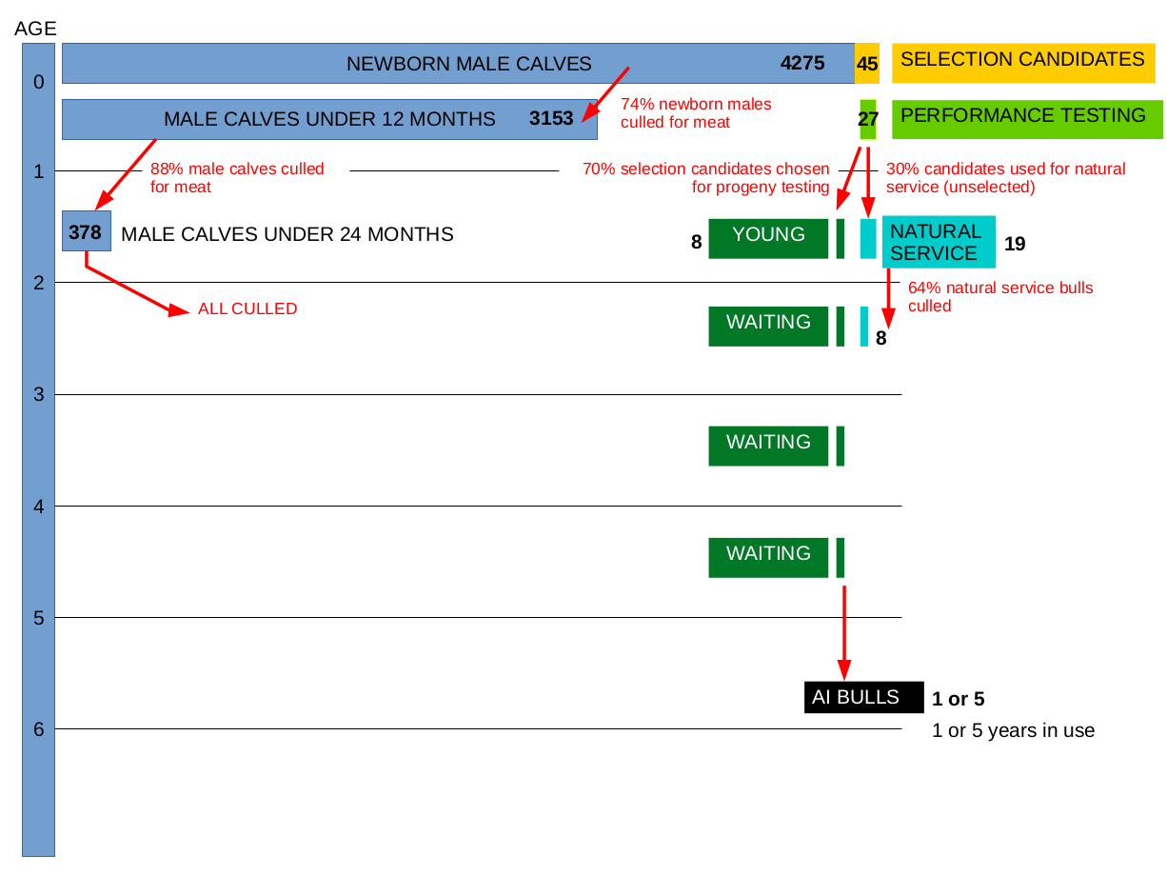

Slide 9
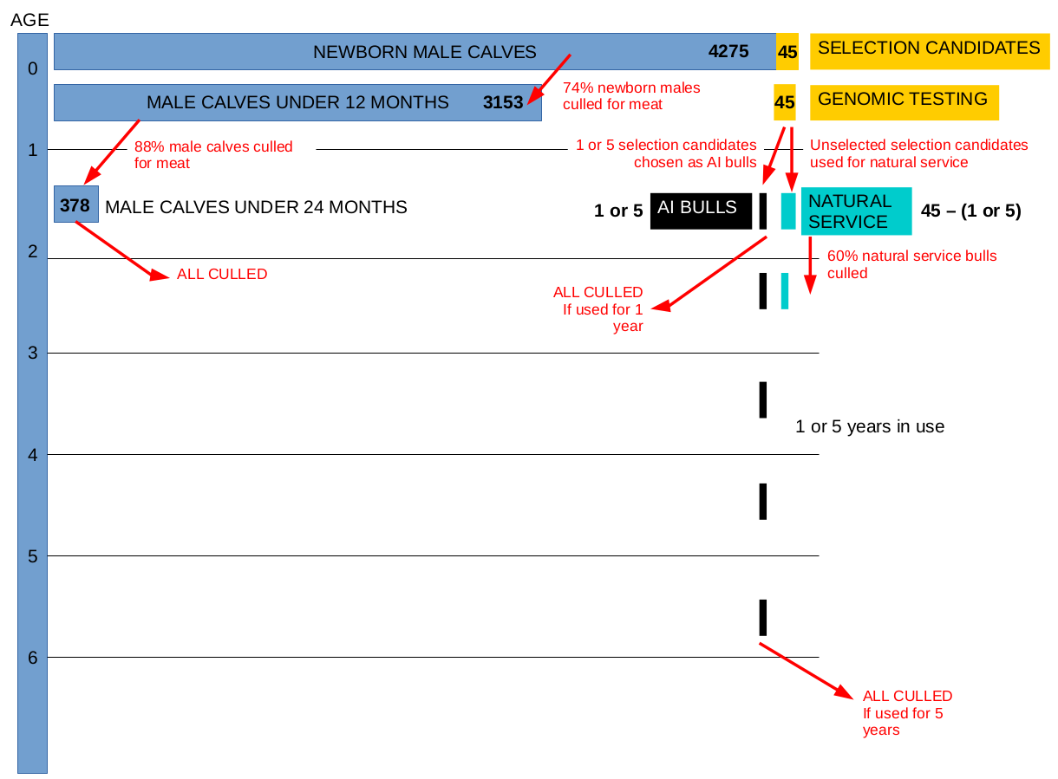

Slide 10
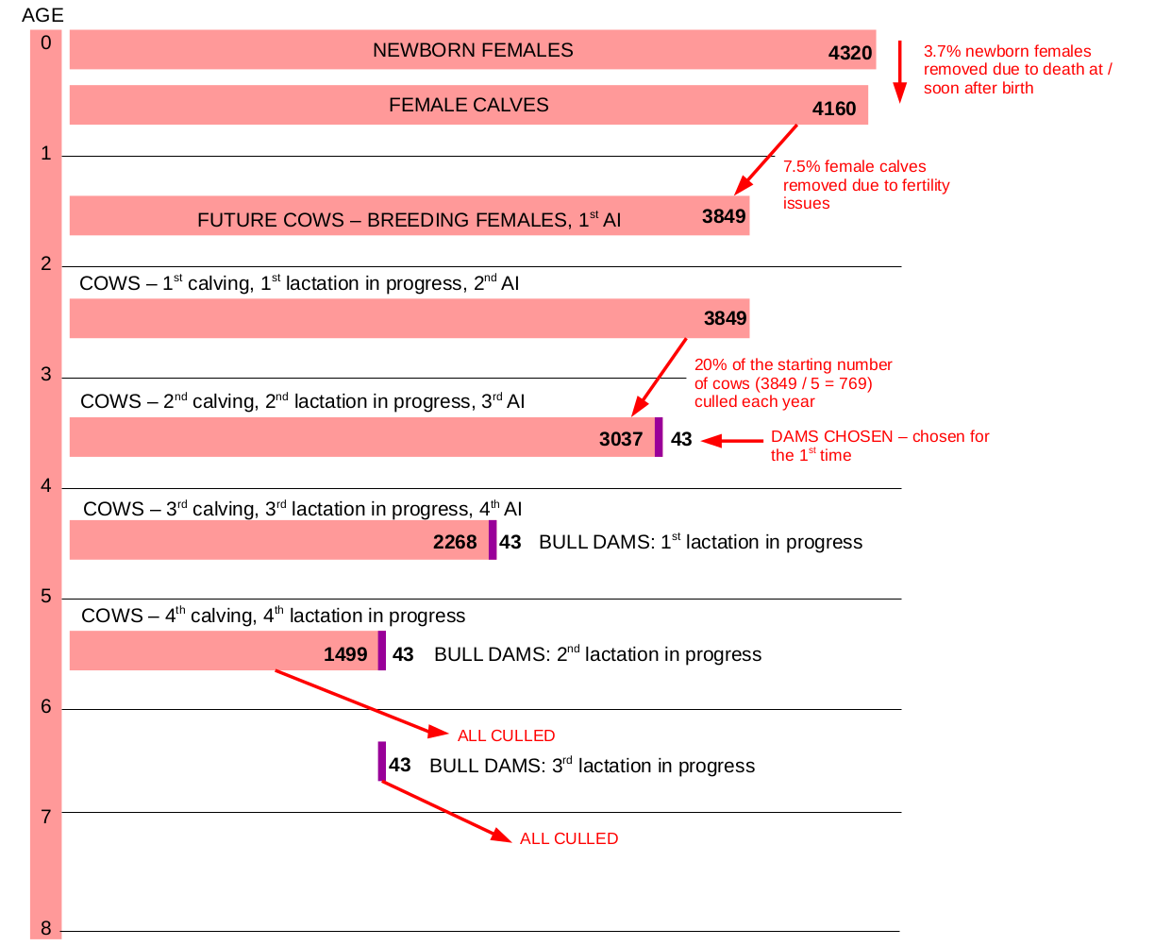

Slide 11
Content
1) Stochastic simulation
2) Example of use
3) R example
Notes:
<number>

Slide 12
Testing genomic scenarios in small cattle population
Mimicked a realistic cattle population ~30,000 active animals (Slovenian Brown Swiss)
20 years burn-in + 20 years evaluation
Python wrapper around
AlphaSim (Faux et al., 2012),
blupf90 (Misztal et al., 2002), ssGBLUP
AlphaMate (Gorjanc and Hickey, 2018)
Notes:
<number>

Slide 13
Truncation selection
PT
GT-PT
GT
PT
Progeny tested sires
Preselection on
gEBV
Genomically tested sires
Notes:
<number>

Slide 14

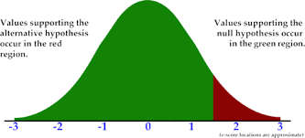
Truncation selection
PT
GT-PT
GT
PT
Progeny tested sires
Preselection on
gEBV
Genomically tested sires
Scenarios | 1. variable | 2. variable
PT | sires | 5 sires / 5 years 5 sires / 1 year 1 sire / 5 years
GT-PT | sires
GT-BD | sires for Bull Dams
GT | sires
Genetic gain
PT
PT
PT
PT
PT
N_{e}
GT-PT
Genetic variability
GT
Conversion efficiency
GT
Notes:
<number>

Slide 15
Genetic gain [sd] with truncation selection
 | 5 bulls / 5 years | 5 bulls / 1 year | 1 bull / 5 years
PT | 2.5 | 2.8 | 3.0
GT-PT | 3.4 | 4.0 | 3.8
GT-BD | 4.2 | 4.6 | 4.5
GT | 4.8 | 6.0 | 5.6
Notes:
<number>

Slide 16
Effective population size of truncation selection
 | 5 bulls / 5 years | 5 bulls / 1 year | 1 bull / 5 year
PT | 172 | 184 | 96
GS-PS | 159 | 146 | 99
GS-BD | 119 | 113 | 93
GS | 90 | 72 | 38
Notes:
<number>

Slide 17
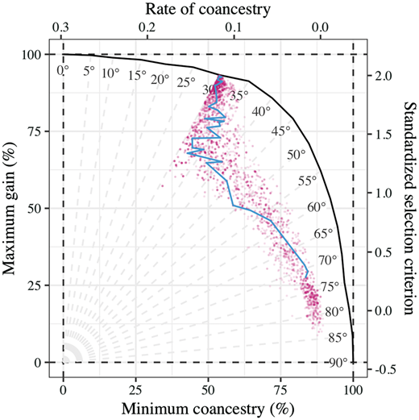
Truncation vs optimum contribution selection
Optimized selection and use of sires
Active bulls (PT, GT) + young candidates
Target degrees:
45
50
55
60
75
Notes:
<number>

Slide 18
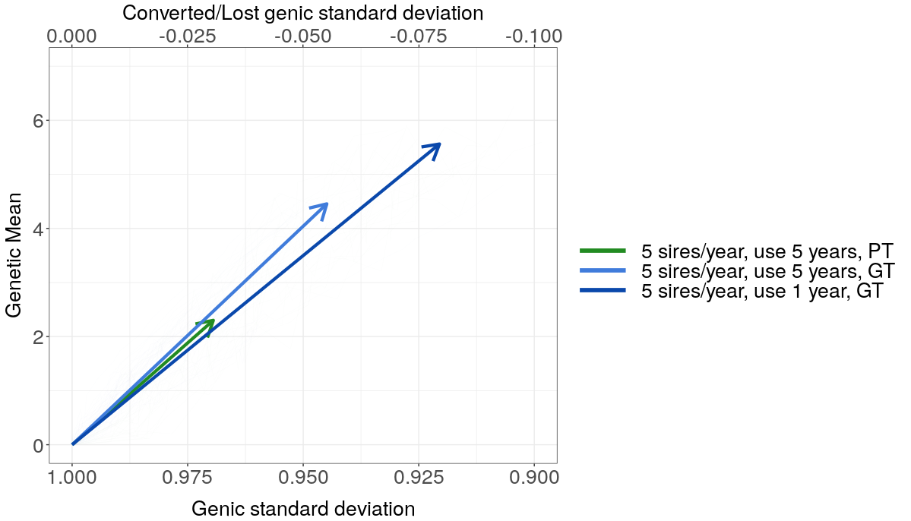
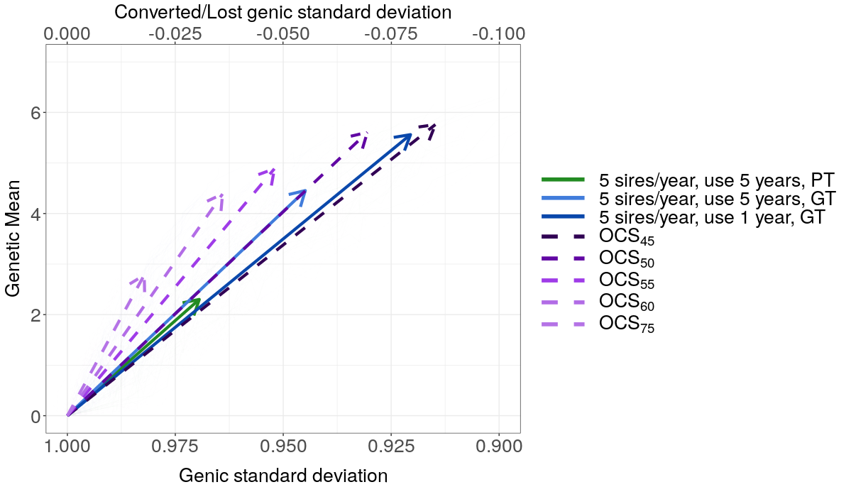
Truncation vs OCS
Notes:
<number>

Slide 19

Content
1) Stochastic simulation
2) Example of use
3) R example
Gabriela Mafra Fortuna’s simulation for Girolando cattle
Notes:
<number>

