Slide 1
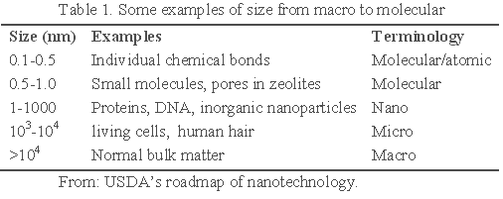
Introduction to Nanomaterials
A nanoparticle is an entity with a width of a few nanometers to a few hundred, containing tens to thousands of atoms.
Nano size:
  One nanometre is a millionth part of the size of the tip of a needle.
1 nm = 10⁻⁶ mm = 10⁻⁹ m

Slide 2
Introduction to Nanomaterials
These materials, notable for their extremely small size exhibit unusual mechanical, electrical, optical and magnetic properties.
Due to their special properties, nanomaterials have the potential for wide-ranging industrial, biomedical, and electronic applications.
The nanoworld lies midway between the scale of atomic and quantum phenomena, and the scale of bulk materials.
At the nanomaterial level, some material properties are affected by the laws of atomic physics, rather than behaving as traditional bulk materials do.
For example, long lasting medical implants of biocompatible nanostructured ceramic and carbides, biocompatible coating, drug delivery, protection coatings, composite materials, anti fogging coatings for spectacles and car windows etc.

Slide 3
Bulk and nanomaterials
What makes these nanomaterials so different and so intriguing?
The properties of nanomaterials deviate from those of single crystals or polycrystals and glasses with the same average chemical composition.
Grain boundaries make up a major portion of the material at nanoscales, and strongly affect properties and processing. In bulk materials, only a relatively small percentage of atoms will be at or near a surface or interface.
In nanomaterials, the small feature size ensures that many atoms, perhaps half or more in some cases, will be near interfaces.
Surface properties such as energy levels, electronic structure, and reactivity can be quite different from interior states, and give rise to quite different material properties.

Slide 4
Bulk and nanomaterials
Nanocrystallites of bulk inorganic solids have been shown to exhibit size dependent properties, such as lower melting points, higher energy gaps etc.
In comparison to macro-scale powders, increased ductility has been observed in nanopowders of metal alloys.
In addition, quantum effects from boundary become significant leading to phenomena such as quantum dots.

Slide 5
Gold : Bulk Vs Nano
Bulk | Nano
Lustrous–they have a shiny surface | Vary in appearance depending on size and shape of cluster
Malleable and Ductile | Size based property
Good conductors of heat and electricity | Are not “metals” but are semiconductors.
Inert-unaffected by most of the reagents | Are very good catalysts
Have high melting point (~1080 deg C) | Melts at relatively low temperature (~940º C)
Often hard and tough with high TS | Size based property

Slide 6
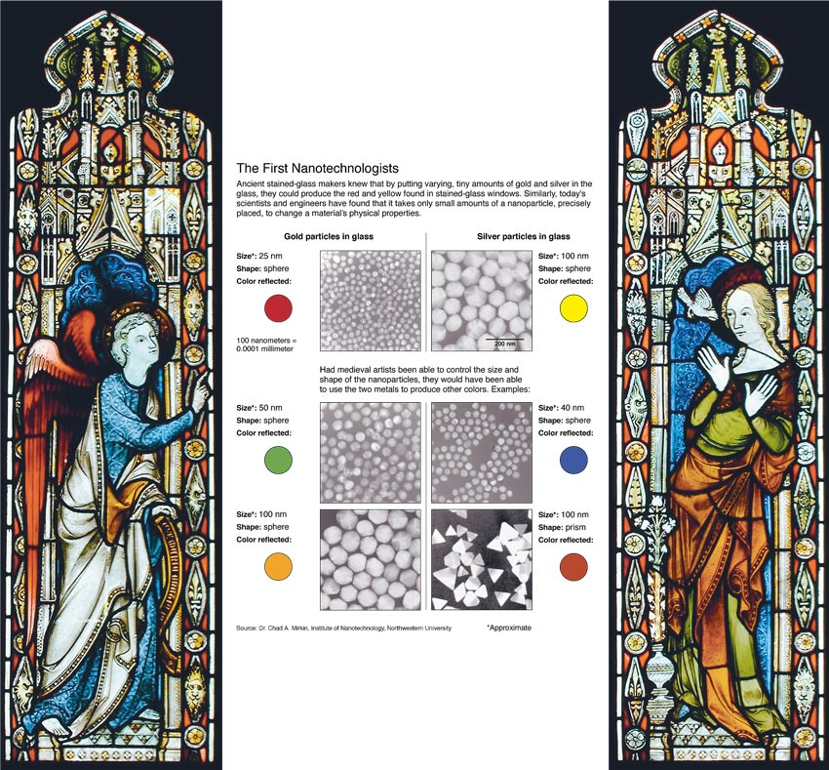

Slide 7


Slide 8
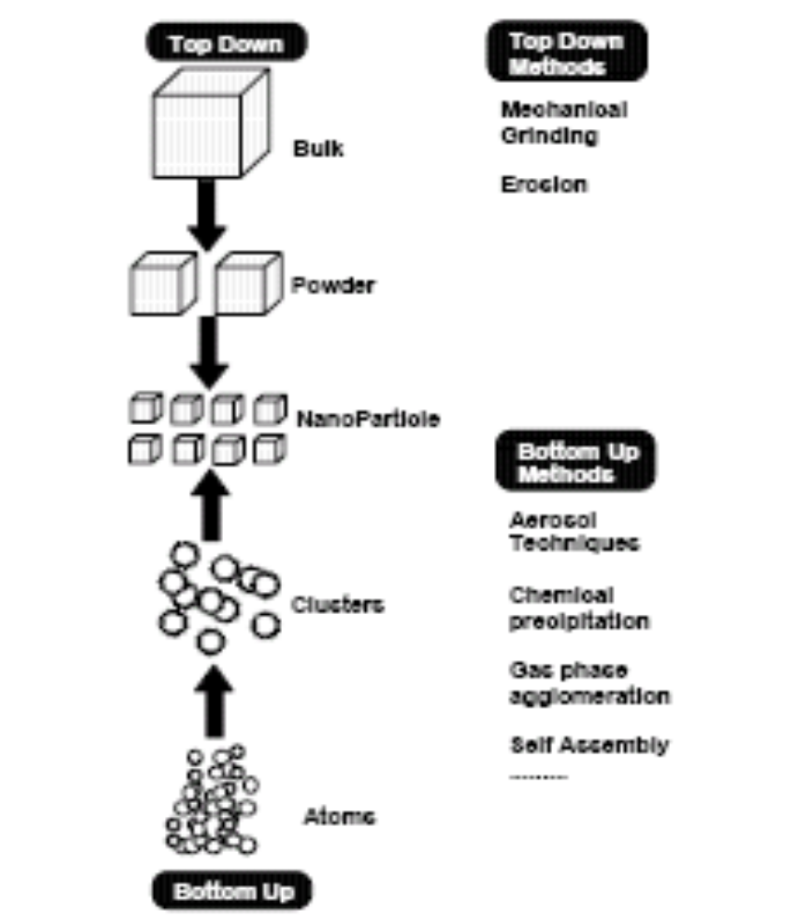
General methods of
preparation of nanomaterials

Slide 9
Preparation of nanomaterials
Any fabrication technique should provide
Identical size of all particles (also called mono sized) or with uniform size distribution.
Identical shape or morphology.
Identical chemical composition and crystal structure
Individually dispersed or mono dispersed i.e., no agglomeration.

Slide 10
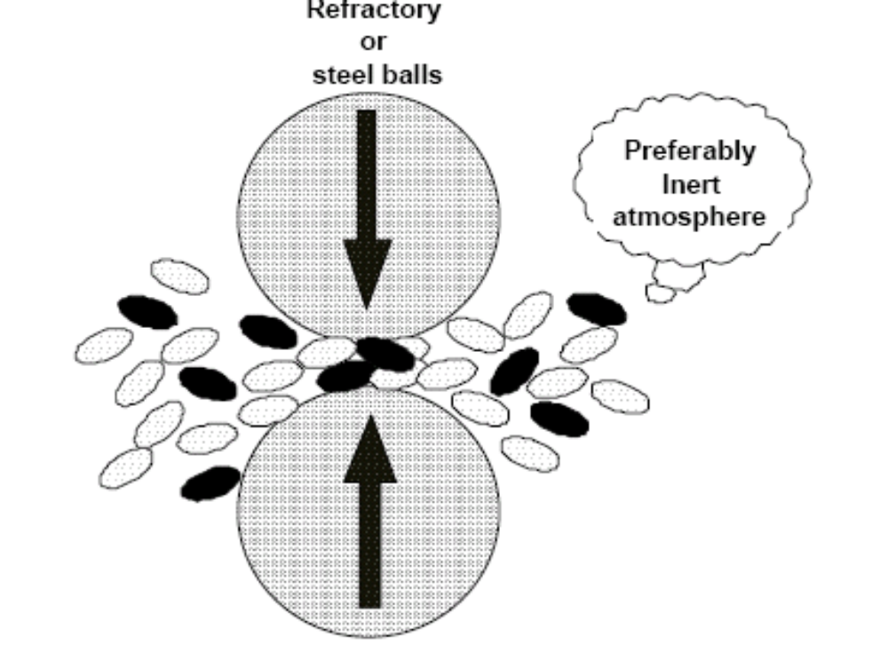
Physical Method - High-Energy ball milling
Objectives of the milling process
Particle size reduction,
Solid-state alloying,
Mixing or blending,
Particle shape changes
Types of ball mills
Tumbler mills
Attrition mills
Shaker mills
Vibratory mills
Planetary mills

Slide 11
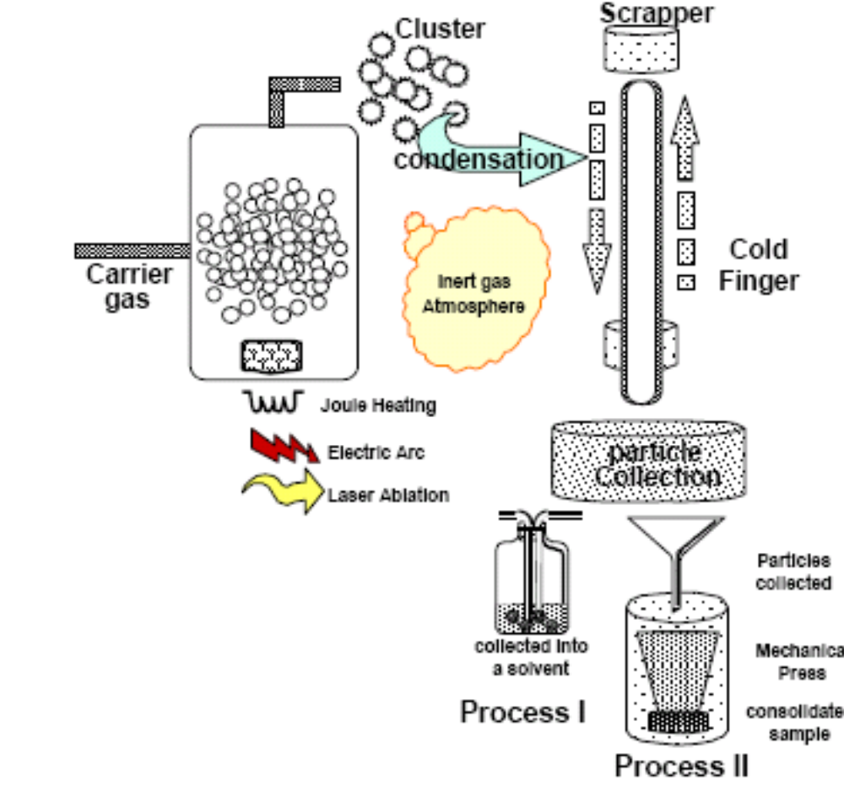
Gas Condensation Processing

Slide 12
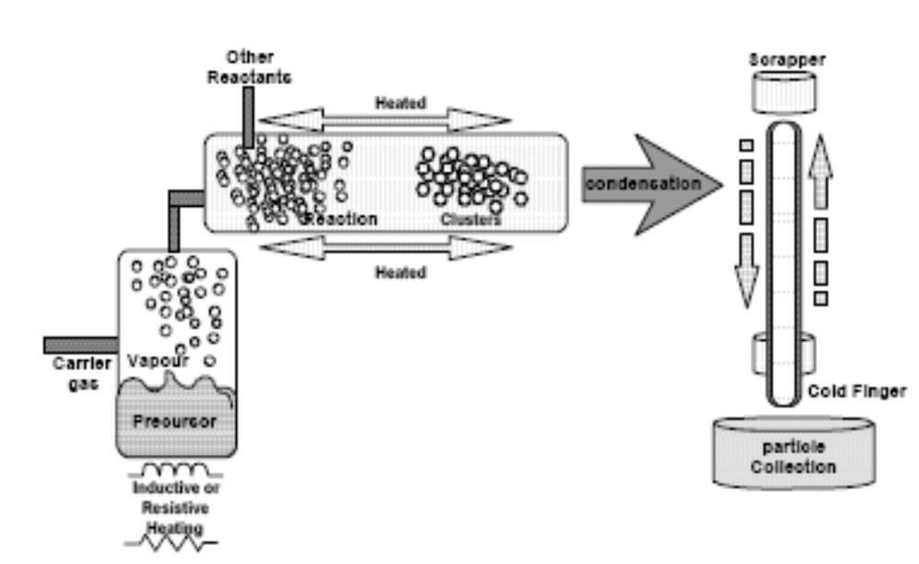
Chemical Vapour Condensation
hexamethyldisilazane (CH₃)₃SiNHSi(CH₃)₃ was used to produce SiCxNyOz powder

Slide 13
Laser ablation method
Laser ablation has been extensively used for the preparation of nanoparticles and particulate films.
In this process a laser beam is used as the primary excitation source of ablation for generating clusters directly from a solid sample in a wide variety of applications.

Slide 14
Chemical Methods
Wet Chemical Synthesis of nanomaterials (Sol-gel process)
The sol-gel process, as the name implies, involves the evolution of inorganic networks through the formation of a colloidal suspension from a solution (sol) and subsequent gelation to form a network in a continuous liquid phase (gel).
The precursors for synthesizing these colloids consist usually of a metal or metalloid element surrounded by various reactive ligands. The starting material is processed to form a sol in contact with water or dilute acid.
Removal of the liquid from the sol yields the gel, and the sol/gel transition controls the particle size and shape. Calcination of the gel produces the product (eg. Oxide).

Slide 15
Sol-gel processing refers to the hydrolysis and condensation of alkoxide-based precursors such as Si(OEt)₄ (tetraethyl orthosilicate, or TEOS).
The reactions involved in the sol-gel chemistry based on the hydrolysis and condensation of metal alkoxides M(OR)_{z} can be described as follows:
MOR + H₂O → MOH + ROH (hydrolysis)
MOH+ROM→M-O-M+ROH (condensation)
Step 1: Formation of different stable solutions of the alkoxide or solvated metal precursor (the sol).
Step 2: Gelation resulting from the formation of an oxide- or alcohol- bridged network (the gel) by a polycondensation or polyesterification reaction which increases the viscocity of the solution.
Step 3: Aging of the gel, during which the polycondensation reactions continue until the gel transforms into a solid mass, accompanied by contraction of the gel network and expulsion of solvent from gel pores.

Slide 16
Step 4: Drying of the gel, If isolated by thermal evaporation, the resulting monolith is termed a xerogel.
If the solvent (such as water) is extracted under supercritical or near super critical conditions, the product is an aerogel.
Step 5: Dehydration, during which surface- bound M-OH groups are removed, there by stabilizing the gel against rehydration. This is normally achieved by calcining the monolith at temperatures up to 800⁰C.
Step 6: Densification and decomposition of the gels at high temperatures (T>800⁰C). The pores of the gel network are collapsed, and remaining organic species are volatilized. The typical steps that are involved in sol-gel processing are shown in the schematic diagram below.

Slide 17
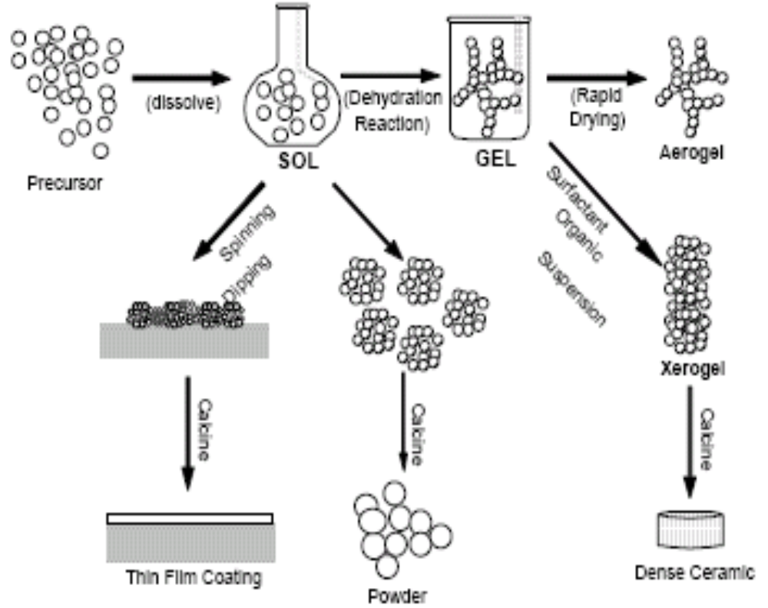
Schematic representation of sol-gel process of synthesis of nanomaterials

Slide 18
Precipitation method
The ZnS powders were produced by reaction of aqueous zinc salt solutions with thioacetamide (TAA).
Precursor zinc salts were chloride, nitric acid solutions, or zinc salts with ligands (i.e., acetylacetonate, trifluorocarbonsulfonate, and dithiocarbamate).
The 0.05 M cation solution was heated in a thermal bath maintained at 70° or 80°C in batches of 100 or 250 ml. Acid was added dropwise to bring it to a pH of 2. The reaction was started by adding the TAA to the zinc salt solution, with the molar ratio of TAA and zinc ions being set to an initial value of either 4 or 8.

Slide 19
SnO₂ nanopowder
SnO₂ nanopowder was prepared by precipitation method using stannic chloride, ammonium hydroxide.
The precipitate obtained by adding ammonia in drops to ice cold solution of stannic chloride was heated at around 100ºC.
The white mass was collected after cooling the mixture and dried.

Slide 20

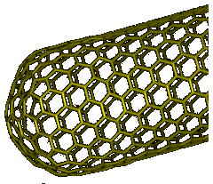
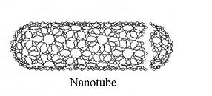
Carbon Nanotubes (CNTs)/Basics
~1 mm
nm

Slide 21
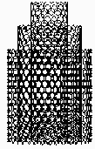
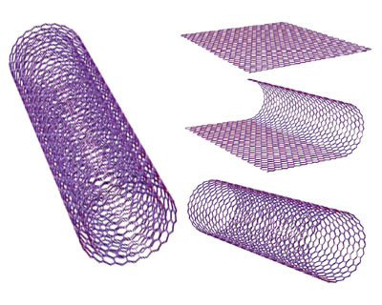
There are two main types of nanotubes:
single-walled nanotubes (SWNTs) and
multi-walled nanotubes (MWNTs,
combination of various CNTs).

Slide 22
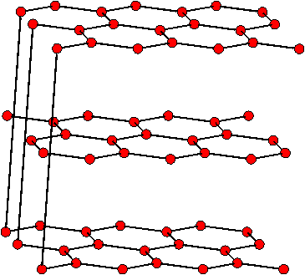
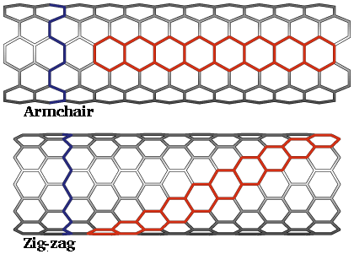
Chemical bonding Structure
Graphite (layered) Rolled graphite (a CNT)
sp² bonded carbon
sp² boned carbon
Chemical structure of graphite (A) and CNT (B). Both having sp² bonded carbons.

Slide 23
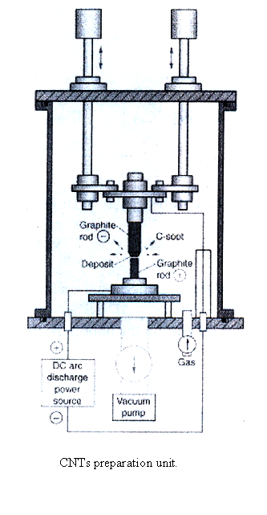
Preparation of CNTs

Slide 24
CNT is prepared by striking an arc between graphite electrodes in ~0.7 atm (~500 torr) of helium, considerably larger than the helium pressure used for the production of fullerene soot.
A current of 60-100 A across a potential drop of about 25 V gives high yields of CNT.
The arcing process can be optimized such that the major portion of the carbon anode gets deposited on the cathode in the form of CNT and graphitic nanoparticles.
The arc evaporation of graphite has been carried out in various kinds of ambient gases (He, Ar, and CH₄).
Carbon nanotubes have been produced in large quantities by using plasma arc-jets by optimizing the quenching process in an arc between a graphite anode and a cooled copper electrode.
If both the electrodes are of graphite, MWNTs are the main products, although side products such as fullerenes, amorphous carbon, and graphite sheets are also formed.

Slide 25
Highly crystalline MWNTs is produced by arc-discharge method in liquid nitrogen where vacuum is replaced with liquid nitrogen.
Direct current was supplied to the apparatus and the anode and cathode is a pure carbon rod of 8-mm diameter and 10-mm diameter.
The Dewar flask is filled with liquid nitrogen and the electrode assembly immersed in nitrogen. Liquid nitrogen prevents the electrodes from contamination with unwanted gases and also lowers the temperature of the electrodes.
Arc discharge occurs as the distance between the electrodes became less than 1 mm, and a current of ~80 A flows between the electrodes. When the arc discharge is over, the carbon deposits near the cathode.
Furthermore, CNTs do not stick to the wall of the chamber. The content of the MWNTs can be as high as 70% of the reaction product. Analysis with Auger-spectroscopy shows no nitrogen was incorporated in the MWNTs. This method considered to be economical and its does not require expensive components.

Slide 26
Chemical vapour deposition
CVD method uses a carbon source in the gas phase and plasma or a resistively heated coil, to transfer the energy to the gaseous carbon molecule.
The commonly used carbon sources are methane, carbon monoxide and acetylene. The energy source cracks the molecule into atomic carbon. The carbon then diffuses towards the substrate, which is heated and coated with a catalyst (usually a first row transition metal such as Ni, Fe or Co) and binds to it.
Use of an appropriate metal catalyst permits the preferential growth of single-walled rather than multi-walled nanotubes.

Slide 27
CVD synthesis of nanotubes is essentially a two-step process, consisting of a catalyst preparation (step-1) step followed by the actual synthesis of the nanotubes (step-2).
The catalyst is generally prepared by sputtering a transition metal onto a substrate and then using etching by chemicals such as ammonia or thermal annealing to induce the nucleation of catalyst particles. Thermal annealing results in metal cluster formation on the substrate, from which the nanotubes grow.
The temperature for the synthesis of nanotubes by CVD is generally in the 650-900ºC range. Typical nanotube yields from CVD are around 30%.
A variety of CVD processes have been used for carbon nanotubes synthesis, which include plasma-enhanced CVD, thermal chemical CVD, alcohol catalytic CVD, aero gel-supported CVD and laser-assisted CVD.

Slide 28
In the thermal CVD process, Fe, Ni, Co or an alloy of these metals is initially deposited on a substrate.
After the substrate is etched (skin removed) by a dilute HF solution, the substrate is placed in a quartz boat, positioned in a CVD reaction furnace.
Nanometer-sized catalytic metal particles get formed after an additional etching of the catalytic metal film using NH3 gas at 750-1050ºC.
The nanotubes grow on the fine catalytic metal particles by the CVD process.

Slide 29
Single-walled carbon nanotubes (SWNT)
The carbon nanotubes generally obtained by the arc method or hydrocarbon pyrolysis are multi-walled, having several graphitic sheets or layers.
Depending on the exact technique, it is possible to selectively grow SWNTs or MWNTs.
Two distinct methods of synthesis can be performed with the same arc discharge apparatus.
If SWNTs are required, the anode has to be doped with a metal catalyst based on Fe, Co, Ni, or Mo.
Several elements and mixtures of elements have been tested and the results vary considerably.

Slide 30
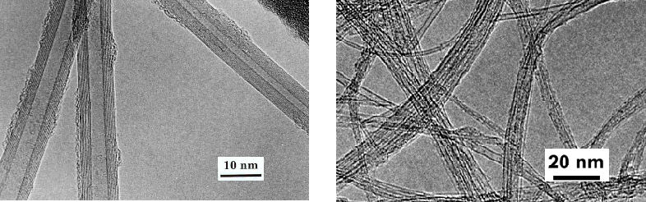
A
B
Transmission electron micrographs (TEM) of
multiwall nanotubes (MWNTs)

Slide 31
Single-walled carbon nanotubes (SWNT)
Single-walled nanotubes were first prepared by the metal-catalyzed dc arcing of graphite rods in a Helium gas atmosphere.
The graphite anode was filled with metal powders (Fe, Co or Ni) and the cathode was of pure graphite.
SWNTs generally occur in the web-like material deposited behind the cathode.

Slide 32
Various metal catalysts have been used to make SWNTs by this route.
Molybdenum (Mo) particles of few nanometer diameters dispersed in a fumed alumina matrix catalyst.
Co (or) a Fe/Ni bimetallic catalyst
Various oxides catalysts: Y₂O₃, La₂O₃, CeO₂ as catalysts.
1% Yttrium and 4.2 at.% Ni as catalyst.
Graphite rods filled with Ni and Y₂O₃ catalyst in a He atmosphere (660 Torr) gives rise to web-like deposits on the chamber walls near the cathode, consisting of SWNT bundles.
Nanoparticles of Fe catalyst

Slide 33
A common problem with SWNT synthesis is that the product contains metal catalyst particles and defects, rendering purification difficult.
On the other hand, an advantage is that the diameter can be controlled by changing the thermal transfer and diffusion, and hence the condensation of atomic carbon.
This has been demonstrated in an experiment where different mixtures of inert gases were used.
Argon, with a lower thermal conductivity and diffusion coefficient, gives SWNTs with a diameter of ~1.2 nm.
A linear fit of the average nanotube diameter showed a 0.2 nm diameter decrease per 10 % increase in argon helium ratio, when nickel/yttrium was used (C/Ni/Y was 94.8:4.2:1) as catalyst.

Slide 34
Purification Techniques of CNTs
A large problem with nanotube application is next to large-scale synthesis also the purification.
The produced SWNT soot contains a lot of impurities.
The main impurities in the soot are graphite (wrapped up) sheets, amorphous carbon, metal catalyst and the smaller fullerenes.
These impurities will interfere with most of the desired properties of the SWNTs.
Basically, these techniques can be divided into two mainstreams, structure selective and size selective separations.
The first one will separate the SWNTs from the impurities; the second one will give a more homogeneous diameter or size distribution.
The techniques that will be discussed are oxidation, acid treatment, annealing, ultrasonication, micro filtration, ferromagnetic separation, cutting, functionalisation and chromatography techniques.

Slide 35
A) By chemical oxidation
Oxidative treatment of the SWNTs is a good way to remove carbonaceous impurities (or) to clear the metal surface. The main disadvantages of oxidation are that not only the impurities are oxidized, but also the SWNTs.
Luckily the damage to SWNTs is less than the damage to the impurities.
Another reason why impurity oxidation is preferred is that these impurities are most commonly attached to the metal catalyst, which also acts as oxidizing catalyst.
Efficiency of the purification procedure dependable on lot of factors; such as metal content, oxidation time, environment, oxidizing agent and temperature. For example, when the temperature is raised above 600 °C, SWNTs will also oxidize, even without catalyst.
Well known method is mild oxidizing in a wet environment with soluble oxidizing agents, such as H₂O₂ and H₂SO₄. These will only oxidize the defects and will clear the surface of the metal.
However, if oxygen impurities present in the solution, that leads to oxidation of metal→ metal oxide and in turn to rupture the CNT structure.

Slide 36
(B) By acid treatment
In general the acid treatment will remove the metal catalyst as soluble metal salts.
In that treatment, the surface of the metal must be first exposed by oxidation or sonication.
The metal catalyst is then exposed to acid and solvated. The SWNTs remain in suspended form.
When using a treatment in HNO₃, the acid only has an effect on the metal catalyst. It has no effect on the SWNTs and other carbon particles.
If a treatment in HCl is used, the acid has also a little effect on the SWNTs and other carbon particles.
The mild acid treatment (4 M HCl reflux) is basically the same as the HNO₃ reflux, but here the metal has to be totally exposed to the acid to solvate it.

Slide 37
By annealing (heat treatment)
Due to high temperatures (873 – 1873 K) the nanotubes will be rearranged and defects will be consumed.
The high temperature also causes the graphitic carbon and the short fullerenes to pyrolyse.
When using high temperature vacuum treatment (1873 K) the metal will be melted and can also be removed.

Slide 38
By ultrasonication
In this technique particles are separated due to ultrasonic vibrations. Agglomerates of different nanoparticles will be forced to vibrate and will become more dispersed.
The separation of the particles is highly dependable on the surfactant, solvent and reagent used. In poor solvents the SWNTs are more stable if they are still attached to the metal.
But in some solvents, such as alcohols, monodispersed particles are relatively stable. When an acid is used, the purity of the SWNTs depends on the exposure time.
When the tubes are exposed to the acid for a short time, only the metal solvates, but for a longer exposure time, the tubes will also be chemically cut .

Slide 39
By magnetic purification
In this method ferromagnetic (catalytic) particles are mechanically removed from their graphitic shells.
The SWNTs suspension is mixed with inorganic nanoparticles (mainly ZrO₂ or CaCO₃) in an ultrasonic bath to remove the ferromagnetic particles.
Then, the particles are trapped with permanent magnetic poles. After a subsequent chemical treatment, a high purity SWNT material will be obtained.
This process does not require large equipment and enables the production of laboratory-sized quantities of SWNTs containing no magnetic impurities.

Slide 40
By micro filtration
Micro filtration is based on size or particle separation. SWNTs and a small amount of carbon nanoparticles are trapped in a filter.
The other nanoparticles (catalyst metal, fullerenes and carbon nanoparticles) are passing through the filter.
One way of separating fullerenes from the SWNTs by micro filtration is to soak the produced SWNTs first in a CS₂ solution. The CS₂ insolubles are then trapped in a filter. The fullerenes which are solvated in the CS₂, pass through the filter.
A special form of filtration is cross flow filtration. In cross flow filtration the membrane is a hollow fibre. The membrane is permeable to the solution.
The filtrate is pumped down the bore of the fibre at some head pressure from a reservoir and the major fraction of the fast flowing solution which does not permeate out the sides of the fibre is fed back into the same reservoir to be cycled through the fibre repeatedly
A fast hydrodynamic flow down the fibre bore (cross flow) sweeps the membrane surface preventing the build-up of a filter cake.

Slide 41
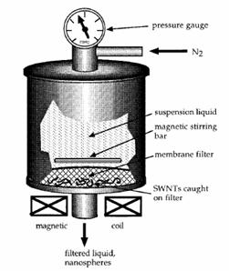
SWNT microfiltration unit.

Slide 42
By cutting
Cutting of the SWNTs can either be induced chemically (Fig.13), mechanically (or) as a combination of these.
SWNTs can be chemically cut by partially functionalizing the tubes, for example with fluorine.
Then, the fluorated carbon will be driven off the sidewall with pyrolisation in the form of CF₄ or COF₂. This will leave behind the chemically cut nanotubes.
Mechanical cutting of the nanotubes can be induced by ball-milling. Here, the bonds will break due to the high friction between the nanoparticles and the nanotubes will be disordered.
A combination of mechanical and chemical cutting of the nanotubes is by ultrasonication induced cutting in an acid solution.
In this way the ultrasonic vibration will give the nanotubes sufficient energy to leave the catalyst surface. Then, in combination with acid the nanotubes will rupture at the defect sites.

Slide 43
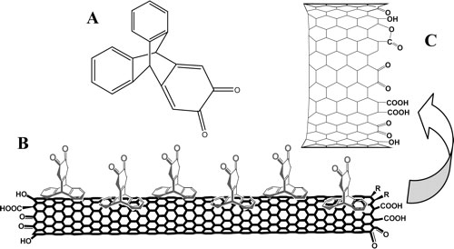
Functionalized SWNT.

Slide 44
By functionalisation
Functionalisation is based on making SWNTs more soluble than the impurities by attaching other groups to the tubes.
Now it is easy to separate them from insoluble impurities, such as metal, with filtration.
Another functionalisation technique also leaves the SWNT structure intact and makes them soluble for chromatographic size separation.
For recovery of the purified SWNTs, the functional groups can be simply removed by thermal treatment, such as annealing.

Slide 45
By chromatography
This technique is mainly used to separate small quantities of SWNTs into fractions with small length and diameter distribution.
The SWNTs are run over a column with a porous material, through which the SWNTs will flow.
The columns used are GPC (Gel Permeation Chromatography) and HPLC-SEC (High Performance Liquid Chromatography - Size Exclusion Chromatography) columns.
The number of pores the SWNTs will flow through depends on their size. This means that, the smaller the molecule, the longer the pathway to the end of the column will be and that the larger molecules will come off first.
The pore size will control what size distribution can be separated. However, a problem is that the SWNTs have to be either dispersed or solvated. This can be done by ultrasonication or functionalisation with soluble groups.

Slide 46
2. Organometallic Approaches Towards Nanomaterials

Slide 47
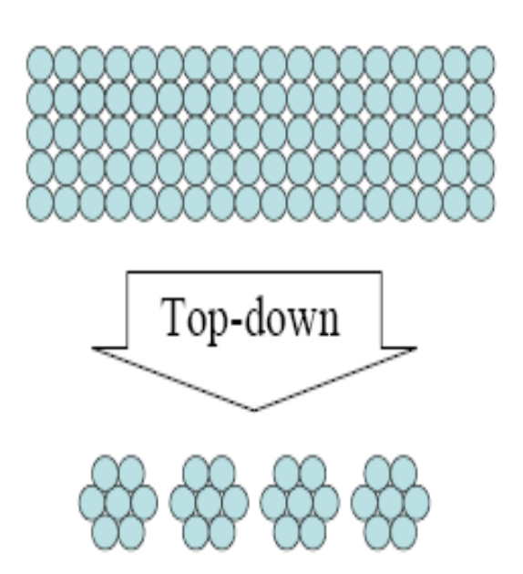
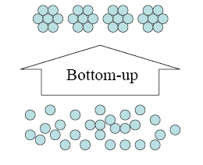
Approaches
Nanostructure can be accomplished by two approaches
Small building blocks are produced and assembled into larger structures.
Large objects are modified to give smaller features.

Slide 48
Organometallic Approach to Nanoparticles
The use of organometallic precursors allows the synthesis of metal nanoparticles in mild conditions with a controlled size, shape and surface environment.
The synthesis of bimetallic magnetic nanoparticles of controlled anisotropy and of semi-conducting oxides also possible.
The self-organization of the particles can lead to the formation of 3D super-lattices of nanoparticles, i.e. a true crystallization process.
Applications in microelectronics have been reported.
B. Chaudret, C. R. Physique 6 (2005) 117.

Slide 49
(Ru(η4-C₈H₁₂)(η6-C₈H₁₀), Co(η3-C₈H₁₃)(η4-C₈H₁₂), Pt(dba)₂ etc.
Olefinic precursors
H₂
Nanoparticles- Fe, Co, Ni, Ru, Rh, Pd, Pt, Cu, Ag, Au, In
&
Bimetallic (Pd–Cu, Ru–Pt, Co–Ru, Co–Rh, Co–Pt)
*
Indium particles are ‘liquid’ at room temperature.
*
Cobalt particles show polytetrahedral structure.
*
The properties of the surface ligands can control their size or shape through their clean surface.
The presence and role of the different ligands (Coordination Chemistry) can alter the particle properties- monodispersity and their shape (spheres, rods, cubes, wires).
*

Slide 50
Organometallic Nanoparticles
To prepare a clean surface able to adsorb small molecules (CO, H₂) or large ligands like phosphines.
These nano-objects display an organometallic surface chemistry comparable to usual organometallic moities and which can be studied by classical spectroscopic methods.
These species display a very rich potential of reactivity, which may concern fields as diverse as dihydrogen formation and storage.

Slide 51
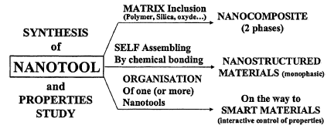
Nanotools are only a step on the way to nanomaterials.
Nanocomposites are obtained by inclusion of nanotools in a matrix.
Nanostructured hybrid materials have the organic unit that is maintained in the solid without any change and the solid exhibits the physical property of the organic unit.
Smart materials correspond to nanomaterials in which at least two physical properties will be interactively coupled together.

Slide 52
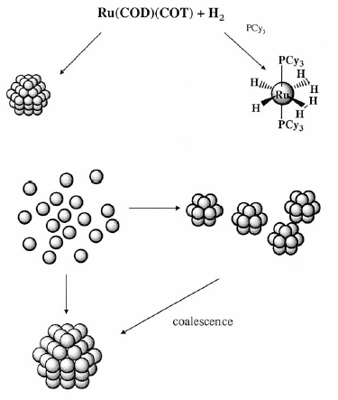
A General Method for the Synthesis of Metal Nanoparticles
Same route can be followed
for Pt, Pd, Ni, Rh and Ir.
Ruthenium particles
and Cyclooctane
The ideal
precursor is an organometallic complex containing
ligands, preferentially olefinic or polyolefinic, able either
to be hydrogenated to give a bare metal atom
which would condense in the reaction medium or to be
substituted by CO to give an unstable intermediate.
Size control needs a
stabilizing agent
K. Philippot, B. Chaudret, C. R. Chimie 6 (2003) 1019–1034.

Slide 53
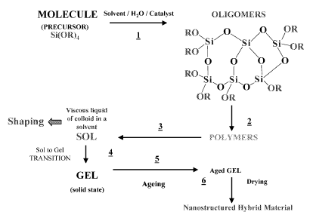
Polymers
Nanostructured Hybrid Materials
R. Corriu, J. Organomet. Chem. 686 (2003) 32.

Slide 54
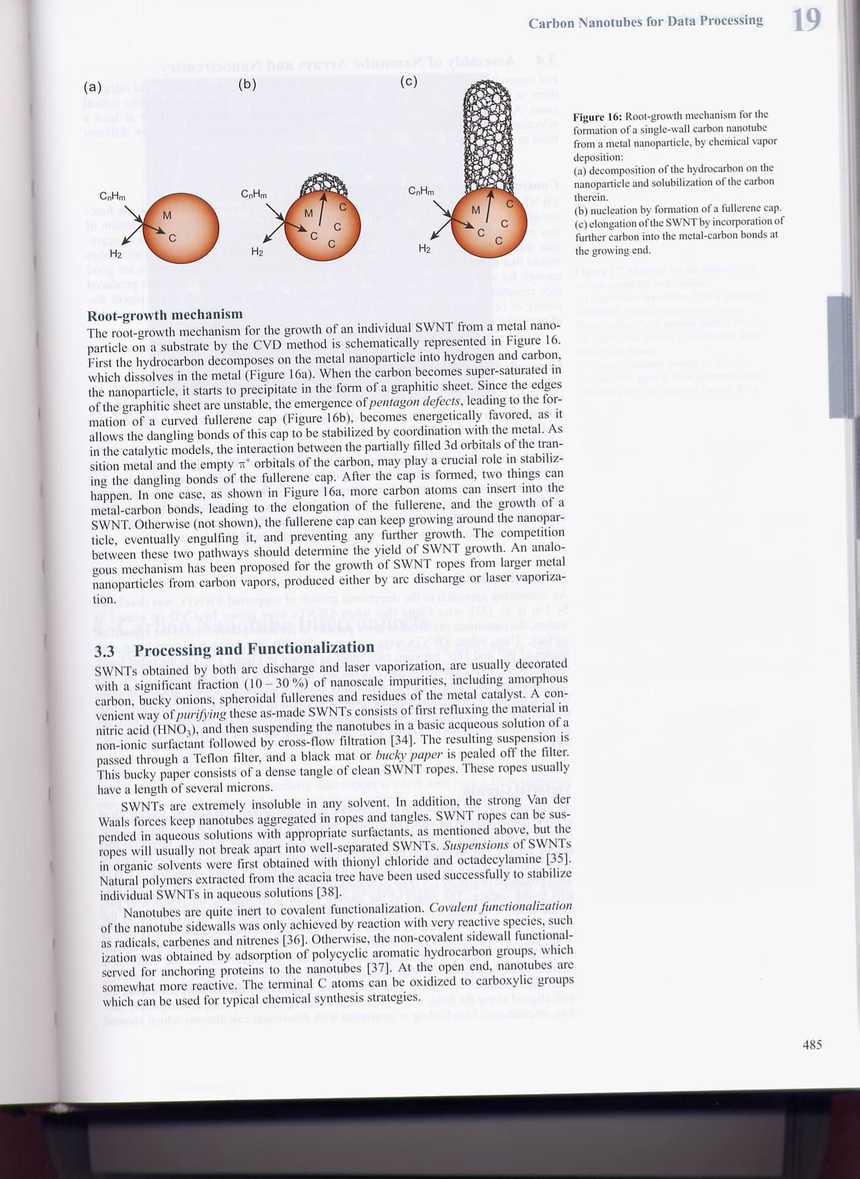
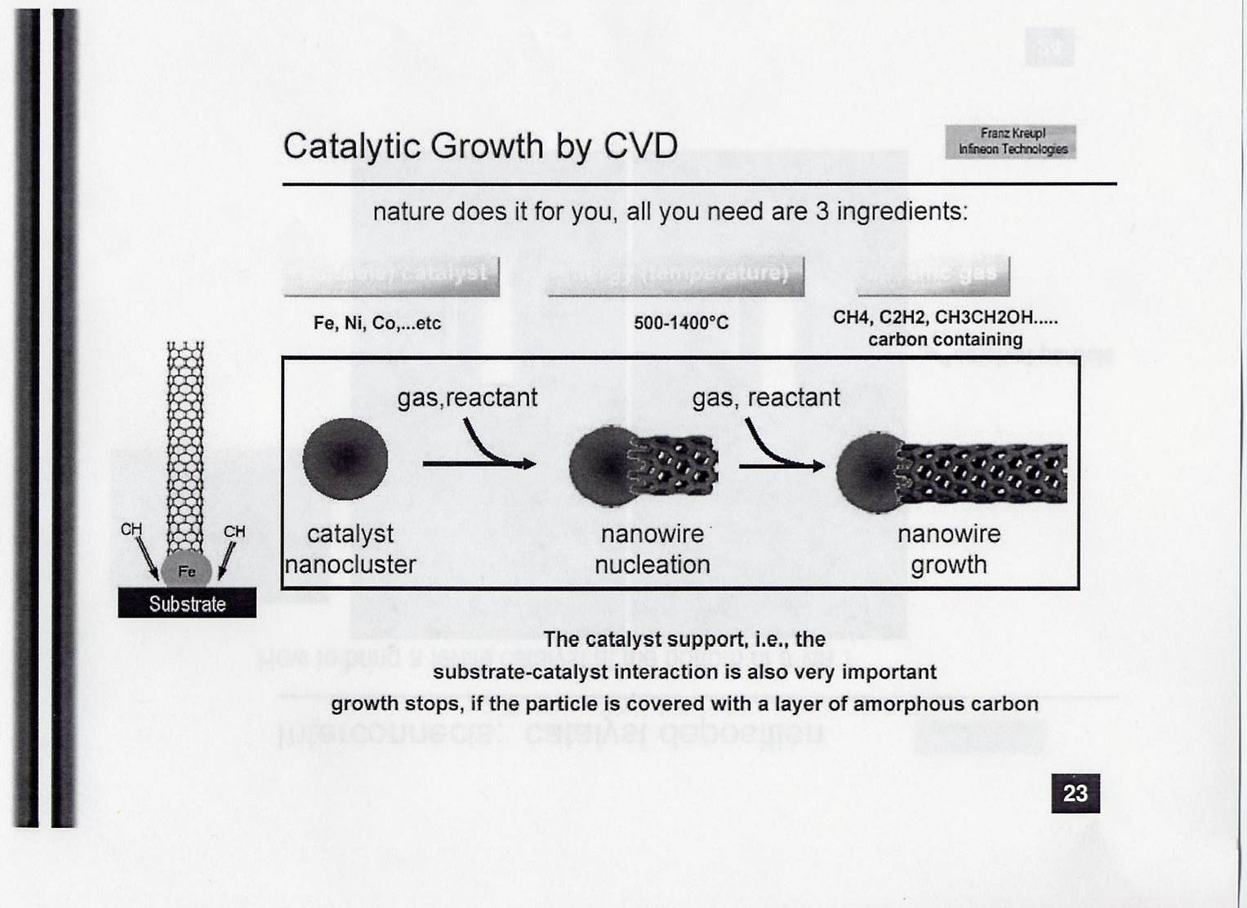
Mechanisms of Carbon Nano tube
Root Growth Mechanism:
Transition metal acts as a catalyst.
Hydrocarbon dissociates at metal surface into H and C.
Once surface saturated with C, it starts to form as graphite sheet with fullerene cap.
More C atoms can be inserted into Metal-C bond so the tube get growing longer.

Slide 55
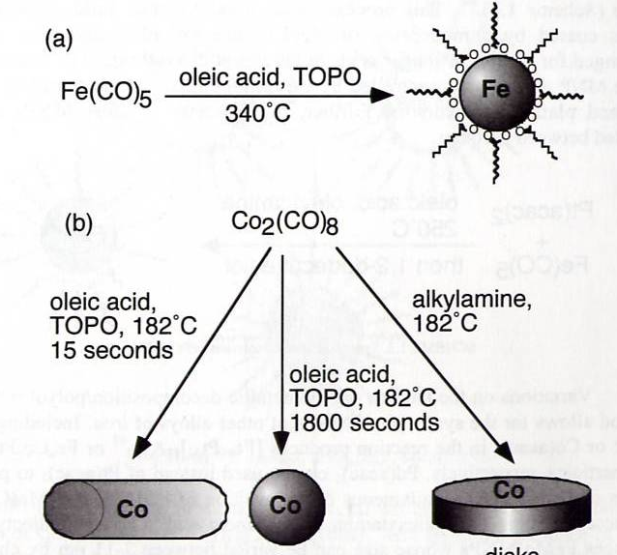
Synthesis of Single Metal MNP by Thermal Decomposition
Thermal Decomposition of organo-metallic complexes can produce highly mono-disperse nano particles.
Size and dispersity control is attained through high reaction temperature.
Capping ligands (e.g. Oleic Acid) can also mediate the particle growth by forming a monolayer of nano particles.
Most common precursors: Metal Carbonyl complexes.
Morphology can also be controlled through various capping ligands.
TOPO: Trioctylphosphine Oxide

Slide 56
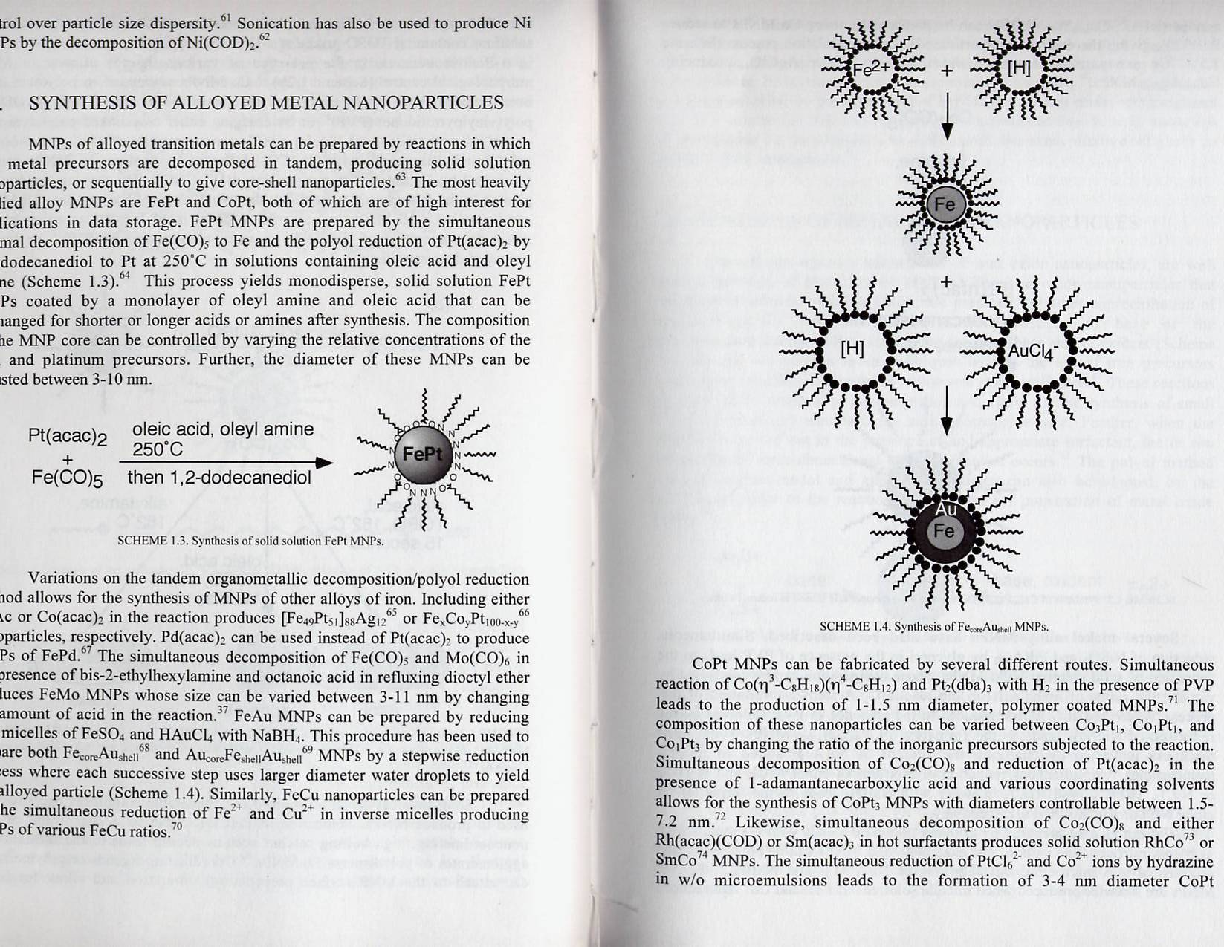
Alloyed Metal Nano Particles
Solid-solution alloyed metallic nano particles can be attained through simultaneous thermal decomposition.
Core-shell alloyed nano particles are produced by a stepwise reduction process where each successive step uses larger diameter water droplet to yield the alloyed core-shell particles

Slide 57
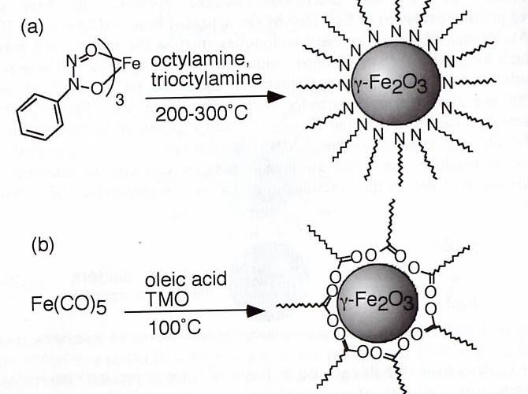
Metal Oxide Nano Particles
Thermal decomposition of metal organic precursors on a hot surface.
The size of the nano particles can be controlled by reaction temperature and / or the ratios of precursor verse capping ligands

Slide 58
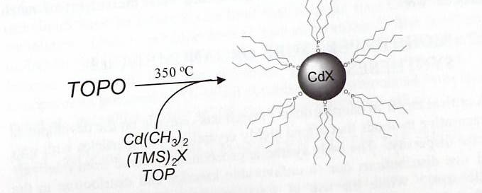
Semiconductor Nano Particles
High Temperature Organometallic Methods are still the most popular for both III-V and II-VI group metals.
Thermal decomposition
Rapid injection of organometallic precursor means fast nucleation.
The following growth can be controlled and terminated by adjusting temperature

Slide 59
3. Molecules on Materials and Their Applications in Catalysis

Slide 60
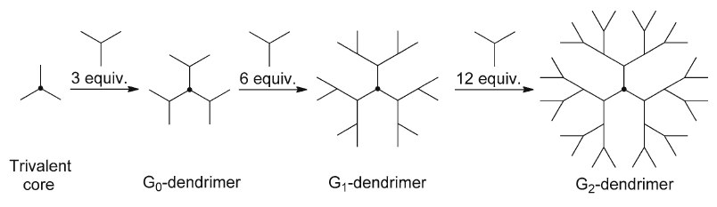
The divergent method for the synthesis of dendrimers

Slide 61
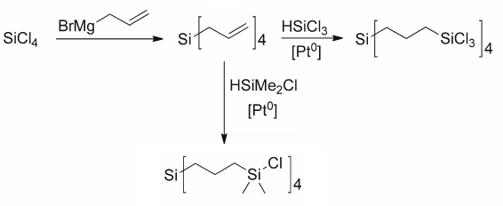
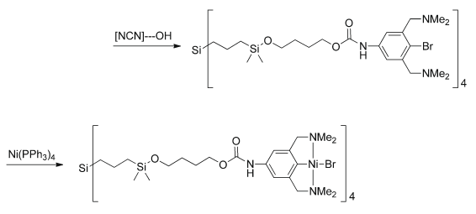
Synthesis of carbosilane dendrimers
Metallodendrimer

Slide 62
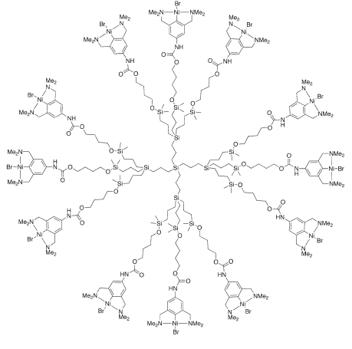
The First Generation Metalladendrimer
P. Barbaro and F. Liguori, Heterogenized Homogeneous Catalysts for Fine Chemicals Production, Catalysis by Metal Complexes 33,2010, 171.

