Slide 1
IP Security

Slide 2
The needs
There are application security mechanisms for a number of applications (S/MIME,PGP, Kerberos, Secure Socket Server,…)
Users have security concerns that cut across multiple protocols
What if implementing security at IP level? ->ensure secure networking also for security ignorant applications
IP-level security encompasses three functional areas:
Authentication
Confidentiality
Key management

Slide 3
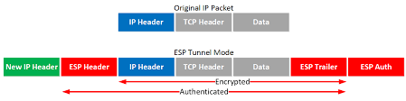
Overview
In 1984 the Internet Architecture Board (IAB) issued a report titled «Security in Internet Architecture» (RFC 1636):
Secure network infrastructure from unauthorized monitoring and control of network traffic
Secure end to end user traffic with authentication and encyrption, through Encapsulating Security Payload (ESP)
-> IPv6
IPSec provides security across LAN, private and public WAN, Internet
Main feature of IPSec: authenticate and encrypt all traffic at IP level through tunnel mode

Slide 4
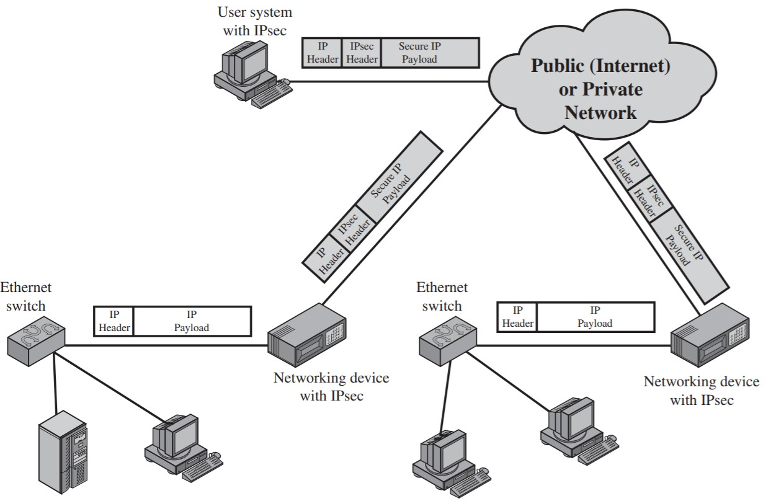
An IPSec VPN scenario
IPSec traffic

Slide 5
Benefits of IPSec
When IPSec is implemented in a firewall or router, it provides strong security that can be applied to all traffic crossing the perimeter.
IPSec in a firewall is resistant to bypass
IPSec is below the transport level and so is transparent to applications
IPSec can be transparent to end users
IPSec can provide security for individual users if needed

Slide 6
Routing Applications
IPSec can assure that:
A router advertisement comes from an authorized router
A neighbor advertisement (a router seeks to establish or maintain a neighbor relationship with a router in another routing domain) comes from an authorized router
A redirect message comes from the router to which the initial IP packet was sent
A routing update is not forged.
Notes:
Questi aggiornamenti avvengono attraverso protocolli come:
OSPF (Open Shortest Path First)
BGP (Border Gateway Protocol)
RIP (Routing Information Protocol)

Slide 7
IPSec Documents
IPSec encompasses 3 key areas:
Authentication
Confidentiality
Key management
RFC 6071: IP Security and Internet Key Exchange (IKE) Document Roadmap
Architecture: RFC 4301, Security Architecture for the Internet Protocol
Authentication Header (AH) RFC 4302, IP Authenticaton Header
Encapsulating Security Payload (ESP): RFC 4303, IP Encapsulating Security Payload (ESP)
Internet Key exchange (IKE): RFC 7296, Internet Key Exchange(IKEv2) Protocol
Cryptographic Algorithms

Slide 8
IPSec Services
RFC 4301 lists the following services:
Access Control
Conncetionless Integrity
Data origin authentication
Rejection of the replayed packets
Confidentiality
Limited traffic flow confidentiality

Slide 9
Transport Mode
AH and ESP support transport and tunnel modes
Transort mode provides security for upper layer protocols (end-to-end communications between two hosts)
AH/ESP over IPv4-> the payload is all that follows IP header
AH/ESP over IPv6-> the payload is all that follows IP header and IPv6 extension headers
ESP in transport mode encrypts and optionally authenticates the IP payload but not the IP header.
AH in transport mode authenticates the IP payload and selected portions of the IP header.

Slide 10
Tunnel Mode
Provides protection to the entire IP packet
AH and ESP fields are added to the IP packet, the entire packet and security fields are treated as the apyload of the new IP packet with a new outer IP header.
No routers along the way are able to examine the inner IP header
The new larger packet may have different source and destination addresses
Tunnel mode can be used when one or both ends of a security association (SA) are a security gateway implementing IPSec.

Slide 11
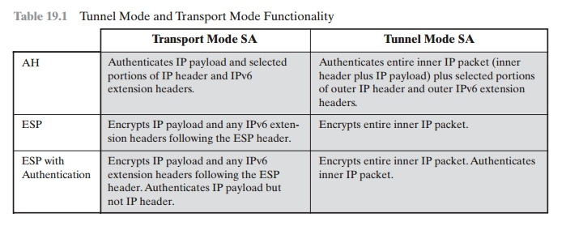

Slide 12
IP Security Policy
IP Security Policy is determined by the interaction of 2 databases:
Security Association Database (SAD)
Security Policy Database (SPD)
As Association is a one-way logical connection between a sender and a receiver that affords security services to the traffic carried on it.
A Security Association is identified by 3 parameters:
Security Parameter Index (SPI): a 32 bit unsigned integer assigned to the SA. It is carried in AH and ESP header
IP destination Address, may be an end user or a network system
Security Protocol Identifier: this field from the outer IP header indicates whether the association is an AH or ESP security Association.
In an IP packet the security association is identified by the destination address in the IPv4 or IPv6 header and the SPI in the extension header (AH or ESP).

Slide 13
Security Association Database
Each SA is defined by the following parameters in an SAD entry:
Security Parameter Index: a 32 bit value identifies the SA
Sequence Number counter: a 32-bit value used to generate the Sequence Number field in AH or ESP headers
Sequence Counter Overflow: a flag indicating whether overflow of the Sequence Number Counter should generate an auditable event and prevent further transmission
Anti-Replay Window:Used to determine whether an inbound AH or ESP packet is a replay
AH Information: authentication algorithm, keys, key lifetime, and related parameters being used with AH
ESP information: encryption and authentication algorithm, keys, initialization values, key lifetimes, and related parameters being used with ESP
Lifetime of this security association: a time interval or byte count after which an SA must be replaced with a new SA and a new SPI or terminated.
IPSec Protocol Mode: Transport, Tunnel or wildcard
PATH MTU: any observed path maximum transmission unit and aging variables

Slide 14
Security Policy Database
Each SPD entry is defined by a set of IP and upper-layer protocol field values, called selectors, used to filter outgoing traffic in order to map it into a particular SA or multiple SAs associated with a single SPD.
Compare the values of the appropriate fileds in the packet against the SPD to find a matching.
Determine the SA if any for this packet and its associated SPI
Do the required IPSec processing (AH or ESP).
Selectors that determine an SPD entry:
Remote IP Address: a single IP address, an enumerated list or range of addresses, or a wildcard address.
Local IP Address: a single IP address, an enumerated list or range of addresses, or a wildcard address-
Next layer Protocol: the IP protocol header (IPv4, IPv6).
Name: a user identifier from the operating system
Local and remote ports: individual TCP or UDP port values

Slide 15
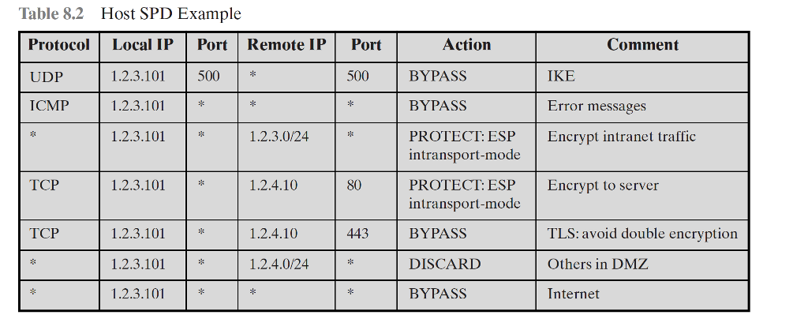

Slide 16
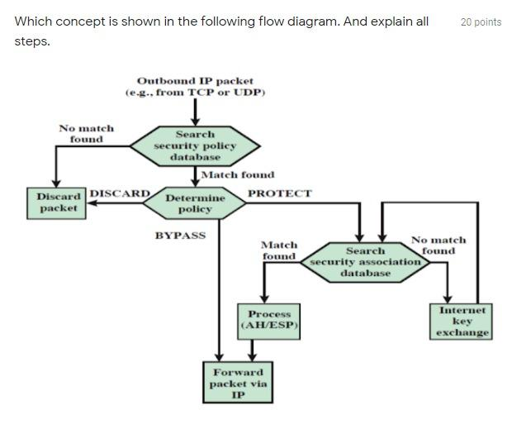
Processing model for outbound packets

Slide 17
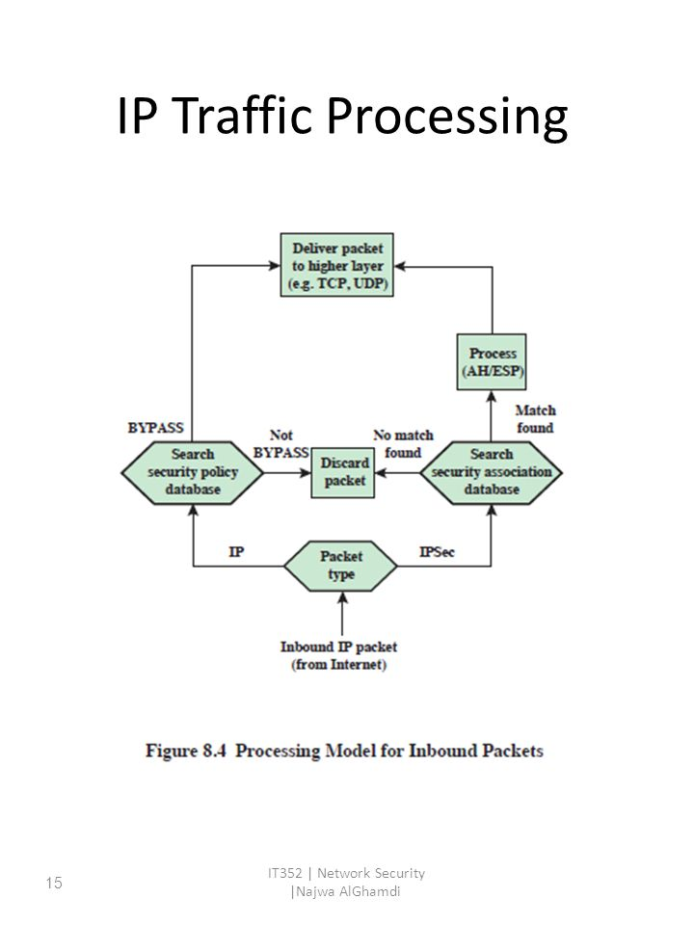
Processing model for inbound packets

Slide 18
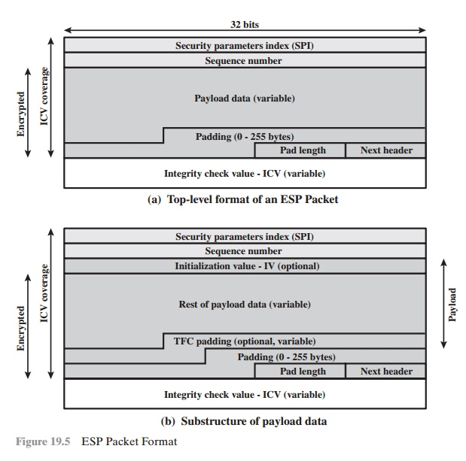
1. Spefici encryption algorithm
2.ESP requires that P.L. & N.H. be alligned with 32-bit word
3.Provide partial traffic-fow confidentiality
Nonce for the encryption, necessary for ESP
Identifies the type of data in the payload
If tunnel mode is necessary
Present only if the integrity check is selected

Slide 19
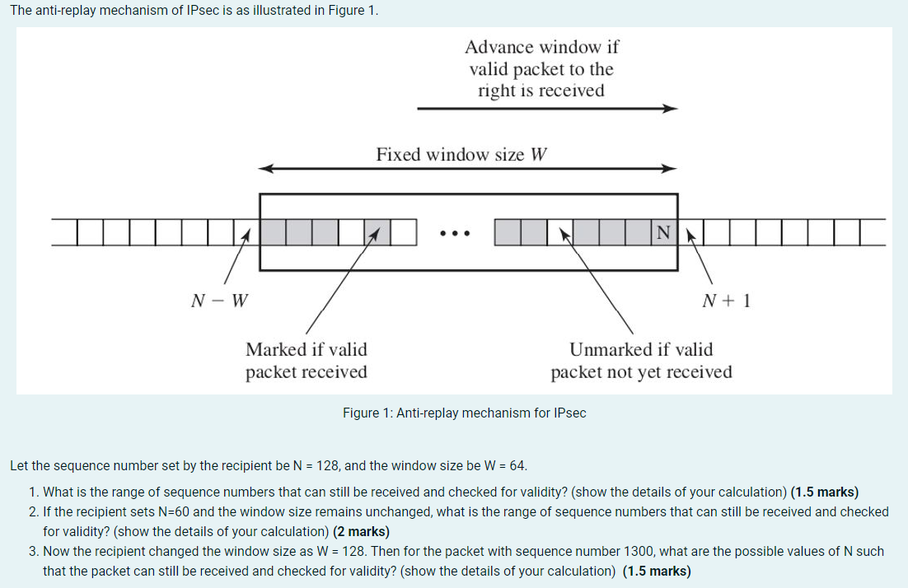
Padding
The Padding Field serves several purposes:
Expand the plaintext
Assure the allignment between Pad lenght and Next Header
Concealing real lenght of the payload
Anti-Replay Service
When a new SA is established, the sender initializes a sequence number counter to 0.
Each time a packet is sent to this SA, the sender increments the counter and places the value in the Sequence Number field.
The receiver implement a window W, with default of W=64.
For any packet with a sequence number of N – W + 1 to N that has been correctly received, the corresponding slot in the window is marked.

Slide 20
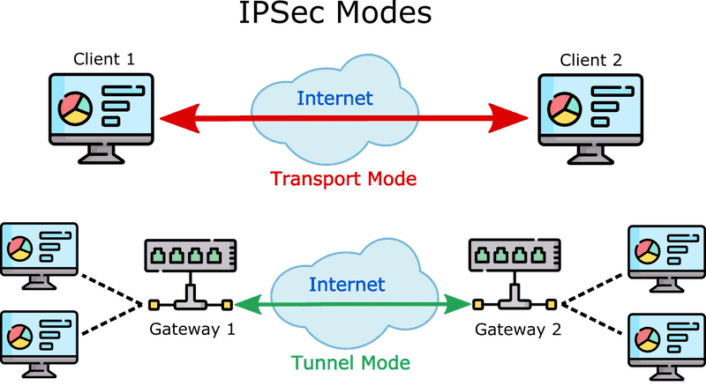

Slide 21
Transport Mode ESP
To enrcypt and optionally authenticate data carried by IP
At the source, the block of data is encrypted and the plaintext of this block is replaced with its cyphertext to form the IP packet for transmission. Authentication is added if this option is selected
The packet is then routed to the destination. Each intermediate router needs to examine and process the IP header plus any plaintext Ip extension headers but does not need to examine the cyphertext.
The destination node examines and processes the IP header plus any plaintext IP extension headers. Then, on the basis of the SPI in the ESP header, the destination node decrypts the remainder of the packet to recover the plaintext transport-layer segment

Slide 22
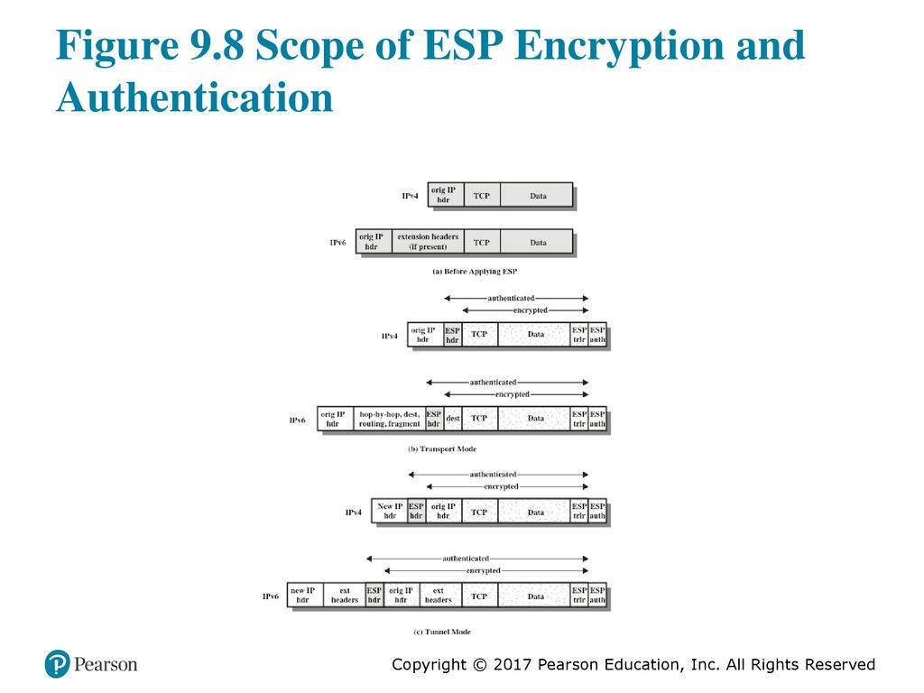

Slide 23
Tunnel Mode ESP
Used to encrypt an entire IP packet. The ESP header is prefixed to the paclet d then the packet plus the ESP trailer is encrypted. This method can be used to counter traffic analysis.
It is necessary to encapsulate the entire block (ESP header + cyphertext + Authentication Data) with a new IP header that will contain sufficient information for routing but not for traffic analysis.
Tunnel mode is useful in configurations that include a firewall or other sort of security gateway. Encryption occurrs only between the security gateway and the external network or between two security gateways.

Slide 24
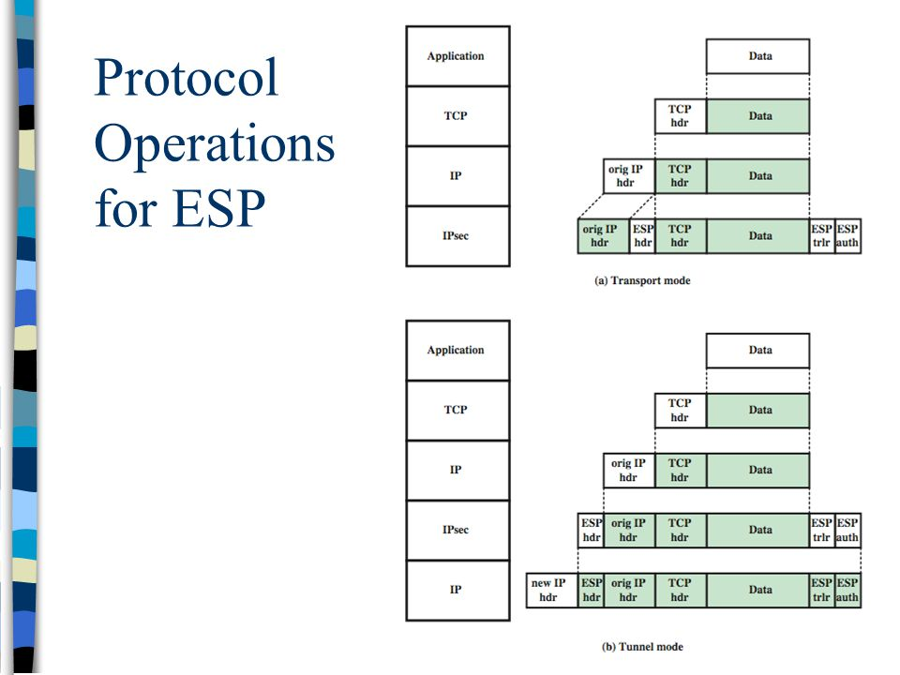

Slide 25
Combining Security Associations
An SA can implement either the AH or ESP but not both.
Multiple SAs may be employed for the same traffic flow to achieve the desired IPSec services.
The term Security Association Bundle refers to a suquence of SAs through which traffic must be processed to provide a desired set of IPSec Services.
SAs may be combined into bundles in 2 ways:
Transport adjacency: applying more than one security protocol to the same iP paclet without invoking tunneling
Iterated tunneling: multiple layers of security protocols effected through IP tunneling. Allows multiple levels of nesting.
The 2 approaches may be combined

Slide 26
Authentication + Confidentiality
The user first applies ESP to the data to be protected and then appends the authenticatoin data field.
Transport mode ESP: authentication and encryption apply to the IP payload delivered to the host, but the IP header is not protected
Tunnel mode ESP: Authentication applies to the entire IP packet delivered to the outer IP destination address (e.g. a firewall) and authentication is performed at that destination. The entire inner IP packet is protected by the privacy mechanism for delivery to the inner IP destination
Transport Adjacency
Another way to apply authentication after encryption is to use 2 bundled transport Sas, with the inner being an ESP SA and the outer being an AH SA.
ESP is used without its autentication option.
Because the inner SA is a transport SA, encryption is applied to the IP payload.
Results in an IP header followed by an ESP.
AH is then applied in transport mode, so that authentication covers the ESP plus the original IP header except for mutable fields.
Pros: authentication covers more fields, including the source and destination IP addresses
Cons: the overhead of 2 Sas versus one SA.

Slide 27
Transport-Tunnel Bundle
The use of authentication prior to encryption might be preferable for several reasons.
Authentication data are protected by encryption
It may be desirable to store the authentication information with the message at the destination for later reference.
An approach to applying authentication before encryption between 2 hosts is to use a bundle consisting of an inner AH transport SA and an outer ESP tunnel SA.
Authentication is applied to the IP payload plus the IP header except for mutable fields. The resulting IP packet is then processed in tunnel mode by ESP. The result is that the entire authenticated inner packet is encrypted and new outer IP header is added.

Slide 28
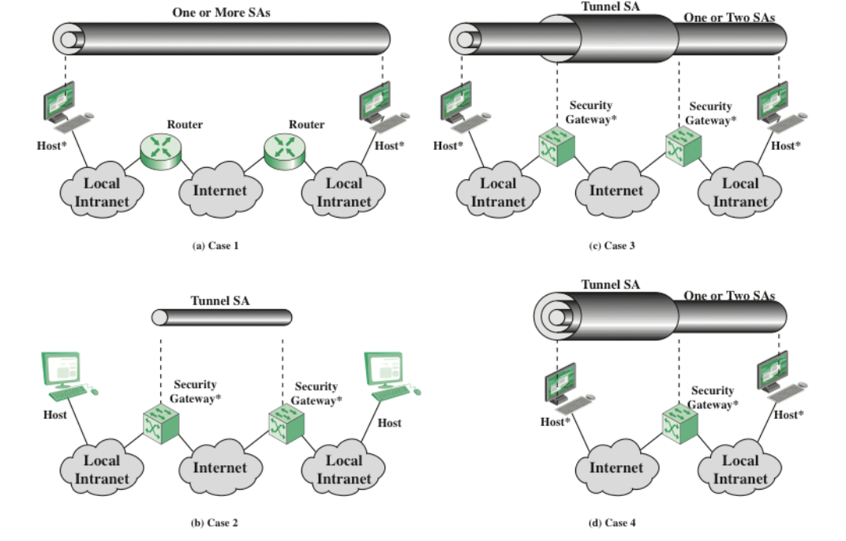
Basic combination of Security Associations

Slide 29
Internet Key Exchange
The key management portion of IPSec involves the determination and distribution of secret keys.
A typical requirement is four keys for communication between two applications: transmit and receive pairs for both integrity and confidentiality.
2 types of key management:
Manual: a systema admin manually configures each system with its own keys and with the keys of other communicating systems.
Automated: an automated system enables on demand creation of keys for Sas and facilitates the use of keys in a large distributed system with an evolving configuration.
The default automated key management protocol for IPSec is referred to as ISAKMP/Oakley and consists of the following elements:
Oakley Key Determination Protocol: Oakley is a key exchange protocol based on Diffie-Hellman algorithm but providing added security. Oakley is generic in that it does not dictate specific formats.
Internet Security Association and Key Management Protocol (ISAKMP): provides a framework for Internet key management and provides the specific protocol support, including formats, for negotiation of security attributes.

Slide 30
ISAKMP enables the use of a variety of key exchange algorithms.
I IKEv2: the terms Oakley and ISAKMP are no loger used and there are significant differences from the use of Oakley and ISAKMP in IKEv1
5 important features of IKE key determination algorithm:
It employs a mechanism known as cookies to thwart clogging attacks
It enables the two parties to negotiate a group
It uses nonces to ensure against replay attacks
It enables the exchange of Diffie-Hellman public keys values
It authenticates the Diffie-Hellman exchange to thwart man-in-the-middel attacks.

Slide 31
IKE mandates that cookie generation satisfy three basic requirements:
The cookie must depend on the specific parties
It must not be possible for anyone other than the issuing entity to generate cookies that will be accepted by that entity.
The cookie generation and verification methods must be fast to thwart attacks intended to sabotage processor resources.
The recommended method for creating the cookie is to perform a fast hash over the IP source and Destination addresses, the UDP Source and Destination ports and a locally generated secret value.
IKE key determination supports the use of different groups for the Diffie-Hellman key exchange. Each group includes the definition of the 2 global parameters and the identity of the algorithm.

Slide 32
Nonces are locally generated pseudorandom numbers. Appears in responses and are encrypted during certain portions of the exchange to secure their use.
3 authentication methods can be used sith IKE key determination:
Digital signatures: the exchange is authenticated by signing a mutually obtainable hash: each party encrypts the hash with its private key. The hash is generated over important parameters, such as user Ids and nonces.
Public key encryption: the exchange is authenticated by encrypting parameters such as Ids and nonces with the sender’s private key
Symmetric-key encryption: a key derived by some outof band mechnaism can be used to authenticate the exchange by symmetric encryption of exchange parameters.

Slide 33
IKEv2 Exchange
The IKev2protocol involves the exchange of messages in pairs.
The first 2 pairs of exchanges are referred to as the initial exchanges.
In the first exchange the 2 peers exchange information concerning cryptographic algorithms and other security parameters they are willing to use along with nonces and Dhvalues.
The result is to set up a special SA called the IKE SA.
The SA defines the parameters for a secure channel between the peers over which subsequent message exchanges take place.
Thus, all subsequent IKE message exchanges are protected by encryption and message authentication.
In the second exchange the 2 parties authenticate one other and set up a first IPSec SA to be placesd in the SADB and used for protecting ordinary communications between the peers.

