Slide 1
Authentication

Slide 2
Authentication Basics
Definition 11–1. Authentication is the binding of an identity to a subject.
What the entity knows (such as passwords or secret information)
What the entity has (such as a badge or card)
What the entity is (such as fingerprints or retinal characteristics)
Where the entity is (such as in front of a particular terminal)
Authentication system:
The set A of authentication information is the set of specific information with which entities prove their identities.
The set C of complementary information is the set of information that the system stores and uses to validate the authentication information.
The set F of complementation functions that generate the complementary information from the authentication information. That is, for f ∈ F, f: A → C.
The set L of authentication functions that verify identity. That is, for l ∈ L, l: A × C→{ true, false }.
The set S of selection functions that enable an entity to create or alter the authentication and complementary information.

Slide 3
Passwords
Definition 11–2. A password is information associated with an entity that confirms the entity’s identity
the password space is the set of all sequences of characters that can be passwords.
The goal is to find an a ∈ A such that, for f ∈ F, f(a) = c ∈ C and c is associated with a particular entity (or any entity). Because one can determine whether a is associated with an entity only by computing f(a) or by authenticating via l(a), we have two approaches for protecting the passwords, used simultaneously:
Hide enough information so that one of a, c, or f cannot be found.
Prevent access to the authentication functions L.

Slide 4
Attacking Passwords System
Definition 11–3. A dictionary attack is the guessing of a password by repeated trial and error.
dictionary attack type 1
If the complementary information and complementation functions are available,
the dictionary attack takes each guess g and computes f(g) for each f ∈ F. If f(g) corresponds to the complementary information for entity E,
then g authenticates E under f.
dictionary attack type 2
If either the complementary information or the complementation functions are unavailable,
the authentication functions l ∈ L may be used.
If the guess g results in l returning true, g is the correct password. This

Slide 5
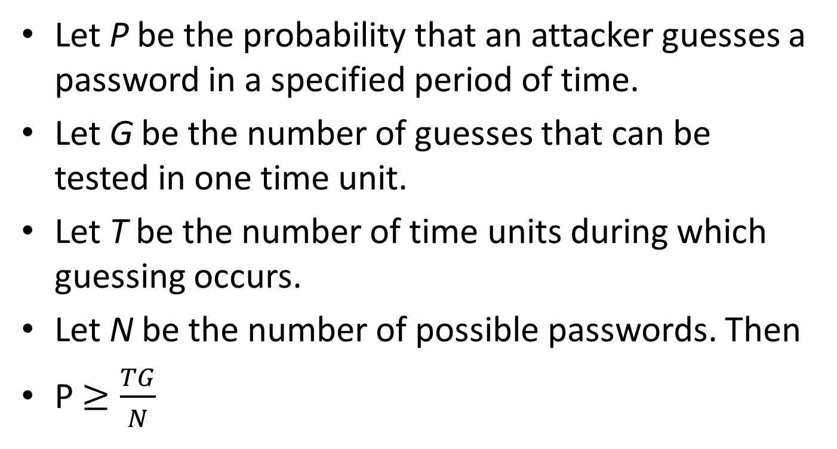
Countering Password Guessing
Let P be the probability that an attacker guesses a password in a specified period of time.
Let G be the number of guesses that can be tested in one time unit.
Let T be the number of time units during which guessing occurs.
Let N be the number of possible passwords. Then
P $≥\frac{TG}{N}$

Slide 6
Random Selection of Passwords
Theorem 11–1. Let the expected time required to guess a password be T. Then T is a maximum when the selection of any of a set of possible passwords is equiprobable.
In practice:
Short passwords -> remove passwords from P->P is searchable
If the period of the password generator is too small, the size of P allows every potential password to be tested.
Human factors
Let X be the set of all strings over some alphabet. A site chooses some simple transformation algorithm t: X → A. Elements of X are distributed on pieces of paper.
Before being used as passwords, they must be transformed by applying t. Typically, t is very simple; it must be memorized, and it must be changed periodically.
(Michele Crabb)

Slide 7
Pronounceable and Other Computer-Generated Passwords
Pronounceable passwords are based on the unit of sound called a phoneme
The advantage of pronounceable passwords is that fewer phonemes need to be used to reach some limit
the number of pronounceable passwords of length n is considerably lower than the number of random passwords of length n.
Definition 11–4. Let n and k be two integers, with n ≥ k. Key crunching is the hashing of a string of length n or less to another string of length k or less.

Slide 8
User Selection Passwords…
Rather than selecting passwords for users, one can constrain what passwords users are allowed to select (proactive passwords selection)
The set of passwords that are easy to guess is derived from experience coupled with specific site information and prior studies
Passwords easy to remember:
Passwords based on account names
Passwords based on user names
Passwords based on computer names
Dictionary words
Reversed dictionary words
Dictionary words with some or all letters capitalized […]

Slide 9
…User Selection Passwords
Definition 11–5. A proactive password checker is software that enforces specific restrictions on the selection of new passwords.
Criteria
Must be invoked
Able to reject password in a set of easily guessed passwords
Discriminate on a per-user basis
Discriminate on a per-site basis
Should have a pttern-matching facility
Should be able to execute subprograms and accept or reject passwords based on the results
Tests should be easy to set up

Slide 10
Reusable Passwords and Dictionary Attacks
eusable passwords are quite susceptible to dictionary attacks of type 1.
Salting -> to determine if the string s is the password for any of a set of n users, the attacker must perform n complementations, each of which generates a different complement.
Thus, salting increases the work by the order of the number of users.

Slide 11
Guessing Through Authentication Functions
Unlike a type 1 dictionary attack, this attack cannot be prevented, because the authentication functions must be available to enable legitimate users to access the system.
Backoff techniques
Disconnection
Disabling
jailing

Slide 12
Password Aging
Definition 11–6. Password aging is the requirement that a password be changed after some period of time has passed or after some event has occurred.

Slide 13
Challenge response
Definition 11–7. Let user U desire to authenticate himself to system S. Let U and S have an agreed-on secret function f. A challenge-response authentication system is one in which S sends a random message m (the challenge) to U, and U replies with the transformation r = f(m) (the response). S validates r by computing it separately.

Slide 14
Pass Algorithms
Definition 11–8. Let there be a challenge-response authentication system in which the function f is the secret. Then f is called a pass algorithm.
Under this definition, no cryptographic keys or other secret information may be input to f. The algorithm computing f is itself the secret.

Slide 15
One time password
Definition 11–9. A one-time password is a password that is invalidated as soon as it is used.
Is a challenge reponse password
Problems:
Generation of ransom passwords
synchronization

Slide 16
Hardware-Supported Challenge-Response Procedures
A program for a general purpose computer
a token, provides mechanisms for hashing or enciphering information
A special purpose hardware support
temporally based. Every 60 seconds, it displays a different number. The numbers range from 0 to 10n – 1, inclusive.

Slide 17
Challenge-Response and Dictionary Attacks
Whether or not a challenge-response technique is vulnerable to a dictionary attack of type 1 depends on the nature of the challenge and the response.
In general, if the attacker knows the challenge and the response, a dictionary attack proceeds as for a reusable password system
Bellovin and Merritt [73] propose a technique, called encrypted key exchange, that defeats dictionary attacks of type 1

Slide 18
encrypted key exchange
Alice uses the shared password s to encipher a randomly selected public key p for a public key system. Alice then forwards this key, along with her name, to Bob.
Bob determines the public key using the shared password, generates a random secret key k, enciphers it with p, enciphers the result with s, and sends it to Alice.
Alice deciphers the message to get k. Now both Bob and Alice share a randomly generated secret key. At this point, the challenge-response phase of the protocol begins.
Alice generates a random challenge RA, enciphers it using k, and sends Ek(RA) to Bob.
Bob uses k to decipher RA. He then generates a random challenge RB and enciphers both with k to produce Ek(RARB). He sends this to Alice.
Alice deciphers the message, validates RA, and determines RB. She enciphers it using k and sends the message Ek(RB) back to Bob.
Bob deciphers the message and verifies RB.

Slide 19
Biometrics
Biometrics is the automated measurement of biological or behavioral features that identify a person

Slide 20
Biometrics
Fingerprints
Fingerprints can be scanned optically, but the cameras needed are bulky
determining matches becomes a problem of graph matching
Voices
Statistical testing-> training
Verbal information
Eyes
Patterns in iris
Retina scans are intrusive

Slide 21
Biometrics
Faces
Locate
Noise impact
Select only some face features
Keystrokes
signature based on keystroke intervals, keystroke pressure, keystroke duration, and where the key is struck
Keystroke recognition can be both static and dynamic
Combinations

