Slide 1
Basic Cryptogrphy

Slide 2
Basics
Cryptography= secret writing
Definition 8–1. A cryptosystem is a 5-tuple (E, D, M, K, C), where M is the set of plaintexts, K the set of keys, C is the set of ciphertexts, E: M × K → C is the set of enciphering functions, and D: C × K → M is the set of deciphering functions.
Attacks:
Ciphertext only
Known plaintext
Chosen plaintext

Slide 3
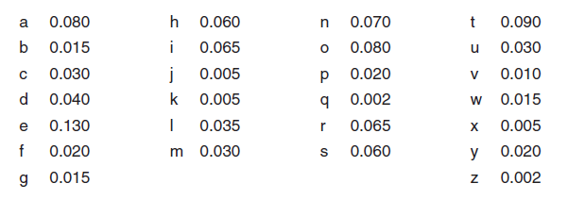
Classical Cryptosystems
Classical cryptosystems (also called single-key or symmetric cryptosystems) are cryptosystems that use the same key for encipherment and decipherment.
for all E_{k} ∈ C and k ∈ K, there is a D_{k} ∈ D such that D_{k} = E_{k}^{–1}.
character frequencies in the English language
Notes:
The Caesar cipher discussed earlier had a key of 3, so the enciphering
function was E3. To decipher “KHOOR,” we used the same key in the decipherment
function D3. Hence, the Caesar cipher is a classical cipher.

Slide 4
Transposition Ciphers
A transposition cipher rearranges the characters in the plaintext to form the ciphertext
HELLO, WORLD -> HLOOLELWRD
Anagramming -> uses tables of n-gram frequencies to identify common n-grams.
HLOOLELWRD
HE -> f = 0.0305 in English (Konheim’s digram table)
HO -> f = 0.0043
“HL,” “HW,” “HR,” and “HD” -> f < 0.0010
WH -> f = 0.0026
“EH,” “LH,” “OH,” “RH,” and “DH” -> f < 0.0002
Thus:
E follows H -> HE LL OW OR LD
Notes:
Because the permutation does not alter the frequency of plaintext characters, a transposition
cipher can be detected by comparing character frequencies with a model of
the language. If, for example, character frequencies for 1-grams match those of a
model of English, but 2-gram frequencies do not match the model, then the text is
probably a transposition cipher.
The cryptanalyst arranges the letters in such a way that the characters in the ciphertext form some n-grams with highest frequency.
This process is repeated, using different n-grams, until the transposition pattern is found.

Slide 5
Substitution Ciphers
A substitution cipher changes characters in the plaintext to produce the ciphertext
A Caesar cipher is susceptible to a statistical ciphertext-only attack.
KHOOR ZRUOG
G 0.1 H 0.1 K 0.1 O 0.3 R 0.2 U 0.1 Z 0.1
Trying the most likely key first, we obtain as plaintext “EBIIL TLOIA” when i = 6, “AXEEH PHKEW” when i = 10, “HELLO WORLD” when i = 3, and “WTAAD LDGAS” when i = 14.

Slide 6

Vigenère Cipher
Notes:
A longer key might obscure the statistics. The Vigenère cipher chooses a sequence of
keys, represented by a string. The key letters are applied to successive plaintext

Slide 7

Vigenère Cipher
The length of the key is called the period of the cipher.
Because this requires several different key letters, this type of cipher is called polyalphabetic
The index of coincidence measures the differences in the frequencies of the letters in the ciphertext
The number of characters between the repetitions is a multiple of the period.
Notes:
The lower the index of coincidence, the
less variation in the characters of the ciphertext and (from our model of English) the
longer the period of the cipher.

Slide 8

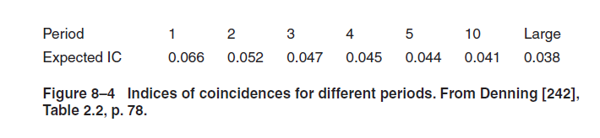
Vigenère Cipher
the string OPK appears twice
The ciphertext repetitions are nine characters apart. Hence, 9 is a multiple of the period (which is 3 here)

Slide 9
One-Time Pad
a variant of the Vigenère cipher
The key string is chosen at random, and is at least as long as the message
it is a threshold scheme [815], and is provably impossible to break [115]

Slide 10
Data Encryption Standard
The Data Encryption Standard (DES) [662] was designed to encipher sensitive but nonclassified data
It is bit oriented
Uses both transposition and substitution -> product chipher
Its input, output, and key are each 64 bits long. The sets of 64 bits are referred to as blocks
The cipher consists of 16 rounds, or iterations. Each round uses a separate key of 48 bits.
These round keys are generated from the key block by dropping the parity
bits (reducing the effective key size to 56 bits), permuting the bits, and extracting 48 bits.
A different set of 48 bits is extracted for each of the 16 rounds . If the order in which the round keys is used is reversed, the input is deciphered.

Slide 11
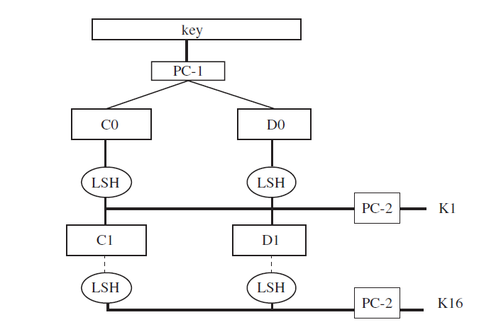
Notes:
The rounds are executed sequentially, the input of one round being the output
of the previous round. The right half of the input, and the round key, are run through
a function f that produces 32 bits of output; that output is then xor’ed into the left
half, and the resulting left and right halves are swapped (see Figure 8–6).
The function f provides the strength of the DES. The right half of the input (32
bits) is expanded to 48 bits, and this is xor’ed with the round key. The resulting 48
bits are split into eight sets of six bits each, and each set is put through a substitution table called the S-box. Each S-box produces four bits of output. They are catenated
into a single 32-bit quantity, which is permuted. The resulting 32 bits constitute the
output of the f function (see Figure 8–7).

Slide 12
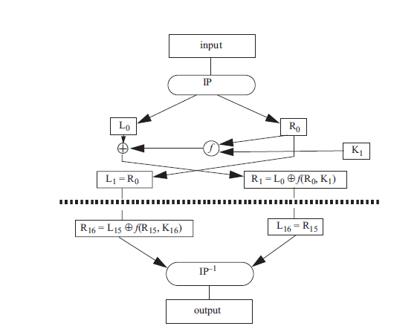
DES message encipherment and decipherment
Notes:
When the DES was first announced, it was criticized as too weak. First, Diffie
and Hellman [268] argued that a key length of 56 bits was simply too short, and they
designed a machine that could break a DES-enciphered message in a matter of days.
Although their machine was beyond the technology of the time, they estimated that it
could soon be built for about $20,000,000. Second, the reasons for many of the decisions
in the design of the DES—most notably, those involving the S-boxes—were
classified. Many speculated that the classification hid “trapdoors,” or ways to invert
the cipher without knowing the key.

Slide 13
Properties of DES
4 weak keys -> keys that were their own inverses
12 semiweak keys -> keys whose inverses were other keys
let k, m, and c be the complement of the key k, the plaintext m, and the ciphertext c, respectively.
Let DES_{k}(m) be the encipherment of plaintext m under key k. Then the complementation property states that
DES_{k}(m) = c ⇒ DES_{k}(m) = c
some of the S-boxes exhibited irregular properties.
The distribution of odd and even numbers was nonrandom, raising concerns that the DES did not randomize the input sufficiently
Several output bits of the fourth S-box seemed to depend on some of the output bits of the third S-box.

Slide 14
Differential cryptanalysis
generate 247 pairs of chosen plaintext and ciphertext
for a known plaintext attack, differential cryptanalysis requires 256 plaintext and ciphertext pairs for a 15-round version of the DES. For the full 16 rounds, 258 known plaintext and ciphertext pairs are needed
small changes in the S-boxes weakened the cipher
making every bit of the round keys independent did not make the DES resistant to differential
cryptanalysis, which suggests that the designers of the DES knew about differential analysis

Slide 15
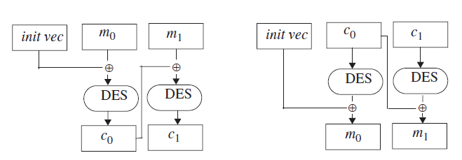
Use of DES
electronic code book (ECB) mode
to generate a pseudoonetime pad are cipher feed back (CFB) mode
output feed back (OFB) mode
Its most common modes of use are cipher block
chaining (CBC) mode, encrypt-decrypt-encrypt (EDE) mode, and triple DES mode.

Slide 16
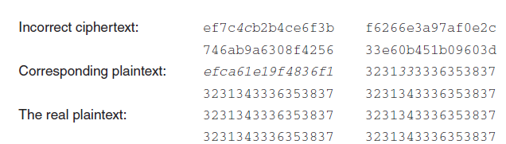
self-healing property
This property says that if one block of ciphertext is altered, the error propagates for at most two blocks.

Slide 17
The EDE mode is used by many financial institutions. It requires two
64-bit keys k and k´. The ciphertext c corresponding to some data m is c = DESk
(DESk´
–1(DESk(m))). Triple DES uses three keys k, k´, and k´´, and the second step is
an encipherment, not a decipherment: c = DESk(DESk´(DESk´´(m))).
In 1998, a design for a computer system and software that could break any
DES-enciphered message in a few days was published
Those challenges had
been solved using computers distributed throughout the Internet.
In late 2001, the National Institute of Standards and Technology announced
the selection of Rijndael as the Advanced Encryption Standard [672], the successor
to the DES. Like the DES, the AES is a product cipher.
Notes:
By 1999, it was
clear that the DES no longer provided the same level of security as it had 10 years
earlier, and the search was on for a new, stronger cipher (to be called the Advanced
Encryption Standard, or AES) to fill the needs that the DES no longer filled.
The DES is one of the most important classical cryptosystems in the history of
cryptography. It provided the impetus for many advances in the field and laid the theoretical
and practical groundwork for many other ciphers. While analyzing it,
researchers developed differential and linear cryptanalysis. Cryptographers developed
other ciphers to avoid real, or perceived, weaknesses; cryptanalysts broke many
of these ciphers and found weaknesses in others. Many of the features of the DES are
used in other ciphers. Hence, even though it is nearing the end of its useful lifetime,
it is well worth understanding.
Unlike the DES, the AES can
use keys of 128, 192, or 256 bits and operates on blocks of 128 bits. It was specifically
designed to withstand the attacks to which the DES showed weaknesses [228].
Time will show how rapidly it supplants the DES, but the lessons learned from the
DES have borne fruit.

Slide 18
Public key cryptography
Diffie and Hellman, 1976 : One of the keys would be publicly known; the other would be kept private by its owner to send a secret message simply encipher the message with the recipient’s public key.
The recipient can decipher it using his private key.
A public key cryptosystem must meet the following three conditions.
It must be computationally easy to encipher or decipher a message given the appropriate key.
It must be computationally infeasible to derive the private key from the public key.
It must be computationally infeasible to determine the private key from a chosen plaintext attack.
The RSA cipher provides both secrecy and authentication.

Slide 19
RSA…
RSA is an exponentiation cipher. Choose two large prime numbers p and q, and let n = pq. The totient φ(n) of n is the number of numbers less than n with no factors in common with n
φ(10) = 4
Choose an integer e < n that is relatively prime to φ(n). Find a second integer d such that ed mod φ(n) = 1.
The public key is (e, n), and the private key is d.
Let m be a message. Then:
c = m^{e} mod n
and
m = c^{d} mod n
In addition to confidentiality, RSA can provide data and origin authentication.

Slide 20
…RSA
The use of a public key system provides a technical type of nonrepudiation of origin.
The underlying assumption is that Alice’s private key has not been compromised
The issue is that, even if n is very large, if one character per block is enciphered, RSA can be broken using the techniques used to break classical substitution ciphers

Slide 21
Cryptographic Checksums
Alice wants to send Bob a message of n bits
She wants Bob to be able to verify that the message he receives is the same one that was sent
she applies a mathematical function, called a checksum function, to generate a smaller set of k bits from the original n bits -> checksum / message digest
When Bob gets the message, he recomputes the checksum and compares it with the one Alice sent

Slide 22
Definition 8–2. A cryptographic checksum function (also called a strong hash function or a strong one-way function) h: A → B is a function that has the following properties.
For any x ∈ A, h(x) is easy to compute.
For any y ∈ B, it is computationally infeasible to find x ∈ A such that h(x) = y.
It is computationally infeasible to find x, x´ ∈ A, such that x ≠ x´ and h(x) = h(x´). (Such a pair is called a collision.)
The third requirement is often stated as:
Given any x ∈ A, it is computationally infeasible to find another x´ ∈ A such that x ≠ x´ and h(x´ ) = h(x).
Notes:
However, properties 3 and 4 are subtlely different. It is considerably harder to find an
x´ meeting the conditions in property 4 than it is to find a pair x and x´ meeting the
conditions in property 3. To explain why, we need to examine some basics of cryptographic
checksum functions.
Given that the checksum contains fewer bits than the message, several messages
must produce the same checksum. The best checksum functions have the same
number of messages produce each checksum. Furthermore, given any message, the
checksum it produces can be determined only by computing the checksum. Such a
checksum function acts as a random function

Slide 23
pigeonhole principle
Definition 8–3. The pigeonhole principle states that if there are n containers for n + 1 objects, at least one container will hold two objects. To understand its application here, consider a cryptographic checksum function that computes hashes of three bits and a set of files each of which contains five bits. This yields 2³ = 8 possible hashes for 2⁵ = 32 files. Hence, at least four different files correspond to the same hash.
Now assume that a cryptographic checksum function computes hashes of 128 bits. The probability of finding a message corresponding to a given hash is 2^{–128}, but the probability of finding two messages with the same hash (that is, with the value of neither message being constrained) is 2^{–64}

Slide 24
Keyed cryptographic
Definition 8–4. A keyed cryptographic checksum function requires a cryptographic key as part of the computation. A keyless cryptographic checksum does not.
MD2
MD4
MD5
SHA-1
HAVAL
Snefru
Vulnerable to differential cryptoanalysis

Slide 25
HMAC
an algorithm that uses a keyless hash function and a cryptographic key to produce a keyed hash function
Let h be a keyless hash function that hashes data in blocks of b bytes to produce a hash l bytes long. Let k be a cryptographic key. We assume that the length of k is no greater than b; if it is, use h to hash it to produce a new key of length b. Let k´ be the key k padded with bytes containing 0 to make b bytes. Let ipad be a sequence of bytes containing the bits 00110110 and repeated b times; let opad be a similar sequence with the bits 01011100. The HMAC-h function with key k for message m is
HMAC-h(k, m) = h(k´ ⊕ opad || h(k´ ⊕ ipad || m))
Bellare, Canetti, and Krawczyk [65] analyze the security of HMAC and conclude that the strength of HMAC depends on the strength of the hash function h. Various HMAC functions are used in Internet security protocols
Notes:
This mechanism enables
Alice to validate that data Bob sent to her is unchanged in transit. Without the key,
anyone could change the data and recompute the message authentication code, and
Alice would be none the wiser.
The need for HMAC arose because keyed hash functions are derived from
cryptographic algorithms. Many countries restrict the import and export of software
that implements such algorithms. They do not restrict software implementing keyless
hash functions, because such functions cannot be used to conceal information.
Hence, HMAC builds on a keyless hash function using a cryptographic key to create
a keyed hash function.
where ⊕ is exclusive or and || is concatenation

Slide 26
Key Management

Slide 27
The statement
X → Y : { Z } k
means that entity X sends entity Y a message Z enciphered with key k
k_{Alice} and k_{Bob} refer to keys belonging to Alice and Bob
If Alice and Bob share a key, that key will be written as k_{Alice},_{Bob} when the sharers are not immediately clear from the context.
In general, k represents a secret key (for a classical cryptosystem), e a public key, and d a private key (for a public key cryptosystem)
a || b means that the bit sequences a and b are concatenated.

Slide 28
Session and Interchange Keys
Definition 9–1. An interchange key is a cryptographic key associated with a principal to a communication. A session key is a cryptographic key associated with the communication itself.
Session keys also prevent forward searches
An interchange key is associated with a principal
Notes:
This distinction reflects the difference between a communication and a user
involved in that communication. Alice has a cryptographic key used specifically to
exchange information with Bob. This key does not change over interactions with
Bob. However, if Alice communicates twice with Bob (and “communication” can be
with, for example, an e-mail or a Web browser), she does not want to use the same
key to encipher the messages. This limits the amount of data enciphered by a single
key and reduces the likelihood of an eavesdropper being able to break the cipher. It
also hinders the effectiveness of replay attacks. Instead, she will generate a key for
that single session. That key enciphers the data only; it does not authenticate either
principal, and it is discarded when the session ends. Hence, the name “session key.”
forward search attack
occurs when the set of plaintext messages is small. The adversary enciphers all plaintexts
using the target’s public key. When ciphertext is intercepted, it is compared
with the precomputed texts. This quickly gives the corresponding plaintext. A randomly
generated session key, used once, would prevent this attack

Slide 29
Key Exchange
The goal of key exchange is to enable Alice to communicate secretly to Bob, and vice versa, using a shared cryptographic key.
Criteria:
The key that Alice and Bob are to share cannot be transmitted in the clear
Alice and Bob may decide to trust a third party (called “Cathy” here).
The cryptosystems and protocols are publicly known. The only secret data is to be the cryptographic keys

Slide 30
Classical Cryptographic Key Exchange and Authentication
Suppose Alice and Bob wish to communicate -> share a common key -> classical cryptosystem -> eavesdropping
rely on a trusted third party, Cathy
Alice → Cathy: {request for session key to Bob }k_{Alice}
Cathy → Alice: { k_{session} }k_{Alice} || { k_{session} }k_{Bob}
Alice → Bob: { k_{session} }k_{Bob}
However, Bob does not know to whom he is talking
Notes:
Assume that Alice sends Bob a
message (such as “Deposit $500 in Dan’s bank account today”) enciphered under
ksession. If Eve records the second message in the exchange above, and the message
enciphered under ksession, she can send Bob the message { ksession }kBob followed by
the message enciphered under ksession. Bob will not know who is sending it.

Slide 31
Avoiding replay attacks
Needham-Schroeder
1. Alice → Cathy : { Alice || Bob || rand₁ }
2. Cathy → Alice : { Alice || Bob || rand₁ || k_{session} || {Alice || k_{session}} k_{Bob} } k_{Alice}
3. Alice → Bob : { Alice || k_{session} } k_{Bob}
4. Bob → Alice : { rand₂ } k_{session}
5. Alice → Bob : { rand₂ – 1 }_{ksession}
Nonces: rand1 and rand2 are two numbers generated at random
session keys will be generated pseudorandomly -> possible to predict
Notes:
The basis for the security of this protocol is that both
Alice and Bob trust Cathy.
The Needham-Schroeder protocol assumes that all cryptographic keys are
secure.

Slide 32
1. Eve → Bob : { Alice || ksession } kBob
2. Bob → Alice : { rand3 } ksession [intercepted by Eve]
3. Eve → Bob : { rand3 – 1 }ksession
Now Bob thinks he is talking to Alice. He is really talking to Eve.
Denning and Sacco suggest using timestamps to enable Bob to detect this
replay. Applying their method to the Needham-Schroeder protocol yields
1. Alice → Cathy : { Alice || Bob || rand1 }
2. Cathy → Alice : { Alice || Bob || rand1 || ksession ||
{Alice || T || ksession} kBob } kAlice
3. Alice → Bob : { Alice || T || ksession } kBob
4. Bob → Alice : { rand2 } ksession
5. Alice → Bob : { rand2 – 1 }ksession
where T is a timestamp

Slide 33
Otway-Rees protocol
The Otway-Rees protocol [706] corrects these problems by avoiding the use of timestamps.
1. Alice → Bob : num || Alice || Bob || { rand1 || num || Alice || Bob }k_{Alice}
2. Bob → Cathy : num || Alice || Bob, || { rand1 || num || Alice || Bob }k_{Alice} ||
{rand2 || num || Alice || Bob }k_{Bob}
3. Cathy → Bob : num || { rand1 || k_{session} }k_{Alice} || { rand2 || k_{session} } k_{Bob}
4. Bob → Alice : num || { rand1 || k_{session} }k_{Alice}
Notes:
This modification
requires synchronized clocks. Denning and Sacco note that a principal with a
slow clock is vulnerable to a replay attack. Gong [368] adds that a party with a fast
clock is also vulnerable, and simply resetting the clock does not eliminate the vulnerability.

Slide 34
Kerberos
Kerberos [526, 872] uses the Needham-Schroeder protocol as modified by Denning and Sacco
The basis of Kerberos is a credential known as the ticket. It contains
T_{Alice,Barnum} = Barnum || {Alice || Alice address || valid time || k_{Alice,Barnum}}k_{Barnum}
The authenticator contains the identity of the sender of a ticket and is used when Alice wants to show Barnum that the party sending the ticket is the same as the party to whom the ticket was issued.
A_{Alice,Barnum} = {Alice || generation time || kt}k_{Alice,Barnum}

Slide 35
Cerberus/ticket granting server
Alice → Cerberus: Alice || Barnum
Cerberus → Alice : { k_{Alice,Barnum}} k_{Alice} || T_{Alice,Barnumù}
Kerberos uses the user’s password as key
Alice → Barnum : Guttenberg || A_{Alice,Barnum} || T_{Alice,Barnum}
4. Barnum → Alice : Alice || {k_{Alice,Guttenberg}} k_{Alice,Barnum} || T_{Alice,Guttenberg}
5. Alice → Guttenberg : A_{Alice,Guttenberg} || T_{Alice,Guttenberg}
6. Guttenberg → Alice : { t + 1} k_{Alice,Guttenberg}
Problems:
Kerberos relies on clocks being synchronized
A dictionary attack can be used to determine shared keys
Notes:
Alice deciphers the first part of the message to obtain the key she will
use to communicate with Barnum
once Alice has the ticket for the ticket-granting
server Barnum
Alice first constructs an authenticator and sends it, with the ticket and
the name of the server, to Barnum. Barnum validates the request by comparing the
data in the authenticator with the data in the ticket. Because the ticket is enciphered
using the key Barnum shares with Cerberus, he knows that it came from a trusted
source. He then generates an appropriate session key and sends Alice a ticket to pass
on to Guttenberg. Step 5 repeats step 3, except that the name of the service is not
given (because Guttenberg is the desired service). Step 6 is optional; Alice may ask
that Guttenberg send it to confirm the request. If it is sent, t is the timestamp.

Slide 36
Public Key Cryptographic Key Exchange and Authentication
PK cryptography:
Alice → Bob : { k_{session} } e_{Bob}
Eve can forge such a message. Bob does not know who the message comes from -> sign the session key
Alice → Bob : Alice, { { k_{session} } d_{Alice} } e_{Bob}
Peter is a server of public key and so Eve…
Alice → Peter : { send me Bob’s public key } [ intercepted by Eve ]
Eve → Peter : { send me Bob’s public key }
Peter → Eve : e_{Bob}
Eve → Alice : e_{Eve}
Alice → Bob : { k_{session} } e_{Eve} [ intercepted by Eve ]
Eve → Bob : { k_{session} } e_{Bob}
MAN IN THE MIDDLE

Slide 37
Cryptographic Key Infrastructures
Classical cryptosystem -> shared keys -> no bind identity to a key
we assume that
the principal is identified by a name of some acceptable sort and
has been authenticated to the entity that generates the cryptographic keys.
The question is: how some (possibly different) principal can bind the public key to the representation of identity
Definition 9–2. A certificate is a token that binds an identity to a cryptographic key.
C_{Alice} = { e_{Alice} || Alice || T } d_{Cathy}
IMMEDIATE PROBLEM: Bob must know Cathy’s public key to validate the certificate.
Notes:
An obvious idea is for the originator to sign the public key with her private
key, but this merely pushes the problem to another level, because the recipient would
only know that whoever generated the public key also signed it.
When Bob wants to communicate with Alice, he obtain’s Alice’s certificate
CAlice. Assuming that he knows Cathy’s public key, he can decipher the certificate.
He first checks the timestamp T to see when the certificate was issued. (From this, he
can determine if the certificate is too old to be trusted; see below.) He looks at the
subject entity (Alice, to whom the certificate was issued). The public key in the certificate
belongs to that subject, so Bob now has Alice’s public key. He knows that
Cathy signed the certificate and therefore that Cathy is vouching to some degree that
the public key belongs to Alice. If he trusts Cathy to make such a determination, he
accepts the public key as valid and belonging to Alice.

Slide 38
Certificate signature Chains
the issuer enciphers:
a hash of the identity of the subject (to whom the certificate is issued),
the public key, and
information such as time of issue or expiration
using the issuer’s private key
To validate the certificate, a user uses the issuer’s public key to decipher the hash and check the data in the certificate
The user trying to validate the certificate must obtain the issuer’s public key
PROBLEM: HOW CAN THE ISSUER’S CERTIFICATE BE VALIDATED?
Tree-like hierarchy
Allow arbitrary arrangement of certifiers

Slide 39
X.509: Certification Signature Chains
Version
Serial number
the pair (issuer’s Distinguished Name, serial number) must be unique.
Signature algorithm identifier
Issuer’s Distinguished Name
Validity interval
Subject’s Distinguished Name
Subject’s public key information
Issuer’s unique identifier
Subject’s unique identifier
Extensions
Signature
Notes:
is the basis for many other protocols.
It defines certificate formats and certification validation in a generic context.
Soon after its original issue in 1988, I’Anson and Mitchell [454] found problems with
both the protocols and the certificate structure. These problems were corrected in the
1993 version, referred to as X.509v3.

Slide 40
Certification Authority
Definition 9–3. A certification authority (CA) is an entity that issues certificates.
If all certificates have a common issuer, then the issuer’s public key can be distributed out of band (infeasible).
Definition 9–4. Two CAs are cross-certified if each has issued a certificate for the other.
Alice forms the signature chain: Cathy<<Dan>> Dan<<Bob>>
Bob validate Alice’s certificate: Dan<<Cathy>> Cathy<<Alice>>
Signature chains can be of arbitrary length. The only requirement is that each certificate can be validated by the one before it in the chain
Certificates can be revoked, or canceled
Notes:
To validate the certificate, the user obtains the issuer’s public key for the particular
signature algorithm (field 3) and deciphers the signature (field 11). She then uses the
information in the signature field (field 11) to recompute the hash value from the
other fields. If it matches the deciphered signature, the signature is valid if the
issuer’s public key is correct. The user then checks the period of validity (field 5) to
ensure that the certificate is current.

Slide 41
PGP Certificate Signature Chains
It uses a certificate-based key management infrastructure for users’ public keys.
An OpenPGP certificate is composed of packets
Version
Time
Validity period
Public key algorithm and parameters
Public key
Version 3:
Version
Signature type
Creation time
Key identifier of the signer
Public key algorithm
Hash algorithm
Part of signed hash value
Signature

Slide 42
PGP certificates and X.509
a single key may have multiple signatures
a notion of “trust” is embedded in each signature, and the signatures for a single key may have different levels of trust.
The users of the certificates can determine the level of trust for each signature and act accordingly.
Henry<<Henry>> Henry<<Giselle>> Giselle<<Bob>>
and
Jack<<Ellen>> Ellen<<Bob>>
A subtle distinction arises here between X.509 and PGP certificates. X.509 certificates include an element of trust, but the trust is not indicated in the certificate.
PGP certificates indicate the level of trust, but the same level of trust may have different meanings to different signers.

Slide 43
Storing and Revoking Keys
STORING
Operating systems and network are not secure
Keystroking or multiusing system
Put the key onto one or more physical devices, such as a special terminal, ROM, or smart card
to encipher a message, the user inserts the smart card into a special device that can read from, and write to, the computer
if the smart card is stolen, the thief has the cryptographic key
Split it on 2 cards
REVOCATION
Probelms:
Ensure revocation is correct
Ensure timeliness of the revocation

Slide 44
Revocation
The X.509 and Internet public key infrastructures (PKIs) use lists of certificates.
Definition 9–5. A certificate revocation list is a list of certificates that are no longer valid.
A certificate revocation list contains the serial numbers of the revoked certificates and the dates on which they were revoked.
It also contains the name of the issuer, the date on which the list was issued, and when the next list is expected to be issued.
The issuer also signs the list [865]. Under X.509, only the issuer of a certificate can revoke it.
PGP allows signers of certificates to revoke their signatures as well as allowing owners of certificates, and their designees, to revoke the entire certificates.
The certificate revocation is placed into a PGP packet and is signed just like a regular PGP certificate. A special flag marks it as a revocation message.

Slide 45
Digital Signatures
Definition 9–6. A digital signature is a construct that authenticates both the origin and contents of a message in a manner that is provable to a disinterested third party.
Let m be a message. Suppose Alice and Bob share a secret key k. Alice sends Bob m || { m }k (that is, the message and its encipherment under k). Is this a digital signature?
Alice has authenticated the contents of the message
Bob has authenticated the origin and the integrity
Let d_{Alice} and e_{Alice} be Alice’s private and public keys, respectively. Alice sends Bob the message m || { m }d_{Alice}.
As before, Bob can authenticate the origin and contents of m, but in this situation a judge must determine that Alice signed the message, because only Alice knows the private key with which the message was signed. The judge merely obtains e_{Alice} and computes { { m }d_{Alice} } e_{Alice}. If the result is m, Alice signed it. This is in fact a digital signature.
Digital signature provides the service of non-repudiation

Slide 46
Classical Signatures
All classical digital signature schemes rely on a trusted third party.
Let Cathy be the trusted third party. Alice shares a cryptographic key k_{Alice}
with Cathy. Likewise, Bob shares k_{Bob} with Cathy. When Alice wants to send Bob a contract m, she computes { m }k_{Alice} and sends it to Bob.
Bob sends it to Cathy, who
deciphers m, enciphers it with k_{Bob}, and returns { m }k_{Bob} to Bob.
He can now decipher it.
To verify that Alice sent the message, the judge takes the disputed messages { m }k_{Alice} and { m }k_{Bob} and has Cathy decipher them using Alice’s and Bob’s keys.
If they match, the sending is verified; if not, one of them is a forgery.

Slide 47
Public key signatures
suppose that Alice wants to trick Bob into signing a message m. She computes two other messages m1 and m2 such that m1m2 mod nBob = m. She has Bob sign m1 and m2. Alice then multiplies the two signatures together and reduces mod nBob, and she has Bob’s signature on m. (See Exercise 6.) The defense is not to sign random documents and, when signing, never sign the document itself; sign a cryptographic hash of the document
A second problem [31] demonstrates that messages that are both enciphered and signed should be signed first, then enciphered
Notes:
We observe that using RSA to authenticate a message produces a digital signature.
However, we also observe that the strength of the system relies on the protocol
describing how RSA is used as well as on the RSA cryptosystem itself.

Slide 48
Suppose Alice is sending Bob her signature on a confidential contract m. She enciphers it first, then signs it and sends the result to Bob
Bob wants to claim that Alice sent him the contract M. Bob computes a number r such that Mr mod nBob = m.
He then republishes his public key as (reBob, nBob)
he claims that Alice sent him M. The judge verifies this using his current public key.
The simplest way to fix this is to require all users to use the same exponent but vary the moduli.

Slide 49
Cipher Techniques

Slide 50
Problems
Simmons discusses the use of a “forward search” to decipher messages enciphered for confidentiality using a public key cryptosystem
Focus on the entropy of messages
Simmons demonstrates that the size of the set of possible plaintexts may not be obvious
Using forward search on numerous set is clearly impractical, but after some analysis of the redundancy in human speech, Simmons reduces the number of potential plaintexts to about 100,000.
This number is small enough so that forward searches become a threat.
Denning [242] points out that in certain cases, parts of a ciphertext message can be deleted, replayed, or reordered.
The regularity arises because each part is enciphered separately, so the same plaintext always produces the same ciphertext.
This type of encipherment is called code book mode, because each part is effectively looked up in a list of plaintext-ciphertext pairs.

Slide 51
Stream and Block Ciphers
Definition 10–1. Let E be an encipherment algorithm, and let Ek(b) be the encipherment of message b with key k. Let a message m = b1b2 …, where each bi is of a fixed length. Then a block cipher is a cipher for which Ek(m) = Ek(b1)Ek(b2) ….
Definition 10–2. Let E be an encipherment algorithm, and let Ek(b) be the encipherment of message b with key k. Let a message m = b1b2 …, where each bi is of a fixed length, and let k = k1k2…. Then a stream cipher is a cipher for which Ek(m) = Ek1(b1)Ek2(b2) ….
Bit-oriented ciphers implement the one-time pad by exclusive-oring each bit of the key with one bit of the message. For example, if the message is 00101 and the key is 10010, the ciphertext is 0⊕1||0⊕0||1⊕0||0⊕1||1⊕0 or 10111. But how can one generate a random, infinitely long key?

Slide 52
Definition 10–3. An n-stage linear feedback shift register (LFSR) consists of an n-bit register r = r0…rn–1 and an n-bit tap sequence t = t0…tn–1. To obtain a key bit, rn–1 is used, the register is shifted one bit to the right, and the new bit r0t0⊕…⊕rn–1tn–1 is inserted.
Definition 10–4. An n-stage nonlinear feedback shift register (NLFSR) consists of an n-bit register r = r0…rn–1. To obtain a key bit, rn–1 is used, the register is shifted one bit to the right, and the new bit is set to f(r0…rn–1), where f is any function of n inputs.
NLFSRs are not common because there is no body of theory about how to build NLFSRs with long periods
A second technique for eliminating linearity is called output feedback mode.
Let E be an encipherment function. Define k as a cryptographic key, and define r as a register. To obtain a bit for the key, compute Ek(r) and put that value into the register.
The rightmost bit of the result is exclusive-or’ed with one bit of the message. The process is repeated until the message is enciphered

Slide 53
A variant of output feedback mode is called the counter method. Instead of using a register r, simply use a counter that is incremented for every encipherment.
The initial value of the counter replaces r as part of the key. This method enables one to generate the ith bit of the key without generating the bits 0…i – 1. If the initial counter value is i0, set the register to i + i0. In output feedback mode, one must generate all the preceding key bits.
Self-synchronous ciphers obtain the key from the message itself. The simplest selfsynchronous
cipher is called an autokey cipher and uses the message itself for the key.
EXAMPLE: The following is an autokey version of the Vigenère cipher, with the key
drawn from the plaintext.
key XTHEBOYHASTHEBA
plaintext THEBOYHASTHEBAG
ciphertext QALFPNFHSLALFCT
Contrast this with the example on page 103. The key there is VIG, and the resulting
ciphertext contains two three-character repetitions.

Slide 54
An alternative is to use the ciphertext as the key stream
EXAMPLE: The following is an autokey version of the Vigenère cipher, with the key
drawn from the ciphertext.
key XQXBCQOVVNGNRTT
plaintext THEBOYHASTHECAT
ciphertext QXBCQOVVNGNRTTM
This eliminates the repetition (ALF) in the preceding example.
A variant of the autokey method, cipher feedback mode, uses a shift register.
Let E be an encipherment function. Define k as a cryptographic key and r as a register. To obtain a bit for the key, compute Ek(r). The rightmost bit of the result is exclusive-or’ed with one bit of the message, and the other bits of the result are discarded. The resulting ciphertext is fed back into the leftmost bit of the register, which is right shifted one bit.
Notes:
A good cipher will
produce pseudorandom ciphertext, which approximates a random one-time pad better
than a message with nonrandom characteristics (such as a meaningful English
sentence).
This type of autokey cipher is weak, because plaintext can be deduced from
the ciphertext. For example, consider the first two characters of the ciphertext, QX.
The X is the ciphertext resulting from enciphering some letter with the key Q. Deciphering,
the unknown letter is H. Continuing in this fashion, the analyst can reconstruct
all of the plaintext except for the first letter.

Slide 55
Cipher feedback mode has a self-healing property. If a bit is corrupted in transmission
of the ciphertext, the next n bits will be deciphered incorrectly. But after n
uncorrupted bits have been received, the shift register will be reinitialized to the value
used for encipherment and the ciphertext will decipher properly from that point on.
As in the counter method, one can decipher parts of messages enciphered in
cipher feedback mode without deciphering the entire message. Let the shift register
contain n bits. The analyst obtains the previous n bits of ciphertext. This is the value
in the shift register before the bit under consideration was enciphered. The decipherment
can then continue from that bit on.

Slide 56
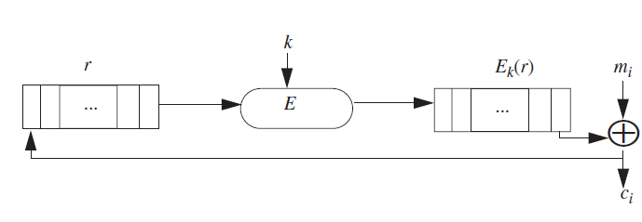
Block Ciphers
Block ciphers encipher and decipher multiple bits at once, rather than one bit at a time. For this reason, software implementations of block ciphers run faster than software implementations of stream ciphers.
Notes:
Errors in transmitting one block generally
do not affect other blocks, but as each block is enciphered independently, using the
same key, identical plaintext blocks produce identical ciphertext blocks. This allows
the analyst to search for data by determining what the encipherment of a specific

Slide 57
EXAMPLE: Consider a banking database with two records:
MEMBER: HOLLY INCOME $100,000
MEMBER: HEIDI INCOME $100,000
Suppose the encipherment of this data under a block cipher is
ABCQZRME GHQMRSIB CTXUVYSS RMGRPFQN
ABCQZRME ORMPABRZ CTXUVYSS RMGRPFQN
If an attacker determines who these records refer to, and that CTXUVYSS is the
encipherment of the INCOME keyword, he will know that Holly and Heidi have the
same income.
Notes:
To prevent this type of attack, some information related to the block’s position
is inserted into the plaintext block before it is enciphered. The information can be
bits from the preceding ciphertext block [311] or a sequence number [502]. The disadvantage
is that the effective block size is reduced, because fewer message bits are
present in a block.

Slide 58
Cipher block chaining does not require the extra information to occupy bit
spaces, so every bit in the block is part of the message. Before a plaintext block is
enciphered, that block is exclusive-or’ed with the preceding ciphertext block. In
addition to the key, this technique requires an initialization vector with which to
exclusive-or the initial plaintext block. Taking Ek to be the encipherment algorithm
with key k, and I to be the initialization vector, the cipher block chaining technique is
c0 = Ek(m0 ⊕ I)
ci = Ek(mi ⊕ ci–1) for i > 0

Slide 59
Multiple Encryption
Other approaches involve multiple encryption. Using two keys k and k´ to encipher a message as c = Ek´(Ek(m)) looks attractive because it has an effective key length of 2n, whereas the keys to E are of length n.
Tuchman [908] suggested using two keys k and k´:
c = Ek(Dk´(Ek(m)))
This mode, called Encrypt-Decrypt-Encrypt (EDE) mode, collapses to a single encipherment
when k = k´. The DES in EDE mode is widely used in the financial community
and is a standard (ANSI X9.17 and ISO 8732).
In this mode, three keys are used in a chain of encipherments.
c = Ek(Ek´(Ek´´(m)))
The best attack against this scheme is similar to the attack on double encipherment,
but requires O(22n) time and O(2n) memory. If the key length is 56 bits, this attack is
computationally infeasible.
Notes:
Merkle and Hellman [624] have
shown that this encryption technique can be broken using 2n+1 encryptions, rather
than the expected 22n (see Exercise 3).

