Slide 1
CVE

Slide 2
https://cyberthreatsummit.com/speakers.php

Slide 3
What is a CVE
Common Vulnerabilities and Exposures (CVE®) is a list of common identifiers for publicly known cyber security vulnerabilities.
Use of "CVE Identifiers (CVE IDs)," which are assigned by CVE Numbering Authorities (CNAs) from around the world,
ensures confidence among parties when used to discuss or share information about a unique software vulnerability,
provides a baseline for tool evaluation, and
enables data exchange for cyber security automation.

Slide 4
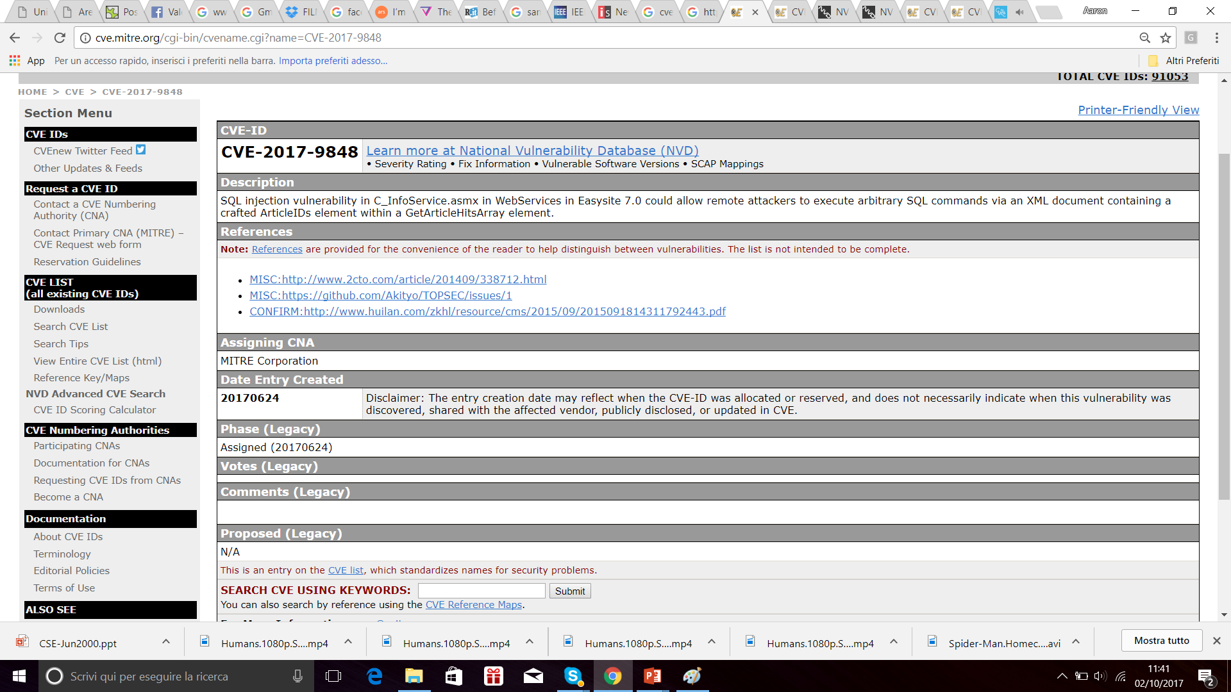

Slide 5


Slide 6
Context: The Vulnerability Life Cycle
Mailing lists, Newsgroups, Hacker sites
Start Here
Discovery
Incident Response Teams
Incident Reports
Incident
Handling
Academic Study
Advisories
Analysis
CVE
Intrusion Detection Systems
Detection
Collection
Databases
Newsletters
Protection
Vulnerability Assessment Tools

Slide 7
Implications
Difficult to correlate data across multiple organizations and tools
E.g. IDS and assessment tools
E.g. security tools and fix information
Incident information
Difficult to conduct a detailed comparison of tools or databases
Vulnerabilities are counted differently
Which is more comprehensive?

Slide 8
Common Vulnerabilities and Exposures (CVE): One Common Language
Lists all publicly known security problems
Assigns unique identifier to each problem
Remains independent of multiple perspectives
Is publicly open and shareable
Community-wide effort via the CVE Editorial Board

Slide 9
Addressing Common Misconceptions of CVE
Not a full-fledged vulnerability database
Simplicity avoids competition, limits debate
Intended for use by vulnerability database maintainers
Not a taxonomy or classification scheme
Focuses on vulnerabilities instead of attacks
Does not cover activities such as port mapping
Not just “vulnerabilities” in the classical sense
Definitions of “vulnerability” vary greatly
“Exposure” covers a broader notion of “vulnerability”
Competing vendors are working together to adopt CVE

Slide 10
CVE Editorial Board
Members from 25 different organizations including researchers, tool vendors, response teams, and end users
Mostly technical representatives
Review and approve CVE entries
Discuss issues related to CVE maintenance
Monthly meetings (face-to-face or phone)
Publicly viewable mailing list archives

Slide 11
Adding new entries
Board member submits raw information to MITRE
Submissions are grouped, refined, and proposed back to the Board as candidates
Form: CAN-YYYY-NNNN
Strong likelihood of becoming CVE-YYYY-NNNN
Delicate balance between timeliness and accuracy
Board reviews and votes on candidates
Accept, modify, recast, reject, reviewing
If approved, the candidate becomes a CVE entry
Entry is included in a subsequent CVE version
Published on CVE web site
Entries may later be modified or deprecated

Slide 12
CVE is:
One name for one vulnerability or exposure
One standardized description for each vulnerability or exposure
A dictionary rather than a database
How disparate databases and tools can "speak" the same language
The way to interoperability and better security coverage
A basis for evaluation among tools and databases
Free for public download and use
Industry-endorsed via the CVE Numbering Authorities, CVE Board, and CVE-Compatible Products

Slide 13
Why CVE
CVE was launched in 1999, as a government US program
different metrics to state the number of vulnerabilities or exposures they detected
CVE is now the industry standard for vulnerability and exposure names.

Slide 14
CVE Identifier
CVE Identifiers (also referred to by the community as "CVE IDs," "CVE entries," "CVE names," "CVE numbers," and "CVEs") are unique, common identifiers for publicly known cyber security vulnerabilities.
Each CVE Identifier includes the following:
CVE identifier number with four or more digits in the sequence number portion of the ID (i.e., "CVE-1999-0067", "CVE-2014-12345", "CVE-2016-7654321").
Brief description of the security vulnerability or exposure.
Any pertinent references (i.e., vulnerability reports and advisories).
CVE Identifiers are used by information security product/service vendors and researchers as a standard method for identifying vulnerabilities and for cross-linking with other repositories that also use CVE Identifiers.

Slide 15
CVE IDs have the format CVE-YYYY-NNNNN.
The YYYY portion is the year that the CVE ID was assigned OR the year the vulnerability was made public (if before the CVE ID was assigned).
The "Description" portion of CVE Identifier (CVE ID) entries are typically written by CVE Numbering Authorities (CNAs), MITRE's CVE Content Team, or individuals requesting a CVE ID.
to write a CVE Description, the MITRE CVE Content Team analyzes public, third-party reports of vulnerabilities (i.e., "references"); extracts the relevant information from each reference; resolves any conflicting information or inconsistent usage of terminology; and then writes the description.
Each CVE Identifier includes appropriate References. Each reference used in CVE
identifies the source,
includes a well-defined identifier to facilitate searching on a source's website, and
notes the associated CVE Identifier.

Slide 16
State of CVE IDs
RESERVED -> it has been reserved for use by a CVE Numbering Authority (CNA)
the CVE is populated with details and published on the CVE List,
it will become available in the U.S. National Vulnerability Database (NVD)
As one of the final steps in the process, the NVD Common Vulnerability Scoring System (CVSS) scores for the CVE ID are assigned by the NIST NVD team.
DISPUTED -> When one party disagrees with another party's assertion that a particular issue in software is a vulnerability
REJECT -> Not accepted as CVE

Slide 17

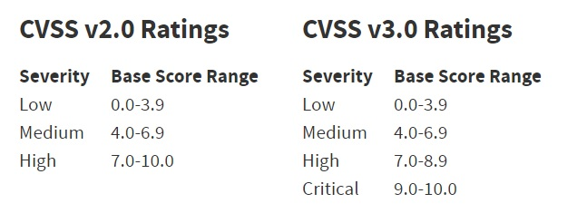
The Common Vulnerability Scoring System (CVSS) provides an open framework for communicating the characteristics and impacts of IT vulnerabilities.

