Slide 1
DDOS

Slide 2
What is Denial of Service?
Denial of Service is an attack which makes an information or data unavailable to its intended hosts
Many types:
Congesting network resources,
Draining CPU memory,
Reducing computing power,
Exploiting timers,
Poisoning domain name translations etc.
There are attacks that are designed to crash a web browser, email application or even a media player -> Application Level Denial of Service
there are attacks that can cause permanent damage to a system: Permanent Denial of Service or Phlashing
Firmware based
Directed towards networking components
Denial of Service attacks and mitigation techniques: Real time implementation with detailed analysis – SANS INSTITUTE

Slide 3
(D)DOS
Business Interruption
For gaining some advantage
Operation Interruption
For attacking systems
SCADA
Ransomware
Acktivism/Terrorism

Slide 4
Low-rate T CP targeted Denial of Service
Exploits the working mechanism of TCP timers thus bringing the throughput of a system to almost zero
Shrew attack: generate packets only periodically in very minimal quantity ->crafted packets are disguised with the legitimate packets
the congestion window is gradually reduced until the network is clear->double the RTO (Retrasmission Time out).
only send packets when the timer is about to expire and push it again into the RTO waiting time

Slide 5
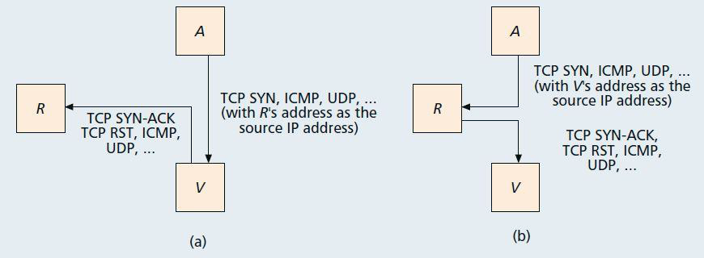
Reflective Denial of Service
Reflective attacks are those which employ intermediate hosts for their attacks
in the reflective attacks, the attacker floods millions of reflectors with its source address spoofed with the victim’s
A classic example for reflective attack would be “Smurf Attack” that sends ICMP ping packets towards the victim.
The Smurf attack is almost similar to the ICMP ping of death attack. The only difference between ping of death and Smurf is that the latter uses reflectors in its operation.

Slide 6
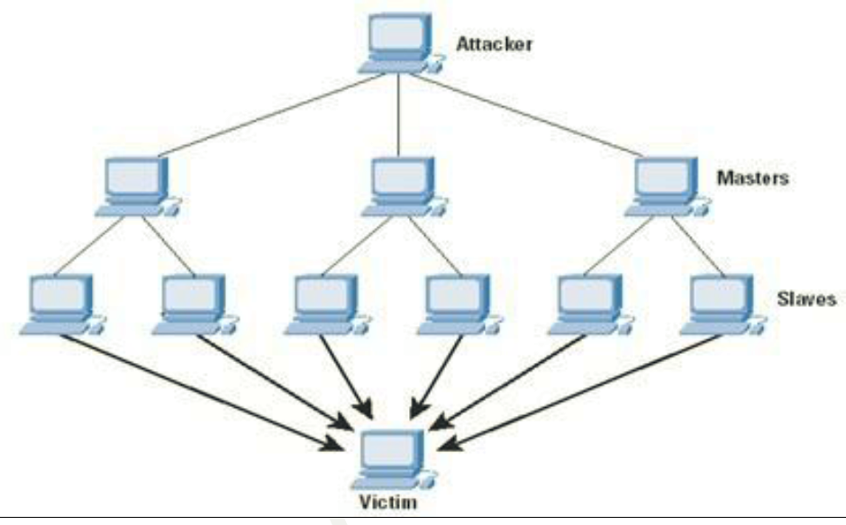
Master Slave Architecture in a Botnet

Slide 7
Attack the service
Two methods according to Erikson Jon:
Flooding: to flood the network not leaving enough bandwidth for the legitimate packets to get through.
to crash a hardware or software item and make it inoperable. Web servers, routing devices, DNS look up servers are the common targets
Smurf attack: flooding victims’s bandwidth with ICMP echo requests to a broadcast address with spoofed source address as victim’s.
Ping flood or ping of death: bombarding victim with ping. In Ping of death, the victim is sent corrupted packets that could crash the system
TCP SYN flood: aims at exploiting server CPU memory.
UDP flood: UDP packets are bombarded against the server. UDP could be a lot more effective than ICMP in smaller networks

Slide 8
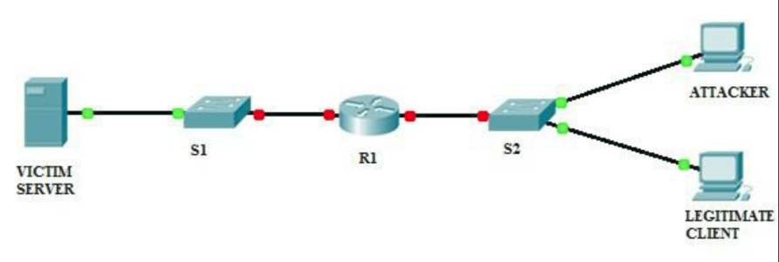
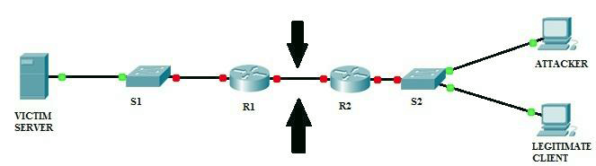
Real time imlementation of DOS
Netflow is a traffic monitoring protocol by CIsco.
Internet Protocol Flow Information Export (IPFIX) is a similar piece of software that was created by the IETF group for the same network monitoring purpose
It monitors traffic in accordance with various metrics like IP source address, destination address, Type of service, Source port, Destination port

Slide 9
Attack Strategies

Slide 10
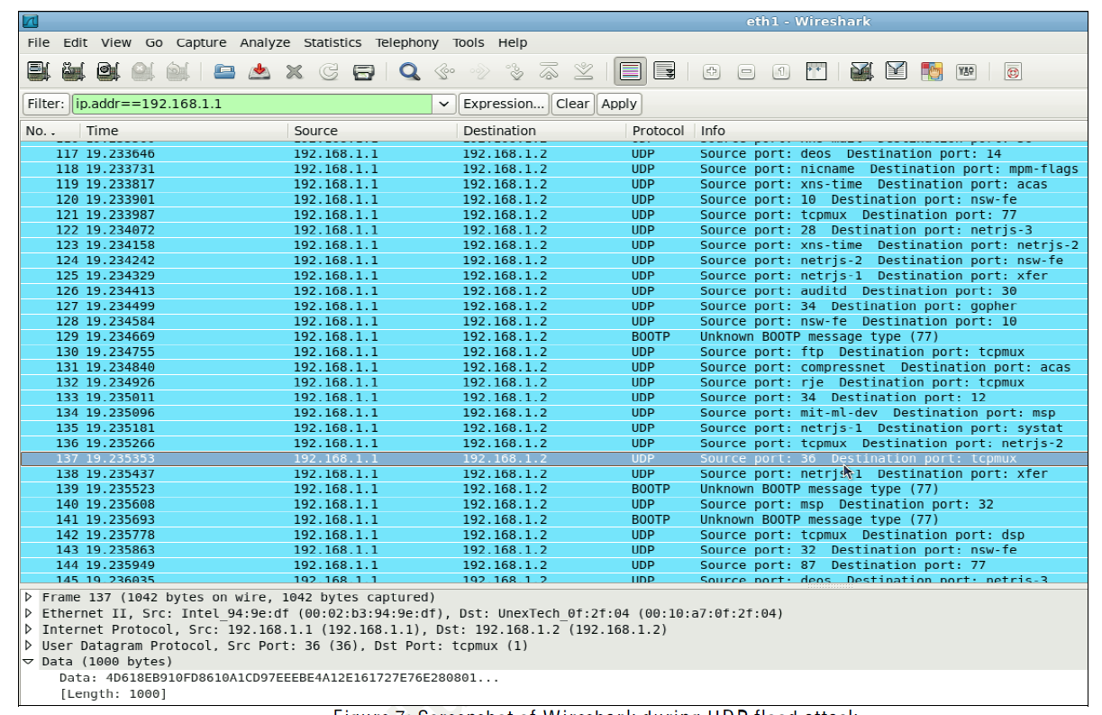
Detecting DOS using Wireshark

Slide 11
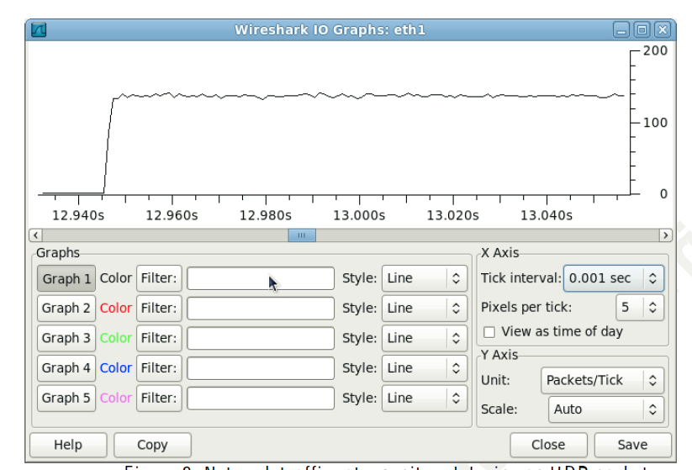

Slide 12
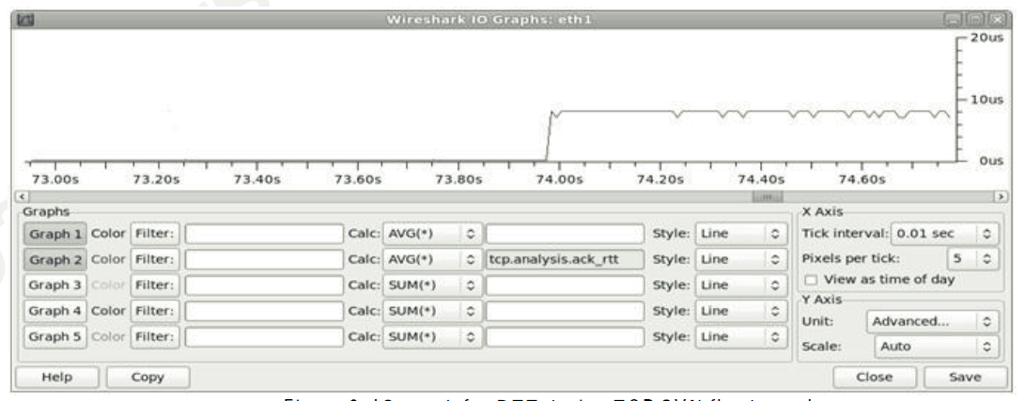
RTT analysis for TCP SYN FLOOD Detection

Slide 13
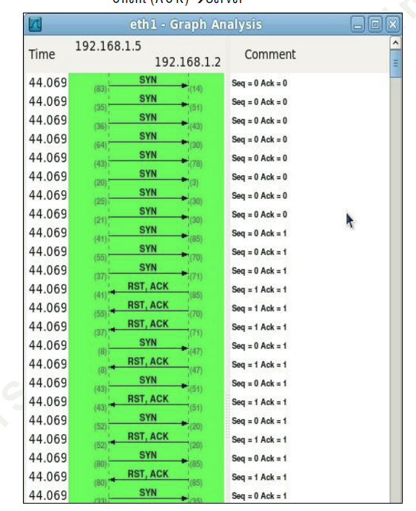

Slide 14
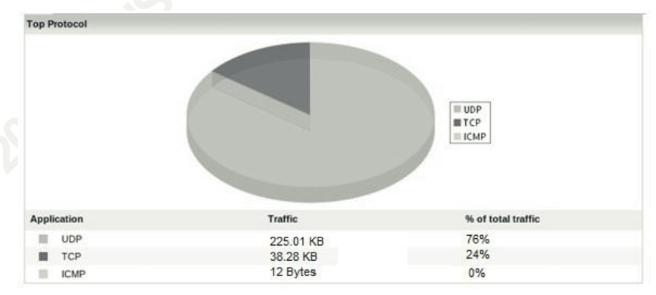
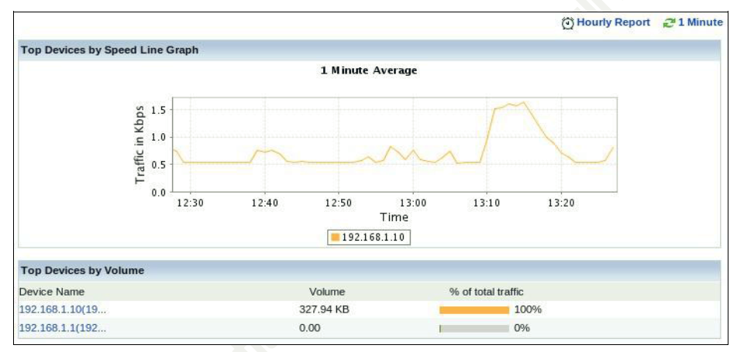
Netflow Reports

Slide 15
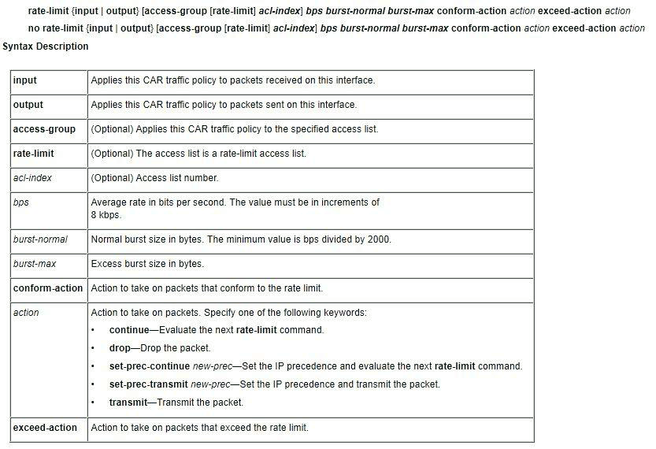
Mitigating DOS with ACLs
when an ACL is applied on a router, the incoming IP packets are checked if they satisfy the ACL table before entering
the ACL table grows in its size -> ACL Compressor
Rate limiting: it places a cap or sets up a threshold limit of traffic that the server would be able to withstand
It still permits attack traffic

Slide 16
DDOS ATTACK: SCOPE AND CLASSIFICATION
Network/transport-level DDoS flooding attack
Flooding attacks: Attackers focus on disrupting legitimate user’s connectivity by exhausting victim network’s bandwidth
Spoofed/non-spoofed UDP flood, ICMP flood, DNS flood, VoIP Flood
Protocol exploitation flooding attacks: Attackers exploit specific features or implementation bugs of some of the victim’s protocols in order to consume excess amounts of the victim’s resources
TCP SYN flood, TCP SYN-ACK flood, ACK & PUSH ACK flood, RST/FIN flood
Reflection-based flooding attacks: Attackers usually send forged requests (e.g., ICMP echo request) instead of direct requests to the reflectors
Amplification-based flooding attacks: Attackers exploit services to generate large messages or multiple messages for each message they receive to amplify the traffic towards the victim.

Slide 17
DDOS ATTACK: SCOPE AND CLASSIFICATION
Application-level DDoS flooding attacks
These attacks focus on disrupting legitimate user’s services by exhausting the server resources
Reflection/amplification based flooding attacks
DNS amplification: The attackers (zombies) generate small DNS queries with forged source IP addresses which can generate a large volume of network traffic since DNS response messages may be substantially larger than DNS query messages
VoIP flooding: Attackers usually send spoofed VoIP packets through SIP at a very high packet rate and with a very large source IP range
HTTP flooding attacks
Session flooding attacks: session connection request rates from the attackers are higher than the requests from the legitimate users
One of the famous attacks in this category is the HTTP get/post flooding attack (a.k.a., excessive VERB) in which attackers generate a large number of valid HTTP requests (get/post) to a victim web server

Slide 18
DDOS ATTACK: SCOPE AND CLASSIFICATION
(HTTP flooding attacks)
Asymmetric attacks: attackers send sessions that contain high-workload requests
Multiple HTTP get/post flood (a.k.a., multiple VERB single request): an attacker creates multiple HTTP requests by forming a single packet embedded with multiple requests and without issuing them one after another within a single HTTP session
Faulty Application : In this attack, attackers take advantage of websites with poor designs or improper integration with databases.

Slide 19
DDOS ATTACK: SCOPE AND CLASSIFICATION
Slow request/response attacks: In this type of attack, attackers send sessions that contain high-workload requests.
Slowloris attack (a.k.a, slow headers attack): Slowloris is a HTTP get-based attack that can bring down a Web server using a limited number of machines or even a single machine. The attacker sends partial HTTP requests (not a complete set of request headers ) that continuously and rapidly grow, slowly update, and never close.
HTTP fragmentation attack : Similar to Slowloris, the goal of this attack is to bring down a Web server by holding up the HTTP connections for a long time without raising any alarms.
Slowpost attack (a.k.a, slow request bodies or R-U-Dead-Yet (RUDY) attack: The attacker sends a complete HTTP header that defines the ”content-length” field of the post message body as it sends this request for benign traffic. Then it sends the data to fill the message body at a rate of one byte every two minutes. Hence, the server waits for each message body to be completed while Slowpost attack grows rapidly which causes the DDoS flooding attack on the Web server.
Slowreading attack (a.k.a, slow response attack: This attack achieves its purpose by setting a smaller receive window-size than the target server’s send buffer. The TCP protocol maintains open connections even if there is no data communication; hence, the attacker can force the server to keep a large number of connections open and eventually causes the DDoS flooding attack on the server.

Slide 20
BOTNET-BASED DDOS ATTACKS
IRC-based
IRC is an on-line text-based instant messaging protocol in the Internet, with a client/server architecture with default channels to communicate between servers
Using IRC channels as handlers, attackers can:
use legitimate IRC ports to send commands to the bots making it much more difficult to track the DDoS command and control structure
hide his presence because of the large volume of traffic
simply log on to the IRC server and see the list of all the available bots
(con) the servers are a potential central points of failure
Web based (aka HTTP-based)
botnets have started using HTTP as a communication protocol to send commands to the bots making it much more difficult to track the DDoS command and control structure.
Web-based botnets do not maintain connections with C&C (like iRC-based)
each Web bot periodically downloads the instructions using web requests (hide themselves within legitimate HTTP traffic)
Bots are configured and controlled through complex PHP scripts and they use encrypted communication over HTTP (port 80) or HTTPS (port 443) protocol

Slide 21
DDOS DEFENSE: SCOPE AND CLASSIFICATION
waste a lot of resources (e.g., processing time, space, etc.) on the paths that lead to the targeted machine.
the ultimate goal of any DDoS defense mechanism is to detect them as soon as possible and stop them as near as possible to their sources
detecting a DDoS flooding attack is relatively easier at the destination (victim), since all the flows can be observed at the destination

Slide 22
trade-off between accuracy of the detection and how close to the source of attack the prevention and response mechanism can stop or respond to the attack
the number of normal packets that reach the victims even when the victims are under a DDoS attack (i.e., in the middle of a DDoS attack) increases when response mechanisms (e.g., packet filtering) drop the attack packets closer to the sources of the attack
the defense mechanisms against two types of DDoS flooding attacks that we presented in section III using two criteria.
location where the defense mechanism is implemented
the point of time when the DDoS defense mechanisms should act in response to a possible DDoS flooding attack
Before during after the attack

Slide 23
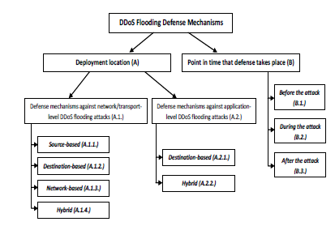
taxonomy of defense mechanisms against DDoS flooding attacks

Slide 24
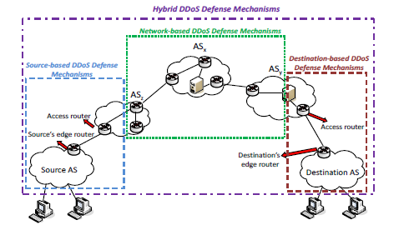
classification of the defense mechanisms against network/transport-level DDoS flooding attacks based on their deployment location

Slide 25
Defense source-based mechanisms
Ingress/Egress6 filtering at the sources’ edge routers
Victims cannot distinguish attack packets from legitimate ones based on source addresses
IPSec protocol can address this problem by authenticating the source addresses of IP packets (not largely used)
the spoofed packets will not be detected if their addresses are still in the valid internal IP address range
D-WARD
monitoring both inbound and outbound traffic of a source network and comparing the network traffic information with predefined normal flow models.
it consumes more memory space and CPU cycles than some of the network-based defense mechanisms
no strong incentives for the providers to protect others’ networks
can be easily bypassed by attackers who can control their traffic to be within a normal range

Slide 26
MUlti-Level Tree for Online Packet Statistics (MULTOPS) and Tabulated Online Packet Statistics (TOPS)
heuristic and a data-structure that network devices (e.g., routers) at the source subnet can use to detect and filter DDoS flooding attacks
the rate of traffic in one direction is proportional to that in the opposite direction during normal operations on the Internet
(-) it uses a dynamic tree structure for monitoring packet rates for each IP address which makes it a vulnerable target of a memory exhaustion attack
TOPS provides an efficient method for detecting packet flow imbalances based on a hashing scheme
MULTOPS and TOPS are based on the assumption that incoming and outgoing traffic rates are proportional, which is not always the case
High false negative rate
attackers can increase the proportion of the incoming and outgoing traffic rates legitimately

Slide 27
MANAnet’s Reverse Firewall
the reverse firewall protects the outside from packet flooding attacks that originate from within a network
reverse firewall limits the rate at which it forwards packets that are not replies to other packets that recently were forwarded in the other direction
(-) it is manual and requires the administrators’ involvement
(-) the reverse firewall’s configuration cannot be dynamically changed at runtime
(-) There is no benefit (e.g., financial gain) for the source networks to deploy costly reverse firewalls since there is no benefit for the source networks.
There are three main reasons which make these mechanisms a poor choice against DDoS flooding attacks:
The sources of the attacks can be distributed in different domains making it difficult for each of the sources to detect and filter attack flows accurately.
it is difficult to differentiate between legitimate and attack traffic near the sources, since the volume of the traffic may not be big enough as the traffic typically aggregates at points closer to the destinations.
the motivation for deployment of the source-based mechanisms is low since it is unclear who (i.e., customers or service providers) would pay the expenses associated with these services. Hence, pure source-based mechanisms are not efficient and effective against DDoS flooding attacks.

Slide 28
Destination-based mechanisms
IP Traceback mechanisms
The process of tracing back the forged IP packets to their true sources rather than the spoofed IP addresses that was used in the attack is called traceback
packet marking mechanisms . Usually routers in the path to the victim mark packets (i.e., add routers’ identification to each packet) so that the victim can identify the path of attack traffic and distinguish it from legitimate traffic after the detection
(-) storing the entire path in the IP identification field of each packet needs certain coding schemes and these schemes sometimes are not able to assign each mark to a unique path false positive.
link testing mechanisms [67], [68] in which the traceback process usually starts from the router closest to the victim and iteratively tests its upstream links until it can be determined which link is used to carry the attacker’s traffic (i.e., the traceback process is recursively repeated on the upstream router until the source is reached).
(-) serious deployment and operational challenges
ensuring a sufficient number of routers that support traceback before it is effective.
attackers can also generate traceback messages; consequently, some form of authentication of traceback messages is necessary. Furthermore, most of the traceback mechanisms have heavy computational, network or management overheads

Slide 29
Management Information Base (MIB)
MIB data is comprised of parameters that indicate various packet and routing statistics
it is possible to map ICMP, UDP, and TCP packets’ statistical abnormalities to a specific DDoS attack by identifying statistical patterns related to different parameters
can also provide ways to adjust network parameters to compensate for the unwanted traffic (e.g., adding more resources to the target network)
Packet marking and filtering mechanisms
mark legitimate packets at each router along their path to the destination so that victims’ edge routers can filter the attack traffic.
These mechanisms let the receivers install dynamic network filters to block the undesirable traffic
History-based IP filtering
the target destination can use an IP address database to keep all the IP addresses that frequently appear at the target.
During a bandwidth attack, the target only admits the packets whose source IP addresses belong to the IP address database.
This technique helps destination hosts in resource management when their inks to the upstream network becomes a bottleneck during a DDoS flooding attack.
(-) any large-scale DDoS attack that simulates normal traffic behaviour will defeat such mechanisms.

Slide 30
Hop-count filtering
Information about a source IP address and its corresponding hops from a destination are recorded in a table at the destination side when the destination is not under attack.
Once an attack alarm is raised, the victim inspects the incoming packets’ source IP addresses and their corresponding hops to differentiate the spoofed packets.
It is not necessary for routers to collaborate mutually in this mechanism;
(-) it is difficult to ensure the integrity and accuracy of the source IP addresses and their corresponding hops from the victim.
Attackers can spoof IP addresses with the same hop-count as their machines do.
(-) legitimate packets can be identified as spoofed ones if their IP to hop-count mappings are inaccurate or if the hop-count updates has a delay.

Slide 31
Path Identifier (Pi)
a path fingerprint is embedded in each packet which enables a victim to identify packets traversing the same paths through the Internet on a per packet basis, despite of the source IP address spoofing.
Pi is a per-packet deterministic mechanism which means that each packet that is travelling along the same path carries the same identifier.
the victim employs the Pi mark to filter out packets matching the attackers’ identifiers on a per packet basis which is considered as a proactive role in defending against a DDoS attack.
Pi is effective if about half of the routers in the Internet participate in packet marking .
(-) the limitation on the size of identification field may result in the same path information representing different paths.
This can decrease the performance of Pi mechanism (i.e., increased false positive/false negative rates).

Slide 32
Packet dropping based on the level of congestion
These destination-based DDoS defense mechanisms drop suspicious packets when the network links are congested to a certain level.
Packetscore is an example of this type.
An automated attack characterization, selective packet discarding and overload control mechanism.
The key idea is to prioritize packets based on per packet score given the attribute values it carries. Then, once the score of a packet is computed by employing a Bayesian-theoretic metric, a score-based selective packet discarding method at the destination is performed.
The dropping threshold for the packet discarding method is dynamically adjusted based on (1) the score distribution of recent incoming packets and (2) the current level of overload of the system. However,
(-) attackers did not provide any results to show how the time-scale of updates of the scorebooks, score cumulative distribution function (CDF), and dynamic discarding threshold could impact the response time and the decision of their proposed selective packet discarding scheme when subjected to more orchestrated synchronized DDoS Attacks

Slide 33
Network-based mechanisms
Route-based packet filtering
Route-based packet filtering extends ingress filtering to the routers at the core of the Internet.
The traffic on each link in the core of the Internet usually originates from a limited set of source addresses. if an unexpected source address appears in an IP packet on a link, then it is assumed that the source address has been spoofed, and hence the packet can be filtered.
(-) ineffective against DDoS attacks if attackers either use genuine IP addresses instead of spoofed ones or spoof with carefully chosen source IP addresses that are not going to be filtered.
Detecting and filtering malicious routers
A range of specialized anomaly detection protocols have been proposed to detect malicious routers involved in packet forwarding between routers.
Watchers detects misbehaving routers that launch DDoS attacks by absorbing, discarding or misrouting packets.
It uses the conservation of flow principle to examine flows between neighbors and endpoints.
(-) Watchers requires explicit communication among the routers.
(-) it cannot detect spoofed packets.
(-) such packets could be used by the attacker to misidentify a target as a bad router. Watchers can only detect compromised routers and it is vulnerable to misbehaving hosts.
(-) It also assumes that every router knows the topology of the network, which is not a feasible assumption for large networks.

Slide 34
(-) Network-based mechanisms usually lead to high storage and processing overheads at the routers.
Various researchers have proposed different approaches to reduce the amount of storage and consumption of CPU cycles for detection and response at the routers such
as Bloom filters [78] [87], Packet sampling [88]
(-) these approaches are not sufficient when routers still do redundantjobs.
(-) reducing the amount of redundant detection and response between the routers requires coordination among them.
Different communication protocols have been proposed to coordinate attack detection and response among the routers.
(-) network-based defense mechanisms that have been proposed thus far are not effective and efficient because of their large overhead of network communication.
the lack of bandwidth during DDoS attacks may limit the protocol for communication and cause network-based mechanisms to fail.

Slide 35
Hybrid (Distributed) mechanisms
(-) no strong cooperation among the deployment points.
(-) detection and response is mostly done centrally either by each of the deployment points (e.g., source-based mechanisms) or by some responsible points within the group of deployment points (e.g., network-based mechanisms).
we call these categories of DDoS defense mechanisms centralized.
As opposed to centralized defense mechanisms, hybrid defense mechanisms are
deployed at (or their components are distributed over) multiple locations such as source, destination or intermediate networks and
thereis usually cooperation among the deployment points.
For instance, detection can be done at the victim side and the response can be initiated and distributed to other nodes by the victim.

Slide 36
Hybrid packet marking and throttling/filtering mechanisms:
All of the previously presented marking and filtering mechanisms place the attack detection module and the packet filtering module at the same location.
Hybrid packet throttling mechanisms usually place the attack detection modules near the victims and execute packet filtering close to the attack sources.
In some of these mechanisms, victims under attack install a router throttle at upstream routers several hops away in order to limit the forwarding rate of the packets destined to those victims.
Basically these mechanisms are packet filtering infrastructures that are leveraging the routers’ support to filter out DDoS flows.
these mechanisms only limit the rate of malicious packets and do not harm legitimate flows.

Slide 37
Hybrid packet marking and throttling/filtering mechanisms
Aggregate-based Congestion Control (ACC) and Pushback
ACC rate limits the aggregates rather than IP sources.
Aggregates are subsets of traffic defined by some characteristics such as specific destination port or source IP address.
routers detect aggregates overwhelming them by using samples of packet drops in their queues.
Then they send a pushback message to the upstream routers along with the information about the aggregates to request a rate limit by presenting a rate limit value.
If the aggregate packets respect the rate limit they can still go through their path to their destinations, otherwise they are dropped to limit their rate and pushback messages are propagated to the upstream router
ACC and Pushback are not effective against uniformly distributed attack sources because of voluminous traffic

Slide 38
Attack Diagnosis (AD) and parallel-AD [91]
AD combines the concepts of pushback and packet marking.
A victim host activates AD, after an attack has been detected, by sending AD-related commands to its upstream routers. Upon receiving such commands, the AD-enabled upstream routers deterministically mark each packet destined for the victim with the information about the input interface that processed that packet.
The victim can then traceback the attack traffic to its source by employing the router interface information which is recorded in the packet marking process.
Then, the victim issues messages that command AD-enabled routers to filter attack packets close to the source after the traceback is completed.
The AD commands can be authenticated by the TTL field of the IP header without relying on any global key distribution infrastructure in the Internet.
AD is not effective against large-scale attacks. An extension to AD, called Parallel AD (PAD), has been proposed to address AD’s shortcomings against large-scale attacks.
The main difference between PAD and AD is that PAD can diagnose and stop the traffic from more than one router at the same time.
Hence, PAD is capable of throttling traffic coming from a large number of attack sources at the same time.

Slide 39
TRACK [92]: This mechanism also combines IP traceback,
packet marking, and packet filtering. TRACK is composed
of two components: router port marking module and packet
filtering module. The router port marking module marks
packets by probabilistically writing a router interface’s port
number, a locally unique 6-digit identifier, to the packets it
transmits. Upon receiving the packets marked by each router
in an attacking path, a victim machine can then use the
information contained in those packets to trace the attack back
to its source. Then, the packet filtering component employs
the information contained in the same packets to filter the
malicious packets at the upstream routers, thus effectively
mitigating attacks. One of the main advantages of TRACK
over previously discussed throttling mechanisms is its low
communication and computation overhead [92]. TRACK has
some limitations to be addressed in the future:
(i) Attackers can modify the marking fields of the packets in
order to avoid being located; hence, TRACK is still vulnerable
to these attacks; and
(ii) TRACK is claimed to be an effective approach for
IP traceback but not effective for attack traceback in which
the objective is to identify the real attacker that ordered the
zombies to launch the DDoS attack. In other words, TRACK
cannot find the IP addresses of the attackers that actually
launch the attack

Slide 40
DEFensive Cooperative Overlay Mesh (DEFCOM)
a distributed framework to enable information and service exchange among all of the defense nodes.
attempts to shift from isolated defense architectures towards a distributed framework of heterogeneous defense nodes in which all the nodes collaborate and cooperate to achieve an effective defense . For instance, since attack
detection is best done near the victim and response is most effective at the source of the attack, defense nodes should be specialized for different aspects of the defense;
Each node in their proposed framework must at least support the followings:
Attack alerts generated from the alert generators should be sent to the rest of the network;
Rate-Limit requests should be sent upstream;
Resource requests that each node issues should be sent to its downstream neighbors;
Traffic Classification nodes must communicate with their downstream neighbors to ensure that the bulk of legitimate traffic will not be dropped.
nodes organized into a P2P network
when an attack alert is raised, it will be possible to discover victim-rooted traffic tree.
Then, upstream and downstream relationships among peers is identified and proper rate limits to control the attack traffic is created and placed as close as possible to the sources of the attack.
(-) there will be no means to verify if the traffic which has been received by a node is legitimate or attack and rate limiters severely rate-limit all the traffic coming from these sources

Slide 41
COSSACK [94]
This mechanism is built on all of the border routers of the edge networks, with the core software system called watchdog.
Assumptions:
the border routers are assumed to have ingress/egress filtering mechanisms implemented.
Second, border routers can prevent IP spoofing by employing ingress/egress filtering.
the existence of an attack signature,
the capability of border routers to filter packets based on the signature
the connection availability between watchdogs
Therefore, the application layer watchdog could multicast attack notifications from the victim side to the source side and stop DDoS attack flows around the source employing the ingress/egress filtering mechanisms implemented on the border routers.
COSSACK is, however, unable to handle attacks from legacy network that do not deploy COSSACK defense mechanism

Slide 42
Capability-based mechanisms
These mechanisms let the destination explicitly authorize the traffic it desires to receive
Traffic Validation Architecture (TVA)
Stateless Internet Flow Filter (SIFF)).
senders obtain the capabilities, which are short-term authorizations, from the receivers and put them as stamps on their packets.
Then, the verification points along the path check if the traffic is certified as legitimate or not.
Basically, destination provides tokens, or capabilities, to sources whose traffic it agrees to accept.
The sources then include these tokens in their packets. The verification points are distributed around the network to check if the traffic has been certified as legitimate by destinations and the path in between.
Privileged packets are prioritized at the routers and most of the bandwidth is allocated to them so that they are never dropped by unprivileged packet flooding.
Privileged packets flooding rarely happens, since receivers can stop any undesirable flow by not sending the capability back to the senders.
Limitations of TVA:
assumes that the receiver can distinguish the attack traffic from the legitimate traffic. its effectiveness depends on the accuracy of the attack detection mechanism that a receiver is employing.
needs a significant amount of per flow state information to be maintained at each router
specific DDoS attacks are still possible even after all the routers implement TVA.

Slide 43
Active Internet Traffic Filtering (AITF)
Capability-based mechanisms enable a receiver to deny by default all the traffic and explicitly accept only the traffic that belongs to established network-layer connections.
The alternative could be the datagram (a.k.a. filtering) mechanism in which a receiver accepts by default all the traffic and explicitly denies the traffic that has been identified as undesirable.
AITF is a hybrid DDoS defense mechanism which enables a receiver to contact misbehaving sources and ask them to stop sending it traffic.
Each of the sources that have been asked to stop is policed by its own ISP, which ensures their compliances.
Each ISP that hosts misbehaving sources must either support AITF mechanism (i.e., accept to police its misbehaving clients), or risk losing all of its access to the complaining receiver;
this provides a strong incentive for all the ISPs to cooperate; especially when the receiver is a popular point of access.
AITF preserves receiver’s bandwidth in the face of DDoS flooding attacks at a per-client cost; thus, it is affordable for the ISPs to employ it.
Argyraki et al. in [103] showed that even the first two networks that would deploy AITF could maintain their connectivity to each other in the face of DDoS flooding attack. AITF verifies the legitimacy of a filter request using a three-way handshake.
However, if the flooded link is outside a victim’s AS, the three-way handshake may not complete because the handshake packets traverse the same flooded link as the attack traffic does, and filters may not have been installed.
(-) it relies on the routers, which are in the middle of the network (during initial deployment), to perform the actual filtering
(-)It also depends on various IP route records to determine where packets come from .

Slide 44
StopIt is a hybrid filter-based DDoS defense mechanism that enables each receiver to install a network filter that blocks the undesirable traffic it receives.
StopIt uses Passport as its secure source authentication system to prevent source address spoofing. Its design employs a novel closed-control and open-service architecture to battle strategic attacks that aim to prevent filters from being installed and to provide the StopIt service to any host in the Internet.
StopIt outperforms filter-based designs such as AITF, and is effective in providing continuous non-interrupted communication under a wide range of DDoS attacks.
However, StopIt does not always outperform capability-based mechanisms.
if the attack traffic does not reach a victim, but congests a link shared by the victim, a capability-based mechanism (e.g., TVA) is more effective. Therefore, both filters (a.k.a. datagram) and capabilities are highly effective DDoS defense mechanisms, but neither is more effective than the other against DDoS flooding attacks.
is vulnerable to the attacks in which attackers flood the routers and StopIt servers with filter requests and packet floods.
needs complex verification/authentication mechanisms, and misbehaving StopIt server detection mechanisms to be implemented in both hosts and routers which makes it a challenging mechanism to deploy and manage in practice

Slide 45
Discussion
Since attackers cooperate to perform successful attacks, defenders must also form alliances and collaborate with each other to defeat the DDoS attacks.
A hybrid (Distributed) defense mechanism is the best way to combat DDoS Attacks Detecting DDoS attack as soon as possible and before it reaches the victims, identifying the attack sources, and finally stopping the attack as close as possible to the attack sources is the ultimate goal of DDoS defense mechanisms
Combining source address authentication (to prevent IP spoofing), capabilities, and filtering would be the most effective and efficient solution because of the robustness of capabilities and the relative simplicity of a capability-based design.
However, there will be a trade-off between performance and accuracy in any DDoS defense solution and the goal is to minimize the gap between performance and accuracy

Slide 46
Destination based mechanisms
Are deployed at the destination of the attack (i.e., victim), which is the server of the application layer protocols’ client-server model or the reverse proxy in a web cluster hosting different web applications.
Most of these mechanisms closely observe the server and model its clients’ behavior and anomalies
Defense against Reflection/Amplification attacks
DNS Amplification Attacks Detector (DAAD)
collects the DNS requests and replies using IPtraf tool
classifies the requests/replies as suspicious or not
VoIP Flood Detection System (VFDS)
detects and blocks VoIP flooding attacks and SIP protocol flooding attacks
employ a genetic algorithm to recognize the authorized users
is used to detect TCP flooding attacks and SIP flooding attacks on SIP devices using their Jacobian Fast and Hellinger distance algorithms.
In their mechanism the Jacobian Fast algorithm has been used to fix the threshold limit and Hellinger distance calculation, which is a statistical anomaly based algorithm to detect deviations in traffic

Slide 47
DDoS-Shield
Uses statistical methods to detect characteristics of HTTP sessions
employs rate-limiting.
a suspicion assignment mechanism and a DDoS-resilient scheduler. The suspicion assignment mechanism assigns a continuous value as opposed to a binary measure, which have been assigned by previous mechanisms, to each client session.
The DDoS-resilient scheduler acts as a rate-limiter and utilizes continues values, assigned by the suspicion assignment mechanism, to determine if and when to schedule a session’s requests.
Anomaly detector based on hidden semi-Markov model
an anomaly detector based on hidden semi-Markov model to describe the dynamics of the access matrix and to detect the attacks.
Uses the entropy of document popularity fitting to the model to detect the potential application-layer DDoS attacks.
(-) high complexity of its algorithm.
DAT (Defense Against Tilt DDoS attacks)
monitors users’ features (e.g., instant traffic volume, session behavior, etc.) throughout a connection session to determine whether users are malicious or not.

Slide 48
Hybrid (Distributed) mechanisms:
Employ collaboration/cooperation between clients and servers to detect and respond to the attacks.
For instance, detection is done at the victim (web server/reverse proxy) and the response is initiated and distributed to the client-sides by the victim.
A.2.2.a. Speak-up
encourage all the clients to automatically send higher volumes of traffic. The attackers are already using most of their upload bandwidth so cannot react to the encouragement.
good clients have spare upload bandwidth and will react to the encouragement
The good clients crowd out the bad ones, thereby capturing a much larger fraction of the server’s resources than before.
Speak-up is applicable mainly against session flooding attacks and it is not applicable in case of request flooding attacks and asymmetric attacks.

Slide 49
DOW (Defense and Offense Wall) :
employs the encouragement method which is presented in the Speak-up mechanism with an anomaly detection method based on K-means clustering to detect and filter session flooding attacks, request flooding attacks, and asymmetric attacks.
Like Speak-up, DOW’s encouragement model (currency model) encourages legitimate clients to increase their session rates so that they get a chance to be served.
In other words, their detection model drops suspicious sessions while their currency model encourages more legitimate sessions.
They believe that if these two models collaborate with each other, normal clients could gain higher service rates and lower delays in their response times.
However, the main question that remains to be answered is with regards to the complexity and performance of this approach. This mechanism at this stage is too resource consuming to be implemented.

Slide 50
Differentiate DDoS flooding bots from human
try to differentiate between the traffic from clients with the legitimate users (Human) and the malicious users (bots).
Kandula et al. [114] propose a system to protect web clusters from application-level DDoS attacks by employing Completely Automated Public Turing test to tell Computers and Humans Apart (CAPTCHA ).
Their proposed framework optimally divides the time spent in authenticating new clients and serving the authenticated ones.
(-) requiring users to solve puzzles in order to authenticate themselves may become annoying for the users and introduce more delay
(-) this policy disables web crawlers’s access to the web sites; hence, search engines may not be able to index the content.

Slide 51
Admission control and congestion control
admission control to limit the number of concurrent clients served by the online service.
Admission control works based on port hiding that renders the online service invisible to unauthorised clients by hiding the port number on which the service accepts incoming requests.
they perform congestion control on admitted clients to allocate more resources to good clients by adaptively setting the client’s priority level in response to the client’s requests in a way that incorporates application-level semantics.
TMH (Trust Management Helmet)
uses trust to differentiate legitimate users and attackers.
The key idea is that servers should give priority to protecting the connectivity of good users during the application layer DDoS attacks instead of identifying all the attack requests.
each user is assigned a license, which is cryptographically secured against forgery or replay attacks, and a trust value, which is based on users’ history.
Detection of attackers is possible by considering these two features provided by each user.

Slide 52
Hybrid detection based on trust and information theory based metrics
hybrid detection scheme based on the trust information and information theory based metrics.
initially filters suspicious flows based on the trust value scored by the client.
an entropy is applied for final filtering of suspicious flows.
Trust value for each client is assigned by the server based on the access pattern of the client and is updated every time the client communicates with the server.
Each request from the client always includes the trust value to identify itself to the server.
Entropy of requests per session is calculated based on the Web user browsing behaviour (HTTP request rate, page viewing time and sequence of the requested objects) of the client which is captured from the system log during non-attack cases.
Entropy is then used for further rate limiting the flows.

Slide 53
discussion
hybrid defense mechanisms are the best way to combat DDoS flooding attacks since all of the defense nodes collaborate with each other to defeat coordinated DDoS flooding attacks

Slide 54
Classification by the point in time which defense takes place
Before the attack
System & Protocol security mechanisms to increase the overall security of the systems: For instance, by preventing illegitimate accesses to the machines, removing bugs, updating installed protocols, installing software patches, removing unused software, etc.
Fail-safe protection: Possible anticipations in case something goes wrong (e.g., replication of services and applications in diverse locations in case DDoS attack occurs successfully, business continuity and disaster management plans, etc.).
Resource allocation & accounting : Providing resources to counter DDoS attacks and control users’ access based on their privileges and behaviors .
Reconfiguration mechanisms: These mechanisms alter the topology of either the victim network to add more resources to tolerate the DDoS attack (e.g., resource replication services) or the intermediate network to isolate the attack sources (e.g., attack isolation strategies) .
Installing firewalls and improved Intrusion Detection & Prevention Systems (IDPSs): All of the end hosts are encouraged to install IDPSs to prevent them from being compromised by the adversaries.
Employing local filters (e.g., Ingress/Egress [55], History-based IP filtering [73], hop-count filtering [74], Pi [76], route-based packet filtering [79], [80], etc.) and globally coordinated filters (e.g., ACC [89], Pushback [89], [90], AD and parallel-AD [91], TRACK [92], etc.) to block attack flows before their bombardment is another important category of the prevention mechanisms against DDoS attacks.
Load balancing [120] and Flow control are two other mechanisms to prevent DDoS attacks. The former improves both the performance and mitigation against DDoS attack, and the latter prevents servers from going down.
Server-side specific security considerations: One of the main problems regarding application-level flooding attacks is that there is a lack of security mechanisms or security policies in place to address the servers vulnerabilities against application-level DDoS flooding attacks. Such security mechanisms or policies can protect servers from various attacks.

Slide 55
During the attack
anomalous patterns are discovered in both the network/transport-level traffic and application-level traffic
Two fundamental challenges
the lack of a wide deployment of DDoS defense mechanisms at different points of the Internet, and
the lack of collaboration and cooperation among distributed deployed defense mechanisms in order to increase the detection accuracy, decrease unnecessary redundant tasks (because of the lack of coordination), and, finally, to increase the performance efficiency of DDoS defense mechanisms.
In case of application-level DDoS flooding attacks, all of the current detection mechanisms are deployed at the destination (servers) since it is not possible to perform detection at the layer 2/layer 3 intermediate networks.

Slide 56
After the attack
After a DDoS attack is detected, the defense system should identify the source of the attack and block the attack traffic.
Today, most of the DDoS response mechanisms cannot completely prevent or stop DDoS attacks.
Therefore, minimizing the attack impact and maximizing the availability of services is the main focus of all after the attack mechanisms.
Moreover, law enforcement agencies must collaborate and cooperate with each other in order to gather and submit evidences that could be used to prosecute attackers.

Slide 57
There are two main categories for most of the after the attack mechanisms:
Attack source identification:
The first category of after the attack mechanisms is responsible to identify the source of the attack.
For instance, an attacker uses host x to launch an attack by representing the spoofed source address of host y, IP traceback mechanism must find out the real source address of the attacker which is host x.
This can be accomplished if there is a way of traversing all the routers from x to the victim in the reverse order or marking the legitimate paths or packets so that spoofed or illegitimate ones are identifiable.
Initiating a proper response:
The second category of after the attack mechanisms is responsible for initiating a proper response to the attack.
Most of the DDoS defense mechanisms apply throttling (rate limit) or packet filtering on upstream routers and hosts for the traffic coming from those identified attack flows (e.g., spoofed IP addresses) after identifying the source of the attack.
For instance, history-based IP filtering [73], hop-count filtering [74], Pi [76], AD [91], TRACK [92], and StopIt [101], [105] employ packet filtering upon detection of DDoS attacks and ACC [89], Pushback [89], [90], PAD [91], AITF [103], and DEFCOM [93] employ throttling upon detection of DDoS attacks. Other mechanisms specially in the case of application-level DDoS flooding attacks employ some encouragement models in which servers ask the legitimate clients to increase their session rates to crowd out the malicious clients (e.g., Speak-up [112], and DOW [113]).

Slide 58
DA QUI

Slide 59
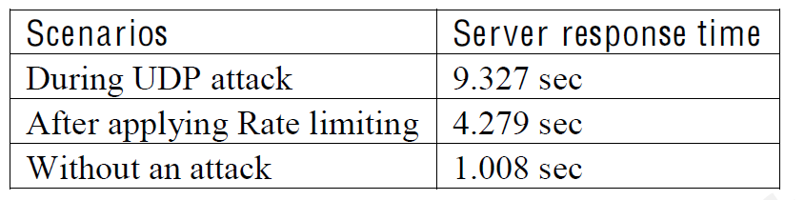
Measuring Server Response Time…
Time Curl
This command sends a HTTP packet to the server and measures the time it takes to process

Slide 60
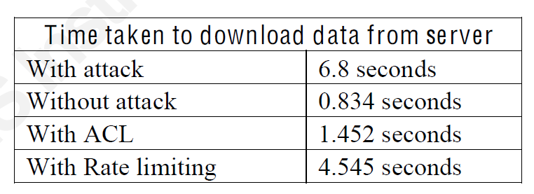
…Measuring Server Response Time…
WGET Utility
Wget is a powerful command that could be used in the Linux terminal in finding the time taken by a client to download server’s data.
if the data to be downloaded is a large file, the reading might not be precise and accurate
ICMP attack

Slide 61

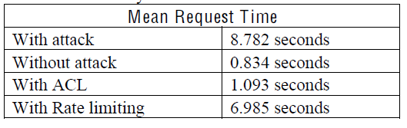
…Measuring Server Response Time…
Apache Benchmarking tool
specially designed by the apache to measure the performance of the Apache HTTP servers

Slide 62
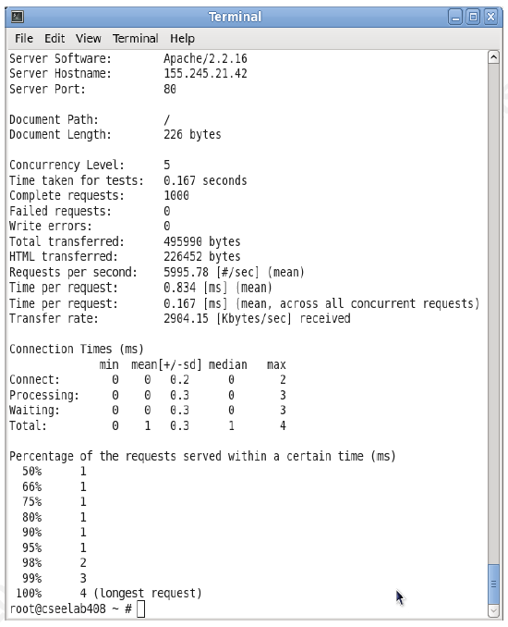

Slide 63
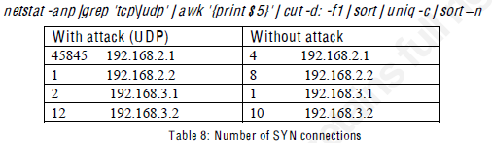
…Measuring Server Response Time…
Netstat commands measuring SYn, UDP, and ICMP
used to list all the inbound and outbound traffic connections of a UNIX machine
used to determine the number of active TCP and UDP connections the server holds
Show only the number of active SYN connections

Slide 64
…Measuring Server Response Time…
Used to pull out the entire details of the existing, awaiting and pending connection requests.

Slide 65
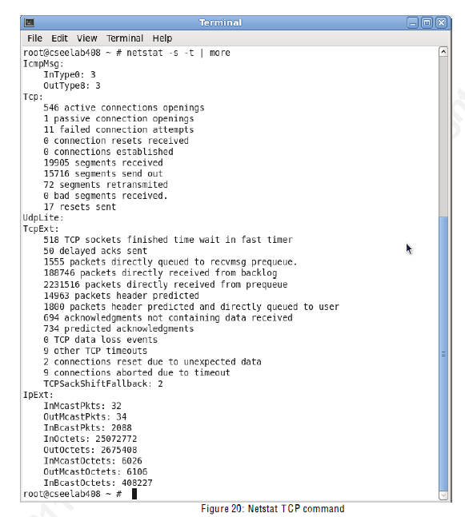

Slide 66
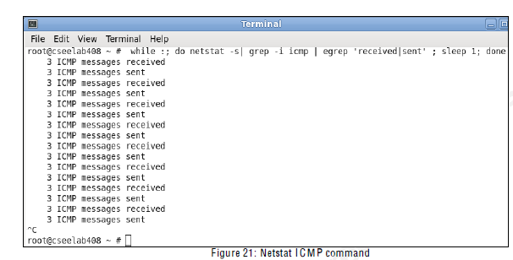
…Measuring Server Response Time
The following command was used during the ICMP ping of death attack and was used to measure the number of ICMP ping requests sent to the server.

Slide 67
Defense
Service providers can also increase redundancy of network and service infrastructure, but:
redundancy asks for additional computing resources to handle incoming traffic.
attackers can easily find a large number of attacking agents in the Internet to overwhelm the capability of redundant equipments.

Slide 68
Client puzzles have been proposed to defend against DoS attacks in TCP (Juels et al. 1999), SYN cookie (Bernstein 1996), authentication protocols (Aura et al. 2000), TLS (Dean et al.2001), graphic Turing test (Kandula et al. 2005), application traffic control (Walfish et al. 2006), etc.
These mechanisms rely on a challenge-reponse schema that requests additional resources-> solved with the distributed puzzle mechanism

Slide 69
Pushback
Mahajan et al. (2002) proposed aggregate-based congestion control (ACC) method that manages packet flows at a finer granularity. An aggregate is defined as a collection of packets that sharesome properties. ACC provides a mechanism for detecting and controlling aggregates at a router using attack signatures and a pushback mechanism to propagate aggregate control requests (and attack signatures) to upstream routers. ACC mechanisms are triggered when a router experiences sustained congestion. The router first attempts to identify the aggregates responsible for the congestion. Then, the router asks its adjacent upstream routers to rate-limit the aggregates. Since the neighbors sending more traffic within the aggregate are more likely to be carrying attack traffic, this request is sent only to the neighbors that send a significant fraction of the aggregate traffic.

Slide 70
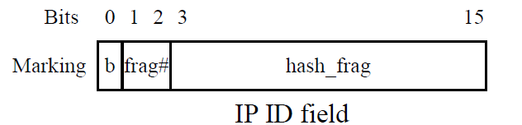
IP Traceback
Packets forwarded by routers can carry information to help victims reconstruct the attack path.
Routers can add extra information as a header or an extra payload to packets so that the border router of the victim can identify the routes close to the attacking sources and ask these routers to filter flooding packets
Probabilistic scheme like FIT (Yaar et al, 2005) allows the reconstruction of the path, based on the distance of fowarded marked packets.

Slide 71
Capability filtering
Routers are designed to forward packets from senders, regardless of whether or not the packets are desired by receivers
researchers proposed the approach of putting a token of capability into each data packet to prove that packets were requested by receivers
Then, routers along the path from the sender to the receiver can verify packets carrying the token and forward the packets with valid tokens.
Capability is bound to a specific network path, including source and destination addresses, in a specific duration. Each router that forwards a request packet generates its own pre-capability and attaches it to the packet.

Slide 72
Overlay Networks
Aforementioned defense technologies require homogeneous system design
Mirkovic et al. (2003) proposed Defensive Cooperative Overlay Mesh (DefCOM) as a new deployment paradigm, which uses a peer-to-peer network to integrate heterogeneous systems
Typs of nodes:
Alert generator (detectors)
Core nodes (rate limit high volume traffic)
Classifiers (differentiate between legitimate and attack flows)

Slide 73
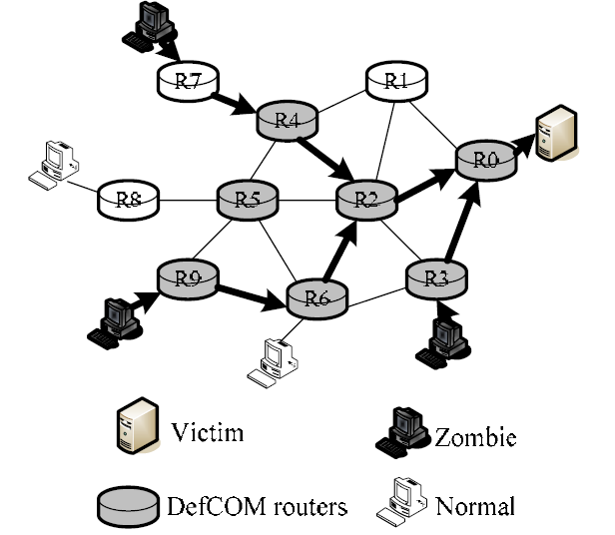

Slide 74
Each system would autonomously perform the defense functions that it is best at and compensate for its weaker traits through cooperation with other systems
As the attacks evolve, new systems could join and either replace or enhance the functionality of the old ones
Overlay network also provides an infrastructure to deploy distributed DDoS defense system
expensive processing tasks of a firewall, such as access control and cryptographic protocol handling, are distributed to a large number of nodes in an overlay network

