Slide 1
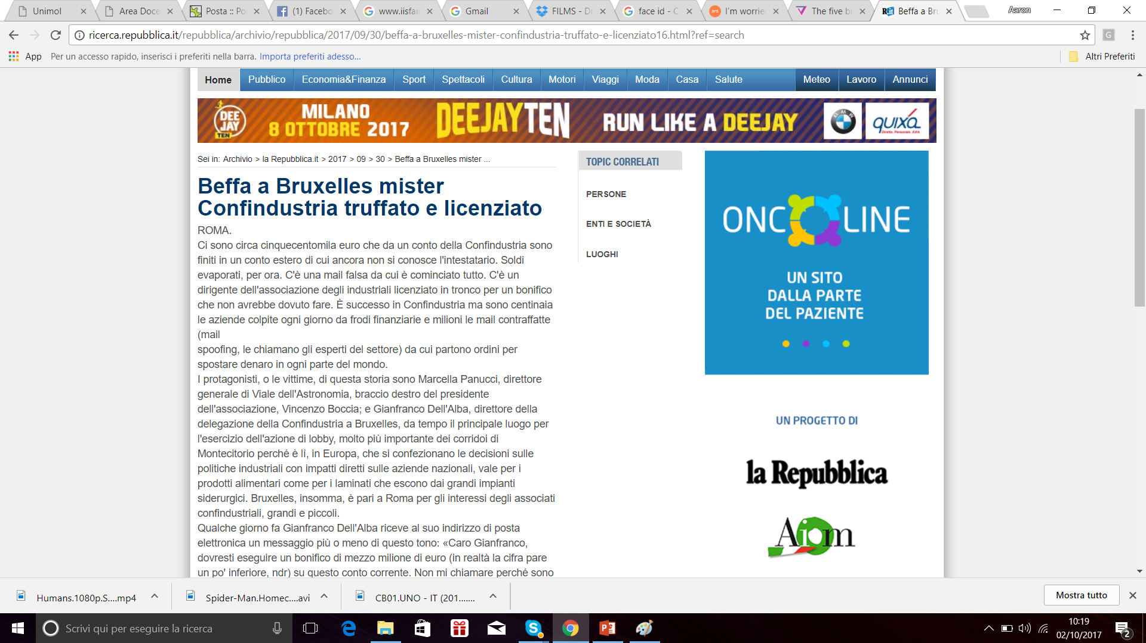

Slide 2
Design Principles

Slide 3
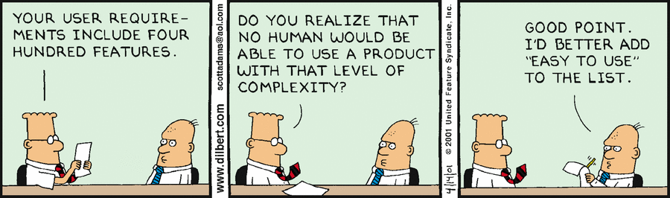
Simplicity is important

Slide 4
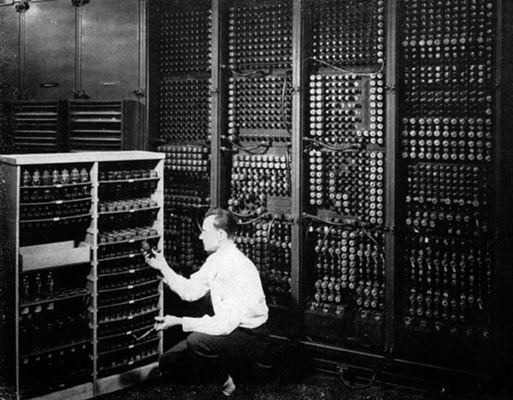
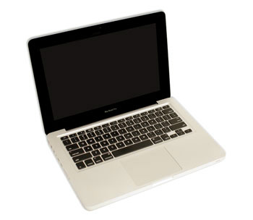
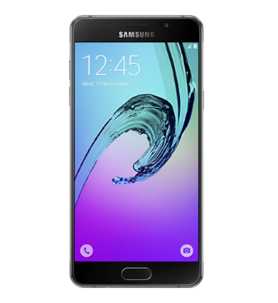
Simplicity is important

Slide 5

Simplicity is important (or User Experience?) 1 of 2

Slide 6
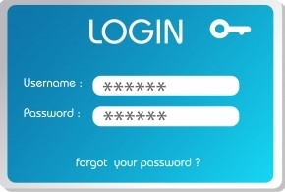

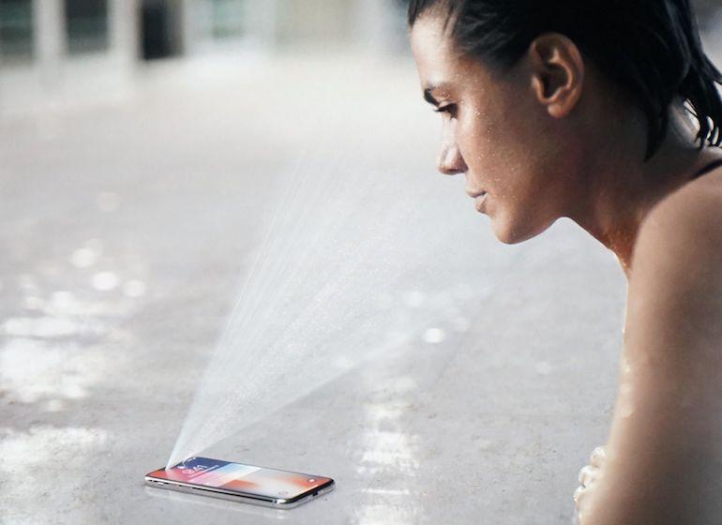
Simplicity is important (or User Experience?) 2 of 2
https://www.theverge.com/2017/9/12/16298156/apple-iphone-x-face-id-security-privacy-police-unlock

Slide 7
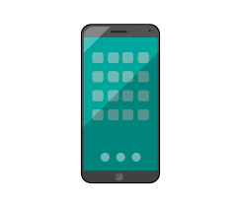


Speaker Recognition

Slide 8

Iris recognition

Slide 9
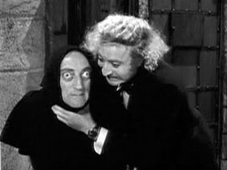
Iris recognition (threats?)

Slide 10
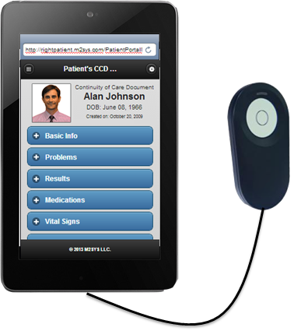
Iris Recognition device

Slide 11
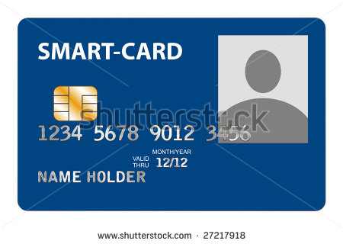
Is that secure?

Slide 12
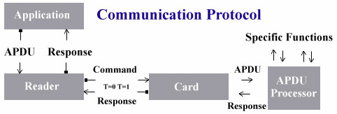
How smart card works
DES, 3 DES, RSA -> 56, 168, 1024 bit
UV lights, high temperature, high voltage: EEPROM modification on the chip
Notes:
The most common encryption methods are symmetric DES (Data Encryption Standard), 3DES (triple DES) and public key RSA (Rivest-Shamir-Adleman's algorithm), allowing up 56, 168, and 1024 bit long keys, respectively. Unfortunately, these keys are not unbreakable, as explained by Ross Anderson and Markus Kuhn in their book `Design Principles for Tamper-Resistant Smart Card Processors'. The pair managed to crack the Dallas DS5002FP Secure Microcontroller, described at the time by one European signals intelligence agency as the most secure processor available on general sale. They used brute force methods on a PC enhanced with a couple of hundred dollars of extra hardware!

Slide 13
Simplicity is important
Minimizing the interaction of system components minimizes the number of sanity checks
Reduces the potential for inconsistencies
Restrictions minimize the power of an entity
Entities can communicate with other entities only when necessary
“Communication” is used in its widest possible sense

Slide 14
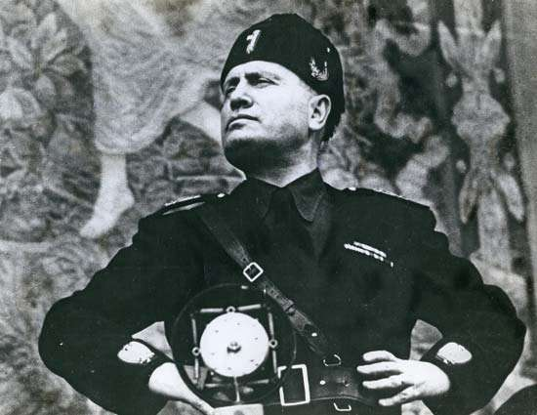
Least Privilege
Notes:
Some of the most famous violations of the principle of least privilege exist in UNIX systems. For example, in UNIX systems, root privileges are necessary to bind a program to a port number less than 1024. For example, to run a mail server on port 25, the traditional SMTP port, a program needs the privileges of the root user. However, once a program has set up shop on port 25, there is no compelling need for it to ever use root privileges again
The UNIX operating system does not apply access controls to the user root. That user can terminate any process and read, write, or delete any file. Thus, users who create back-ups can also delete files. The administrator account on Windows has the same powers.

Slide 15
Least Privilege
Definition 12–1. The principle of least privilege states that a subject should be given only those privileges that it needs in order to complete its task.
the function of the subject (as opposed to its identity) should control the assignment of rights
Extra rights should be relinquished immediately on the completion of the action
In practice, most systems do not have the granularity of privileges and permissions required to apply this principle precisely
This principle requires that processes should be confined to as small a protection domain as possible.
Notes:
Some of the most famous violations of the principle of least privilege exist in UNIX systems. For example, in UNIX systems, root privileges are necessary to bind a program to a port number less than 1024. For example, to run a mail server on port 25, the traditional SMTP port, a program needs the privileges of the root user. However, once a program has set up shop on port 25, there is no compelling need for it to ever use root privileges again
The UNIX operating system does not apply access controls to the user root. That user can terminate any process and read, write, or delete any file. Thus, users who create back-ups can also delete files. The administrator account on Windows has the same powers.

Slide 16
Example
in UNIX systems, root privileges are necessary to bind a program to a port number less than 1024.
For example, to run a mail server on port 25, the traditional SMTP port, a program needs the privileges of the root user.
However, once a program has set up shop on port 25, there is no compelling need for it to ever use root privileges again
The UNIX operating system does not apply access controls to the user root.
That user can terminate any process and read, write, or delete any file. Thus, users who create back-ups can also delete files.
The administrator account on Windows has the same powers.

Slide 17

Principle of Fail-Safe Defaults
Definition 12–2. The principle of fail-safe defaults states that, unless a subject is given explicit access to an object, it should be denied access to that object.
Whenever access, privileges, or some security-related attribute is not explicitly granted, it should be denied

Slide 18
DWORD dwRet = IsAccessAllowed(...);
if (dwRet == ERROR_ACCESS_DENIED)
{ // Security check failed.
// Inform user that access is denied.
}
else
{ // Security check OK. }
DWORD dwRet = IsAccessAllowed(...);
if (dwRet == NO_ERROR) {
// Secure check OK.
// Perform task. }
else {
// Security check failed.
// Inform user that access is denied. }

Slide 19
Principle of Economy of Mechanism
Definition 12–3. The principle of economy of mechanism states that security mechanisms should be as simple as possible.
Less testing
Less errors
Less assumptions
Less interactions
User experience!
Notes:
ESEMPI: FIREWALL, ANTIVIRUS

Slide 20
Principle of Complete Mediation
Definition 12–4. The principle of complete mediation requires that all accesses to objects be checked to ensure that they are allowed.
Most systems would not make the second check
UNIX process tries to read a file -> OS determines if it is allowed -> the process receives a file descriptor -> the process presents the file descriptor to the OS -> the Kernel allows the access
The owner disallows the permission after the file descriptor is issued, the kernel still allows the process -> violaiton of the principle.
Notes:
UNIX process tries to read a file -> OS determines if it is allowed -> the process receives a file descriptor -> the process presents the file descriptor to the OS -> the Kernel allows the access
The owner disallows the permission after the file descriptor is issued, the kernel still allows the process -> violaiton of the principle.
DNS poisoning the same.

Slide 21
Principle of Open Design
Definition 12–5. The principle of open design states that the security of a mechanism should not depend on the secrecy of its design or implementation
Security by obscurity
Criptography
OpenSSL
Firefox
PfSense
ClearOS
Untangle
ZeroShell

Slide 22
Principle of Separation of Privilege & Least Common Mechanism
Definition 12–6. The principle of separation of privilege states that a system should not grant permission based on a single condition.
On Berkeley-based versions of the UNIX operating system, users are not allowed to change from their accounts to the root account unless two conditions are met.
The first condition is that the user knows the root password. The second condition is that the user is in the wheel group (the group with GID 0). Meeting either condition is not sufficient to acquire root access; meeting both conditions is required.
Definition 12–7. The principle of least common mechanism states that mechanisms used to access resources should not be shared.
Amazon suddivide le password di accesso in due parti depositate su due server differenti.
Notes:
On Berkeley-based versions of the UNIX operating system, users are not
allowed to change from their accounts to the root account unless two conditions are
met. The first condition is that the user knows the root password. The second condition
is that the user is in the wheel group (the group with GID 0). Meeting either condition
is not sufficient to acquire root access; meeting both conditions is required.

Slide 23
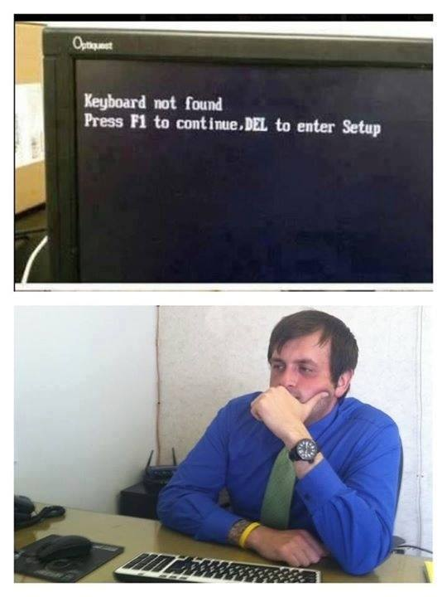
Principle of Psychological Acceptability
Definition 12–8. The principle of psychological acceptability states that security mechanisms should not make the resource more difficult to access than if the security mechanisms were not present.

Slide 24

User Security

Slide 25
Policy
U1. Only users have access to their accounts.
U2. No other user can read or change a file without the owner’s permission.
U3. Users shall protect the integrity, confidentiality, and availability of their files.
U4. Users shall be aware of all commands that they enter, or that are entered on their behalf.

Slide 26
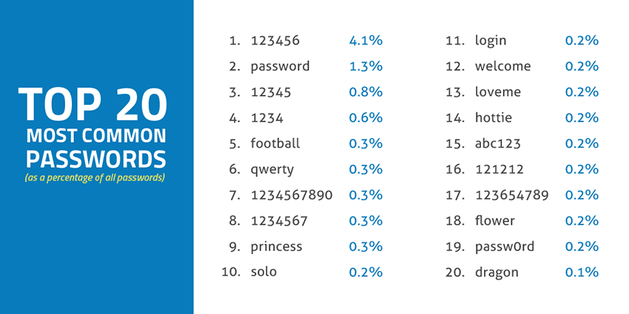

Slide 27
Access
Passwords
Centrally manage the system of password generation
Login Procedure
Captive login screen
Shoulder surfing
Trusted hosts
The notion of “trusted hosts” comes from the belief that if two hosts are under the same administrative control, each can rely on the other to authenticate a user.
Leaving the system
A common problem is that users will leave their sessions unattended
Screen locking programs may have security holes (master password)
Notes:
The first potential attack arises from the lack of mutual authentication on most systems.
Secure Xenix [361] had an alternative approach that is common to systems that desire high assurance authentication of users. When a user wished to log in,
he struck a particular combination of keys that created a trusted path to the kernel. No application program could disable this feature; no application program could
read or alter the information given to the kernel over that path. The kernel then performed
the identification and authentication processing and granted or denied the
user access.
Many protocols,
such as ftp and telnet, do not encipher messages. If a user name and password are
sent over such a connection, they are visible at every intermediate node and network.
Other protocols, such as SSH and SSL, provide enciphered “tunnels” through which
other protocols can be sent.8 This provides the user with confidentiality even when
the protocols themselves do not. In some environments, this is unnecessary. For
example, the Drib firewalls block any traffic to the Internet, and hosts and networks
within the Drib are trusted not to capture network traffic. In other environments,
especially when messages are sent over untrusted links, enciphering of all messages
is prudent.

Slide 28
Files and Devices
Users must protect confidentiality and integrity of the files to satisfy policy component U2
Groups must be formed only on a role based approach.
users should limit access as much as possible when creating new files.
Definition 25–1. A direct alias is a directory entry that points to (names) the file. An indirect alias is a directory entry that points to a special file containing the name of the target file. The operating system interprets the indirect alias by substituting the contents of the special file for the name of the indirect alias file.
The representation of containment in a directory affects security. If each direct alias can have different permissions, the owner of a file must change the access modes of each alias in order to control access.
When a user deletes a file, the directory entry is removed
The second issue affecting file deletion is persistence
The third issue lies in the difference between direct and indirect aliases
Notes:
Windows NT -> ACL inherited by the parent directory
UNIX-> user identified permission to be denied -> umask: permission to deny
The file attribute table contains information
The representation of containment in a directory affects security. If each direct
alias can have different permissions, the owner of a file must change the access
modes of each alias in order to control access. To avoid this, most systems associate
the file attribute information with the actual data, and directory entries consist of a
pointer to the file attribute table.
When a user deletes a file, the directory entry is removed. The system tracks
the number of directory entries for each file, and when that number becomes 0, the
data blocks and table entries for that file are released. This means that deleting a file
does not ensure that the file is unavailable; it merely deletes the directory entry. about the file. The file mapping table contains information that allows the operating system to locate the disk blocks that compose the file.

Slide 29
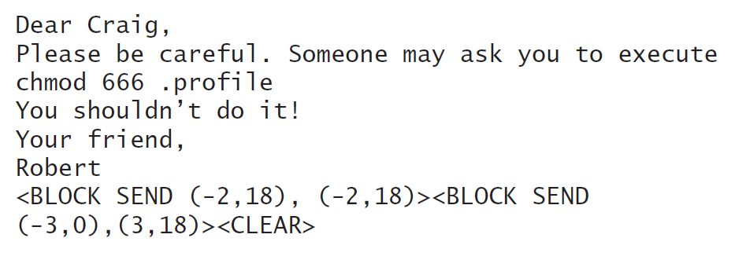

Devices
Writable devices: allow any user to write to them
Smart terminals: built-in functions.
In smart terminals block send can be used to implant a Trojan horse.

Slide 30
Processes
Copying a file duplicates its contents. If the attributes are not copied, the user may need to take steps to preserve the integrity and confidentiality of the file.
the file attributes of the move command follow those of the copy command. Otherwise, the move command may preserve the attributes of the original command.
Part of policy component U3 is to protect users from themselves. Sometimes people make mistakes when they enter commands. These mistakes can have unpleasant consequences

Slide 31



Slide 32
Encryption
The basis for encryption is trust
The circumstances under which a password should reside in a system are few. Unless unavoidable, no password should reside unenciphered in a system, either on disk or in memory.
The set of start-up files, and the order in which they are accessed, affect the execution of the program.
Users should know which of their programs grant additional privileges to others. They should also understand the implications of granting such privileges.

Slide 33
Malicious Logic
Because programs rely on search paths, users must take care to set theirs appropriately.
U4 requires that the users have only trusted directories in their search paths
Electronic mail comes from untrusted sources. Hence, in general, the contents of e-mail messages are not trustworthy
a certificate may validate a signature, but the certificate itself may be compromised, invalid, or expired
Attachments to electronic mail may contain data of which the sender is not aware.
When these files are sent, the recipient may see more than the sender intended.

