Slide 1
Network security

Slide 2
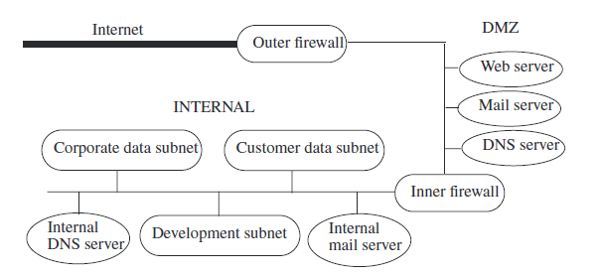
Network organization
The DMZ is a portion of a network that separates a purely internal network from an external network.
Information: Internet -> internal network, confidentiality is not at issue. However, integrity is.
Information: internal network -> Internet, confidentiality and integrity are both at issue.

Slide 3
Firewall & Proxies
A firewall is a host that mediates access to a network, allowing and disallowing certain types of access on the basis of a configured security policy.
A filtering firewall performs access control on the basis of attributes of the packet headers, such as destination addresses, source addresses, and options.
A proxy is an intermediate agent or server that acts on behalf of an endpoint without allowing a direct connection between the two endpoints.
A proxy (or applications level) firewall uses proxies to perform access control. A proxy firewall can base access control on the contents of packets and messages, as well as on attributes of the packet headers.

Slide 4
Analysis of the Network Infrastructure
limit the flow of information from the internal network to the DMZ.
The basic idea: the public cannot communicate directly with any system in the internal network,
nor can any system in the internal network communicate directly with other systems on the Internet (beyond the “outer firewall”).

Slide 5
PUBLIC ENTITIES
INTERNET
Internal network
?
DMZ
Corporate perimeter
Outer firewall
Hides knowledge of the internal network
Inner
firewall
proxy

Slide 6
PUBLIC ENTITIES
INTERNET
Internal network
?
DMZ
Corporate perimeter
Outer firewall
Inner
firewall

Slide 7
The DMZ mail server must know an address in order for the internal mail server to pass mail back and forth.
External connections to the Web server go into the DMZ and no farther. If any information is to be transmitted from the Web server to the internal network (for example, the customer data subnet), the transmission is made separately, and not as part of a Web transaction.

Slide 8
Privilege of the least privilege
Complete mediation
Separation of privilege

Slide 9
Outer Firewall Configuration
The public needs to be able to access the Web server and mail server, and no other services.
Firewall interface allows: HTTP(S) + SMTP.
Firewall analyzes the mail and sends it to the DMZ mail server.
Firewall analyzes the message and sends it to the DMZ Web Server.
Attackers should:
Enter through the web server ports
Through SMTP ports
Through vulnerability in the firewall

Slide 10
Inner Firewall Configuration
the inner firewall will block all traffic except for that specifically authorized to enter
such information will come from the DMZ
It allows:
STMP connection, all e-mail are sent to the DMZ mail server
Limited transfer of information to the DMZ to the DNS server in the DMZ
System administrators to access the systems in the DMZ from a trusted administrative server
All other traffic is blocked

Slide 11
DMZ Mail Server
The mail server in the DMZ performs address and content checking on all electronic mail messages
The mail proxy reassembles the message into a set of headers, a letter, and any attachments. The attachments are assembled into their native form (not the form used to transmit them through electronic mail).
The mail proxy scans the letter and attachments, looking for any “bad” content. The attachments are then restored to the form used to transmit them through electronic mail. The headers, the letter, and the attachments are rescanned for any violation of the SMTP specification.
The mail proxy scans the recipient address lines. The addresses that directed the mail to the Drib are rewritten to direct the mail to the internal mail server. The DMZ mail server then forwards the mail to the internal mail server.

Slide 12
DMZ WWW Server
The Web server accepts and services requests from the Internet. It does not contact any servers or information sources within the internal network. This means that if the Web server is compromised, the compromise cannot affect internal hosts.
The Web server uses the IP address of the outside firewall. This hides part of the DMZ configuration in accordance with the principle of least privilege (because people outside the network need not know the address), and forces external entities to send Web traffic to the firewall.
Periodically (or on request), an administrator will copy the contents of the WWW-clone to the DMZ Web server
Like the mail server, the WWW server also runs an SSH server for maintenance and updating

Slide 13
DMZ DNS Server
The DMZ DNS host contains directory name service information about those hosts that the DMZ servers must know.
It contains entries for the following.
DMZ mail, Web, and log hosts
Internal trusted administrative host
Outer firewall
Inner firewall
Note that the DNS server does not know the addresses of the internal mail server. The inner firewall will forward mail to that server.

Slide 14
DMZ Log Server
attackers can delete logs, so if the logs were on the attacked machines, they might be tampered with or erased.
The log system is placed in the DMZ to confine its activity. It never initiates transfer to the inner network.
the log server accepts connections from the internal
trusted administrative host. Administrators can view the logs directly, or they can replace the write-once media with another instance of the media and read the extracted media directly.

Slide 15
System Security

Slide 16
Web Server Consequences
no unrequested network connections except those from the outer firewall over the HTTP and HTTPS ports, and those from the internal trusted administrative server over SSH, should be accepted.
user access to the system is to be limited to those users on the internal trusted administrative server
Web server should be configured to provide minimal access to the system.
all software must have a very high assurance of functioning correctly
the Web server must contain as few programs, and as little software, configuration information, and other data, as possible

Slide 17
The Development System
The development system lies in the internal network, on the development subnet
The infrastructure systems:
the devnet firewall (which separates it from other internal subnets),
a DNS server,
a logging host (which provides a central repository for logs),
one or more file servers, and
one or more systems containing user information common to the workstations (the UINFO servers).
an isolated system used to build a “base system configuration”

Slide 18
Dev System constraints
Only authorized users are allowed to use the devnet systems
Workstation system administrators must be able to access the workstations at all times, unless the particular workstation has crashed
Within the devnet itself, users are trusted not to attack devnet systems. Users not on the devnet are not trusted
All network communications, except electronic mail, are to be confidential
The base standard configuration for each devnet system cannot be changed on that system
Backups shall enable system administrators to restore any devnet system with the loss of at most one day’s changes in user and local files
Security officers shall perform both periodic and ongoing audits of devnet systems.

Slide 19
The development System consequences
the need for authenticated, enciphered, integrity-checked communications.
each workstation have one or more local privileged accounts to administer the system locally
there be a notion of a “login” or “audit” user
If a developer wants to install a program from the outside onto his devnet workstation, he must first obtain approval from the security officers
each workstation protect the base system configuration, as installed, from being altered
an employee’s files be available to her continuously regular backups
Security precautions
Logging
Sweep of the network

Slide 20
The Web Server System in the DMZ…
External users can reach the Web Server only by using Web services and connecting through the outer firewall
Internal users can reach the system by using SSH from the trusted administrative system, through the inner firewall.
A security mechanism must block any other types of connections, or any connections from sources other than the outer firewall or the trusted administrative server
the DMZ Web server is configured to accept requests from the inner firewall as
well as the outer firewall. The server will not accept requests from other DMZ systems, because they are not to be used for accessing the Web server

Slide 21
… The Web Server System in the DMZ
the Web server system must request IP addresses and host names, it must make requests of, and receive replies from, a DMZ DNS server
The Web server system also runs a logging client to send log messages to the log server.
The system is configured to log any attempts to connect to network ports on which no servers are listening.
The three reasons:
Check the outer firewall is intercepting all probes
Detects probes from the internal network
Probes to other ports from within the DMZ indicate unhautorized activities on the DMZ systems.

Slide 22
The Development System
the development system
accept user connections only when they are authenticated and encrypted
run SSH servers to provide such access
Unlike the DMZ Web server system, the development system runs several other servers.
The development system does not have the ftp or Web services
The workstations run an SMTP server as a convenience to users,15 but all mail is forwarded to a central mail server and is never delivered locally
users can make files available for ftp and Web access by placing them into user-specific directories on the central file server
The development system uses access control wrappers to support access controls

Slide 23
The Web Server System in the DMZ (users)
The Web server requires at most two users and a sysadmin
The first user is a user with enough privileges to read (and serve) Web pages and to write to the Web server transaction area.
The second user is a user who can move files from the Web transaction area to the commerce transaction spooling area.
The commerce server and the Web server should be different users in order to prevent an attacker from compromising the Web server and then deleting files from the commerce server’s area

Slide 24
The development System (users)
Unlike the DMZ WWW server system, the development system requires:
at least one user account per developer
administrative accounts
This account gives administrators access should the workstation be unable to contact the NIS server. Because there are both primary and secondary NIS servers, and backups for each, the only reason that this situation might arise would be either a network problem or a workstation problem.
Using the local root account, the administrator could access the workstation, diagnose the problem, and (if possible) correct the problem at the client
Pag 555 introtoComp

Slide 25
Vulnerability Analysis
The specific failure of the controls is called a vulnerability or security flaw; using that failure to violate the site security policy is called exploiting the vulnerability. One who attempts to exploit the vulnerability is called an attacker.
Formal verification and property-based testing are techniques for detecting vulnerabilities
What about policies procedures operating environment
Penetration testing is a testing technique, not a proof technique. It can never prove the absence of security flaws; it can only prove their presence

Slide 26
Penetration Studies
A penetration study is a test for evaluating the strengths of all security controls on the computer system. The goal of the study is to violate the site security policy.
Example goals of penetration studies are gaining of read or write access to specific objects, files, or accounts; gaining of specific privileges; and disruption or denial of the availability of objects.
EXAMPLE: A vendor is implementing a subsystem designed to provide password protection for user files. With this subsystem, the owner of a file can require others to provide a password before gaining access to that file. The goal of a penetration study is to test these controls. The metric is binary: were the testers able to gain access to a (possibly designated) password protected file, either by not using a password or by gaining unauthorized access to a password?

Slide 27
Penetration study: the goals
A second type of study does not have a specific target; instead, the goal is to find some number of vulnerabilities or to find vulnerabilities within a set period of time.
the most notable contraints are constraints on resources (such as money) and constraints on time.
EXAMPLE: A company obtains documents from other vendors and, after 30 days, publishes them on the World Wide Web. The vendors require that the documents be confidential for that length of time. A penetration study of this site might set the goal of obtaining access to a specific file; the test could be limited to 30 days in order to duplicate the conditions under which the site will operate. An alternative goal might be to gain access to any of these files; in this case, no time limit should be specified because a test could involve planting of Trojan horses that would last more than 30 days.

Slide 28
Layering of tests
A penetration test is designed to characterize the effectiveness of security mechanisms and controls to attackers:
External attacker with no knowledge of the system
External attacker with access to the system
Internal attacker with access to the system
The usefulness of a penetration study comes from the documentation and conclusions drawn from the study and not from the success or failure of the attempted penetration

Slide 29
Flaw Hypothesis Methodology
The Flaw Hypothesis Methodology was developed at System Development Corporation and provides a framework for penetration studies
Information gathering. In this step, the testers become familiar with the system’s functioning. They examine the system’s design, its implementation, its operating procedures, and its use. The testers become as familiar with the system as possible.
Flaw hypothesis. Drawing on the knowledge gained in the first step, and on knowledge of vulnerabilities in other systems, the testers hypothesize flaws of the system under study.
Flaw testing. The testers test their hypothesized flaws. If a flaw does not exist (or cannot be exploited), the testers go back to step 2. If the flaw is exploited, they proceed to the next step.
Flaw generalization. Once a flaw has been successfully exploited, the testers attempt to generalize the vulnerability and find others similar to it. They feed their new understanding (or new hypothesis) back into step 2 and iterate until the test is concluded.
Flaw elimination. The testers suggest ways to eliminate the flaw or to use procedural controls to ameliorate it.

Slide 30
Information Gathering and Flaw Hypothesis
Design
Information flows
Internal inconsistencies
Incorrect assumptions
Interfaces
Design documents
Manuals
Policies
Critical to this step is the identification of the structures and mechanisms that control the system.

Slide 31
Flaw testing
determine the order in which to test the flaws
the testers study the hypothetical flaws
From analysis?
If not, demonstrate why and how it arises
The test should be as simple as possible but must demonstrate that the exploitation succeeded
Flaw generalization
Flaw elimination

Slide 32
Vulnerability Classification
The ability to specify, design, and implement a computer system without vulnerabilities.
The ability to analyze a computer system to detect vulnerabilities (which feeds into the Flaw Hypothesis Methodology step of penetration testing).
The ability to address any vulnerabilities introduced during the operation of the computer system (possibly leading to a redesign or reimplementation of the flawed components).
The ability to detect attempted exploitations of vulnerabilities.

Slide 33
RISOS (intro)
The RISOS (Research Into Secure Operating Systems) study was prepared to aid computer and system managers and information processing specialists in understanding security issues in operating systems
Incomplete parameter validation
Inconsistent parameter validation
Implicit sharing of privileged/confidential data
Asynchronous validation/inadequate serialization
Inadequate identification/authentication/authorization
Violable prohibition/limit
Exploitable logic error

Slide 34
Flaw classes
Incomplete parameter validation occurs when a parameter is not checked before use
Inconsistent parameter validation is a design flaw in which each individual routine using data checks that the data is in the proper format for that routine, but the routines require different formats.
implicit sharing of privileged/confidential data flaws
asynchronous validation/inadequate serialization
Inadequate identification/authorization/authentication
Violable prohibition/limit flaws arise when system designers fail to handle bounds conditions properly
Exploitable logic error flaws encompass problems not falling into any of the other classes;

Slide 35
Protection Analysis Model
The Protection Analysis (PA) study attempted to break the operating system protection problem into smaller, more manageable pieces
Improper protection domain initialization and enforcement
Improper choice of initial protection domain (domain)
Improper isolation of implementation detail (exposed representations)
Improper change (consistency of data over time)
Improper naming (naming)
Improper deallocation or deletion (residuals)
Improper validation (validation of operands, queue management dependencies)
Improper synchronization
Improper indivisibility (interrupted atomic operations)
Improper sequencing (serialization)
Improper choice of operand or operation (critical operator selection errors)

Slide 36
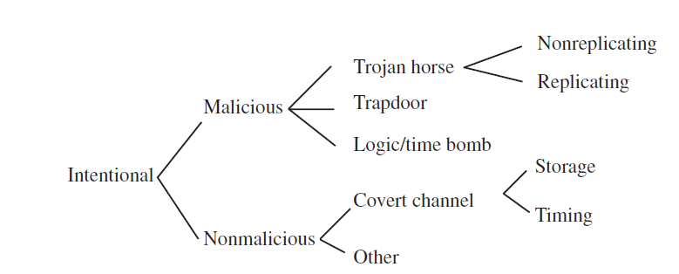
NRL Taxonomy…
Developed by In 1992, Landwehr, Bull, McDermott, and Choi.
Flaws by genesis

Slide 37
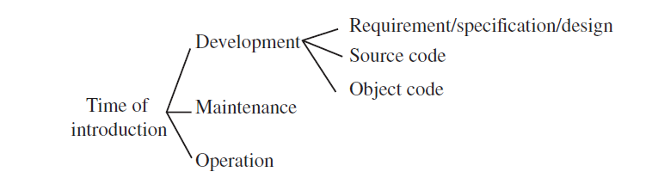
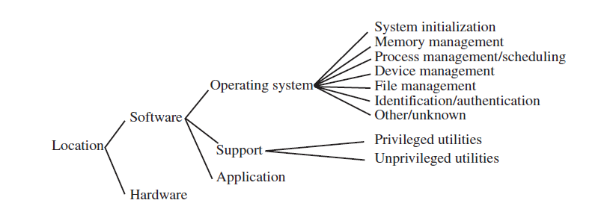
… NRL Taxonomy…
Flaws by time of introduction
Flaws by location

Slide 38
Alam’s Model
Coding faults
synchronization errors
Condition validation errors
Emergent faults
configuration errors
environment faults

Slide 39
Auditing
Logging is the recording of events or statistics to provide information about system use and performance
Auditing is the analysis of log records to present information about the system in a clear and understandable manner
Highlight usage patterns
Which information to log and which information to audit

Slide 40
Logger
Logging mechanisms record information. The type and quantity of information are dictated by system or program configuration parameters. The mechanisms may record information in binary or human-readable form or transmit it directly to an analysis mechanism. A log-viewing tool is usually provided if the logs are recorded in binary form, so a user can examine the raw data or manipulate it using text-processing tools.

Slide 41
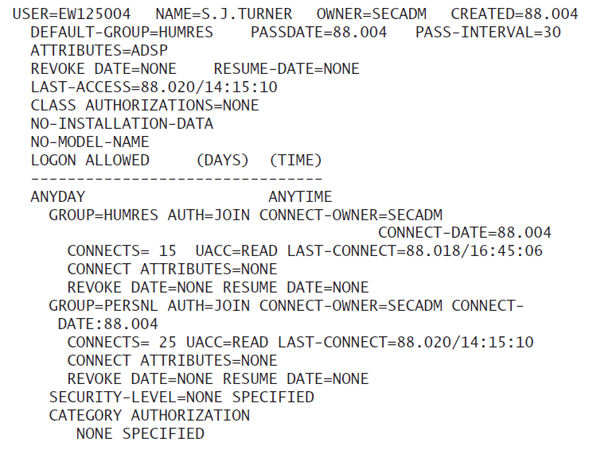
RACF

Slide 42
Analyzer
An analyzer takes a log as input and analyzes it. The results of the analysis may lead to changes in the data being recorded, to detection of some event or problem, or both.
The analyzer passes the results of the analysis to the notifier. The notifier informs the analyst, and other entities, of the results of the audit. The entities may take some action in response to these results.

Slide 43
Design of an Auditing System
The goals of the auditing process determine what information is logged
the auditors desire to detect violations of policy
Represent constraints as “action ⇒ condition.” Implication requires that the action be true (which means that the action occurred, in this context) before any valid conclusion about the condition can be deduced.

Slide 44
Syntactic Issues
One critical issue is how to log: what data should be placed in the log file, and how it should be expressed
a single log entry may not contain all the information about a particular action.
Flack and Atallah suggest using a grammar-based approach to specifying log content
most current log entries are not specified using grammars

Slide 45
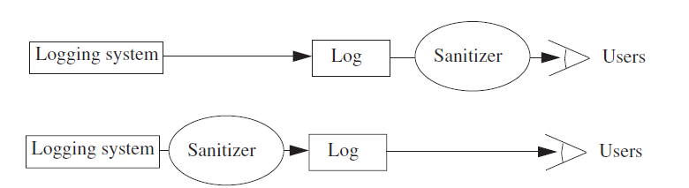
Log Sanitization
Let U be a set of users. The policy P defines a set of information C(U) that members of U are not allowed to see. Then the log L is sanitized with respect to P and U when all instances of information in C(U) are deleted from L.
P may forbid the information to leave the site

Slide 46
An anonymizing sanitizer deletes information in such a way that it cannot be reconstructed by either the recipient or the originator of the data in the log.
A pseudonymizing sanitizer deletes information in such a way that the originator of the log can reconstruct the deleted information.
Biskup and Flegel point out that one need not sanitize data that is not collected. Therefore, if a log is to be sanitized to provide anonymity, the simplest technique is simply not to collect the data.

Slide 47
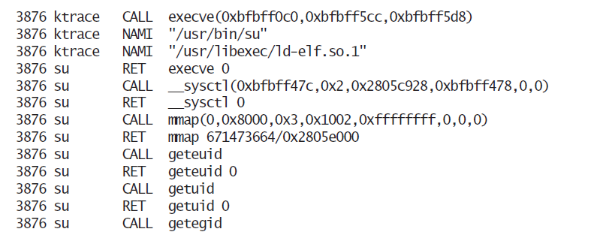
Application & System Logging
Application logs consist of entries made by applications. These entries typically use high-level abstractions, such as
System logs consist of entries of kernel events. These entries do not include high-level information. They report system calls and events

Slide 48
Application & System Logging
If the audit is to focus on application events, such as failures to provide correct passwords (the su entry) or failures to deliver letters (the SMTP entry), an application log provides a simple way of recording the events for analysis
The advantage of system logs is the completeness of the information recorded
The advantage of application logs is the level of abstraction
The correlation problem relates system and application logs. Given a system log composed of events from one execution of an application, and the corresponding application log, how can one determine which system log entries correspond to entries in the application log, and vice versa?

Slide 49
A posteriori Design
Most security breaches arise on existing systems that were not designed with security considerations in mind. In this case, auditing may have two different goals.
The first goal is to detect any violations of a stated policy; the second is to detect actions that are known to be part of an attempt to breach security.
Analysts must analyze the system to determine what actions and settings are consistent with the policy. They then design mechanisms for checking that the actions and settings are in fact consistent with the policy.

Slide 50
State-Based Auditing
A state-based logging mechanism records information about a system’s state. A state-based auditing mechanism determines whether or not a state of the system is unauthorized.
There is a tacit assumption that a state-based logging mechanism can take a snapshot of the system.

Slide 51
Transition-Based Auditing
A transition-based logging mechanism records information about an action on a system. A transition-based auditing mechanism examines the current state of the system and the proposed transition (command) to determine if the result will place the system in an unauthorized state.
transition-based logging may not be sufficient to enable a transition-based auditing mechanism to determine if the system will enter an unauthorized state.
Used only when specific transitions always require an examination (as in the example of changes of privilege) or when some state analysis is also performed

Slide 52
Auditing to Detect Known Violations of a Policy
In many cases, the security policy is not stated explicitly
However, certain behaviors are considered to be “nonsecure.”
Under these conditions, analysts can determine specific sequences of commands, or properties of states, that indicate a security violation and look for that violation

Slide 53
Auditing Mechanisms
Systems designed with security in mind have auditing mechanisms integrated with the system design and implementation.

Slide 54
Audit Browsing
The audit mechanisms may miss information or irregularities in the log that a knowledgeable auditor can detect
The goal of an audit browsing tool is to present log information in a form that is easy for the analyst to understand and use.
Text display shows the logs in a textual format
Hypertext display shows the logs as a set of hypertext documents with associated log entries linked by hypertext constructs.
Relational database browsing requires that the logs be stored in a relational database
Replay presents the events of interest in temporal order
Graphing provides a visual representation of the contents of logs.
Slicing obtains a minimum set of log events and objects that affect a given object.
Audit browsing tools emphasize associations that are of interest to the auditor.
Hence, their configurations depend on the goals of the audit.

Slide 55
Intrusion Detection

Slide 56
principles
The actions of users and processes generally conform to a statistically predictable pattern
The actions of users and processes do not include sequences of commands to subvert the security policy of the system.
The actions of processes conform to a set of specifications describing actions that the processes are allowed to do
Denning hypothesized that systems under attack fail to meet at least one of these characteristics.

Slide 57
Basic Intrusion Detection
An attack tool is an automated script designed to violate a security policy.
security violations can be detected by looking for abnormalities
Denning model:
Deviation from usual actions (anomaly detection),
execution of actions that lead to break-ins (misuse detection), and
actions inconsistent with the specifications of privileged programs (specification-based detection).
Systems that do this are called intrusion detection systems (IDS)

Slide 58
Goals of IDS
Detect a wide variety of intrusions.
Detect intrusions in a timely fashion
Present the analysis in a simple, easy-to-understand format
Be accurate.
Intrusion detection systems determine if actions constitute intrusions on the basis of one or more models of intrusion
A model classifies a sequence of states or actions as “good” (no intrusions) or “bad” (possible intrusions).
Anomaly models use a statistical characterization
Misuse models compare actions or states with sequences known to indicate intrusions
Specification-based models classify states that violate the specifications
models may be
adaptive : alter their behavior on the basis of system states and actions,
Static: are initialized from collected data and do not change as the system runs

Slide 59
Anomaly Modeling
Anomaly detection analyzes a set of characteristics of the system and compares their behavior with a set of expected values. It reports when the computed statistics do not match the expected measurements.
Three Models from Denning
Threshold metric
Determining the threshold complicates use of this model
statistical moments
Profile may evolve over time
The statistical moments model provides more flexibility than the threshold model, but it is more complex
Markov Model
The effectiveness of Markov-based models depends on the adequacy of the data used to establish the model

Slide 60
Misuse Modeling
Misuse detection determines whether a sequence of instructions being executed is known to violate the site security policy being executed. If so, it reports a potential intrusion.
Modeling of misuse requires a knowledge of system vulnerabilities or potential vulnerabilities that attackers attempt to exploit (rule set)
Misuse-based intrusion detection systems often use expert systems to analyze the data and apply the rule set
Cannot detect unknown attacks

Slide 61
Specification Modeling
Specification-based detection determines whether or not a sequence of instructions violates a specification of how a program, or system, should execute. If so, it reports a potential intrusion.
Specification-based intrusion detection is in its infancy. Among its appealing qualities are the formalization (at a relatively low level) of what should happen. This means that intrusions using unknown attacks will be detected.

Slide 62
The Agent
An agent obtains information from a data source (or set of data sources).
The information, once acquired, may be sent directly to the director.
the agent may discard information that it deems irrelevant.
The director may determine that it needs more information from a particular information source. In that case, the director can instruct the agent to collect additional data, or to process the data it collects differently

Slide 63
Host-based information gathering
Host-based agents usually use system and application logs to obtain records of events, and analyze them to determine what to pass to the director
The logs may be security-related logs or accounting logs
the agents are not portable
A variant of host-based information gathering occurs when the agent generates its own information. Policy checkers do this

Slide 64
Network based agents
Network-based agents use a variety of devices and software to monitor network traffic.
It can detect network-oriented attacks, such as a denial of service attack introduced by flooding a network. It can monitor traffic for a large number of hosts. It can also examine the contents of the traffic itself (called content monitoring).
Monitoring of network traffic raises several significant issues. The critical issue is that the analysis software must ensure that the view of the network traffic is exactly the same as at all hosts for which the traffic is intended.
Furthermore, if the traffic is end-to-end enciphered, monitoring the contents from the network is not possible.

Slide 65
The director
The director itself reduces the incoming log entries to eliminate unnecessary and redundant records. It then uses an analysis engine to determine if an attack (or the precursor to an attack) is underway. The analysis engine may use any of, or a mixture of, several techniques to perform its analysis.
it is usually run on a separate system
Correlates information from multiple sources
Many types of directors alter the set of rules that they use to make decisions.
Directors rarely use only one analysis technique, because different techniques highlight different aspects of intrusions. The results of each are combined, analyzed and reduced, and then used.

Slide 66
The Notifier
The notifier accepts information from the director and takes the appropriate action.
Notification
Take actions
Incident response is a type of notification
disconnecting from the network,
Filtering packets from attacking hosts,
increasing the level of logging, and
instructing agents to forward information from additional sources.

Slide 67
Organization of Intrusion detection Systems

Slide 68
Network Security Monitor
The Network Security Monitor (NSM) develops a profile of expected usage of a network and compares current usage with that profile the definition of a set of signatures to look for specific sequences of network traffic that indicate attacks
It runs on LAN
The NSM monitors the source, destination, and service of network traffic. It assigns a unique connection ID to each connection
The source, destination, and service are used as axes for a matrix. Each element of the matrix contains the number of packets sent over that connection for a specified period of time, and the sum of the data of those packets.
NSM also generates expected connection data from the network.
The data in the array is “masked” by the expected connection data, and any data not within the expected range is reported as an anomaly.

Slide 69
The NSM’s use of a matrix allowed a simple signature-based scheme to look for known patterns of misuse
The implementation of the NSM also allowed the analyst to write specific rules against which to compare network traffic
The NSM provided a graphical user display to enable the system security officer to see at a glance the state of the network.
The NSM is important for two reasons.:
it served as the basis for a large number of intrusion detection systems.
It proved that performing intrusion detection on networks was practical.

Slide 70
Distributed Intrusion Detection System
combined the abilities of the NSM with intrusion detection monitoring of individual hosts
DIDS used a centralized analysis engine (the DIDS director) and required that agents be placed on the systems being monitored as well as in a place to monitor the network traffic.
The agents scanned logs for events of interest
The DIDS director invoked an expert system for data analysis.
The expert system was a rule-based system that could make inferences about individual hosts and about the entire system (hosts and networks). Pass results to the user interface
Results are displayed in a simple, easytograsp manner for the system security officer.

Slide 71
Autonomous Agents: AAFID
In 1995, Crosbie and Spafford noted that an intrusion detection system that obtains information by monitoring systems and networks is a single point of failure.
An autonomous agent is a process that can act independently of the system of which it is a part.
Each agent has its own model and is dedicated to a particular function
The director itself is distributed among the agents
Other advantages include the specialization of each agent
The agents could also migrate through the local network and process data on multiple systems
The approach is scalable
The drawbacks of autonomous agents lie in the overhead of the communications

Slide 72
Intrusion response
Intrusion

Slide 73
Incident Prevention
In the context of response, prevention requires that the attack be identified before it completes. The defenders then take measures to prevent the attack from completing. This may be done manually or automatically.
multilevel secure systems are excellent places to implement jails, because they provide much greater degrees of confinement than do ordinary systems.
More sophisticated host-based approaches may be integrated with intrusion detection mechanisms.
Signature-based methods enable one to monitor transitions for potential attacks.
Anomaly-based methods enable one to monitor relevant system characteristics for anomalies and to react when anomalies are detected in real time.

Slide 74
Intrusion handling
Preparation for an attack. This step occurs before any attacks are detected. It establishes procedures and mechanisms for detecting and responding to attacks.
Identification of an attack. This triggers the emaining phases.
Containment (confinement) of the attack. This step limits the damage as much as possible.
Eradication of the attack. This step stops the attack and blocks further similar attacks.
Recovery from the attack. This step restores the system to a secure state (with respect to the site security policy).
Follow-up to the attack. This step involves taking action against the attacker, identifying problems in the handling of the incident, and recording lessons learned (or lessons not learned that should be learned).

Slide 75
Containment
Containing or confining an attack means limiting the access of the attacker to system resources.
passively monitoring the attack, and
Partially useful, helps to understand and study the attack
constraining access to prevent further damage to the system
Constraint the actions of the attacker
Don’t know what the goals of the attacker are.

Slide 76
Eradication
Eradicating an attack means stopping the attack. The usual approach is to deny access to the system completely (such as by terminating the network connection) or to terminate the processes involved in the attack
to place wrappers around suspected targets
To place firewalls
The Intruder Detection and Isolation Protocol provides a protocol for coordinated responses to attacks
A boundary controller is a system that can block connections from entering a perimeter
The neighbors propagate information about the attack and proceed to trace the connection or datagrams to the appropriate boundary controllers.
The boundary controllers can then coordinate their responses

Slide 77
Follow-up
In the follow-up phase, the systems take some action external to the system against the attacker.
Legal mechanisms-> take a «chain of evidence»
technical attack
The counterattack may harm an innocent party
The counterattack may have side effects
The counterattack is antithetical to the shared use of a network
The counterattack may be legally actionable

