Slide 1
Threat Intelligence

Slide 2
Investigation and Analysis

Slide 3
Threat Intelligence
The question is not if but when!
New approach to opposite malware attacks
Antivirus
Reactive
Approach
SIEM
old
IDS
Firewall
Proactive
Approach
new
Threat Intelligence

Slide 4

Threat Intelligence
We must face off new threats collaborating with other many entities.
It is necessary a continous and timely sharing of knowledge

Slide 5
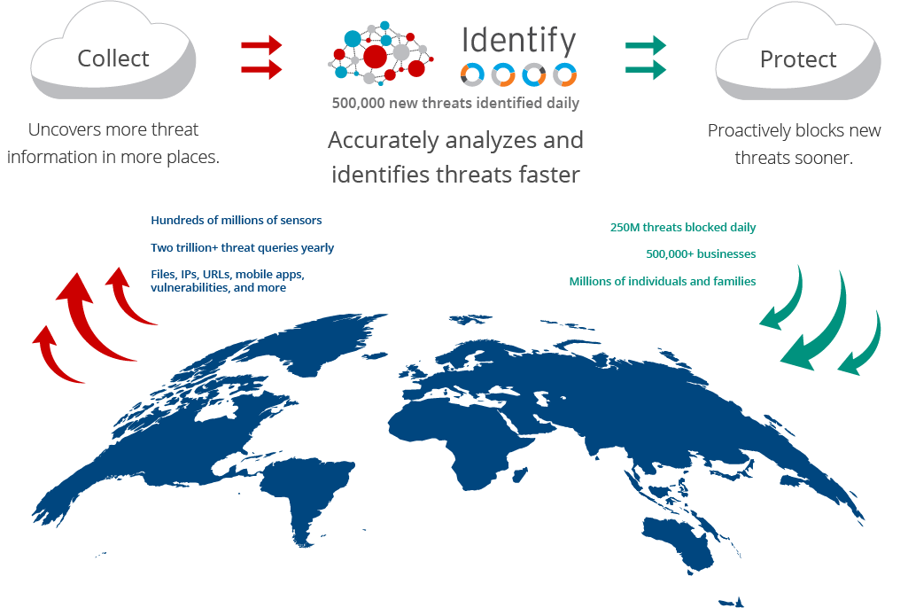
Threat Intelligence
Source:
https://www.trendmicro.com/en_ca/business/technologies/smart-protection-network.html

Slide 6
Threat Intelligence
Threat intelligence is created by a process which takes raw data and information from a variety of sources and turns it in to strategically, tactically or operationally valuable information.
The typical sources of this raw data and information often include:
Human-supplied: human intelligence (HUMINT).
Internet-published: open-source intelligence (OSINT)
Network-traffic-derived: signals intelligence (SIGINT).
Technical artefacts: cyber-intelligence (CYBINT) or cyber-specific technical intelligence (TECHINT).

Slide 7
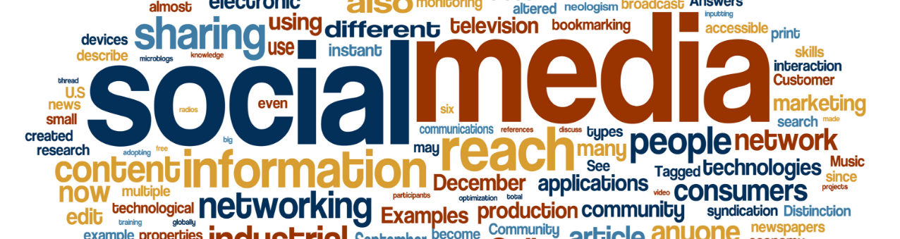
OSINT
Open Source INTelligence (OSINT)
collection of information and sources that are generally available, including information obtained from the media (newspapers, radio, television, etc.), professional and academic records papers, conferences, professional associations, etc.), and public data (government reports, demographics, hearings, speeches, etc.). Cit. FBI

Slide 8
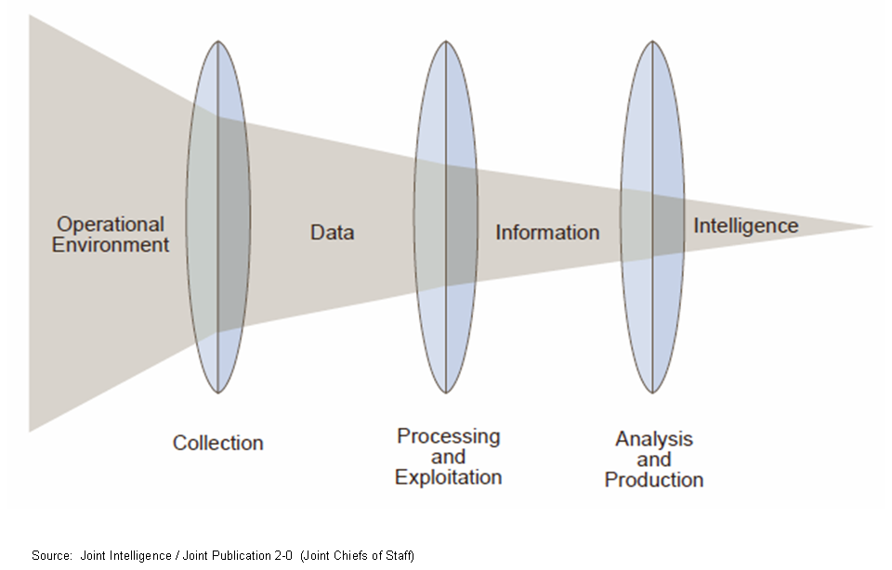
OSINT
Process of structuration of an information

Slide 9
OSINT
Hostnames
Services
Networks
SW/HW versions and OS information
GEO-Location
Network Diagram
Database
Documents, papers, presentations, and configuration files
Metadata
Email and employee search (name and other personal information)
Technology infrastructure
IP
The OSINT Process
Identifying the source
Where you can find the information?
Harvesting
It is time to collect the relevant data from the identified sources
Data Processing
Process the acquired data and get the meaningful information
Analysis
Reporting
Join the data acquired from multiple sources
Create the final report

Slide 10
Threat Intelligence
“Threat intelligence is the output of analysis based on identification, collection, and enrichment of relevant data and information regarding cyber attacks.”
Threat intelligence falls into two categories.
Operational intelligence is produced by computers
Strategic intelligence is produced by human analysts.
The two types of threat intelligence are heavily interdependent

Slide 11
Threat Intelligence
Operational Intelligence:
A common example of operational threat intelligence is the automatic detection of distributed denial of service (DDoS) attacks, whereby a comparison between indicators of compromise (IOCs) and network telemetry is used to identify attacks much more quickly than a human analyst could.
Strategic Intelligence:
focuses on the much more difficult and cumbersome process of identifying and analyzing threats to an organization’s core assets, including employees, customers, infrastructure, applications, and vendors.

Slide 12
Threat Intelligence
What share?
Indicators of Compromise – IoC
«is an artifact observed in a system or on a network that with high confidence indicates a compromission»
IP, URLs, Virus signatures, Hashes, Malware files
Tactics, Techniques and Procedures – TTP
«Are representations of the behavior or modus operandi of cyber adversaries»
Report
IDPS rules

Slide 13

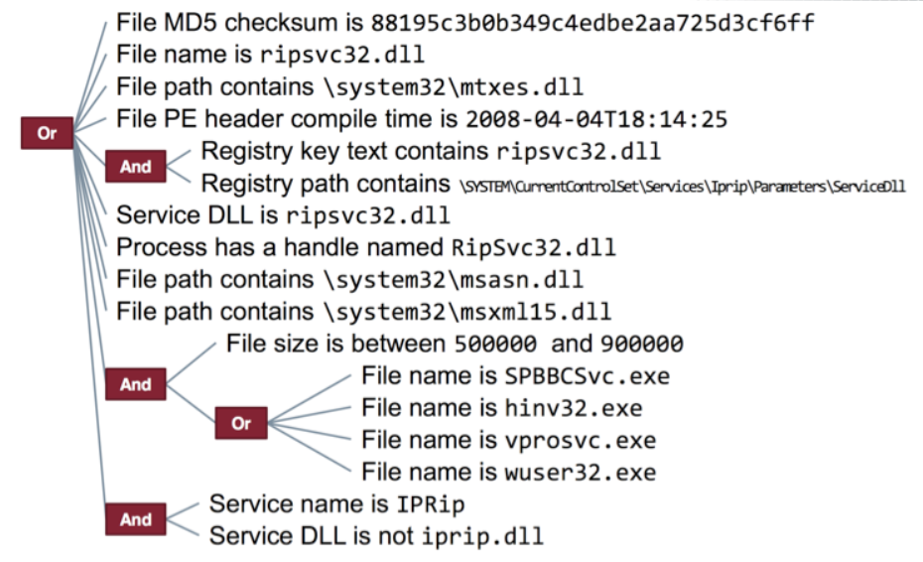

Threat Intelligence
How share?
OpenIoc
Yara
TAXII
Stix
Cybox
Source:
https://threatpost.com/misunderstanding-indicators-of-compromise/117560/

Slide 14
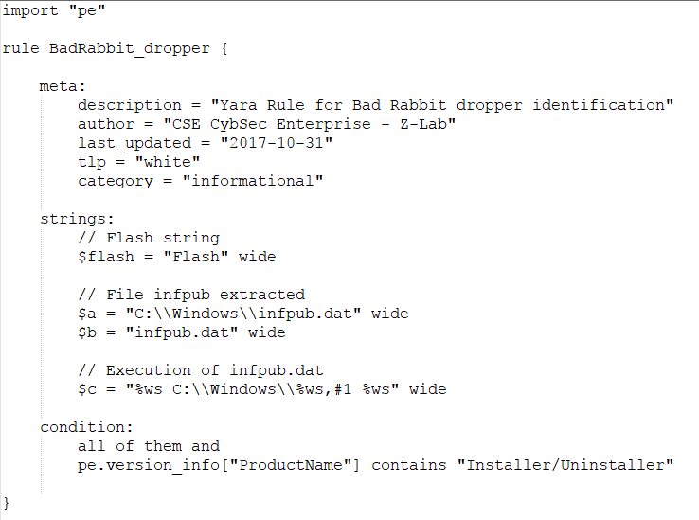
Threat Intelligence
Yara rules example

Slide 15
Sandbox Analysis
https://www.joesecurity.org/reports/report-fbbdc39af1139aebba4da004475e8839.html

Slide 16





Threat Intelligence Platforms
Where share?
OTX by Alienvault
XForce by IBM
MISP
Anomali
Threatcrowd
Threatconnect
Blueliv

Slide 17

Threat Intelligence & IoC
How extract malwares’ IoCs and other characteristics to share?

Slide 18

The Malware Analysis Process
Malware Sample
VERTICAL AND INCREMENTAL DEEPENING
Sandbox
Basic Static Analysis
Threat Intelligence
Dynamic Analysis
Advanced Analysis
Goal
Forensics
Report
IoCs

Slide 19
Malware Sample
Retrieve malware from:
Infected machines
Disk images
Network traffic
Suspicious files
Public sources
Deep web
HoneyNet

Slide 20


Sandbox
Submit the sample into Cuckoo Sandbox private instance or Payload Security
Malware’s first impressions and initial triaging

Slide 21




Basic Static Analysis
Retrieve the first info’s about the characteristics of the malicious file:
FileType
Hashes
Strings
Sections
Imports
Packers

Slide 22


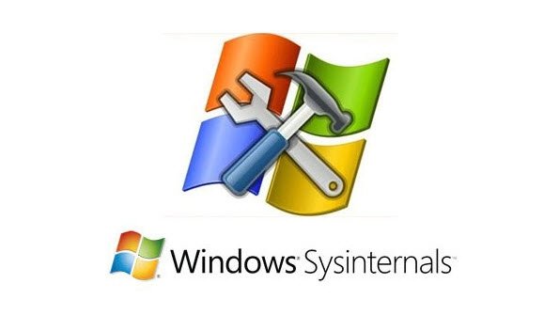

Dynamic Analysis
Observe the malware in action:
Runtime API calls
Network Traffic
Files’ accesses
Registry Keys’ accesses
System settings alteration
Disk Modification
Lateral movements
Privilege Escalation

Slide 23



Advanced Analysis
Advanced Static&Behavioural Analysis
Refine the characteristics of the malware through the correspondence of the malware execution in a debugger with its disassembled code
Find particular structures and IoC in the malware’s code

Slide 24




Forensics
Extract evidences and digital artifacts from various supports
Disk
Memory
Volatility Framework

Slide 25

IoC extraction
Synthetize the info about malwares to recognize them in rules that allow their detection
Yara
OpenIoC

Slide 26





Gather intelligence from reports and IoCs
Take comparison in all previous steps between the info gathered in various Threat Intelligence Platforms and those extracted during the analysis
Compare hashes
Compare behaviour
Compare IoCs

