Slide 1
VA/PT

Slide 2
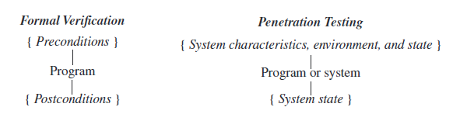
Intro
Computer system is hw+sw and
Policies, procedures, organization
The specific failure of the controls is called a vulnerability or security flaw; using that failure to violate the site security policy is called exploiting the vulnerability. One who attempts to exploit the vulnerability is called an attacker.
Formal verification and property-based testing are techniques for detecting vulnerabilities.
formal verification proves the absence of flaws within a particular program
Penetration testing proves the presence of flaws

Slide 3
Penetration Studies
A penetration study is a test for evaluating the strengths of all security controls on the computer system
The goal is to violate the security policy
This formulation implies a metric for determining whether the study has succeeded.
The first type of study has a specific target
A second type of study does not have a specific target
constraints affect the penetration study
Time
Resources

Slide 4
Layering of tests
External attacker with no knowledge of the system
Social engineering
Superficial fingerprint
Usually skipped
External attacker with access to the system
Typical pentest
Internal attacker with access to the system
The more exaustive

Slide 5
Flaw Hypothesis Methodology
Developed at System Development Corporation
Information gathering
Flaw hypothesis
Flaw testing
Flaw generalization
Flaw elimination

Slide 6
Information Gathering and Flaw Hypothesis
Discrepancies in the components
Access to manuals and documents
Observe privileged users
Sharing accounts
identification of the structures and mechanisms that control the system.

Slide 7
Flaw Testing
Once the testers have hypothesized a set of flaws, they determine the order in which to test the flaws
the testers study the hypothetical flaws
When a system must be tested, it should be backed up and all users should be removed from it.
The test should be as simple as possible but must demonstrate that the exploitation succeeded

Slide 8
Flaw generalization & elimination
The testers must confer enough to make each other aware of the nature of the flaws, and often two different flaws can be combined for a devastating attack.
The flaw elimination step is often omitted because correction of flaws is not part of the penetration
Understanding the origins of the flaw, its context, and its affect on the system leads to proper corrective measures based on the system and the environment in which it functions

Slide 9
Vulnerabilities Classification
Vulnerability classification frameworks describe security flaws from various perspectives.
Techniques used to exploit them
Components to make up the vulnerability
Abilities:
The ability to specify, design, and implement a computer system without vulnerabilities.
The ability to analyze a computer system to detect vulnerabilities (which feeds into the Flaw Hypothesis Methodology step of penetration testing).
The ability to address any vulnerabilities introduced during the operation of the computer system (possibly leading to a redesign or reimplementation of the flawed components).
The ability to detect attempted exploitatons of vulnerabilities.

Slide 10
RISOS
The investigators classified flaws into seven general classes.
Incomplete parameter validation
Inconsistent parameter validation
Implicit sharing of privileged/confidential data
Asynchronous validation/inadequate serialization
Inadequate identification/authentication/authorization
Violable prohibition/limit
Exploitable logic error pag 407

Slide 11
The flaw classes…
Incomplete parameter validation occurs when a parameter is not checked before use.
Buffer overflow
Integer division
Inconsistent parameter validation is a design flaw in which each individual routine using data checks that the data is in the proper format for that routine, but the routines require different formats entered into the database.
implicit sharing of privileged/confidential data flaw occurs when an operating system fails to isolate processes and users properly
asynchronous validation/inadequate serialization regards race conditions
Inadequate identification/authorization/authentication flaws arise when a system allows a user to be erroneously identified, when one user can assume another’s privilege, or when a user can trick the system (or another user) into executing a program without authorization.

Slide 12
…The flaw classes
Violable prohibition/limit flaws arise when system designers fail to handle bounds conditions properly.
Exploitable logic error flaws encompass problems not falling into any of the other classes; examples include incorrect error handling, unexpected side effects of instructions, and incorrect allocation of resources.

Slide 13
Protection Analysis Model
The Protection Analysis (PA) study [95] attempted to break the operating system protection problem into smaller, more manageable pieces.
The study aimed at development of techniques that would have an impact within 10 years.
It developed a general strategy, called pattern-directed protection evaluation, and applied it to several operating systems.
Neumann’s presentation of this study
organizes the ten classes of flaws in order to show the connections among the major classes and subclasses of flaws

Slide 14
Neumann Classification
Improper protection domain initialization and enforcement
Improper choice of initial protection domain (domain)
Improper isolation of implementation detail (exposed representations)
Improper change (consistency of data over time)
Improper naming (naming)
Improper deallocation or deletion (residuals)
Improper validation (validation of operands, queue management dependencies)
Improper synchronization
Improper indivisibility (interrupted atomic operations)
Improper sequencing (serialization)
Improper choice of operand or operation (critical operator selection errors)

Slide 15
The Flaw Classes
The first class is improper protection domain initialization and enforcement
It includes security flaws arising from initialization of the system or programs and enforcement of the security requirements.
The subclass:
improper choice of initial protection domain, which includes any flaw related to an initial incorrect assignment of privileges or of security and integrity classes
improper isolation of implementation detail. includes flaws that allow users to bypass the operating system and write directly to absolute I/O locations or to alter data structures in ways that are inconsistent with their functions
Improper change
improper naming
improper deallocation or deletion errors
Notes:
Another example of an improper protection flaw can arise when a privileged
program needs to open a file after checking that some particular condition holds. The
goal of the adversary is to have the privileged program open another file for which
Improper change: the condition does not hold. The attack is an attempt to switch the binding of the
name between the check and the open.

Slide 16
improper validation. These flaws arise from inadequate checking
fingerd’s lack of bounds checking
in some versions of Secure NIS
Subclasses:
Improper synchronization arises when processes fail to coordinate their activities. These flaws can occur when operations that should be uninterruptable are interrupted
The flaw in the UNIX mkdir command in Version 7
improper indivisibility
improper sequencing, arises in at least one one-time password scheme.
improper choice of operand or operation, includes calling of inappropriate or erroneous functions.
cryptographic key generation software calling pseudorandom number generation functions that produce predictable sequences of numbers or sequences of numbers with insufficient randomness

Slide 17
The NRL Taxonomy
In 1992, Landwehr, Bull, McDermott, and Choi [546] developed a taxonomy to help designers and operators of systems enforce security. They tried to answer three questions:
how did the flaw enter the system,
when did it enter the system, and
where in the system is it manifest?
They built three different classification systems, one to answer each of the three questions, and classified more than 50 vulnerabilities in these schemes.

Slide 18
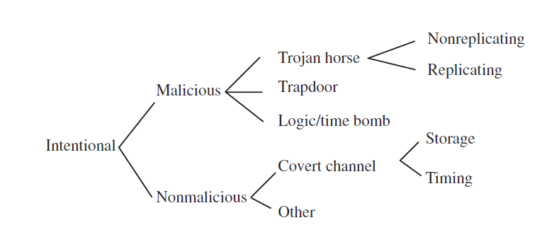
The Flaw Classes
The first classification scheme classified vulnerabilities by genesis
The class of inadvertent flaws was broken down using the RISOS categories
the class of intentional flaws was broken into malicious and nonmalicious flaws.
Notes:
The investigators felt that because most security flaws were
inadvertent, better design and coding reviews could eliminate many of them; but if
the flaws were intentional, measures such as hiring more trustworthy designers and
programmers and doing more security-related testing would be more appropriate.

Slide 19
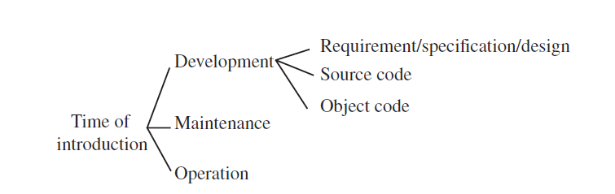
The second scheme classified vulnerabilities by time of introduction
They defined the development phase to be all activities up to the release of the
initial version of the software, the maintenance phase to be all activities leading to
changes in the software performed under configuration control, and the operation
phase to be all activities involving patching of the software and not under configuration
control

Slide 20
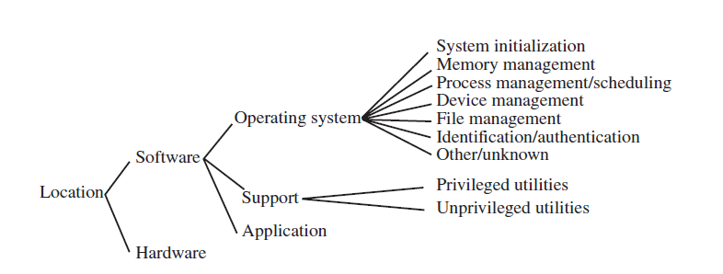
The third scheme classified by location of the flaw

Slide 21
Alam’s Model
Aslam [40] developed a classification scheme for security flaws that categorized faults and grouped similar faults together.
It differed from both the PA and RISOS studies in
it drew on software fault studies to develop its categories, and
It focused specifically on implementation flaws in the UNIX system.
The categories and classes in both PA and RISOS had considerable overlap; Aslam presented a decision procedure for classifying faults unambiguously.

Slide 22
The Flaw classes
Aslam distinguished between coding faults, which were introduced during software development, and emergent faults, which resulted from incorrect initialization, use, or application.
The class of coding faults is subdivided into
synchronization errors
arise when a timing window between two operations allows a fault to be exploited or when operations are improperly serialized
Condition validation errors.
configuration errors or environment faults

Slide 23
Comparison and Analysis
Consider the flaws described in Section 20.3.1. Both depend on the interaction of two processes: the trusted process (xterm or fingerd) and a second process (the attacker).
the processes use operating system services to communicate. So, three processes are involved: the flawed process, the attacker process, and the operating system service routines.
The view of the flaw when considered from the perspective of any of these processes may differ from the view when considered from the perspective of the other two.
At the lowest level, the flaw may be, say, an inconsistent parameter validation because successive system calls do not check that the argument refers to the same object. At a higher level, this may be characterized as a race condition or an asynchronous validation/inadequate serialization problem. At an even higher level, it may be seen as an exploitable logic error because a resource (object) can be deleted while in use.

Slide 24
The xterm Log File Flaw…
PA taxonomy:
From the point of view of the xterm process, the flaw is clearly an improper change flaw
W.r.t.the attacker process, the flaw is an improper deallocation or deletion flaw
from the operating system’s point of view, the flaw is an improper indivisibility flaw
a directory object is seen simply as an object
the flaw may be seen as a violation of the Bernstein conditions [79] (requiring no reading during writing, and a single writer),
which means that the flaw is one of improper sequencing.

Slide 25
…The xterm Log File Flaw…
W.r.t the design
the attacking process should not be able to write into the directory in the first place
improper choice of initial protection domain
At the implementation level, with respect to the xterm process and the RISOS taxonomy, the xterm flaw is clearly an asynchronous validation/inadequate serialization flaw: the file access is checked and then opened nonatomically
From the point of view of the attacker, the ability to delete the file makes the flaw an exploitable logic error as well as a violable prohibition/limit flaw
from the operating system’s point of view, the flaw is an inconsistent parameter validation

Slide 26
…The xterm Log File Flaw…
At the design level, a write being allowed where it should not be is an inadequate identification/authentication/authorization flaw because the resource (the containing directory) is not adequately protected
this single flaw has several different characterizations.
The classification under the NRL taxonomy depends on whether this flaw was intentional or not; the history is unclear. If it was intentional, at the lowest level, it is an inadvertent flaw of serialization/aliasing; if it was unintentional (because on earlier systems xterm need not be privileged), it is a nonmalicious

Slide 27
…The xterm Log File Flaw
The selection criteria for fault classification in Aslam’s taxonomy places the
flaw in the object installed with incorrect permissions class from the point of view of
the attacking program (because the attacking program can delete the file), in the
access rights validation error class from the point of view of the xterm program
(because xterm does not properly validate the file at the time of access), and in the
improper or inadequate serialization error class from the point of view of the operating
system (because the deletion and creation should not be interspersed between the
access and open).

Slide 28
The fingerd Buffer Overflow Flaw…
PA taxonomy:
Is clearly an improper validation
W.r.t. the attacker process (the finger program), the flaw is one of improper choice of operand or operation because an operand (the data written onto the connection) is improper (specifically, too long, and arguably not what fingerd is to be given). And from the operating system’s point of view, the flaw is an improper isolation of implementation detail flaw
From the operating system’s point of view, this makes the flaw an improper change flaw because a parameter—specifically, the return address—changes unexpectedly.

Slide 29
…The fingerd Buffer Overflow Flaw…
At the highest level, the system is changing a security-related value in memory and is executing data that should not be executable. Hence, this is again an improper choice of initial protection domain flaw.
With respect to the fingerd process using the RISOS taxonomy, the buffer
overflow flaw is clearly an incomplete parameter validation flaw because the problem
is failure to check parameters, allowing the buffer to overflow. However, with
respect to the fingerd process, the flaw is a violable prohibition/limit flaw because the
limit on input data to be sent can be ignored (violated). And from the operating system’s
point of view, the flaw is an inadequate identification/authentication/authorization
flaw because the user is allowed to write directly to what should be in the
space of the process (the return address) and to execute what should be treated as
data only.

Slide 30
…The fingerd Buffer Overflow Flaw…
From the operating system’s point of view, this makes the flaw one of asynchronous validation/inadequate serialization because a parameter—specifically, the return address—changes unexpectedly.
From the fingerd point of view is improper validation—specifically, failure to validate the type of the instructions being executed. So the flaw is an inadequate identification/authentication/authorization flaw.
At the highest level, this is again an inadequate identification/authentication/authorization flaw because the system is changing a security-related value in memory and is executing data that should not be executable.

Slide 31
…The fingerd Buffer Overflow Flaw
The NRL taxonomy:
the time of introduction is clearly during development, and the location is in the support: privileged utilities class.
Aslam’s taxonomy:
the flaw is a boundary condition error from the point of view of the attacking program (because the limit on input data can be ignored) and from the point of view of the xterm program (because the process writes beyond a valid address boundary) and an environment fault from the point of view of the operating system (because the error occurs when the program is executed on a particular machine—specifically, a stack-based machine).
in the absence of the explicit decision procedure, the flaw could also have been placed in the class of access rights validation errors because the code executed in the input buffer should be data only and because the return address is outside the protection domain of the process and yet is altered by it.

