Slide 1
Botnet
Corrado Aaron Visaggio

Slide 2



Slide 3
Goals of Botnet
Distributed Denial of Service
Spamming
Financial Fraud
Search engine optimization poisoning
Pay per click
Corporate & industrial espionage
Bitcoin mining
Anatomy of a Botnet – Fortify Whitepaper

Slide 4
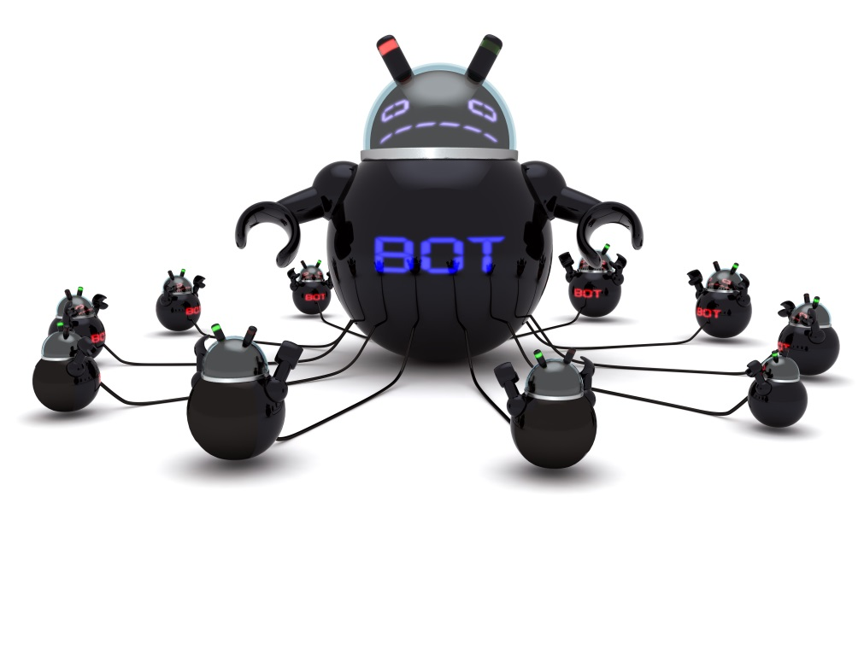
How a Botnet begins
Drive by download
Email
Pirated software
Opt-in Botnets
Mobile Botnets

Slide 5
Botnet detection
DNS Data
Netflow data
Packet Tap Data
Address allocation Data
HoneyPot Data
Host Data
A Survey of Botnet Technology and Defenses
Notes:
DNS Data: Data regarding name resolution can be obtained by mirroring data to and from the local DNS servers or resolvers and can be used to detect both botnet attack behavior such as email spam (MX query
lookups), as well as botnet communication behavior such as DNS lookups for suspicious domains.
• Netflow Data: Netflow data represents information gathered from the network by sampling traffic flows and obtaining information regarding source and destination IP addresses and port numbers. At a course
level, this data is useful for identifying malicious communication patterns and course grained attacks, but often visibility is limited to the peering edge of a network, missing large amounts of backbone (ISP) or
switched (enterprise) traffic
Packet Tap Data: Packet tap data, while providing a more fine grained view than netflow and offering an attractive deployment model (switches or taps, not routers), is generally more costly in terms of hardware
and computation. While providing a much deeper level of insight for signature-based detection algorithms, simple encryption reduces this visibility back to the same order as netflow.
Address Allocation Data: Knowing where hosts and users are in the network can be a powerful tool for identifying reconnaissance behaviors of bots and for tying them to specific machines or users. Internal routing
protocols, such as OSPF, and dynamic allocation protocols, such as DHCP, provide a level of detail generally unavailable to the bots, but this visibility is generally reserved for the enterprise only.
Honeypot Data: The use of sacrificial hosts, placed in the network with the express intention of them being turned into bot members, can be a powerful tool for gaining insight into botnet means and motives without
actually involving production hosts. Unfortunately, as propagation techniques tend towards social engineering, these honeypots must increasingly emulate not only user systems but the users themselves to be useful.
Host Data: Host level data, from operating system and application configurations, antivirus and firewall logs, to user activity (e.g., attaching a process name to a network flow), provides a wealth of security information
and can avoid the visibility issues with encrypted data. Unfortunately, visibility into these behaviors are limited to the network edge, and this often requires instrumenting tens of thousands of devices.

Slide 6
Detection Techniques
Detection via cooperative behaviors
  A set of loosely ordered communciation flows between an internal host % more external entities (Bothunter)
  Multiple crowd-like behaviors (Botsneiffer)
Detection via signatures
  Regular expressions (for nick names)
Detection by attack behaviors
  Large volume of spam in short period
  Spam signature
Notes:
Detection of attack behaviors Brodsky et al. [4] relied on an assumption that botnets tend to send large number of spam in a relatively short period of time to detect botnet
generated spam. Similarly, Xie et al. [28] used spam server traffic properties and spam payload to construct a spam signature generation framework.

Slide 7
Topology

Slide 8
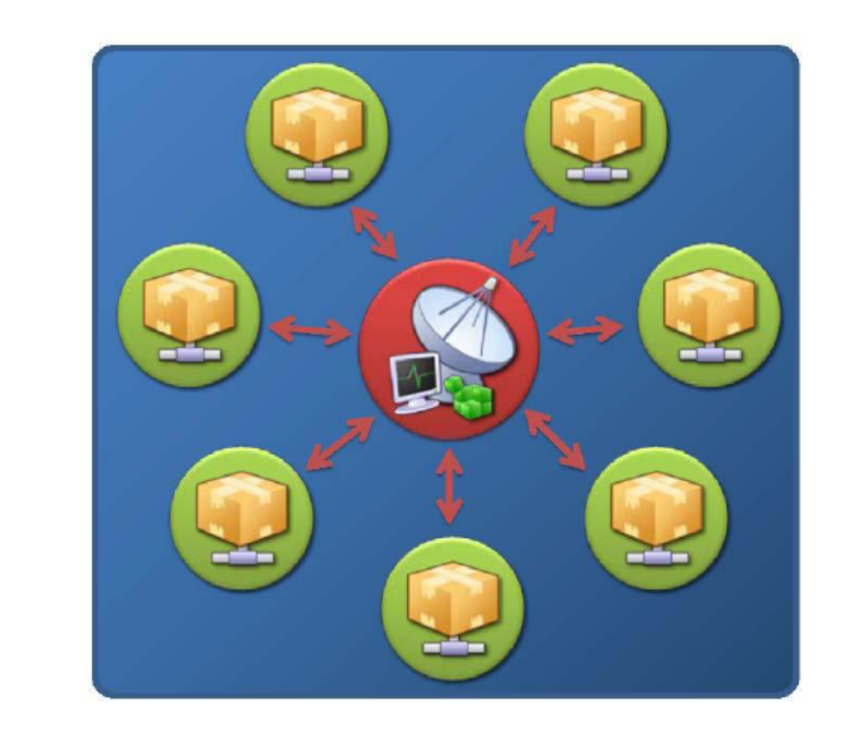
Star
Botnet Communication Topologies
Notes:
Botnets with a Random topology (i.e., a dynamic master-slave or peer-to-peer relationship) have no centralized C&C infrastructure. Instead, commands are injected in to the botnet via any bot agent. These commands are often “signed” as authoritative, which tells the agent to automatically propagate the commands to all other agents.

Slide 9
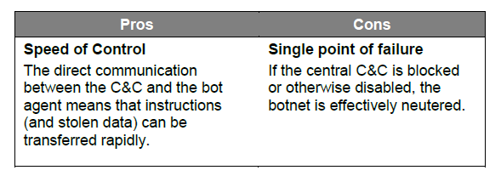
Star Pros&Cons

Slide 10
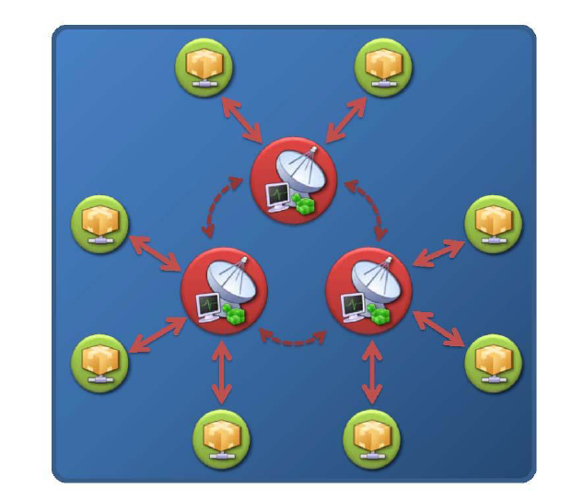
Multiserver

Slide 11
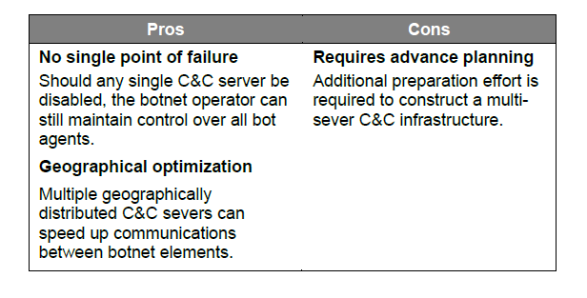
Multiserver Pros&Cons
Notes:
Same bot net for centralized and multiserver
Legal advantages

Slide 12
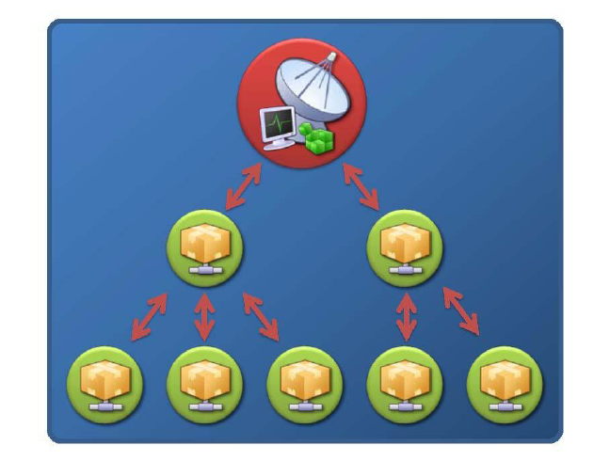
Hierarchical

Slide 13
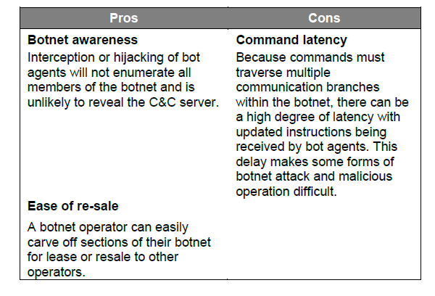
Hierarchical Pros&Cons

Slide 14
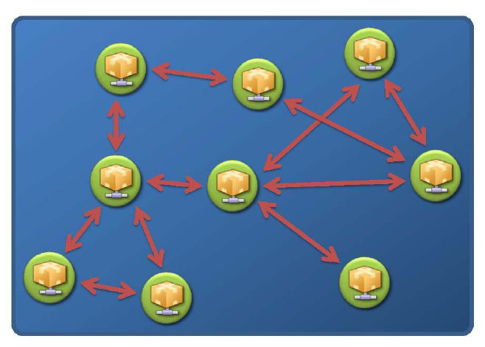
Random

Slide 15
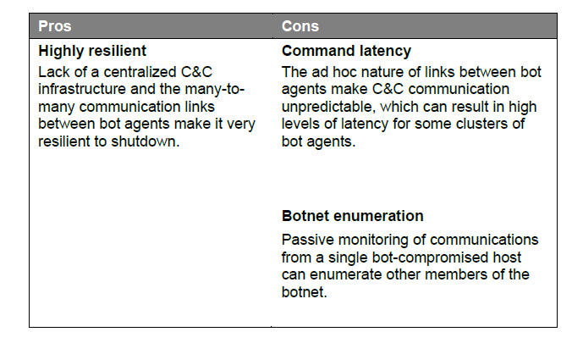
Random Pros&Cons

Slide 16
Look up Resilience
IP Flux
  Constant change of IP address information related to a particular fullyqualified domain name
    Single flux: multiple IP addresses associated with a domain name
    Double flux: Double-flux not only fluxes the IP addresses associated with the fully-qualified domain name (FQDN), but also fluxes the IP addresses of the DNS servers (e.g., NS records)
Notes:
Bot
Single flux: net operators abuse this ability to change IP address information associated with a host name by linking multiple IP addresses with a specific host name and rapidly changing the linked addresses
These IP addresses are registered and de-registered rapidly using a combination of round-robin allocation and very short Time-to-live (TTL) values – against a particular DNS Resource Record (i.e., A records).
Domain Flux: constant changing and allocation of multiple FQDN’s to a single IP address or C&C infrastructure

Slide 17
Lookup resilience
Domain Flux
  constant changing and allocation of multiple FQDN’s to a single IP address or C&C infrastructure
    Domain Wildcarding abuses native DNS functionality to wildcard (e.g., *) a higher domain such that all FQDN’s point to the same IP address. For example, *.damballa.com could encapsulate bothmypc.atl.damballa.com and myserver.damballa.com.
    Domain Generation Algorithms .They create a dynamic list of multiple FQDN’s each day, which are then polled by the bot agent as it tries to locate the C&C infrastructure
Blind Proxy Redirection
  Redirection helps disrupt attempts to trace or shutdown IP Flux service networks. As a result, botnet operators often employ bot agents that proxy both IP/domain lookup requests and C&C traffic. These agents act as redirectors that funnel requests and data to and from other servers under the botnet operator’s control. These other servers actually serve the content.
Notes:
Domain wildcarding: This technique is most commonly associated with botnets that deliver spam and phishing content – whereby the wildcarded information that appears random (e.g. “asdkjlkwer” of asdkjlkwer.atl.damballa) is used by the botnet operator to uniquely identify a victim, track success using various delivery techniques, and bypass anti-spam technologies.
Domain generation: Since the created domain names are dynamically generated in volume and typically have a life of only a single day, the rapid turnover makes it very difficult to investigate or block every possible domain name.

Slide 18
History records
2005 Torpig
  Steal online bank accounts
  1.2 Million unique IP
2006 virut
  DDOS Attacks, spam, financial fraud, data theft
2007 Zeus
  secretly monitor a victim’s PC and steal banking information
2007 Storm
  50 Millions of infections
  Defend itself with reverse eng
2008 Grum
  hundreds of billions of pharmaceutical spam emails

Slide 19
History records
2008 Lethic
  At its peak, the botnet had 300,000 computers under its control
  was responsible for sending out tens of billions of messages per day
2008 Mariposa
  13 million infections that were capable of generating at least 250,000 Euros a month in revenue for the owners
2011 ZeroAccess
  two million computers
  is still generating millions of dollars per year in bitcoin mining and click fraud.

Slide 20
Communication

Slide 21
Communication intro
Many existing botnet C&Cs are based on IRC (Internet Relay Chat) protocol, which provides a centralized command and control mechanism
few botnets that use the HTTP protocol for C&C. HTTP-based C&C is still centralized, but the botmaster does not directly interact with the bots using chatlike mechanisms
Botnet C&C traffic is difficult to detect because:
  Follows normal protocol usage and is similar to normal traffic
  The traffic volume is low
  There may be very few bots in the monitored network
  May contain encrypted communication
BotSniffer: Detecting Botnet Command and Control Channels
in Network Traffic
Notes:
The botmaster can interact with the bots (e.g., issuing commands and receiving responses) in real-time by using IRC PRIVMSG messages. This simple IRC-based C&C mechanism has proven to be
highly successful and has been adopted by many botnets.
http: the bots periodically contact the C&C server(s) to obtain their commands. Because of its proven effectiveness and efficiency, we expect that centralized C&C (e.g., using IRC or HTTP) will still be widely used by botnets in the near future.
The bots of a botnet demonstrate spatial-temporal correlation and similarities due to the nature of their pre-programmed response activities to control commands
For instance, at a similar time, the bots within a botnet will execute the same command (e.g., obtain system information, scan the network), and report to the C&C server with the progress/result of the task (and these reports are likely to be similar in structure and content). Normal network activities are unlikely to demonstrate such a synchronized or correlated behavior.

Slide 22
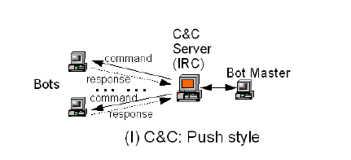
IRC
In a push style C&C, the bots are connected to the C&C server, e.g., IRC server, and wait for commands from botmaster.
The botmaster issues a command in the channel, and all the bots connected to the channel can receive it in real-time
  Ex: Phatbot, Spybot, Sdbot, Rbot/Rxbot, GTBot
Notes:
That is, in a push style C&C the botmaster has real-time control over the botnet
A botmaster sets up an (or a set of) IRC server(s) as C&C hosts. After a bot is newly infected, it will connect to the C&C server, join a certain IRC channel and wait for commands from the botmaster. Commands will be
sent in IRC PRIVMSG messages (like a regular chatting message) or a TOPIC message. The bots receive commands, understand what the botmaster wants them to do, and execute and then reply with the results.
The botmaster first authenticates himself using a username/password. Once the password is accepted, he can issue commands to obtain some information from the bot
The bots respond to the commands in pre-programmed fashions. The botmaster has a rich command library to use [5], which enables the botmaster to fully control and utilize the infected machines.

Slide 23
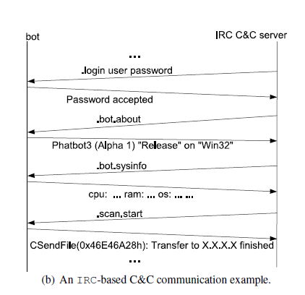
IRC-based C&C communication example

Slide 24
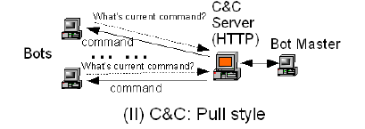
HTTP
In a pull style C&C, the botmaster simply sets the command in a file at a C&C server (e.g., a HTTP server).
  Loose/ not real time control
  Bobax
    Spammer
    The bots of this botnet periodically connect to the C&C server with an URL such as http://hostname/reg?u=[8-digit-hex-id]&v=114, and receive the command in a HTTP response.
Notes:
The bots frequently connect back to read the command file. This style of command and control is relatively loose in that the botmaster typically does not have real-time control over the bots because there is a delay between the time when he “issues” a command and the time when a bot gets the command.
Botnets can have fairly frequent C&C traffic. For example, in a CERT report [16], researchers report a Web based bot that queries for the command file every 5 seconds and then executes the commands.

Slide 25
Bot response
Message response
  IRC-based PRIVMSG reply -> When a bot receives a command, it will execute and reply in the same IRC channel with the execution result (or status/progress)
Activity Response
  the network activities the bots exhibit when they perform the malicious tasks (e.g., scanning, spamming, binary update) as directed by the botmaster’s commands
Response crowd
  for a normal network service (e.g., an IRC chatting channel), it is unlikely that many clients consistently respond similarly and at a similar time.
Notes:
About 53% of botnet commands observed in thousands of realworld IRC-based botnets are scan related (for spreading or
DDoS purpose), about 14.4% are binary download related (for malware updating purpose).
HTTP- botnet botnets are mainly used to send spams
If there are multiple bots in the channel to respond to commands, most of them are likely to respond in a similar fashion. For example, the bots send similar message or activity traffic at a similar time window, e.g., sending spam as in [23].

Slide 26
Botnet Analysis
An Inside Look at Botnets

Slide 27
Architecture
Agobot
  October 2002 / Many hundreds of variants /20k LOC of C/C++
  an IRC-based command and control mechanism,
  a large collection of target exploits,
  the ability to launch different kinds of DoS attacks,
  modules that support shell encodings and limited polymorphic obfuscations,
  the ability to harvest the local host for Paypal passwords, AOL keys and other sensitive information either through traffic sniffing, key logging or searching registry entries,
  mechanisms to defend and fortify compromised systems either through closing back doors, patching vulnerabilities or disabling access to anti-virus sites, and
  mechanisms to frustrate disassembly by well known tools such as SoftIce, Ollydbg and others

Slide 28
SDBOT
October 2002, hundreds of variants , 2k LOC of C
DoS capabilities, and is published under GPL
utilitarian IRC-based command and control system
scanning, DoS attacks, sniffers, information harvesting routines and encryption routines
System of patch that facilitates generation of custom botnets

Slide 29
SpyBot
April 2003
Hundreds of variants / <3k LOC
Much of SpyBot’s command and control engine appears to be shared with SDBot
Notes:
Much of SpyBot’s command and control engine appears to be shared with
SDBot, and it is likely, in fact, that it evolved from SDBot. However, unlike
SDBot, there is no explicit attempt to diffuse accountability or to hide the malicious
intent of this codebase

Slide 30
GTBot
April 1998
Hundreds of variants
limited set of functions based on the scripting capabilities of mIRC which is a widely used shareware IRC client for Windows
Event handlers to respond to commands capabilities including port scanning, DoS attacks, and exploits for RPC and NetBIOS services
GT Bot is often packaged with its own version of the mIRC.exe
Notes:
Other useful pieces of software that are often packaged with GT Bot include
BNC (pronounced “bounce”) which is a proxy system that allows users to
bounce through shells to a IRC server providing anonymity and DoS protection,
and psexec.exe (SysInternals) which is a utility that facilitates remote process
execution. Based on the limited capabilities in GT Bot, it appears that different
versions have been generated for specific malicious intent, instead of general
enhancement of the code to provide a broad set of capabilities

Slide 31
Control Mechanisms

Slide 32
Agobot
The protocol used by compromised systems to establish connections to control channels is standard IRC
Command language consists of both standard IRC commands and specific commands

Slide 33
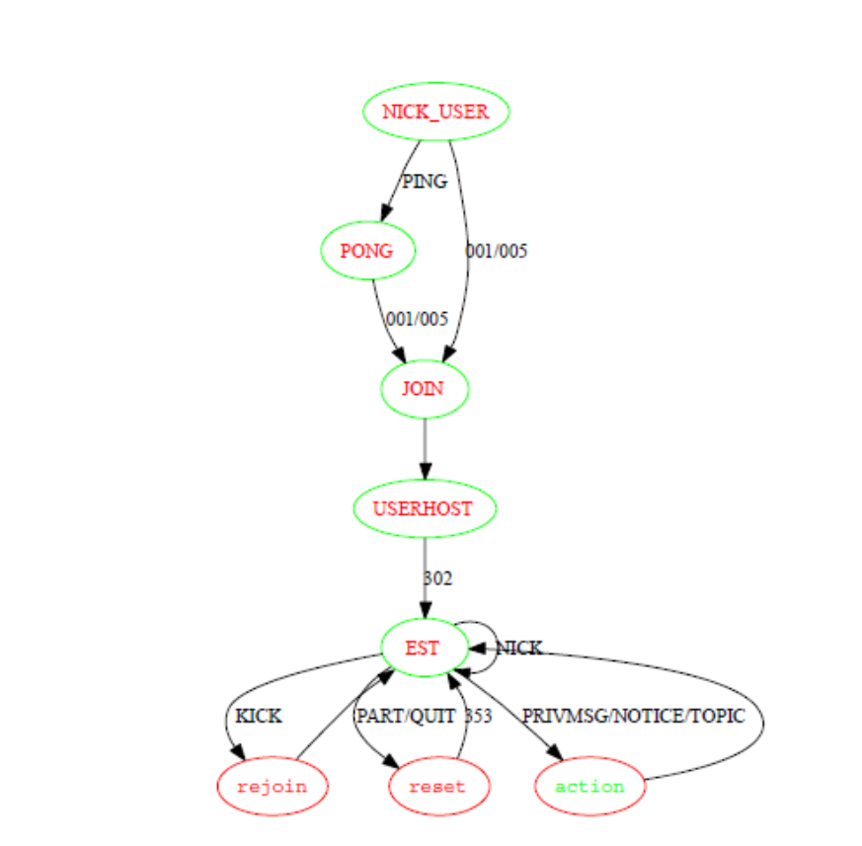
SDBOT
The command language implemented in SDBot is essentially a lightweight version of IRC.
Notes:
The bot begins by establishing a connection
to the IRC server through the following steps: (i) send NICK (name) and
USER (name) to login to the server, (ii) if a PING is received, respond with a
PONG, (iii) when connected to the server (i.e., return code 001 or 005), send a
JOIN message followed by a USERHOST request to obtain the hostname, (iv)
wait for a 302 response that indicates a connection is established, (v) listen and
react to commands sent by the master which can include the following:
1. KICK: the bot rejoins the channel if it is kicked off. Otherwise the bot resets the master if the master is kicked.
2. NICK: if master’s nickname is replaced, then it is updated on the bot.
3. PART (or QUIT): resets the master if the master parts or quits.
4. 353: return code that indicates that the bot has successfully joined the IRC channel. The bot then expects all other commands will be sent as part of the PRIVMSG,
NOTICE or TOPIC IRC messages. The commands available in SDBot are listed
in Table 1.2. Additional features supported by SDBot but absent from Agobot
include IRC cloning and spying. Cloning is when a bot connects to an IRC channel
multiple times. This can be used to deny service on a particular IRC server.
Spying is simply the act of logging activity on a specified IRC channel.

Slide 34
Further
SpyBot
  SpyBot language is a subset of the SDBot command language
  The IRC connection set up protocol is the same as SDBOT, as well as the mechanisms to pass and execute commands on bots
GTBot
  Uses IRC as its control infrastructure
  The command language is simple

Slide 35
Host Control Mechanisms

Slide 36
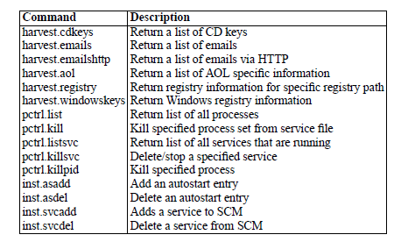
Agobot

Slide 37
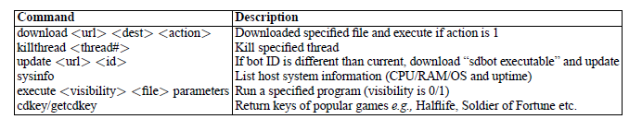
SDBot
Notes:
The host control capabilities provided in the base distribution of SDBot
are somewhat limited. They include some basic remote execution commands and
some capability to gather local information. The lack of host control capabilities
in the basic distribution is likely due to SDBot’s benign intent as described above.
However, these capabilities can be easily enhanced through auxiliary patches and
a large number of these are readily available.

Slide 38
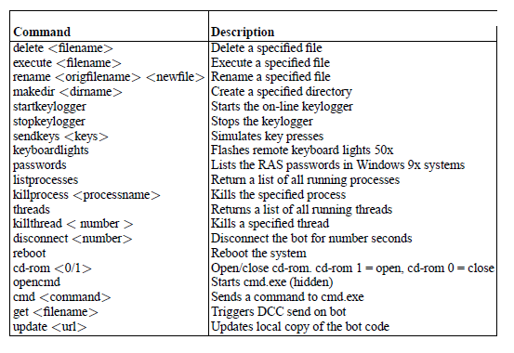
SpyBot
Notes:
The host control capabilities included in SpyBot are relatively rich, and
similar in most respects to what is provided by Agobot. These include commands
for local file manipulation, key logging, process/system manipulation and remote
command execution.

Slide 39
Propagation mechanisms

Slide 40
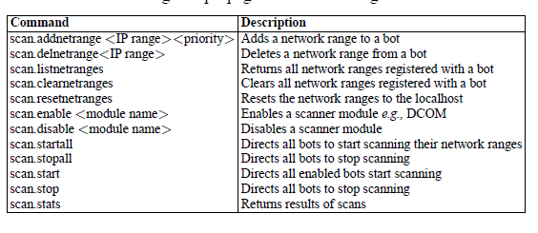
Agobot
Notes:
The scanning mechanisms included in Agobot are relatively simple and
do not extend very far beyond horizontal and vertical scanning. Agobot scanning
is based on the notion of network ranges (network prefixes) that are configured
on individual bots. When so directed, a bot can scan across a range or randomly
select IP addresses within a range. However, the current scanning command set
provides no means for efficient distribution of a target address space among a
collection of bots.

Slide 41

Further
SDBOT
  Does not have scanning or propagation capability in its base distribution.
  In many similar to Agobot
SpyBot
  The command interface for Spybot scanning is quite simple, consisting of horizontal and vertical capability.
Notes:
(SDBot) the interface for a
NetBIOS scanner for SDBot accepts starting and ending IP addresses as parameters
and then randomly selects addresses between these two markers.

Slide 42
Attacks

Slide 43
Agobot
Bagle scanner: scans for back doors left by Bagle variants on port 2745.
Dcom scanners (1/2): scans for the well known DCE-RPC buffer overflow.
MyDoom scanner: scans for back doors left by variants of the MyDoom worm on port 3127.
Dameware scanner: scans for vulnerable versions of the Dameware network administration tool.
NetBIOS scanner: brute force password scanning for open NetBIOS shares.
Radmin scanner: scans for the Radmin buffer overflow.
MS-SQL scanner: brute force password scanning for open SQL servers.
Generic DDoS module: enables seven types of denial service attack against a targeted host.

Slide 44
Malware delivery Mechanisms
Agobot: open a shell, exploiting a vulnerability and then upload the binary via HTTP or FTP.
GT/SD/Spy Bots all deliver their exploit and encoded malware packaged in a single script, distributed via packers and encoders
Notes:
Agobot has adopted a new strategy for malware delivery based on separating exploits and delivery

Slide 45
P2P Botnet
Peer-to-Peer Botnets

Slide 46
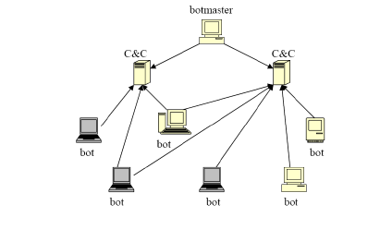
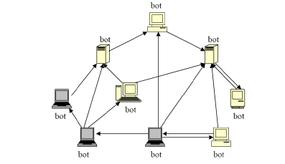
Why P2P botnet
In a P2P botnet there is no centralized servers
P2P botnet are more robust and difficult for security community to defend
centralized
P2P

Slide 47
Botnet Construction
An attacker needs to compromise many computers
Different actions depending on the attacker’s goal
Select Bot candidates
  P2p worms may be
    Active -> try to infect other peers in a hit list or
    Passive -> duplicate themselves and reside in the local file sharing directory as files with popular names, and expect other peers to download, execute them and get infected
The scale of parasite P2p is limited by the number of vulnerable hosts in the P2P network
Notes:
It is straightforward for attackers to target hosts in existing P2P networks and build their zombie army of botnets.
Active worms: Peers in the hit-list could be those who have been contacted before, or those who have responded after a file search query.
Once a vulnerable host in a P2P network has been compromised by botnet malware, it can directly become a bot member without any further joining
botnet action. This is because the botnet itself resides within the current P2Pnetwork. Bots can find and communicate with each other by simply using
current P2P protocol. Up to this point, the botnet construction is done and this botnet is ready to operate by botmaster.
The above discussion shows that it is convenient and simple to build a P2P
botnet, if all the bot candidates are chosen from an existing P2P network. For
the convenience of further discussion, we call such a botnet a “parasite P2P
botnet”.
Therefore P2P
botnets we have witnessed recently do not confine themselves to existing P2P
networks, but recruit members in the entire Internet through all possible spread
mediums like email, instance message and file exchanging. For this type of P2P
botnets, upon infection, the most important thing is to let newly compromised
computers join in the network and connect with other bots, regardless of whether
the connection is direct or indirect. Otherwise, they are just isolated individual
computers without much use for botmasters.

Slide 48
Forming a Botnet
Bootstrap procedure:
  An initial list of peers are hard-coded in each P2P client
  new peers can refresh its neighboring peer list by going to the web cache and fetching the latest updates (Gnutella).
bootstrap is a vulnerable procedure and it could become a single point of failure for botnet construction
in the hybrid P2P botnet, when a bot A compromises a vulnerable host B, A passes its own peer list to this newly infected host B, and B will add A into this neighboring peer list
Notes:
if a random host is compromised, it has to know how to find and join the botnet.
Step 1-> When a new peer is up, it will try to contact each peer in that initial list to update its neighboring peer information.
Step 3 -> There is a shared web cache, such as Gnutella web cache [8], stored at some place on the Internet, and the location of the cache is put in the client code.
Vulnerability of bootstrap: If the initial list of peers or web cache is obtained by defenders, they may be able to prevent botnet from growing simply by shutting down those bootstrap peers or web caches.
Any two bots that have found each other (e.g., through Internet scanning) will exchange their peer lists to construct new lists. In this way, the P2P botnet avoid bootstrap procedure relying
on hard-coded lists. In [49] a similar procedure was presented to construct a super botnet instead of bootstrapping.

Slide 49
Classification
Parasite P2P botnet -> botnet that only targets vulnerable hosts in an existing P2P network
  (+) exploits existing protocols of existing p2p networks
  (-)Limited by the number of bots
Leeching P2P botnet -> bots are chosen from vulnerable hosts throughout the internet and eventually they share parts of existing P2P botnet
  (+) more flexible than Parasite
  (-) partially like parasite P2P botnet / find new bot
Bot-only p2P botnet, botnet that resides in an independent network, and there are no benign peers except bots.
  (+) the most flexible, even in terms of protocols to use
  (-) more effort to build.
Notes:
Since parasite and leeching P2P botnets are both built upon existing P2P networks, they usually directly employ the protocols of those networks for C&C communication (Sect. 1.4). But as we discussed in Sect. 1.3.2, bootstrap is required during construction process for leeching P2P botnets, while it is not needed for parasite P2P botnets. Bot-only P2P botnets are the most flexible ones among these three types of P2P botnets. Their botmasters can design a new C&C protocol or use an existing P2P protocol, and bootstrap is optional.

Slide 50
P2P Botnet Command&Control mechanisms
Each bot member acts as both a command distribution server and a client who receives commands.
Proprietary vs new mechanisms (Parasite/Leeching/bot-only)
Pull mechanisms: command publishing/subscribing -> bots retreive commands from a place where botmasters publish commands
  Typically used in centralized P2P
  IRC channel
Push mechanisms:bot members passively wait for commands to come and then they will forward commands to other bots
Notes:
P2p are more resilisent against defenses
For centralized botnets, pull mechanism is commonly used. Take botnets based on HTTP as an example, normally a botmaster publishes commands on a web page, and bots periodically visit this web page via HTTP to check for any command updates. The address of this web page comes with the bot code and can be changed afterwards by issuing an address changing command. IRC-based botnets is another case of pull C&C mechanism: all bots periodically connect to a pre-determined IRC channel, waiting for their botmaster to issue a command in this channel.
in a leeching P2P botnet or a parasite P2P botnet, bots are mixed with normal P2P users, and they can communicate with each other using corresponding P2P protocol. Thus it is natural to leverage the
existing P2P protocols for C&C communication. On the other hand, bot-only P2P botnets are not confined to any current P2P protocols. Botmasters have the flexibility to either adopt existing P2P protocols (such as Trojan.Peacomm botnet) or design a new communication protocol (such as the hybrid P2P botnet
in [50]).

Slide 51
Pull mechanisms
Parasite P2P:
  A botmaster can randomly choose one of more bots to publish a command, just letting the bot declare that there is a file on it
  The command can be directly encoded in the query hit message, or the query hit only includes the address of a place where the command was published.
Centralized P2P (Napster): this C&C model is centralized
Decentralized P2P:
  (Gnutella) Ultrapeers
    (+) much robust
    (-) overlaod of orchestration
  DHT-based structure
    Use the Overnet protocol for controlling their bot memebers.
    Each bot periodically queries a search key when issuing a command, the botmaster needs to publish it under 32 different keys
    (-) defender with a bot’s code can retrieve the key generation algorithm
Notes:
In P2P file-sharing systems, a peer sends out a query looking for a file. The query message will be passed around in the network according to an applicationdependent routing protocol. If a peer who has the searched file receives the query, it will respond with a query hit message to the peer who initiates the query.
The title of this file needs to be predetermined or can be calculated using an algorithm which is hard-coded in bot code, such that the other bots know what file to query in order to retrieve the command.
In a centralized P2P Network, such as Napster, there is a central server, which maintains the whole file directory and provides support for file search requests and download requests. command can be directly encoded in the query hit message, or the query hit only includes the address of a place where the command was published.
Decentralized: unstructured (ultrapeers) & DHT-based
With a copy of captured bot
code, it is not hard for defenders to either figure out the query generation algorithm,
or observe and predict bot queries. This C&C design makes it possible
for defenders to monitor or disrupt a small set of botnet control communication
channels.

Slide 52
Push Mechanism – command Forwarding
Push mechanism means when a botmaster issues a command to some bots, and these bots will actively forward the command to others
Which peers should a bot forward a command to?
  the simplest way is to let a bot use its current neighboring peers as targets.
    (-) slow / small number of neighbors
    (-) easier to detect
  Discover bots in the net with query of specific file
    (+) more difficult to detect
How to forward a command: using in-band message (normal P2P traffic) or out-of-band message (non-P2P traffic)?
  If a bot just targets its neighboring peers, in-band message would be a good choice (a)
  If the target list is generated in other ways a bot has to contact those peers using out-of-band message (-) easier to detect (b)
Notes:
In this way, bots can avoid periodically requesting or checking for new command, and hence, reduce the risk of being detected.
There are two major design issues for this
mechanism:
• Which peers should a bot forward a command to? -> One solution might be a bot could initiate a
search for a file, and use the peers who respond to the query as the command
forwarding targets.
In a parasite P2P botnet or a leeching P2P botnet, since not all members in the P2P network belong to the botnet, some peers in the neighboring list may
not be bot members. Thus it is possible that a command is not forwarded to any bot. To solve this issue, botmaster could design some strategies to increase
the chance that the command hits an actual bot.
• How to forward a command: using in-band message (normal P2P traffic)
or out-of-band message (non-P2P traffic)?
The above discussion mainly focused on unstructured P2P networks, where
the query messages are flooded to the network. In structured P2P networks
(e.g., Overnet), a query message is forwarded to the nodes whose node IDs are
closer to the queried hash value of a file, which means a query for the same
hash value is always forwarded by the same set of nodes. Therefore, it would be
more efficient that a bot can generate different hash keys associated with the
same command. In this way, a single command can be forwarded to different
parts of the network, letting more nodes receive the command search query and
obtaining the command.

Slide 53
Communication Protocols in Hybrid P2P
Design new communication protocols: avoid bootstrap
  (-) never tested before!
  passing a peer list from one bot to a host that is infected by this bot
  exchanging peer lists when two bots communicate
  botmaster could ask bots to renew their peer lists from sensors
  When a bot receives a command, forward it to all the bots of the list
A super botnet (army of botnets) is composed of a number of small centralized botnets.
  Each C&C server in a small botnet has routing information to a certain number of other C&C servers.
Notes:
When a bot receives a command, it will try to forward it to all the peers in the list (push mechanism), and for those who cannot accept connection from others, such as bots either with private IP addresses or are behind a
firewall, they will periodically contact other bots in the list and try to retrieve new commands (pull mechanism).
Super botnet: When a C&C server receives a command from the botmaster, it will push the command to the C&C servers which appear in its routing table. Meanwhile, bots in a small botnet will pull the command from their C&C server periodically

Slide 54
How to measure Botnet

Slide 55
Effectiveness
how powerful a P2P botnet can be when launching an attack.
botnet size is a key metric to estimate the effectiveness of a botnet.
  # concurrent online bots
  # total population of a botnet

Slide 56
Efficiency
how long it would take for majority members of a P2P botnet to get informed after a command is issued.
If a P2P botnet is built upon a network where there is no mapping between a message and where it should go, then the distance between a pair of peers is a good measure for efficiency
Betweenness of a node i, bi, is defined as the total number of shortest paths between pairs of nodes that pass through node i .
For structured P2P network, the efficiency of message delivery is determined by DHT algorithm it implements.
Notes:
In centralized botnets command delivery is guaranteed by C&C server, while for P2P botnets, the efficiency is affected by several factors.
Betweeness indicates indicates the capability of a node to control the flow of traffic between node pairs. If commands are first issued at nodes with high betweenness, they can be passed
around in less amount of time. On the contrary, removal of those nodes may result in great increase of distance between others, and reduce command delivery
efficiency.

Slide 57
Robustness
how resilient a botnets is to failures in the network, such as bots being removed by defenders.
  The degree of a node is the number of edges incident to the node,
  the degree distribution is the probability distribution of these degrees over the whole network,
    the degree distribution expresses how balanced connections to peers in a network are.
  Clustering coefficient ci is a measure of how well the neighbors of a given node are locally interconnected.
    the ratio between the number of edges Ni among the neighbors of a node i of degree ki and the maximum number of possible edges ki(ki + 1)/2.

Slide 58
Countermeasures

Slide 59
Monitoring
Sensors
  In parasite networks ultrapeers are the candidates for sensors, especially those with high connectivities.
  In DHT-based networks, sensors should be selected from a set of peers whose IDs are evenly distributed in the DHT
Honeypots
  a compromised honeypot can join a IRC C&C channel and collect important botnet information, such as commands issued by botmasters, identities of bots connected to the same channel.

Slide 60
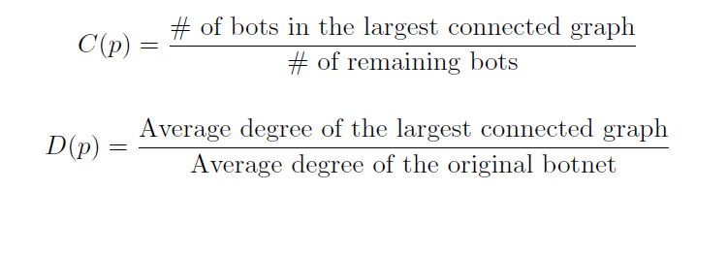
Shutdown
Isolating or shutting down bootstrap servers or the bots in the initial list that is hard-coded in bot code
P2P botnets can also be shut down or at least partially disabled by removing detected bot members, especially bots that are important for the botnet C&C communication.
C(p) -> connected ratio
D(p)-> degree ratio
Notes:
The metric C(p) shows how well a botnet survives a defense action; the
metric D(p) exhibits how densely the remaining botnet is connected together
after bot removal

Slide 61
Shutdown
interrupt a botnet’s C&C communication such that bots cannot receive any order from their botmaster
IRC-based botnets through shutting down the IRC C&C channels or servers
P2P botnets that rely on publishing/subscribing mode for C&C communication is as vulnerable as traditional centralized botnets against defense -> due to index poisoning attack
Notes:
Shutting down each detected bot is slow in disabling a botnet and sometime
impossible to do (e.g., you have no control of an infected machine abroad).

Slide 62
Index Poisoning Attack
Peers can target a set of files and insert massive number of bogus records. when a peer search for a targeted file, the poisoned index returns bogus result, such that the peer cannot locate the file or download a bad one.
If defenders know the specific values that bots will query for getting commands, then they can try to overwrite corresponding records in file index with false information.
Notes:
For instance, in P2P botnets Peacomm.Trojan [27] and Stormnet [32], each
day there are fixed 32 hash values that may be queried by bots for retrieving
commands. By analyzing the bot code or monitoring the bot behavior with the
assistance of honeypots, defenders are able to generate or observe these specific
hash values. And they can publish bogus information under these hashes. In
this way, a bot has little chance to get the correct command and lose contact
with its botmaster. Therefore poisoning the indices related to these hash values
can interrupt the botnet C&C communication effectively.
We can see that publishing/subscribing based P2P botnets have this fundamental
vulnerability against index poisoning attacks. This vulnerability is due
to two reasons:
• Any peer in a P2P network can insert or rewrite records in file index
without any authentication;
• The P2P botnet uses a limited number of predefined hash values for command
communication and these values can be figured out by defenders.

Slide 63
Others
Sybil attack
  The way it works is to forge identities to subvert the reputation system in P2P networks. But it can also be turned to a mitigation strategy for fighting against P2P botnets.
Blacklisting
  A query blacklist which holds query related to botnet command, or a peer blacklist which holds identified bots, can be maintained in a P2P network.
Notes:
The important difference between index poisoning attack and sybil attack
is that sybil nodes must remain active and participate in the underlying P2P
protocols, in order to remain in the peer list of bot nodes. However, nodes used
for index poisoning do not have to stay online all the time. They only need to
refresh some specific index records with bogus information periodically.

