Slide 1
SNORT
Network Analysis and Intrusion Detection with Snort

Slide 2
What is an IDS
An IDS is an application that detects attacks against your computer or network, and lets you know when the attacks occur.
  Detecting attacks
  Enforcing policies
  Providing an audit trail
  Resource justification

Slide 3
Key IDS concepts
False positives are alerts generated by an IDS because it thinks it has detected a valid attack against a monitored system, but the attack really isn’t valid.
A false negative is a real attack that was missed by the IDS, and therefore not alerted on.
Signature detection. An IDS that uses signature detection matches the network traffic it sees against a list of attack signatures.
Anomaly detection. An IDS that uses anomaly detection works in a different manner.
A network-based IDS (NIDS) analyzes packets coming across a network connection for data that look like its part of an attack
Notes:
NIDS analyze network traffic for attacks, using signature or anomaly
detection (or both). Its network interface card (NIC) runs in promiscuous
mode, which means that it captures all network traffic that goes by
its NIC, not just the traffic destined for the IDS system itself.
Generates alerts to notify you of an attack in real-time.
Generates logs to drill down deeper into an attack, typically after the
attack has occurred.
NIDS can often be distributed to different parts of your network infrastructure,
yet can send alerts to one central console. Snort is a fine example of a NIDS.

Slide 4
HIDS
Host-based IDS (HIDS): While a NIDS looks at all the traffic on a network to detect intrusions, a host
  Uses signature or anomaly detection
  Examine system logs
  Check integrity of files on the system
Notes:
HIDS look at incoming network traffic for attacks, using signature or
anomaly detection. Typically, the NIC on a system running a HIDS is not
in promiscuous mode.
HIDS examine system logs for unusual events, such as multiple invalid
login attempts.
HIDS check the integrity of files on the system. This has nothing to do
with the files’ moral character, but rather whether or not a file has been
modified. Integrity checking will also let you know if files have been created
or deleted. This is useful for detecting when backdoor or Trojan
programs have been installed on your system.

Slide 5
Snort
Designed as a network sniffer.
Useful for traffic analysis.
Useful for intrusion detection.
    Warning: Has become a target of attackers!
      What’s more fun for them than to find a vulnerability in security software.

Slide 6
Why Snort
Configurable
Free
Multiple platforms
Widely used
Constantly updated

Slide 7
Snort
Snort is a good sniffer.
Snort uses a detection engine, based on rules.
Packets that do not match any rule are discarded.
Otherwise, they are logged.
Rule matching packets can also trigger an alert.

Slide 8
Snort
Forensic Use:
  Filter logs of large size quickly.
  Snort filters are very sophisticated.

Slide 9
Intrusion Detection Basics
Intrusions have “signatures”
Examples
  Directory Traversal Vulnerability
    Solaris Sadmind/IIS worm (2001)
      Allowed HTTP GET requests to change to root directory with “../../”.
      Allowed to copy cmd.exe into the Scripts directory.
      Gained control usually at admin level
GET/ scripts/../../winnt/system32/cmd.exe /c+
copy+\wint\system32\CMD.exe+root.exe

Slide 10
Intrusion Detection Basics
Code Red Worm 2001
  Exploited vulnerability in IIS 4.0 and 5.0
  Buffer overflow vulnerability
  Footprint:
/default.ida?NNNNNNNNNNNNNNNNNNNNNNNNNNNNNNNNNNNNNNNNNNNNNNNNNNNNNNNNNNNNNNNNNNNNNNNNNNNNNNNNNNNNNNNNNNNNNNNNNNNNNNNNNNNNNNNNNNNNNNNNNNNNNNNNNNNNNNNNNNNNNNNNNNNNNNNNNNNNNNNNNNNNNNNNNN%u9090%u6858%ucbcd3%7801%u9090%u6805%ucbd3%u7801

Slide 11
Intrusion Detection Basics
Most known attacks have an attack signature.
Sequence of bytes that characterize an attack packet almost for sure.
Intrusion Detection System can look for footprints, drop the packet, and raise an alert.

Slide 12
Intrusion Detection Basics
IDS ≠ Firewall
  Firewall needs to process all packets.
  Filtering capacity at firewall limited by need to deliver packets in timely manner.
  IDS can take its time.
  IDS does not drop packets, but sends alerts and logs.

Slide 13
Intrusion Detection Basics
Intrusion Detection System can be deployed
  Network IDS (behind the firewall and internal router.)
  Host based IDS (at all hosts)
  Distributed IDS (throughout the local network at strategic locations)

Slide 14
Snort: Architecture
Sniffer
Preprocessor
Detection Engine
Alert Logging
Notes:
Marty Roesch, Snort’s creator, took tcpdump’s
ability to grab packets, and added the ability to analyze those packets
against a set of attack signatures.

Slide 15
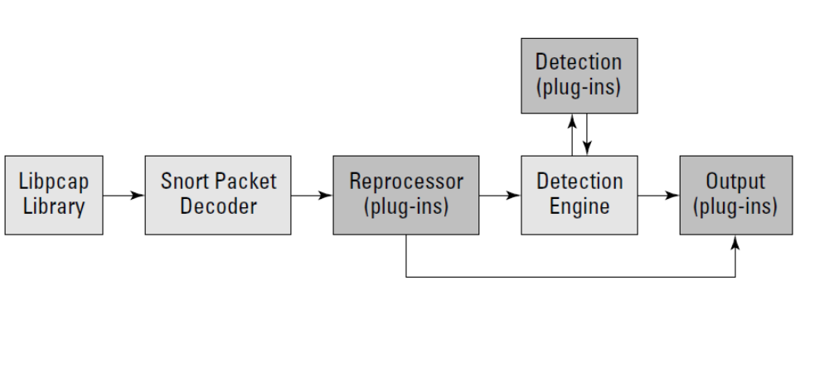
Snort Components
Notes:
Packet capture library. Illustrated as “Libpcap library” in Figure 1-1, the
packet capture library is a separate piece of software that tosses Snort
network packets from the network card. There are unprocessed Data-Link
Layer (Layer 2 of the OSI model) packets, such as Ethernet frames. On
Linux and Unix systems, Snort uses libpcap (covered in Chapter 4). On
Windows systems, Snort uses WinPcap (covered in Chapter 5).
2. Packet decoder. The packet decoder takes the Layer 2 data sent over
from the packet capture library and takes it apart. First it decodes the
Data Link frame (such as Ethernet, TokenRing, or 802.11), then the IP protocol,
then the TCP or UDP packet. When finished decoding, Snort has all
the protocols information in all the right places for further processing.
3. Preprocessor. Snort’s preprocessor has several plug-ins that can be
turned on or off. Preprocessing operates on the decoded packets, performing
a variety of transformations making the data easier for Snort to
digest. Preprocessors can alert on, classify, or drop a packet before
sending it on to the more CPU-intensive detection engine. We tell you
more about Snort’s preprocessors in Chapter 9.
4. Detection engine. The detection engine is the heart of Snort. It takes
information from the packet decoder and preprocessors and operates
on it at the transport and application layers (Layers 4 and 5 of the OSI
5. Output. When a preprocessor or rule is triggered, an alert is generated
and logged (optionally along with the offending packet). Snort supports
a variety of output plug-ins, including its own text- and binary-based logging
formats, a number of databases, and syslog. Chapter 6 covers
Snort’s output methods.

Slide 16
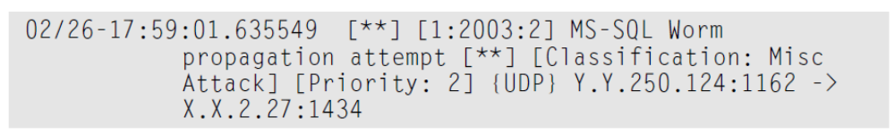
Snort Output
The date and time the attack occurred
Signature identification information to match the alert to a specific Snort rule
A description of the alert
What type of attack the alert is classified as
The alert’s priority (the lower the number, the more serious the attack)
What protocol the attack came over (in this case UDP)
The source IP address and port number, and the destination IP address and port number

Slide 17
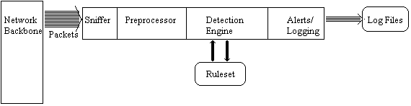
Snort Architecture

Slide 18
SNORT Architecture
Packet Sniffer
  Taps into network
Preprocessor
  Checks against plug-ins
    RPC plug-in
    Port scanner plug-in
    …

Slide 19
SNORT Architecture
Detection Engine
  Snort is a signature-based IDS
  Implemented via rule-sets
  Rules
    Consists of rule header
      Action to take
      Type of packet
      Source, destination IP address
      …
    And rule option
      Content of package that should make the packet match the rule

Slide 20
SNORT Architecture
Snort Alerting
Incoming “interesting packets” are sent to log files.
Also sent to various Add-ons
  SnortSnarf (diagnostics with html output)
  SnortPlot (Perl script that plots attacks)
  Swatch (provides email alerts).
  …

Slide 21
Snort: Architecture
Packet Decode Engine
  Uses the libpcap package
  Packages are decoded for link-level protocols, then for higher protocols.
Preprocessor Plug-ins
  Each preprocessors examines and manipulates packages, e.g. for alerts.
Detection Engine
  Checks packages against the various options in the snort rules files.
Detection Plug-Ins
  Allow additional examinations
Output Plug-Ins

Slide 22
Snort: Architecture
Package View:
NIC in promiscuous mode.
Grab packages from the network card.
Decode packages
Run through various rule sets.
Output logs and alerts.

Slide 23
Snort Rules: Example
Rule Header
  alert tcp $External_NET any -> $Home_Net21
Rule Options
  (msg: “ftp Exploit”; flow_to_server, established; content: “|31c031db 41c9b046 cd80 31c031db|”; reference: bugtraq,1387; classtype:attempted-admin; sid 344; rev4;)

Slide 24
Snort Rules
Rule Header
  Alert / log / pass / dynamic / activate
  tcp: Protocol being used. UDP / IP / ICMP
  $External_NET: This is the source IP, default is any.
  any: This is the source port set to “any”
  ->: Direction of conversation.
  $Home_Net: This is a variable that Snort will replace with
  21: Port to be monitored.
The header concerns all tcp packages coming from any port from the outside to port 21 on the inside.
Notes:
The network source and destination arguments use the variables established
at the beginning of the snort.conf file (the arguments beginning
with the $).

Slide 25
Snort Rules
Rule Options
  ( ): Rule option is placed in parentheses.
  msg: “ftp Exploit”;
  flow_to_server, established;
  content: “|31c031db 41c9b046 cd80 31c031db|”; Snort will look whether the package contains this string, the dangerous payload.
  reference: bugtraq,1387; Snorts allow links to third-party warnings.
  classtype:attempted-admin; Class Types allow users to quickly scan for attack types
  sid 344; Snort rule unique identifier. Can be checked against www.snort.org/snort-db.
  rev4; All rules are part of a revision process to limit false positives and detect new attacks.
Notes:
The
flow says that the connection should be going to the server and
should already be established.

Slide 26
Flow and direction
The > operator tells Snort that the network on the left should be regarded as the source, and the one on the right should be the destination.
There isn’t a <- operator.
The <> operator will match any traffic between the network on the left and the network on the right, regardless of which network originated the traffic.
Most Snort rules look something like this:
$EXTERNAL_NET any -> (internal host / port)
A rule that matches too broadly (which the preceding rule would do if it contained <>) produces a huge Snort log and unduly burdens the processing engine as it inspects everything that passes by.
Notes:
The directionless operator (<>) can sometimes cause a bit of confusion
with its use. It seems to makes sense that you would inspect traffic flowing
both ways from one computer or network to another, but that inspection
happens infrequently.

Slide 27
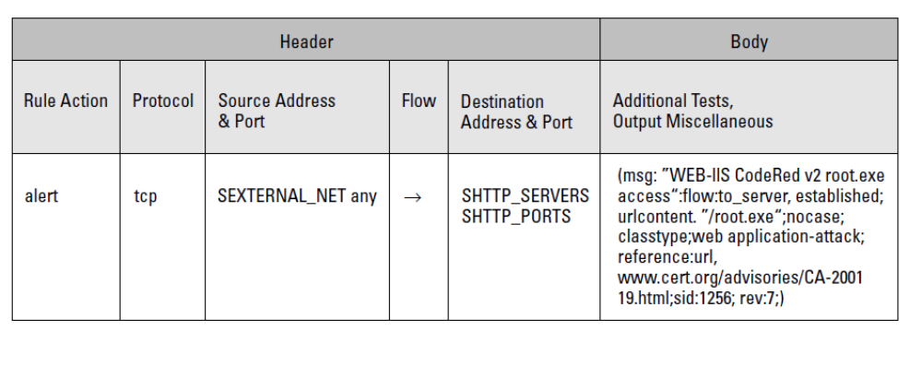

Slide 28
Snort Rules
Activation: Alert and then turn on another dynamic rule.
Dynamic: Log the traffic when called by the above activation rule.
Pass: Ignore the traffic.
Log: Log the traffic, but do not alert.
Alert: print a log entry and post a notification
Notes:
Activate operates in concert with the dynamic action by triggering an
alert and running what’s specified by the associated dynamic rule.
The activate/dynamic pair is ideal for catching a complex series of
attacks that may otherwise go unnoticed.
The dynamic action is associated with a rule that shouldn’t run until
another event is encountered
The pass action is useful when you’re tuning your rules and need to disable
some of the noisier ones so that you can actually see the output of
what you’re working with.

Slide 29
Snort Rules
TCP: TCP protocol, for example SMTP, HTTP, FTP
UDP: For example DNS traffic
ICMP: For example ping, traceroute.
IP: For example IPSec, IGMP

Slide 30
Source Destination
(source network) (port) -> (destination network) (port)
CIDR (Classless Inter Domain Routing) notation is used for the network arguments. 10.35.24.0/24
For the Snort rules files, you really deal with only two types of entries:
  Networks (which contain a /)
  Hosts (which omit /)
log tcp 192.168.1.18/32 any -> any 1:1023 (msg:”eBaying”; uricontent:”ebay.com”;)
  :1023 means a range of ports from 0–1023, and 1024: refers to a range of 1024–65535.

Slide 31
Wildcards
the any keyword is the most powerful wildcard
alert tcp $EXTERNAL_NET any -> $HOME_NET 22 (msg:”EXPLOIT ssh CRC32 overflow filler”; flow:to_server,established; content:”|00 00 00 00 00 00 00 00 00 00 00 00 00 00 00 00 00 00|”;reference:bugtraq,2347; reference:cve,CVE-2001-0144; classtype:shellcode-detect;sid:1325; rev:3;)
The depth option specifies how many bytes into a packet the Snort processor should look before moving on to the next rule.
web-misc.rules:alert tcp $EXTERNAL_NET any -> $HTTP_SERVERS $HTTP_PORTS (msg:”WEB-MISC sadmind worm access”; flow:to_server,established; content:”GET x HTTP/1.0”; offset:0; depth:15; classtype:attemptedrecon; reference:url,www.cert.org/advisories/CA-2001-11.html; sid:1375; rev:5;)

Slide 32
offset:90 skips the first 90 bytes of the packet and then begins searching for the string given as part of the content keyword.

Slide 33
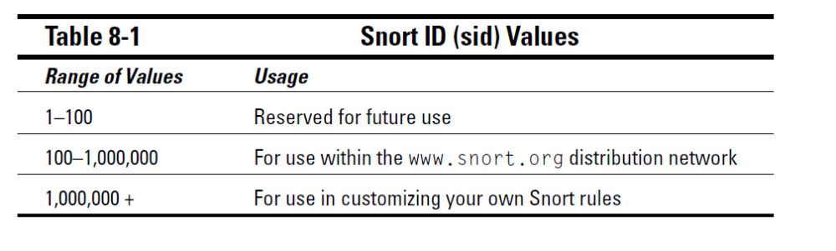
Rule Classification

Slide 34
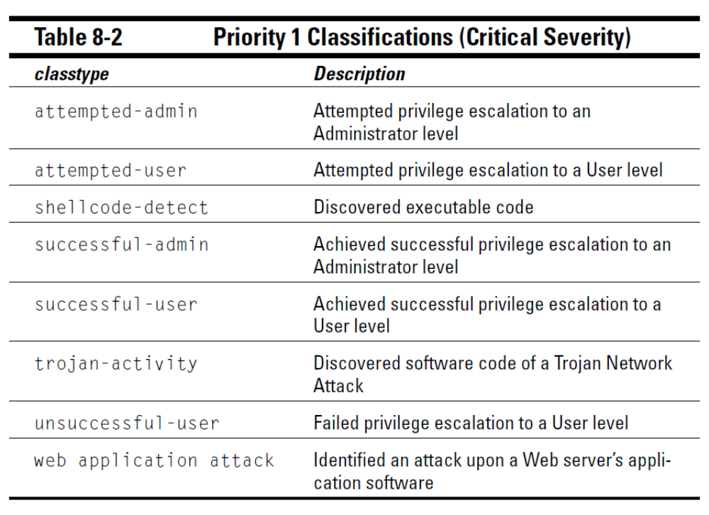
Classtype

Slide 35
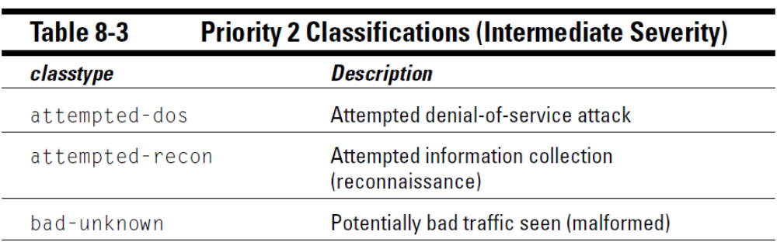

Slide 36
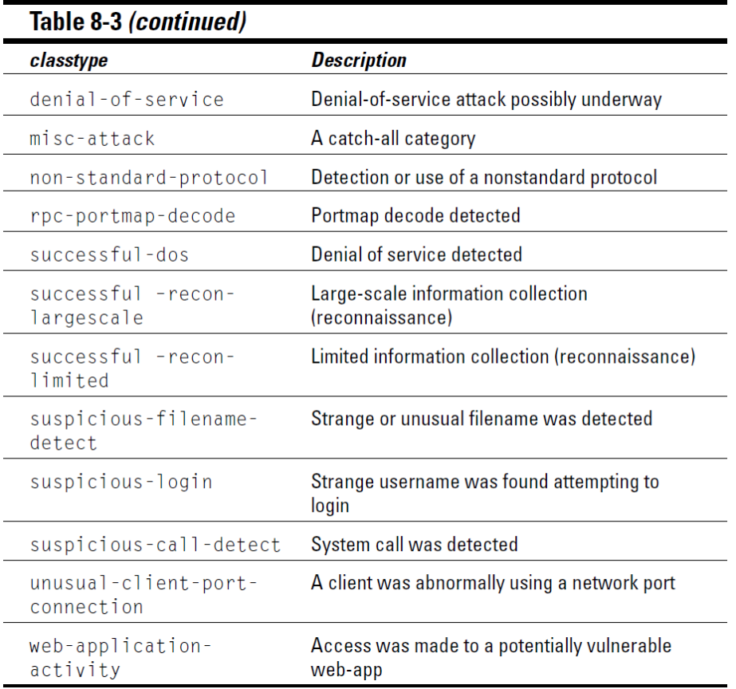

Slide 37
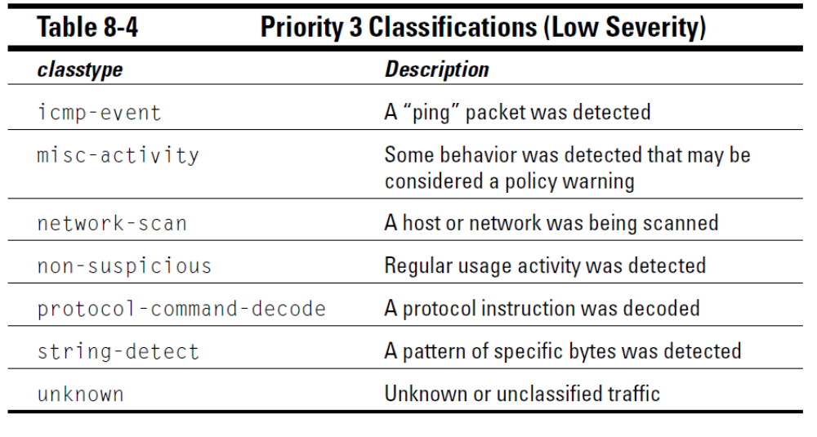

Slide 38
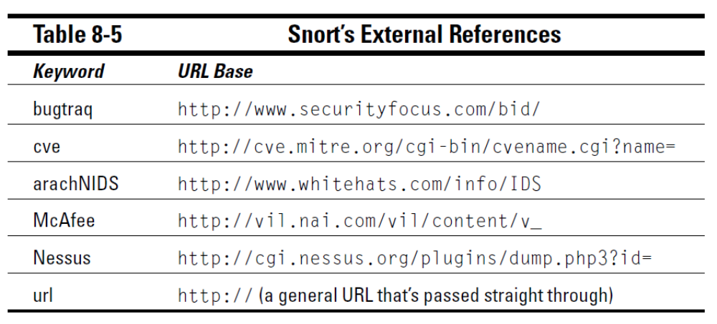
External References

Slide 39
Using Snort
Install with libcap / wincap.
Move config / rule files to correct directory and alter them.
Use Snort from the commandline.
Snort can be used to sniff or to decode.

Slide 40
Using Snort
Sniffer Mode
Run-time switches:
  -v verbose
  -d dump package payloads
  -x dump entire package in hex
  -a display arp packages //does not work on your version.
  -e display link layer data
snort -dvae

Slide 41
Using Snort
Packet Logger Mode
Tell snort to output packages to a log file.
Command line options:
  -l dump packages into log directory
  -b log packages in binary (tcpdump) format
Example: snort –b –l /temp/snort

Slide 42
Using Snort
Binary log files are in tcpdump format
Can be read by snort with the –r switch
Readback can be used to dump, log, or perform detection

Slide 43
Using Snort
Full Text Logging
Packets are logged in plain ascii format
One file created per protocol port pair
A port scan creates too many files.

Slide 44
Using Snort
NIDS Mode
Load snort with a set of rules, configure packet analysis plug-ins, and let it monitor hostile network activity

Slide 45
Using Snort
Use –c switch to specify configuration file.
  Snort –c snort.conf
If no config file is specified, snort looks in the /etc directory.

Slide 46
Using Snort
NIDS mode:
Specify an alternative logging directory with –l
Specify an alternate alert mode
  -AL fast, full, none, console
  -M <wrkstn> Send SMB (popup) alerts

Slide 47
Snort analysis example
Snort rule in rule file “rules”:
snort –r cap.wdp –b –l snortlog –c rules
This captures all traffic destined to port 12345, usually used for BackOrifice traffic.
alert tcp any any -> any 12345

Slide 48
Snort Rules
Rules contains the rule header and the rule option.
alert tcp !10.1.1.0/24 any -> 10.1.1.0/24 any (flags: SF; msg: “SYN-FIN scan)
Alerts to traffic from outside the 10.1.1.x subnet to the 10.1.1.x subnet with the Syn and the Fin flags set.

Slide 49
Snort Rules
Rule Header Fields
  Action Field
    Alert
    Log
    Pass (no longer look at package)
    Activate (turns on other rules)
    Dynamic (needs to be turned on by another rule)

Slide 50
Snort Rules
Rule Header Fields
  Protocol Field
    TCP
    UDP
    ICMP
    IP
    Others (ARP, RARP, GRE, …) to come

Slide 51
Snort Rules
Rule Header Fields
  Source and Destination IP Address Field
    Format: Address/netmask or any or
      Address x.x.x.x
      Netmask = bits of network mask
      For example
        24.0.0.0/8 Class A
        24.3.0.0/16 Class b
        192.185.67.0/24 Class C
        192.185.67.188 host address
    Special keywords:
      any
      ! (negation)
      $HOME_NET (variable defined elsewhere)

Slide 52
Snort Rules
Rule Header Fields
  Source and Destination Port Field
    Static port: 111
    All ports: any
    Range: 110:3000
    Negation: !80
    Less than or equal :1023
    Greater than or equal 1024:

Slide 53
Snort Rules
Rule Header Fields
  Direction Indicator (optional)
    ->
    Source information specified to the left of arrow, destination information specified to the right of the arrow

Slide 54
Snort Rules
Rule Options
  Separated by parentheses
alert tcp !$HOME_NET any -> $HOME_NET any (flags: SF; \
msg: “Syn-Fin” scan”;)

Slide 55
Snort Rules
Rule Options
  Msg Option
    Allows user to assign an appropriate message to the output of a triggered rule.
    Alert or log entries only give the packet, not the rule that was triggered.

Slide 56
Snort Rules
Rule Options
  Msg Option
alert udp any any -> 129.210.18.0 / 24 31337 \
(msg: “Back Orifice”;)
Rule:
Log:
[**] Back Orifice [**]
05/10-08:44:26.398345 192.120.81.5:60256 -> 129.210.18.34:31337
UDP TTL:41 TOS:0x0 ID:49951
Len: 8

Slide 57
Snort Rules
Rule Options
  Logto Option
    Specifies filename to which to log the activity.
    Allows to separate the annoyances from the truly dangerous.
alert udp any any -> 129.210.18.0 / 24 31335 \
(msg: “trinoo port”; logto “DDoS”)

Slide 58
Snort Rules
Rule Options
  TTL option
    Allows to use the time to live field in packet
    Format: ttl: number
alert udp any any -> 129.210.18.0 / 24 33000;34000 \
(msg: “Unix traceroute”; ttl: 1;)

Slide 59
Snort Rules
Rule Options
  ID option
    16-bit value found in the IP header of each datagram.
alert udp any any -> 129.210.18.0 / 24 33000;34000 \
(msg: “Suspicious IP Identification”; ID: 0;)

Slide 60
Snort Rules
Rule Options
  Dsize option
    Size of payload
alert icmp any any -> 129.210.18.0 / 24 any \
(msg: “Large ICMP payload”; dsize: >1024;)

Slide 61
Snort Rules
Rule Options
  Sequence Option
    Value of tcp sequence number
  Ack option
    Value of ack number in tcp
alert tcp any any -> any any \
(msg: “Possible Shaft DDoS”; seq: 0x28374839;)
alert tcp any any -> any any \
(msg: “nmap tcp ping”; flags: A; ack: 0;)

Slide 62
Snort Rules
Rule Options
  Itype and Icode Options
    Select ICMP message type and operations code
alert icmp 1.1.1.0/24 any -> 129.210.18.0 / 24 any \
(msg: “port unreachable”; itype: 3; icode: 3;)

Slide 63
Snort Rules
Rule Options
  Flags option
alert tcp any any -> any any \
(msg: “null scan”; flags: 0;)

Slide 64
Snort Rules
Rule Options
  Content Option
alert udp $EXTERNAL_NET any -> $HOME_NET 53 \
(msg: “Exploit bind tsig Overflow attempt”; \
content: “|00 FA 00 FF|”; content: “/bin/sh”;)

Slide 65
Snort Rules
Rule Options
  Offset option
    Specifies offset of content
  Depth option
    Specifies how far into packet to search for content
  Nocase option
    Makes content searches case insensitive
  Regex Option
    Allows wildcards in content searches

Slide 66
Snort Rules
Rule Options
  Session Options
    Allows to capture TCP session.
  Rest Option
    Allows an automatic active response
  Tag Option
    Allows to dynamically capture additional packages after a rule triggers.

Slide 67
Identify NMAP Ping Scan
alert icmp any any -> 192.168.1.105 any (msg: "NMAP ping sweep Scan"; dsize:0;sid:10000004; rev: 1; )
Identify NMAP TCP Scan
alert tcp any any -> 192.168.1.105 22 (msg: "NMAP TCP Scan";sid:10000005; rev:2; )
Identify NMAP XMAS Scan
alert tcp any any -> 192.168.1.105 22 (msg:"Nmap XMAS Tree Scan"; flags:FPU; sid:1000006; rev:1; )

Slide 68
Identify NMAP FIN Scan
alert tcp any any -> 192.168.1.105 22 (msg:"Nmap FIN Scan"; flags:F; sid:1000008; rev:1;)
Identify NMAP NULL Scan
alert tcp any any -> 192.168.1.105 22 (msg:"Nmap NULL Scan"; flags:0; sid:1000009; rev:1; )
Identify NMAP UDP Scan
alert udp any any -> 192.168.1.105 any ( msg:"Nmap UDP Scan"; sid:1000010; rev:1; )

