Slide 1

IBM INTERNSHIP
PS #13
FITNESS
BUDDY
AI-Powered Personal Fitness Coach
Built with LangFlow + IBM watsonx.ai + IBM Granite
Edunet Foundation | IBM 4-Week Internship | Problem Statement #13
Janardan Kaki
Transforming Fitness with Conversational AI

Slide 2

STUDENT PROFILE
Full Name:
Janardan Kaki
Email ID:
janardankaki1125@gmail.com
Domain:
Health & Fitness / AI
FITNESS
BUDDY
Project:
Fitness Buddy – AI Fitness Coach
Problem Statement
#13
github.com/janardankaki1125/Fitness-Buddy-/tree/main

Slide 3

PROBLEM STATEMENT #13
⚡ THE CHALLENGE
🎯 THE OBJECTIVE
In today's fast-paced world, many individuals struggle to maintain a healthy lifestyle due to:
Build Fitness Buddy — an AI conversational fitness coach that:
Lack of personalized fitness guidance
Recommends home workouts based on user input
Time constraints and busy schedules
Provides motivational tips and daily inspiration
Inconsistent motivation and habit building
Suggests nutritious meal ideas
Expensive gym memberships & rigid plans
Encourages habit-building and consistency
No accessible, 24/7 fitness assistant
Remembers user preferences using Memory

Slide 4






TECHNOLOGY STACK
LangFlow
IBM watsonx.ai
IBM Granite
Visual AI workflow builder to design and orchestrate the Fitness Buddy chatbot pipeline
IBM's enterprise AI platform for model deployment, scaling and AI governance
ibm/granite-8b-code-instruct model via IBM watsonx.ai — mandatory IBM AI model
Message History
Prompt Template
IBM Cloud
LangFlow Memory component for conversation history and personalized responses
Dynamic prompt engineering to guide AI responses for fitness coaching behavior
IBM Cloud Lite plan infrastructure hosting watsonx.ai Runtime (Sydney region)
Approach Used: LangFlow + IBM watsonx.ai + IBM Granite Models

Slide 5



PROPOSED SOLUTION
Fitness Buddy is an AI-powered conversational fitness coach built using LangFlow and IBM watsonx.ai. It provides personalized home workout routines, healthy meal suggestions, daily motivation, and habit-building guidance through an intelligent chat interface — available 24/7, completely free.
Workout Plans
Meal Guidance
Motivation
Memory
Personalized home workout routines based on fitness level and goals
Healthy meal ideas and nutrition suggestions for weight management
Daily fitness inspiration and motivational tips to stay consistent
Remembers user name, goals and preferences across the conversation

Slide 6
LANGFLOW COMPONENTS USED
1
Chat Input
Interface where users enter fitness queries, goals, and preferences through natural language conversation
2
Prompt Template
Dynamic prompt engineering that instructs IBM Granite to behave as a fitness coach with specific rules and format
3
IBM watsonx.ai
IBM's AI model component using ibm/granite-8b-code-instruct to generate personalized fitness plans and advice
4
Message History
Memory component that stores conversation history so Fitness Buddy remembers user name, goals and context
5
Chat Output
Displays AI-generated workout plans, meal suggestions, motivation tips and fitness guidance to the user

Slide 7
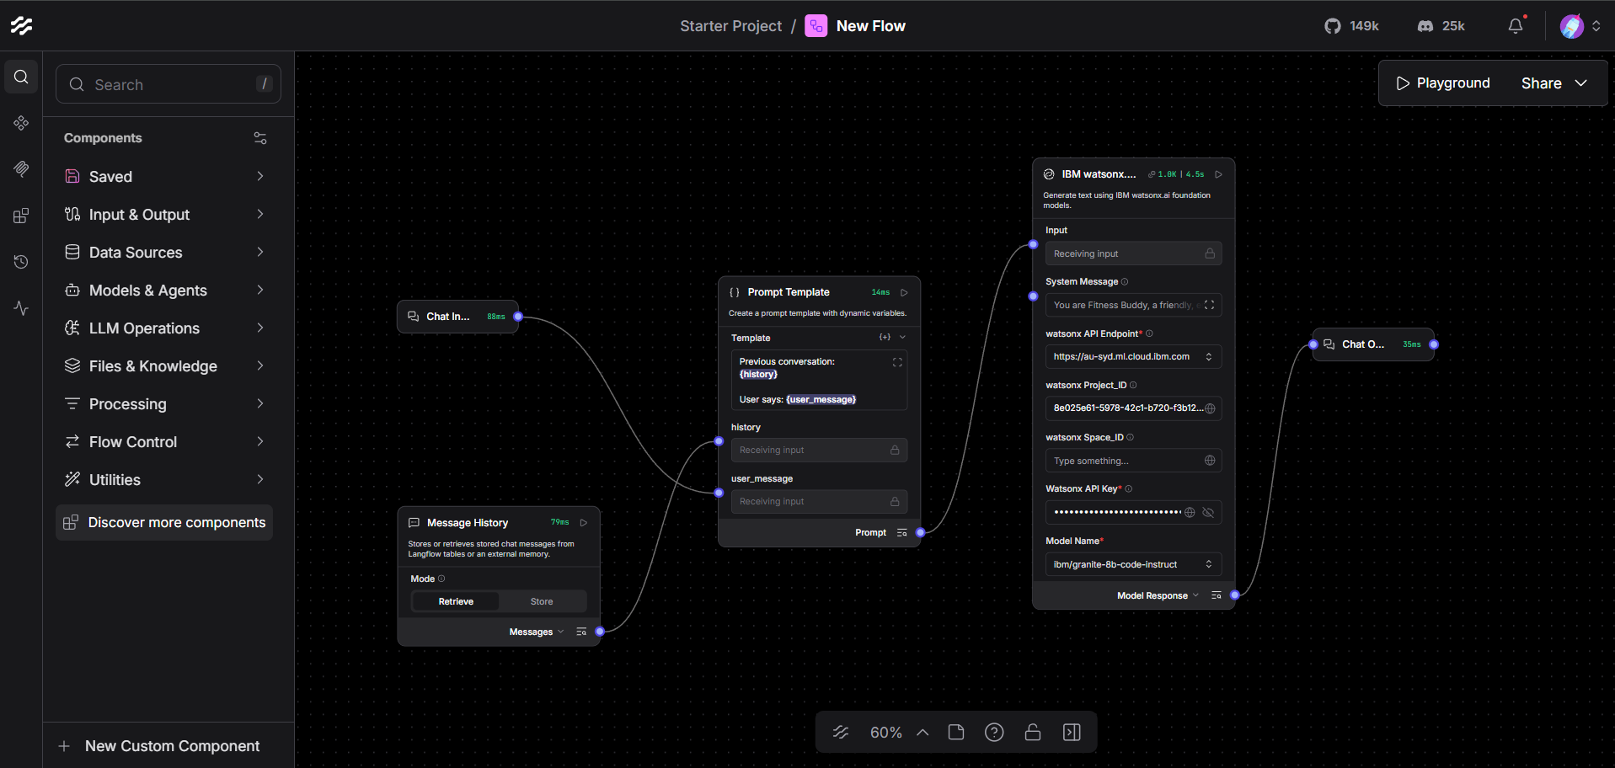
LANGFLOW WORKFLOW
Message
History
Chat
Input
IBM
watsonx.ai
Chat
Output
Prompt
Template
LangFlow Canvas: Chat Input → Message History → Prompt Template → IBM watsonx.ai (Granite) → Chat Output

Slide 8
ARCHITECTURE BLUEPRINT
USER
CHAT INPUT
MEMORY
PROMPT
TEMPLATE
IBM GRANITE
Web Browser
LangFlow Playground
LangFlow
Input Component
Message History
LangFlow Component
Dynamic Prompt
Engineering
watsonx.ai
granite-8b-instruct
☁ IBM CLOUD INFRASTRUCTURE
IBM Cloud Lite Account • watsonx.ai Studio • watsonx.ai Runtime (Sydney au-syd) • API Key Authentication • Project ID
📤 Chat Output → AI Response sent back to user → Fitness plans, meal ideas, motivation displayed
📸 Add architecture diagram or LangFlow screenshot here

Slide 9
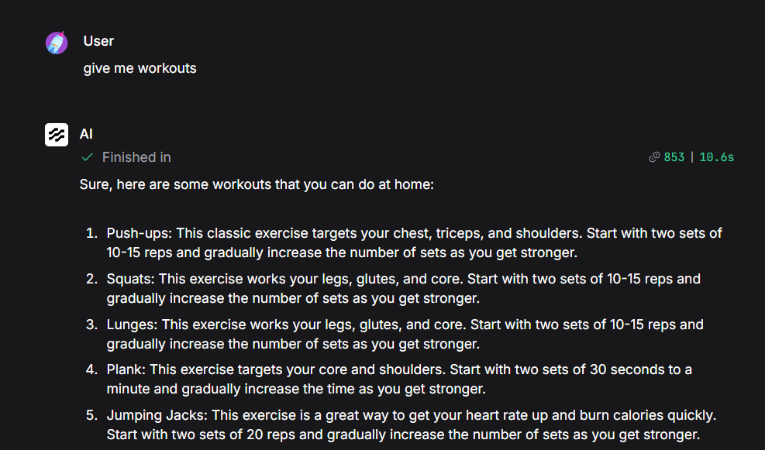
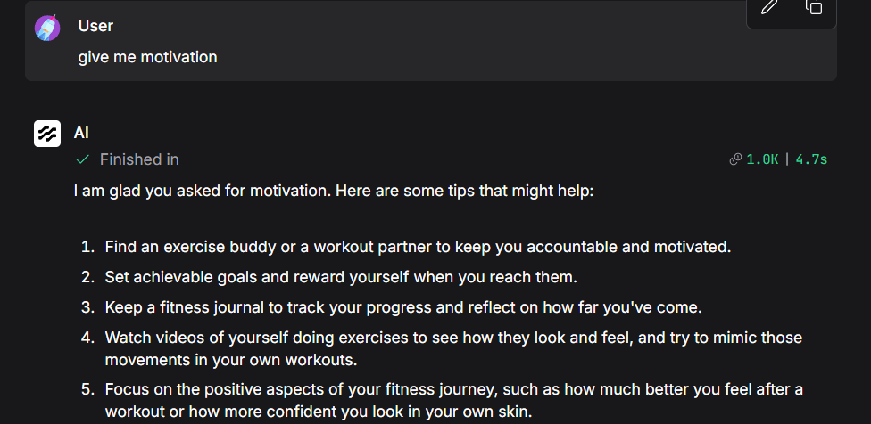
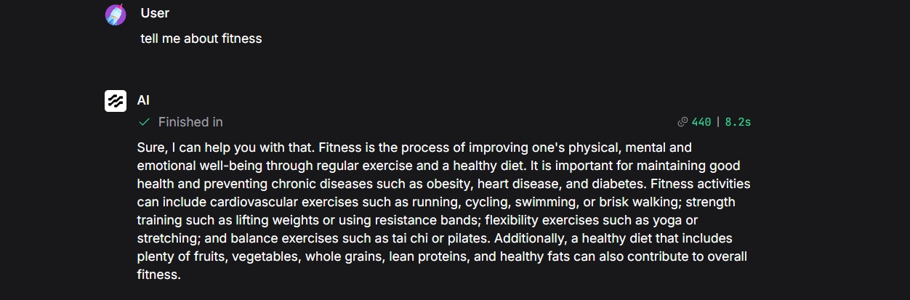
PROJECT DEMO — OUTPUT
📸
Add screenshot
here
📸
Add screenshot
here
📸
Add screenshot
here
💪 Workout Plan Output
🔥 Motivation Response
📅 Daily Fitness Routine
Add screenshots from LangFlow Playground showing Fitness Buddy in action

Slide 10





ROLE OF AGENTIC AI IN FITNESS BUDDY
Intelligent Understanding
IBM Granite model understands user intent, fitness goals, and health context to generate meaningful responses rather than generic answers
Personalization Engine
Fitness Buddy adapts its recommendations based on user-provided fitness level, goals, and preferences for hyper-personalized guidance
Memory & Context Awareness
Message History component enables Fitness Buddy to remember user name, goals and conversation context across the entire session
Autonomous Decision Making
The AI autonomously decides what type of response to generate — workout plan, meal advice, or motivation — based on user query
Goal-Oriented Behavior
Acts like a proactive digital fitness coach, always driving users toward their fitness goals with structured plans and encouragement

Slide 11





NOVELTY & UNIQUENESS
Conversational AI Coach
Memory-Enabled Chat
Prompt Engineering
Unlike static fitness apps, Fitness Buddy uses natural language conversation powered by IBM Granite for dynamic guidance
Unique conversation memory using LangFlow's Message History — remembers user context throughout the entire session
Custom system prompts make IBM Granite behave specifically as a fitness coach — not a generic AI assistant
IBM Enterprise AI
Zero-Cost Solution
24/7 Availability
Built on IBM watsonx.ai — enterprise-grade AI infrastructure ensuring reliability, governance and scalability
Completely free using IBM Cloud Lite plan and LangFlow open-source — accessible to everyone without subscriptions
Always-on AI fitness coach available anytime — no appointments, no expensive gym memberships required

Slide 12

GITHUB REPOSITORY
github.com/janardankaki1125/Fitness-Buddy-/tree/main
Public Repository • MIT License • README included
Files Uploaded to Repository:
📄 Fitness_Buddy.json
Complete LangFlow workflow export file
📸 Screenshots/
Demo screenshots of all chatbot responses
📋 README.md
Project description, setup instructions and flow architecture
📊 Presentation.pptx
This project presentation for final submission

Slide 13
FUTURE SCOPE
01
Wearable Device Integration
Connect with smartwatches and fitness trackers to collect real-time health data (steps, heart rate, calories burned) and provide dynamic, activity-based fitness recommendations
02
Voice Assistant & Multilingual
Add voice interaction and support for multiple languages including Telugu, Hindi and Tamil — making Fitness Buddy accessible to diverse users across India
03
Progress Tracking Dashboard
Build a visual dashboard showing weekly workout progress, calorie tracking, fitness milestones and goal completion charts using IBM Analytics
04
RAG-Based Nutrition Database
Integrate Retrieval-Augmented Generation with verified nutrition databases (USDA, WHO) to provide evidence-based meal recommendations and dietary advice

Slide 14

THANK YOU!
Fitness Buddy — AI Fitness Coach
Janardan Kaki
Edunet Foundation IBM Internship | Problem Statement #13
github.com/janardankaki1125/Fitness-Buddy-/tree/main

