Slide 1
Hotel Booking Demand Analysis & Cancelation prediction
Data Science Use case
S T A R T
Open

Slide 2
Content
01.
Tools & Technologies
03
02.
Use Case – Hotel Booking
Hotel Booking - Overview
Hotel Booking Pain Points
Data
Sample Examples
05
Open

Slide 3
Tools & Technologies
Open

Slide 4
Tools & Technologies
Programming Languages –
Preferably use Python or R
If you are not comfortable with above, then can use any other programming languages
IDE –
Preferably use Jupyter, Rstudio, Pycharm, Spyder, VS Code etc
If you are not comfortable with above, then can use Azure ML or any other platforms
Visualization/ EDA –
Preferably use Python or R
If you are not comfortable with above, then can use Power BI, Tableau, Excel or any other tools
Documentation
Preferably use Markdown languages
If you are not comfortable with above, then can use any other tools/languages
Final Report –
Share your development code base (if in a separate script)
Provide the final report and approach analysis in Jupyter notebook, Google Colab or R markdown
If you are not comfortable with above, use your preferred reporting tool (Word, PDF etc)
Open

Slide 5
Use Case – Hotel Booking
Open

Slide 6

Hotel Booking - Overview
Have you ever wondered:
When is the best time of the year to book a hotel room?
What is the optimal length of stay in order to get the best daily rate?
What if you wanted to predict whether or not a hotel is likely to receive a disproportionately high number of special requests?
Whether a booking is going to be cancelled?
This hotel booking dataset can help you to explore those questions!
Open

Slide 7



Hotel booking pain points from the perspectives of Hotel, Guest and Data Science
Hotels currently don’t know about the guests' preferences, booking / cancelation patterns, deeper insights etc.
It would be nicer for the hotels to have a model to predict if a guest will come.
Hotel
Guest
Data Science
Descriptive analytics
Q1. Provide various descriptive analytics and insights
Data Science Use Cases
Q2. Suggest the use cases suitable here from the perspective of the hotel owner?
Data Science Use Cases
Q3. Suggest the use cases suitable here from the perspective of the guests?
Q4. Develop a model to predict bookings cancellation and explain the model as well as it’s output.
Q5. Develop a model to predict the number of booking nights for any new booking.
Open

Slide 8
Data
This data set contains booking information for a city hotel and a resort hotel and includes information such as when the booking was made, length of stay, the number of adults, children, and/or babies, and the number of available parking spaces, among other things.
Hotel Dataset
Description
Open

Slide 9
Data
Dataset contains following features:
hotel
is_canceled
lead_time
arrival_date_year
arrival_date_month
arrival_date_week_number
arrival_date_day_of_month
stays_in_weekend_nights
stays_in_week_nights
adults
children
babies
meal
country
market_segment
Dataset Features
distribution_channel
is_repeated_guest
previous_cancellations
previous_bookings_not_canceled
reserved_room_type
assigned_room_type
booking_changes
deposit_type
agent
company
days_in_waiting_list
customer_type
adr
required_car_parking_spaces
total_of_special_requests
reservation_status
reservation_status_date
Open

Slide 10
Sample Examples
Open

Slide 11

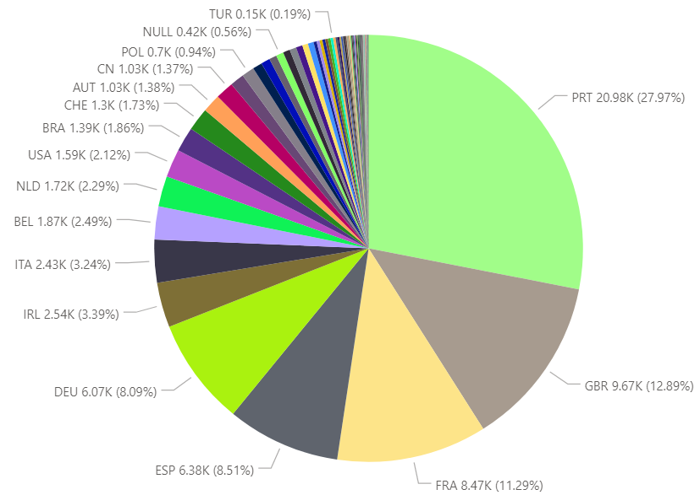
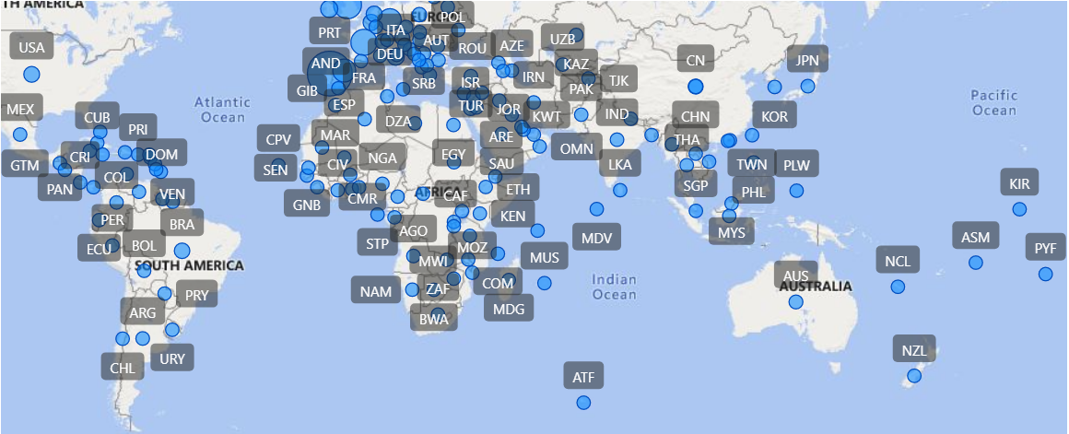
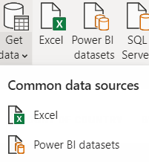
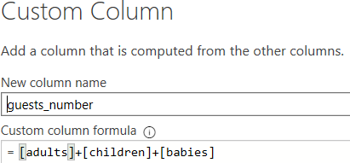
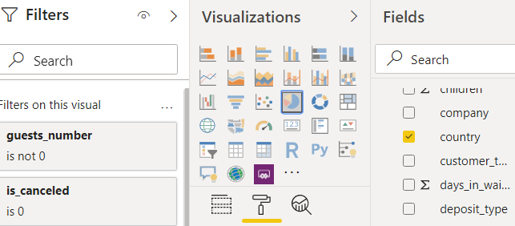
Example: Using Power BI to answer the user queries on Hotel Booking
Where do the guests come from?
Data Ingestion
Data Transformation
Data Visualization
Open

Slide 12

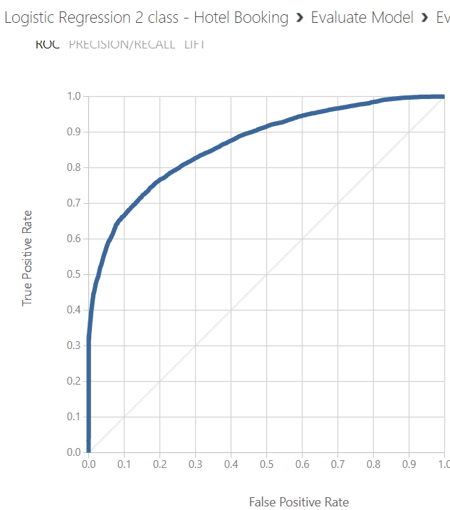
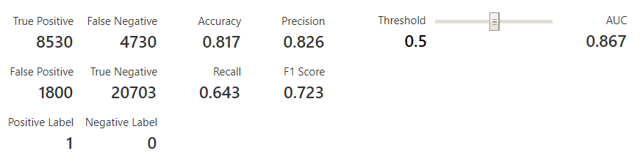
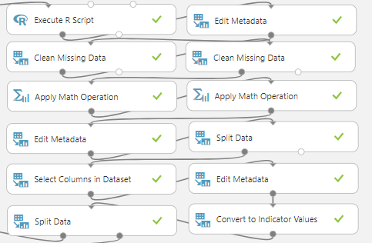
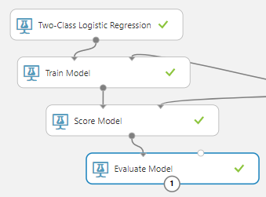
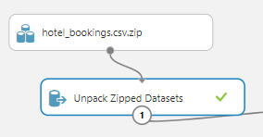
Example: Using Azure ML to predict cancellation of hotel bookings
Predict the particular booking cancelation
Data Ingestion
Data Transformation
Data Visualization
Open

Slide 13
Thank you for your passion!
Open

