Slide 1
Global Economic & Population Analysis
Excel | SQL | Power BI
Presented By : Janarthanan M

Slide 2
Project Overview
Analysis of global GDP, population, and sector-wise contribution across countries
Focus on long-term trends rather than visual-heavy dashboards
Designed a clean dashboard using Power BI

Slide 3
Data Sources
GDP data (1960–2016)
Country-wise population datasets
Country metadata for standardization
Countries World dataset/DB

Slide 4
Data Cleaning & Preparation
Removed countries with insufficient historical data
Handled missing values using power query
Standardized country names and formats
Converted wide time-series data into analysis-ready format
Merged dataset using Country name and Country code

Slide 5
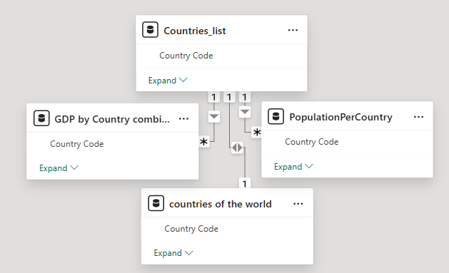
Data modelling
The star schema model facilitates easy data retrieval and visualization, enhancing insights through clean relationships between dimensions and fact tables in our Power BI project.

Slide 6
Dax calculation
Population growth over time
GDP growth
Average GDP per capita
Average Literacy Rate
Average Agriculture Rate

Slide 7
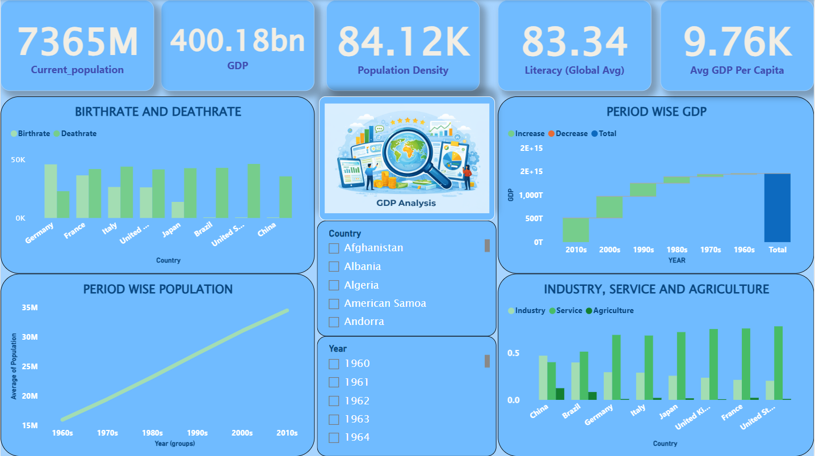
GDP analysis Dashboard

Slide 8
DASHBOARD OVERVIEW
The Power BI dashboard includes:
Period-wise Population Trends
Period-wise GDP Growth
Birthrate vs Deathrate Comparison
Industry, Service & Agriculture Contribution
Country & Year Slicers for interactivity

Slide 9
Key Insights
Global population continues to grow steadily over time, especially from the 1990s onward, indicating sustained long-term demand for food, healthcare, housing, and infrastructure.
GDP growth is concentrated in recent decades, with the 2000s and 2010s contributing the largest increases, reflecting rapid globalization, technological advancement, and expansion of international trade.
High population density combined with moderate GDP per capita highlights productivity gaps, suggesting that economic growth depends more on efficiency, skills, and innovation than population size alone.
Literacy rate being consistently high at the global level supports workforce quality, enabling economies to transition toward service-based and knowledge-driven industries.
Service and industry sectors dominate over agriculture across major economies, showing a clear structural shift away from agriculture toward higher-value economic activities.

Slide 10
Conclusion
Global economic growth is driven more by productivity and sectoral transformation than by population growth, emphasizing the importance of skills and efficiency.
Recent decades contribute the largest share of GDP growth, highlighting the impact of globalization, technology adoption, and service-sector expansion.
High literacy levels support the shift toward knowledge-based and service-oriented economies, enabling sustainable long-term growth.
Balanced development across industry and services is essential, while agriculture plays a supportive but smaller role in modern economic structures.

