Slide 1
Python for STEM
Jessica A. Nash
September 30, 2026
Innovation Co-Lab Roots
Notes:
Hands-on introduction to scientific and quantitative work with Python. Some prior programming experience is helpful, but not required.

Slide 2
Outline
What is Python?
  History, Popularity, & Applications
Advantages and Disadvantages of Python
Jupyter Notebooks
Hands-On

Slide 3
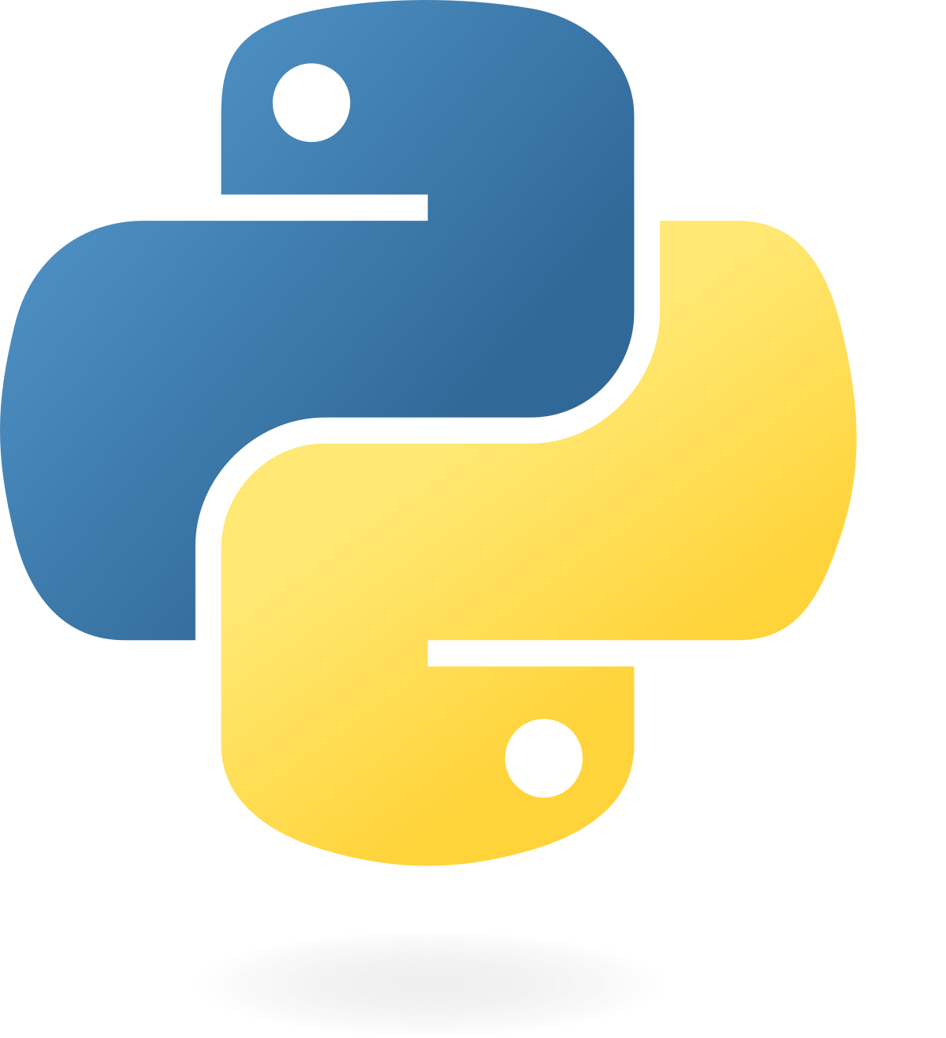
What is Python?
Python is a high-level, general-purpose programming language designed for readable code.
It was created by Guido van Rossum: development began in 1989, and the first public release was in 1991.
Python is interpreted and dynamically typed. It manages memory automatically.
It is free and open source, and is used for everything from scientific calculations to web applications.
Python documentation · History and general FAQ
Notes:
Sources:
https://docs.python.org/3/faq/general.html#why-was-python-created-in-the-first-place

Slide 4
Python popularity
In the 2025 Stack Overflow survey, 57.9% of respondents to the language question reported using Python.
Python use rose by about 7 percentage points from 2024.
Scientific computing, data science, machine learning, AI, and backend development all contribute to its broad appeal.
Stack Overflow Developer Survey 2025 · All respondents · 31,771 responses · Multiple selections allowed
Notes:
The chart displays the six most-used programming, scripting, and markup technologies among respondents to this question. It is survey usage, not a measure of every developer worldwide. Values: [('JavaScript', 66.0), ('HTML/CSS', 61.9), ('SQL', 58.6), ('Python', 57.9), ('Bash/Shell', 48.7), ('TypeScript', 43.6)]
Sources:
https://survey.stackoverflow.co/2025/technology

Slide 5
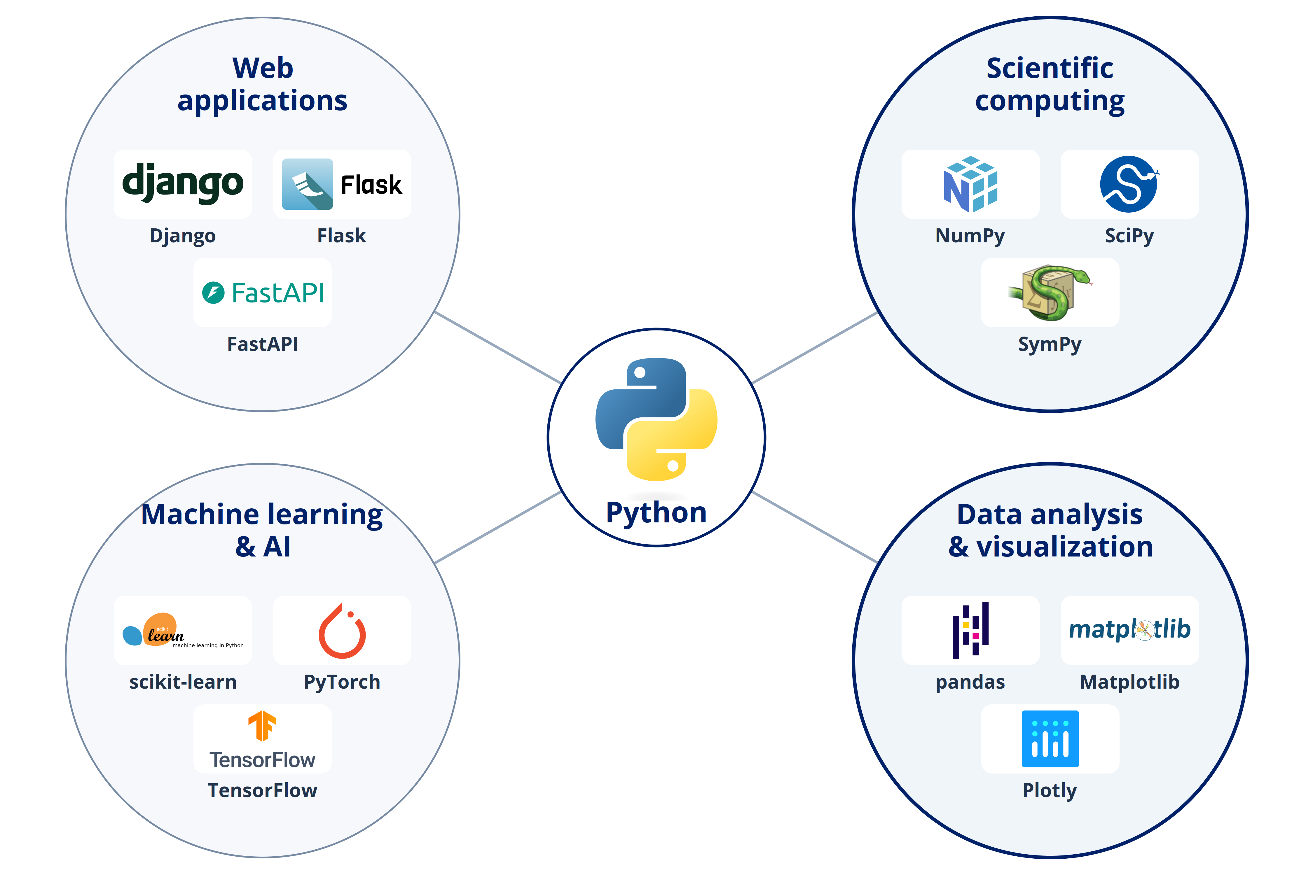
What can you build with Python?
Scientific software: simulations, numerical models, and data analysis with NumPy and SciPy.
Machine learning and AI: predictive models, image recognition, and language-model applications with scikit-learn and PyTorch.
Web applications and APIs: websites and services built with Django, Flask, or FastAPI.
Python.org · Applications for Python

Slide 6
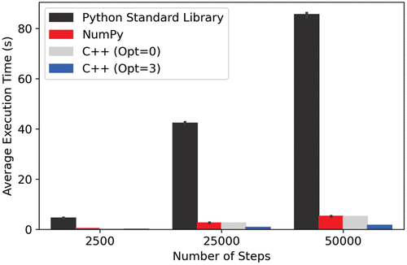
What are the disadvantages?
Python loops and runtime checks can make numerical code much slower than compiled languages.
Some errors appear only when the affected code runs.
Package versions and dependencies need management; environments (not covered in this workshop) help organize them.
Monte Carlo benchmark from the C++ workshop.
Times depend on the task and implementation.

Slide 7
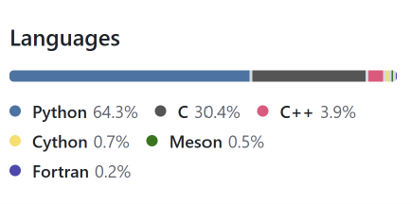
How can you make Python faster?
Python can coordinate work performed by compiled C, C++, or Fortran routines.
Many libraries have a Python interface (API), but use compiled languages like C++ or Fortran for calculations.
Your Python code
Describe the analysis
↓
NumPy / SciPy
Operate on arrays and models
↓
Compiled numerical routines
Perform much of the computation
Language breakdown for NumPy library.

Slide 8
The SciPy stack
Scientific Python is an ecosystem of open-source libraries that can be used for data analysis, calculations, and visualization.
NumPy
SciPy
Arrays, vectorized calculations, and linear algebra
Optimization, integration, signal processing, and statistics
pandas
Matplotlib
Read files, organize tables, filter rows, and summarize data
Create and customize scientific plots
Our workshop also uses Plotly for interactive plots and Jupyter for notebooks.
Notes:
SciPy is both the name of a specific library and part of the broader ecosystem often called the SciPy stack. The packages shown have complementary roles; this is not a strict dependency diagram. Introduce import statements during hands-on work.
Sources:
https://numpy.org/
https://scipy.org/
https://pandas.pydata.org/
https://matplotlib.org/
https://plotly.com/python/

Slide 9
Other Python Libraries
Plotly
Creates interactive visualizations, including scatter plots, line plots, and more.
Supports zooming, panning, and hovering over points to inspect values.
Plotly Express provides a concise interface for plotting data, including pandas DataFrames.
statsmodels
Provides tools for fitting statistical models and conducting statistical tests.
Reports model coefficients, uncertainty estimates, and measures of fit.
We’ll use it for linear regression: fitting a relationship between variables and examining the resulting model.

Slide 10
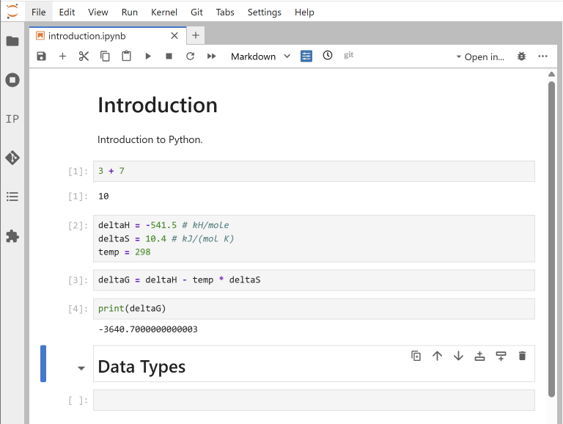
What is a Jupyter notebook?
In this workshop, we will write code into a Jupyter notebook.
A Jupyter notebook is an interactive document that combines code, explanatory text, equations, and results.
Code is organized into cells that you can run and edit individually. Markdown cells describe the question and method.
Select a code cell and press Shift+Enter to run it.

Slide 11
Hands-On

Slide 12
Environment: Duke Container Manager
cmgr.oit.duke.edu/containers

Slide 13
Making your work easy to follow
Explain the question and method in Markdown before presenting the calculation.
Use meaningful variable names, record units, and label the axes on your plots.
Inspect the data and intermediate results instead of assuming that code which runs is correct.
Before sharing a notebook, restart the kernel and run all cells from the top. Keep the data and environment information needed to repeat the work.

