Slide 1

ZAYATHON-2026
PROBLEM STATEMENT TITLE -
" CrowdSafe-Real Time Public Safety Alert System“
PROBLEM STATEMENT-
Public safety in crowded areas is compromised due to the absence of real-time reporting and alert systems. Delayed communication between citizens and authorities leads to slow emergency response, increased panic, and higher risk to human life.
THEME –Public Safety & Smart Cities
PS CATEGORY-Software
TEAM ID-
TEAM NAME-CTRL F

Slide 2


PROPOSED SOLUTIONS
•Enables citizens to report real-time public safety hazards.
•Supports reporting of accidents, fire, unsafe zones, and suspicious activity.
•Prioritizes alerts based on severity.
•Sends instant notifications to nearby users.
•Identifies high-risk areas using collected data.
WHY IT MATTERS
•Prevents accidents through early hazard warnings.
•Improves public safety in crowded areas.
•Reduces response time during emergencies.
•Encourages community participation in safety.
•Supports smart and safer cities

Slide 3
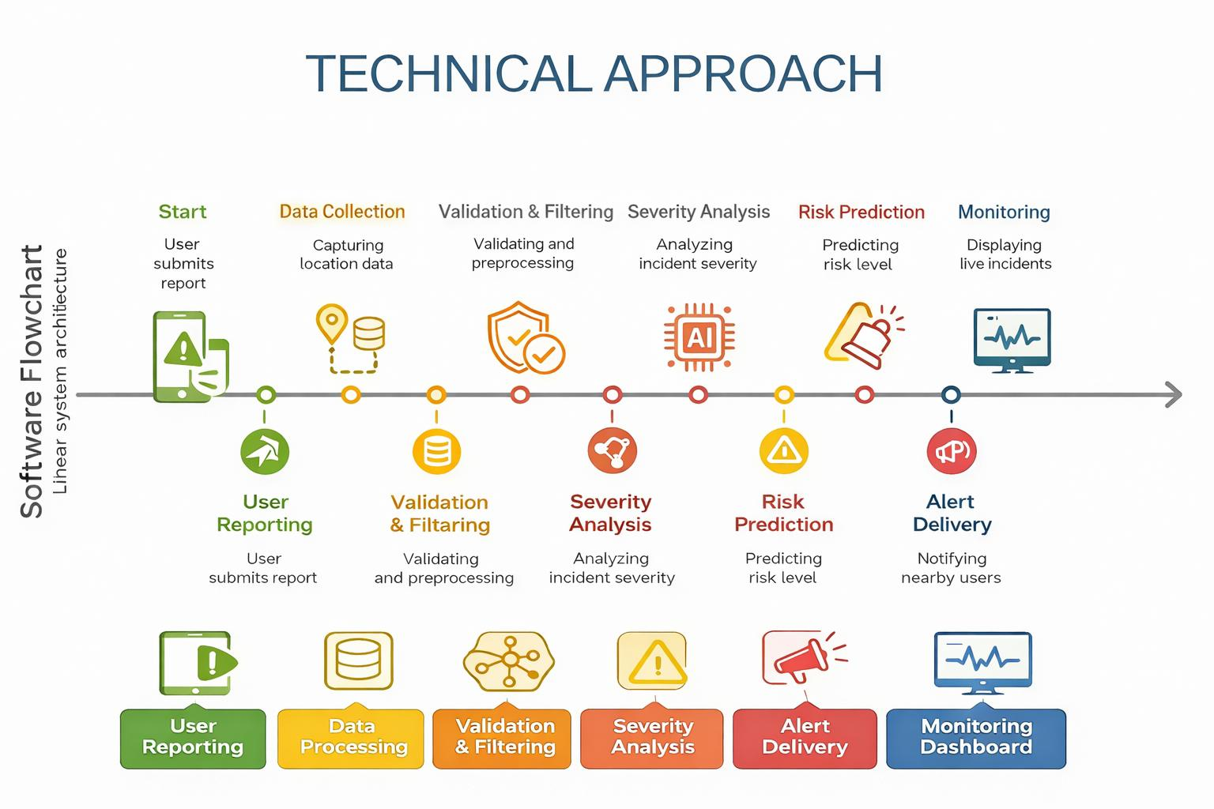

Slide 4

FEASIBILITY SURVEY
•Can be implemented as a software-based solution.
•Requires only basic internet and smartphones.
•Suitable for public places, events, and urban areas.
•Easy to use with minimal user training.
•Scalable for different locations and user groups.
CHALLENGES AND RISK
•Possibility of false or misleading reports.
•Dependence on internet connectivity.
•Alert fatigue due to frequent notifications.
•Accuracy of user-provided location data.
•Privacy and data security concerns.
VIABILITIES
•Low-cost implementation with no hardware dependency.
•Can integrate with authorities and emergency services.
•Supports large-scale public safety applications.
•Enhances community-driven safety awareness.
•Aligns with smart city and digital governance goals.

Slide 5
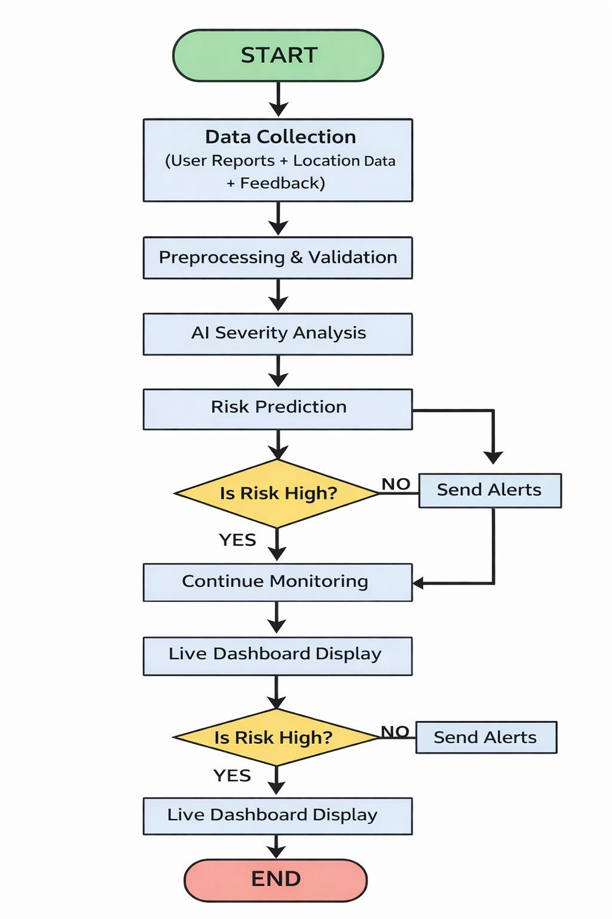
Proposed System Work Flow
IMPACTS
•Improves public safety through real-time alerts.
•Reduces accidents and emergency response time.
•Increases awareness in crowded and public areas.
•Helps identify high-risk zones using collected data.
•Supports development of safer smart cities.
BENEFITS
•Saves lives by providing early hazard warnings.
•Easy to use and accessible to common users.
•Low-cost, software-only solution.
•Encourages community participation in safety.
•Scalable for cities, campuses, and public spaces.

Slide 6
References
Publicly available research and datasets
Smart Cities Mission, Govt. Of India
WHO – Public Safety & Urban Risk Reports

