Slide 1
College code:7125
Name: N.Muthulingaselvi
Register number:712521104025
Data warehousing with IBM cloud Db2 warehouse

Slide 2


Slide 3


Slide 4


Slide 5


Slide 6


Slide 7
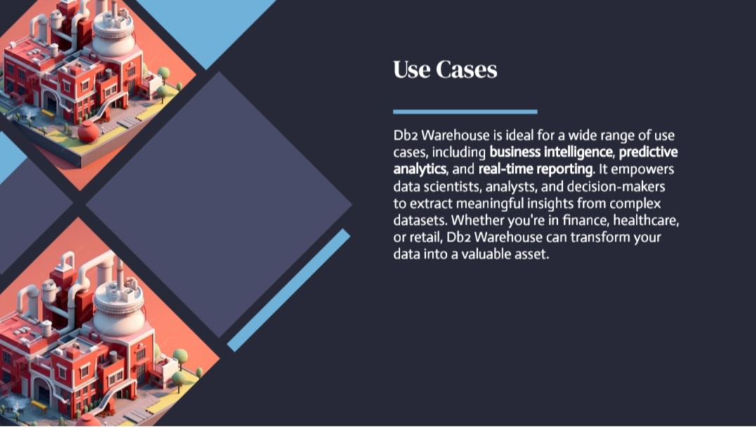

Slide 8


Slide 9
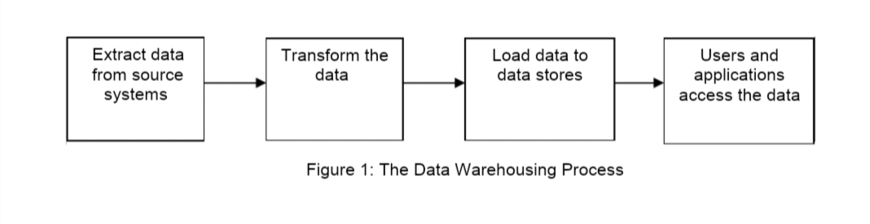

Slide 10
