Slide 1
Tech Talk
Building Responsive Websites
@CodeFellowsPDX / @JanaUhrich

Slide 2
Contents
{
Contact Information
Technical Skills
Education
Work Experience
Responsiveness – A Cliodynamic History
#Wins
One Grid to Rule Them All
Questions
metadata
{
data

Slide 3

Contact Information
Jana Uhrich (Jana, like banana, Yur-ick, like a grossed out pre-teen)
Portland, OR (Ok, actually Vancouver, WA)
203-543-7445
janauhrich@gmail.com
linkedin.com/in/janauhrichllc
janauhrich.com

Slide 4

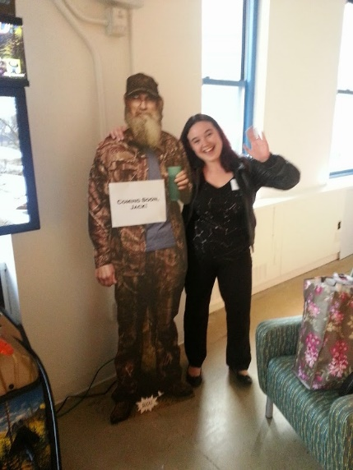

Technical Skills
HTML ★ CSS ★ JavaScript
Education
Marist College ★ Digital Media
Self-slogged nerd
Gigs
A&E Television Networks ★ Aardvark Brigade
WebMD Health Services ★ Jana Uhrich LLC
Notes:
I’m a front-end developer so I check the big three boxes, I studied Digital media which is a fancy way of saying I majored in Photoshop. I say I’m a self-slogged nerd instead of self-taught because let’s be real when you’re bleary-eyed and pouring through grunt documentation there’s nothing glamorously ivory tower educational about it. I’ve been lucky enough to get gigs at A&E Television Networks, a small boutique web dev shop with lots of facial hair, and nowadays I work at WebMD.

Slide 5

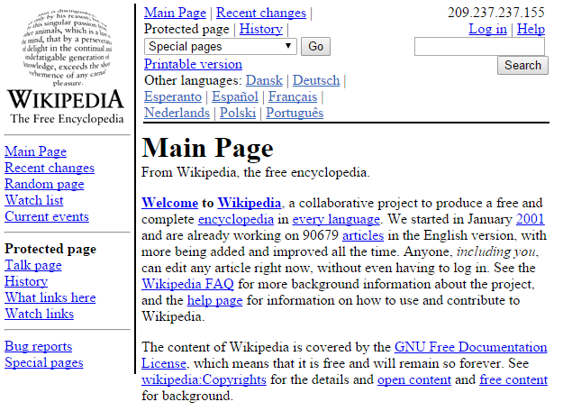

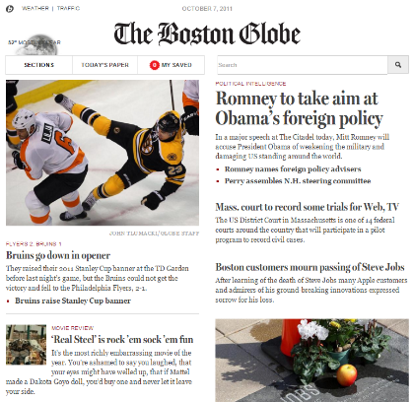
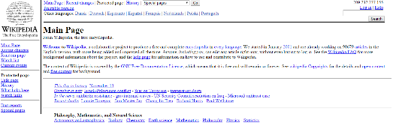



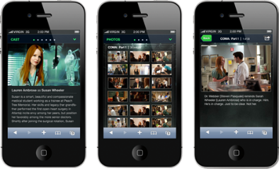
Responsiveness – A Cliodynamic History
2002
2011
2002
2006
2008
Notes:
Usually, when we talk about responsiveness we’re talking about a web site that that responds to the users screen size. I call this a cliodynamic history because you can kinda tell the future from the past… so let’s hop in our Tardis... Back in 2002 we built the web with tables, and one of the things you could do was set the width of the table to 100% thus making it de facto responsive. Now tables are great when you’re dealing with tabular data <example>. But they really sucked when you tried to design stuff with them<example>. But as you can see it’s still responsive! Alright, fast forward to 2006 when flash came around and let people make some truly beautiful and truly horrible websites that were not at all responsive, but back then that was a feature not a bug. Browsers rendered everything so differently that at least you could count on flash to offer a consistent experience. Thing was, your 2007 sidekick couldn’t even. So we started making separate websites for mobile users… which worked great on your blackberry but was not awesome for anyone else. Then this cat comes along and writes a little book called “Responsive Web Design” that fixes everything and we can go home. Just kidding, he lays out some ways to have one website to rule them all that really changes the industry pretty meaningfully.

Slide 6
#Wins Baking Adventures
Usability wins happen when the user is able to accomplish their goal
Mobile
I’m at Safeway using one hand to push a cart and I want to see the list of ingredients to make sure I have everything I need. I just want the list, SHOW ME THE LIST!
Tablet
I’m balancing my tablet on top of my slow cooker so it doesn’t get egg juice on it and trying to follow the directions while also not burning the house down.
Desktop
I’m surfing Pinterest looking at food porn trying not to think about the egg juice on the counter. I didn’t know you could put earl grey in a muffin, I bet Picard would like these. Oh look, brownies!
Mobile
Make the list easy to find and read
Tablet
Make the directions clear and eliminate all distractions
Desktop
Be fun, delight the user, offer up content of interest.

Slide 7

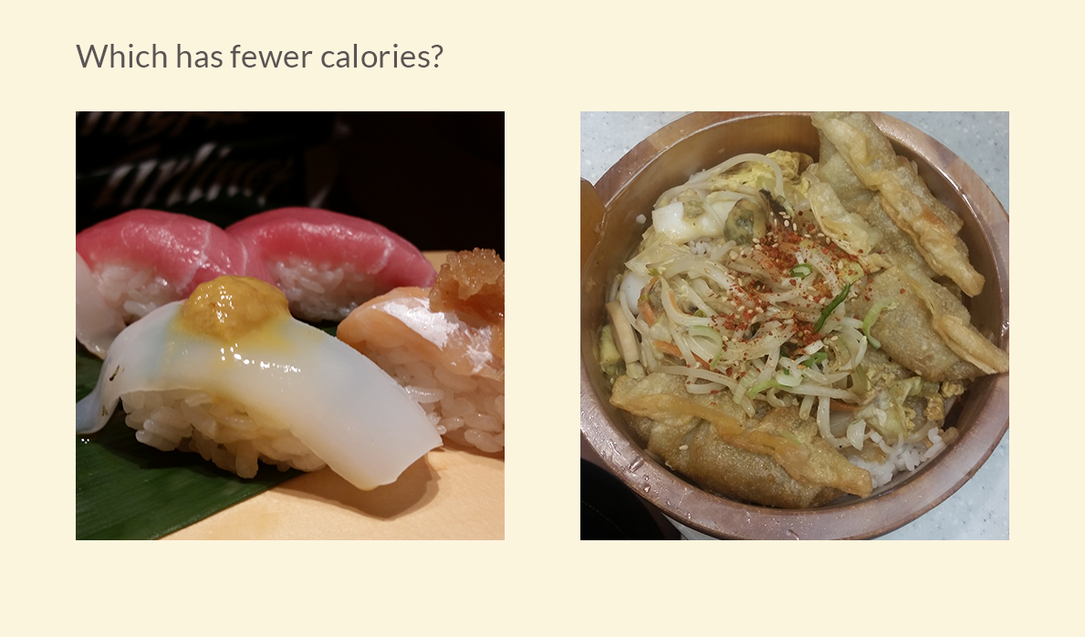
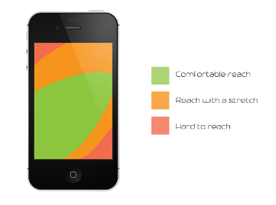
One Grid to Rule Them All
Image credit @ http://designmodo.com/phablets-ux/

Slide 8
One Grid to Rule Them All
Must start with a “container” or “container-fluid”
Add a “row” inside the container
Add columns col-size-number e.x. “col-md-6”
Offset columns to the right col-size-offset-number “col-sm-offset-1”
Set Variables in the .LESS
Use Media Queries to sure it up

Slide 9
Q&A
Notes:
Before we begin a workshop, what questions do you have?

