Slide 1
Redo segmentation

Slide 2
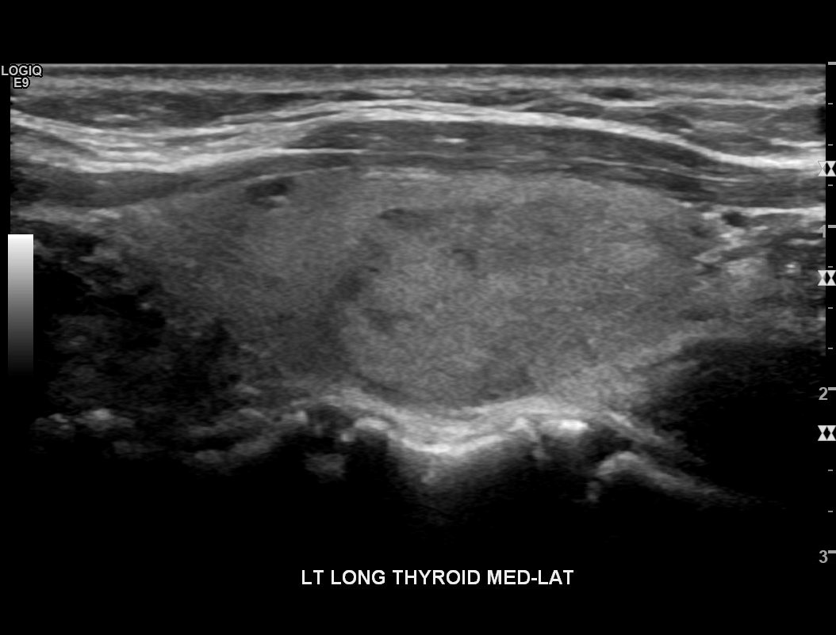

Raw

Slide 3
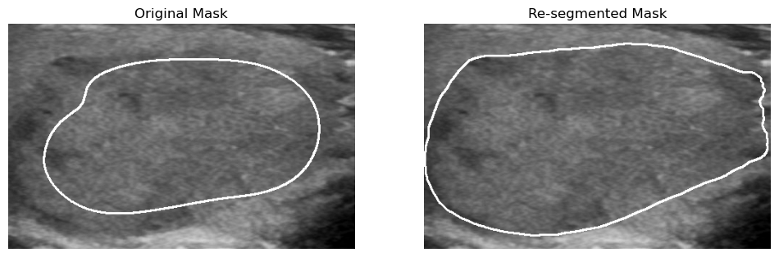

Slide 4
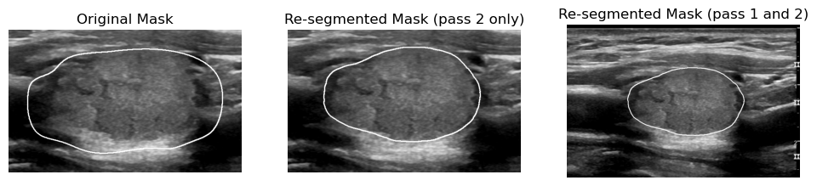

Slide 5
Re-segmented only pass 2
Extract region of interest (ROI) from original mask ± 50 pixels
Improved segmentation results by redoing fine segmentation

Slide 6
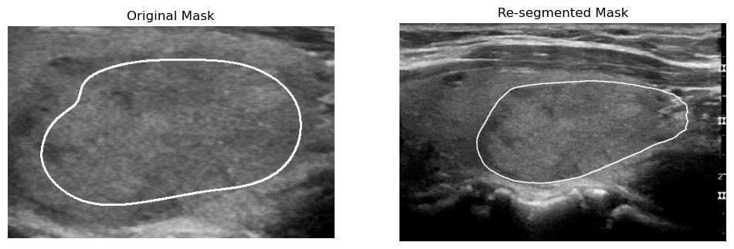
Re-segmented pass 1 and pass 2
Extract region of interest (ROI) from first pass re-segmentation ± 50 pixels
Improved ROI + segmentation results by redoing fine segmentation

Slide 7
Re-segmented
Also corrects overshoot
Notes:
Sample 99, frame 46

Slide 8
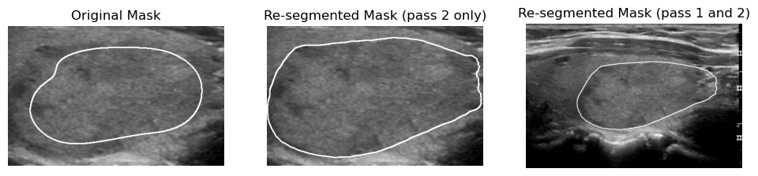
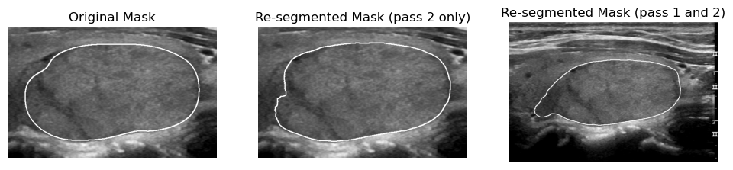
However..
Using the original mask as coarse segmentation sometimes misses part of the nodule
Notes:
Sample 99, frame 14 (top) and 21 (bottom)

Slide 9
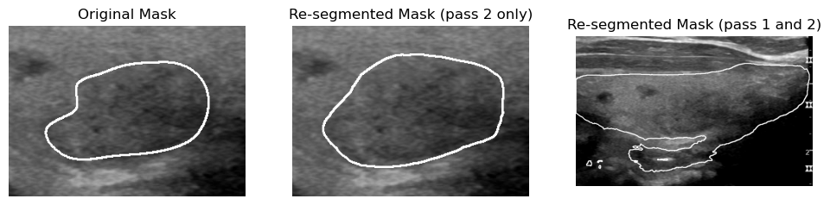
But…
Using the two-pass segmentation sometimes overshoots nodule
Notes:
Sample 99 frame 7

Slide 10
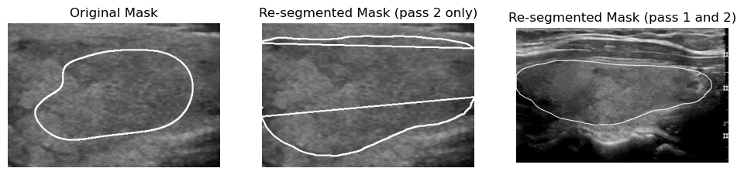
And…
Sometimes a mix of both
Notes:
Sample 99, frame 10

Slide 11
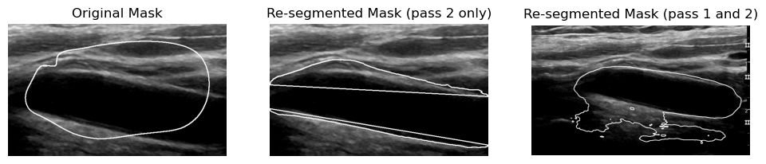
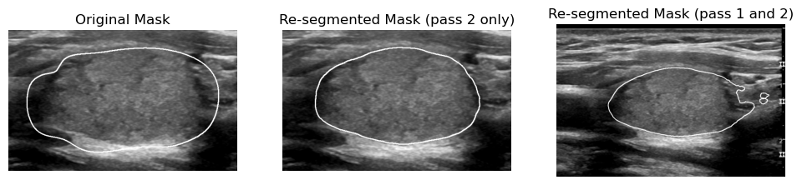
Also…
None of them recognise other issues (e.g. no actual nodule)
And miscellaneous problems
Notes:
Sample 99, frame 50 (top) and 42 (bottom)

