Slide 1
IMDB MOVIE DATA · 2010–2019
What Gets Made
vs. What Gets Watched
Genre supply, audience reach, and the data cleaning a deeper analysis needs
Jan Balangue
Notes:
This is an exploratory look at IMDB data on movies released 2010 to 2019, built with SQL queries in the accompanying notebook. The short version: the genres that get produced the most are the ones least likely to find an audience.

Slide 2
01 · INITIAL EXPLORATION
A large catalog with thin, uneven ratings
145,081
50.9%
12,146
titles released 2010–2019, out of 146,144 in the database
of those titles have any rating; 71,225 have none
rated titles rest on fewer than 10 votes, so I use a 1,000-vote floor
1,084
30,765
2115
genre combinations, with up to 3 genres packed into one text field
titles missing runtime and 5,359 missing genre; excluded, never imputed
the latest release year in the data; 1,063 titles are dated after 2019
Notes:
Before asking a business question I profiled the database. It covers 145,081 titles in the 2010 to 2019 window, but only about half have a rating, and most of those ratings rest on very few votes. That is why every rating figure in this deck only counts titles with at least 1,000 votes. Genres are stored as a comma-separated list, and runtime is missing for about a fifth of titles; those rows are excluded, never filled in.

Slide 3
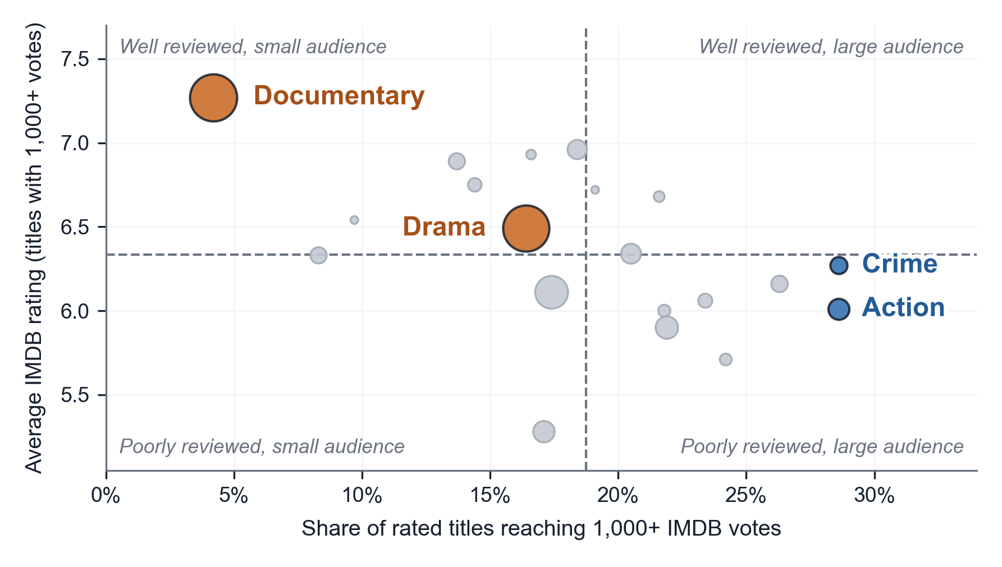
02 · THE PATTERN
The most-produced genres reach the fewest viewers
Documentary
4.2%
reach, yet the most titles (51,556) and top rating (7.27)
Drama
16.4%
reach across 49,545 titles, below the 18.75% median
Action & Crime
28.6%
reach, nearly 7× Documentary on a fraction of its volume
Bubble = genre, sized by titles produced. Reach = share of rated titles with 1,000+ IMDB votes. Dashed lines are medians; gray bubbles are the other 16 genres.
Notes:
Each bubble is a genre. Left to right is how often a rated title in that genre reaches at least 1,000 votes; bottom to top is its average rating. Documentary is the paradox: the most titles made and the best reviewed, but only 4.2 percent of rated documentaries find an audience. Action and Crime reach one 28.6 percent of the time. The full chart with every genre labeled is in the notebook.

Slide 4
03 · BUSINESS QUESTION
The genres produced most are the least likely to find an audience.
Which genre and runtime combinations give a new title the best chance of reaching a wide audience without sacrificing its rating?
1
Where production outruns demand
2
Runtime adds a second signal
3
What answering it would take
Documentary: 51,556 titles, 4.2% reach an audience. Drama: 49,545 titles, 16.4%. Action and Crime: 28.6%.
80–99 min is the most common length (4,188 of 9,603 titles) and the lowest rated (5.85). Audience size peaks at 120–149 min.
Budget and box-office data, since IMDB votes measure reach, not profit, with genre and runtime examined together.
Notes:
The question for deeper analysis follows from that pattern. Which genre and runtime combinations give a new title the best chance of reaching a wide audience without sacrificing its rating, and where is production outrunning demand? Runtime points the same way: the most common length, 80 to 99 minutes, is also the lowest rated. Answering it properly needs budget and box-office data, because votes measure reach, not profit.

Slide 5
04 · DATA CLEANING
Ten cleaning tasks before a deeper analysis
Type | Task | Evidence from exploration
Scope | Restrict to 2010–2019 release years | 1,063 titles are dated later, one of them 2115
 | Flag 2019 as a partial year | 8,379 titles vs 16,849 in 2018
Normalization | Split genres into a movie_genres table | 1,084 comma-separated combos, up to 3 per title
 | Standardize the title fields | 14,456 titles where primary ≠ original title
Null handling | Exclude nulls, never impute them | 30,765 missing runtimes, 5,359 missing genres
 | Label rating results as rated-only | Only 50.9% of in-range titles have a rating
Reliability | Set and state a minimum-vote floor | 12,146 titles rated on fewer than 10 votes
 | Bound runtimes to a plausible range | Runtimes run from 1 to 51,420 minutes
Integrity | Review duplicate titles | 1,859 title-and-year pairs appear twice or more
 | Declare primary and foreign keys | No keys on movie_id or person_id
Identified during exploration and, per the brief, listed rather than performed. Each figure comes from a query in the notebook.
Notes:
These are the cleaning tasks a deeper analysis would need, grouped by type. The two the brief emphasizes are normalization, mainly splitting the genres field into its own table, and null handling, where rows missing a value are excluded rather than filled in. Every number on this slide comes from a query in the notebook.

