Slide 1
















Sponsoren
Softwaresponsoren
Mediasponsoren
Notes:
EVENT SPONSORS; DO NOT EDIT OR REMOVE THIS SLIDE

Slide 2
Einführung in die Ajax Library
Jan Molnar
Jan-Cornelius.Monlnar@studentprogram.de
Dennis Zielke
i-denniz@microsoft.com
Notes:
PROVIDE YOU SESSION CODE AND NAME AS IT WAS DEFINED BY AGENDA OWNERS.
WELCOME ATTENDEES. INTRODUCE YOURSELF AND YOUR SESSION.

Slide 3
Agenda
Ajax Library Grundlagen
Javascript Debugging, Webservices
Javascript Events
Javascript Authentifizierung
Databinding
UI Effekte
Notes:
PROVIDE AN AGENDA FOR YOUR SESSION. SET EXPECTATIONS.

Slide 4
Mehr als nur Ajax
Cross-Browser Framework
Objekt-Orientiertes Javascript
.NET Event Modell
Imperative + Deklarative Programmierung
ControlBinding
Control Extensions + Behaviours
Data Binding
Support für ASP.NET, Java, PHP...

Slide 5


Architektur
Client
Server
Components
Script Support
Browser Compability
Web Services
Networking
Application Services
Core Services
Server Controls
Notes:
Components: Nicht sichtbar
Networking: JSON Serialisierung, Asynchrone Request
Core: Base Class Extentsions, Typ System
Script Support: Localisation, Debugging
Proxy Generierung, JSON Serialisierung
Aplicat: Auth, Profile
Server Scriptmanagaer, UpdatePanel

Slide 6
MicrosoftAjax.js
Sys
Sys.Net
Sys.Services
Sys.Serialization
Sys.UI
String-
Builder
WebRequest-
Executor
_ProfileService
JavaScript-
Serializer
DOMElement
_Debug
XMLHttp-
EXecutor
ProfileGroup
DOMEvent
EventArgs
_WebRequest-
Manager
_Authentication-
Service
Behavior
Component
WebRequest
Control
_Application
WebService-
Proxy
Point
CultureInfo
WebService-
Error
Bounds
Other
Other
_Timer

Slide 7
Javascript Erweiterungen
Vererbung
Interfaces + Abstrakte Klassen
Namespaces
Enumerations
Delegates
Events
Partial Rendering Engine
Reflection

Slide 8
Base Type Extensions
Microsoft AJAX Library erweitert JavaScript
Array - add, addRange, contains, insert, etc.
Boolean - parse
Date - format, parselocale, parseInvariant, etc.
Error - argumentOutOfRange, etc.
Number - format, parseLocale, parseInvariant
Object - getType, getTypeName
String - format, endsWith, startWith, trim, etc.

Slide 9
$get, $find & $create …
Globale Funktionen
Verweise auf statische Klassen
$get -> Sys.UI.DomElement.getElementById
$create -> Sys.Component.create
$find -> Sys.Application.findComponent
$addHandler -> Sys.UI.DomEvent.addHandler
$removeHandler -> System.UI.DomEvent.removeHandler
$clearHandlers -> Sys.UI.DomEvent.clearHandlers

Slide 10
Javascript Webservices
JSON statt XML
Ca. 30% weniger Overhead
Neues [ScriptService] Attribut
Automatische Generierung
Webservices Bridge
Alternative: PageMethod

Slide 11
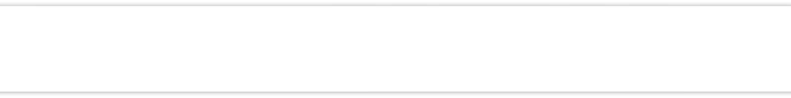
Javascript Webservices
demo
Notes:
USE THIS SLIDE TO INTRODUCE YOUR DEMO. NAME YOUR DEMO.

Slide 12
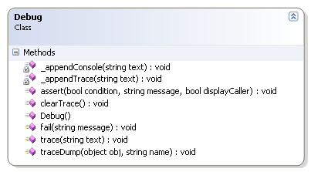
Javascript Debugging
Sys.Debug Objekt
Debugging
Tracing
MicrosoftAjax.debug.js
Lesbare Formatierung
Kommentare

Slide 13
Debuggint
Debugging unterstützt
"assert"
"fail"
"trace"
"traceDump"
Sys.Debug = new Sys._Debug();

Slide 14
Javascript Debugging
demo
Notes:
USE THIS SLIDE TO INTRODUCE YOUR DEMO. NAME YOUR DEMO.

Slide 15
Sys.Application
Zuständig für den Client-Page-LifeCycle
Läd & initialisiert Komponenten

Slide 16
Client Page LifeCycle
Window
Sys.Application
Component
1. Open Page
2. init
3. $create
4. load
5. $get
6. Close Page
7. unload

Slide 17
Client-Page-LifeCycle
demo
Notes:
USE THIS SLIDE TO INTRODUCE YOUR DEMO. NAME YOUR DEMO.

Slide 18
Ajax Events
function pageLoad() {
var element = $get(“elementId“);
$addHandler(element, „click“, elementClick);
}
function elementClick(e) {
// event handling
}

Slide 19
Ajax DOM
Sys.UI.DomElement
addCssClass / removeCssClass
containsCssClass
toggleCssClass
getBounds
setLocation
setVisible

Slide 20
Ajax DOM
demo
Notes:
USE THIS SLIDE TO INTRODUCE YOUR DEMO. NAME YOUR DEMO.

Slide 21
Ajax Services
Authentication Service Zugriff auf ASP.NET Membership
Profile Service Zugriff auf ASP.NET Profil

Slide 22
Ajax Services
demo
Notes:
USE THIS SLIDE TO INTRODUCE YOUR DEMO. NAME YOUR DEMO.

Slide 23
Sys.Preview.[UI.].Data
Enthält Databinding fähige Klassen
ItemView und ListView

Slide 24
Javascript Databinding
demo
Notes:
USE THIS SLIDE TO INTRODUCE YOUR DEMO. NAME YOUR DEMO.

Slide 25
Sys.Preview.UI
Component
Timer, DragDropManager, …
Behavior
Floating, DropZone, Opacity, …
Control
TextBox, Menu, CheckBox, …

Slide 26
Ajax Drag & Drop
demo
Notes:
USE THIS SLIDE TO INTRODUCE YOUR DEMO. NAME YOUR DEMO.

Slide 27
Summary
Notes:
SESSION SUMMARY. PROVIDE A SUMMARY FOR YOUR SESSION. REVIEW COVERED TOPICS WITH AUDIENCE.

Slide 28
Q&A
Notes:
PROVIDE 5 MIN BEFORE SESSION ENDS FOR Q&A.

Slide 29




www.justcommunity.de
www.dnug-koeln.de

Slide 30
Sponsoren
Softwaresponsoren
Mediasponsoren
Notes:
EVENT SPONSORS; DO NOT EDIT OR REMOVE THIS SLIDE

