Slide 1
Windows Azure Workshop
Jan-Cornelius Molnar
Jan.molnar@studentpartners.de

Slide 2
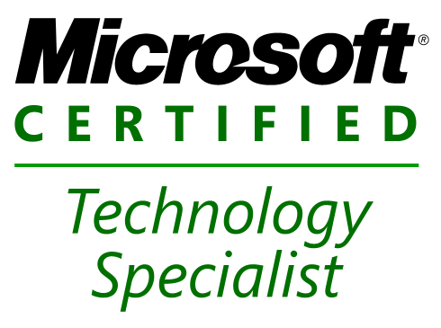
Über Jan Molnar
Uni Stuttgart / Mathematik
9 Jahre Praxiserfahrung .NET
Microsoft Expert Student Partner
http://janmolnar.de
Jan.molnar@studentpartners.de

Slide 3
Agenda
Überblick Azure Platform
Demos
Praxisteil

Slide 4
Windows Azure
Windows Azure != OS you can install
Pltaform for Cloud Computing, Hosting, Storage, Database

Slide 5

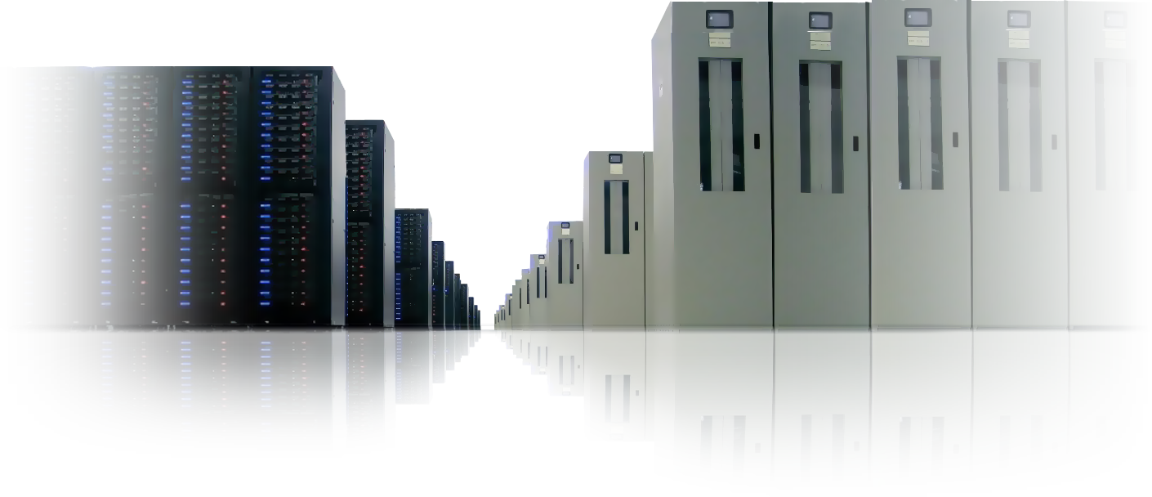
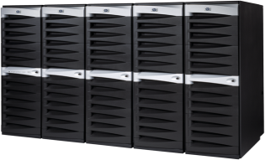

Platform Continuum
On-Premises
Servers
Hosted Servers
Cloud Platform
Bring your own machines, connectivity, software, etc.
Complete control
Complete responsibility
Static capabilities
Upfront capital costs for the infrastructure
Renting machines, connectivity, software
Less control
Fewer responsibilities
Lower capital costs
More flexible
Pay for fixed capacity, even if idle
Shared, multi-tenant infrastructure
Virtualized & dynamic
Scalable & available
Abstracted from the infrastructure
Higher-level services
Pay as you go
Notes:
Slide objectives:
Explain what the cloud is in relationship to on-premises servers and hosted severs.
Speaking Points:
To put the cloud in perspective, let’s first think about the available options for deploying and running your application today.
Today, there are a few established approaches for deploying and running applications.
Server
On one side you have on-premises servers or a self-hosted model.
With on-premises servers, you bring your own machines, connectivity, software, and in some cases software licenses.
You have complete control of the environment, the software stack, the hardware, etc.
However, you also have complete responsibility. Your organization must have the skills and expertise to operate and manage the environment and software. You must take on the responsibility of patching the environment, replacing hardware, etc.
These days, very few people want to be in this business.
However, on-premises servers are not going away anytime soon.
In some cases organizations have to maintain solutions running in an on-premises environment due to regulatory, data, or privacy requirements.
Hosted Servers
An established alternative to the on-premises model is with a hosted environment.
With hosted servers, you are effectively renting capacity – including machines, connectivity, and in some cases software.
With this model, you have less control then when you’re managing your own servers. For instance, you can’t walk up to a machine, and plug in an external drive to load data. Or easily make hardware or software adjustments to optimize for performance.
However, you also have fewer responsibilities when it comes to operating, updating, patching, and managing the environment.
What is generally much more attractive about a hosted model is the cost model.
The upfront capital costs can be much lower then building out your own infrastructure.
However, one of the downsides is that you generally pay for the fixed capacity on a monthly basis – even if your application is idle.
Cloud
What we are starting to see in the industry is the emergency of the cloud as a platform for building and running applications.
So what is the cloud and how does it relate to these established options for running your apps?
A cloud platform is designed as a shared, multi-tenant infrastructure.
Cloud platforms utilize virtualization to: share hardware resources, provide isolation of applications or tenants, and also to provide a more dynamic infrastructure.
Ability to scale out your application over multiple server instances.
Because it is a shared infrastructure, there is even less control compared to a hosted environment.
As this is an emerging space, there is a wide range of different types of cloud solutions. Some of the solutions focus purely on providing virtualized infrastructure. Servers you can remote into.
However, many cloud platforms are starting to focus on raising the level of abstraction – so you can focus on building and deploying applications rather than remoting into machines and maintaining or patching servers.
Old:
Level of abstraction varies greatly today with the solutions in the market
Within the cloud, there are things that are delivered as an infrastructure
Services – services provided by the infrastructure and services you would consume programmatically
Finally, one of the primary reasons why organizations ranging from startups, independent software vendors, and large enterprises are starting to investigate the cloud is the pricing model.
With a cloud platform, you can expect a pay as you go pricing model – where you pay for what you use.
[build arrow]
I believe it’s important to understand that the cloud is part of a continuum. It is one of potential approaches that you can begin to use to deploy and run your applications. However, it’s important to understand that the cloud is not the silver bullet. It is not the perfect solution for every application.
Notes:
We view cloud as scale out, automated service management, high availability and multi-tenant
But cloud has other considerations: location, infrastructure, business model, ownership and management

Slide 6


Windows Azure Platform
Compute: Virtualized compute environment based on Windows Server
Storage: Durable, scalable, & available storage
Management: Automated, model-driven management of the service
Database: Relational processing for structured/unstructured data
AppFabric
Service Bus: General purpose application bus
Access Control: Rules-driven, claims-based access control

Slide 7
Web Role
Worker Role
Windows Server 2008 x64
IIS 7
ASP.NET 3.5 SP1
FastCGI – PHP
Native Code
Full Trust
User Mode
Windows Server 2008 x64
.NET Start
Native Code
User Mode
Inbound any TCP Port

Slide 8

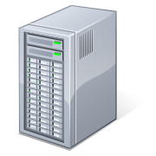

Service Deployment
Service
Service
Service
Model
Your
Service
DNS
LB
Web Portal
(API)
DNS
config
Fabric
Controller
LB

Slide 9
Service Scaling
Your
Service
Service
DNS
Service
Service
Service
Service
Service
LB
Service
Web Portal
(API)
Service
Fabric
Controller
LB
Model

Slide 10
Service Monitoring & Recovery
Your
Service
DNS
Service
Service
LB
Service
Service
Web Portal
(API)
!
Fabric
Controller
LB
Model

Slide 11
Web / Worker
Kein Remote Desktop / FTP / …
Keine Installation von Komponenten
Automatisches Failover
N Instanzen auf Knopfdruck
„pay as you go“

Slide 12
Storage
Blob, Table & Queue
Unlimited Storage
Container Based
Access Policy
CDN

Slide 13
Sql Datenbank == Sql Server Express
Web Edition (1GB)
Business Edition (10GB)
Failover, Replication, Backup, …
Zugriff mittels T-Sql
Keine Reporting Services
Kein Business Intelligence

Slide 14
Summary
Web Role : ASP / PHP Applikation
Woker Role : „C# Prozess“
Storage : Blob / Table / Queue
Database : Cloud RDMS
Fully managed

Slide 15
Szenarios
„Youtube“ Video streaming, hoher Traffic
Business Intelligence Hoher Workload 1. des Montas / Ende des Jahrs
„Standard“ High available Web applications

Slide 16
Szenarios
Jede Komponente einzeln nutzbar

Slide 17
Platform Continuum
On-Premises
Servers
Hosted Servers
Cloud Platform
Bring your own machines, connectivity, software, etc.
Complete control
Complete responsibility
Static capabilities
Upfront capital costs for the infrastructure
Renting machines, connectivity, software
Less control
Fewer responsibilities
Lower capital costs
More flexible
Pay for fixed capacity, even if idle
Shared, multi-tenant infrastructure
Virtualized & dynamic
Scalable & available
Abstracted from the infrastructure
Higher-level services
Pay as you go
Notes:
Slide objectives:
Explain what the cloud is in relationship to on-premises servers and hosted severs.
Speaking Points:
To put the cloud in perspective, let’s first think about the available options for deploying and running your application today.
Today, there are a few established approaches for deploying and running applications.
Server
On one side you have on-premises servers or a self-hosted model.
With on-premises servers, you bring your own machines, connectivity, software, and in some cases software licenses.
You have complete control of the environment, the software stack, the hardware, etc.
However, you also have complete responsibility. Your organization must have the skills and expertise to operate and manage the environment and software. You must take on the responsibility of patching the environment, replacing hardware, etc.
These days, very few people want to be in this business.
However, on-premises servers are not going away anytime soon.
In some cases organizations have to maintain solutions running in an on-premises environment due to regulatory, data, or privacy requirements.
Hosted Servers
An established alternative to the on-premises model is with a hosted environment.
With hosted servers, you are effectively renting capacity – including machines, connectivity, and in some cases software.
With this model, you have less control then when you’re managing your own servers. For instance, you can’t walk up to a machine, and plug in an external drive to load data. Or easily make hardware or software adjustments to optimize for performance.
However, you also have fewer responsibilities when it comes to operating, updating, patching, and managing the environment.
What is generally much more attractive about a hosted model is the cost model.
The upfront capital costs can be much lower then building out your own infrastructure.
However, one of the downsides is that you generally pay for the fixed capacity on a monthly basis – even if your application is idle.
Cloud
What we are starting to see in the industry is the emergency of the cloud as a platform for building and running applications.
So what is the cloud and how does it relate to these established options for running your apps?
A cloud platform is designed as a shared, multi-tenant infrastructure.
Cloud platforms utilize virtualization to: share hardware resources, provide isolation of applications or tenants, and also to provide a more dynamic infrastructure.
Ability to scale out your application over multiple server instances.
Because it is a shared infrastructure, there is even less control compared to a hosted environment.
As this is an emerging space, there is a wide range of different types of cloud solutions. Some of the solutions focus purely on providing virtualized infrastructure. Servers you can remote into.
However, many cloud platforms are starting to focus on raising the level of abstraction – so you can focus on building and deploying applications rather than remoting into machines and maintaining or patching servers.
Old:
Level of abstraction varies greatly today with the solutions in the market
Within the cloud, there are things that are delivered as an infrastructure
Services – services provided by the infrastructure and services you would consume programmatically
Finally, one of the primary reasons why organizations ranging from startups, independent software vendors, and large enterprises are starting to investigate the cloud is the pricing model.
With a cloud platform, you can expect a pay as you go pricing model – where you pay for what you use.
[build arrow]
I believe it’s important to understand that the cloud is part of a continuum. It is one of potential approaches that you can begin to use to deploy and run your applications. However, it’s important to understand that the cloud is not the silver bullet. It is not the perfect solution for every application.
Notes:
We view cloud as scale out, automated service management, high availability and multi-tenant
But cloud has other considerations: location, infrastructure, business model, ownership and management

Slide 18
Q & A

Slide 19
Windows Azure
Demo

Slide 20
Praxisteil
Infos, Aufgaben, … http://www.janmolnar.de/

Slide 21
Ressourcen
Infos, Aufgaben, … http://www.janmolnar.de/
http://www.microsoft.com/windowsazure/
Traning Kits
How-To Videos, Demos, Whitepapers, …

Slide 22
Q & A
Jan.molnar@studentpartners.de

Slide 23
Service Models & Roles
Bid Now Service
Web A
(port 80)
Worker X
Main Web
100 instances
Image Resize
2 instances
Worker Y
Auction Processing
25 instances
Web B
(port 8081)
Admin
2 instances
Worker Z
Notifications
10 instances

Slide 24

Storage
Table
Entity Data Store
Partitioned by key
Unlimited keys
Not a RDBMS
Blob
Blob Storage
Partitioned by container
Unlimited containers
CDN Capable
Queue
Simple Queue
Read at least once
Delete to remove message, otherwise is returned to queue
Partitioned by Queue Name

Slide 25
Partitions
Partition = Table Partition or Container
Not just about size
More Partitions = More Nodes

Slide 26
Developer Experience
Demo

Slide 27
Pricing
Compute
$0.12 / CPU hour (or part thereof)
~ 1.7 GHz, 2GB Ram, Single Core
$2.88 / Day
$86.4 / 30 days (billing period)
2 instances = $172.80 / month
Storage
$0.15 / GB/Month
Bandwidth
$0.10 /GB inbound
$0.15 /GB outbound

Slide 28
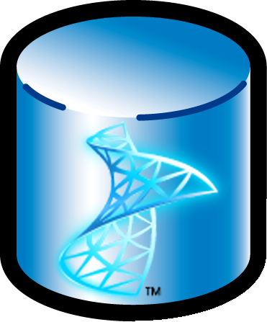

SQL Azure
Data Sync
Reporting
Business Intelligence
Database
Initial Services
Database – Core SQL Server database capabilities
Future Services
Data Sync – Enables the sync framework
Additional SQL Server capabilities available as a service: Business Intelligence and Reporting

Slide 29
SQL Azure Deployment
Web Portal
(API)
DB Script
SQL Azure
TDS

Slide 30
SQL Azure Accessing databases
Web Portal
(API)
Your App
SQL Azure
TDS
Change Connection String

Slide 31
SQL Azure
Demo

Slide 32
Database Replicas
Single Database
Multiple Replicas
Replica 1
Single Primary
Replica 2
DB
Replica 3

Slide 33
Shared Environment
Hardware Boundary
Hardware Boundary
C
D
A
B
D
Hardware Boundary
Hardware Boundary
C
C
A
B
A
B
D

Slide 34
SQL Azure Database Monitoring & Recovery
Web Portal
(API)
!
Your App
SQL Azure
TDS

Slide 35
Pricing
WEB Edition
Business Edition
1 GB Database
$9.99 / month
Bandwidth
$0.10 /GB inbound
$0.15 /GB outbound
10GB Database
$99.99 / month
Bandwidth
$0.10 /GB inbound
$0.15 /GB outbound

Slide 36
Pricing
Type specified by MAXSIZE on CREATE DATABASE command or portal (post-CTP1)
Cannot switch between Web and Business Editions
Monthly billing period

Slide 37
Sharding Databases
1 x 10GB database
1 Instances
10 x 1GB databases
10 Instances

Slide 38
Windows Azure Platform Benefits
Windows Azure
SQL Azure
High Level of Abstraction
Hardware
Server OS
Network Infrastructure
Web Server
Availability
Automated Service Management
Scalability
Instance & Partitions
Developer Experience
Familiar Developer Tools
Higher Level of Abstraction
Hardware
Server OS
Network Infrastructure
Database Server
Availability
Automated Database Management & Replication
Scalability
Databases Partitioning
Developer Experience
Familiar SQL Environment

Slide 39
AppFabric
Extending .NET to the cloud with Internet Scale Utility Services
Service Bus
Access Control
Service Bus: General purpose application bus
Access Control: Rules-driven, claims-based access control
Notes:
Slide objectives:
Define and enumerate the Windows Azure Platform Appfabric (aka .NET Services.)
Speaking points:
Much in the same way that SQL Services is about extending SQL Server to the cloud, we are also extending key .NET capabilities to the cloud as services.
We call these .NET Services. Some of you maybe familiar with previous codenames such as BizTalk Services.
These services are really key components you would need for building distributed, connected applications.
When we talk about connecting to your existing on-premises applications and enabling the composition of hybrid (Cloud + on-premises) applications – that is where .NET Services really comes in.
There are currently two .NET Services: the Service Bus & the Access Control Service
Service Bus:
The Service Bus is designed to provide a general purpose application bus, available on the internet at internet scale.
You can really thin of the Service Bus as being similar to an Enterprise Service Bus that many enterprise organizations have today.
However, we believe that when providing a Service Bus as a programmable service on the internet, there are a wider range of scenarios for many more types of organizations.
Fundamentally, the .NET Service Bus is about connecting applications across network and application boundaries and making key message exchange patterns such as publish and subscribe messaging very simple.
Access Control:
The Access Control service is designed to provide rules-driven, claims-based access control for applications.
Essentially, this allows you to define authorization rules for your applications using the claims-based approach that we are adopting within many Microsoft products and technologies and that is becoming adopted in the industry.
Notes:
Windows Azure has the .NET Framework built into it so that you can use those services within your application.
But just like your application must be designed to scale out, the services that we have built into Windows over time in .NET also need to be designed and built in a way that can scale out naturally. We want to create services for you, and that's the purpose of .NET services, creating a pool of resources available to you to take advantage of and do things within your application very simply.
So we're including a built-in, scale-out implementation of a service bus. The service bus lets you connect your on-premises systems securely into the cloud, into the Azure environment, while allowing your data and your information to traverse firewalls, solving a problem that is a bane of many application developments.

Slide 40
Pricing & SLA
$0.15 / 100k “transactions”
Transaction:
ACS Tokens
Messages on Service bus
Bandwidth
$0.10 /GB inbound
$0.15 /GB outbound

Slide 41

© 2009 Microsoft Corporation. All rights reserved. Microsoft, Windows, Windows Vista and other product names are or may be registered trademarks and/or trademarks in the U.S. and/or other countries.
The information herein is for informational purposes only and represents the current view of Microsoft Corporation as of the date of this presentation. Because Microsoft must respond to changing market conditions, it should not be interpreted to be a commitment on the part of Microsoft, and Microsoft cannot guarantee the accuracy of any information provided after the date of this presentation. MICROSOFT MAKES NO WARRANTIES, EXPRESS, IMPLIED OR STATUTORY, AS TO THE INFORMATION IN THIS PRESENTATION.

