Slide 1
Photovoltaics off thebeaten track
Potential of solar energy in highway turnoffs across Germany Jan Besler, Yvette Bodry, Marvin Hoberg, Felix Schulz

Slide 2
Motivation
Germany has heavily relied on coal and gas (25% in 2010) (BDEW, 2022)
Climates pledges require a transition to renewable energy (Bundesregierung, 2022)
Wind parks often face opposition from local communities (DW, 2022)
Solar energy is a promising alternative because of its low footprint
Photovoltaics (PV) can be installed in places with little alternative use
Most prominently: Roofs
But also: Artifical lakes, parking lots, highways
Figure credit: EnBW.com, solarbusinesshub.com, Xinhua News Agency via Getty Images

Slide 3
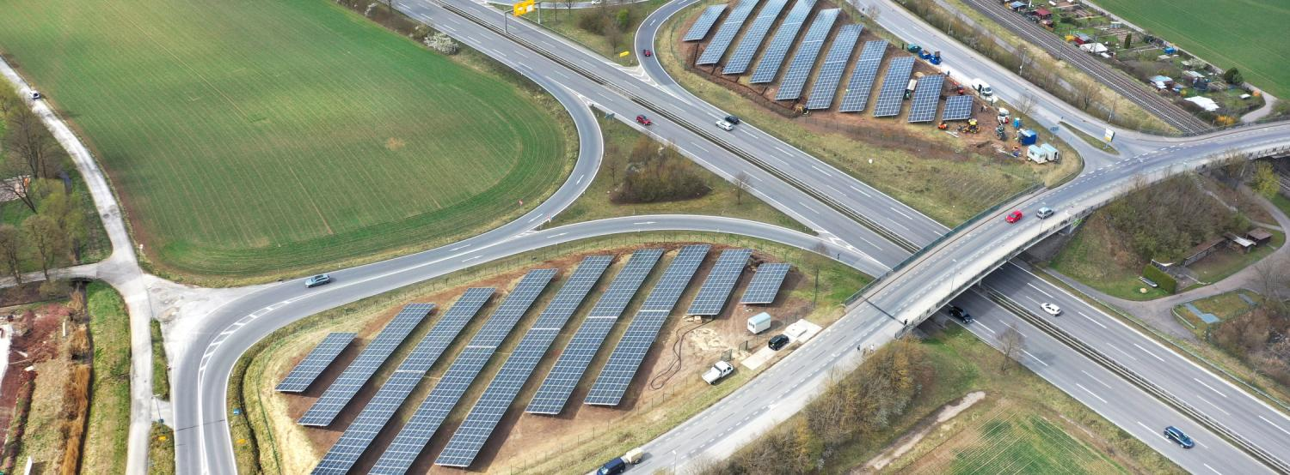
PV in highway turnoffs: The idea
Highway turnoffs are unattractive for most uses
The city of Tübingen realized that they could be utilized for PV
After several years of legal hassle, a site at the B28 in Lustnau is now the city’s largest source of green energy
Figure 2: Lustnauer Ohren

Slide 4
Scaling across Germany
How much potential for such projects is yet unused?
We seek to answer this question by taking a closer look at the state of Brandenburg

Slide 5
Derivation of the project’s objective
Illustrate potentials for renewable energies (PV) in a user-friendly way
Online application as information desk for municipalities and citizens
Alternative to complex expert reports

Slide 6
When is a turnoff suitable for PV?
We held expert interviews with the Tübingen project lead and an expert geologist
Insights from pilot project “Lustnauer Ohren”
Pilot project: 8 weeks construction and 8 years approval (DER SPIEGEL, 2022)
Nowadays:
More awareness and pressure from the public
Direct communication with the public via social media when bureaucratic hurdles arise
Consequently, authorities urged not to insist on 50-year-old regulations

Slide 7
Conclusions for contextual focus of our project
Driving factors for one-off costs due to construction and operating costs:
Environmental assessment for compensation areas
Nature in a potential ear is under protection (§ 44 Naturschutz Gesetz)
PV plant is an encroachment on the landscape
Woody plants such as bushes and trees are assessed differently (i.a. according to size, age)
Compensation areas must be equivalent or greater and geographically close
If landowner of the ear has no free compensation areas, they need to be must be rented (lease fees)
landowner for federal roads is the Regional Council of the county (in German: Regierungsbezirk)
for motorways the Autobahn GmbH/ indirectly the federal government)
Note: The environmental assessment determines one-off costs and long-term profitability of the PV.

Slide 8
Conclusions for our project from insights (pilot project)
Driving factors for one-off costs due to construction and operating costs:
Distance to grid
Meteorological details: Sunshine hours
Geographical details: Ground conditions and slope
[Sky alignment of the road]
Due to the technical innovations of recent years, the factor is less important nowadays as PVs can be built more flexibly than in Lustnau (insight from interview with Prof. Thomas Scholten)

Slide 9
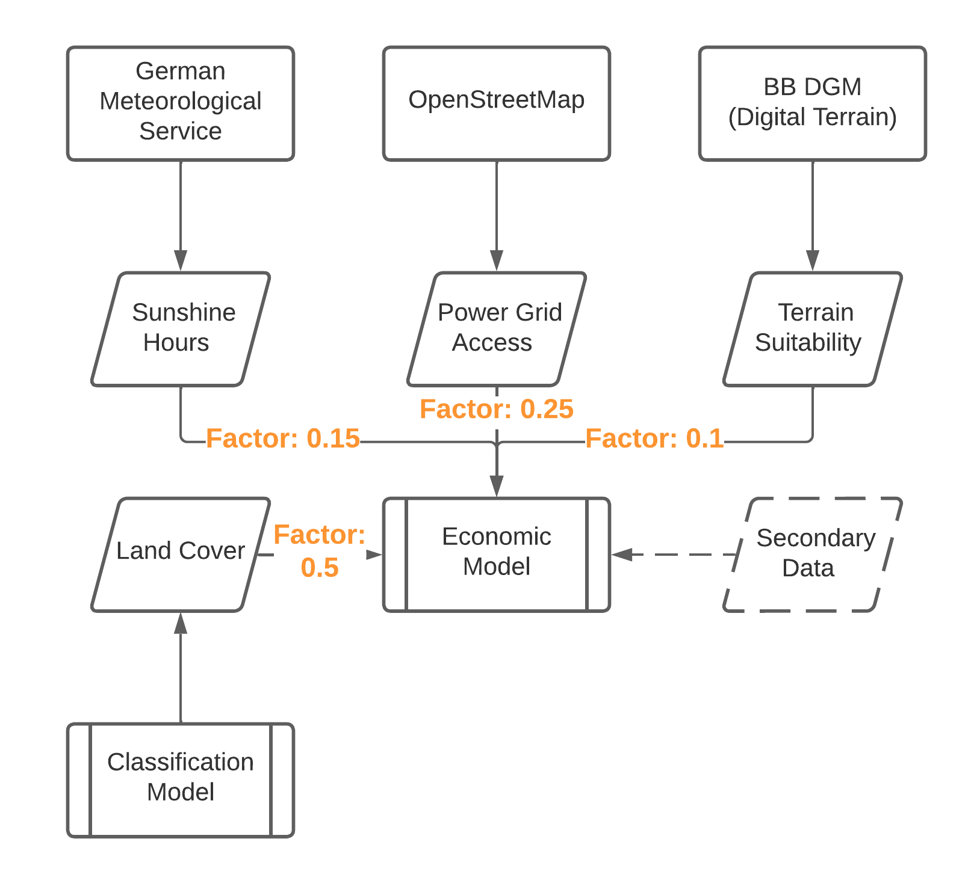
Economic Model
Figure 4: The economic model used for the evaluation of turnoffs

Slide 10
Data acquisition
Built a data pipeline to automatically download and process all data sources
All data is publicly available and free of charge
In total, 5 sources of data are utilized for final product
Selected challenges
Satellite imagery is needed in very fine resolution to allow segmentation
Thousands of accesses to a WebMapService API to download data in tiles
Lossless storage of 106GB of imagery
Processing of OSM source data is very resource-intensive
Utilized bwUniCluster for processing and mass data storage

Slide 11
Data preparation
Selected challenges
Identification of turnoffs from raw OSM data
Combined turnoff road segments with nearby road segments in a radius of 500m

Slide 12
Data preparation
Selected challenges

Slide 13
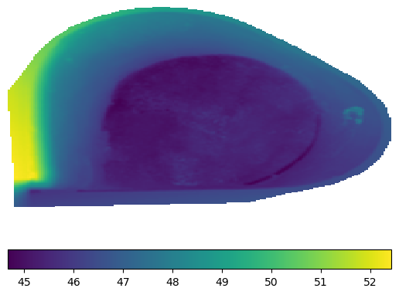
Data analysis
Selected challenges
How to remotely sense potential issues with uneven terrain?
Use elevation model of finest resolution available (1m)
Calculate slope between each raster cell and its 8 neighbors
Calculate standard deviation of slope and normalize with benchmark of 90 degrees
Figure 7: The height model of a selected driveway. The standard deviation of the slope is 4.68, the rating therefore 0.95 (© GeoBasis-DE/LGB)

Slide 14
Data analysis
Results
Spatial data is aggregated within polygons of the turnoffs:
Segmentation of satellite imagery into 6 classes
Calculation of the slope
Calculation of the average distance to the grid
Calculation of the average sunshine intensity
Runtime after data acquisition: >8 hours
Survey encompasses 206 turnoffs, 1253 polygons, >6,5 km² of potential area

Slide 15
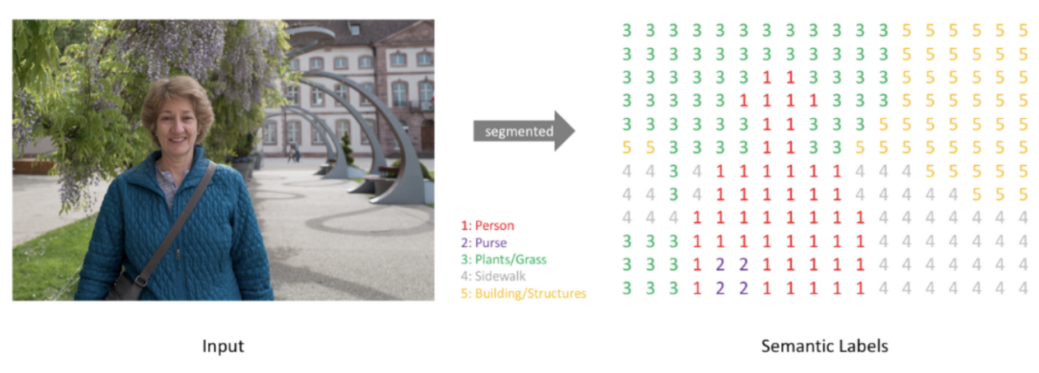
Land cover segmentation
Problem: precisely predict the areal distribution of relevant features
High vegetation, low vegetation, buildings, etc.
Solution: Image segmentation
Divide image into regions belonging to different semantic classes.
Pixel-based classification
Pixel-wise mask for each object/unit in the image

Slide 16
Figure credit: Choi, U. (2021, March 19) Semantic Segmentation (FCN, U-Net, DeepLab V3+).

Slide 17
Training data - Postdam
Potsdam 2D Semantic Segmentation dataset for the German city Potsdam, provided by the International Society for Photogrammetry and Remote Sensing (ISPRS)

Slide 18
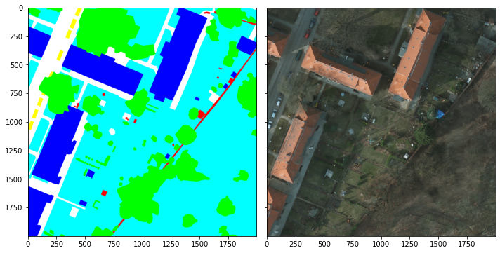
Label | Color
1.) Impervious surfaces | white
2.) Building | blue
3.) Low vegetation | light-blue
4.) Tree | green
5.) Car | yellow
6.) Clutter/background | red

Slide 19
Data Source: 2D Semantic Labeling Contest - Potsdam. Available online: https://www.isprs.org/education/benchmarks/UrbanSemLab/default.aspx (accessed on 14 December 2022).

Slide 20
Training data - Postdam
Advantages
Aerial images, not satellite images
High resolution (6,000 px × 6,000 px with 5 cm ground res.)
Precise and reliable labeling
Best dataset for German pixel-based labels
Classes are useful for our segmentation problem
Disadvantages
Urban structures, whereas in ears more rural structures
Rural structures are characterised by greater contiguous areas, like forests
Narrow, detailed urban structure in training creates fuzzy predictions for ears
Weight Biasing: Giving greater weight to classes “tree” and “low vegetation”
Improves detection of organic structures
Good in detecting single trees, but not forests

Slide 21
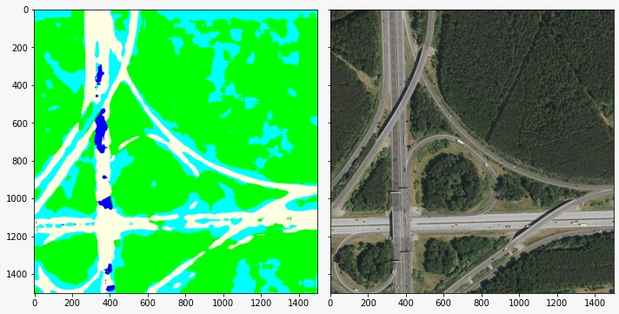
Training data - Postdam

Slide 22
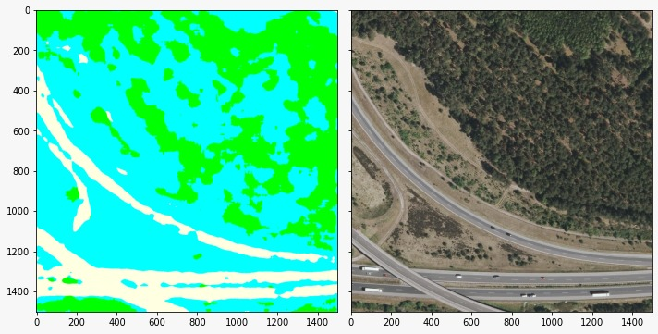

Slide 23
Color Labels: White - Impervious surfaces; Light-blue - Low vegetation; Green - Tree

Slide 24
Training data - LoveDA
Land-cOVEr Domain Adaptive semantic segmentation (LoveDA) dataset
High spatial resolution land-cover mapping (spatial resolution of 30 cm)
Source Google Earth platform
Nanjing, Changzhou and Wuhan / China

Slide 25
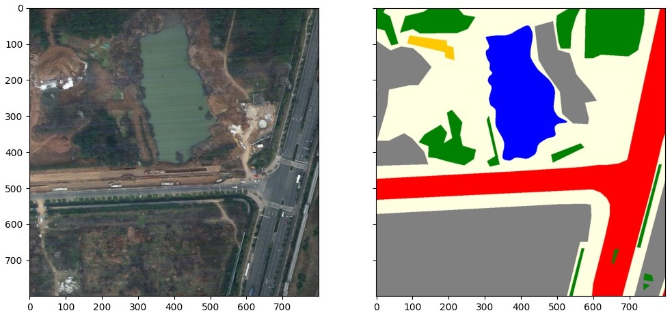
Label | Color
1.) Background | white
2.) Building | pink
3.) Road | red
4.) Water | blue
5.) Barren | gray
6.) Forest | green
7.) Agriculture | yellow
0.) Unknown | black

Slide 26
Training data - China
Advantages
Dataset differentiates between rural and urban images
More rural scenes, but quite balanced dataset (2713 urban, 3274 rural)
Dataset created with the intention of achieving model transferability
“[U]rban and rural scenes can show completely different geographical landscapes, and the inadequate [generalization] of these algorithms hinders city-level or national-level mapping” (Wang et al., 2022, p. 1)
Dataset encounters for: 1) multi-scale objects; 2) complex background samples; 3) inconsistent class distributions
Disadvantages
Lower resolution than images from Brandenburg (30 cm vs. 20 cm, respectively)
Satellite images (vs. aerial images from Brandenburg)
[Less detailed labeling compared to Potsdam dataset]
Useful in training for the recognition of larger contiguous areas, but not individual trees
China vs. Germany
Different geography

Slide 27
Semantic Segmentation - UNet
Advantages | Disadv.
- widely used basic segmentation model | - training from scratch
- feedback from interim presentation | - model overfits to training data
- good starting point | - labelled data not specific for our task
Output (class per pixel) is the same size as the input (pixel)
Network consists of a contracting path (downsampling) and an expansive path (upsampling) (Stevens et al., 2020b)
Downsampling:
Specific, detailed detectors (e.g. texture, color, characterising shapes)
Information reduction to relevant feature information
Upsampling:
Combination of the feature and spatial information
Extracting high-resolution features
U-shaped network architecture: Early breakthrough for image segmentation

Slide 28
Semantic Segmentation - ResNet50 + BigEarthNet (Sumbul et al., 2019)
Residual networks (ResNets) allow very deep networks to be successfully trained (Stevens et al., 2020a)
Deep networks represent very complex functions
Problem with large networks: Gradient signal that goes to zero
Large number of multiplications, the gradient can decrease exponentially quickly to zero
Skip Connections: Additional layers do not hurt the model’s performance as regularisation will skip over them if those layers were not useful

Slide 29
Semantic Segmentation - ResNet50 + BigEarthNet (Sumbul et al., 2019)
Advantages | Disadv.
- pre-trained weights | - trained for classification task
- seasonal satellite images | - inferior predictions
- big dataset on European countries
Transfer learning using pre-trained model backbones
Transfer knowledge learned from source dataset (BigEarthNet) to target dataset (training)
Model can already extract more general image features (e.g. textures, shapes)
Pre-trained on BigEarthNet dataset
Atmospherically corrected satellite images from different seasons
10 European countries
Multiple land-cover classes (tile classification task, not segmentation)

Slide 30
Semantic Segmentation - ResNet101 + COCO (Lin et al., 2014)
Advantages | Disadv.
- pre-trained weights | - COCO dataset contains vastly different objects (no aerial images)
- segmentation task
- superior predictions after few training iterations
- least overfitting
- complexity of model seems to fit task
Pre-trained on COCO (Common Objects in Context) dataset
Large-scale object detection and segmentation dataset
Recognition in context (background awareness)

Slide 31
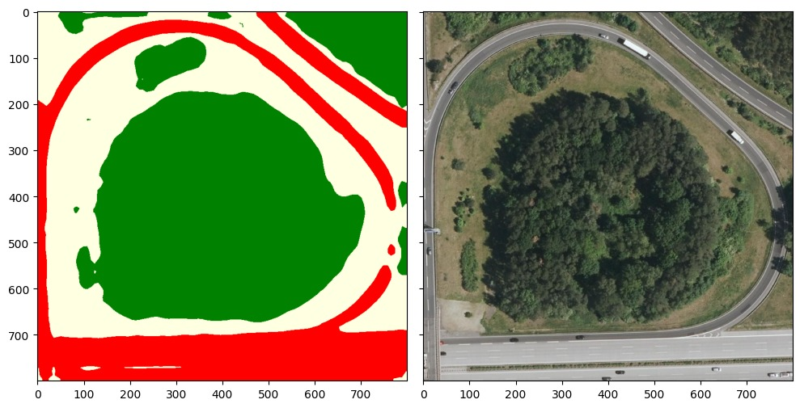
Semantic Segmentation - ResNet101 + COCO - Results
Recognition of small forest areas very good.
Individual trees are partly not recognized.
Shadow areas are not always clearly assigned.

Slide 32
Color Labels: White - Impervious surfaces; Red - Road; Green - Trees

Slide 33
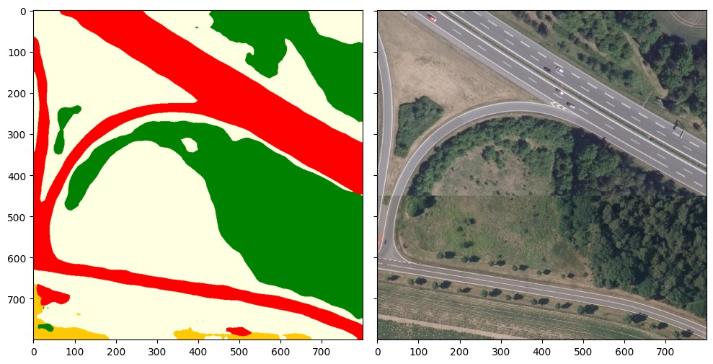
Semantic Segmentation - ResNet101 + COCO - Results
Agricultural areas are better recognized when they are planted.
Similar results for single trees that are leafy or bare.

Slide 34
Color Labels: White - Impervious surfaces; Red - Road; Green - Trees; Yellow - Agricultur

Slide 35
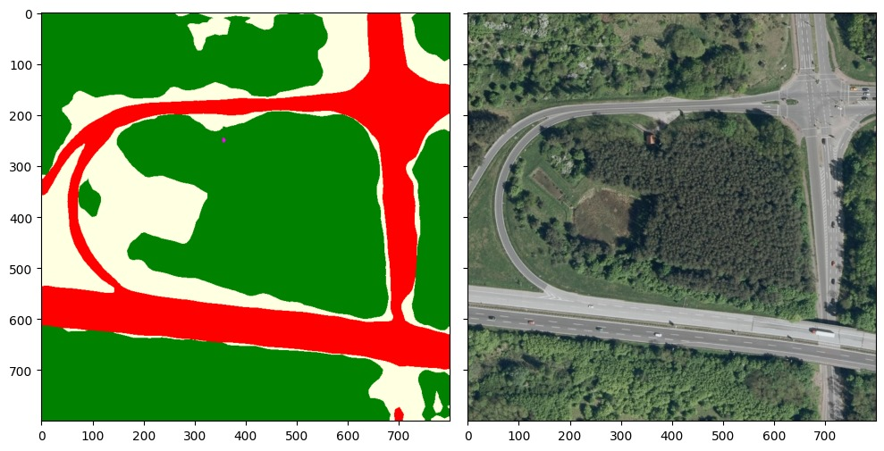
Semantic Segmentation - ResNet101 + COCO - Results
Road recognition is so good that you could use it to identify the shape of an ear.
Even small buildings in shaded areas are detected.
The model is trained to recognise organic structures very well (characteristic for landscape in ears), however, human-made structures (fields, buildings) are therefore less regular.

Slide 36
Color Labels: White - Impervious surfaces; Red - Road; Green - Trees; Pink - Building

Slide 37
Presentation of the result - Dashboard
http://solarexit.de/

Slide 38
References
DER SPIEGEL. (2022, November 23, 0:50). Die Klima-Streber: Tübingens Weg in die Energiewende | SPIEGEL TV [Video]. YouTube. https://www.youtube.com/watch?v=WywER5wRLEI.
Lin, T. Y., Maire, M., Belongie, S., Hays, J., Perona, P., Ramanan, D., … & Zitnick, C. L. (2014). Microsoft coco: Common objects in context. In Computer Vision–ECCV 2014: 13th European Conference, Zurich, Switzerland, September 6-12, 2014, Proceedings, Part V 13 (pp. 740-755). Springer International Publishing.
Stevens, E., Antiga, L., & Viehmann, T. (2020a). Using convolutions to generalize (Chapter 8). In Deep learning with PyTorch. Manning Publications.
Stevens, E., Antiga, L., & Viehmann, T. (2020b). Using segmentation to find suspected nodules (Chapter 13). In Deep learning with PyTorch. Manning Publications.
Sumbul, G., Charfuelan, M., Demir, B., & Markl, V. (2019). Bigearthnet: A large-scale benchmark archive for remote sensing image understanding. In IGARSS 2019-2019 IEEE International Geoscience and Remote Sensing Symposium (pp. 5901-5904). IEEE.
Wang, J., Zheng, Z., Ma, A., Lu, X., & Zhong, Y. (2022). LoveDA: A remote sensing land-cover dataset for domain adaptive semantic segmentation. arXiv preprint arXiv:2110.08733v6 [cs.CV].

