Slide 1
Air Quality Monitoring Dashboard
Web Application Programming Final Project
Janbubu 202255635

Slide 2


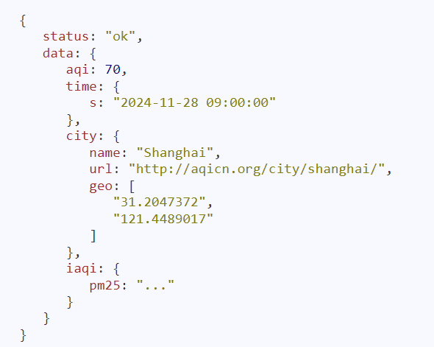
What is used?
For this project, I used:
HTML, CSS, and JavaScript for the frontend.
jQuery for making API calls.
Chart.js for creating dynamic and responsive charts.
Air Quality API for fetching real-time data.

Slide 3
Fails
Google maps platform
Kakao Maps API
Data.go.kr
Weekly info
Hourly info
Directly finding by name

Slide 4
Challenges
Integrating the API into the dashboard and ensuring smooth chart updates were initial hurdles
Styling the page to maintain responsiveness was also challenging.

Slide 5
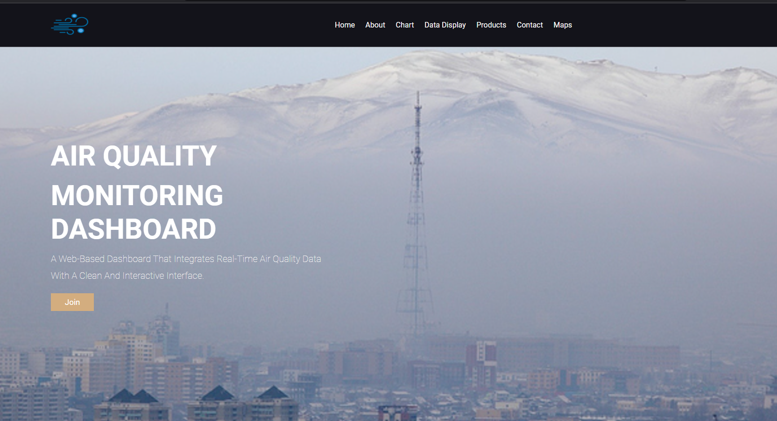
My web
Home page

Slide 6
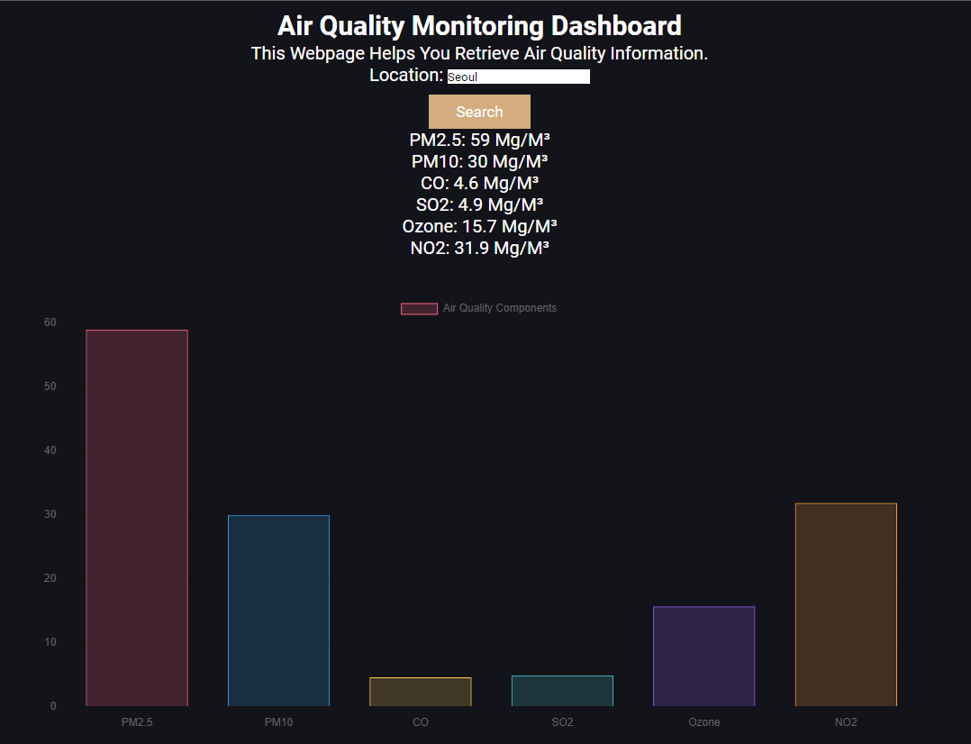
charts

Slide 7
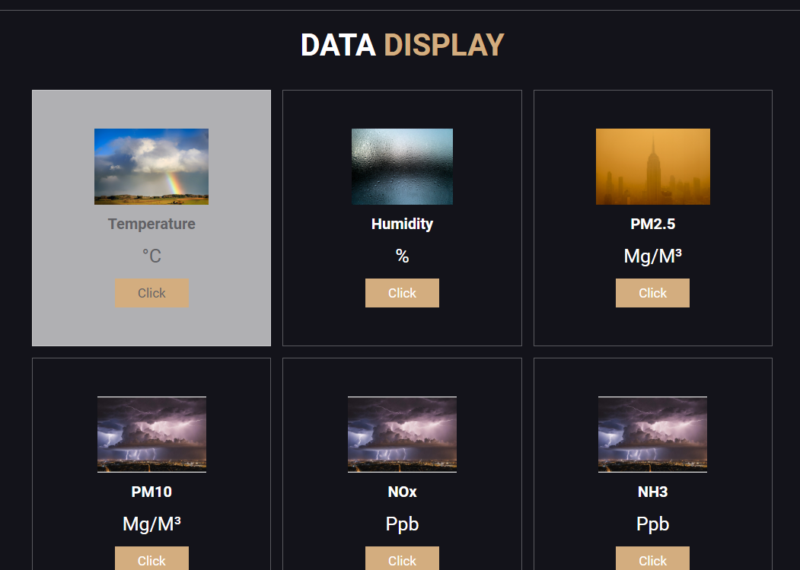
Data display

Slide 8
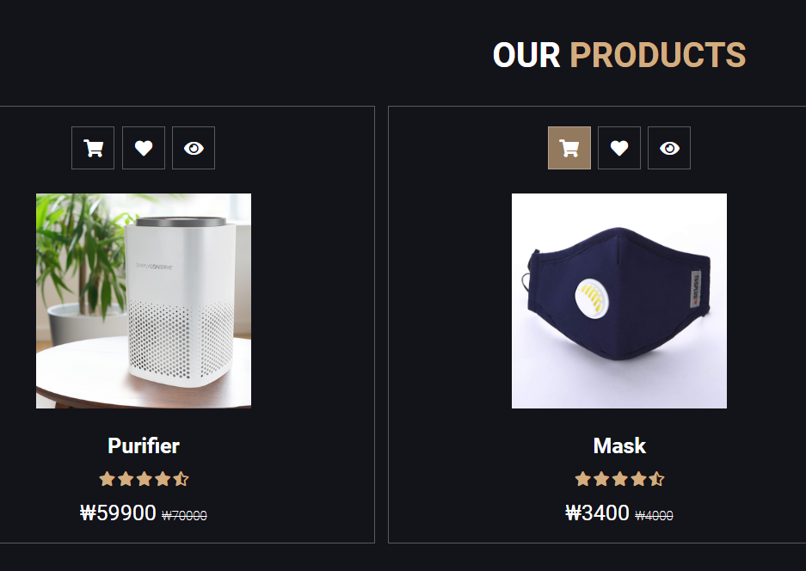
Advertisement

Slide 9
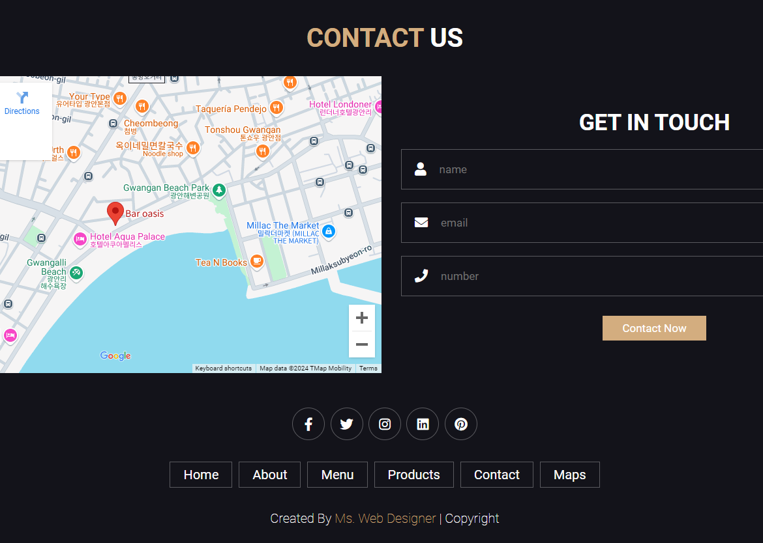
Contact
https://janbubu247.github.io/web-project/

Slide 10
Further Development
In the future, I plan to:
Add historical data visualization for trends over time.
Integrate location-based suggestions for reducing exposure to pollution.

Slide 11
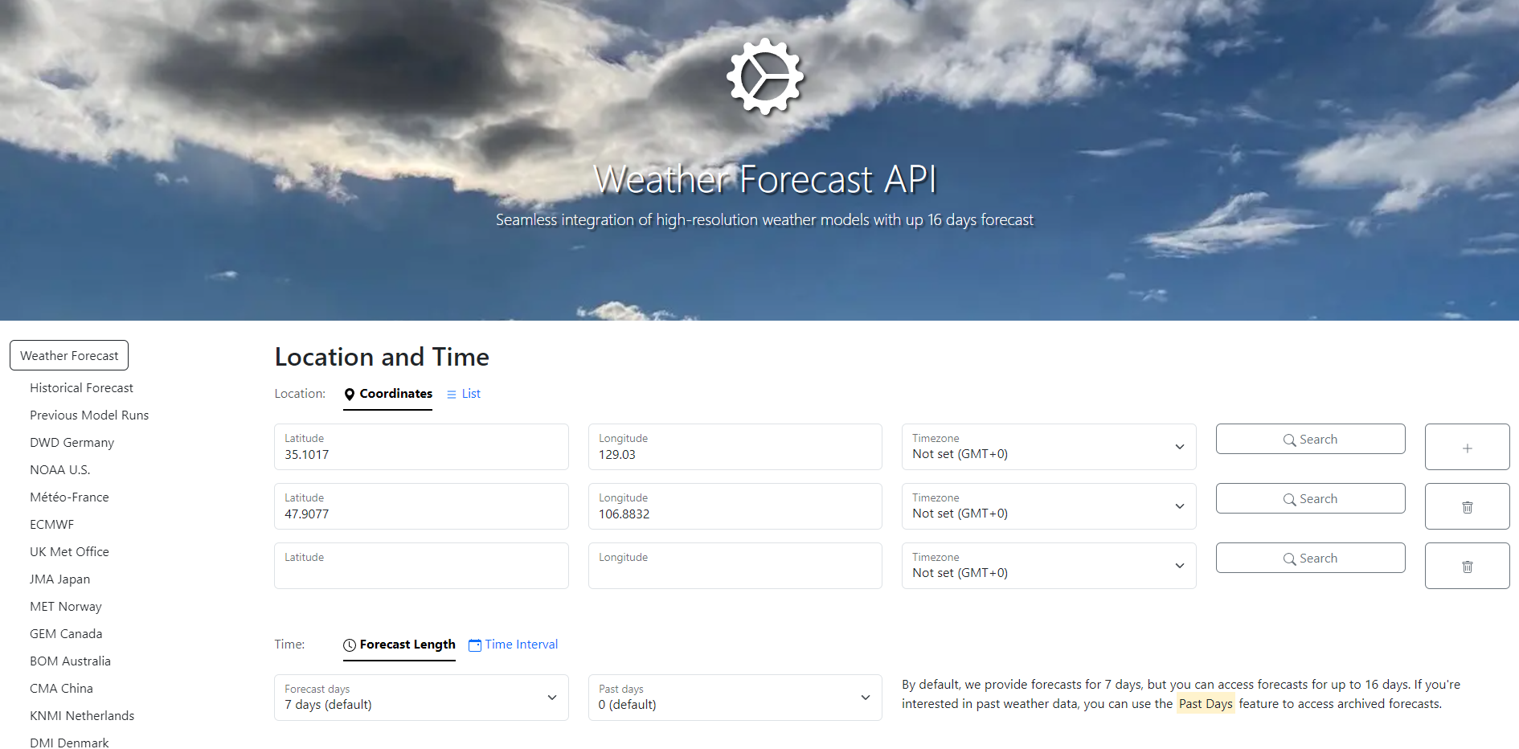
Addable location input and coordinate

Slide 12
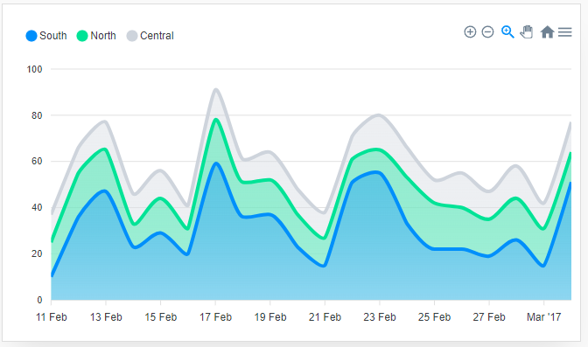
Comparing up to three countries temperature

Slide 13
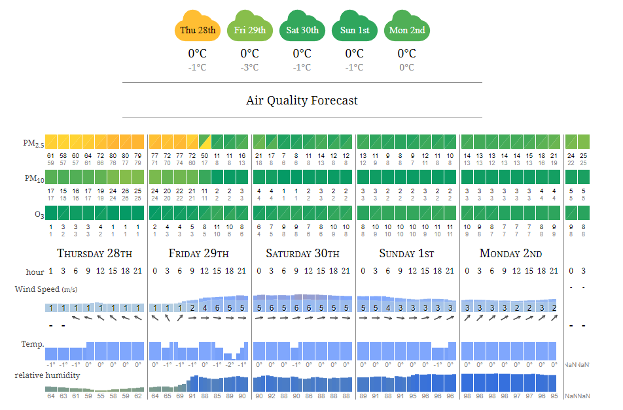
Displaying current AQI

Slide 14
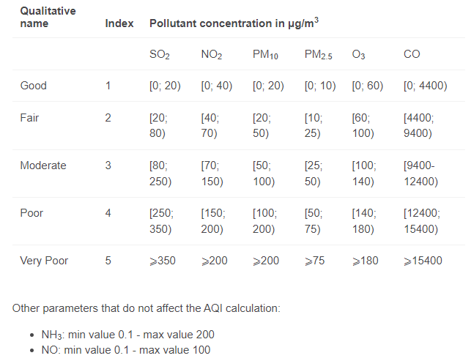
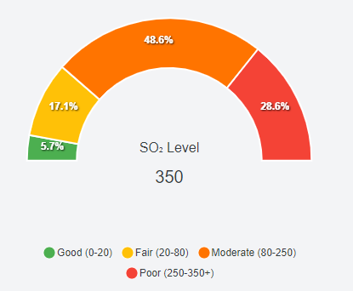
Pollutant levels – Semi donut

Slide 15
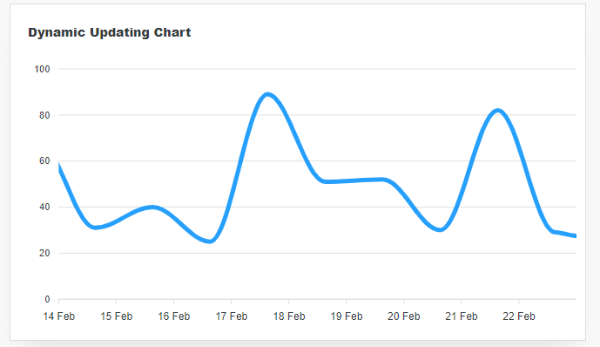
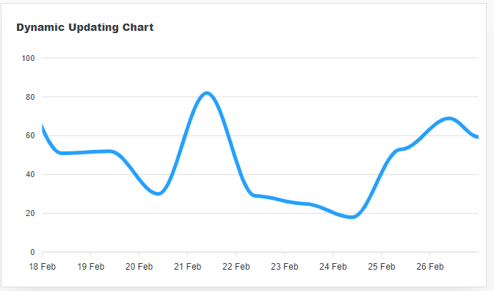
Realtime Dynamic Updating chart

Slide 16
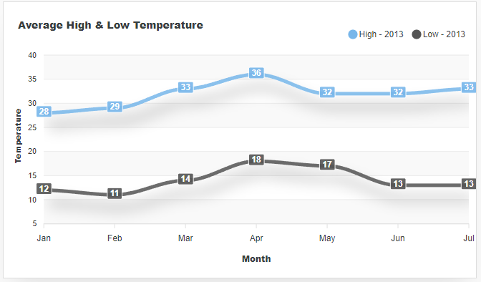
Average high and low temperature

Slide 17
THANK YOU

