Slide 1
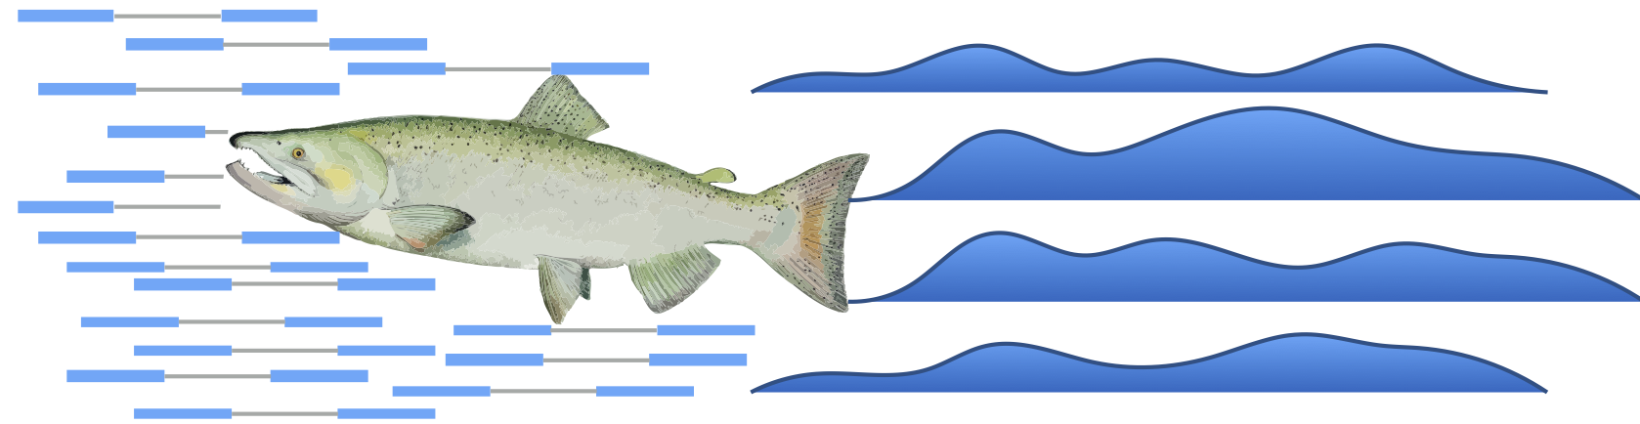

– Don’t count…quantify!

Slide 2
free, quick, little memory
takes into account experimental attributes and biases typical of RNA-seq data, including positional biases in coverage, sequence-specific biases at the 5′ and 3′ end of sequenced fragments, fragment-level GC bias, strand-specific protocols, and the fragment length distribution
input: set of target transcripts

Slide 3
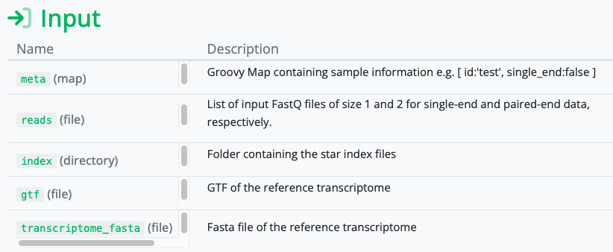

Slide 4
mapping-based mode
alignment-based mode

Slide 5
MAPPING-BASED MODE
Mapping instead of alignment
Salmon index
Decoy-aware transcriptome
Outputs .fs file
Building index:
> ./bin/salmon index –t transcripts.fa –i transcripts_index –decoys decoys.txt –k 31
Paired-end reads:
> ./bin/salmon quant -i transcripts_index -l <LIBTYPE> -1 reads1.fq -2 reads2.fq --validateMappings -o transcripts_quant
Single-end reads:
> ./bin/salmon quant -i transcripts_index -l <LIBTYPE> -r reads.fq --validateMappings -o transcripts_quant

Slide 6
MAPPING-BASED MODE
Multiple samples:
> ./bin/salmon quant -i index -l <LIBTYPE> -1 lib_1_1.fq lib_2_1.fq -2 lib_1_2.fq lib_2_2.fq --validateMappings -o out
> ./bin/salmon quant -i index -l <LIBTYPE> -1 <(cat lib_1_1.fq lib_2_1.fq) -2 <(cat lib_1_2.fq lib_2_2.fq) --validateMappings -o out
Zipped files:
> ./bin/salmon quant -i index -l <LIBTYPE> -1 lib_1_1.fq.gz lib_2_1.fq.gz -2 lib_1_2.fq.gz lib_2_2.fq.gz --validateMappings -o out
> ./bin/salmon quant -i index -l <LIBTYPE> -1 <(gunzip -c lib_1_1.fq.gz lib_2_1.fq.gz) -2 <(gunzip -c lib_1_2.fq.gz lib_2_2.fq.gz) --validateMappings -o out

Slide 7
ALIGMENT-BASED MODE
Pre-aligned data
.bam files
Outputs .fs file
> ./bin/salmon quant -t transcripts.fa -l <LIBTYPE> -a aln.bam -o salmon_quant

Slide 8

LIBTYPE
Automatic library type detection in alignment-based mode
argument -l A
the relative orientation of the reads (only if the library is paired-end)

Slide 9
LIBTYPE
the strandedness of the library
the directionality of the reads (only if the library is stranded)

Slide 10
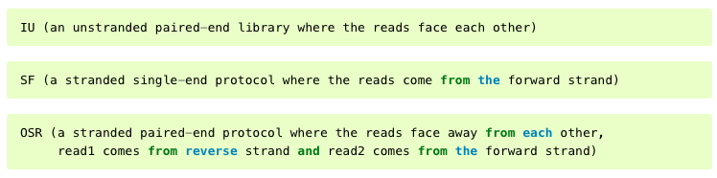
LIBRARY FORMAT STRINGS

Slide 11
THREADS
mapping-based mode: more threads = faster quantification
alignment-based mode: 8-12 (4 threads for BAM decompression, rest for quantification) for maximum speed
-p argument (default = maximum number of available threads - 1)

Slide 12
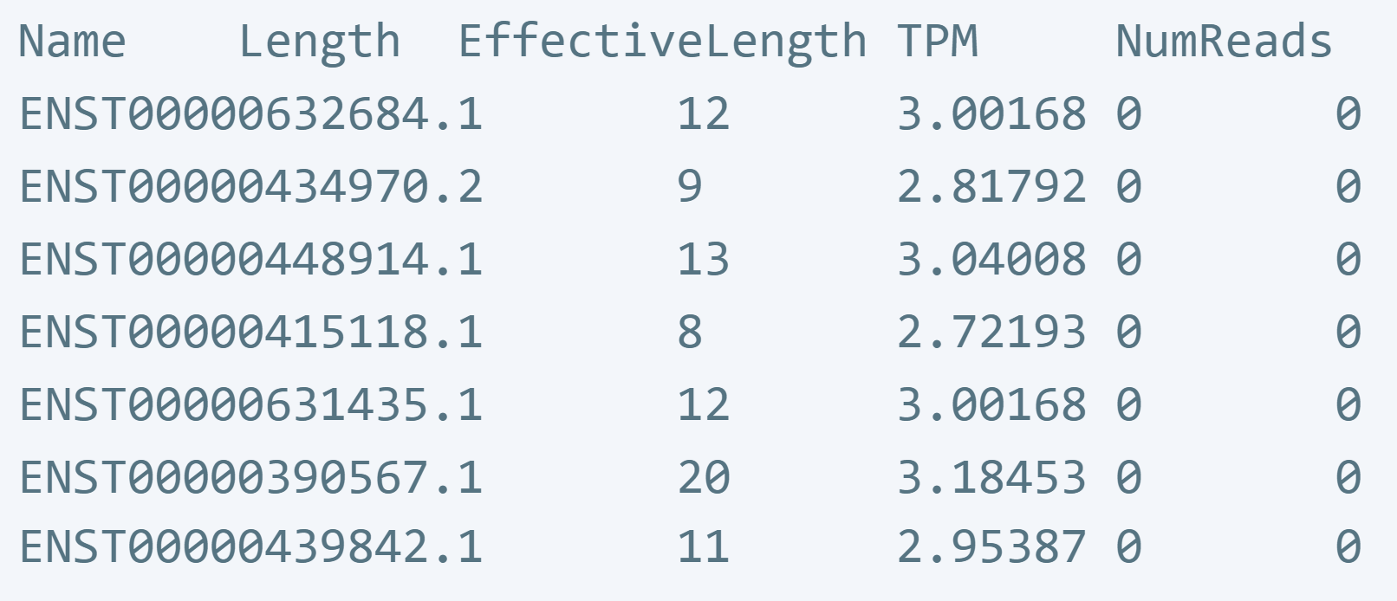
OUTPUT

Slide 13
TPM
Transcripts per kilobase million
How to calculate:
Divide the read counts by the length of each gene in kilobases. This gives you reads per kilobase (RPK)
Then count how many RPK values you have in a sample and divide this number by million to get your “per million” scaling factor
And then divide each RPK value by the scaling factor and the result is TPM.

Slide 14
SOURCES
https://combine-lab.github.io/salmon/
https://salmon.readthedocs.io/en/latest/salmon.html
https://nf-co.re/modules/salmon_quant#input
https://sailfish.readthedocs.io/en/develop/salmon.html
https://www.rna-seqblog.com/rpkm-fpkm-and-tpm-clearly-explained/

