Slide 1
Graduate Admissions Semester project for EECS 738 Guided by Dr. Martin Kuehnhausen
Team
Jan Polzer
Kunal Karnik
Nishil Parmar
Rohan Choudhari
Ryan Duckworth

Slide 2
Roadmap
Problem statement
Data Set
Exploratory Data Analysis
Random Forest Regressor
XGBoost
Neural Network
Multivariate Linear Regression
Ridge Regression
Negative Binomial Distribution

Slide 3
Problem Statement
Applying to Master’s program is a very expensive and intensive work!
Use Machine Learning to help students get to know their chance of admit before they apply
Rarely few schools with no application fee
Most application fees fall between $50 - $85
Graduate program application fee at KU ≈ $65 - $85 too expensive !!

Slide 4
Data Set
https://www.kaggle.com/mohansacharya/graduate-admissions
This dataset is created for prediction of Graduate Admissions
Inspired by the UCLA Graduate Dataset
Mohan S Acharya, Asfia Armaan, Aneeta S Antony:
A Comparison of Regression Models for Prediction of Graduate Admissions
IEEE International Conference on Computational Intelligence in Data Science 2019

Slide 5
Data Set
The dataset contains several parameters which are considered important during the application for Masters Programs.
The parameters included are:
1. GRE Scores ( out of 340 )
2. TOEFL Scores ( out of 120 ) Test of English as a Foreign Language
3. University Rating ( out of 5 )
4. Statement of Purpose and Letter of Recommendation Strength ( out of 5 )
5. Undergraduate GPA ( out of 10 )
6. Research Experience ( either 0 or 1 )
7. Chance of Admit ( ranging from 0 to 1 )

Slide 6
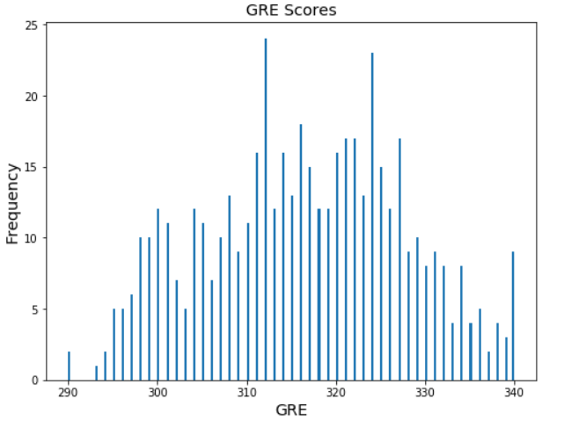
Exploratory Data Analysis

Slide 7
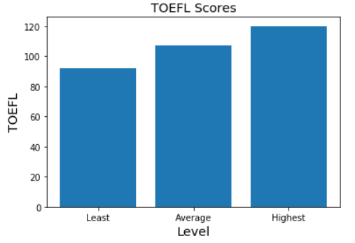
Exploratory Data Analysis

Slide 8
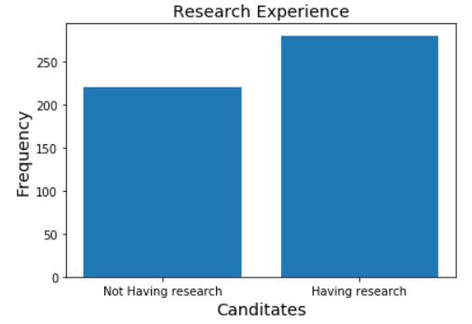
Exploratory Data Analysis

Slide 9
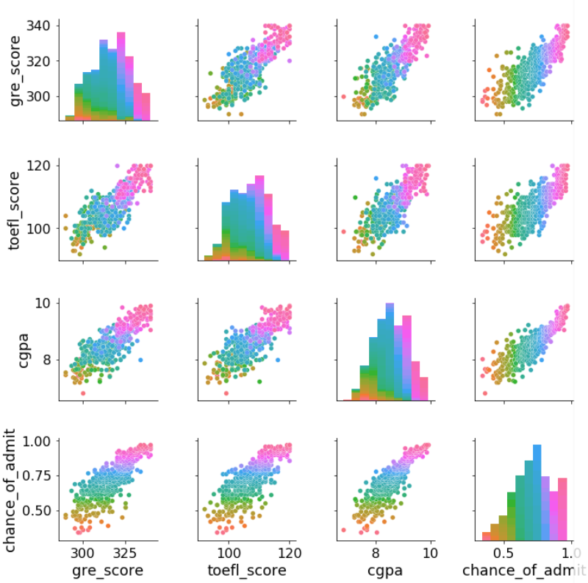

Slide 10
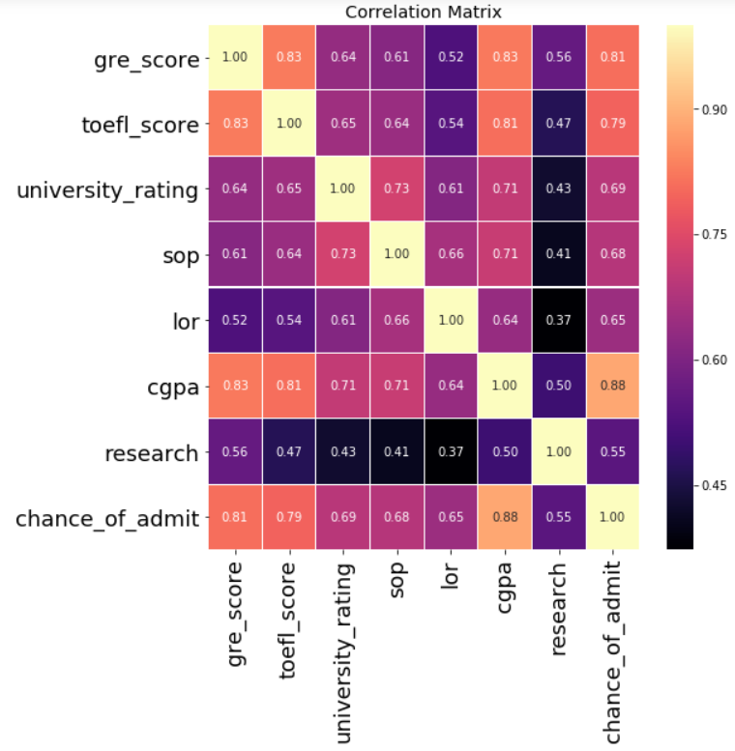
Exploratory Data Analysis

Slide 11
Random Forest Regressor
Ensemble learning method for regression
Operates by constructing a multitude of decision trees at training and outputting mean prediction of individual trees
used with bootstrapping - better model performance, it decreases variance without increasing bias
Number of trees = 100
R^2 score = 0.7885063612224901
RMSE = 0.06576507365615947

Slide 12
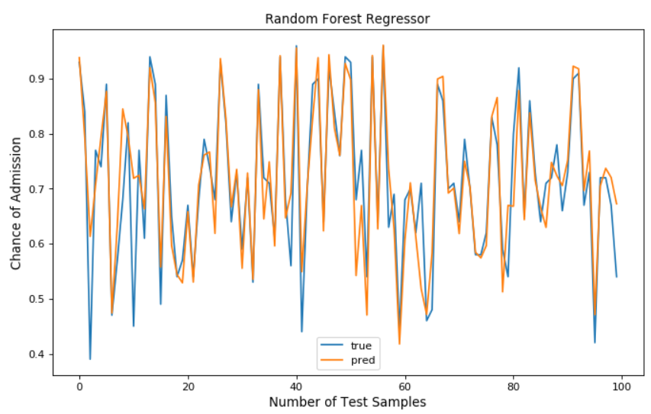

Slide 13
XGBoost
XGBoost stands for eXtreme Gradient Boosting.
"XGBoost is an open-source software library which provides a gradient boosting framework" –Wikipedia
https://en.wikipedia.org/wiki/XGBoost

Slide 14
Boosting
"Boosting is an ensemble technique where new models are added to correct the errors made by existing models. Models are added sequentially until no further improvements can be made. A popular example is the AdaBoost algorithm that weights data points that are hard to predict."

Slide 15
Gradient Boosting
"Gradient boosting is an approach where new models are created that predict the residuals or errors of prior models and then added together to make the final prediction. It is called gradient boosting because it uses a gradient descent algorithm to minimize the loss when adding new models."

Slide 16
XGBoost
Machine Learning presentation given in June 2016:
"17 out of 29 winning solutions in Kaggle last year used XGBoost "
- Tianqi Chen
"…CERN recognized it as the best approach to classify signals from the Large Hadron Collider. This particular challenge posed by CERN required a solution that would be scalable to process data being generated at the rate of 3 petabytes per year and effectively distinguish an extremely rare signal from background noises in a complex physical process. XGBoost emerged as the most useful, straightforward and robust solution."

Slide 17
Gradient Boosting
"Gradient boosting is a machine learning technique for regression and classification problems, which produces a prediction model in the form of an ensemble of weak prediction models, typically decision trees. It builds the model in a stage-wise fashion like other boosting methods do, and it generalizes them by allowing optimization of an arbitrary differentiable loss function. " –Wikipedia
https://en.wikipedia.org/wiki/Gradient_boosting

Slide 18
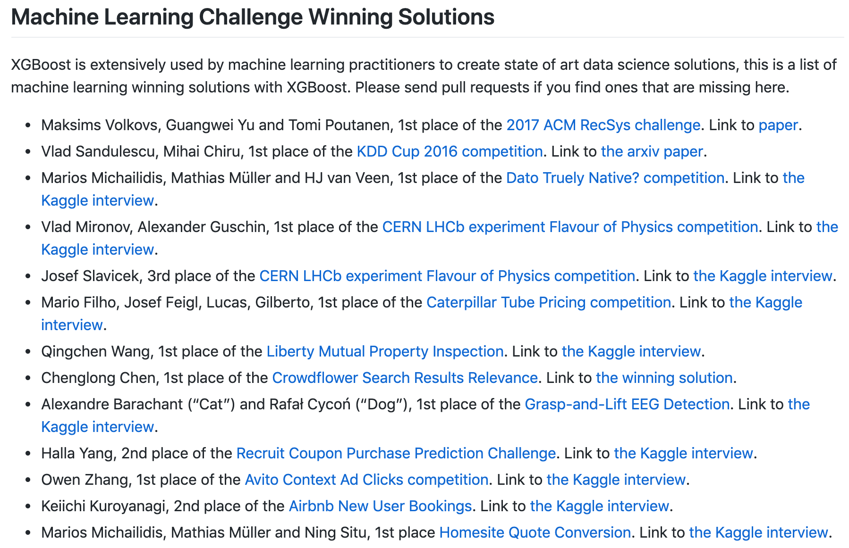
Why is XGBoost so popular?
https://github.com/dmlc/xgboost/tree/master/demo#machine-learning-challenge-winning-solutions

Slide 19
Neural Network
Used sequential model
linear stack of layers
3 layer dense neural network
Activation function: ReLu -Rectified linear units
Loss function: mean squared error
Learning rate: 0.001
Epochs: 80
RMSE = 0.07099454017742718

Slide 20
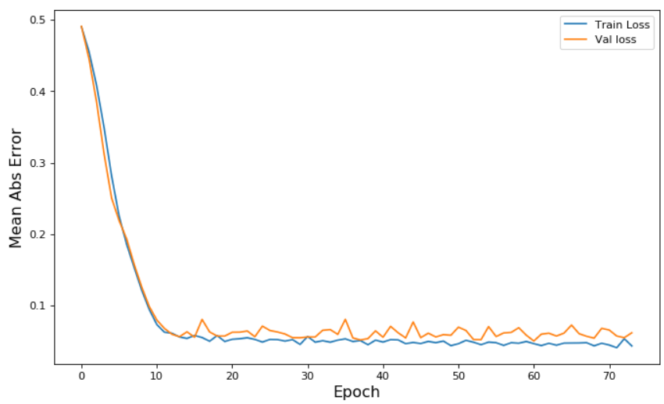

Slide 21
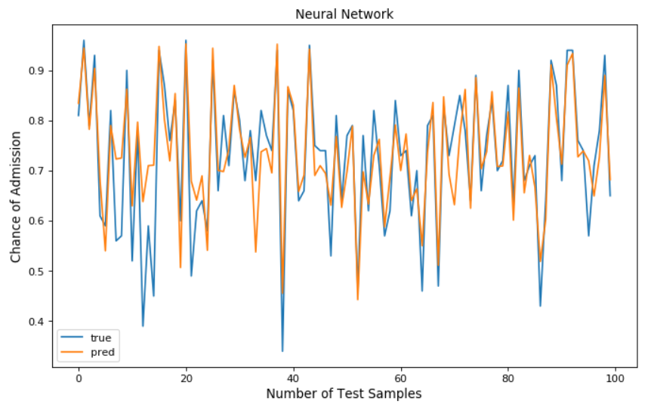

Slide 22
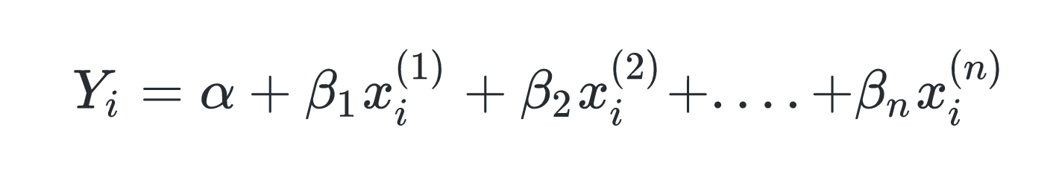
Multivariate Linear Regression
Multiple linear regression attempts to model the relationship between two or more explanatory variables and a response variable by fitting a linear equation to observed data

Slide 23
Multivariate Linear Regression
Used 3 modules
Hypothesis function
Gradient Descent Algorithm function
Linear Regression principal function
Learning rate: 0.001
Epochs: 1000
RMSE = 0.0618767204629624

Slide 24
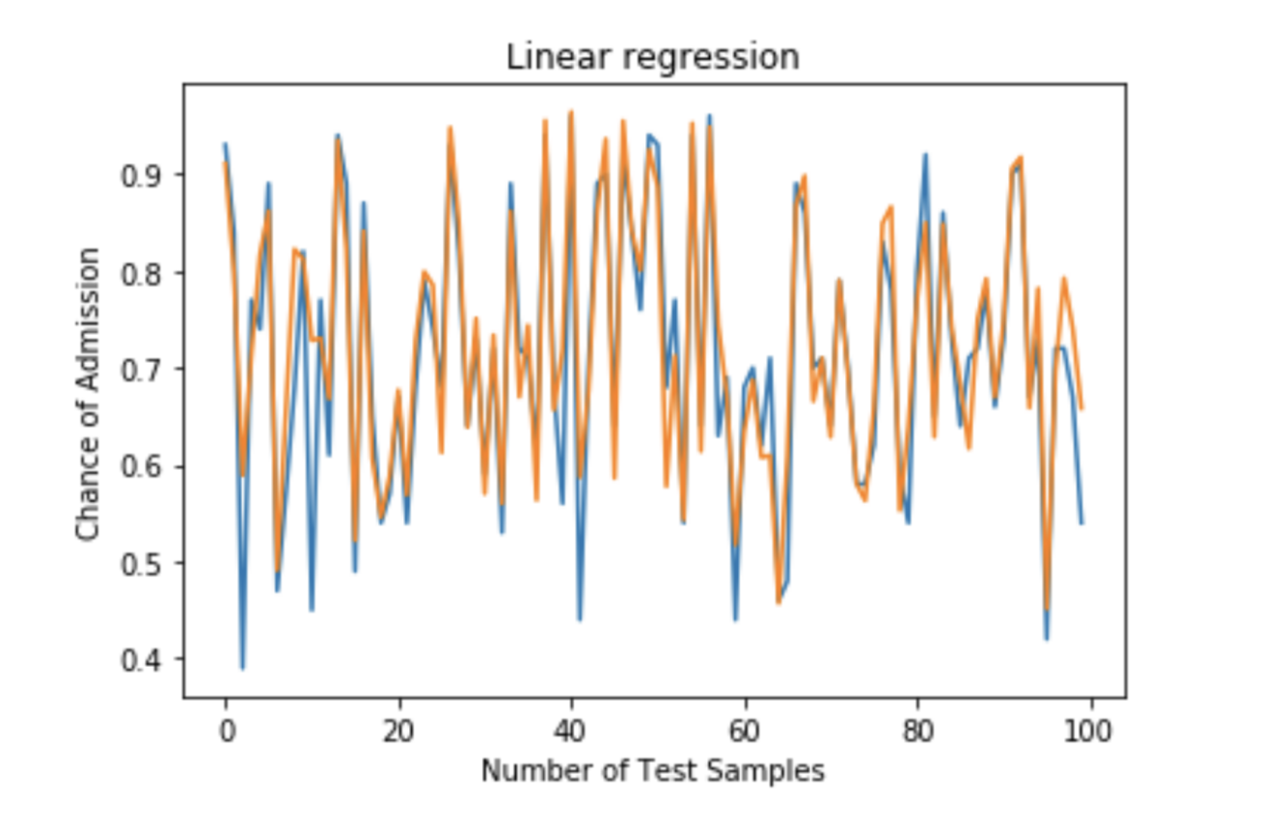

Slide 25
Ridge Regression
Ridge Regression is a technique for analyzing multiple regression data that suffer from multicollinearity. When multicollinearity occurs, least squares estimates are unbiased, but their variances are large so they may be far from the true value. By adding a degree of bias to the regression estimates, ridge regression reduces the standard errors. It is hoped that the net effect will be to give estimates that are more reliable.

Slide 26
Multicollinearity
Multicollinearity is the existence of near-linear relationships among the independent variables.
Effects:
can create inaccurate estimates of the regression coefficients
inflate the standard errors of the regression coefficients
degrade the predictability of the model

Slide 27
Detection of Multicollinearity
Correlation Matrix
Construction of a correlation matrix among the explanatory variables will yield indications as to the likelihood that any given couplet of right-hand-side variables are creating multicollinearity problems. Correlation values (off-diagonal elements) of at least 0.4 are sometimes interpreted as indicating a multicollinearity problem.

Slide 28
Correlation Matrix
We can see there's significantly high correlation (>0.8) between 'GRE' and 'TOEFL', 'CGPA' and 'GRE', and 'TOEFL' and 'CGPA'

Slide 29
Detection of Multicollinearity
Studying pairwise scatter plots
We take a look at scatter plots of pairs of independent variables.
We consider 'GRE', 'TOEFL', 'CGPA' because the correlation matrix suggested that the three have have high correlation

Slide 30
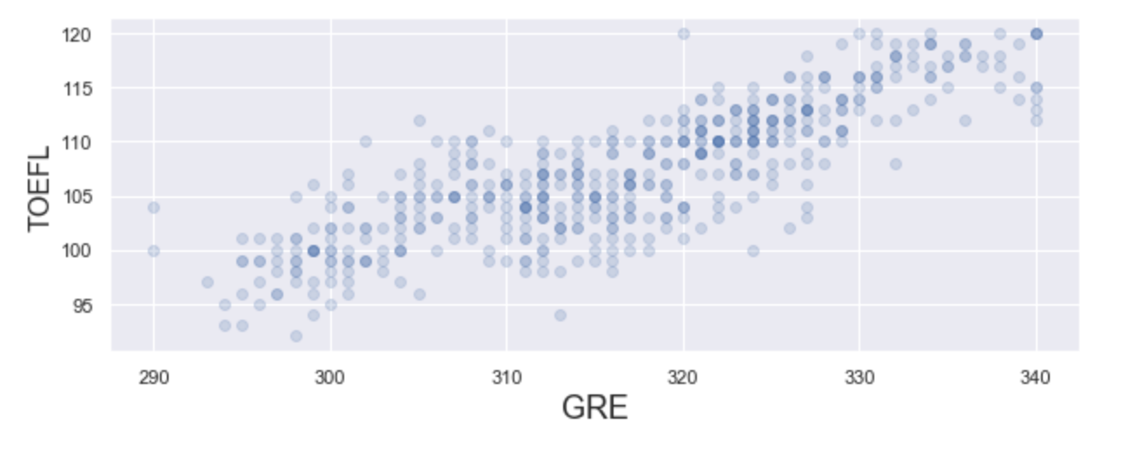
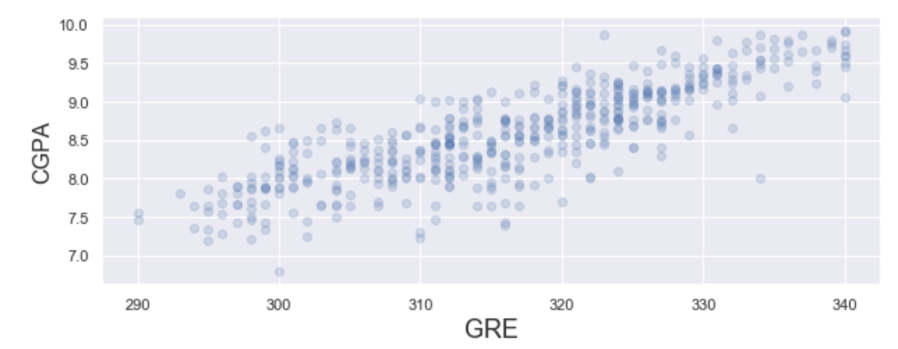
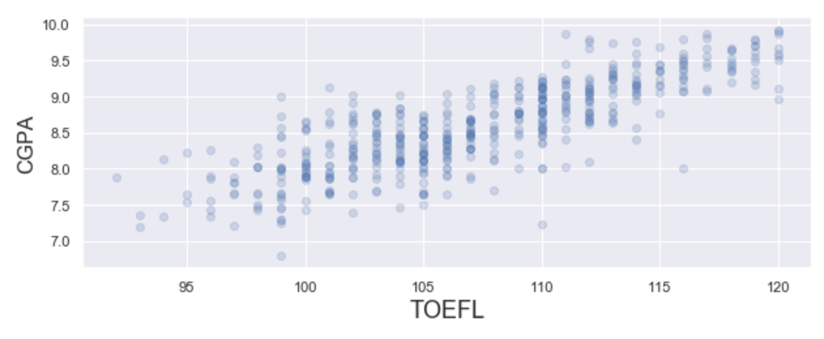
Scatter plots
A cursory look at the scatter plots hint at the presence of multicollinearity. However, multicollinearity does not always show up when considering two variables at a time. We need to take a few more steps before we confirm multicollinearity

Slide 31
Detection of Multicollinearity
Variance Inflation Factors (VIF)
VIF is the ratio of variance in a model with multiple terms, divided by the variance of a model with one term alone
It quantifies the severity of multicollinearity and provides an index that measures how much the variance of an estimated regression coefficient is increased because of collinearity.

Slide 32
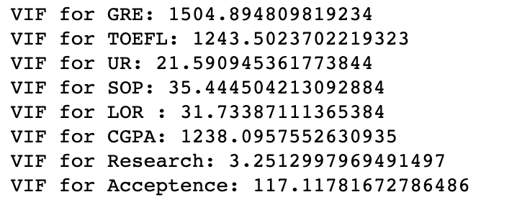
Detection of Multicollinearity
A VIF > 5 is indication that the particular explanatory variable is highly collinear with other explanatory variables. When a variable is independent, it is not affected at all by any other variables. When a variable isn't independent for certain, it's an explanatory variable.

Slide 33
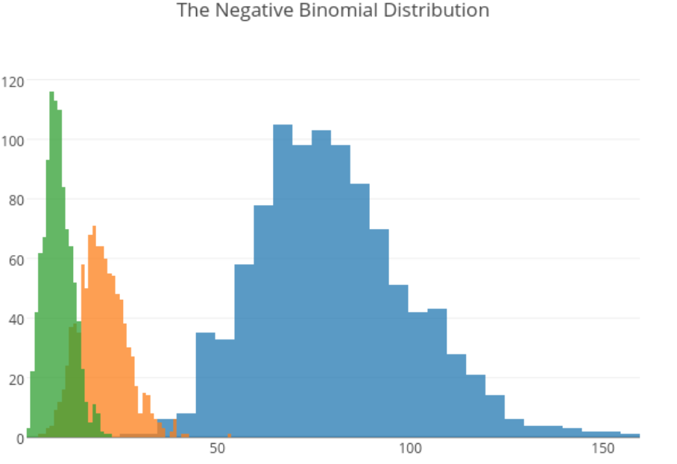
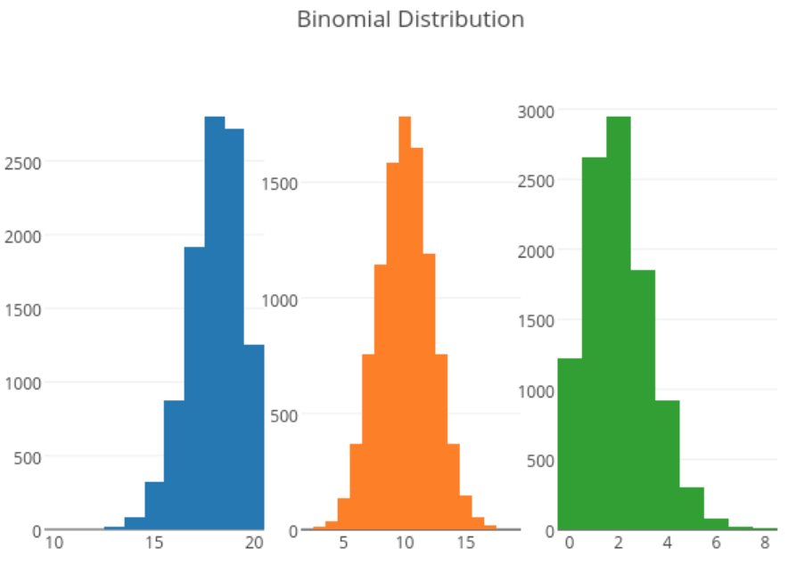
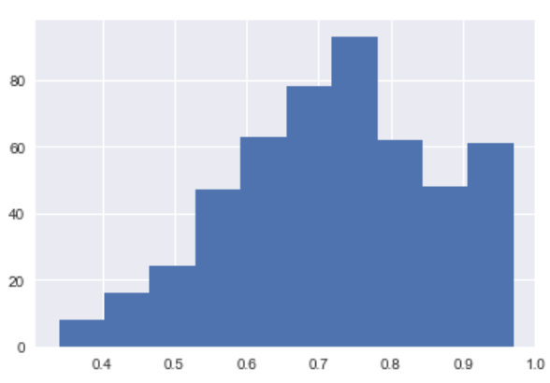
Negative Binomial Regression
Chance of admit

Slide 34


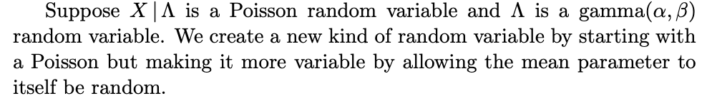
Negative Binomial Regression
2 Versions :
first version counts the number of the trial at which the rth success occurs
second version counts the number of failures before the rth success.
Poisson-gamma distribution
Unequal mean and Variance
https://www.johndcook.com/negative_binomial.pdf

Slide 35
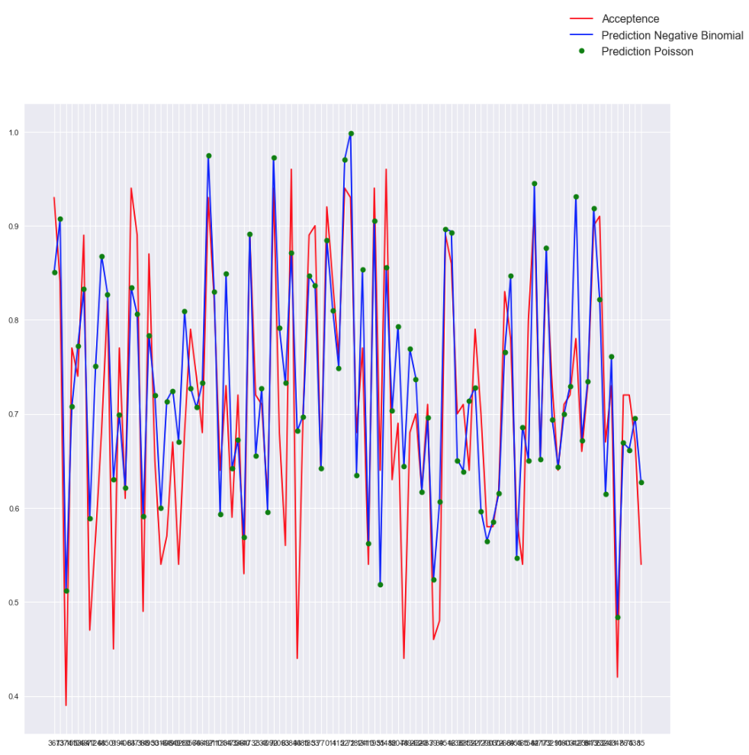

Slide 36
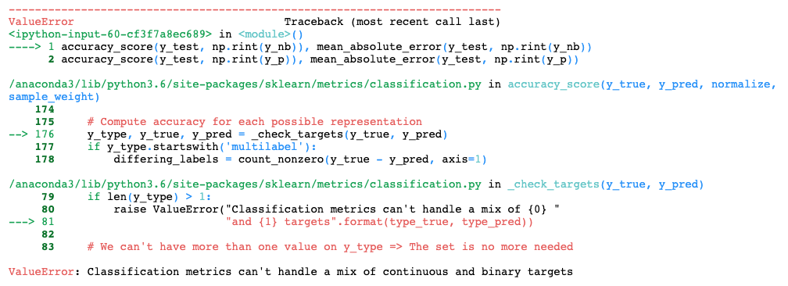
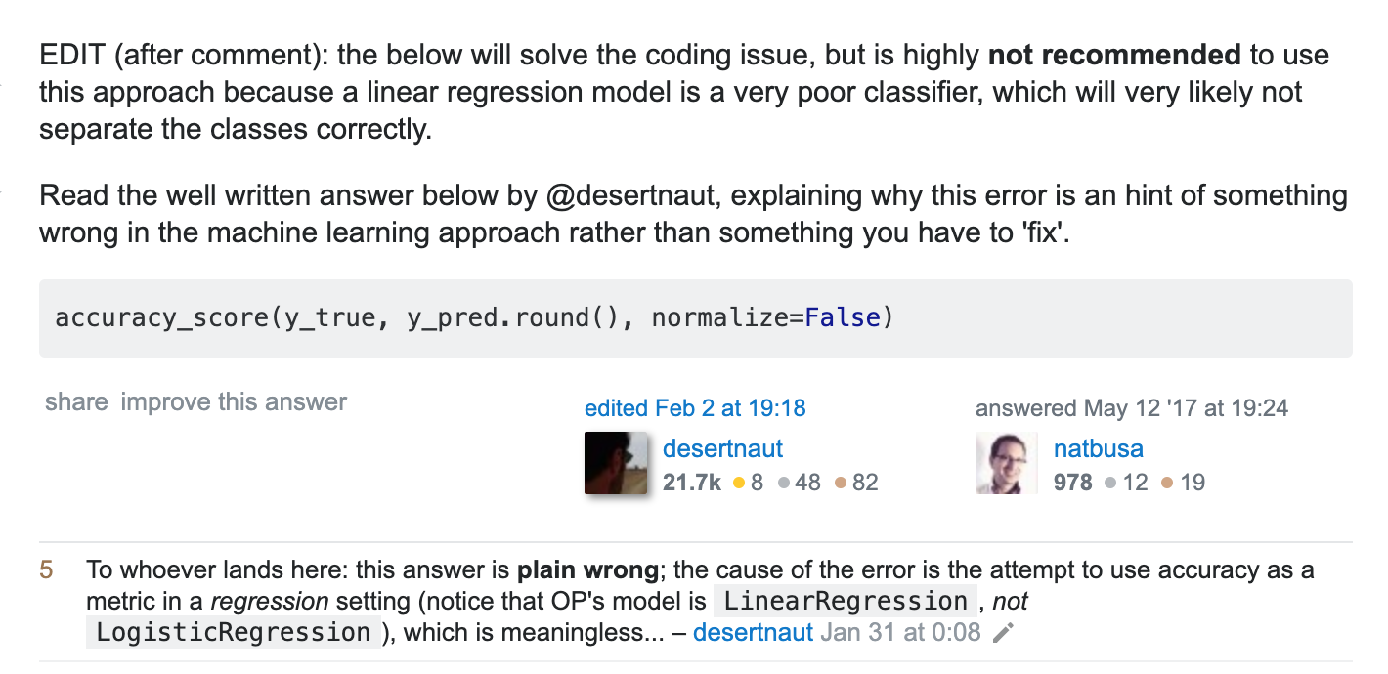

Slide 37
Future Work
Build a web interface
Add more algorithms

Slide 38
References
Dataset
https://www.kaggle.com/mohansacharya/graduate-admissions
Mohan S Acharya, Asfia Armaan, Aneeta S Antony :
A Comparison of Regression Models for Prediction of Graduate Admissions, IEEE International Conference on Computational Intelligence in Data Science 2019

Slide 39
References
https://en.wikipedia.org/wiki/XGBoost
https://github.com/dmlc/xgboost/tree/master/demo#machine-learning-challenge-winning-solutions
https://en.wikipedia.org/wiki/Gradient_boosting
http://datascience.la/xgboost-workshop-and-meetup-talk-with-tianqi-chen/
https://machinelearningmastery.com/gentle-introduction-xgboost-applied-machine-learning/
https://www.analyticsvidhya.com/blog/2018/09/an-end-to-end-guide-to-understand-the-math-behind-xgboost/
https://www.johndcook.com/negative_binomial.pdf

Slide 40
Thank you!
Questions ?

