Slide 1
Matching and routing of trippoints
Way Estimation Value
Spatial queries and features calculation
Classification of non-tricky and tricky points
Optimization
Output

Slide 2
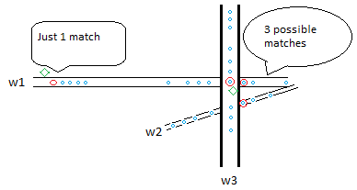

Way Estimation Value (w)
w is calculated for each neighboring way and the neighbour with lowest w is picked. It is calculated for tricky trippoints!
$w=(x)+(y)+(z)$
w
LEGEND Green: GPS point
Red: Matched point
Blue: OSM nodes

Slide 3

Way Estimation Value (w)
x: Distance to the estimated matching point in the closest way
y: Path cost from the estimated matching point to previous matched point
z: Distance to the neighbouring way
$w=(x)+(y)+(z)$

Slide 4
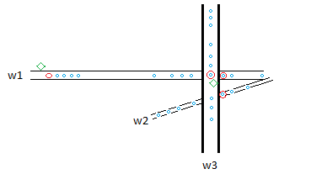
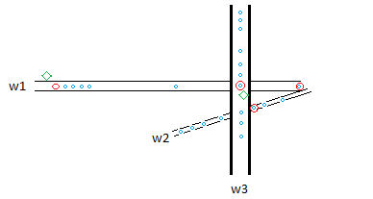
Way Estimation Value (w)
Q: Why the way estimation value is important?
A: w helps in finding the actual matching point.
LEGEND Green: GPS point
Red: Matched point
Blue: OSM nodes

Slide 5
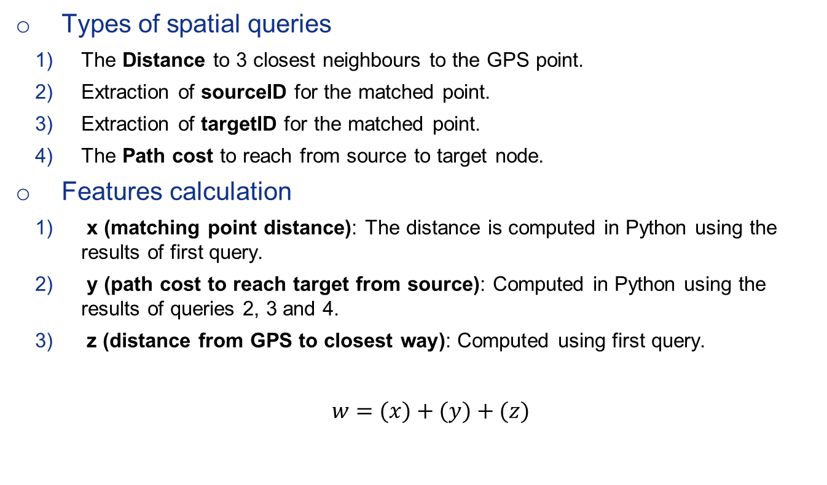
Spatial queries and features calculation
Types of spatial queries
The Distance to 3 closest neighbours to the GPS point.
Extraction of sourceID for the matched point.
Extraction of targetID for the matched point.
The Path cost to reach from source to target node.
Features calculation
x (matching point distance): The distance is computed in Python using the results of first query.
y (path cost to reach target from source): Computed in Python using the results of queries 2, 3 and 4.
z (distance from GPS to closest way): Computed using first query.
$w=(x)+(y)+(z)$

Slide 6
Classification of non-tricky and tricky points
Non-tricky Points
Mostly number of neighbouring way is one.
If not then the distance difference to other neibhours is more than 10m.
Tricky Points
At most 3 or atleast 2 neighboring ways.
Distance of all the neighboring ways is slightly different from others.

Slide 7
Optimization and execution time
Indexing of the routing table (hh_2po_4pgr)
Postgres database configuration by analysing query execution plan.
Dummy features ([1, 0]) in Python code by considering:
Road name of previously matched trippoint
Difference of distances between candidate road instances.
Average execution time to process 1 tricky trip point is 45 ms.
Average execution time to process 1 non-tricky trip point is 30 ms.

Slide 8
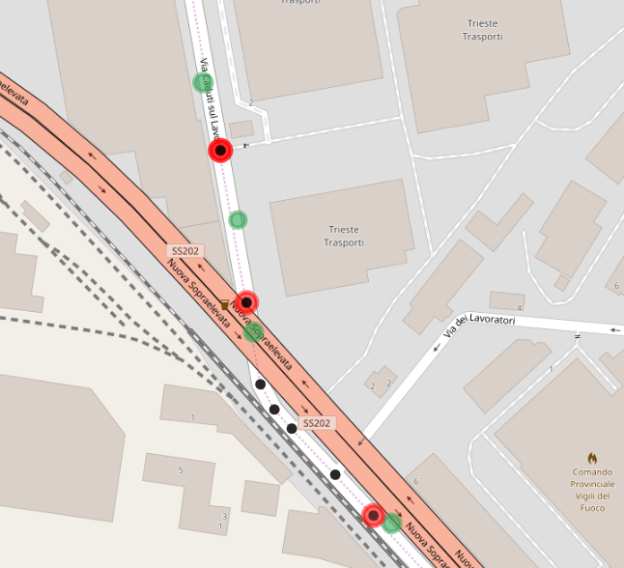
Output
Tricky trippoint
LEGEND Green: GPS point
Red: Matched point
Black: OSM nodes

Slide 9
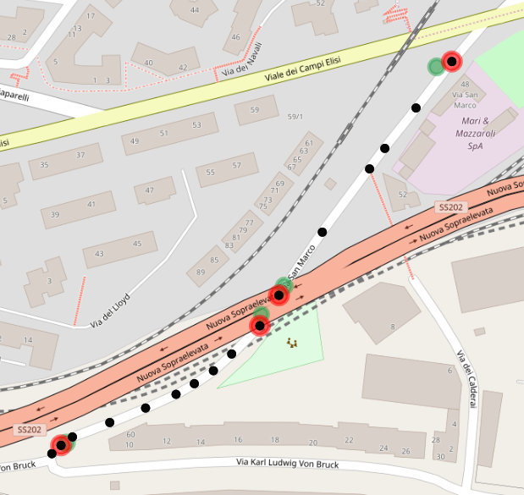
Output
Tricky trippoint
Tricky trippoint

