Slide 1









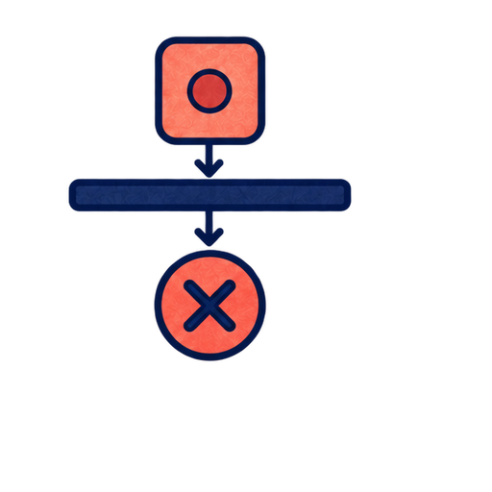
SELECT EVIDENCE
RECONSTRUCT MEANING
APPLY AUTHORITY
POLICY
EXECUTE
COMPILER
BIND
GRAMMAR
INTENT
VERIFY
CLARIFY
REQUEST
REGISTRY
REJECT

