Slide 1
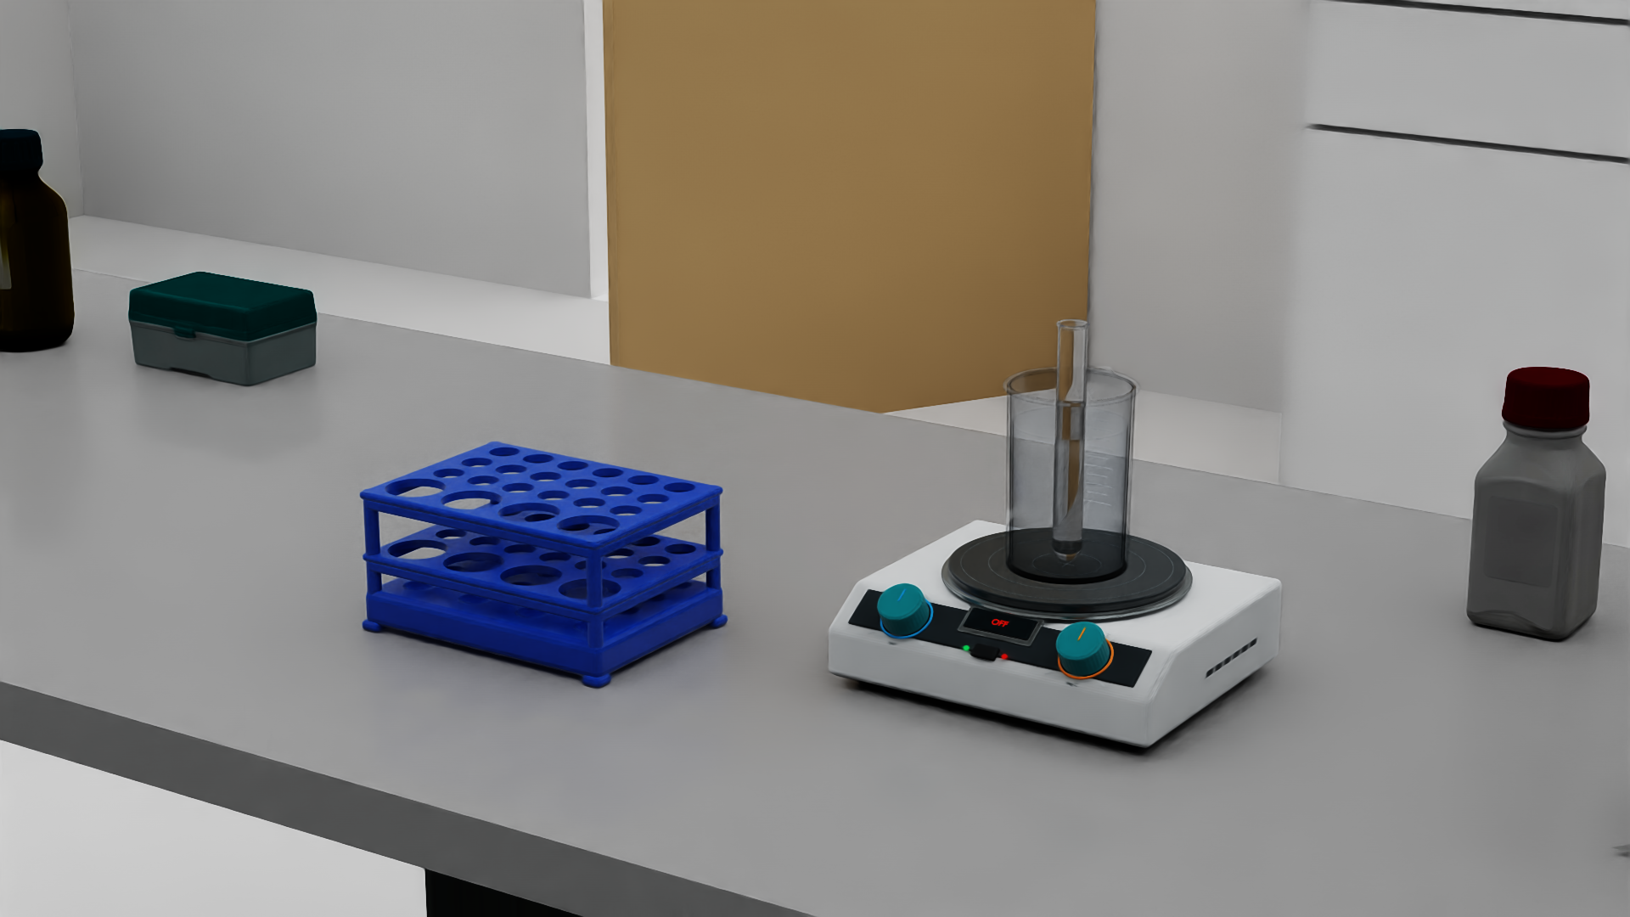
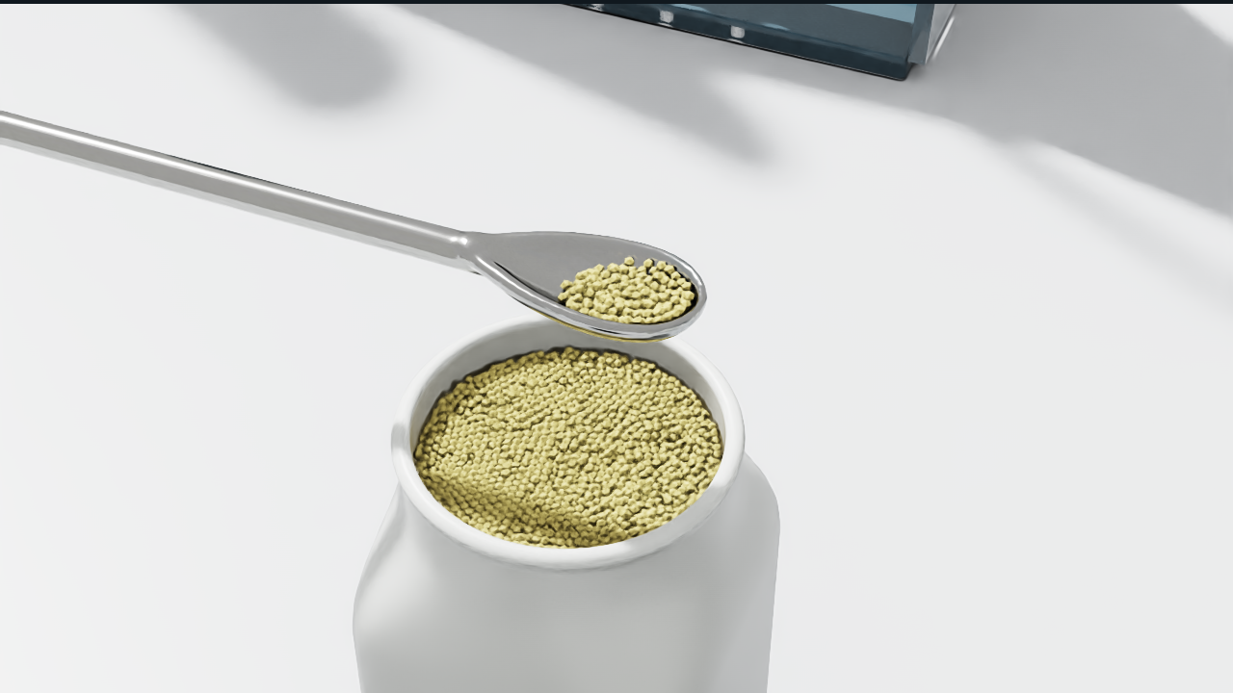
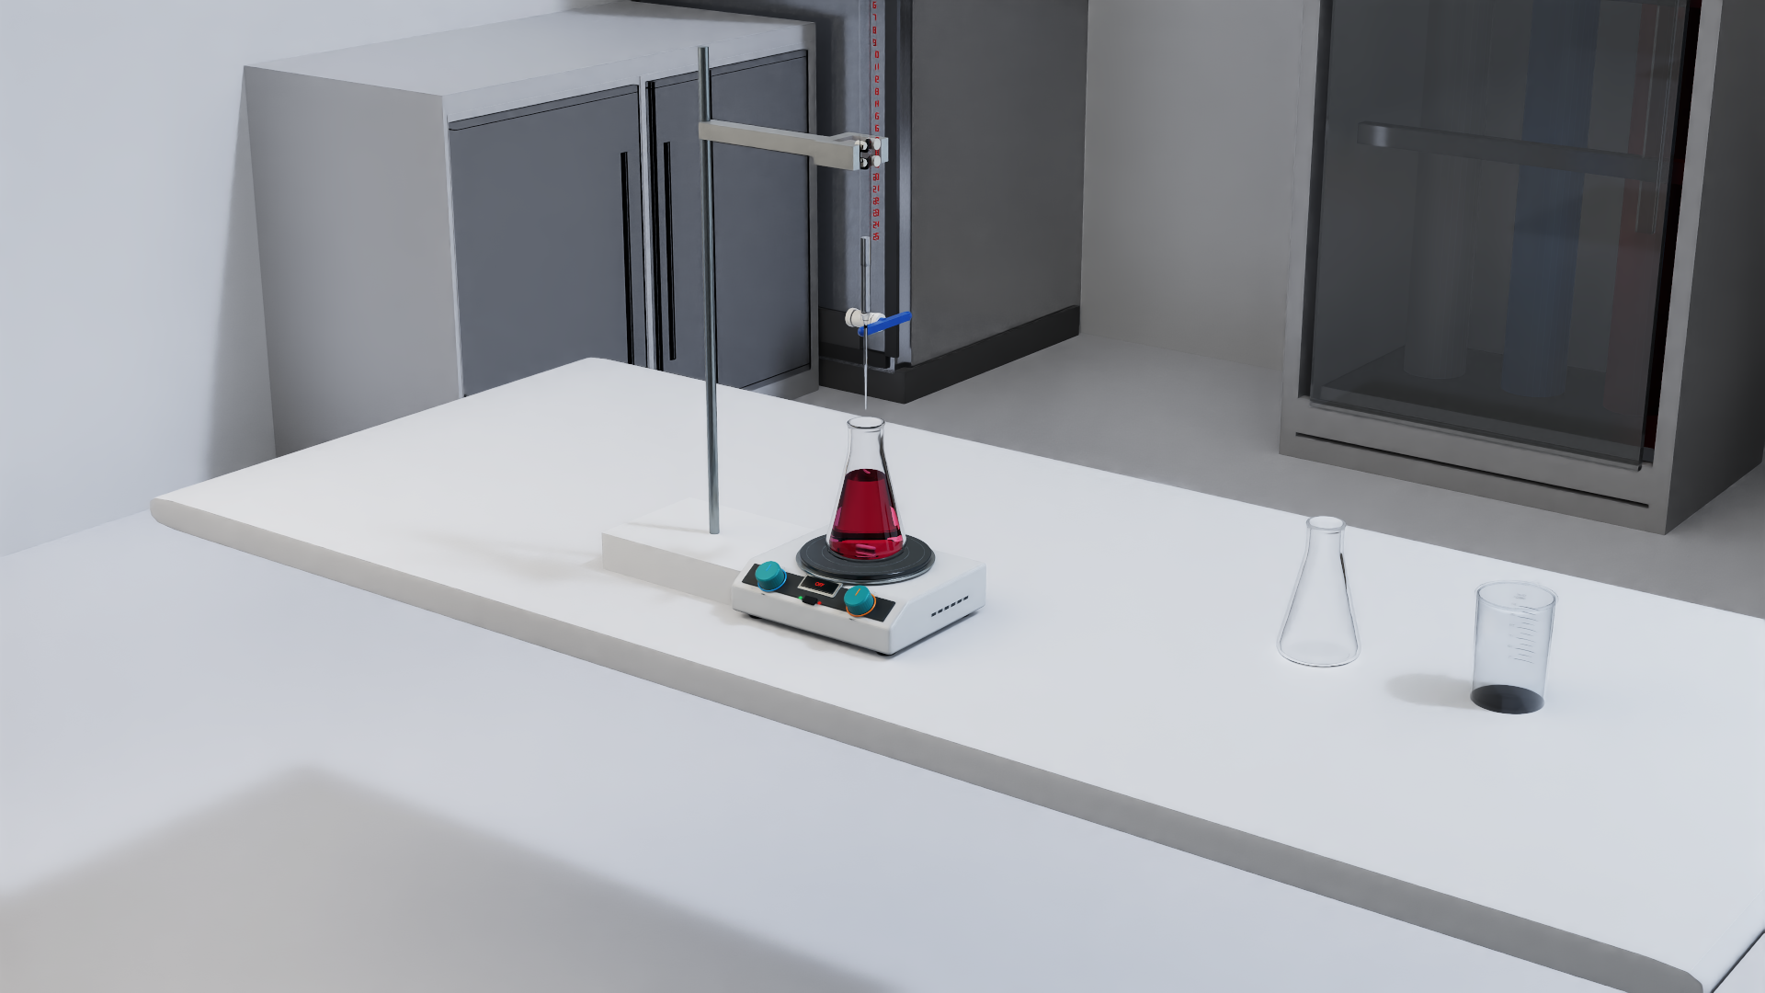
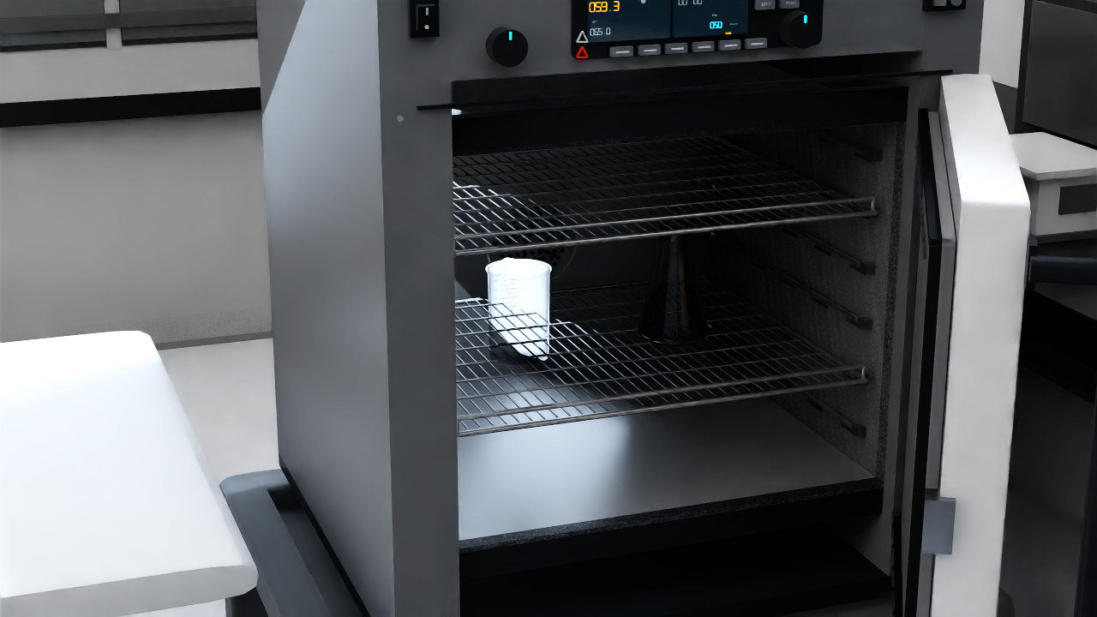
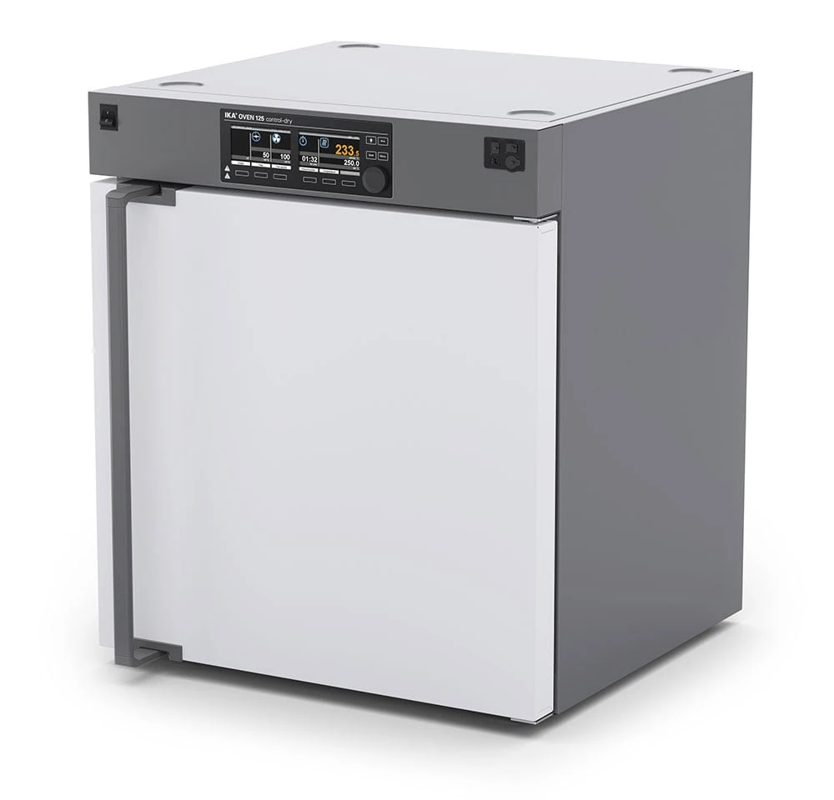
Input
Lab2Sim agent
Robot-ready Isaac scenes
Text
Search
Spec
Build
Admit
Image
OVEN 125
DOOR 180°
SHELF ×6
Convert
Asset
PhysX
Video
Web
docs
USD
PASS
Fehling
Powder
Titration
OVEN 125
Notes:
{"spec":"lab2sim-hero.figure-spec.json","mode":"inspired","canonical":"SVG","provenance":[{"id":"prov-reference-decisions","source":"fig1-reference-audit.md","section":"Reference-led decisions","claim":"Inspired editorial hierarchy and output-gallery allocation","applies_to":["rule-headers","result-region"],"status":"verified"},{"id":"prov-pipeline","source":"../../../../../docs/design/agent-driven-asset-generation-pipeline.md","section":"Five-stage pipeline","claim":"Evidence retrieval, spec freeze, generation, and ConvertAsset admission","applies_to":["stage-retrieve","stage-spec","stage-build","stage-admit"],"status":"verified"},{"id":"prov-oven-spec","source":"../../../../../docs/design/asset-specs/ika-oven-125.md","section":"Frozen manufacturer fields","claim":"OVEN 125 identity, door articulation, and shelf count","applies_to":["spec-body"],"status":"verified"},{"id":"prov-input-photo","source":"../../../../../external_artifacts/asset_evidence/ika-oven-125/image1.png","section":"Multimodal image request","claim":"Manufacturer photograph of IKA OVEN 125","applies_to":["input-catalog-photo"],"status":"user-provided"},{"id":"prov-fehling-r10","source":"../../../../../outputs/lab2sim_fig1_retake_20260917/fehling_r10/t30_hero_tabletop.png","section":"Figure 1 current-delivery scenes","claim":"Camera-only render of the Fehling r10 retained t30 scene state","applies_to":["scene-fehling"],"status":"verified"},{"id":"prov-powder-r4","source":"../../../../../outputs/task09_powder_bottle_r4_20260911/video/close_0960.png","section":"Figure 1 current-delivery scenes","claim":"Powder r4 observed-state replay with the HUD removed by a documented crop","applies_to":["scene-powder"],"status":"verified"},{"id":"prov-titration-r17","source":"../../../../../outputs/scientific_workbench_traditional_acid_base_titration_vr_r1_7_20260908/handoff/scientific_workbench_traditional_acid_base_titration_vr_r1_7/evidence/initial_scene/after_end_scale_scene_overview.png","section":"Figure 1 current-delivery scenes","claim":"Titration r1.7 endpoint scene overview","applies_to":["scene-titration"],"status":"verified"},{"id":"prov-oven-r2","source":"../../../../../outputs/scientific_workbench_task12_oven_unload_dual_glassware_vr_r2_20260904/handoff/scientific_workbench_task12_oven_unload_dual_glassware_vr_r2/evidence/initial_scene/open_oven_station.png","section":"Figure 1 current-delivery scenes","claim":"OVEN r2 open-door station with dual glassware","applies_to":["scene-oven"],"status":"verified"}],"limitations":"PptxGenJS uses editable native panels, text, and segmented connectors; rounded SVG connector geometry may differ from the canonical SVG."}

