Slide 1

ROBOTICS

Slide 2

WHAT IS ROBOTICS ?
ROBOTICS is a branch of engineering and computer science that involves the conception, design , manufacture and operation of robots.

Slide 3
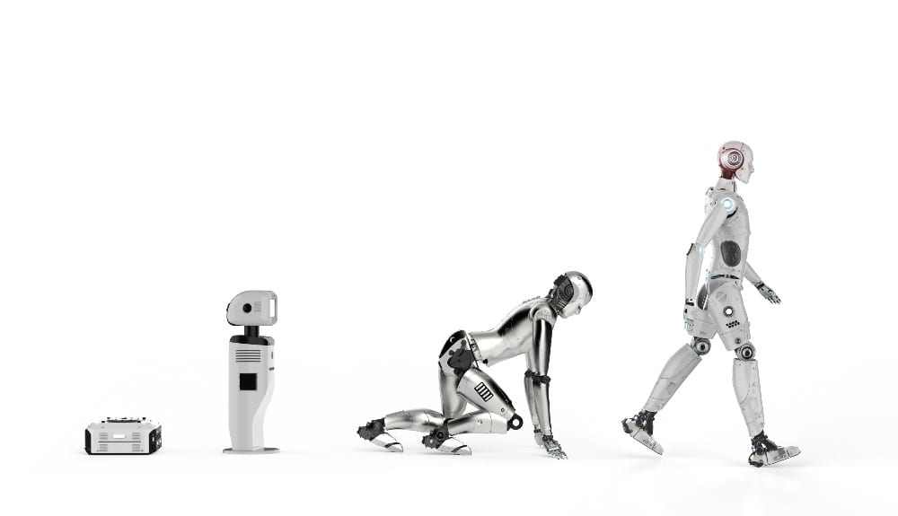
HISTORY OF ROBOTICS :
The robot was introduced to the published by Czech writer KAREL CAPEK(1890- 1938) .
The word robotics used to describe this field of study was in 1940s .
In 1942, Russian born American scientist and science fiction writer created three “law of robotics” and he later added “zeroth law”.

Slide 4
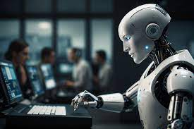
WHY ROBOTICS ?
More speed.
It can easily work.
To perform repetitive task.
Efficiency.
Accuracy.
Adaptability.
Solve complex problems.
Healthcare.
Programming skill.

Slide 5
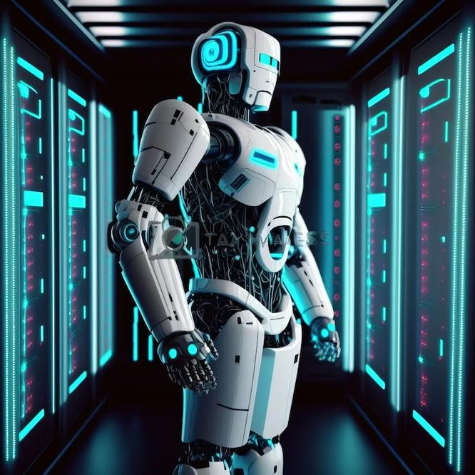
TYPES OF ROBOTS :
HUMANOIDS :
SPACE ROBOTS :
COLLABORATIVE ROBOTS :
HYBRIDS :
DELTA :
MILITARY ROBOTS :
INDUSTRIAL ROBOTS :
ARTICULATED ROBOTS :
MEDICAL ROBOTS :
SCARA(SELECTIVE-COMPLIANCE-ASSEMBLY ROBOT ARM.) :

Slide 6
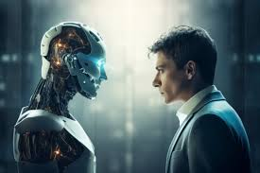
ABOUT HUMANOIDS :
Humanoids robots are designed to mimic human appearance and behavior.
They typically have a head, arms and legs, enabling them to perform tasks that require a human like form.
Humanoids robots are used in various fields From customer service and healthcare to research and entertainment.
Advance sensors and artificial intelligence to interact with people and adapt to different environments.

Slide 7
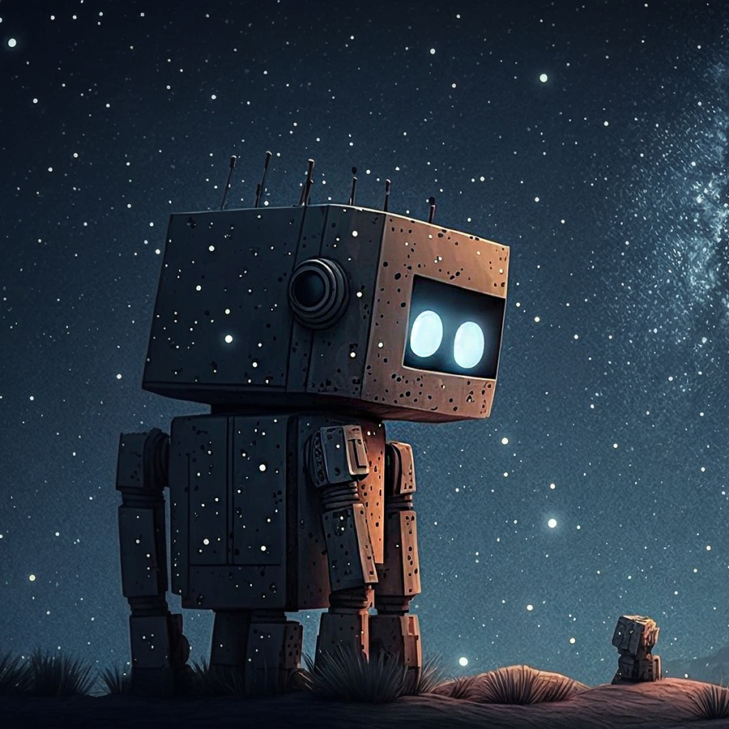
ABOUT SPACE ROBOT :
Space robots are specialized machines designed to operate in the challenging conditions of outer space.
These robots are used for various tasks such as exploring distant planets, servicing satellites, assembling space stations, and assisting during missions.
Space robots are essential tools for space exploration and operations, enabling humanity to reach further enhancing safety and efficiency.

Slide 8
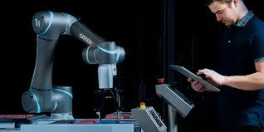
ABOUT COLLABORATIVE ROBOT :
Collaborative robots are robots designed to work alongside human in a shared workspace.
Collaborative robots are known as co-robots.
Co-robots are built with features that make them safe for direct interaction with humans.
They are increasingly being used to various industries due to their flexibility, ease of programming, and ability to safely assist Human in performing tasks.

Slide 9
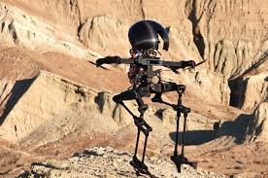
ABOUT HYBRID ROBOT :
Hybrid robots are robotic systems that combine different types of functions or technologies to enhance their capabilities.
They can switch between various modes of operation, making them adaptable to a wide range of environments and missions.

Slide 10
THANK YOU

