Slide 1
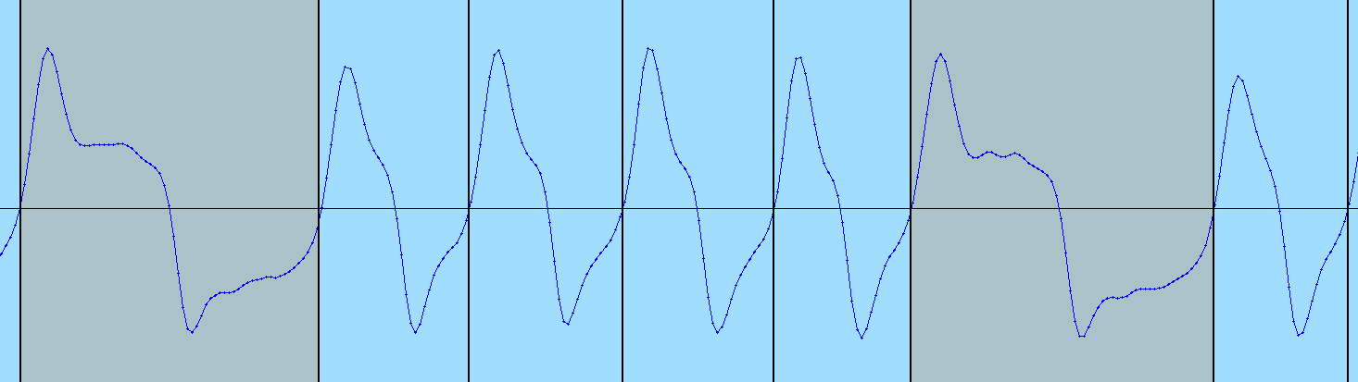
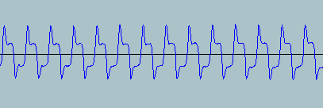
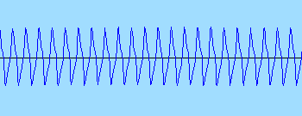
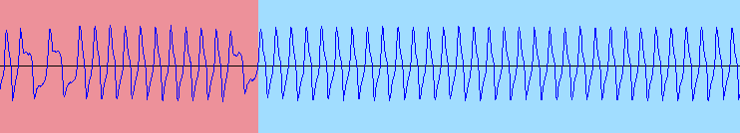
silence
tuning rampup, low freq
tuning steady, low freq
header #1, mixed freq
high freq
header #2, mixed freq
spacer arc
low freq
data, mixed freq
high freq
closing, mixed freq
closing arc
silence

