Slide 1
Underwater Scene
Jander Nascimento, Oleg Iegorov

Slide 2
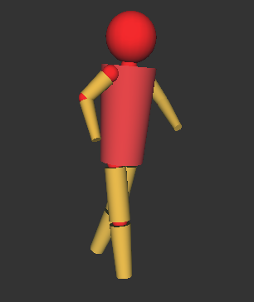
Modelling of a deep-sea diver
Procedural modeling was used (our diver is just a set of spheres and cylinders)

Slide 3
Animation of a deep-sea diver
Procedural animation is used
The key frames at the specific times are defined in an XML file
The objects are interpolated between the keyframes (rotation and/or translation are possible)
The hierarchical structure of elements is maintained

Slide 4
Animation of a deep-sea diver (cont.)
An excerpt from XML file:
<Node>
  <KeyFrame time=”25”>
    <TranslationKeyFrame x=”1.0” y=”0.0” z=”0.0”>
  </KeyFrame>
  ...
</Node>
All objects in this Node change their positions to (1,0,0) at time 25
Their transitive positions are interpolated

Slide 5
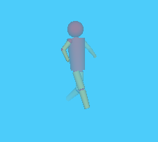
Light Scattering
We use standard GL_FOG
Specify the params (color, start/end positions)

Slide 6
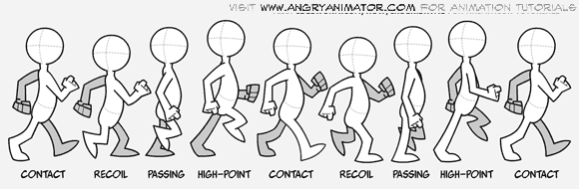
Articulated Animation
Use the procedural animation described before
The following are the used keyframes:

Slide 7
Texture
Specification
  2D texture
  No bumping map
  Loaded from a bitmap image
Results
  Plain image
  Bounding box

Slide 8
Texture on XML
<PlanTexture
index="1"
filepathname="img/turtle.bmp"
bottomleft_x="-1.0" bottomleft_y="-1.0" bottomleft_z="-1.0"
bottomright_x="-2.0" bottomright_y="1.0" bottomright_z="-1.0"
topright_x="-2.0" topright_y="1.0" topright_z="1.0"
topleft_x="-1.0" topleft_y="-1.0" topleft_z="1.0">
</PlanTexture>

Slide 9
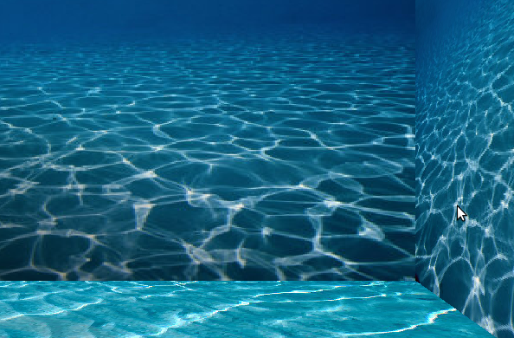
Texture - Example

Slide 10
Rope
Physically-based animation
Spring to attach each particle
Custom Stiffness, Gravity, Viscosity to increase realism
Two attached points: diver's head and the sea surface

Slide 11
Fish Flock
Implemented using Boids algorithm (Craig Reynolds, SIGGRAPH'87)
Simple rules for independent boids – complex rule for a flock:
1) Separation
2) Cohesion
3) Alignment

Slide 12
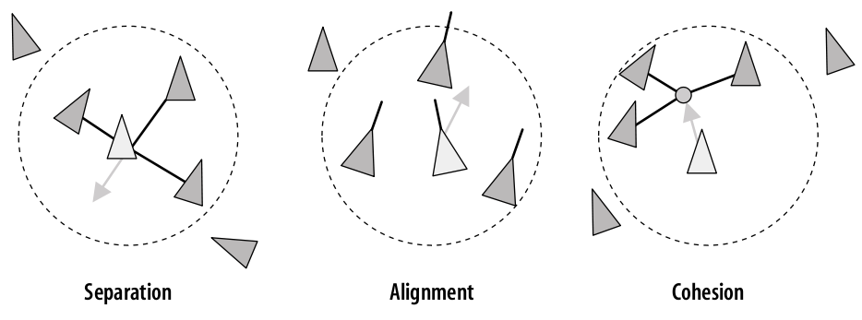
Fish Flock (Cont.)

