Slide 1
Sinfonia: A New Paradigm for Building Scalable Distributed Systems
Marcos K. Aguilera, Arif Merchant, Mehul Shah, Alistair Veitch, Christos Karamanolis
HP Laboratories and VMware
- presented by Mahesh Balakrishnan
*Some slides stolen from Aguilera’s SOSP presentation

Slide 2
Motivation
Datacenter Infrastructural Apps
  Clustered file systems, lock managers, group communication services…
Distributed State
Current Solution Space:
  Message-passing protocols: replication, cache consistency, group membership, file data/metadata management
  Databases: powerful but expensive/inefficient
  Distributed Shared Memory: doesn’t work!

Slide 3
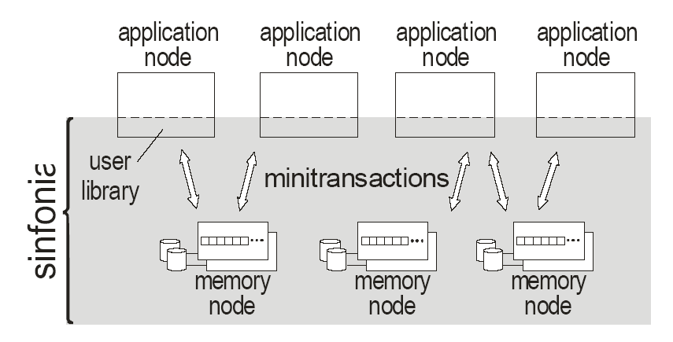
Sinfonia
Distributed Shared Memory as a Service
Consists of multiple memory nodes exposing flat, fine-grained address spaces
Accessed by processes running on application nodes via user library

Slide 4
Assumptions
Assumptions: Datacenter environment
  Trustworthy applications, no Byzantine failures
  Low, steady latencies
  No network partitions
Goal: help build infrastructural services
  Fault-tolerance, Scalability, Consistency and Performance

Slide 5
Design Principles
Principle 1: Reduce operation coupling to obtain scalability. [flat address space]
Principle 2: Make components reliable before scaling them. [fault-tolerant memory nodes]
Partitioned address space: (mem-node-id, addr)
  Allows for clever data placement by application (clustering / striping)

Slide 6
Piggybacking Transactions
2PC Transaction: coordinator + participants
  Set of actions followed by 2-phase commit
Can piggyback if:
  Last action does not affect coordinator’s abort/commit decision
  Last action’s impact on coordinator’s abort/commit decision is known by participant
Can we piggyback entire transaction onto 2-phase commit?

Slide 7
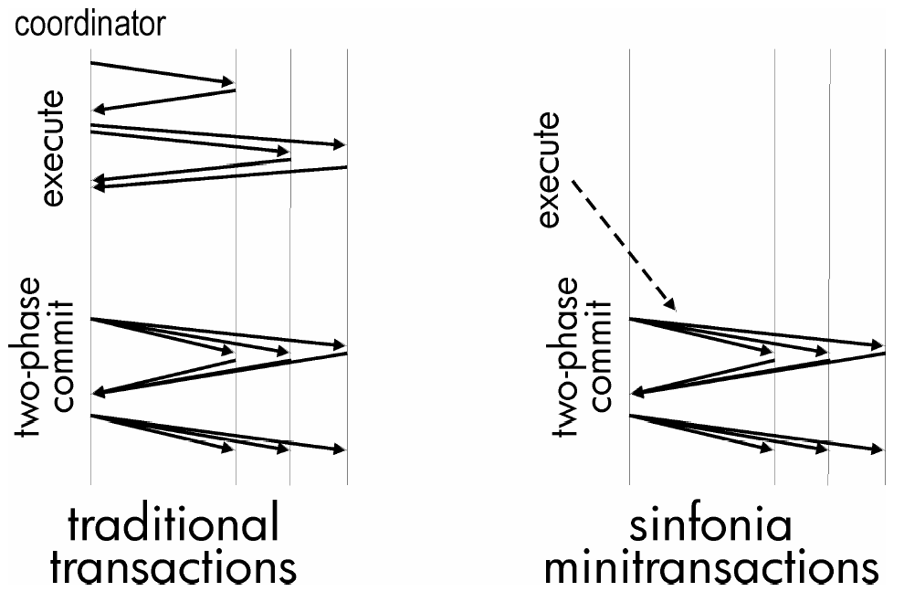
Minitransactions

Slide 8
Minitransactions
Consist of:
  Set of compare items
  Set of read items
  Set of write items
Semantics:
  Check data in compare items (equality)
  If all match, then:
    Retrieve data in read items
    Write data in write items
  Else abort

Slide 9
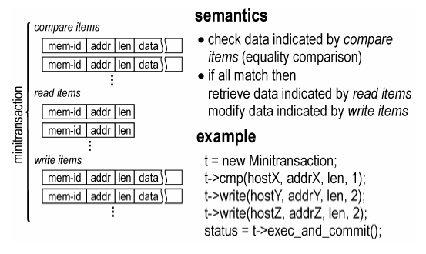
Minitransactions

Slide 10
Example Minitransactions
Examples:
  Swap
  Compare-and-Swap
  Atomic read of many data
  Acquire a lease
  Acquire multiple leases
  Change data if lease is held
Minitransaction Idioms:
  Validate cache using compare items and write if valid
  Use compare items to validate data without read/write items; commit indicates validation was successful for read-only operations
How powerful are minitransactions?

Slide 11
Other Design Choices
Caching: none
  Delegated to application
  Minitransactions allow developer to atomically validate cached data and apply writes
Load-Balancing: none
  Delegated to application
  Minitransactions allow developer to atomically migrate many pieces of data
  Complications? Changes address of data…

Slide 12
Fault-Tolerance
Application node crash → No data loss/inconsistency
Levels of protection:
  Single memory node crashes do not impact availability
  Multiple memory node crashes do not impact durability (if they restart and stable storage is unaffected)
  Disaster recovery
Four Mechanisms:
  Disk Image – durability
  Logging – durability
  Replication – availability
  Backups – disaster recovery

Slide 13
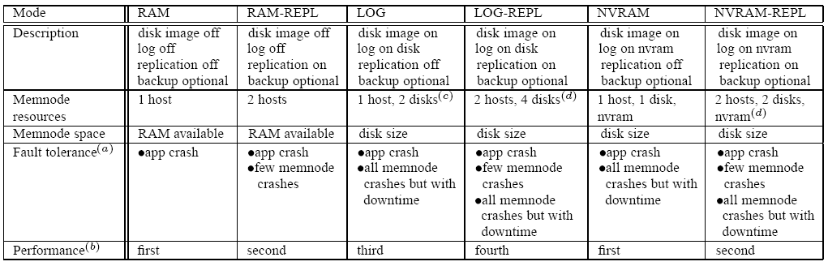
Fault-Tolerance Modes

Slide 14
Fault-Tolerance
Standard 2PC blocks on coordinator crashes
  Undesirable: app nodes fail frequently
  Traditional solution: 3PC, extra phase
Sinfonia uses dedicated backup ‘recovery coordinator’
Block on participant crashes
  Assumption: memory nodes always recover from crashes (from principle 1…)
Single-site minitransaction can be done as 1PC

Slide 15
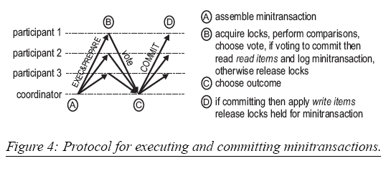
Protocol Timeline
Serializability: per-item locks – acquire all-or-nothing
  If acquisition fails, abort and retry transaction after interval
What if coordinator fails between phase C and D?
  Participant 1 has committed, 2 and 3 have not …
  But 2 and 3 cannot be read until recovery coordinator triggers their commit → no observable inconsistency

Slide 16
Recovery from coordinator crashes
Recovery Coordinator periodically probes memory node logs for orphan transactions
Phase 1: requests participants to vote ‘abort’; participants reply with previous existing votes, or vote ‘abort’
Phase 2: tells participants to commit i.f.f all votes are ‘commit’
Note: once a participant votes ‘abort’ or ‘commit’, it cannot change its vote → temporary inconsistencies due to coordinator crashes cannot be observed

Slide 17
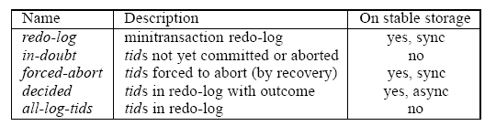
Redo Log
Multiple data structures
Memory node recovery using redo log
Log garbage collection
  Garbage collect only when transaction has been durably applied at every memory node involved

Slide 18
Additional Details
Consistent disaster-tolerant backups
  Lock all addresses on all nodes (blocking lock, not all-or-nothing)
Replication
  Replica updated in parallel with 2PC
  Handles false failovers – power down the primary when fail-over occurs
Naming
  Directory Server: logical ids to (ip, application id)
Notes:
Why application id, why not offset?

Slide 19
SinfoniaFS
Cluster File System:
  Cluster nodes (application nodes) share a common file system stored across memory nodes
Sinfonia simplifies design:
  Cluster nodes do not need to be aware of each other
  Do not need logging to recover from crashes
  Do not need to maintain caches at remote nodes
  Can leverage write-ahead log for better performance
Exports NFS v2: all NFS operations are implemented by minitransactions!

Slide 20
SinfoniaFS Design
Inodes and data blocks (16 KB), chaining-list blocks
Cluster nodes can cache extensively
  Validation occurs before use via compare items in minitransactions.
  Read-only operations require only compare items; if transaction aborts due to mismatch, cache is refreshed before retry
Node locality: inode, chaining list and file collocated
Load-balancing
  Migration not implemented

Slide 21
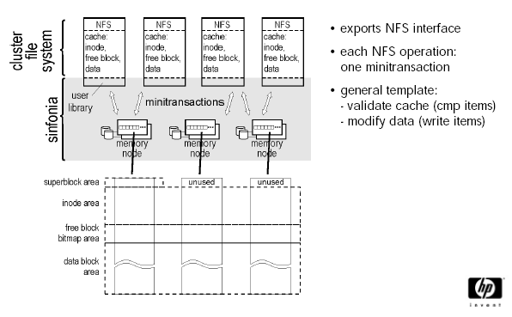
SinfoniaFS Design

Slide 22
SinfoniaGCS
Design 1: Global queue of messages
  Write: find tail, add to it
  Inefficient – retries require message resend
Better design: Global queue of pointers
  Actual messages stored in per-member queues
  Write: add msg to data queue, use minitransaction to add pointer to global queue
Metadata: view, member queue locations
Essentially provides totally ordered broadcast

Slide 23
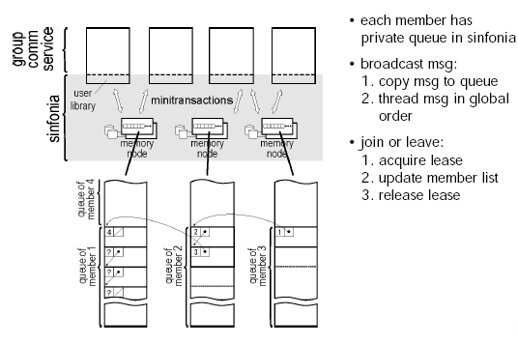
SinfoniaGCS Design

Slide 24
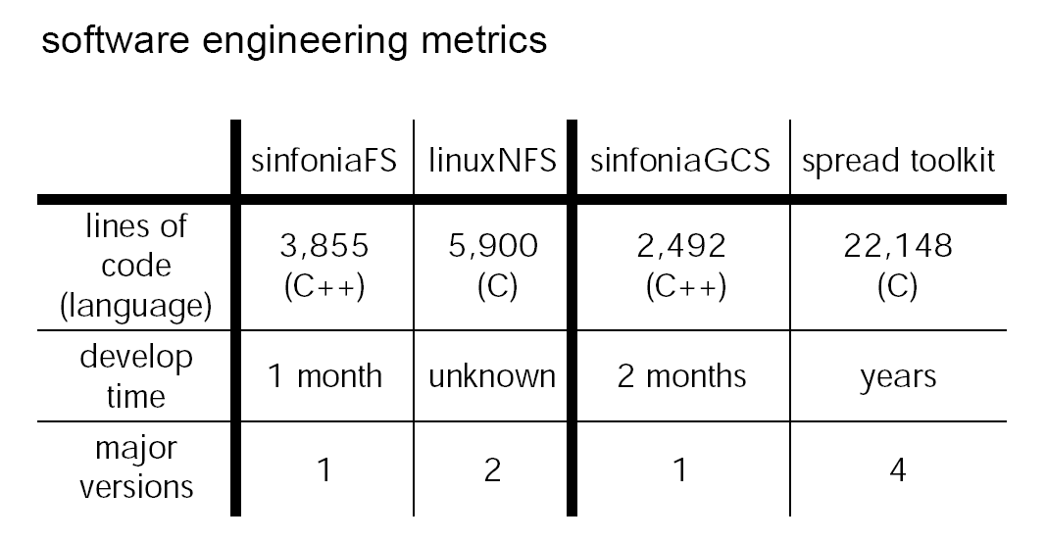
Sinfonia is easy-to-use

Slide 25
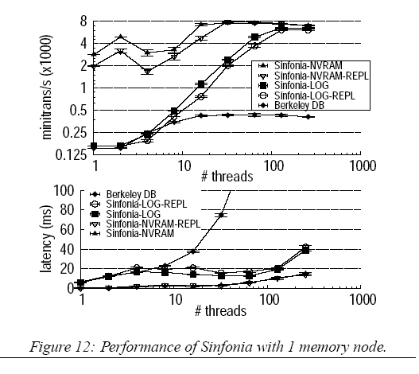
Evaluation: base performance
Multiple threads on single application node accessing single memory node
6 items from 50,000
Comparison against Berkeley DB: address as key
B-tree contention
Notes:
NV-RAM mode is just RAM --- not fair comparison with DB, but good scalability indicator
Peak bottleneck is cpu at application node
Latency of Log is longer, hence throughput lower for lower numbers of threads
B-Tree contention causes peak throughput of berkeleydb to be low: using a database as a hashtable, plus page-level locking

Slide 26
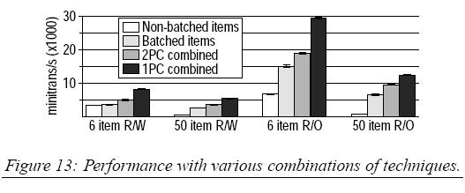
Evaluation: optimization breakdown
Non-batched items: standard transactions
Batched items: Batch actions + 2PC
2PC combined: Sinfonia multi-site minitransaction
1PC combined: Sinfonia single-site minitransaction
Notes:
32 threads, 4 memory nodes, 4 application nodes, 50000 items
For 1PC graph, do they explicitly select all items from single node or just optimize when this is the case?

Slide 27
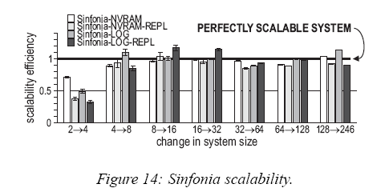
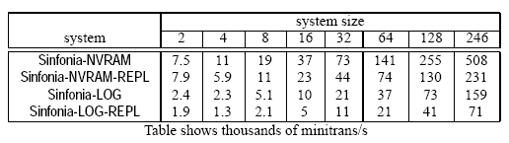
Evaluation: scalability
Aggregate throughput increases as memory nodes are added to the system
System size n → n/2 memory nodes and n/2 application nodes
Each minitransaction involves six items and two memory nodes (except for system size 2)
Notes:
From 2->4 we lose 1PC, hence not perfectly scalabl

Slide 28
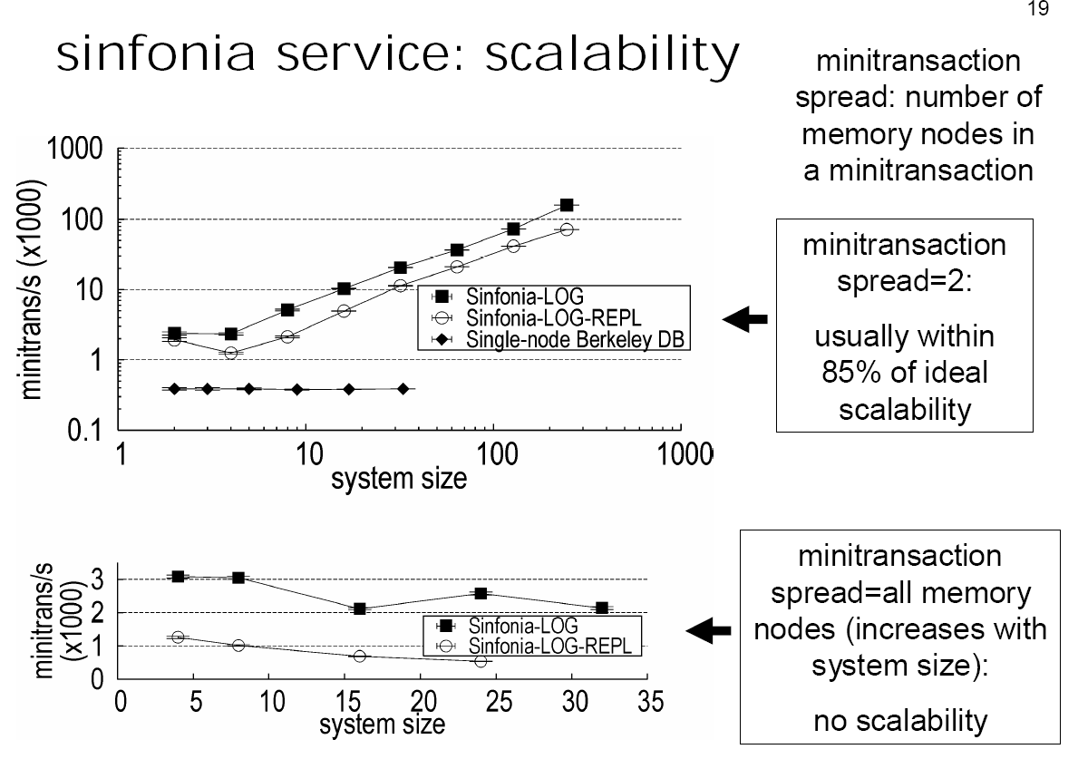
Evaluation: scalability
Notes:
Focus each minitransaction into single site, spread minitransactions across sites

Slide 29
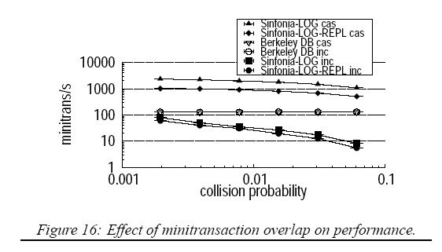
Effect of Contention
Total # of items reduced to increase contention
Compare-and-Swap, Atomic Increment (validate + write)
Operations not directly supported by minitransactions suffer under contention due to lock retry mechanism
Notes:
8 items, sinfonia minitransaction spread = 2

Slide 30
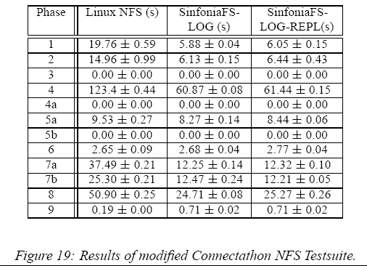
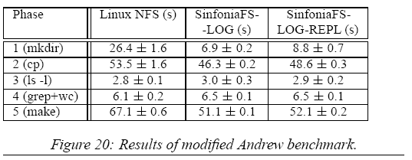
Evaluation: SinfoniaFS
Comparison of single-node Sinfonia with NFS
Notes:
Nfsv2 in ordered journaling mode
Connectathon is metadata intensive
Performs worse in read-intensive phases where NFS kernel implementation gives it edge

Slide 31
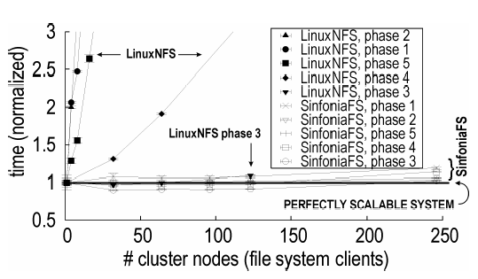
Evaluation: SinfoniaFS
Notes:
Phase 3 uses data cached at clients, everything else is against a single NFS server

Slide 32
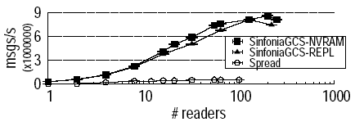
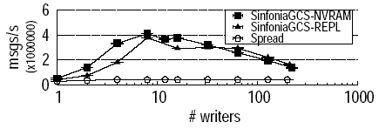
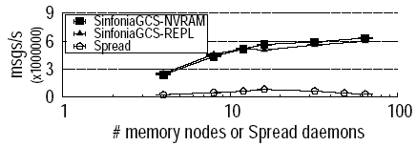
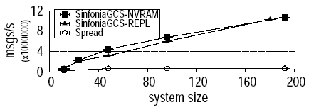
Evaluation: SinfoniaGCS
Notes:
Top left: 8 writers and 8 memory nodes/daemons
Top right: 16 readers, 8 memory nodes/daemons
Bottom left: 32 readers, 64 writers

Slide 33
Discussion
No notification functionality
  In a producer/consumer setup, how does consumer know data is in the shared queue?
Rudimentary Naming
No Allocation / Protection mechanisms
SinfoniaGCS/SinfoniaFS
  Are comparisons fair?

Slide 34
Discussion
Does shared storage have to be infrastructural?
  Extra power/cooling costs of a dedicated bank of memory nodes
  Lack of fate-sharing: application reliability depends on external memory nodes
Transactions versus Locks
What can minitransactions (not) do?

Slide 35
Conclusion
Minitransactions
  fast subset of transactions
  powerful (all NFS operations, for example)
Infrastructural approach
  Dedicated memory nodes
  Dedicated backup 2PC coordinator
  Implication: fast two-phase protocol can tolerate most failure modes

