Slide 1







$${\hat{a}}_{z}$$
$${\hat{a}}_{φ}$$
$${\hat{a}}_{r}$$
$$r$$
$$ℓ$$
$$ε_{ri},μ_{ri}$$
$$ε_{ro},μ_{ro}$$

Slide 2
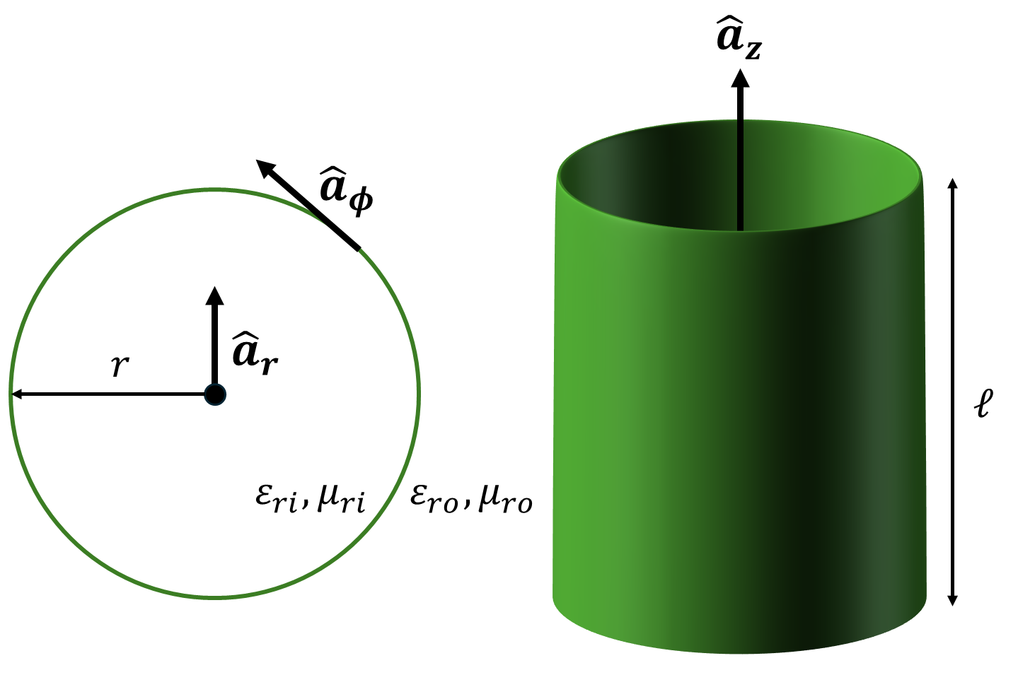

Slide 4

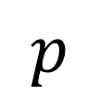

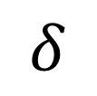

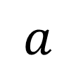

$$δ$$
$$p$$
$$a$$
$$ψ$$
$${\hat{a}}_{r}$$
$${\hat{a}}_{z}$$
$${\hat{a}}_{φ}$$

Slide 5
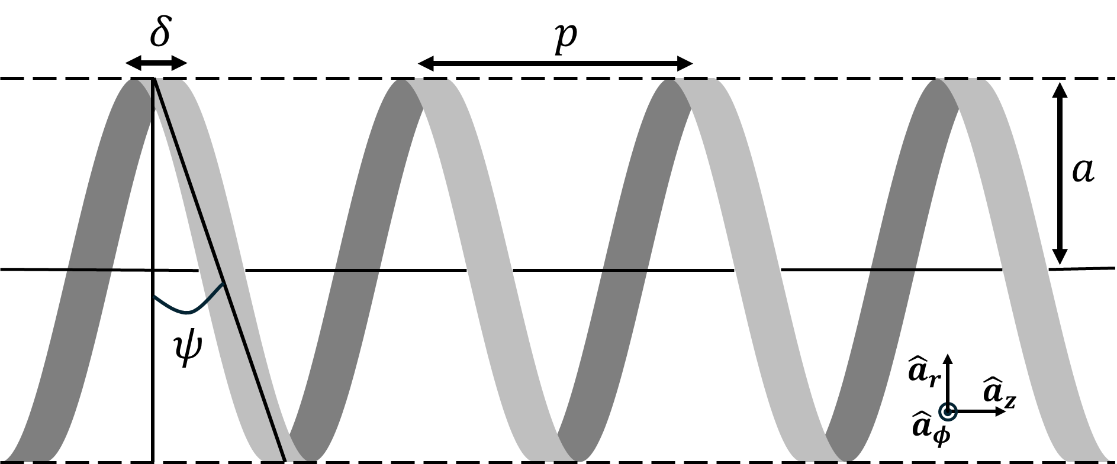

Slide 6
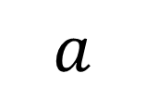
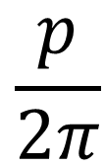


$$\sqrt{a^{2}+{\left(\frac{p}{2π}\right)}^{2}}$$
$$ψ$$
$$a$$
$$\frac{p}{2π}$$

Slide 7
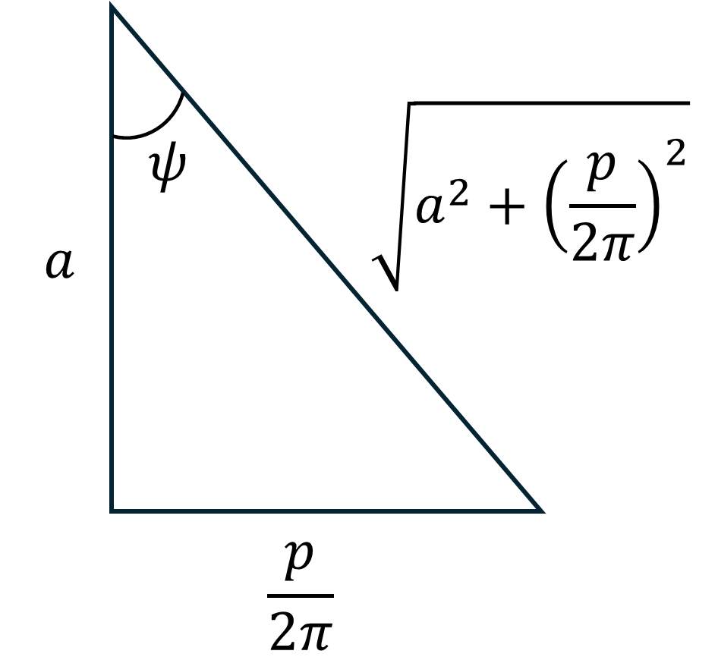

Slide 8
Sheath Helix Interpretation #1

Slide 9
$$δ$$
$$p$$

Slide 10
$$δ$$
$$p$$

Slide 11
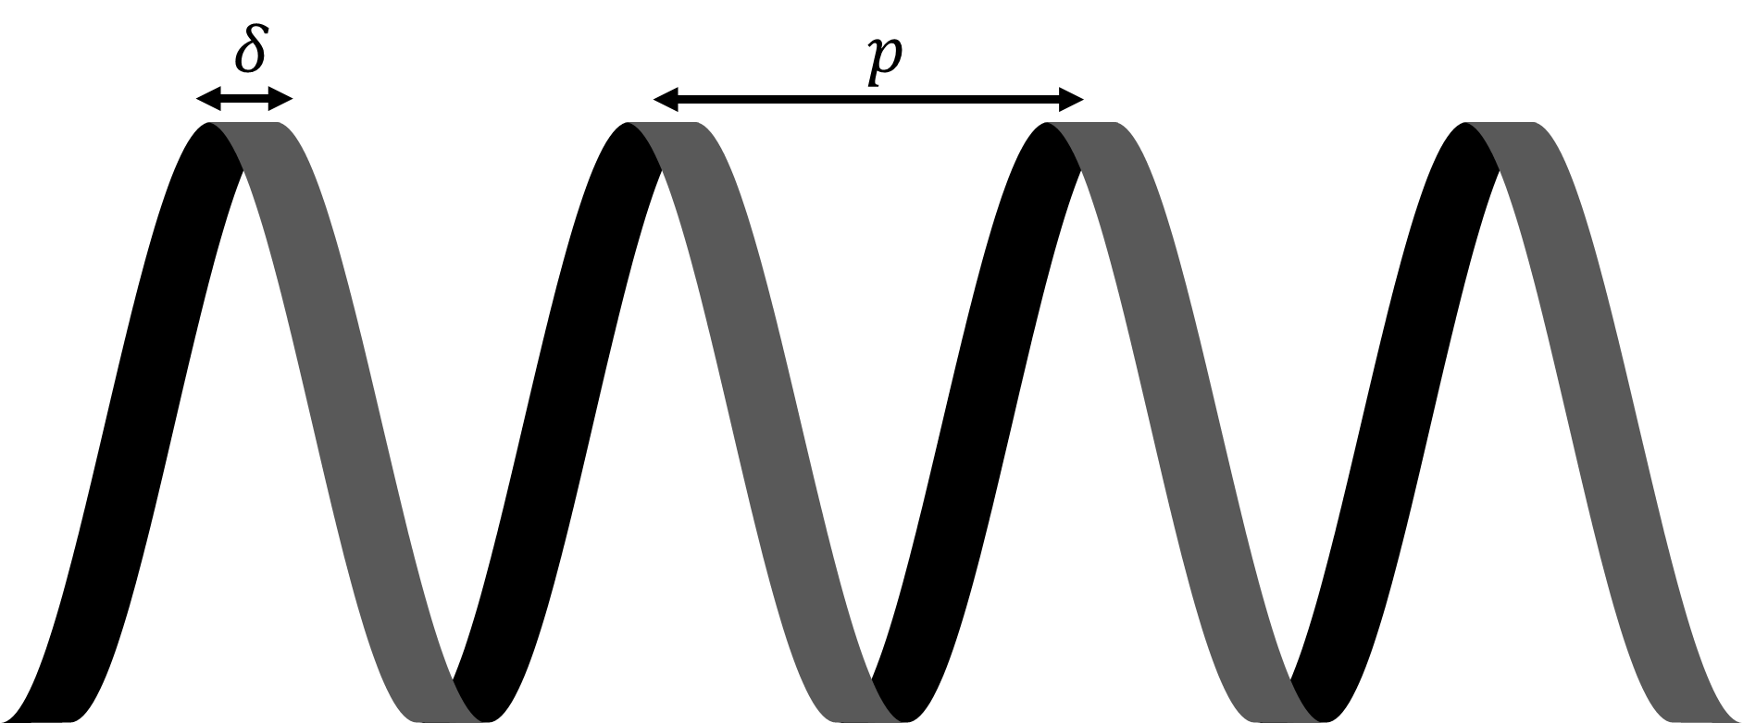
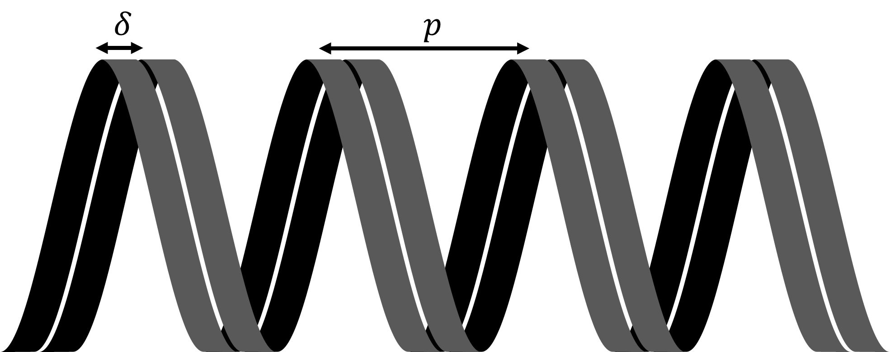
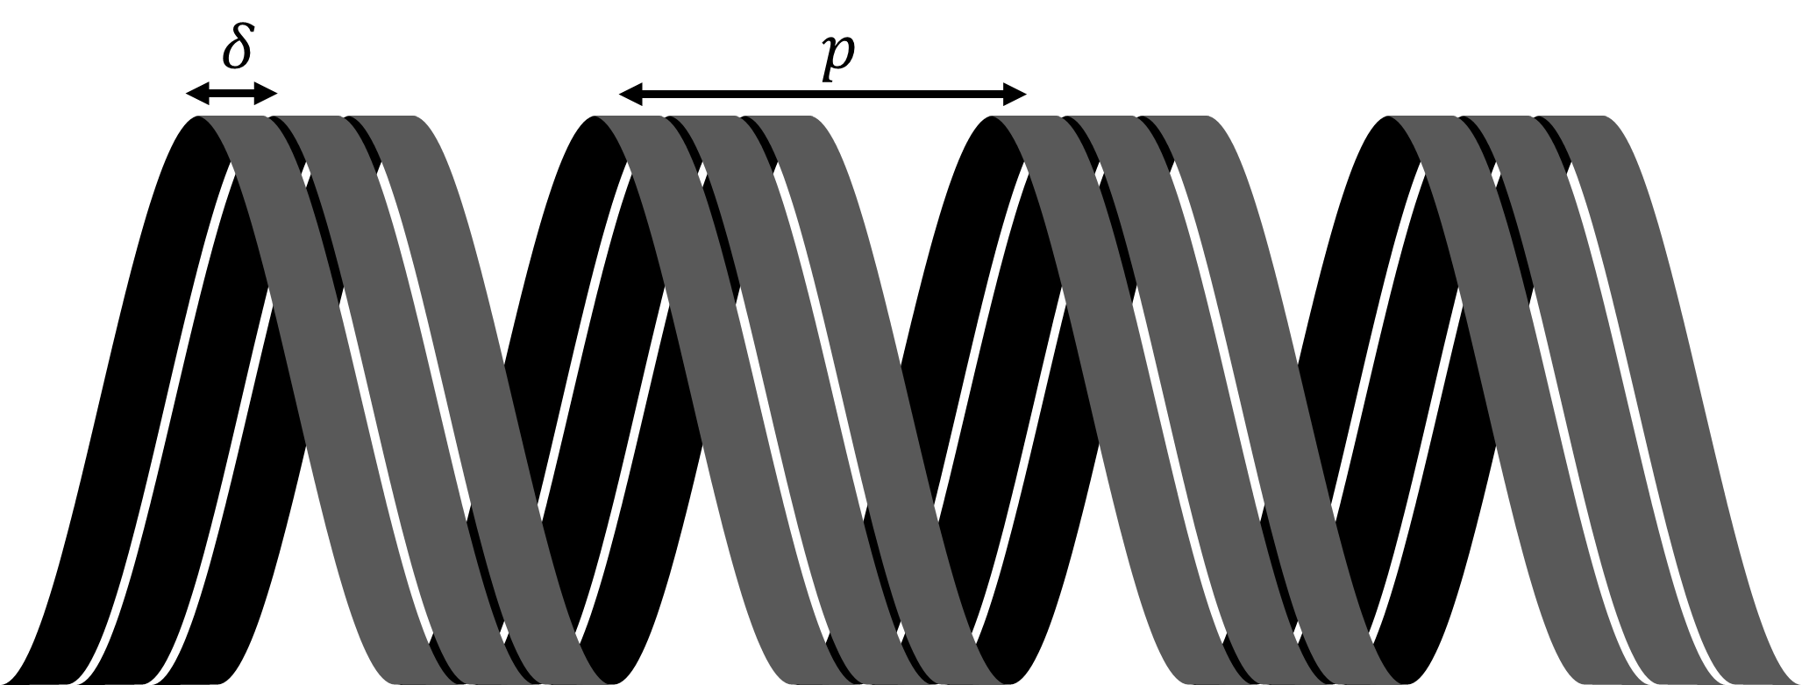
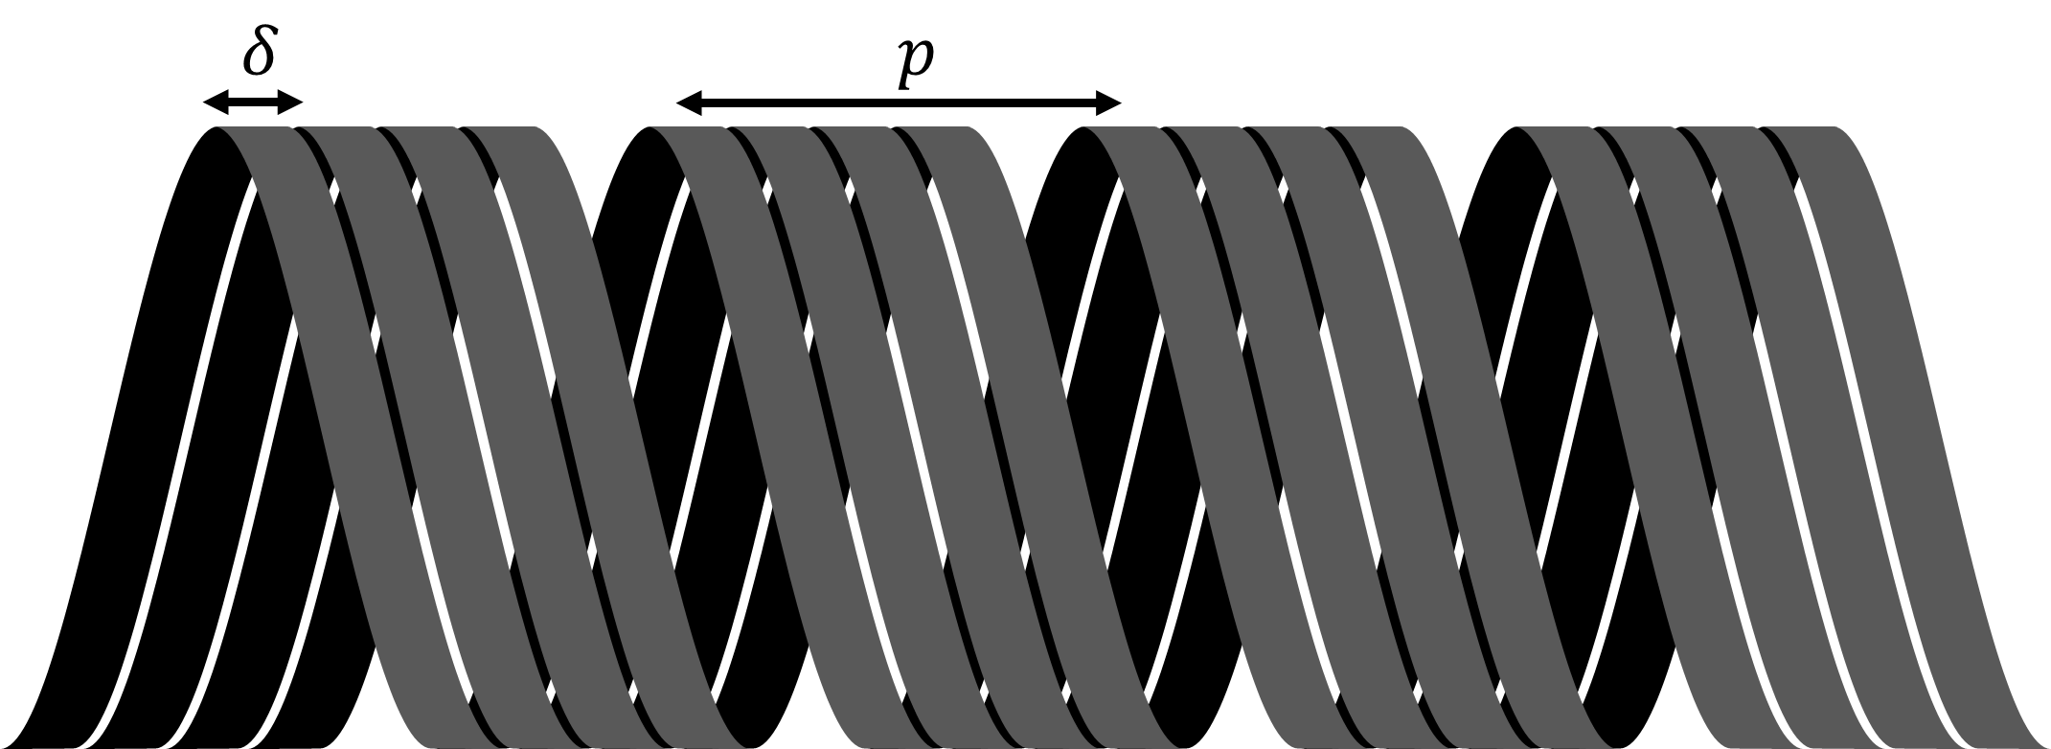

Slide 12
$$δ$$
$$p$$

Slide 13
$$δ$$
$$p$$

Slide 14
Sheath Helix Interpretation #2

Slide 15
$$δ$$
$$p$$

Slide 16
$$δ$$
$$p$$

Slide 17



$$r_{c}$$
$$a$$
$$b$$

Slide 18
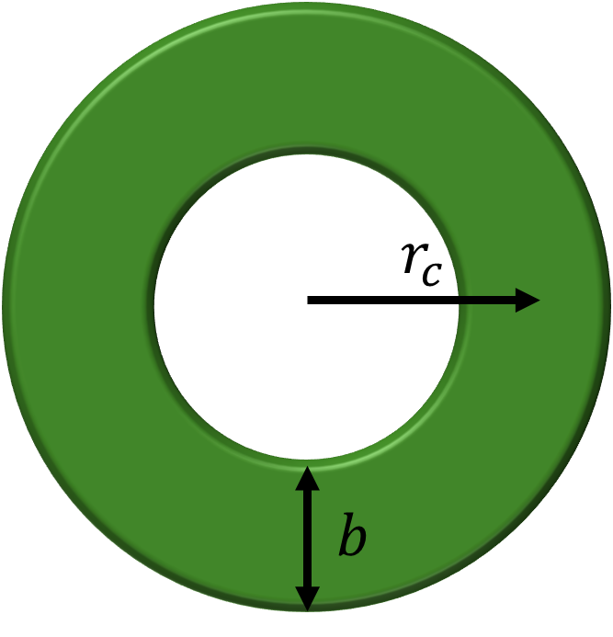
$$a$$

Slide 19
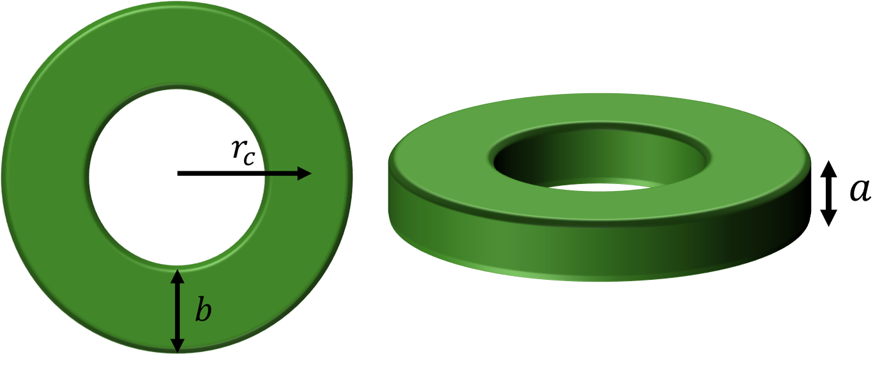

Slide 20
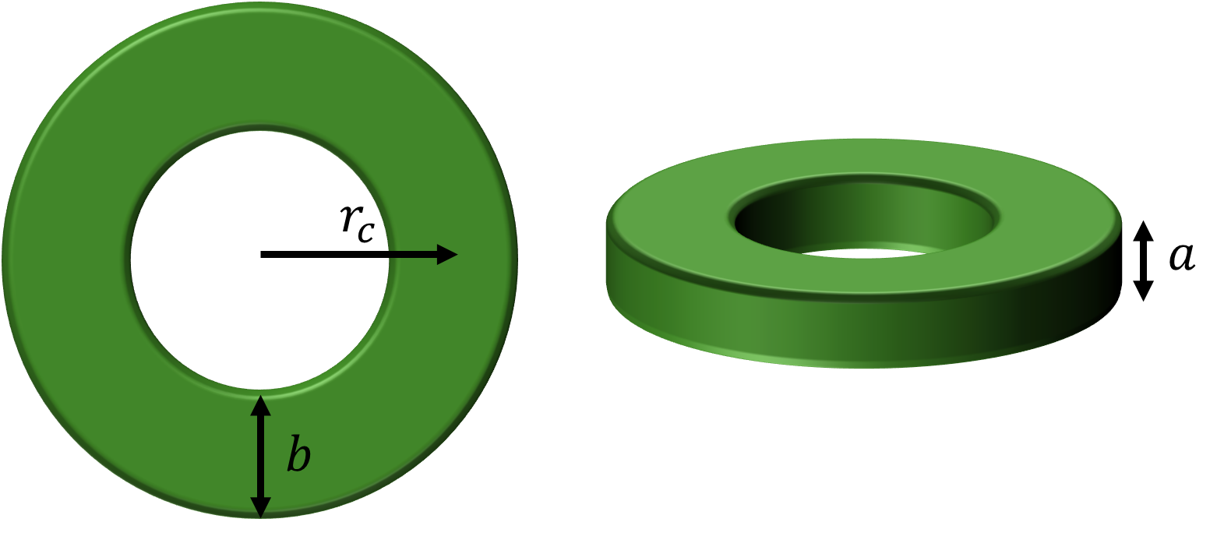
$$a$$

Slide 21




$${\hat{a}}_{z}$$
conductive sheath
$$l_{c}$$
$$a$$
$$b$$

Slide 22
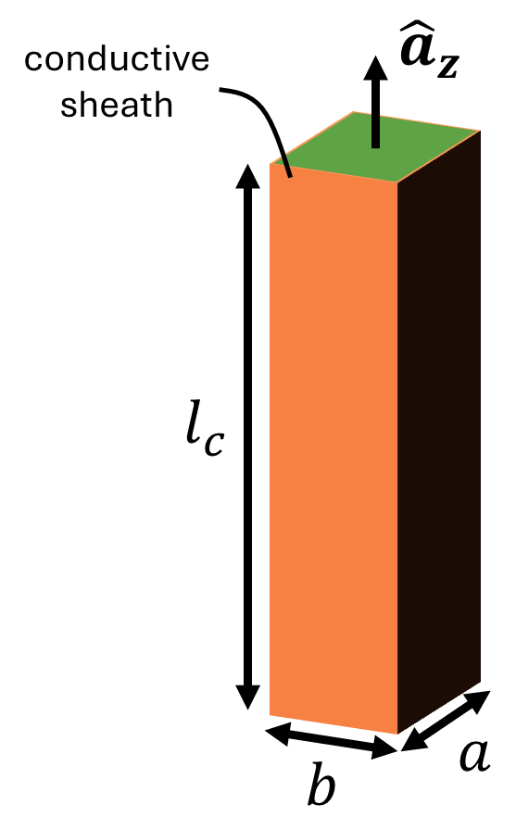

Slide 23






$$ε_{rc},μ_{rc}$$
$$ε_{rd},μ_{0}$$
$$r_{c}$$
$$r_{b}$$
$$r_{a}$$
$$ε_{0},μ_{0}$$

Slide 24



$$l$$
$$p$$
$$r_{c}$$

Slide 25
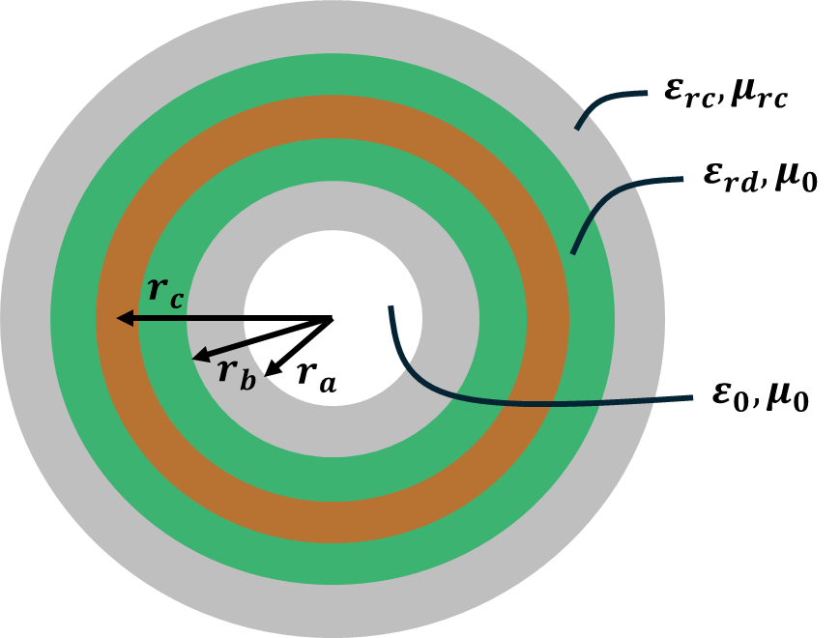

Slide 26
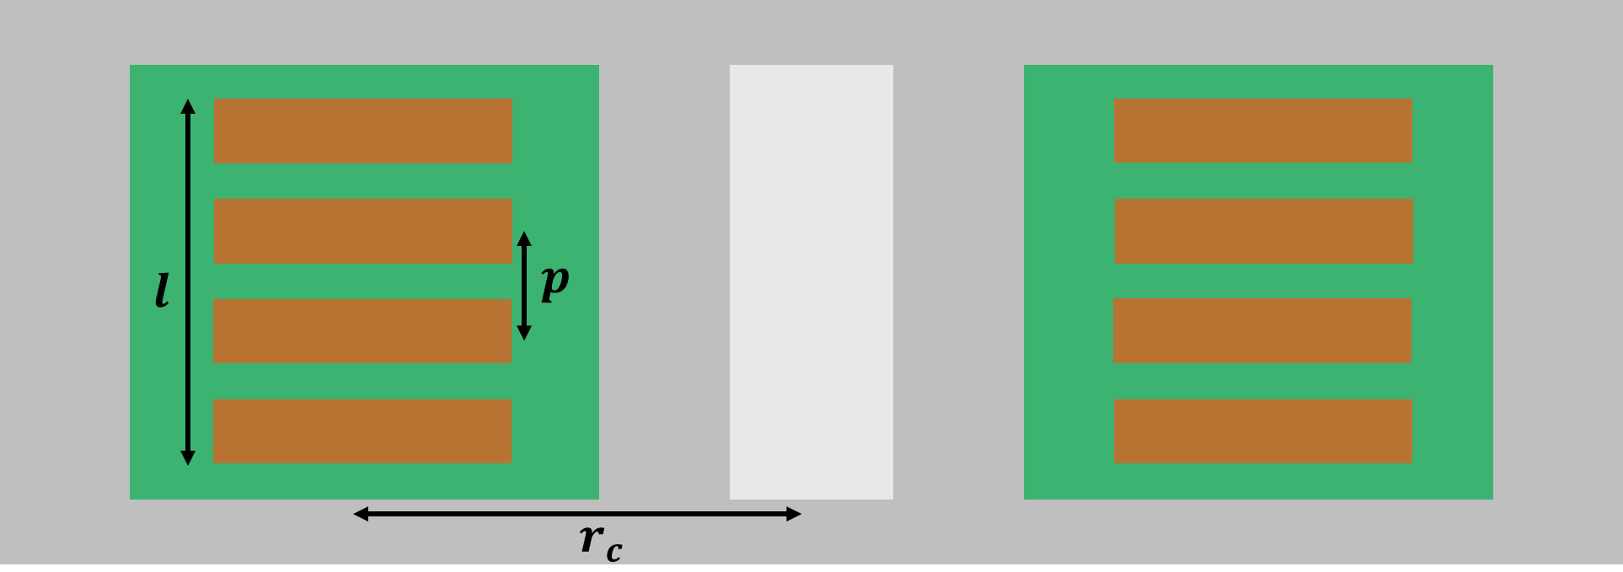

Slide 27
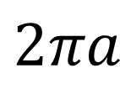
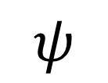

$$ψ$$
$$2πa$$
$$s$$

