Slide 1
PIZZAGATE
Predicting and Preventing Pizza Delivery Delays
A Data Analytics Project
Team RAD
ITEC 460 - Business Intelligence
Professor Gwanhoo Lee
Notes:
Welcome everyone. We're Team RAD for research, analytics, and decisions, presenting our analysis on pizza delivery delays - a project we've called Pizzagate. Over the next 15 minutes, we'll show you what's driving delivery delays in our network and what we can do about it.

Slide 2
Meet the Team
1
Sultan Al Nahyan
Lead Analyst | Data Cleaning | Predictive Modeling
2
Jordan Anderson
Tableau Developer | Product Analysis
3
Eitan Toubia
Tableau Developer | Time-Series Analysis
4
Ali Filali
Gen AI Visualizations | Visual Storytelling
5
Jarvis (AI)
Analytical Partner | Code Assistant | Reviewer
Team RAD | ITEC 460 | Pizzagate
2
Notes:
Quick introduction to our team. Each member contributed unique skills - Sultan led the data cleaning and predictive modeling work, Jordan and Eitan built our Tableau visualizations, and Ali handled our Gen AI work. We also worked closely with Jarvis, our AI assistant, throughout the project.

Slide 3
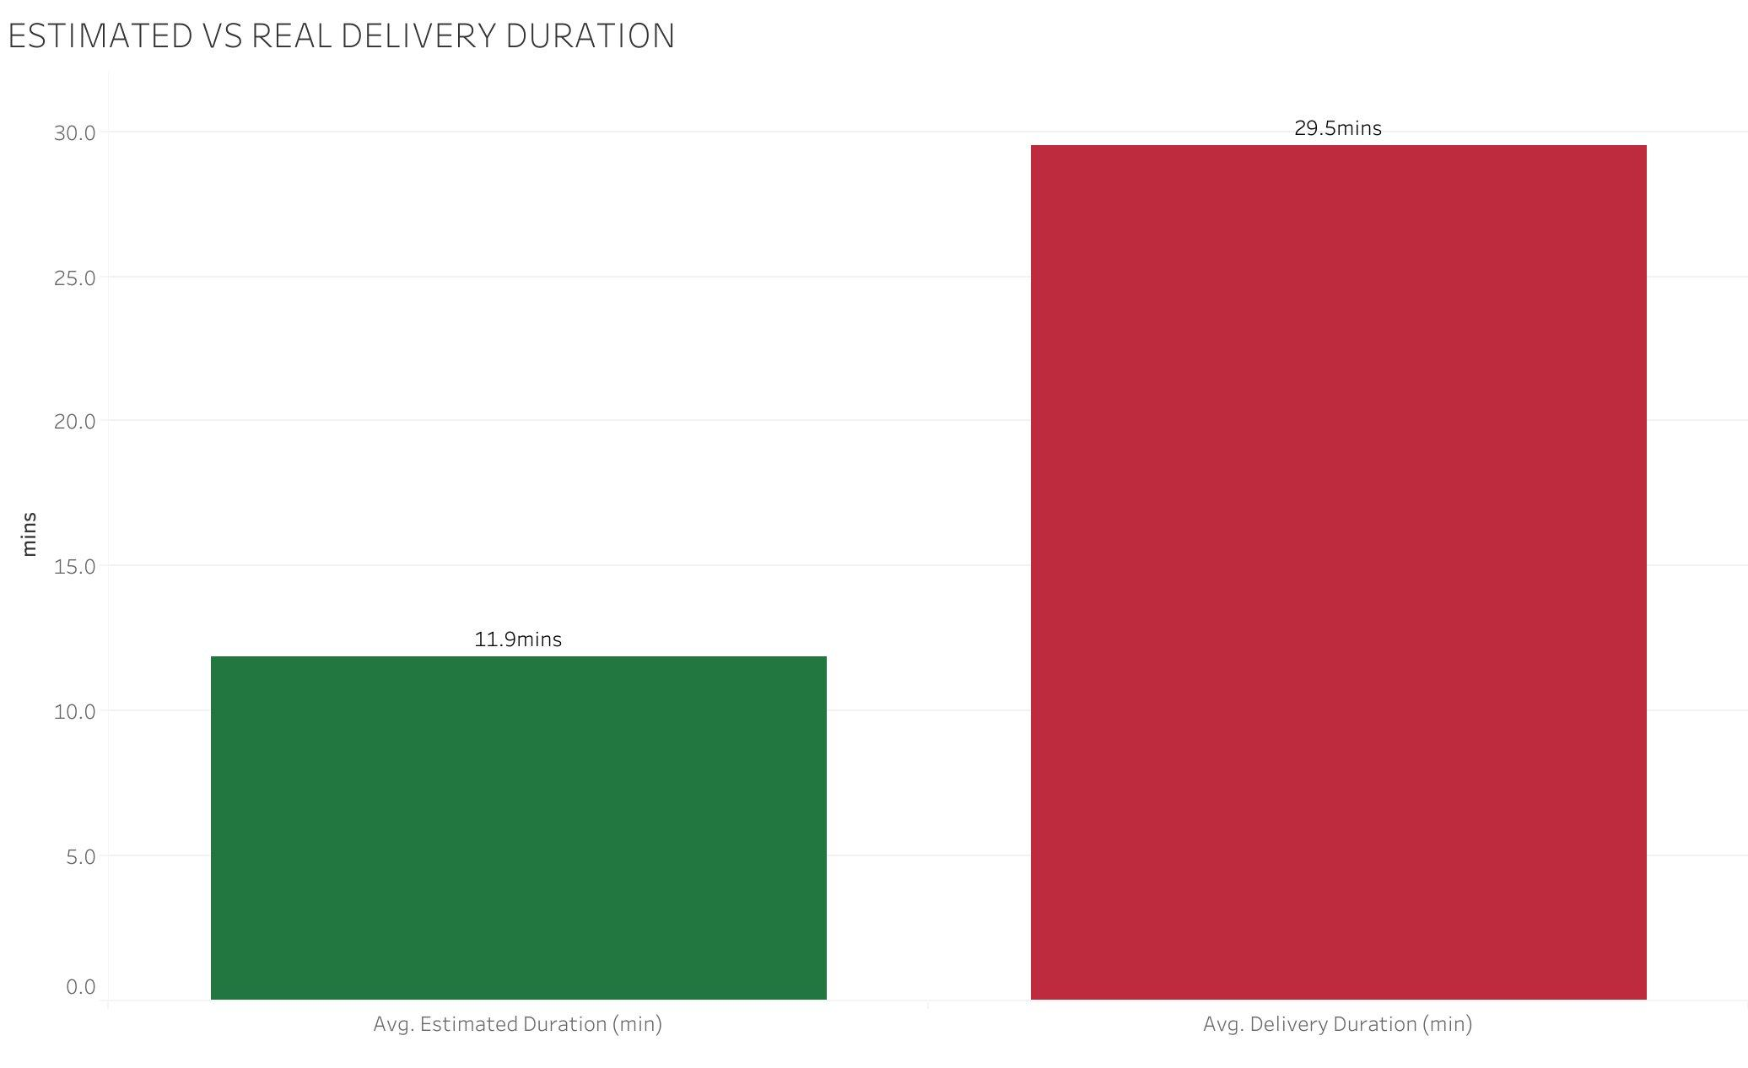
The Problem: We're Breaking Our Promises
Customers expect 12 minutes. We deliver in 30.
PRESENTING AS Data analytics team → TO Operations leadership at our delivery platform
17.6 min
AVERAGE GAP
between what we promise customers and what we actually deliver
This isn't just an operations issue, it's a credibility issue. Every broken ETA erodes customer trust.
Team RAD | ITEC 460 | Pizzagate
3
Notes:
Let's start with the problem. Our customers see an estimated delivery time of about 12 minutes when they place an order. The reality? They wait 30 minutes on average. That's a 17.6 minute gap between promise and reality. Across thousands of orders, this isn't just an operations issue - it's a credibility issue. Every broken ETA erodes customer trust. So our analysis sets out to answer: where does this gap come from, and what can we do about it?

Slide 4
Who We Serve & What We're Asking
Our role as the platform's analytics team
CENTRAL QUESTION
What operational and behavioral factors most predict pizza
delivery delays, and what should we do about it?
OUR STAKEHOLDERS
Dispatch & Drivers
Customer Experience
Executive Leadership
Restaurant Partners
Manages drivers, routing, and on-the-road decisions
Owns the app, ETA promises, and customer trust
Sets budget and decides where to invest resources
Brands like Domino's, Papa John's whose name is on the order
OUR ROLE Translate operational data into evidence-based recommendations leadership can act on.
Team RAD | ITEC 460 | Pizzagate
4
Notes:
Our central question, framed as the platform's analytics team: what operational and behavioral factors most predict pizza delivery delays, and what should we do about it? We're answering this for four stakeholder groups - Operations who runs day-to-day decisions, Product who owns the customer-facing ETA, Strategy for resource allocation, and our Restaurant Partners whose brands are affected. Our role throughout is to translate operational data into evidence-based recommendations leadership can act on.

Slide 5
About Our Data
IMPORTANT: This analysis uses a synthetic dataset for academic purposes. Patterns are realistic but data is generated.
1,004
5
Total Deliveries Analyzed
Restaurant Brands
84
21%
Locations Across U.S.
Overall Delay Rate
Data sources: Order timestamps, delivery durations, restaurant info, distance, traffic conditions, pizza characteristics
Team RAD | ITEC 460 | Pizzagate
5
Notes:
Quick note on our data: this is a synthetic dataset of 1,004 deliveries. The patterns we'll show are realistic but the data itself is generated for academic purposes. We have 5 restaurant brands across 84 locations, with about 21% of orders delayed overall - giving us a workable sample to investigate.

Slide 6
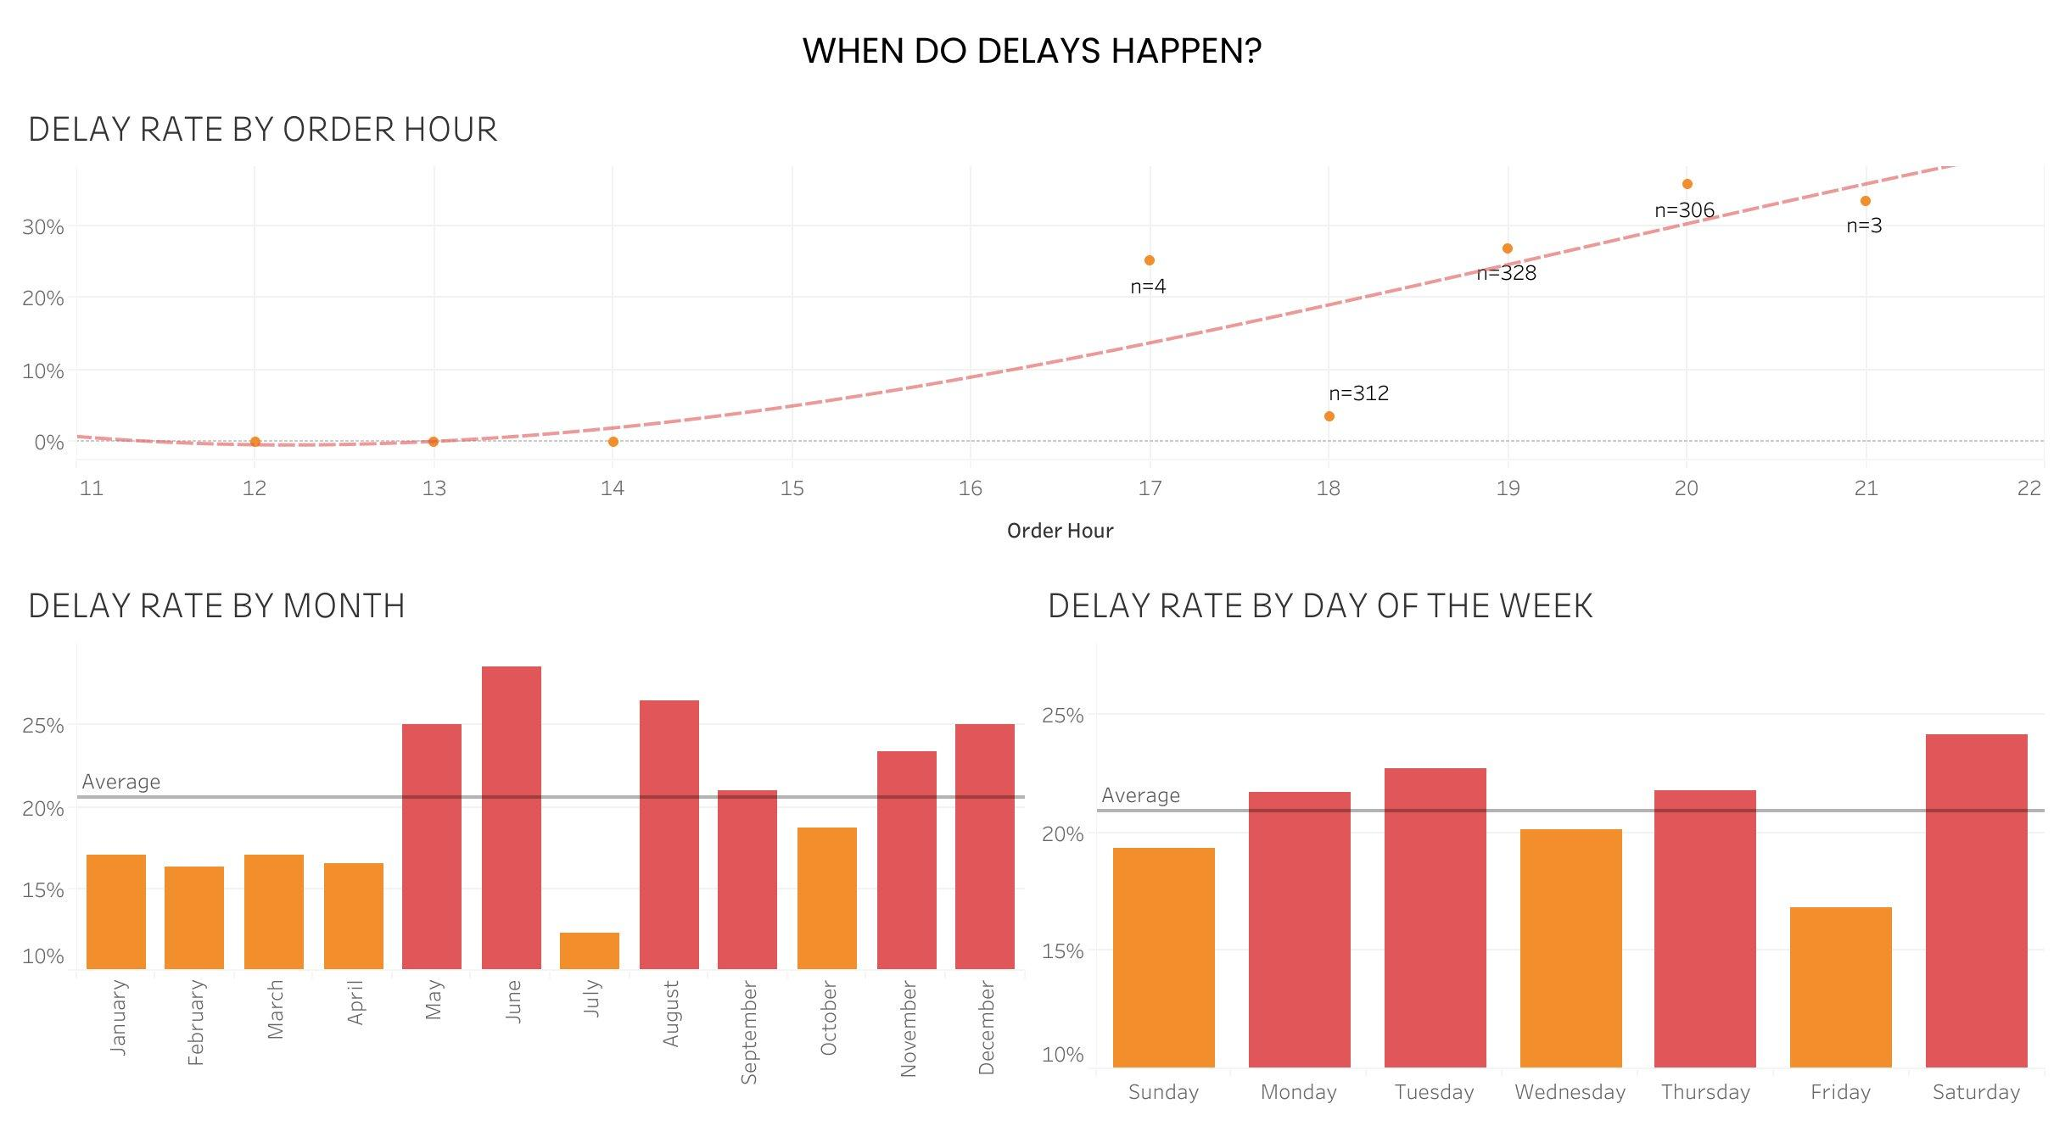
WHEN do delays happen?
Time-of-day is the strongest pattern; day-of-week is surprisingly flat
KEY TAKEAWAYS
HOUR
Delays climb steadily through the day, peaking ~8 PM
MONTH
Summer (May-Aug) and Dec are seasonal hotspots
DAY OF WEEK
Surprisingly flat — only 7 point spread
INSIGHT
Operational lever is time-of-day staffing, not day-of-week scheduling
BOTTOM LINE
Time-of-day is the strongest temporal pattern. Day-of-week is essentially flat, staffing decisions should be hour-driven, not day-driven.
Team RAD | ITEC 460 | Pizzagate
6
Notes:
First, when do delays happen. Three time scales here. Hour is the strongest pattern - delays climb steadily and peak around 8 PM. Months show clear seasonal hotspots in summer and December - likely tied to weather and holidays. But day of week is interesting - it's surprisingly flat. Only 7 percentage points between the best and worst day. The insight: our operational lever here is time-of-day staffing, not day-of-week scheduling. That's a finding by itself - it tells leadership where NOT to spend time.

Slide 7
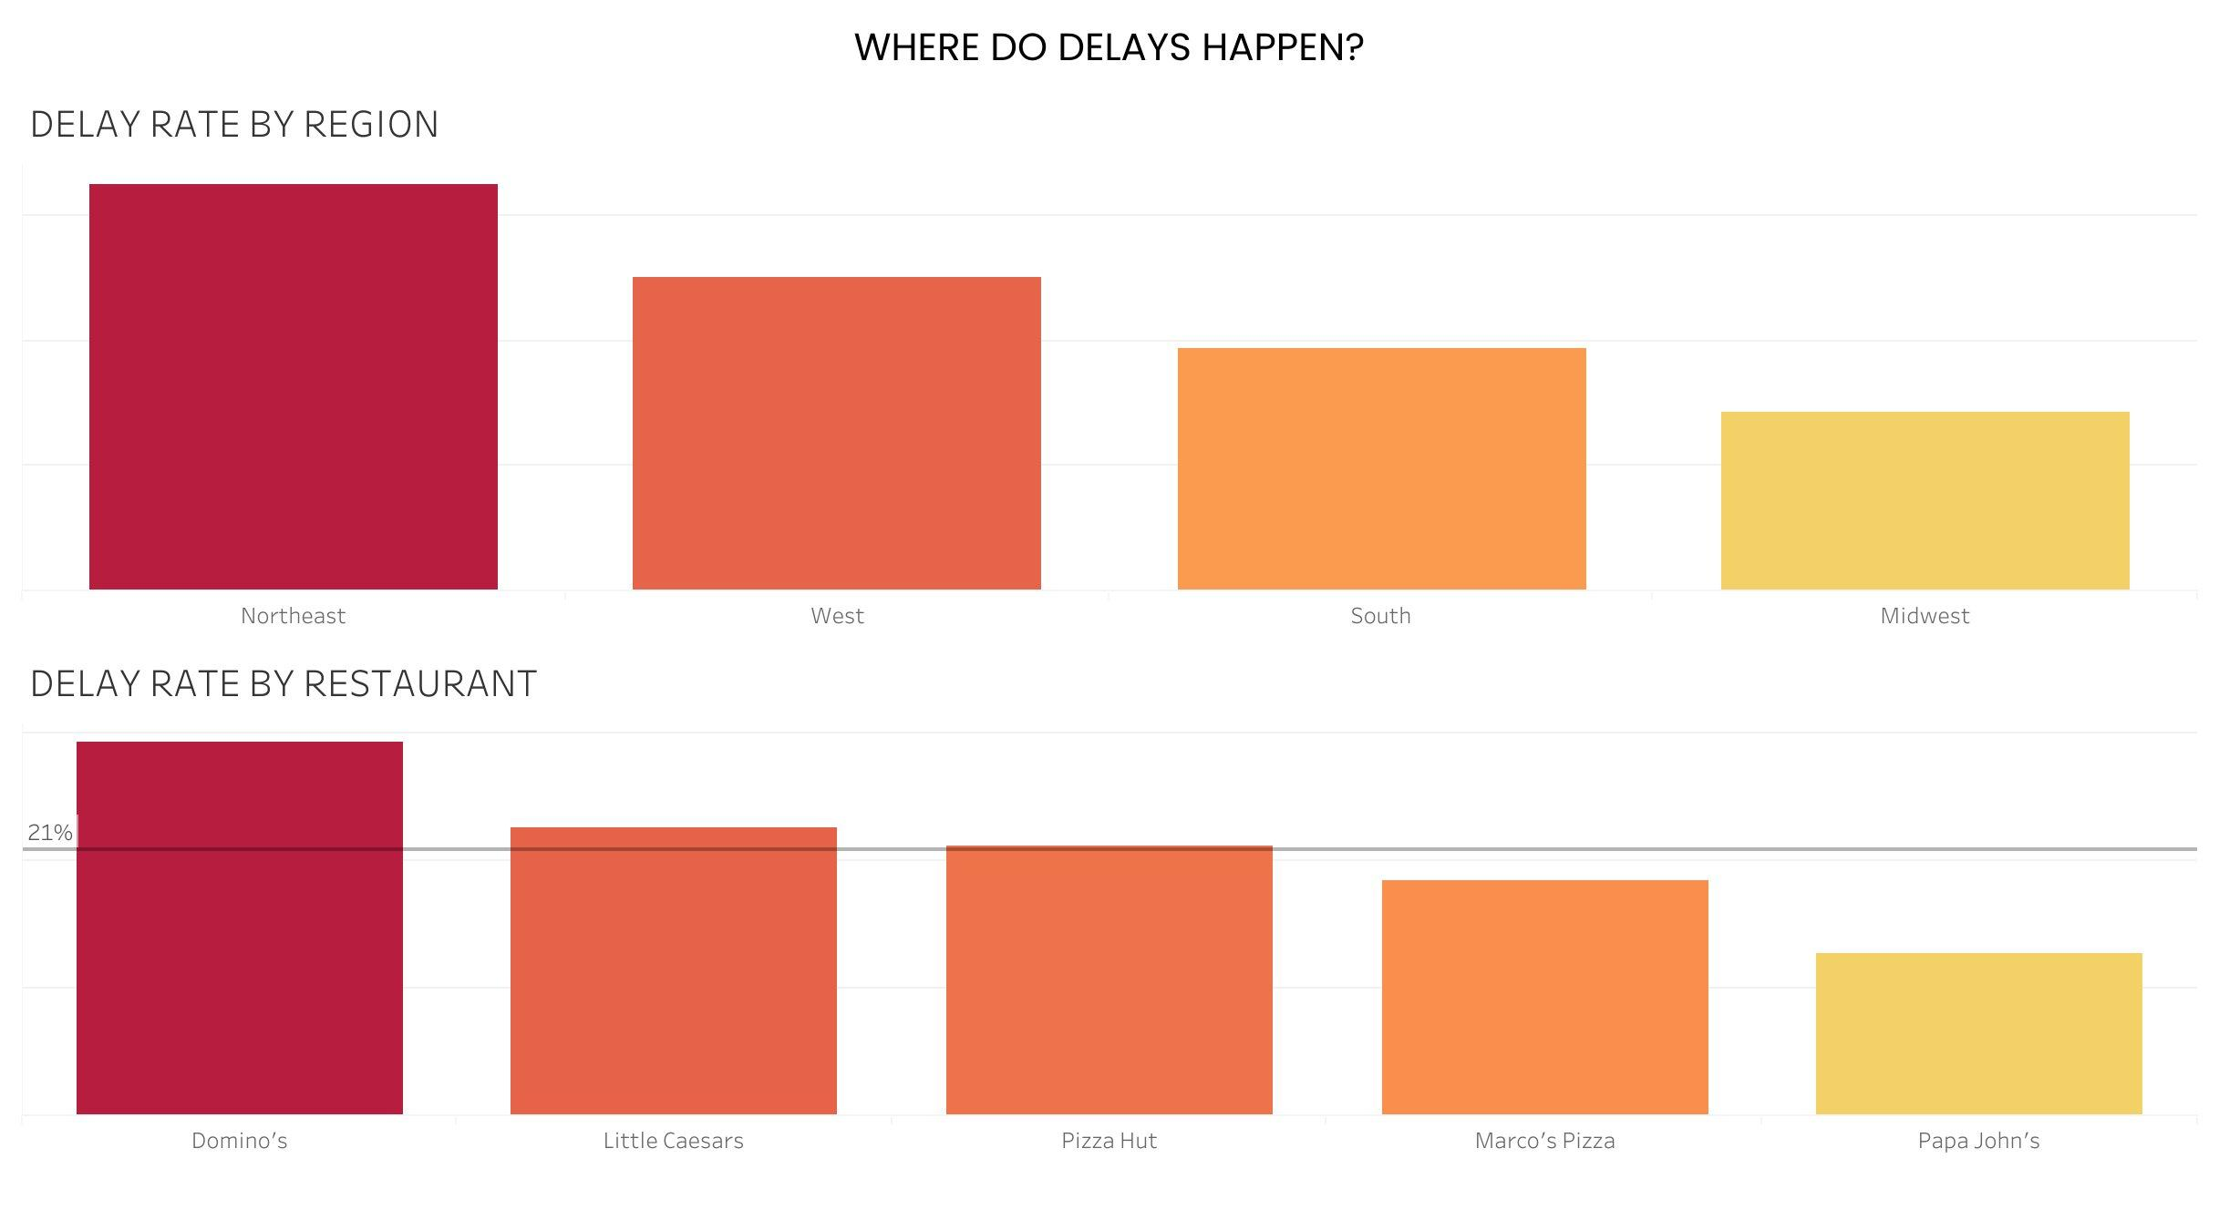
WHERE do delays happen?
Northeast leads geographically; Domino's has the highest raw delay rate
KEY TAKEAWAYS
REGION
Northeast 32% vs Midwest 14% — over 2x spread
RESTAURANT
Domino's worst at 30%, Papa John's best at 13%
CAVEAT
Raw rates don't account for traffic and order mix
INSIGHT
Geographic patterns are real and addressable through regional capacity planning
BOTTOM LINE
Geographic patterns are real and consistent. Northeast and Domino's stand out, but raw rates don't yet control for traffic or order mix.
Team RAD | ITEC 460 | Pizzagate
7
Notes:
Now where do delays happen. Northeast leads with 32% delays - more than double the Midwest at 14%. Among restaurants, Domino's has the highest raw rate at 30%, Papa John's the lowest at 13%. One caveat: these are raw rates that don't control for traffic conditions or what kinds of orders each brand takes. We'll come back to that in our predictive layer. The insight here: regional patterns are real and we can address them through regional capacity planning.

Slide 8
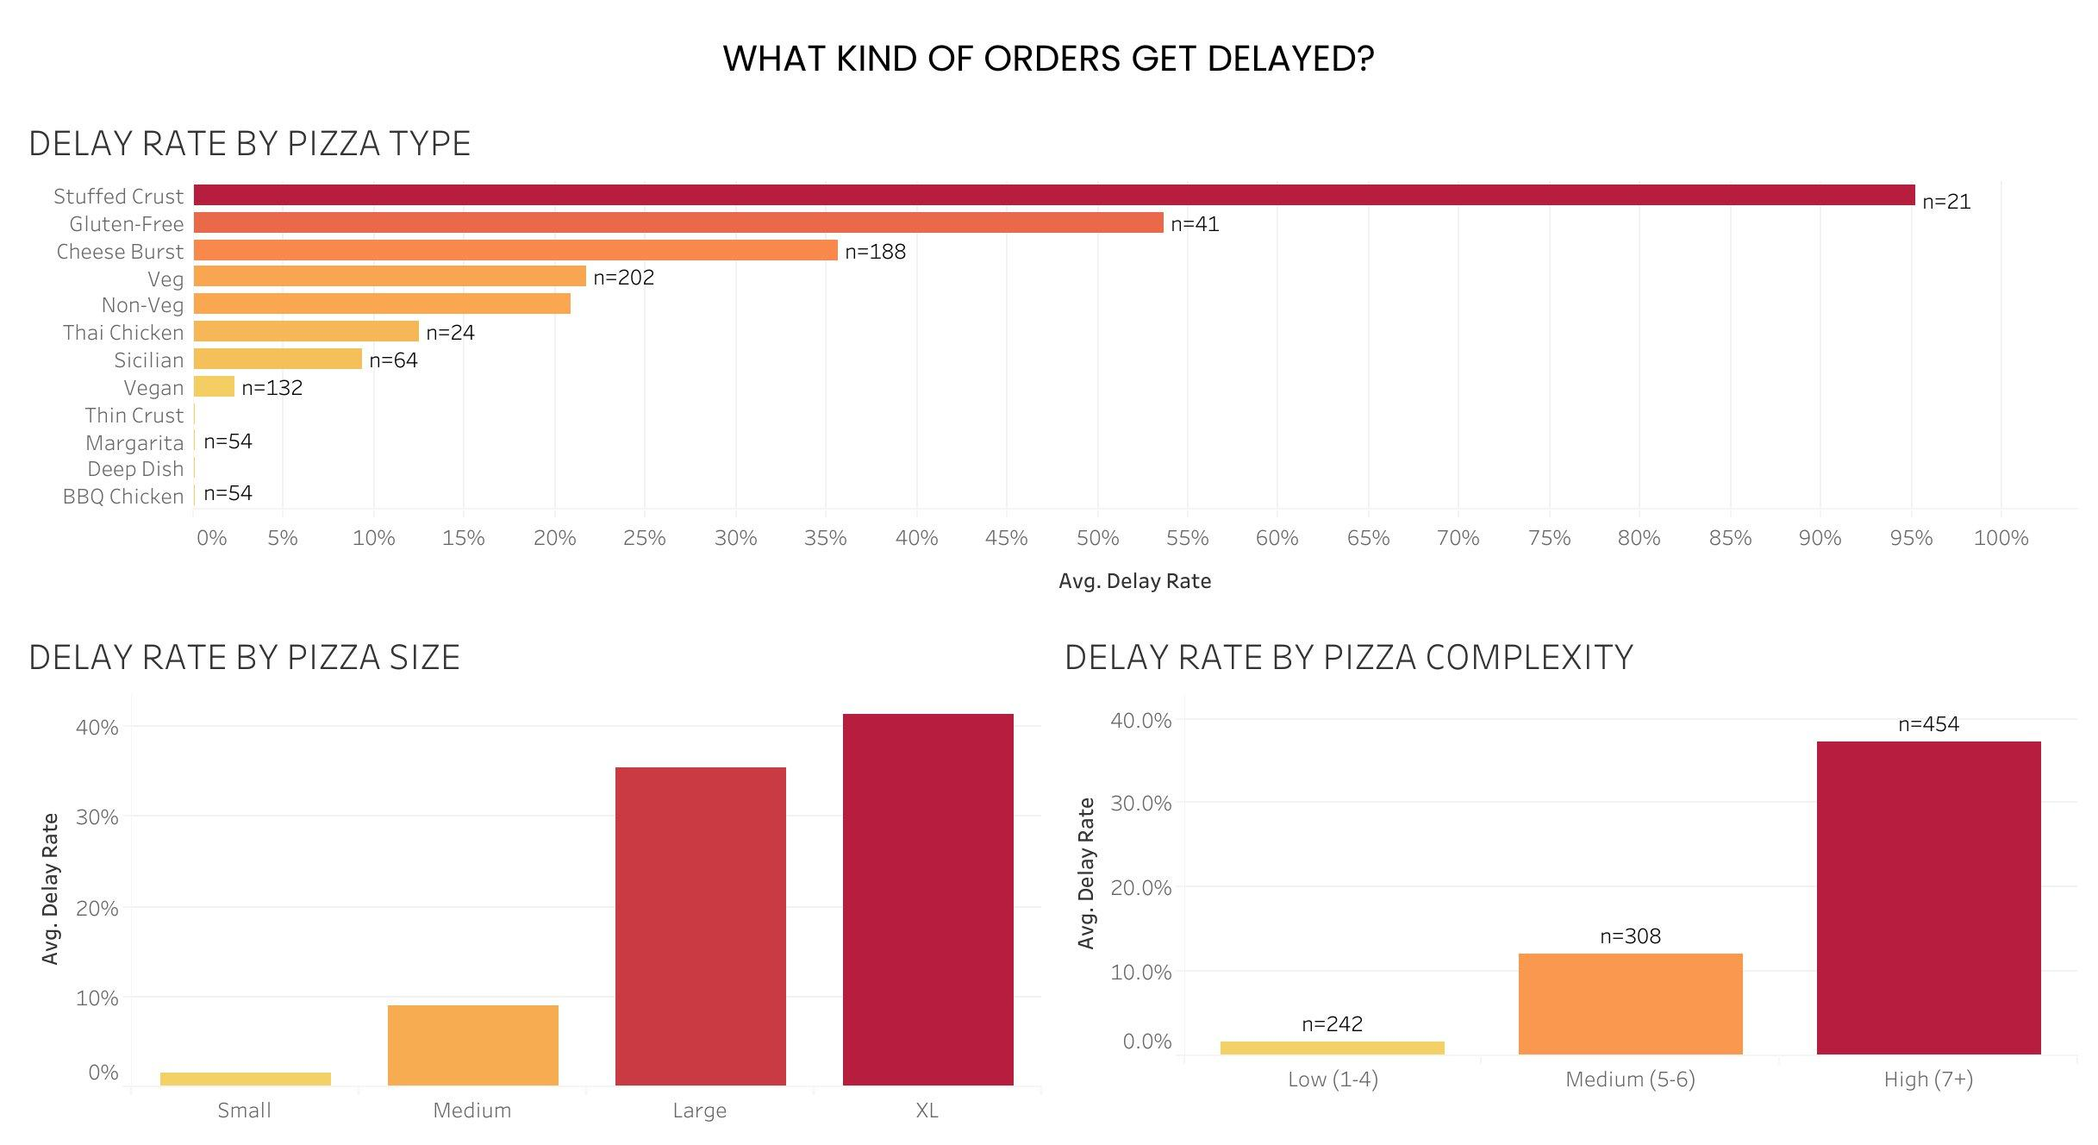
WHAT kinds of orders get delayed?
Bigger pizzas with more complexity dominate
KEY TAKEAWAYS
SIZE
XL pizzas: 41% delayed. Small: only 1.5%
COMPLEXITY
High complexity (7+ items): 37% delay rate
TYPE
Stuffed Crust shows 95% but small sample (n=21)
INSIGHT
Product complexity is a powerful and actionable predictor of kitchen delays
BOTTOM LINE
Order complexity drives delays from the kitchen side. Bigger pizzas + more toppings = significantly higher delay risk.
Team RAD | ITEC 460 | Pizzagate
8
Notes:
Finally, what kinds of orders get delayed. Bigger pizzas with more complexity dominate. XL pizzas are delayed 41% of the time versus only 1.5% for small. Pizza complexity tells the same story - high complexity orders hit 37%. Stuffed Crust looks alarming at 95%, but with only 21 orders we want to flag that as a small sample to investigate further. The insight: product complexity is a powerful and actionable predictor of kitchen-driven delays.

Slide 9
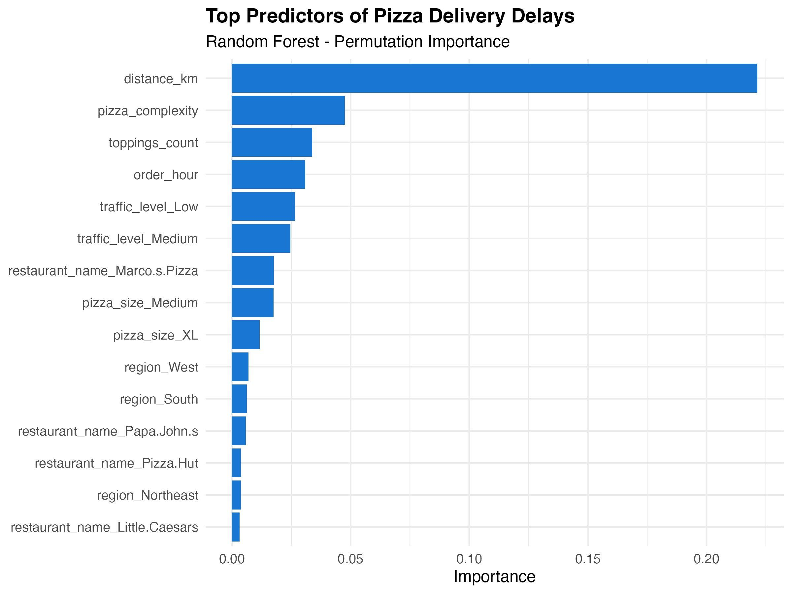
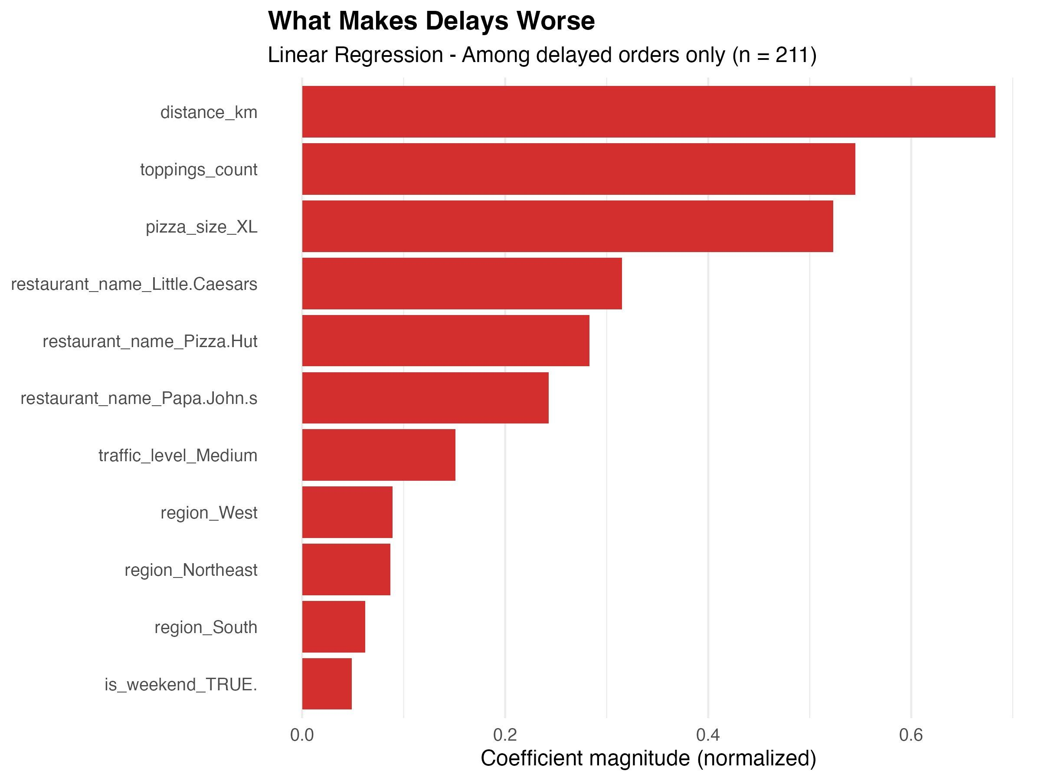
Two Models, One Master Variable
Distance predicts both whether a delay happens AND how bad it gets
WHETHER a delay happens
HOW BAD the delay is
Random Forest • 98% accuracy
Linear Regression • Among delayed orders
DISTANCE LEADS BOTH the single biggest factor in both models.
KITCHEN VARIABLES PLAY DIFFERENT ROLES complexity predicts whether a delay happens; XL and toppings predict how bad it gets.
RESTAURANT BRAND matters more for severity than for occurrence.
Team RAD | ITEC 460 | Pizzagate
9

Slide 10
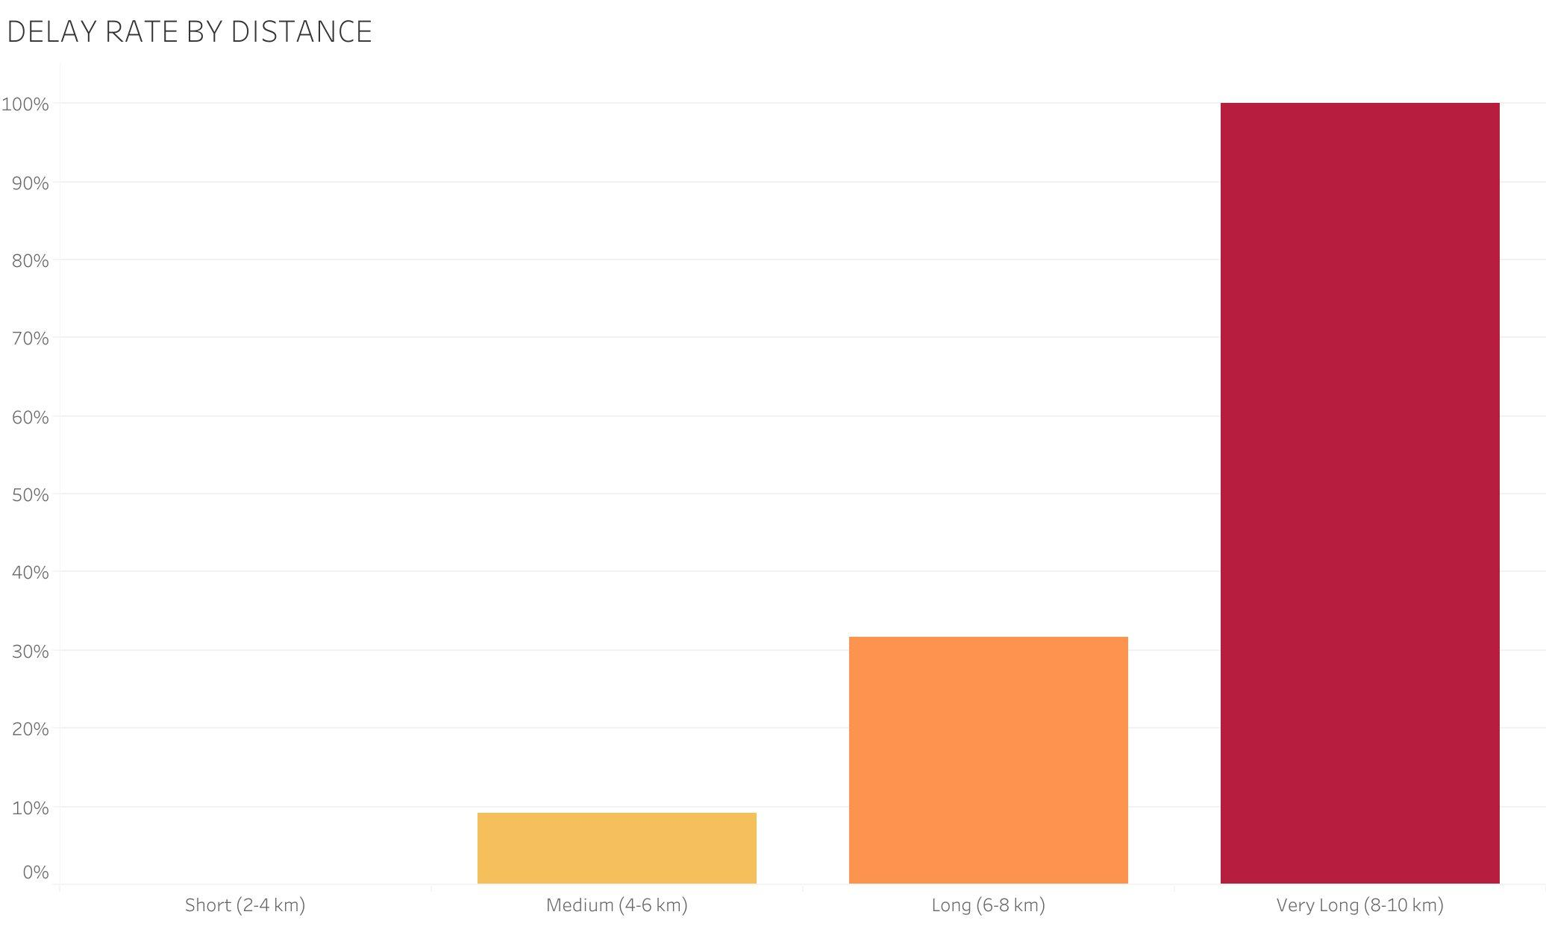
Distance is the Single Strongest Driver
Past 8 km, delays go from rare to near-certain
0%
Short trips (2-4 km)
32%
Long trips (6-8 km)
~100%
Very Long (8-10 km)
Operational implication: Past 8 km, decline orders or set realistic ETAs that match actual performance.
Team RAD | ITEC 460 | Pizzagate
10
Notes:
This is what 'distance is the #1 predictor' actually looks like. Past 8 kilometers, delays go from rare to near-certain. Short trips under 4 km have basically a 0% delay rate. By 6-8 km we're at 32%. Beyond 8 km, virtually every delivery is delayed. This suggests an immediate operational lever: we should reconsider whether to even accept orders past a certain distance threshold, or set very different ETA expectations for them.

Slide 11
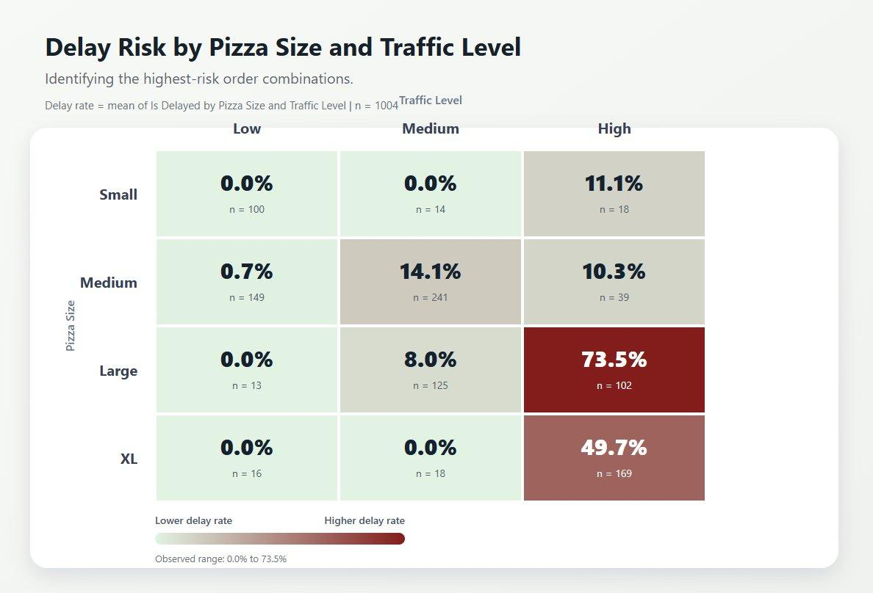
When Risk Factors Stack, Delays Explode
Compound risk: pizza size × traffic level interaction
HIGHEST RISK
73.5%
Large pizza + High traffic
LOWEST RISK
0%
Most low-traffic combinations
Risk multiplies, not adds.
Target the worst combinations first — that's where the biggest wins are.
AI-generated visualization
Team RAD | ITEC 460 | Pizzagate
12
Notes:
Beyond individual factors, there's an interaction effect. We used a Gen AI tool to visualize how pizza size and traffic level combine. Look at the difference: in low-traffic conditions, almost every order combination has zero delays. But Large pizza in high traffic? 73.5% delay rate. That's a compound risk - factors don't just add up, they multiply. This tells us the highest-leverage interventions are at the worst combinations - high traffic plus large orders is where to focus operational improvements first.

Slide 12
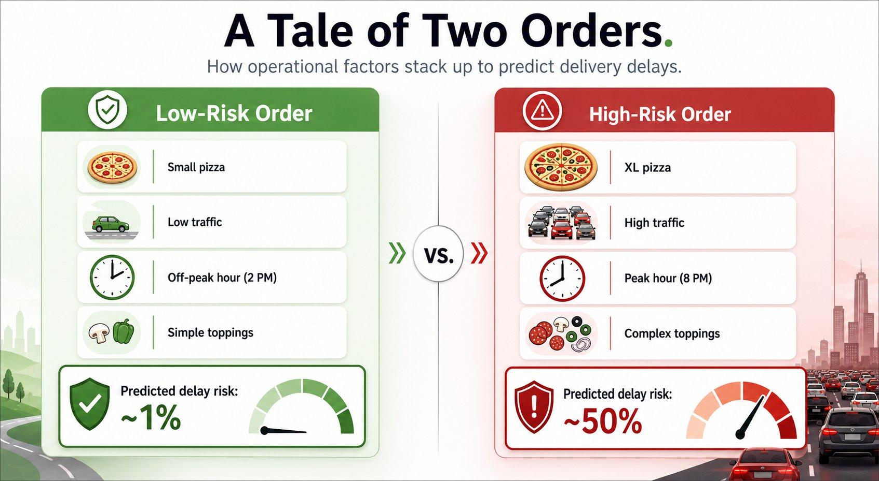
A Tale of Two Orders
Cumulative risk: how operational factors stack to predict delivery outcomes
Same platform, same model, two completely different outcomes. The operational variables we control are the difference between 1% risk and 50% risk.
Team RAD | ITEC 460 | Pizzagate
13
Notes:
To make the 'two strategies' insight concrete, here's a tale of two orders. On the left: small pizza, low traffic, off-peak hour, simple toppings - predicted delay risk of 1%. On the right: XL pizza, high traffic, peak hour, complex toppings - 50% delay risk. Same platform, same delivery model. The difference is entirely in the operational variables we control. This is what 'compound risk' looks like in human terms.

Slide 13
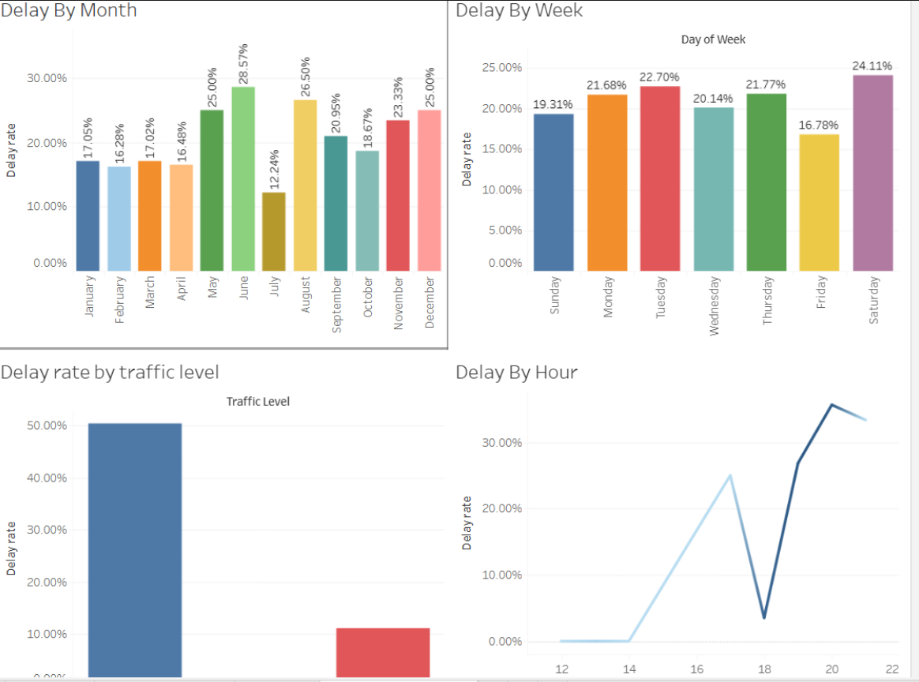
How AI Feedback Improved Our Work
Iteration cycle: draft → AI critique → refined output
BEFORE
AFTER
14
Notes:
This slide is a placeholder for the team to fill in with before/after screenshots from the AI critique cycle. We will run a structured AI critique on our draft work, identify 3-4 specific improvements, implement them, and document the change here. This addresses the Step 6 requirement.

Slide 14
What We Recommend
Four operational changes leadership should prioritize
01
Recalibrate the ETA algorithm
Factor in distance, traffic, and pizza size when generating customer-facing delivery estimates. Stop systematically under promising.
02
Implement an early-warning system
Use our predictive model to flag at-risk orders at order intake. Enable dispatch to intervene before the customer is disappointed.
03
Set delivery distance thresholds
Past 8 km, delays approach 100%. Either decline these orders or set realistic ETAs that reflect actual conditions.
04
Differentiate operational playbooks
Distance is the master lever, but toppings count and XL size add real minutes once a delay starts. Add kitchen prep priority for XL orders and topping caps on long-distance deliveries.
Team RAD | ITEC 460 | Pizzagate
15
Notes:
So what should leadership do? Four recommendations. First: recalibrate our ETA algorithm to factor in the variables we know predict delays. Stop systematically underpromising. Second: build an early-warning system using our model to flag at-risk orders at intake, so dispatch can intervene. Third: set distance thresholds. Past 8 km is essentially a guaranteed delay - we need to either decline those orders or set realistic ETAs. Fourth: build two operational playbooks - one for prevention, one for damage control. Different problems need different solutions.

Slide 15
Thank You
Questions & Discussion
AI TOOLS USED IN THIS PROJECT
Claude (Anthropic) — Analytical partner, code review, deck design
ChatGPT (OpenAI) — Cross-validation, prompt iteration
Image generation tools — Custom heatmap and infographic creation
Team RAD • ITEC 460 • Professor Gwanhoo Lee
Notes:
Thank you for your time. Before we open to questions, a quick acknowledgment of the AI tools we used throughout this project: Claude was our main analytical partner for code review and deck design. ChatGPT and NotebookLM helped with cross-validation and concept generation. Image generation tools created our custom heatmap and tale-of-two-orders infographic. We're happy to take any questions.

