Slide 1
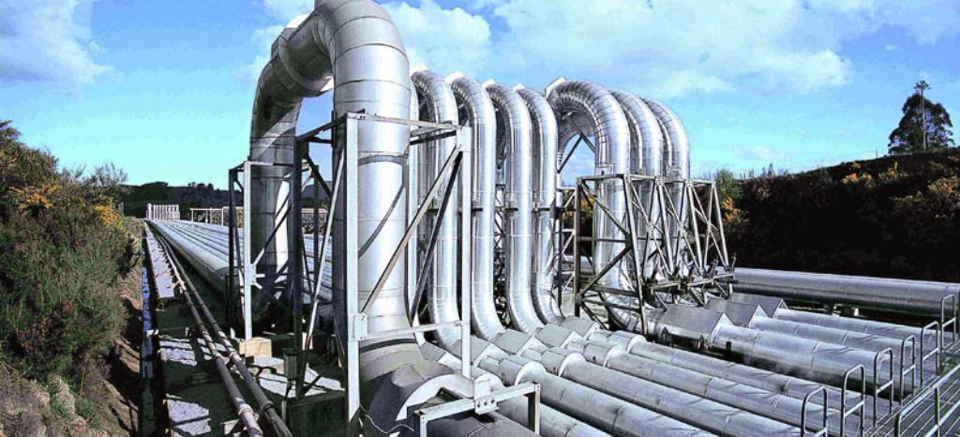
TPL Dataflows
Paralelní zpracování toku dat

Slide 2
Agenda
Motivation
TPL - Task Parallel Library
TPL Dataflow
Building Blocks
Linking and filtering
Complete propagation

Slide 3
TPL – Task Parallel Library
From .NET Framework 4.5 and C# 5.0 (august 2012)
System.Threading.Tasks
Async/Await
ThreadPool, CancellationTokens, TaskScheduler…

Slide 4
Multi-Threaded pipeline
Input
Queue
Output
Queue
Task 1
Task 2

Slide 5
TPL Dataflow
System.Threading.Tasks.Dataflow namespace
Implements pipeline pattern
Foundation for message passing and parallelizing CPU-intensive and I/O-intensive applications that have high throughput and low latency.
Consist of DataFlow blocks:
Buffering Blocks
Execution Blocks
Grouping Blocks
Notes:
pipeline consists of a chain of processing elements

Slide 6
Buffering Blocks
BufferBlock<T>
BroadcastBlock<T>
WriteOnceBlock<T>
Buffer
Broadcast
Write-Once

Slide 7
Execution Blocks
ActionBlock<TInput>
TransformBlock<TInput,TOutput>
TransformManyBlock<TInput,TOutput>
Action
Transform
TransformMany

Slide 8
Grouping Blocks
BatchBlock<T>
JoinBlock<T1,T2>
BatchedJoinBlock<T1,T2>
A
A
A
A
A
B
A
B
Batch
Join
BatchedJoin
A[]
A,B
A[],B[]

Slide 9
Linking and filtering
Step2
Step4-A
Step1
Step2
Step3
Step5
Step4-B
Step2

Slide 10
Complete propagation
When we need to wait for the message to get through the pipeline.

Slide 11
Resources
Samples and this presentation: https://github.com/jandeu/tpl-dataflow-samples
Microsoft docs: https://docs.microsoft.com/en-us/dotnet/standard/parallel-programming/dataflow-task-parallel-library
Pipeline pattern implementation https://michaelscodingspot.com/pipeline-pattern-implementations-csharp/
DataflowEx https://github.com/gridsum/DataflowEx

